Slide 1

QIAGEN Solutions for Microbial Surveillance

Slide 2
Legal disclaimer
QIAGEN products shown here are intended for molecular biology applications. These products are not intended for the diagnosis, prevention or treatment of a disease.
For up-to-date licensing information and product-specific disclaimers, see the respective QIAGEN kit instructions for use or user operator manual. QIAGEN instructions for use and user manuals are available at www.qiagen.com or can be requested from QIAGEN Technical Services (or your local distributor).

Slide 3

QIAGEN offers a comprehensive portfolio of solutions across the workflow from microbiome to microbial detection
  QIAamplifier
  QIAquant qPCR
  QIAcuity
  Rotor-Gene Q
  TissueLyser II
  PowerLyzer 24
  Vortex adapters
  QIAcube Connect
  QIAcube HT
  QIAsymphony SP
Microbial sample disruption
Nucleic acid isolation – host and microbes
NGS
PCR/
digital PCR
Data analysis
  PowerBead Pro Tubes
  PowerBead Pro Plates
  QIAamp PowerFecal Pro DNA
  DNeasy PowerSoil Pro
  RNeasy PowerSoil Total RNA
  RNeasy PowerFecal Pro
  RNeasy PowerWater
  AllPrep Kits
  Microbial Genotyping
  QIAseq xHYB Viral and Bacterial Panels
  QIAseq DIRECT SARS-CoV-2
  16S rRNA and ITS profiling
  QIAseq 16S/ITS Panels
  Metagenomic shotgun sequencing
  QIAseq FX DNA Library Prep
  Microbiome WGS SeqSets
  Metatranscriptomics
  QIAseq FastSelect 5S/16S/23S
  QIAseq Stranded Total RNA Library
  Digital PCR
  dPCR microbial assay
  PCR
  UCP Multiplex PCR
  UCP HiFidelity PCR
  Microbial DNA qPCR Assays and Arrays
  QIAstat-Dx
  QIAGEN CLC Workbench Premium
  GeneGlobe analysis
  Microbial Analysis Portal

Slide 4



QIAseq xHYB Microbial Panels
Respiratory
  Includes probes for whole genome enrichment, detection and characterization of 89 separate viral targets, including SARS-CoV-2, influenza, rhinovirus, enterovirus and more
Adventitious Agent
  For the detection of 132 separate viral targets, including human adenovirus, norovirus, rotavirus, influenza, SARS-CoV-2, HPV, Epstein-Barr, HIV, hepatitis A/B viruses and more
0
0
Viral STI (sexually transmitted infections)
  Sequencing and detection of common STI viruses: HBV, HIV-1 and 19 types of high-risk HPV
MPXV Spike-In
  Contains probes for the whole genome enrichment of MPXV that can be spiked into any other QIAseq xHYB Viral panel
  Enriches for the whole genome of all MPXV clades, including ITRs
AMR (antimicrobial resistance)
  Sequencing and detection of the presence of 2786 antimicrobial resistance genes (6200+ AMR markers) in bacteria
  Consists of targets pulled from the QIAGEN CLC QMI-AR database
MPXV Panel
  Contains all reagents necessary for the hybrid capture enrichment of the whole genome of MPXV.
  Enriches for the whole genome of all MPXV clades, including ITRs
Notes:
All panels have been used with wastewater
All viral panels target the whole genome of each virus. Excel file with target list is available on q.com
Analysis is available on gg.com as well as already established workflows on CLC
GG Analysis is basic / “high level”
The slides after this one just give a basic example of wastewater data with each panel / publications
The MPXV panel enriches 100% of the genome of MPXV, including ITRs and works with both MPXV Clades
The ITR part and both clades part are important. Our competitors don’t manage this.
While the Adventitious Agent panel is also WGS, it is a detection panel and has fewer extra probes tiled into the more variable areas like the other viral panels.
Custom will launch in Q1 2023 and allow customers to choose any human pathogenic virus (this includes animal viruses that infect humans)
Will also include some bacterial targets. A targeted WGS panel for TB is planned
Targeted WGS is worthwhile vs metagenomic approaches because it allows higher multiplexing on the sequencer while allowing for greater sensitivity with significantly higher coverage.
We say that customers can multiplex more than 10x as many samples per sequencing run, saving significantly on flowcell cost and sequencing time

Slide 5
Markedly more reads on target vs kits from other suppliers – thanks to the built-in QIAseq FastSelect rRNA removal
Example: SARS-CoV-2 sequencing

Slide 6
Flexible sample to sequencing workflow
Supports RNA, DNA and total nucleic acids (TNA)
Total RNA, TNA input
DNA input
Double-stranded cDNA
Library preparation
Hybridization, capture and wash
QIAseq xHYB RT
QIAseq FX DNA Library Kit
QIAseq xHYB Microbial Panels
Sequencing
Analysis
~2 h
~3.5 h
Overnight
    GeneGlobe*
    QIAGEN CLC Genomics Workbench
    Analysis tool of choice
Cleanup
Post-capture pooling
Cleanup
Hybridization 16 h
Second-strand cDNA synthesis
Library amplification
Library QC
Cleanup
Dry down
Cleanup
First-strand cDNA synthesis
Adapter ligation
Post-capture amplification
Library pooling
Random priming
DNA fragmentation and end polishing
Library QC
Bead bind and wash
*GeneGlobe analysis is included with the purchase of QIAseq xHYB Microbial Panels

Slide 7

QIAseq FX DNA Library Kit versus similar kits from other suppliers
By considering analytical performance as well as cost and hands-on time, we retained two recommended protocols as the basis for our SOPs for sequencing library construction. More specifically, we recommend protocol B (QIAseq FX DNA Library Kit) for taxonomic profiling based on its high accuracy of quantification of the DNA mock community, low GC bias, and excellent transferability across laboratories owing to the use of enzymatic DNA fragmentation. In addition, protocol B can be run with and without PCR across a wide range of DNA input amounts and, while not evaluated here, is also amenable to automation using robotic liquid handlers.
Source: Tourlousse, D.M. et al. (2021) Validation and standardization of DNA extraction and library construction methods for metagenomics-based human fecal microbiome measurements. Microbiome 9, 95
Notes:
Chosen by the Japan Microbiome Consortium as the #1 kit for microbial metagenomics. Study compared FX against ILMN, KAPA, NEB and Takara. Technically they chose both an enzymatic and mechanical shearing method. FX won the enzymatic frag library prep benchmark, Takara won mechanical shearing benchmark.

Slide 8
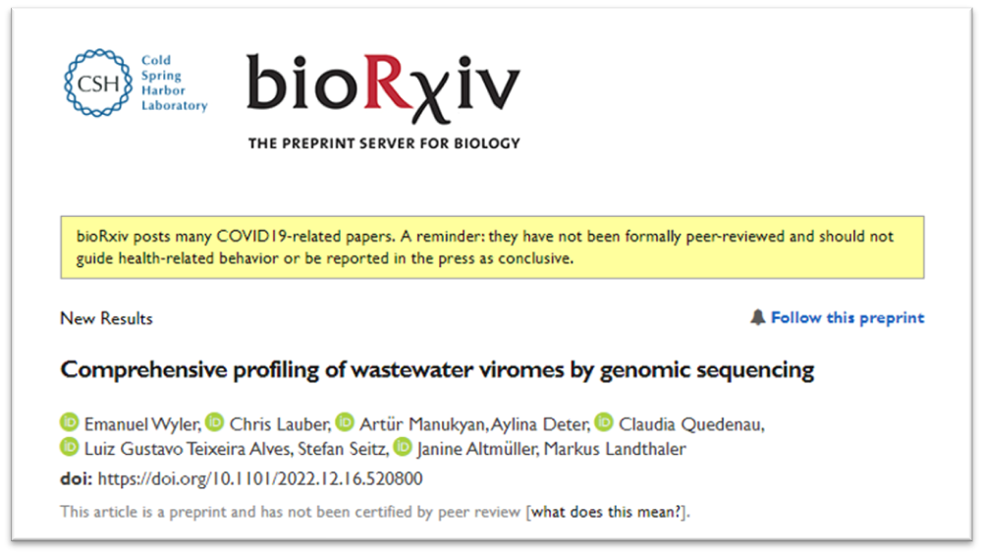

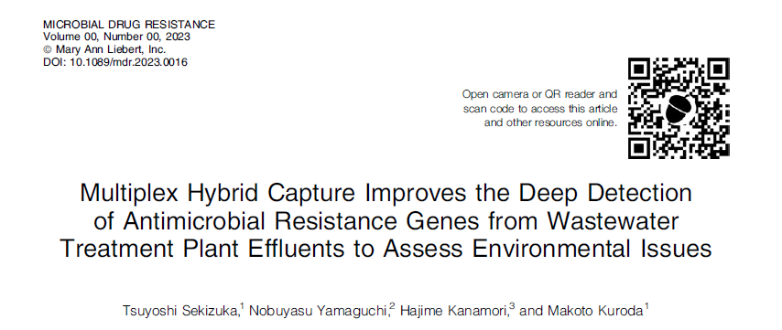
Publications in Wastewater

Slide 9
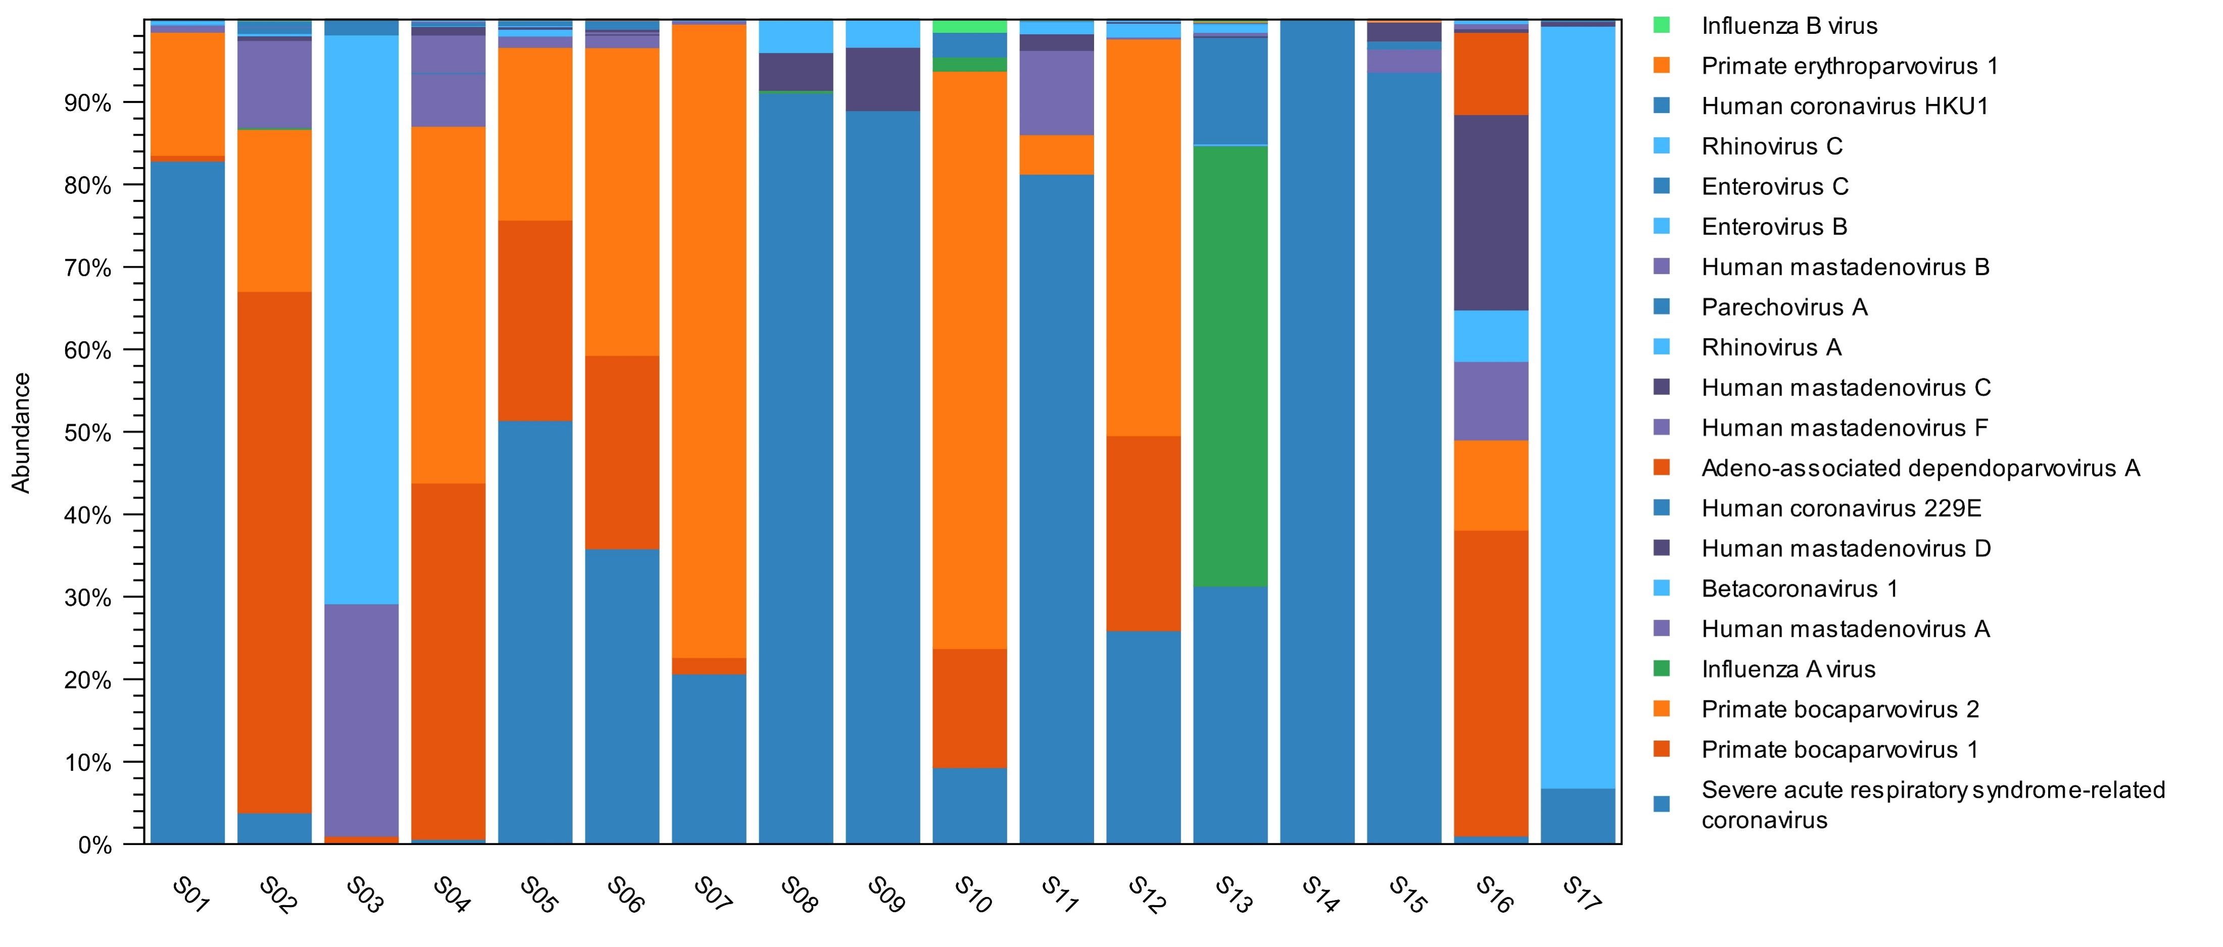
Identify the viral community in wastewater
Notes:
Just highlighting all the different viruses we can see in wastewater at once.
17 different wastewater samples.
“We find that if you can get high quality data from wastewater, you can get high quality data from any sample type”

Slide 10



Microbiome WGS SeqSets: All-in-one sets tailored for microbiome research
Microbial sample
DNA extraction
Whole genome sequencing (WGS)
Bioinformatic analysis
QIAamp PowerFecal Pro WGS SeqSet
QIAamp PowerFecal Pro DNA
    Stool samples
DNeasy PowerSoil Pro
    Soil samples
QIAseq FX DNA Library Kit
    All-enzymatic library prep for WGS
QIAseq Normalizer Kit
    Rapid library normalization for high-throughput sequencing
QIAseq Beads
Microbial Analysis Portal (MAP)
    Comprehensive metagenomic analysis
DNeasy PowerSoil Pro WGS SeqSet

Slide 11
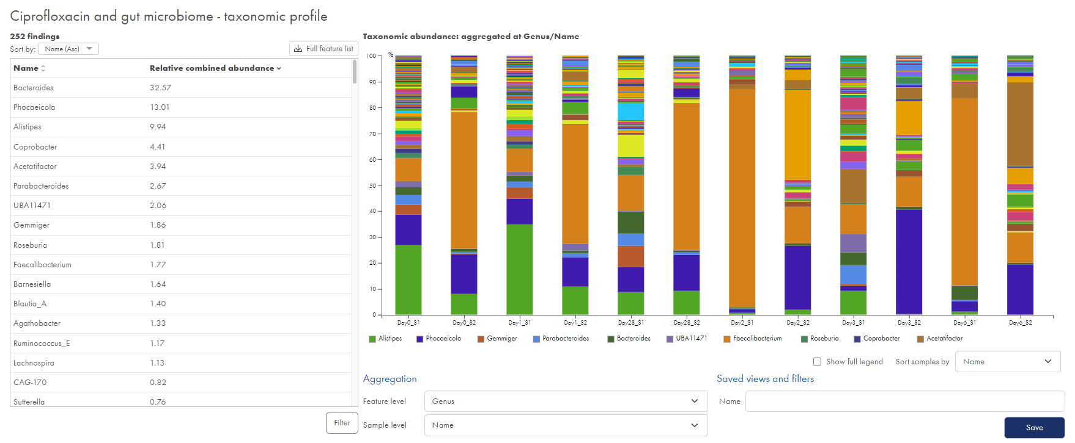
Taxonomic ID and abundance

Slide 12
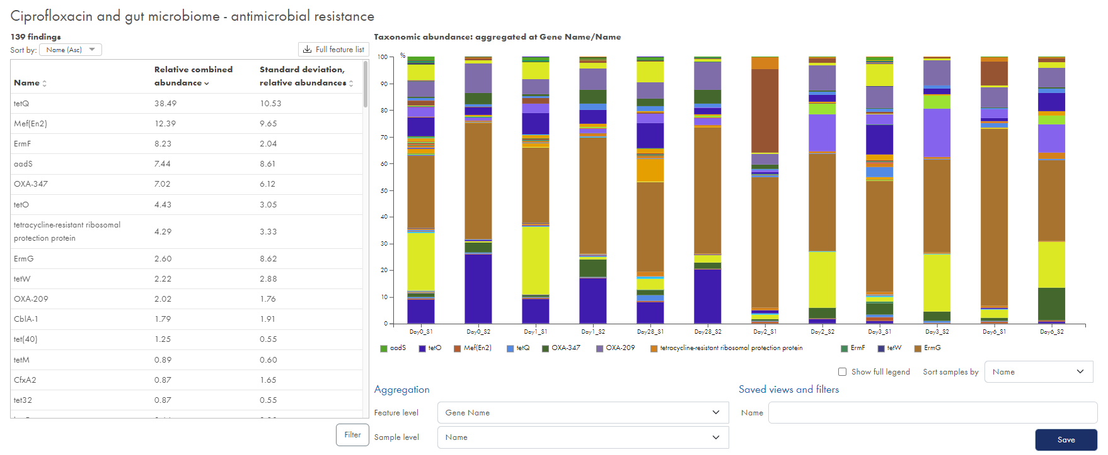
AMR abundance and profiling

Slide 13
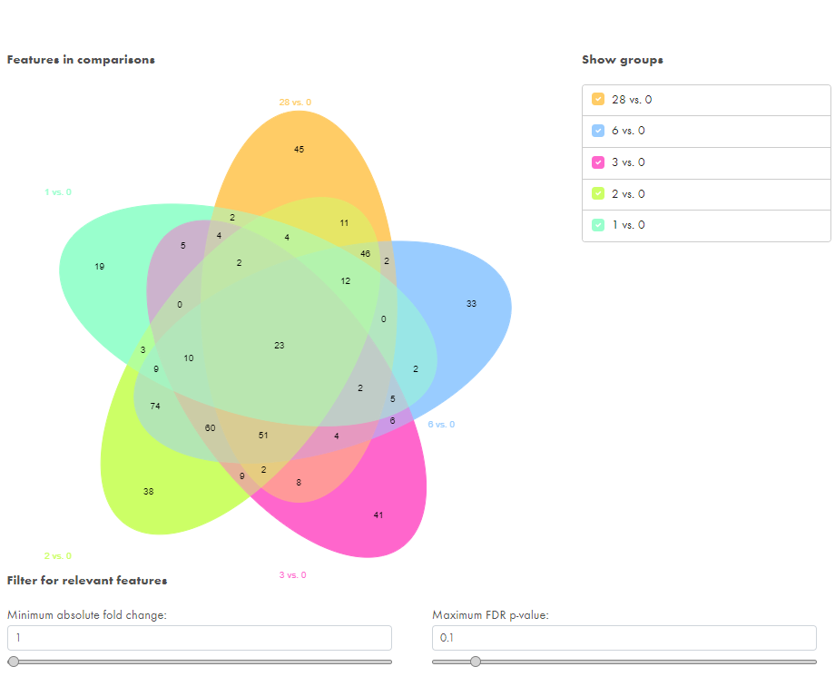
Calculate differential abundance

Slide 14

Thank you for your attention.
Questions?
Trademarks: QIAGEN®, Sample to Insight®, QIAcuity®, GeneGlobe®, LNA®, miRCURY®, RNeasy® (QIAGEN Group). Registered names, trademarks, etc. used in this document, even when not specifically marked as such, may still be protected by law. PROM-19557-001 © 2021 QIAGEN, all rights reserved.

