Slide 1
Laboratory Flexible Funding Model (LFFM)
Updates
Lauren Yeung, FDA HFP OLOAS ORTS
GenomeTrakr Annual Meeting
October 17, 2024

Slide 2
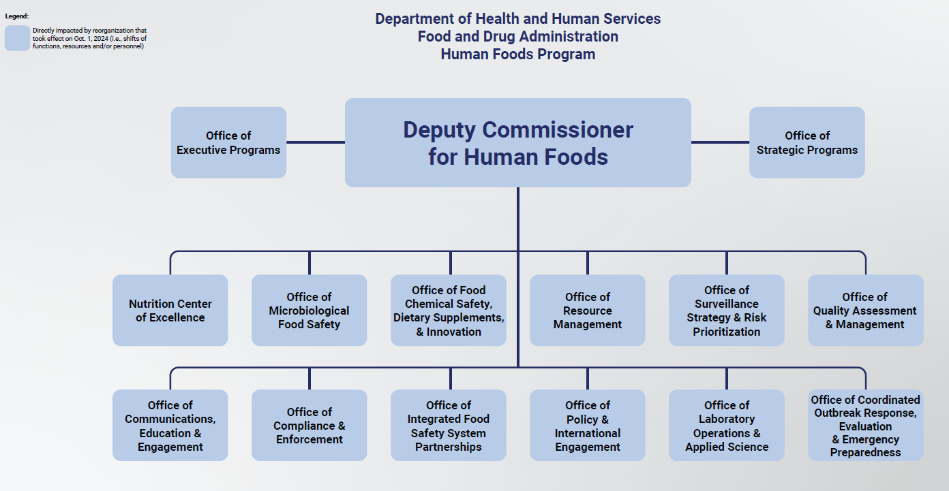
Where are we in the re-org?

Slide 3
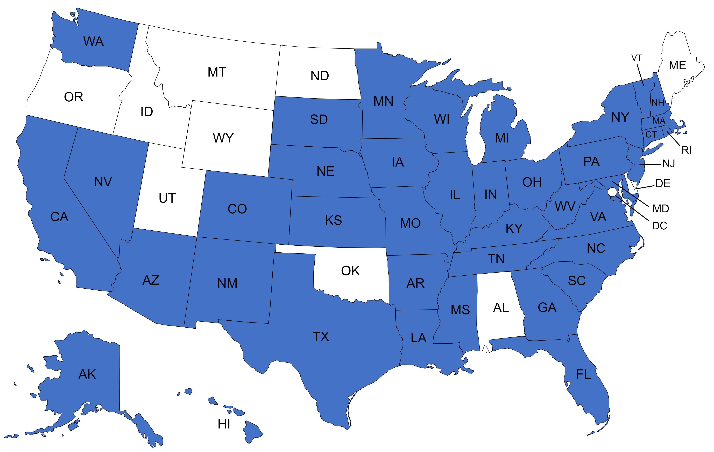
LABORATORY FLEXIBLE
FUNDING MODEL
In Year 5 of a 5-Year Cooperative Agreement Program
July 1, 2024 – June 30, 2025
13
55
40
TRACKS across chemistry, microbiology, and radiochemistry disciplines
LABORATORIES participating in at least one track
STATES

Slide 4
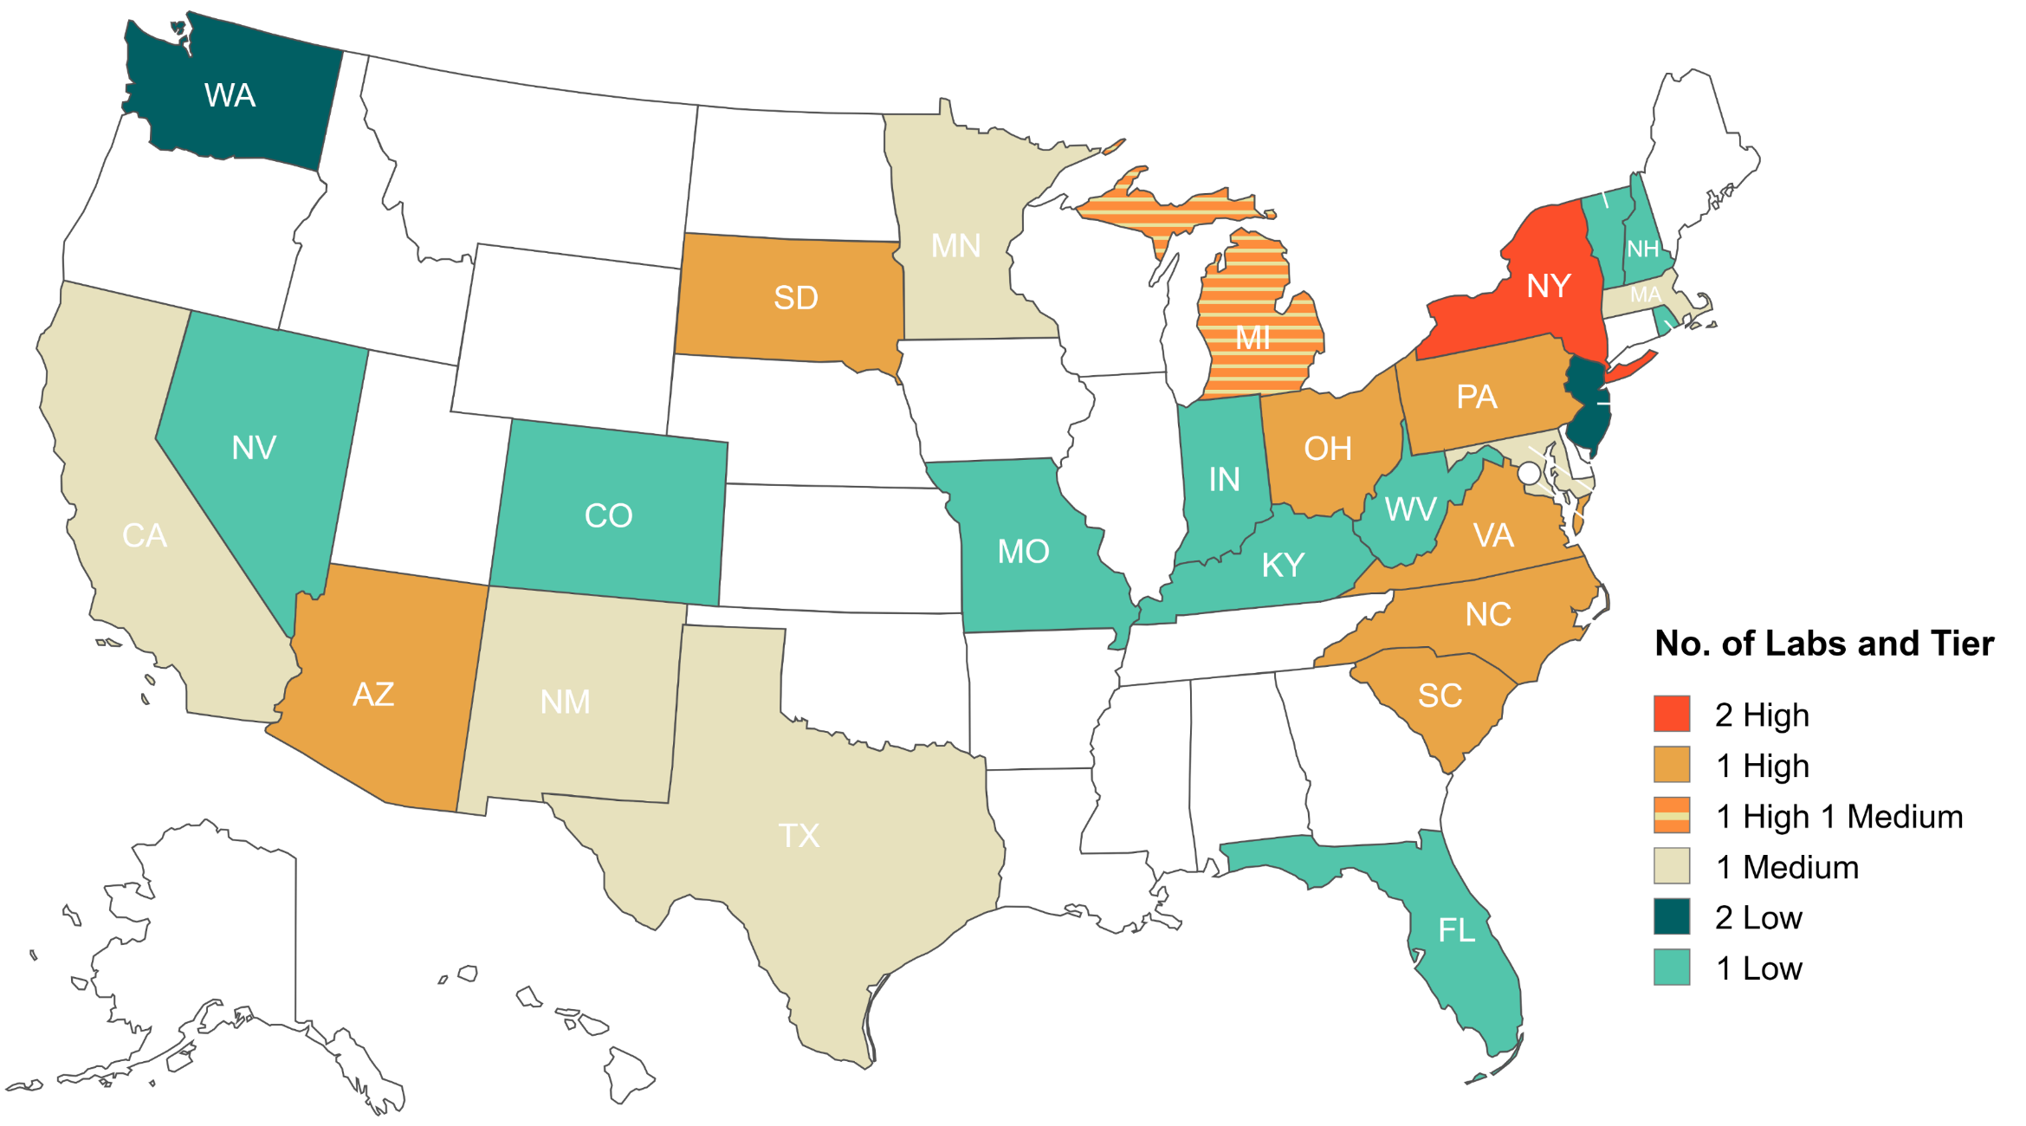
LFFM WGS TRACK TIERS BY STATE
VT
RI
NJ
DE
MD
High Tier: 400 isolates/year
Medium Tier: 250 isolates/year
Low Tier: 100 isolates/year
Notes:
16 labs are also approved for product testing tracks;

Slide 5
Accomplishments – WGS Track
Year | # Labs | WGS Track Total Funding
YR3 | 31 | $2.8M
YR4 | 31 | $2.8M
YR5 | 31 | $2.7M
Year | # of labs | Planned isolates | Sequenced Isolates
YR1 | 28 | 7,900 | 3,566 (45%)
YR2 | 31 | 8,050 | 5,824 (72%)
YR3 | 31 | 7,900 | 5,980 (75%)
YR4 | 31 | 7,300 | 6,354 (87%)
YR5 | 31 | 7,150 | Year in progress
Annual objectives:
Annual GenomeTrakr PT
Sequence food/env isolates from surveillance, outbreaks, collaborations
Support equipment, supplies, personnel, training associated with sequencing food/env isolates
16 WGS Tracks labs are also in M-HAF tracks
YR2: 121 isolates from M-HAF surveillance
YR3: 111 isolates from M-HAF surveillance
YR4: 107 isolates from M-HAF surveillance
Shout out to labs who have assisted with sequencing isolates from M-HAF labs who lack sequencing capabilities (MI Dept of Health, VA Division of Consolidated Lab Services!!)

Slide 6
WGS related MDV and C/C projects
Year 1: 6 labs developed WGS capabilities
  5 of 6 labs rolled over to WGS Track and have sequenced 523 isolates in YR2-3.
Year 4-5: Multi-lab project to implement and/or validate portable Oxford Nanopore Technology (ONT) for real-time sequencing of foodborne bacterial pathogen
  5 labs in YR4, 4 joined in YR5
  Labs currently purchasing GridION, training week of GenomeTrakr, PT samples sent out afterwards
  Labs will use the ONT capability at their discretion; on deck for MLV down the road

Slide 7

ISOLATE TRACKING
“Project_name” for tracking isolate in NCBI:
  GenomeTrakr-LFFM;FY1
  GenomeTrakr-LFFM;FY2
  GenomeTrakr-LFFM;FY3
  GenomeTrakr-LFFM;FY4
  GenomeTrakr-LFFM;FY5
“Sequenced_by” to identify sequencing laboratory
Notes:
LFFM labs enter the Project_name using a drop-down box. Although compliance wasn’t expected until FY2 – we highly encourage labs to populate the FY1 nomenclature for those sequences.

Slide 8
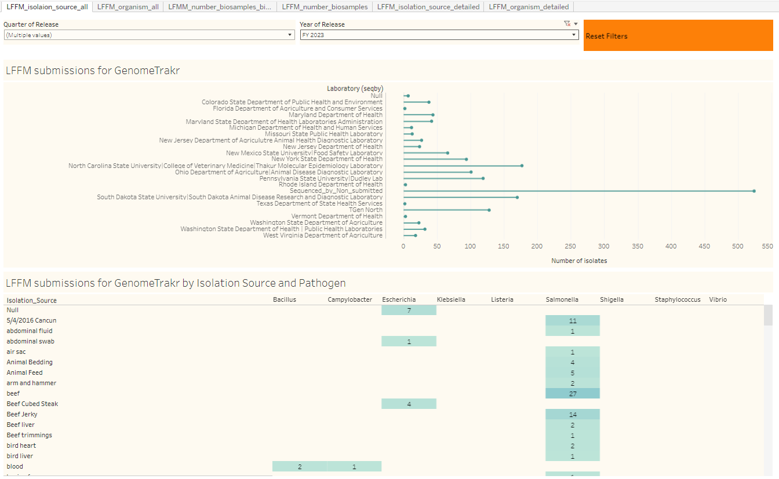
Isolate Tracking Dashboard (EXAMPLE)
Isolate Sources:
LFFM M-HAF surveillance
State surveillance
Outbreak sampling
Domestic and international collaborations
Wastewater samples
Genomic diversity study (multiple isolate picks from same sample)

Slide 9
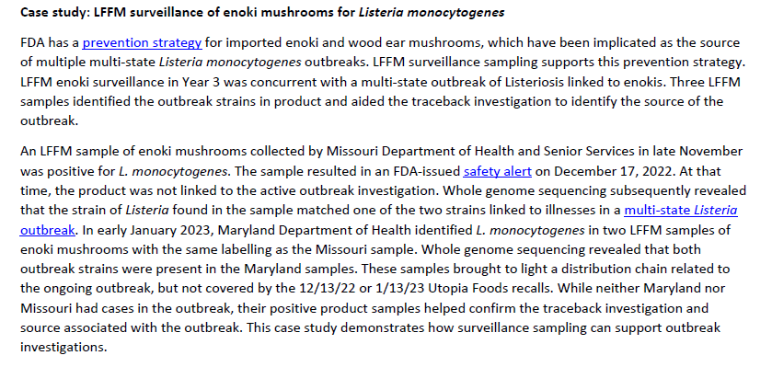
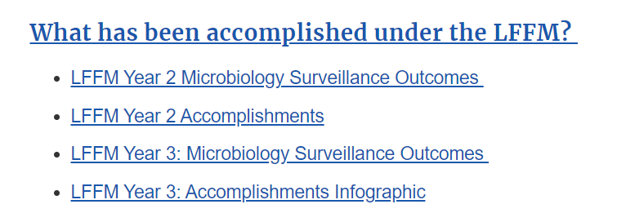
Publicly posted LFFM documents
Laboratory Flexible Funding Model Cooperative Agreement Program | FDA

Slide 10
LFFM – next 5 years – current thinking
NOFO is anticipated to be posted in November (fingers crossed)
20.88 required for any labs in product surveillance or food defense tracks
ISO 17025 accreditation required for labs in product testing tracks
FERN membership required for all applicants
Two WGS Tracks (either/or, not both) — current thinking/what we anticipate
  Maintenance — sequence isolates from LFFM M-HAF surveillance, outbreaks, LFFM NARMS, state samples
    This track is for labs in a M-HAF or LFFM NARMS track
    No isolate quota
    We hope that WGS laboratories not currently participating in a product testing track, but who have a relationship with a regulatory program will apply to the product testing track (with WGS maintenance support) in the next LFFM NOFO.
  Throughput testing — two options
    Sequencing an annual quota of isolates from collaborations (400/year)
    Conducting/supporting environmental pathogen surveillance, including the collection, microbiological analysis, isolation, and sequencing of enteric pathogens from routine samples, like water, in agricultural growing regions.
    Both labs in micro human or animal food surveillance tracks and labs with no product testing track participation are eligible to apply
    We anticipate making a limited number of awards based on the strength of the proposed projects
  If a laboratory in a product testing track applies to the throughput option but is not selected, the WGS maintenance track will be awarded.

