Slide 1
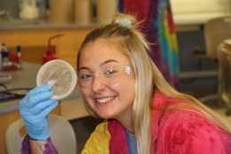

Surveillance of Environmental Pathogens: An Academic/Virginia State Lab Collaboration
James B. Herrick, Ph.D.
James Madison University
Harrisonburg, Virginia USA
herricjb@jmu.edu

Slide 2

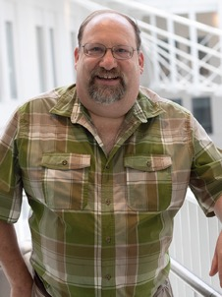
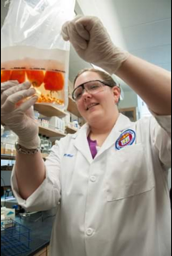
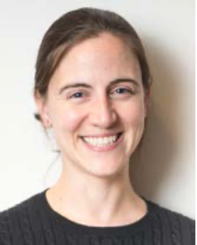

Slide 3
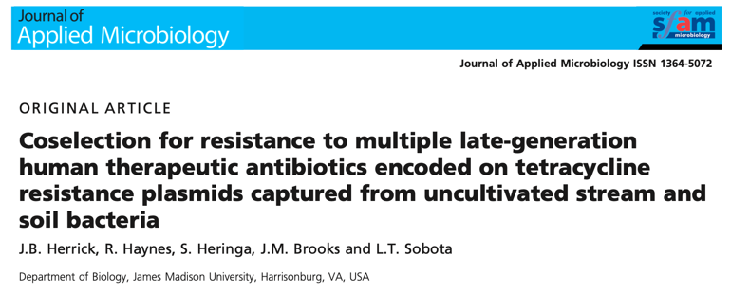
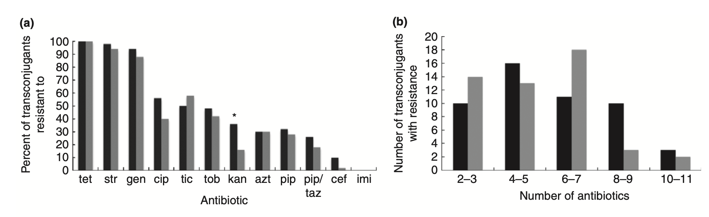

Slide 4
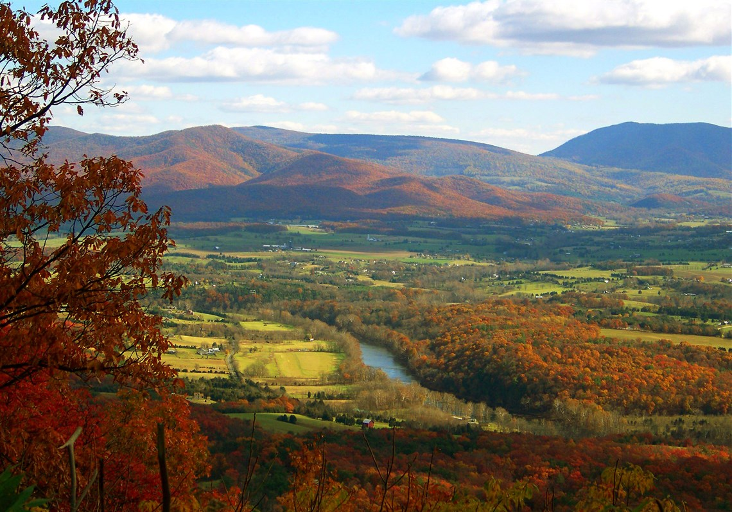
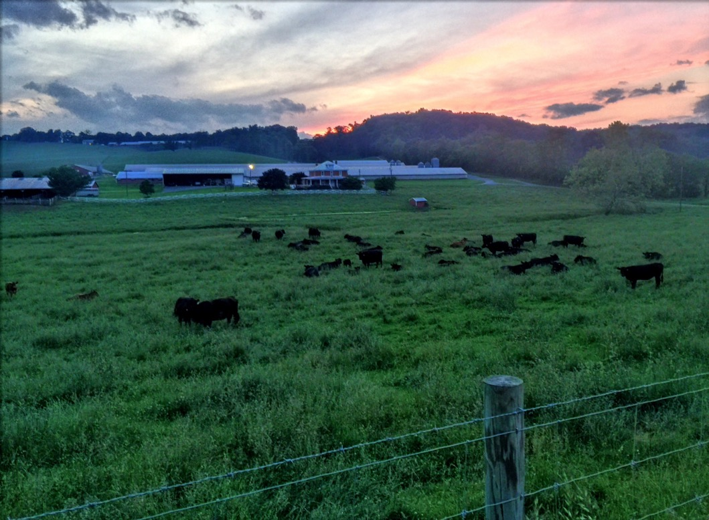

Slide 5
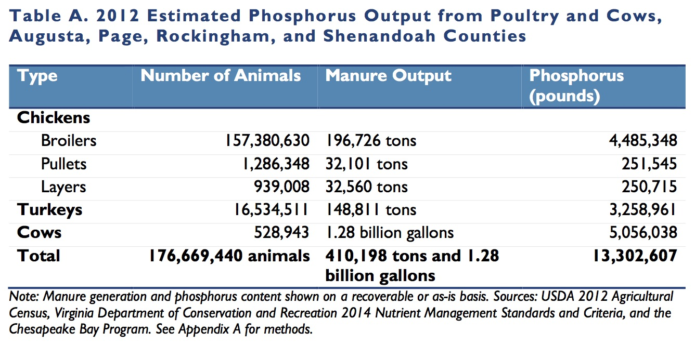
Manure Production in the Shenandoah Valley
Water Pollution from Livestock in the Shenandoah Valley. April 26, 2017. Environmental Integrity Project. https://tinyurl.com/r7xed7z

Slide 6
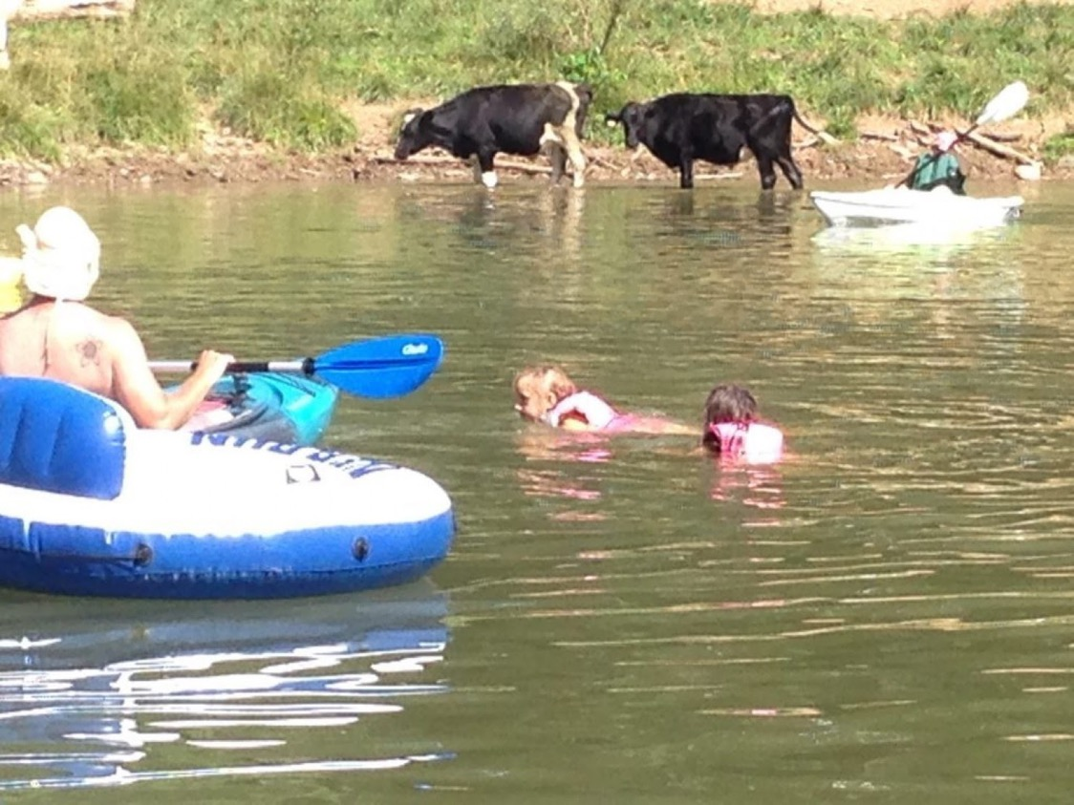

Slide 7
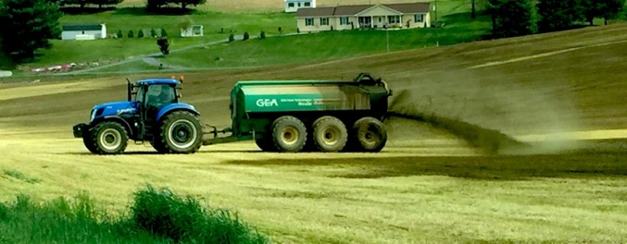
Contaminated Waterways
Field application of poultry litter
Water Pollution from Livestock in the Shenandoah Valley. April 26, 2017. Environmental Integrity Project. https://tinyurl.com/r7xed7z

Slide 8
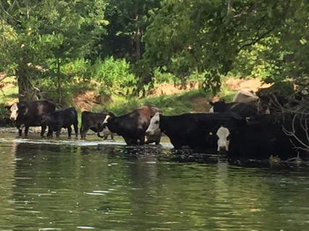
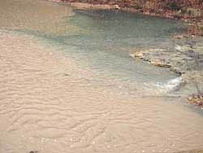
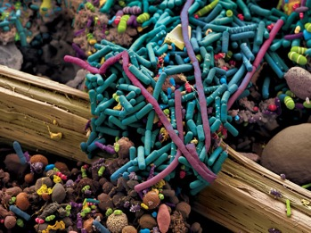

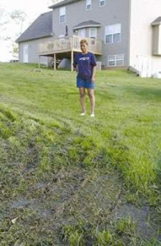
Environmental reservoirs of pathogens, transmissible antibiotic resistance and virulence?
Beyond the possible health implications of persistent pathogens in streams, what is the effect of having soil and stream bacteria constantly bathed in high numbers of fecal bacteria?
Introduced pathogenic (and commensal) bacteria may persist long enough for horizontal gene transfer (HGT), especially in sediments
Possible “hot spots” for HGT due to:
  Large total surface area
  High numbers
  High nutrient content

Slide 9
Potential in situ recombination and transmission in stream populations
Genes, transposons, genomic islands, and other mobile genetic elements may also recombine in situ within native and introduced stream populations
These may then be transmissible to and from pathogens (e.g. via plasmids)

Slide 10
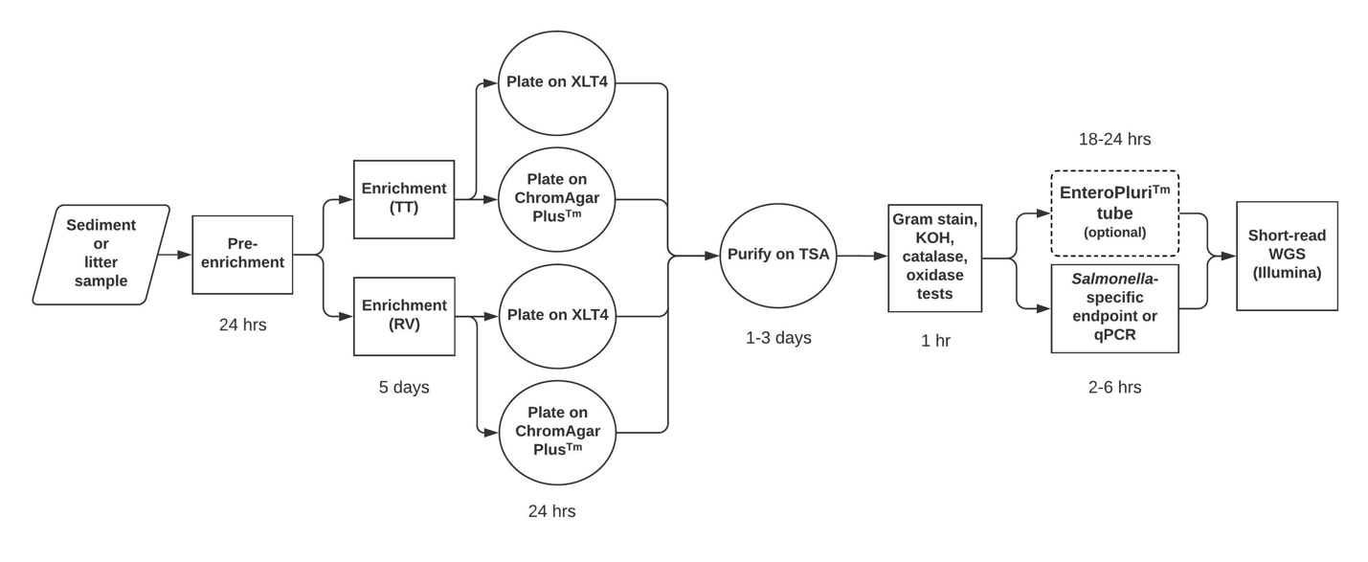
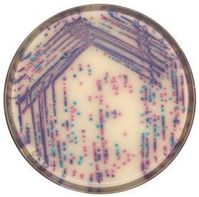
Salmonella Isolation and Identification
Workflow
ChromAgar Plus
Notes:
Developed protocols for enrichment and isolation from environmental and manure samples
Rappaport-Vassiliadis (RV) medium
Tetrathionate (TT) broth

Slide 11

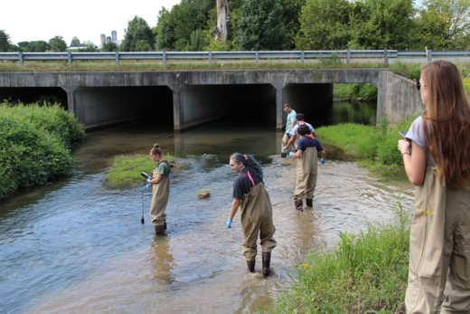
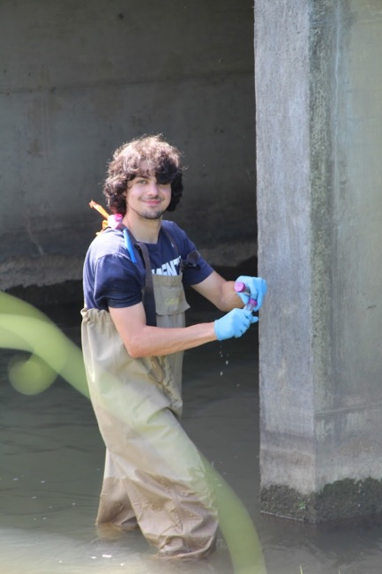
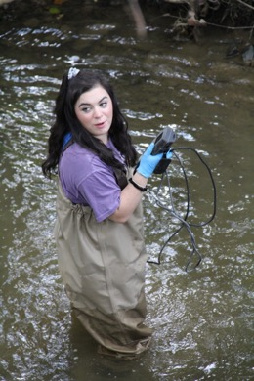
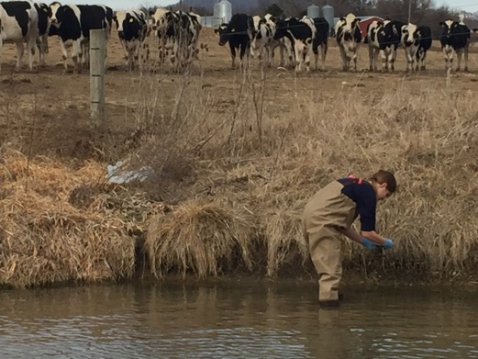
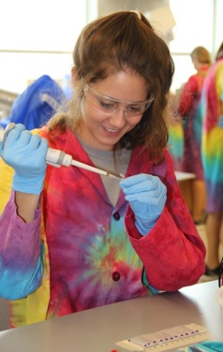
BIO346. Laboratory in Bacterial Pathogenomics
Jurgensen SK, Harsh J, Herrick JB. 2021. A CURE for Salmonella: A laboratory course in pathogen microbiology and genomics. CourseSource 8.
Notes:
Laboratory course taught to junior and senior college students each semester: Student isolation, identification, and basic genomics of waterborne pathogens
Other implementations of this model:
Kansas State University: Valentina Trinetta
Longwood University (microbial genomics only): Dale Beach

Slide 12
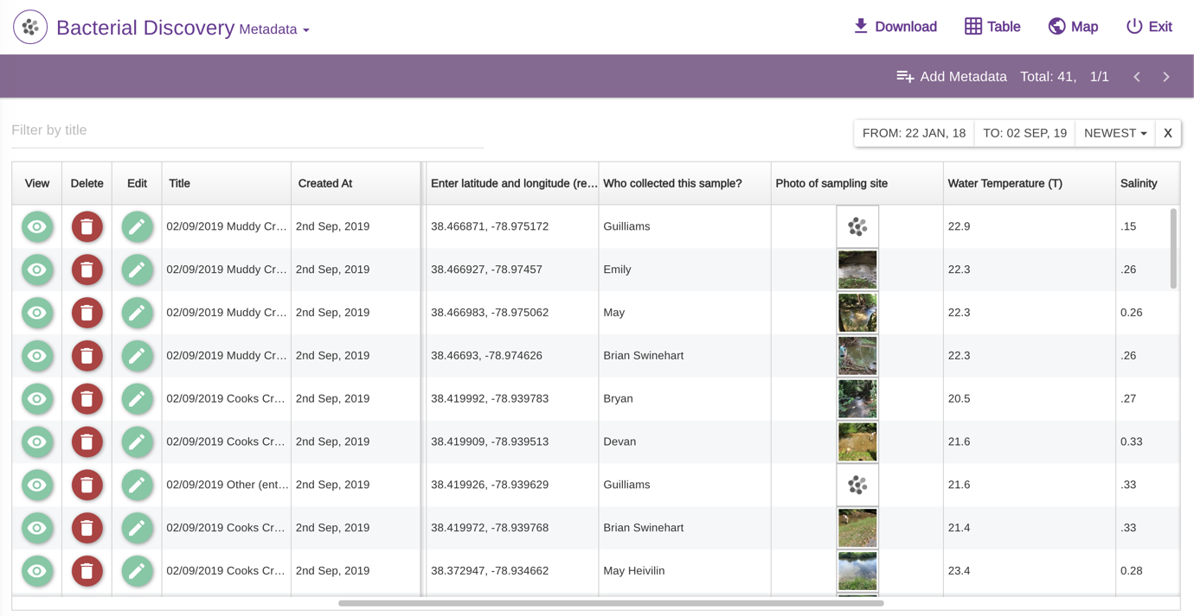
Sampling & Metadata (Epicollect5)
Sampling & Metadata (Epicollect5)
https://five.epicollect.net
Notes:
As students collect their stream samples, they also collect metadata using their phones, e.g. time/date, latitude/longitude, various abiotic site characteristics such as water temperature, pH, salinity, etc.
Compiled using the app “EpiCollect5”

Slide 13
Wet lab protocols

Slide 14
Up-to-date protocols & guides available on Open Science Framework at: https://osf.io/e2hqu/

Slide 15
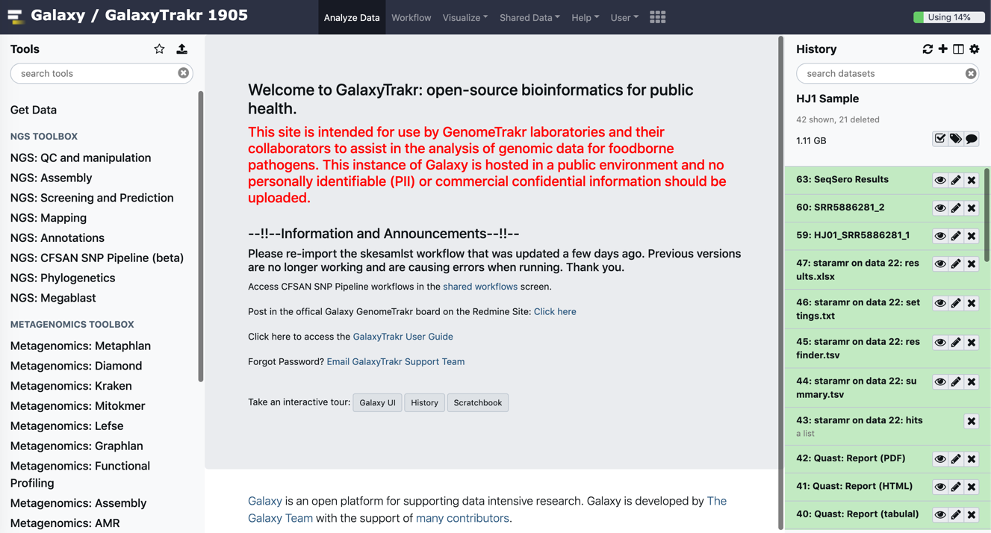
GalaxyTrakr, a genomics tool box ideal for teaching & training
Gangiredla J, Rand H, Benisatto D, Payne J, Strittmatter C, Sanders J, Wolfgang WJ, Libuit K, Herrick JB, Prarat M, Toro M, Farrell T, Strain E. 2021. GalaxyTrakr: a distributed analysis tool for public health whole genome sequence data accessible to non-bioinformaticians. BMC Genomics 22:114.

Slide 16
Bioinformatics Workflow
Also prophages, genomic islands, virulence genes, MLST, etc.

Slide 18
Bioinformatics protocols

Slide 19
Results

Slide 20
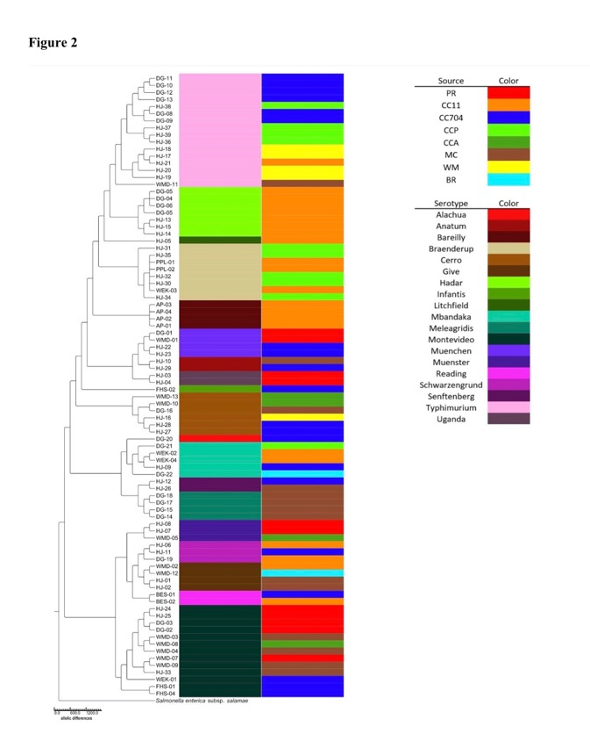
Serotype diversity and distribution of Salmonella enterica from stream sediments
Serotype
Source
Greenman et al. 2021. Genomics of Environmental Salmonella. Frontiers in Microbiology 12:592422.
Notes:
Can visualize by phylogenetic relationship, serotype, source, etc.
In our case, we had broad diversity of serotypes and core-genome multilocus sequence types, with 7 of the serotypes falling in the top 20 human disease-causing serotypes (CDC)

Slide 21
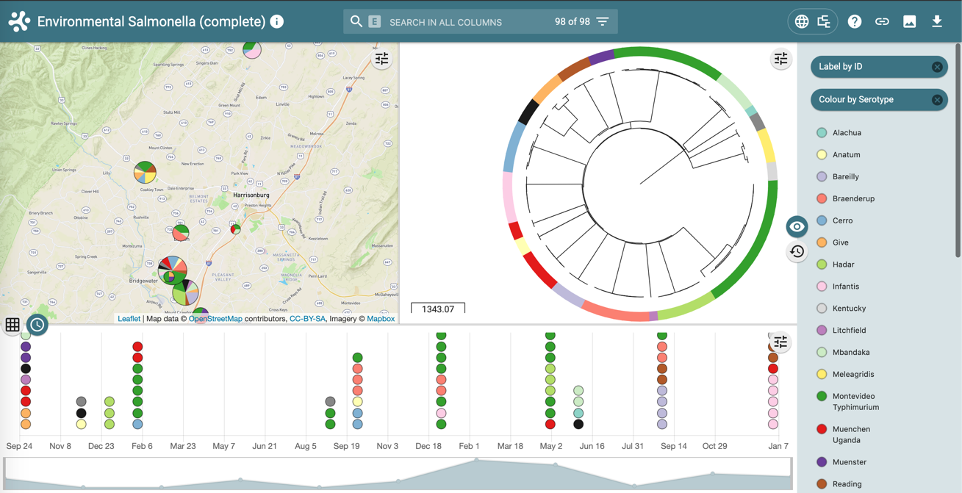
Visualization of isolate data using Microreact, an interactive, web-based platform from Wellcome Sanger
Microreact: Argimón et al. 2016. Microbial Genomics 2(11): doi:10.1099/mgen.0.000093
Notes:
A very useful interactive, web-based application from the Wellcome Sanger Instiute then allows us to look at the distribution of these Salmonella isolates across both the geographic space and the time in which they’re collected.
Can look at everything isolated from your sites, then their serotype and placement on a phylogenetic tree, and see when they were isolated.

Slide 22
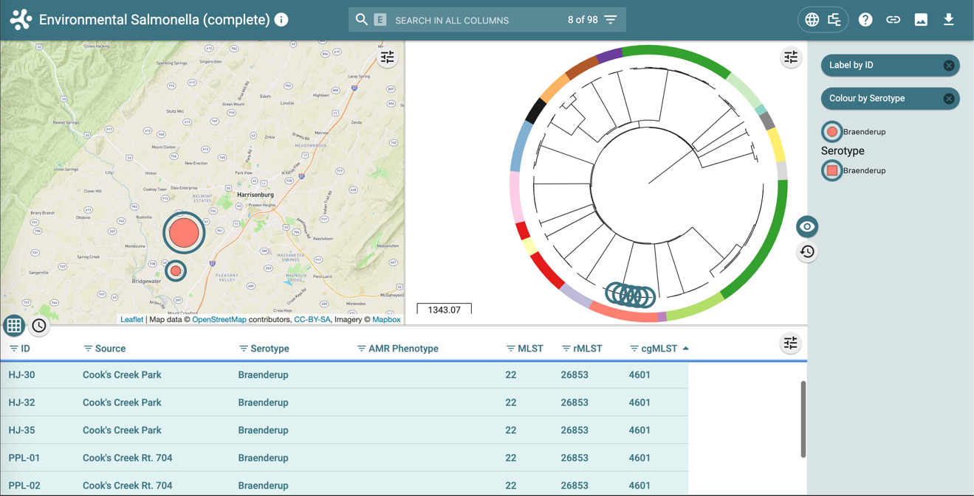
Virtually identical S. Braenderup found across multiple locations
Enterobase: Alikhan NF, Zhou Z,Sergeant MJ, Achtman M (2018) “A genomic overview of the population structure of Salmonella.” PLoS Genet 14 (4): e1007261.
Notes:
One can look at any data or metadata related to the isolates, for example MLST, rMLST, cgMLST, AR phenotypes.

Slide 23
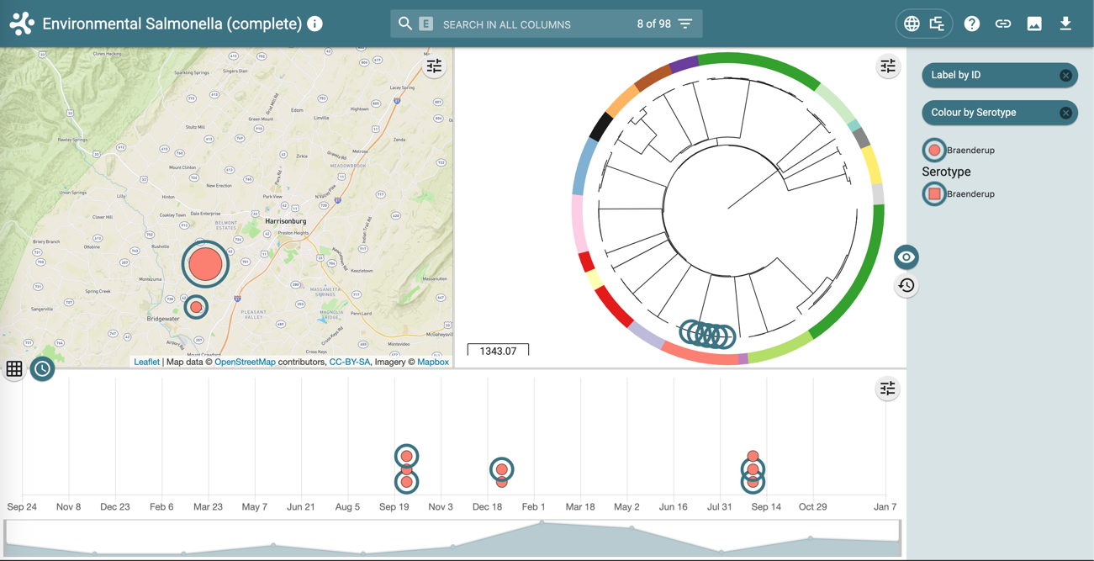
Identical S. Braenderup found across multiple locations and timepoints
Mark Achtman (Enterobase, Warwick U.): “What the tree shows is that your 6 isolates were part of a cluster of very tightly related strains isolated between 2011 and 2018 in Maryland and Virginia. It looks like they were present in rivers and sediments throughout both states and the water from those streams was used for watering cucumbers and bell peppers, some of which resulted in rare human infections. Most of these related strains were from 2015 but there was a resurgence in 2018.”
Notes:
Mark Achtman (Enterobase, Warwick U.): “What the tree shows is that your 6 isolates were part of a cluster of very tightly related strains isolated between 2011 and 2018 in Maryland and Virginia. It looks like they were present in rivers and sediments throughout both states and the water from those streams was used for watering cucumbers and bell peppers, some of which resulted in rare human infections. Most of these related strains were from 2015 but there was a resurgence in 2018.”

Slide 24
Isolation of Klebsiella spp.

Slide 25
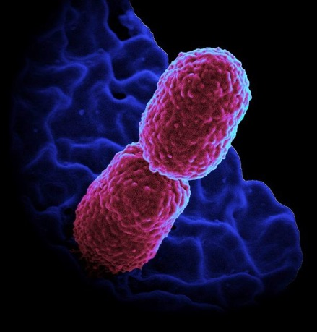
Notes:
Strain WORT-01 carries the serine beta-lactamase SHV-27, an ESBL
Encodes resistance to 3rd generation cephalosporins (cefotaxime, ceftazidime) and aztreonam (a monobactam)
Identical gene found in a K. pneumoniae (also ST661) isolate (SASK-01) downstream about a mile, 1 ½ years later

Slide 26
Klebsiella Isolation and Identification Workflow
Also capsule stain, SIM, EMB
Klebsiella isolation
Plate on Chromo-Select Agar
Notes:
Developed protocols for enrichment and isolation from environmental and manure samples
Rappaport-Vassiliadis (RV) medium
Tetrathionate (TT) broth

Slide 27


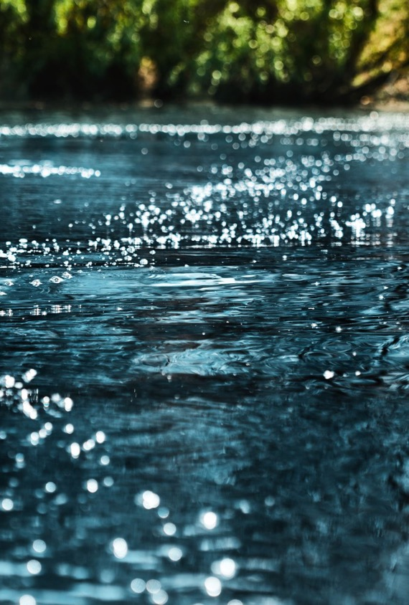
Transmissible plasmids in streams

Slide 28
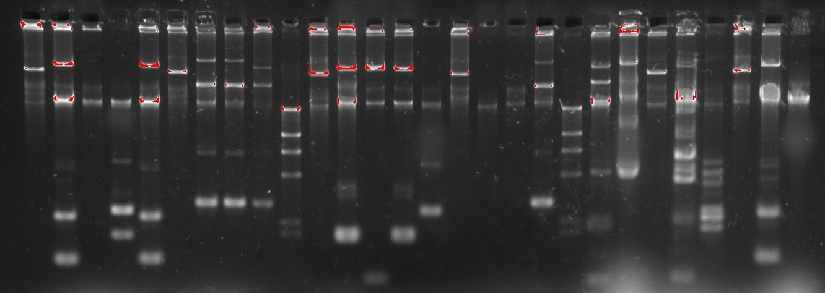
Plasmid Phenotyping and Genotyping
84% of the ARGs in isolated Salmonella were plasmid-borne.
All the S. Typhimurium ARGs were plasmid-borne.
Some (nearly) identical isolates differed only in whether their ARGs were on plasmids or not.
*Exclusive of aac6-Iaa and aac6-Iy, which are part of the core genome.
Notes:
Our lab has a particular interest in plasmids. We have developed a very easy, efficient method for isolating large, self-transmissible plasmids.
These isolated by students in the class.
Particular interest in transmissible antibiotic resistance

Slide 29
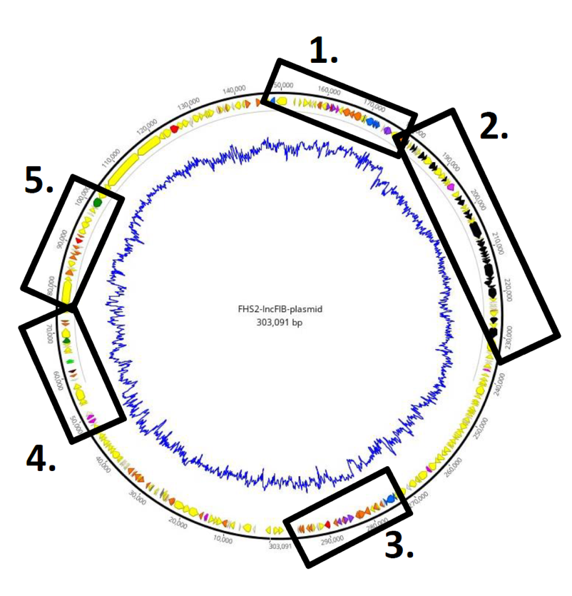
Plasmid pFHS2
Transmissible 303 kb megaplasmid identified in Salmonella Infantis FHS-02
Isolated from sediment of Cooks Creek, Virginia
Related to pESI (emerging Salmonella Infantis), identified in the epidemic spread of S. Infantis infections worldwide.
Greenman et al. 2021. Genomics of Environmental Salmonella. Front Microbiol 12:592422.
Notes:
This is a very large, self-transmissible plasmid from a student isolate, which one of my research lab students assembled using a hybrid approach.
Appears to be related to pESI, which may play a key role in the successful spread of an emergent S. Infantis clone in Israel and elsewhere.

Slide 30
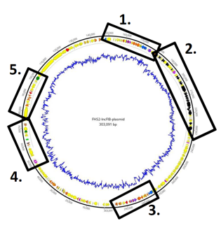
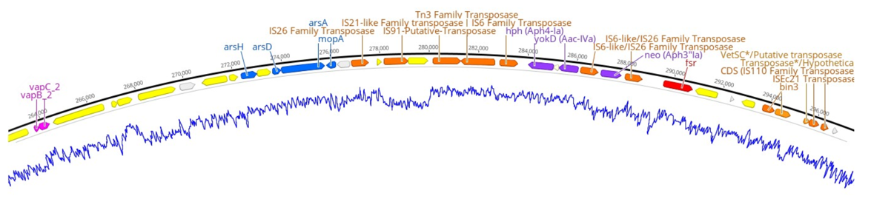
Plasmid pFHS2
11 predicted AR genes
11 predicted heavy metal resistance genes (mercury, arsenic, tellurite, molybdenum)
Multiple transposons & IS elements
4 predicted ‘plasmid addiction’ systems
Prophage-associated virulence gene (gipA), associated with Peyers patch colonization and macrophage survival
pil genes encoding a pilus for conjugation in liquid environments
Rare retron gene (rvt-1) encoding a bacterial reverse transcriptase
Accessory gene region 3
Notes:
Has an amazing number of AR genes, of metal resistance genes, of transposons and IS elements, and even a virulence gene gipA.
Along with tra genes, pil genes were also present. These genes encode a different pilus than those typically encoded by tra genes, one usually associated with conjugation in liquid environments (Bradley, 1984; Zatyka and Thomas, 1998).
Has great potential for mobilizing resistance genes to and from other pathogens and to other bacteria in the stream where it was found.
A “retron” gene (rvt-1) is encoded on fragment 4. It encodes a bacterial reverse transcriptase, a relatively rare gene (especially in Salmonella) and perhaps previously unknown on transmissible plasmids. “Although retrons were discovered three decades ago, their function remained unknown until recently that they were found to function as phage defense mechanisms (12,13).” (Fatemeh Sharifi, Yuzhen Ye, Identification and classification of reverse transcriptases in bacterial genomes and metagenomes, Nucleic Acids Research, Volume 50, Issue 5, 21 March 2022, Page e29).
Retrons have advantages over CRISPR as gene-editing tools (https://wyss.harvard.edu/news/move-over-crispr-the-retrons-are-coming/)

Slide 31

Implications
Bacterial communities in stream sediments may harbor significant reservoirs of Salmonella and Klebsiella, as well as resistance, virulence & other genes.
These genes are often found on mobile genetic elements.
Animal husbandry carried out on a massive scale may be adding to these reservoirs.
The ease of recovery of transmissible MDR plasmids suggests that these reservoirs exist, and that plasmids and other MGEs may facilitate gene recombination and spread to and from pathogens.

Slide 32



Acknowledgements
Graduate Students
  Jim Brooks
  Erika Gehr
  Kevin Libuit
  Curtis Kapsak
  Noah Greenman
Undergraduates
  Scott Benham
  Ross Haynes
  Spencer Heringa
  Lindsay Trower
  Sophie Jurgensen
  Charles Holmes
  Shahzeb Kahn
  Seana Sears
  Elena Balkanska
  Selena Hise
  Max Maza
  Raechel Davis
  and a host of others!
Special Thanks:
  Drs. Marc Allard and Rebecca Bell (FDA – CFSAN)
  Dr. Lauren Turner (Virginia DCLS)
  Dr. Stephen Turner (Signature Science, formerly @ UVa Bioinformatics Core)
  Dr. Jonathan Frye (USDA)
  The FDA GalaxyTrakr team

