Slide 1
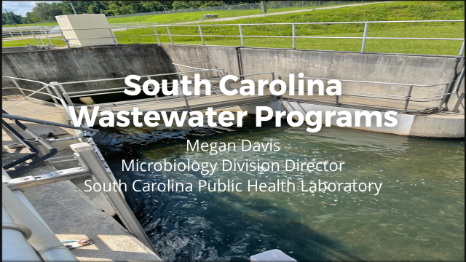

Slide 2
Overview
History of Wastewater Testing in SC
Wastewater Sampling Program
COVID Wastewater Testing
Culture Dependant Wastewater Testing

Slide 3
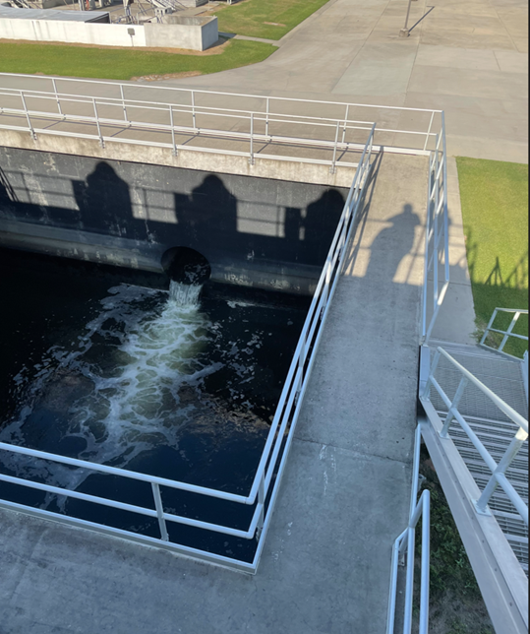
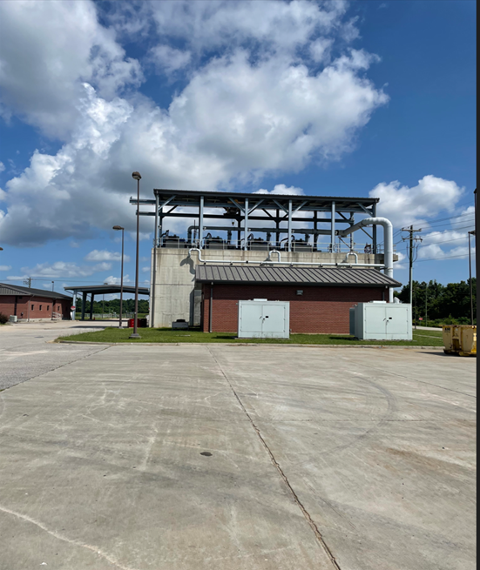
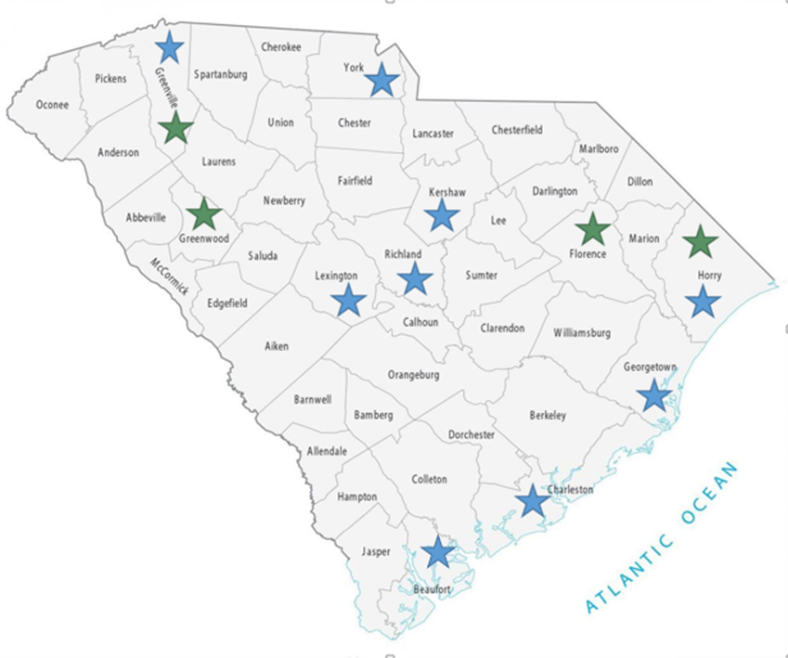
South Carolina Wastewater Collection Sites
Total population covered is approximately 1.1 million people

Slide 4
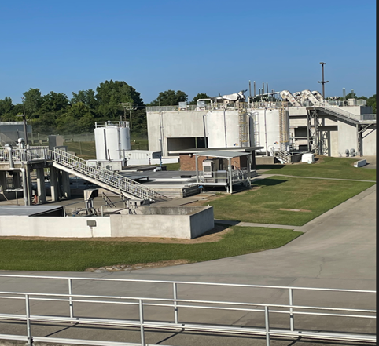
Wastewater Sampling
24 Hr Composite Influent Samples-1 Liter
Shipped next day delivery by Fed Ex
Receive samples Tuesday through Friday
Depending on the site the Virology Laboratory receives one
or two samples a week
The Virology Laboratory provides collection material and pre-paid shipping labels

Slide 5
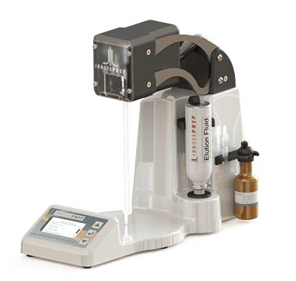
COVID Wastewater Testing
50 ml is poured off and pasteurized 1 hr at 56°C
Concentrate on the Innovaprep concentrating pipet
Extraction on the Qiacube- Allprep PowerViral DNA/RNA Kit
Run Digital-PCR on the QIAcuity
Extracted samples are frozen or given to the Advanced Molecular Laboratory for sequencing

Slide 6
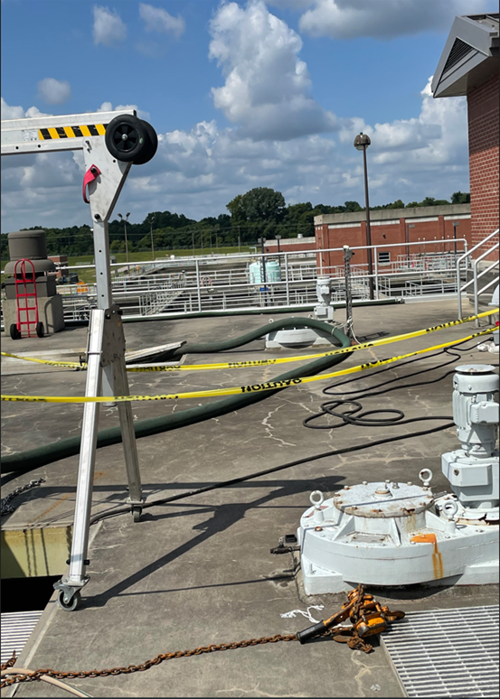
COVID Sequencing
cDNA Synthesis
  Lunascript RT Supermix
Targeted cDNA Amplification:
  Artic V.4.1 Primers - just switched to Artic V5.3.2
  Clean up done if multiple peaks are identified on the Aligent TapeStation
Library Prep
  Modified Illumina® DNA Prep (M) Tagmentation Library Preparation for cDNA amplicons from wastewater protocol. (found on protocols.io)
Sequencing on MiniSeq
  Illumina MiniSeq Mid- Output Kit (300 cycles)
Analysis
  GalaxyTrakr - SSQuAWK4 workflow

Slide 7
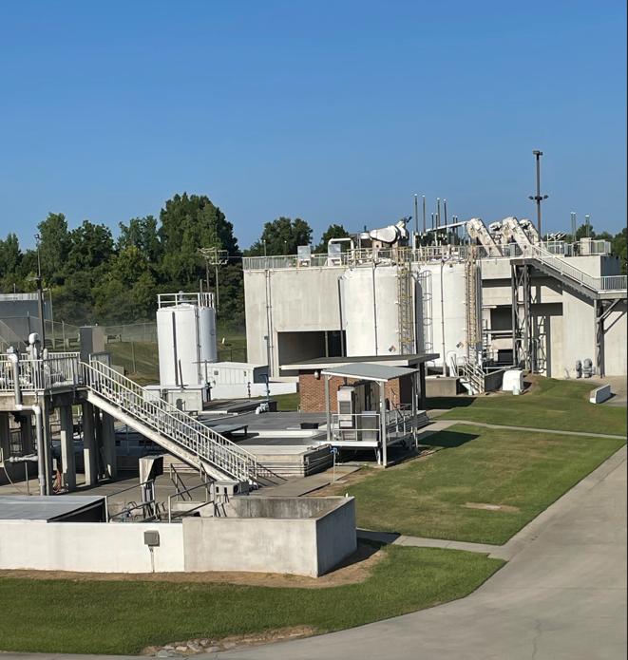
Culture Dependent Wastewater Sampling
February 2023
  Unable to obtain the 400 isolates needed to meet grant requirements of LFFM Grant
    175 E.coli from Penn State
    4 Campylobacter from Chicken Liver

Slide 8
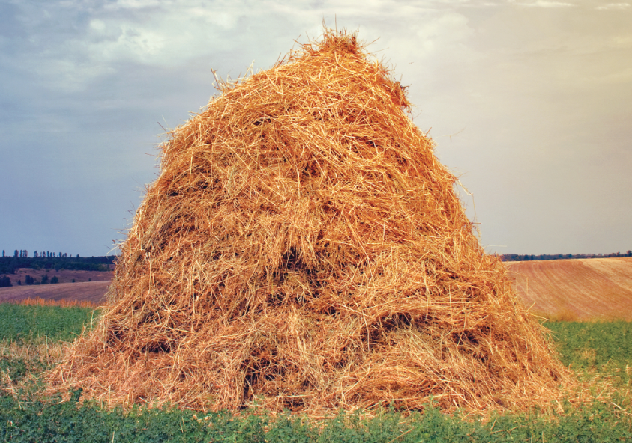
February-March 2023
Started by looking just for STEC
  1ml of wastewater into 9 ml of Butterfields Phosphate Water (BPW) , incubated at 42°C overnight (18-36 hours)
  Plated 10 ul unto CT-SMAC, L-EMB, and Rainbow Agars and incubated overnight at 36° C
  WAY to much growth to find the needle in the haystack

Slide 9
February-March 2023
Tried Bead Retriever
  CT-SMAC, L-EMB, and Rainbow
  Colonies subbed to blood agar and incubated and checked the next day by indole
  Indole positive were tested by the Remel O157 kit
  No STEC isolated, but were able to isolate generic E.coli
  Isolates given Advanced Molecular Laboratory

Slide 10
Updated Guidance for LFFM
GenomeTrakr
  Pathogenic E. coli
  Salmonella
  Vibrio parahaemolyticus
  Vibrio vulnificus
  Cronobacter sakazakii
  Campylobacter jejuni
  Listeria monocytogenes
  Bacillus cereus
  Clostridium botulinum
ESKAPE
  Klebsiella oxytoca
  Enterococcus faecium
  Staphylococcus aureus
  Klebsiella pneumoniae
  Acinetobacter baumannii
  Pseudomonas aeruginosa
  Enterobacter spp.

Slide 11
Organism | Enrichment Broth(s) | Selective and/or Differential Media
Listeria | LPT 29-31°C, 18-24 hrs | Rapid L’mono 35-37°C, 18-24 hrs
Vibrio | APW 35-37°C, 18-24 hrs | TCBS 35-37°C, 18-24 hrs
Salmonella | Lactose 35-37°C, 18-24 hrs RVR10 42°C, 18-24 hrs | XLD or HE 35-37°C, 18-24 hrs
E. coli | BPW 35-37°C, 18-24 hrs | L-EMB 35-37°C, 18-24 hrs

Slide 12
July 2023
2x Enterococcosel Broth 45°C, 18-24 hrs
Positive broths streaked Enterococcosel Agar, 35-37° 18-24 hrs
Isolates streaked for isolation on Blood Agar and Maldi-ToF used for Identification
One colony from each plate

Slide 13
Organisms Isolated from Wastewater
Salmonella (16)
  newport
  hadar
  braenderup
  muenchen
  cannstat
  seftenberg
  montevideo
  javianna
  typhimurium
  species
Enterococcus (12)
  faecium
  raffinosus
Escherichia coli (78)
  O121:H27
  O103:H2
  O145:H34
  O148:H40/H53
  O11:H4
  O37:H4

Slide 14
Organisms Isolated from Wastewater
Enterobacter (33)
  cloacae complex
  cloaeae
  kobei
  species
Citrobacter (9)
  freundii
  species
Cronobacter sakazakii (3)
Klebsiella (47)
  pneumoniae
  varicola
  oxytoca
  aerogenes
  species
Listeria (29)
  monocytogenes
  innocua
  welshimeri
  species

Slide 15
Organisms Isolated from Wastewater
  Proteus mirabilis
  Proteus species
  Providencia rettgeri
  Raoultella ornithinolytica
  Raoultella planticola
  Serratia marcescens
  Shewanella species
Pseudomonas (18)
  aeruginosa
  species
Other Organisms Isolated (47)
  Acinetobacter baumanni
  Aeromonas hydrophila
  Aeromonas species
  Bacillus cereus
  Lysinibacillus species
  Kluyvera ascorbate
  Morganella morganii

Slide 16
Wastewater Isolate Sequencing
Manual Extraction - Qiagen Blood and Tissue Kit
Library Prep (Automated, EpMotion)
  Illumina DNA Prep Kit
  IDT® for Illumina® DNA/RNA UD Indexes Sets A-D, Tagmentation (96 indexes, 96 Samples)
Clean up
  Illumnia Purification Beads and Agilent TapeStation
Sequencing
  MiSeq® Reagent Kit v2 (500 cycle)
  MiSeq® Reagent Kit v (600 cycle)
Analysis
  PulseNet org → Bionumerics
  If NOT supported within Bionumerics → GalaxyTrakr

Slide 17
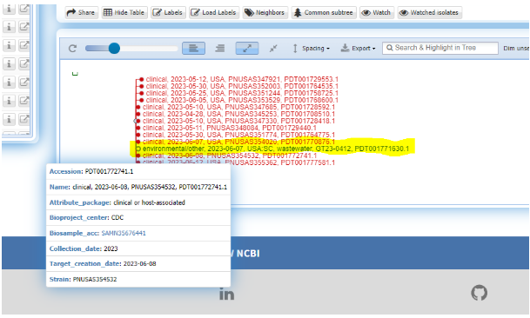
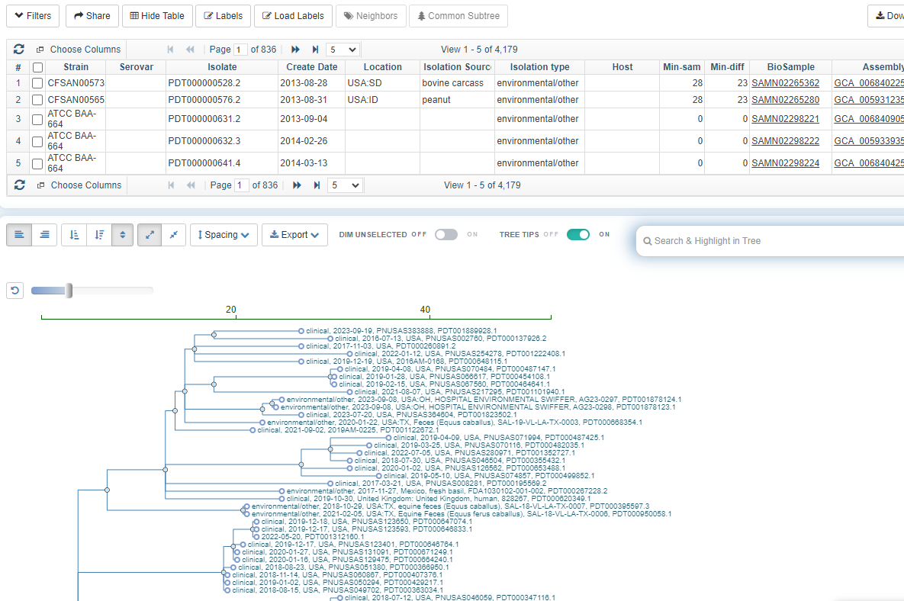
Isolates of Interest
Salmonella javiana 2306MLJGG-1 cluster
Salmonella braenderup
Proteus mirabillis

Slide 18
Future Considerations
Enhanced targeted ESKAPE organisms
Automate library prep for wastewater COVID samples

Slide 19
Acknowledgements
Virology Laboratory
  Supervisor- Christy Greenwood
    John Bonaparte
    Mitchell Landry
    Cara Culpepper
    Robyn Abernethy
Advanced Molecular Laboratory
  Supervisor-Greggory Goodwin
    Jessica Freeman
Food Microbiology Laboratory
  Supervisor-Dana Waggoner
    Sean Swinney

