Slide 1
Developing the toolkit to support equitable access to pathogen genomic surveillance: The International Pathogen
Surveillance Network (IPSN)
GenomeTrakr, 16 October 2024

Slide 2
The IPSN is a global network bringing together the pathogen genomic community to improve public health decision making
Vision
Mission
Every country has equitable access to sustained capacity for genomic sequencing and analytics as part of its public health surveillance system.
Engage a mutually supportive global network of genomic surveillance actors that amplifies and accelerates the work of its members to improve access and equity.
Launched in May 2023.
Supported by a secretariat @ the WHO Hub in Berlin

Slide 3






The challenge: pathogen genomics are not optimally deployed to prevent pandemics and reduce endemic burdens
Challenges
Implications
Country capacity in WGS increased;
coordination, integration and
sustainability remain a challenge
Public Health decision-making still hampered by lack of timely integration of genomic data
Lots of innovation and good
practices but
limited knowledge sharing
Significant barriers to pivot capacity to local disease priorities
New pathogens & variants in many geographies & disease areas still likely to be detected & shared late
Data sharing burdened by problems
at all levels
(technical and political)

Slide 4



In April 2022, WHO released a genomic surveillance strategy with five objectives to strengthen national and global systems
Improve access to tools for better
geographic representation
Maximize connectivity for timely value-add in the broader surveillance architecture
Strengthen the workforce to deliver at speed, scale and quality
Strategic
Objectives of
WHO Genomic Surveillance
Strategy
Maintain a readiness posture for emergencies
Enhance data sharing and utility for streamlined local to global public health decision-making and action

Slide 5
IPSN partners span all regions of the globe – 200 partner organizations across 71 countries engaged in the last year
IPSN launch
35 partners
18 countries
Global Partners Forum 2023
94 partners
48 countries
TODAY
200 partners
71 countries
Countries in which active IPSN partner organizations are located, *excl. countries in which global/regional organizations are HQ

Slide 6





The IPSN convenes technical, policy and financing communities together to deliver on global priorities
Who is the IPSN?
What does the IPSN do?
A network of pathogen genomic communities, including:
National and international lab networks & disease programs
Public and veterinary health systems
Academic groups
Private sector
Philanthropy & civil society
International standard organizations
Platform providers
Communities of Practice to solve common challenges
Country Scale-up Accelerator to enable exchange & amplify country voices
Catalytic grant fund to support member projects
Advocacy & communications to keep pathogen genomics high on the agenda
Convene partners to share progress and innovations

Slide 7
Bodies

Slide 8



Community of Practice on Pathogen Genomics Data
Community of Practice on Environment, Wastewater and Vector Surveillance
Community of Practice on Specialized Surveillance for Emergency Response
Support the connectivity and interoperability of data for better analysis
Foster the development of a bioinformatics ecosystem that supports equitable access to pathogen genomic surveillance
Define cost-effective use cases in public health surveillance
Provide technical support for standards
Encourage intersectoral collab. with One Health approach
Support knowledge exchange
Identify gaps for utilizing pathogen genomics and wastewater surveillance in the emergency response
Current focus on MPOX

Slide 9
Community of Practice on Pathogen Genomics Data
Support the connectivity and interoperability of data for better analysis
Foster the development of a bioinformatics ecosystem that supports equitable access to pathogen genomic surveillance

Slide 10
Development of new WHO document on genomic data sharing platforms
Operationalizes the WHO guiding principles for pathogen genome data sharing published in 2022.
Describes desired attributes of genomic data sharing platforms supporting surveillance of pathogens with epidemic and pandemic potential.
Landscape analysis; first document
Revision of document by WHO
Consultation with external expert group
Public consultation
Prepare for publication

Slide 11
Objectives of a Genomic Data Sharing Platform
To supports the public health community in the prevention of infectious threats a GDSP should:
Encourage data sharing through a secure, transparent, equitable and sustainable approach to storage of pathogen genomic data and linked metadata.
Facilitate rapid sharing of pathogen genomic data and metadata from users with a range of technical capabilities.
Facilitate analysis to support local to global surveillance.
Support collaboration and the formation of a trustworthy communities.

Slide 12


Attributes and principles linked to the objectives
Attribute | Objectives | No. of Principles
1. Governance | 1 | 4
2. Transparency | 1, 2, 3 | 9
3. Infrastructure and security | 1, 2 | 4
4. Data scope | 2, 3 | 7
5. Data provenance | 1, 3, 4 | 3
6. Data submission | 2 | 3
7. Data curation | 3 | 3
8. Access | 2, 3, 4 | 3
9. Interoperability | 2, 3, 4 | 2
10. Data usage licence and code of practice | 1, 2, 4 | 3
11. Analytic and reporting capabilities | 3 | 2
Table 1. Describes the attributes and links to the objectives
Box 1. Lists the principles for each attribute.

Slide 13



Supporting the development of a global, equitable bioinformatics ecosystem
On-going expert consultation on developing a community accepted model of a future bioinformatics ecosystem to align capacity building, workforce development, funding and prioritisation.
Characteristics of a more equitable, future bioinformatics ecosystem model
Empower local decision-making and facilitate local impact
  Lower the barriers in terms of infrastructure and bioinformatics requirements
  Facilitate bringing algorithms to data
Promote interoperability and transparency of genomic data stores
  Operate within global best practice of governance
  Support data pulls for local analysis or data upload for global surveillance efforts
  Facilitate standardised machine-to-machine communication
Provide resilience and scalability for preparedness and global surveillance
  Facilitate a global goods of analytical pipelines and workflows, compatible with quality requirements
  Support reproducibility and community driven validation
  Make data-sharing an integrated part of PGS workflows

Slide 14
Toolkit

Slide 15









Tool kit to support pathogen genomic surveillance scale-up
Global investment case
Country capacity framework
Lab costing tool
Use cases framework
IPSN Secretariat- supported products
WHO Global Strategy- driven products
Global data sharing attributes
Bioinformatics landscaping
Partner- driven products
M&E framework
Workforce training/ competencies framework
Sampling framework
Prioritization tool

Slide 16

IPSN Toolkit lead partners and timelines
Country
Capacity Framework
RKI
CPG
UKHSA
Piloting with partners and then ready for publication
Use Cases Framework
Asia PGI
Ready for publication
Global
Investment Case
WTSI
UKHSA
Wellcome
FIND
Ready for publication
Bioinformatics
Landscape
CoP Data members
Consultation

Slide 17
IPSN Toolkit lead partners and timelines
Prioritization
Tool
Asia PGI
CPG
US CDC
WPRO
SEARO
Workshop in September with WPRO and SEARO
M&E Framework Tool
CPG
FIND
APHL
US CDC
Workshop in September with partners
Training and Competencies
CPG
WCS
UKHSA
US CDC
RKI
Workshop in September with partners
Sampling framework
CPG
US CDC
Establishing working group

Slide 18
IPSN Toolkit lead partners and timelines
Global Costing Tool
FIND
APHL
Global Fund
UKHSA
WHO EURO
Piloting in countries, launch at the GPF
Global Data
Sharing Attributes
CoP Data members
Cross-WHO departments
Ready for publication

Slide 19
Tool kit to support pathogen genomic surveillance scale-up
Global investment case
Country capacity framework
Lab costing tool
Use cases framework
IPSN Secretariat- supported products
WHO Global Strategy- driven products
Global data sharing attributes
Bioinformatics landscaping
Partner- driven products
M&E framework
Workforce training/ competencies framework
Sampling framework
Prioritization tool

Slide 20
Catalytic Grants Fund

Slide 21






The IPSN is established a catalytic grant fund to support members in pathogen genomic surveillance
Members can propose projects that support the IPSN mission and bodies
Funding will support equitable participation in IPSN projects and events
IPSN members can apply for funding as a consortium or individually
Funds are available for IPSN members to apply for from 2024
Around 10 grants per year, $50,000 - 250,000, to fund projects for approx. one year in duration
Funds will go towards supporting global, regional and country-level IPSN projects
Lead applicants must be from LMICs
HICs can be part of a consortium
First funding cycle is complete
Next cycle in early 2025

Slide 22
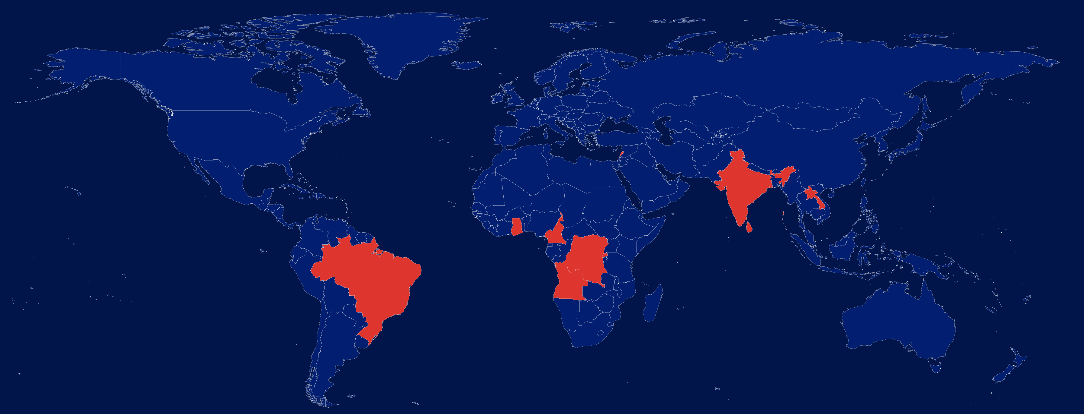
Broad category:
Capacity building
Better tools / Global goods
In-country piloting of innovative approaches
Sector:
MoH
Academic
Wastewater Genomic Surveillance of Viral Diarrheal Diseases among Refugee Populations (Noro/Rota/HepA virus)
American University of Beirut
Quantitative mapping of environmental to clinical AMR via DNA barcoding
Ashoka University
Environmental genomic surveillance of avian Influenza A in live-bird markets
Institute Pasteur du Laos
Air Sampling Surveillance for AMR Monitoring
Noguchi Memorial Institute for Medical Research
Piloting pathogen genomics surveillance of food borne disease (Salmonella, Shigella)
Medical Research Institute of Colombo
Offline capable pipeline for real-time analysis of untargeted metagenomics data (Pathogen X)
Federal University of Rio de Janeiro
Establishing a Rwandan One Health genomic surveillance network for Rift Valley Fever
Rwanda Biomedical Centre
Integrating surveillance of malaria into the genomics platform in Cameroon
National Public Health Laboratory
Sequencing drug-resistant bacterial pathogens in the DRC by extending the Mini-Lab with a MinION
Evangelical University of Africa
Metagenomic surveillance for epidemic prevention in the Angola-DRC border (dengue, yellow fever)
Instituto Nacional de Investigação em Saúde

Slide 23
Take homes
The role of networks is critical to break the silos that challenge sustainable PGS capacity development
Networks of networks are just as important!
We’d love to hear from you!
ipsn-secretariat@who.int

Slide 24
Thankyou

