Slide 1
Office of Partnership Updates
Christina Chrysogelos, Project Manager
FDA Office of Partnerships
Oct. 24, 2023
GenomeTrakr Meeting

Slide 2
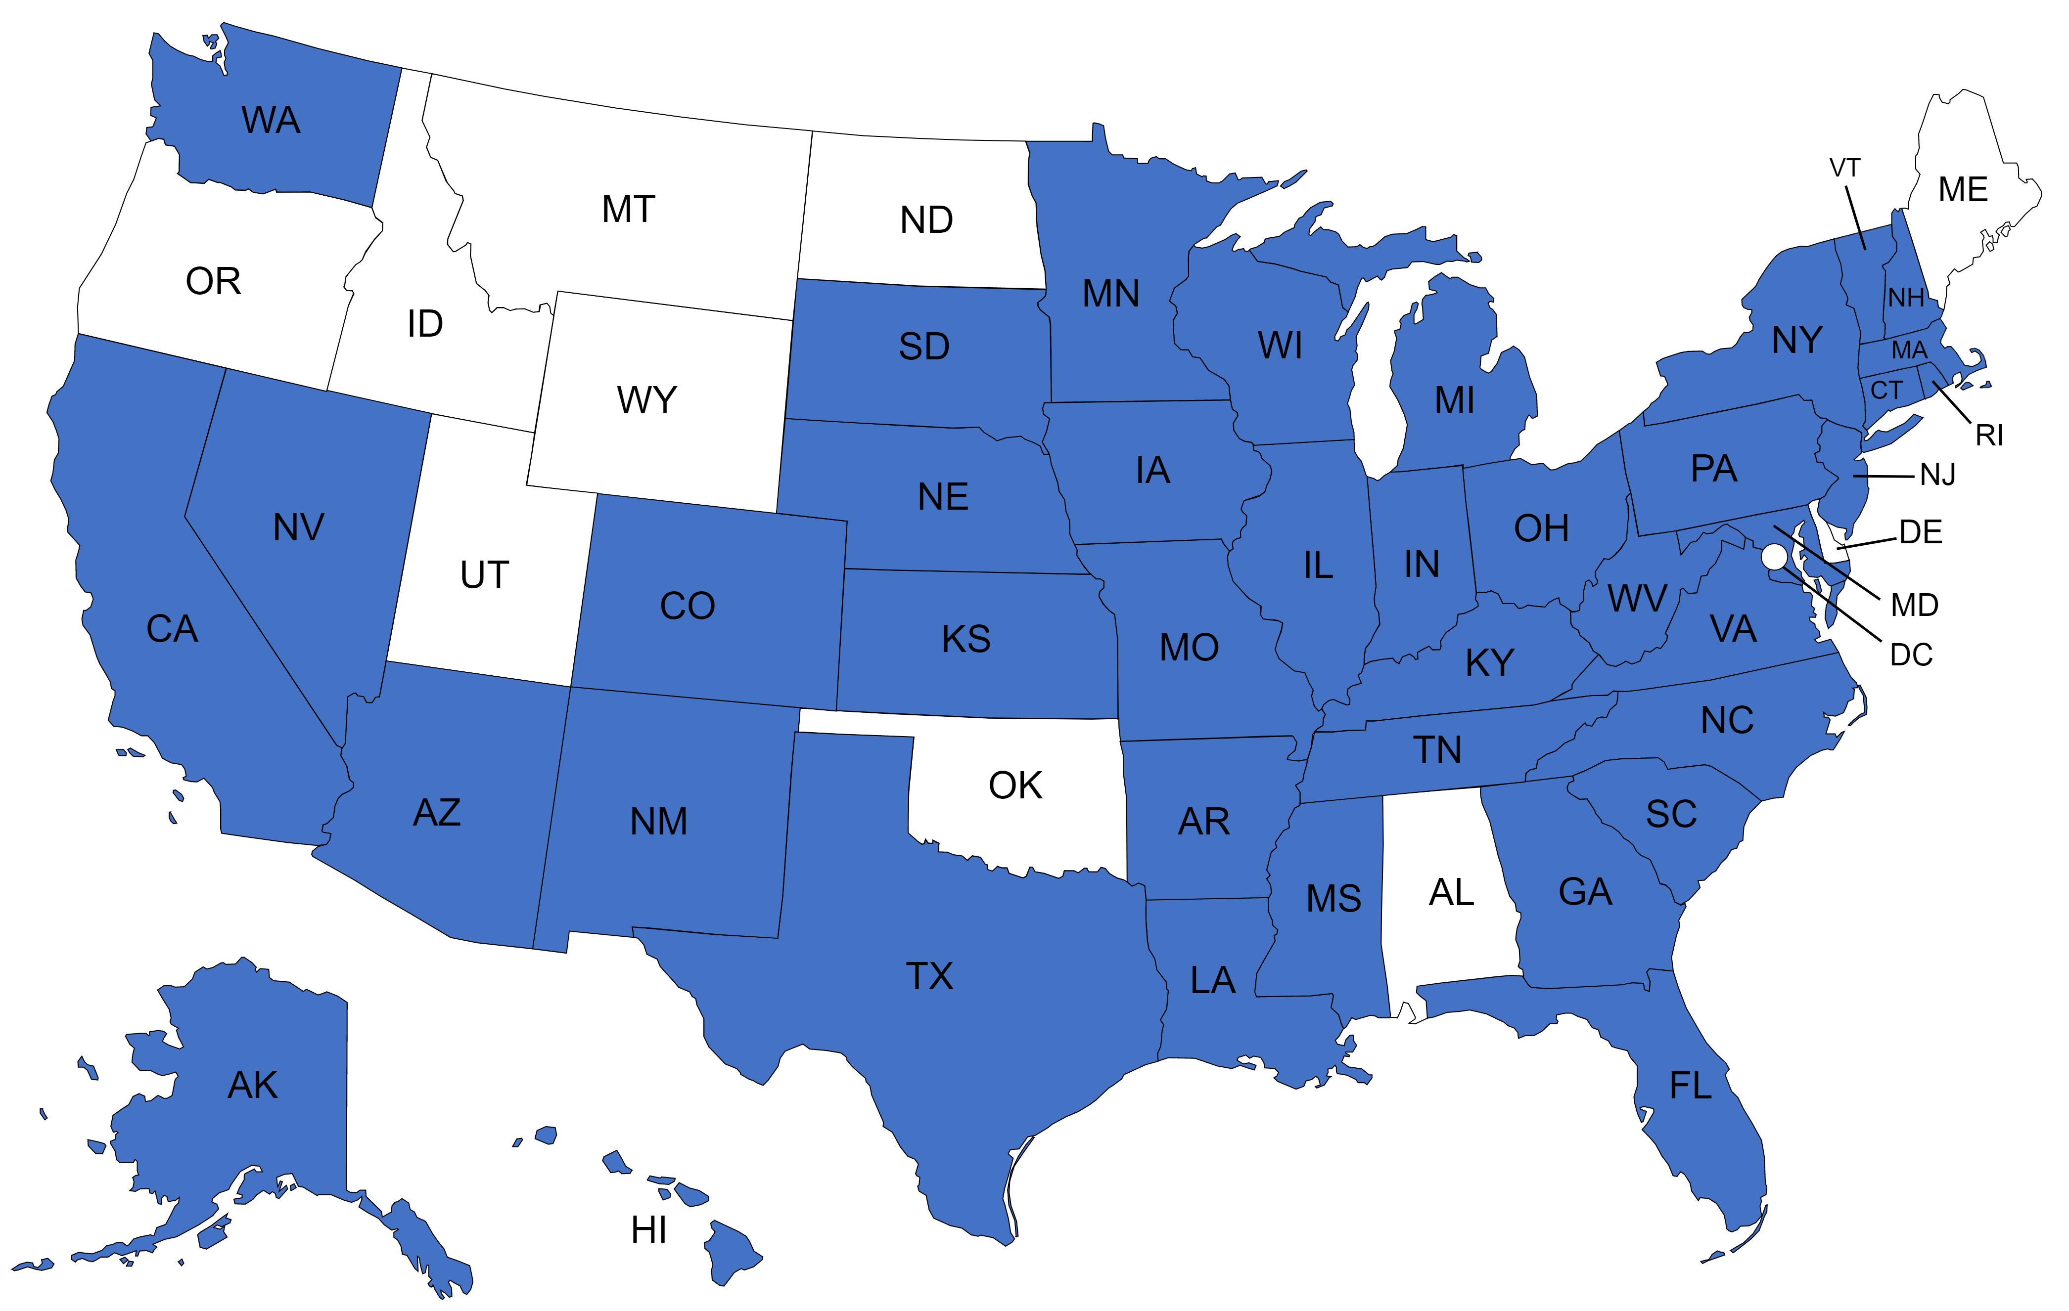
LABORATORY FLEXIBLE
FUNDING MODEL
In Year 4 of a 5-Year Cooperative Agreement Program
Cycle: July 1 – June 30, annually
14
55
40
TRACKS across chemistry, microbiology, and radiochemistry disciplines
LABORATORIES participating in at least one track
STATES

Slide 3
WGS TRACK
31 Labs
Arizona State Department of Health Services
California Department of Public Health
Colorado State Department of Public Health and Environment
Florida Department of Agriculture and Consumer Services
Indiana State Department of Health
Kentucky State Cabinet for Health and Family Services
Maryland State Department of Health Laboratories Administration
Massachusetts State Department of Public Health
Michigan State Department of Agriculture
Michigan State Department of Health and Human Services
Minnesota State Department of Health
Missouri State Department of Health and Senior Services
New Hampshire State Department of Health and Human Services, Health Statistics and Data Management
New Jersey State Department of Agriculture
New Jersey State Department of Health and Senior Services
New Mexico State University
New York State Department of Agriculture and Markets
New York State Department of Health
North Carolina State University
Ohio State Department of Agriculture
Pennsylvania State University
Rhode Island Department of Health
South Carolina Department of Health and Environmental Control
South Dakota State University
Texas Department of State Health Services
University of Nevada, Reno
Vermont State Agency of Human Services
Virginia Division of Consolidated laboratory Services
Washington State Department of Agriculture
Washington State Department of Health
West Virginia Department of Agriculture

Slide 4
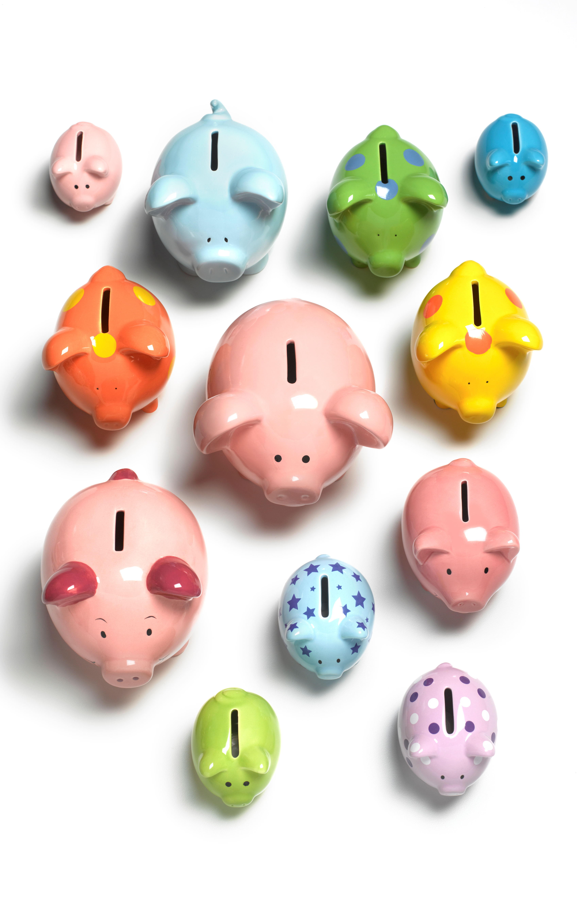
FUNDING
$23.5M for LFFM in Y4
Maintenance fund is allocated by the lab across their microbiology track(s)
Tier | Isolates | Labs | Base | Maintenance
Low | 100 | 14 | $20k | Up to $90k, $110k, or $130k
Medium | 250 | 6 | $55k
High | 400 | 11 | $90k
 |  | Total | $2.8M for WGS track
Notes:
$20M in new funding ($3M in offsets). CFSAN provided $382k in funding for a chemotherapeutics/shrimp project.

Slide 5
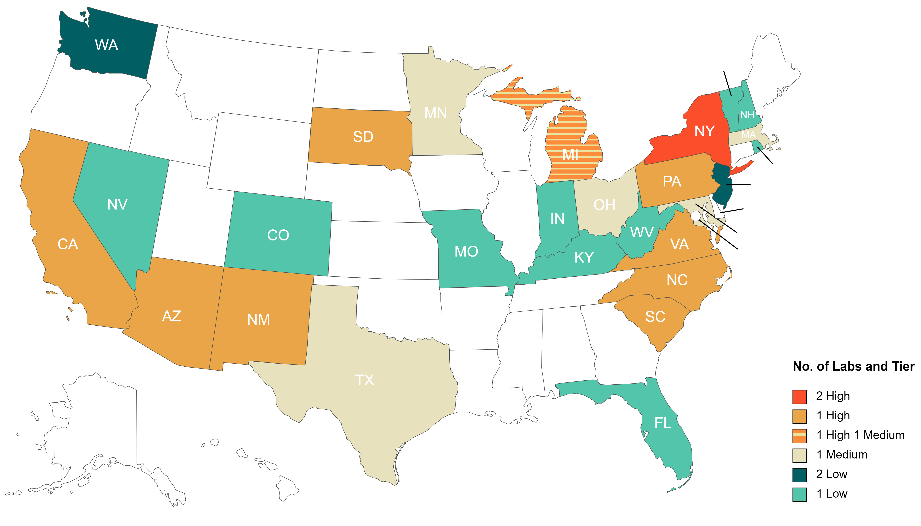
LFFM WGS TRACK TIERS BY STATE
VT
RI
NJ
DE
MD
DC
Notes:
16 labs are also approved for product testing tracks

Slide 6
LABS PER LFFM TRACK
 | Year 1 | Year 2 | Year 3 | Year 4
Food Defense Tracks
Micro | 12 | 12 | 12 | 12
Chem | 11 | 11 | 11 | 11
Rad | 15 | 18 | 18 | 18
Development Tracks
Micro | 18 | 14 | 11 | 18
Chem | 11 | N/A | 6 | 9
Rad | 14 | N/A | N/A | N/A
WGS | 28 — 3566 of 7900 isolates | 31 — 5824 of 8050 isolates | 31 — 5980* of 7900 isolates | 31 — 7300 isolates in progress
Product Testing Tracks
Micro – Human Food | 25 | 25 | 25 | 25
Micro – Animal Food | 21 | 16 | 19 | 18
Chem – Human Food | 26 | 26 | 26 | 26
Chem – Animal Food | 21 | 15 | 15 | 15
Special Project Tracks
Data Exchange Implementation | 15 | 6 | 1 | 1
Method Development/Validation | 22 | 27 | 15 | 23
Sample Collection | 31 | 31 | 31 | 31
SARS-CoV-2 Variant Surveillance | N/A | 20 | NCE** | NCE**
* We are still working on the automated tracking
** Some labs are completing work under a no-cost extension
Notes:
Y1 – no reporting mechanism besides the end of year report due before the project is complete
Y2 – created a mechanism for reporting, added 2 new metadata fields for all LFFM isolates. Sequenced by lab can be different than LFFM lab. Information is reviewed and validated by labs to ensure proper tracking.

Slide 7
Y4 LFFM TRACKS
Project Type |  | No. Labs | Unique analyses planned |  | No. Labs | Unique analyses planned |  | No. Labs | Unique analyses planned
Food Defense | MICRO………………………………. | 12 | n/a | CHEM……………………………. | 11 | n/a | RAD………………………………. | 18 | n/a
Development |  | 18 | n/a |  | 9 | n/a |  | Not open in Y4 | n/a
Animal Food Product Testing |  | 18 | 3,300 |  | 15 | 3,000 |  | - | -
Human Food Product Testing |  | 25 | 9,150 |  | 26 | 7,150 |  | - | -
Whole Genome Sequencing |  | 31 | 7,300 isolates |  | - | - |  | - | -
Special Projects |  | No. Labs
Sample Collection |  | 31 |  | 31 | 31
Method Development/ Validation Studies |  | 23 |  | 23 | 23
Data Exchange Implementation |  | 1 |  | 1 | 1
SARS-CoV-2 Wastewater |  | No-Cost Extension
Notes:
This is a snapshot of the Year 4 tracks, with number of labs and samples per Track. 2 of the 3 Development tracks open this year, supporting micro and chem projects. There will not be a renewal of the SARS-CoV-2 variant wastewater surveillance track, but some labs may be finishing work for that track under no cost extension.
Some tracks have variable funding levels that depend on the sample or isolate tier the laboratory selected. For example, sample tiers for product testing can range from 100 to 500 unique analyses per year. In Year 4, across the 25 participating Micro Human Food Product Testing laboratories, a total of 9,150 unique analysis are anticipated.
The Data Exchange Implementation Track supports laboratories interested in establishing an automated or manual data exchange connection with FDA’s IT system. This data exchange platform and effort is termed ORA DX. This will allow for sharing sample data in real time, accessible through the FDA IT system

Slide 8
ACCOMPLISHMENTS FOR
PRODUCT TESTING TRACKS
Planned vs. Accomplished Samples
Track | Year 1 | Year 2 | Year 3 | Year 4 (In Progress)
Micro – Human Food | 25 labs Planned: 5,919 samples* Analyzed: 5,938 samples (100%) | 25 labs Planned: 7,070 samples* Analyzed: 7,728 samples (109%) | 25 labs Planned: 9,150 analyses Analyzed: 11,053 analyses (8,406 samples) (121%)^ | 25 labs Planned: 9,150 analyses
Micro – Animal Food | 21 labs Planned: 4,557 samples* Analyzed: 4,163 samples (91%) | 16 labs Planned: 3,250 samples Analyzed: 3,058 samples (94%) | 19 labs Planned: 3,550 analyses Analyzed: 3,624 analyses (2,709 samples) (102%)^ | 18 labs Planned: 3,300 analyses
Chem – Human Food | 26 labs Planned: 3,923 samples* Analyzed: 5,025 samples (128%) | 26 labs Planned: 6,068 samples* Analyzed: 6,134 samples (101%) | 26 labs Planned: 7,400 analyses Analyzed: 7,105 analyses (6,139 samples) (96%)^ | 26 labs Planned: 7,150 analyses
Chem – Animal Food | 21 labs Planned: 4,305 samples* Analyzed: 4,213 samples (98%) | 15 labs Planned: 3,300 samples Analyzed: 3,200 samples (97%) | 15 labs Planned: 3,000 analyses Analyzed: 3,029 analyses (1,576 samples) (101%)^ | 15 labs Planned: 3,000 analyses
*Planned sample accomplishments prorated due to delays in approval to start sampling for the year
^Year 3 data analysis is still pending finalization; final accomplishment numbers for Year 3 may differ
Notes:
As was mentioned earlier the amount of planned samples for each track depends on the number of participating laboratories and each laboratory’s selected sampling tier.
In Years 1-2, planned sample accomplishments were prorated due to delays in approval at the start of the year. Year 3 started on time. Year 3 also marked the shift towards counting unique analyses, versus samples processed. This was introduced to create parity in accomplishments counting, since some samples are more labor intensive than others if multiple methods are required.
LFFM is current in the middle of Year 4, so there is no accomplishment data available to date.

Slide 9
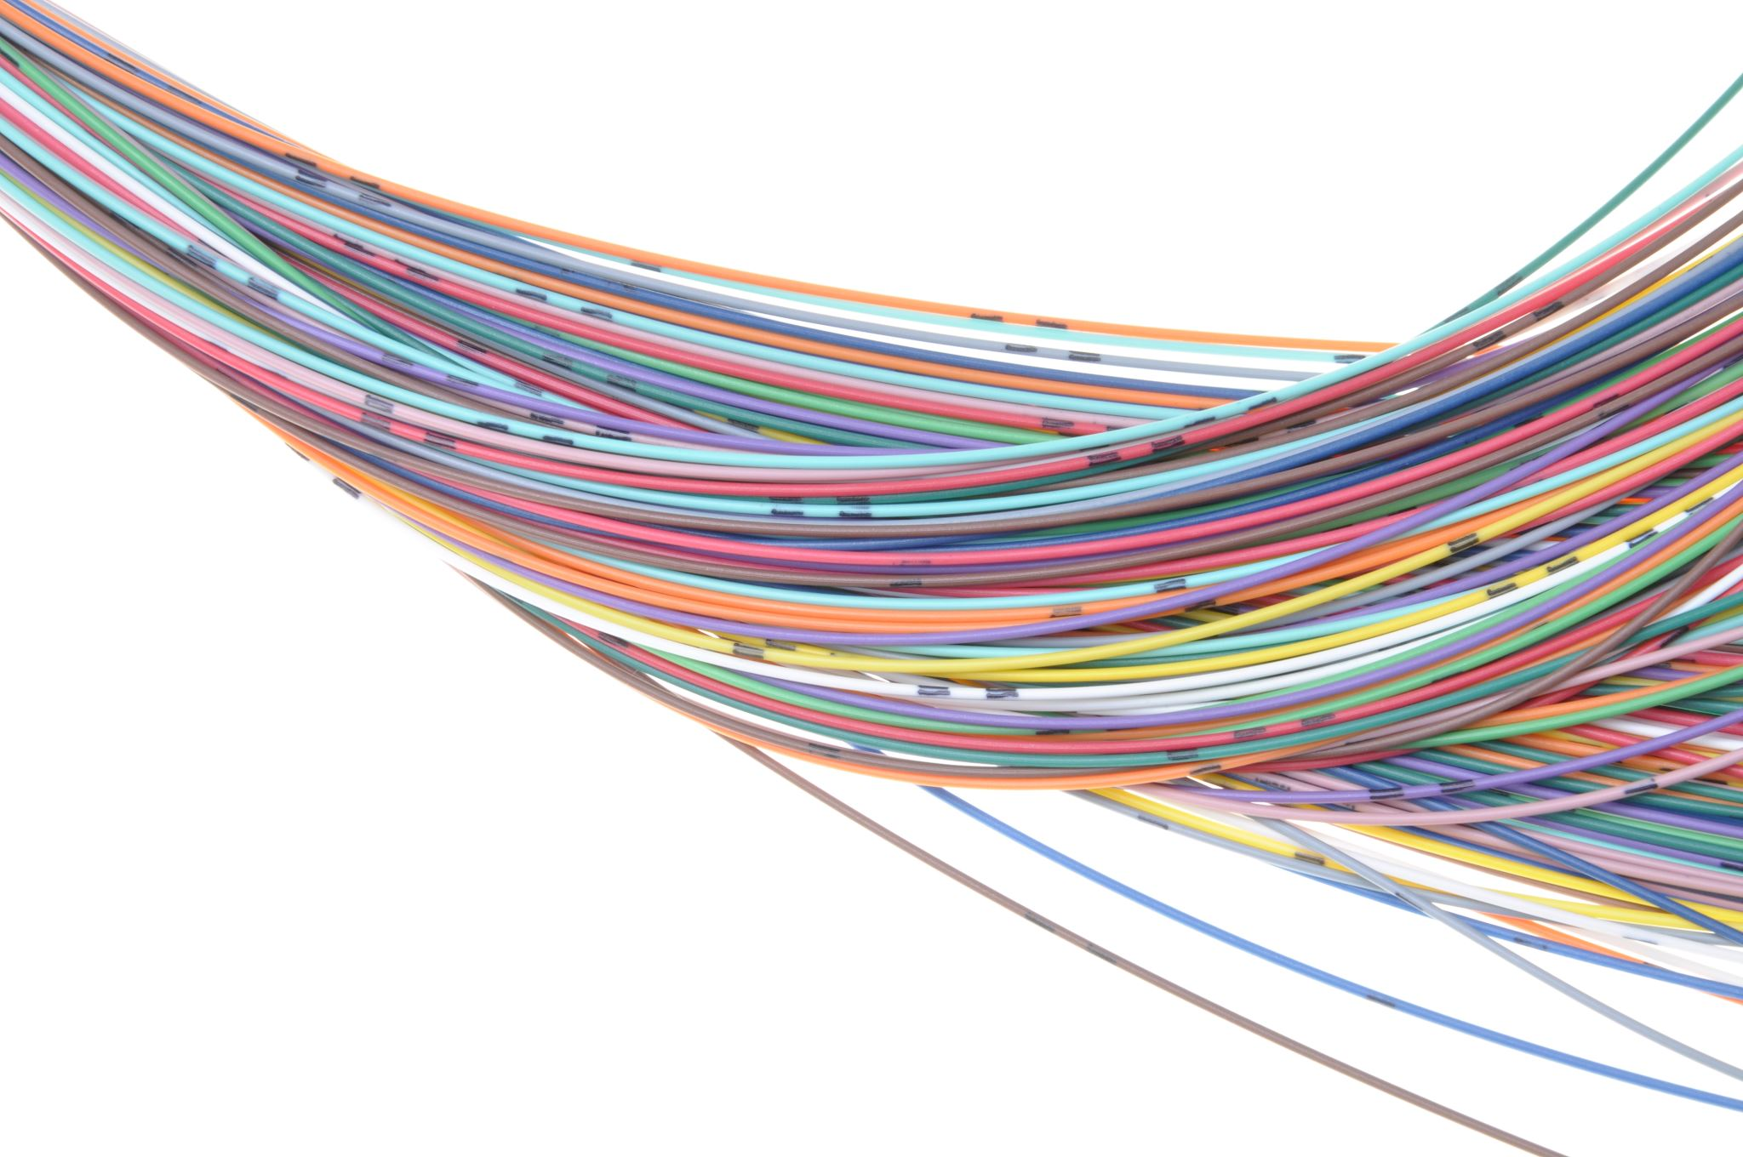
ISOLATE TRACKING
“Project_name” for tracking isolate in NCBI:
  GenomeTrakr-LFFM;FY2
  GenomeTrakr-LFFM;FY3
  GenomeTrakr-LFFM;FY4
“Sequenced_by” to identify sequencing laboratory
Notes:
LFFM labs enter the Project_name using a drop-down box.

Slide 10
WGS CONTACTS
LFFM Labs - ORA ORS
  Kirsten Hirneisen (Kirsten.Hirneisen@fda.hhs.gov)
  Lauren Yeung (Lauren.Yeung@fda.hhs.gov)
GenomeTrakr - CFSAN
  genometrakr@fda.hhs.gov:
    Ruth Timme
    Maria Balkey
    Marc Allard
    Tina Pfefer

Slide 11
FEEDBACK
OP welcomes your feedback on this presentation and any services provided by OP. Any feedback provided to this address will be reviewed by the Director of Office of Partnerships.
OP.Feedback@fda.hhs.gov

