Slide 1
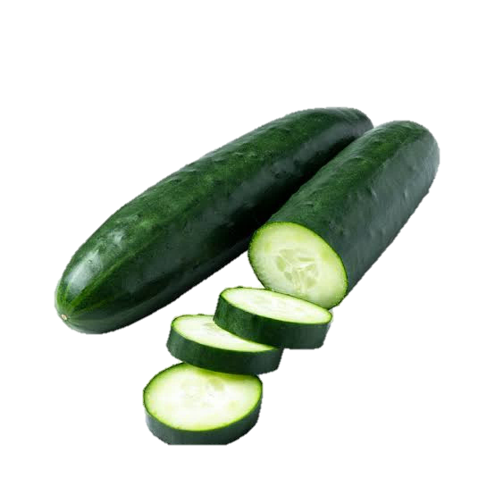
Not so cool: A 2024 Multistate outbreak investigation of salmonella Africana and S. Braenderup in cucumbers
Tyann Blessington, PhD, MS, MPH
Kailey Lewis, MPH
Margaret Kirchner, PhD, MS
Office of Coordinated Outbreak Response, Evaluation, & Emergency Preparedness (OCORE+EP)
Human Foods Program, FDA
Notes:
Today we will be describing an interesting outbreak that occurred earlier this year. It was an outbreak involving salmonellosis of multiple serotypes and the on-farm investigation also yielded multiple serotypes. These unique circumstances are a good example of how our surveillance and response activities must be resilient and flexible.

Slide 2





Outbreak Identification and Early Activities
Began investigating a new cluster of Salmonella Bochum, which was later reclassified as S. Africana.
MAY 2024
Began investigating 3 S. Braenderup clusters.
A 4th S. Braenderup cluster was identified.
Initiation of traceback for cucumbers for the S. Africana outbreak.
JUNE 2024
Initiated traceback for cucumbers for S. Braenderup polyclonal outbreak.
S. Africana and S. Braenderup investigations were combined into a single outbreak.
Notes:
This slide highlights some of the early outbreak surveillance and investigational activities.
5/1: CDC notified FDA of a cluster of a cluster of Salmonella Bochum, which was later reclassified as S. Africana.
5/15: FDA initiated traceback for cucumbers for the S. Africana outbreak. CDC notified FDA of 3 genetically distinct S. Braenderup clusters.
5/20: CDC combined all 3 S. Braenderup clusters into a single polyclonal outbreak
5/23: CDC identified a 4th S. Braenderup cluster and combined it to the polyclonal outbreak.
6/3: FDA initiated traceback for cucumbers for S. Braenderup outbreak.
6/27: S. Africana and S. Braenderup investigations were combined into a single outbreak

Slide 3
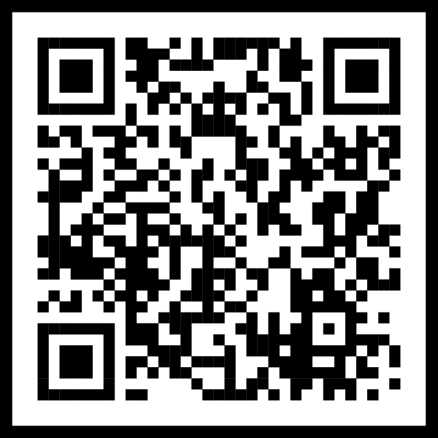
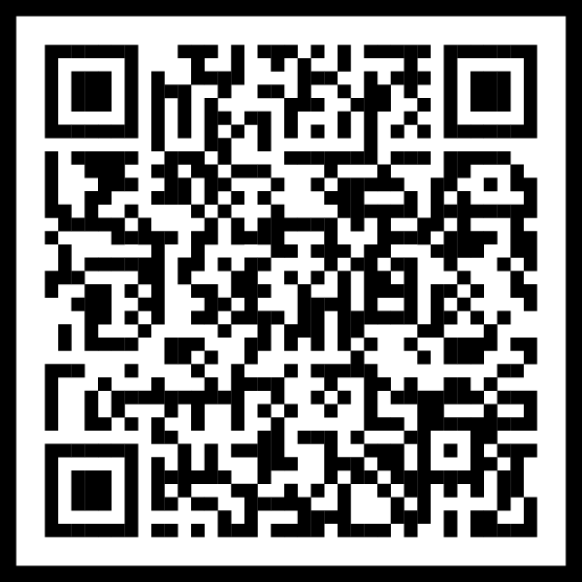
Genetic Relatedness
Salmonella Africana
Salmonella Braenderup
1
1
2
3
Span: 0-8 SNPs
Clades: 1
Span: 0-64 SNPs
Clades: 4
4
*Illustrative Representations
Notes:
We were investigating two different serotypes, Africana and Braenderup. These two serotypes were not genetically related and the genetic patterns within the serotypes were different, as well. Salmonella Africana is a rare serotype and this cluster was the first coded cluster in the US. This slide includes an Illustrative representation of the sequencing tree as well as a NCBI link to an isolate of the cluster.
S. Africana isolates had limited diversity, and all isolates fell in a single clade. All isolates were related within 0-8 SNPs (0-5 alleles)
S. Braenderup isolates were much more diverse, and isolates fell in 4 clades. Isolates were related by 0-64 SNPs.
(Braenderup interclade diversity: Clade 1: 0-5 alleles, Clade 2: 0-6 alleles, Clade 3: 0-6 alleles, Clade 4: 0-9 alleles.)

Slide 4
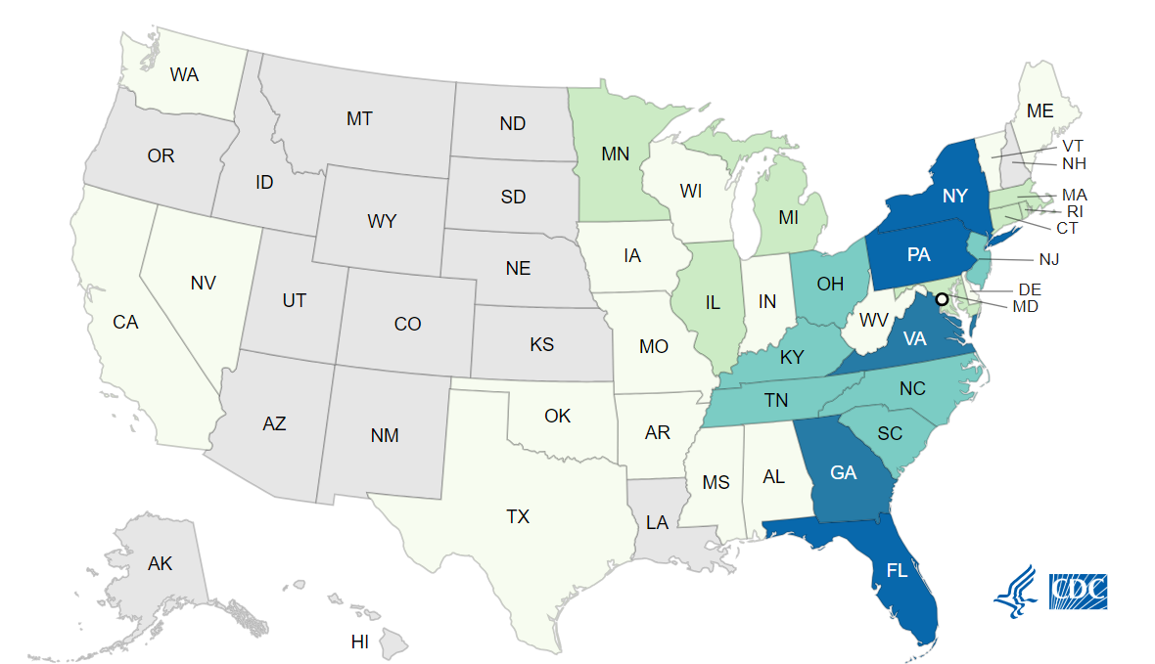
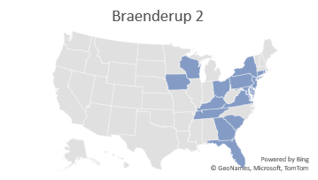
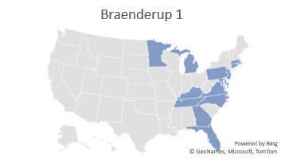
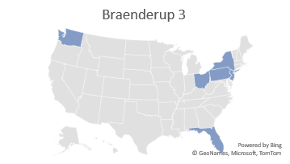
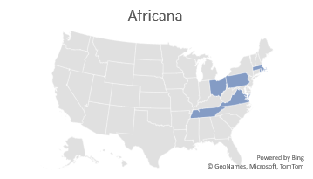
Case Distribution
Initial Case Distributions for Individual Strains
Final Case Distribution for the Polyclonal Outbreak
Notes:
Beyond similar timeframes for cluster identification, the case distribution of the illnesses were very similar. On the left side of the screen, are the initial case distributions for the Africana and the first 3 Braenederup clusters. Shortly after the 3rd Braenderup cluster was identified the 4 clusters were rolled into a single polyclonal outbreak cluster. Once the 4th cluster was identified, it was immediately added the polyclonal outbreak cluster. That case distribution is not displayed.
On the right side of the screen, is the case distribution at the end of the outbreak investigation. The outbreak included 551 cases from 34 states and the District of Columbia. Of these illnesses, 269 people were infected with the Salmonella Braenderup strain and 282 people were infected with the Salmonella Africana strain.
Illnesses: 551
Hospitalizations: 155
Deaths: 0
States: 34 states and the District of Columbia

Slide 5
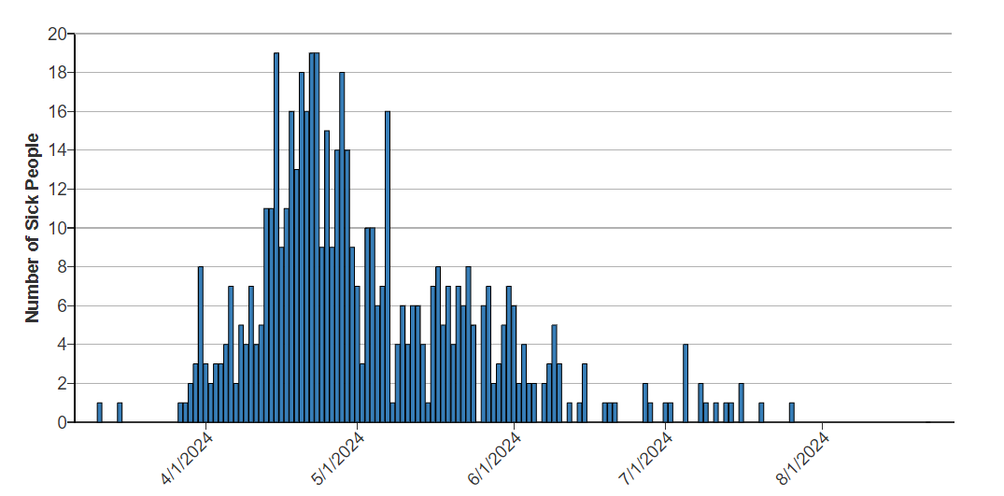

Polyclonal Salmonella Africana and S. Braenderup Outbreak
Epidemiology Overview
Total Cases | 551
Africana Braenderup | 282 269
Age Range | <1-94
Median Age | 48
% Female | 68
Hospitalization (Deaths) | 155 (0)
Onset Date Range | 3/11/2024 to 7/26/2024
Onset Dates
Notes:
Illness onset dates range from March 11, 2024, to July 26, 2024. 155 were hospitalized and no deaths were reported.
The case demographics across the individual clusters, prior to rolling them all in the polyclonal cluster, were similar. At the conclusion of the investigation, overall, ages range from <1 to 94 years with a median of 48 years, and 68% of cases were female. Of those with available outcome information, 155/456 (34%) cases were hospitalized, and there were no pathogen attributable deaths associated with this outbreak.
(Isolation dates ranged from 03/31/2024 to 08/03/2024 and reported onset dates (n=428) range from 03/11/2024 to 07/26/2024.)

Slide 6




Traceback Investigation
FDA conducted a traceback investigation on regular cucumbers.
FDA initiated 15 CORE issued assignments for record and information collection.
FDA initiated two CORE issued assignments for farm inspections which included on-site visits and environmental sampling.
Notes:
After narrowing down the vehicle of interest, a traceback investigation was conducted by FDA on regular cucumbers for both outbreak strains. Traceback investigations are a critical component of any foodborne illness outbreak investigation and are used to determine and document the movement of food product(s) of interest through the supply chain by following the food product back through the points of distribution, processing, and production to determine the source of the product. Through traceback, investigators can determine if there’s any convergence or a firm in common and help identify where contamination may have taken place.
This was a complicated traceback across multiple states. FDA Office of Regulatory Affairs Human and Animal Foods divisions/districts (ORA/HAF) initiated 15 CORE issued assignments for record and information collection.
​
FDA Office of Regulatory Affairs Produce Safety Network (ORA/PSN) initiated two CORE issued assignments for farm inspections which included an on-site visit to collect information and records, as well as conduct environmental sample collection.

Slide 7
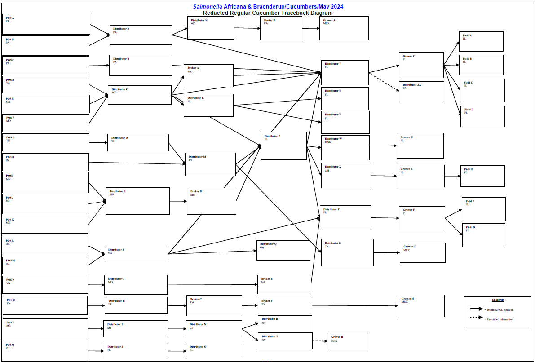
Notes:
The traceback investigation included 19 cases from nine states that were reported to have purchased or consumed cucumbers from 17 different points of service prior to their illness onset. These points of service included two grocery chains consisting of five different locations across two states, six restaurants representing ten different locations across seven states, a university dining hall, and a hospital cafeteria. Based on exposures related to these 17 points of service, two farms of interest (Grower C and Grower F) were identified in Southeast Florida.

Slide 8


Farm Inspections
Grower C
Grower F
Canal Water
Some issues with equipment and materials noted
Farm not growing cucumbers during inspection
Some issues with water source documentation and cleaning/sanitizing
Farm not growing cucumber during inspection
Salmonella Braenderup in water
Multiple Salmonella spp. in water and soil
Notes:
On-site inspections were conducted at both farms and included environmental sampling. Neither farm was growing or harvesting produce at the time of inspection, however of the items that could be observed, some potential issues were noted. Furthermore, both farms used water supplied by canals and a S. Braenderup outbreak strain was found. There were also non-outbreak related Salmonella spp. found in the water and soil. Some matched to clinical isolates (but this was not investigated as part of the outbreak)

Slide 9
Salmonella Diversity
Grower | Sample Type | Salmonella + Samples | # Isolates | # Serovars | # Distinct Genetic Strains
Grower C | Dead-End ultrafiltration (DEUF), Environmental, Soil | 3/7 | 95 | 10 | 19
Grower F | DEUF, Drag Swab, Environmental, Soil, Water (grab) | 9/14 | 92 | 24 | 45
Notes:
ORA/PSN collected seven environmental samples (four soil, two DEUF, and one environmental sample) from Grower C. Three of the seven samples (two DEUF and one soil) were positive for Salmonella spp., yielding 95 isolates which were identified to belong to ten different Salmonella serovars, representing 19 different Salmonella strains including one strain that matched one of the S. Braenderup outbreak strains (group three).
ORA/PSN collected 14 environmental samples (seven DEUF, four soil, one grab water, one drag swab, and one environmental sample) from Grower F. Nine of the 14 samples (seven DEUF, one grab water, and one drag swab sample) were positive for Salmonella spp., yielding 92 isolates which were identified to belong to 24 different Salmonella serovars, representing 45 Salmonella strains including one strain that matched one of the S. Braenderup outbreak strains (group four).

Slide 10
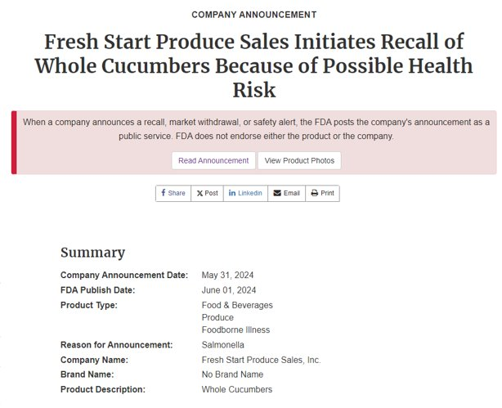
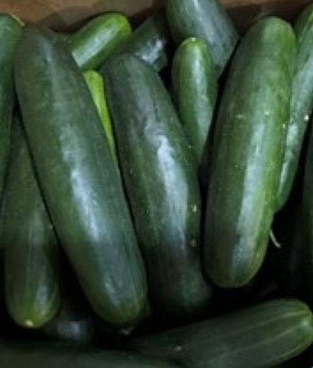
Product and Firm Actions
Distributor T
Notes:
Pennsylvania Department of Agriculture (PDA) collected one cucumber product sample from retail supplied by Distributor T and sourced from Grower C that was reported to be positive for another Salmonella Serovar that we hadn’t previously seen in the environmental samples. Pennsylvania Department of Agriculture sent 18 isolates associated with this positive sample to FDA ORA/Office of Regulatory Science (ORS) for additional laboratory testing and analysis. ORA/ORS confirmed the isolates provided were positive for Salmonella and consistent with the reported findings from the PDA.
PA Dept of Ag informed the firm of a Salmonella positive product sample, and the firm initiated a recall of whole cucumbers.

Slide 11
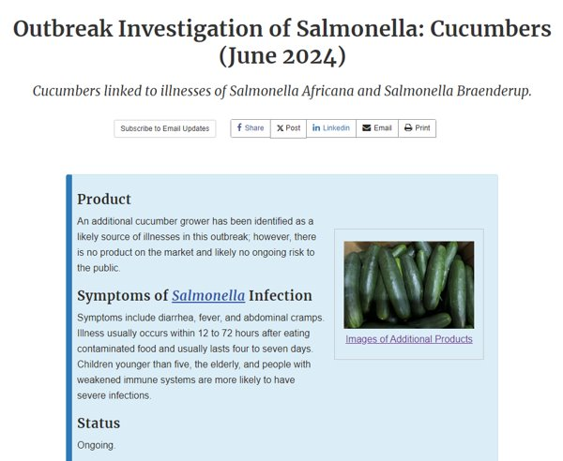
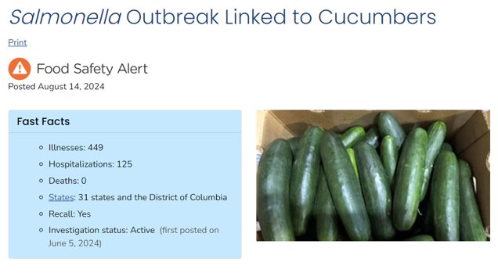
Communications
Notes:
FDA and CDC both issued webposts to communicate about the outbreak and provide advice to consumers/retailers to prevent further diseases. They were updated as new information was identified until the outbreak was declared over marked by a final update to both webposts. The incident was also added to the CORE Investigation Table and updated as needed.

Slide 12
Conclusions
Epidemiological, traceback and laboratory data identified cucumbers from Grower C and Grower F as likely sources of illnesses.
An additional Salmonella serovars was identified in a retail product sample and regulatory action was taken.
Environmental contamination was likely due to canal water used in the growing environment.​
Notes:
Epidemiologic, traceback and laboratory data identified cucumbers from Grower C and Grower F as likely sources of illnesses. These two farms supplied cucumbers to nearly 60% of all points of service included in the traceback analysis; however, do not account for all illness included in this outbreak.
Furthermore, product sampled from retail sourced from Grower C identified an additional Salmonella serovar resulting in regulatory action (recall).
The traceback data coupled with laboratory findings from the identified farms lend support to a potential regional contamination issues for produce grown in Southeast Florida.

Slide 13


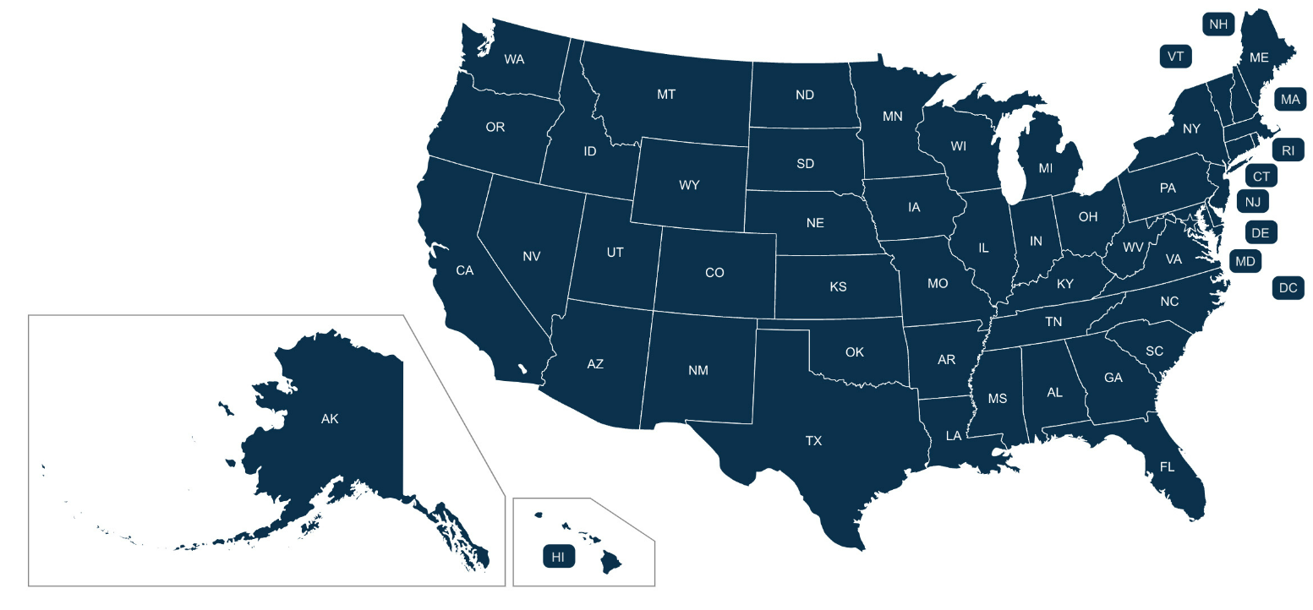
Acknowledgements
FDA CFSAN
CORE
  Signals
  Response Team 2 and 3
  Communications Team
Office of Food Safety
Office of Analytics
Office of Regulatory Science
CDC
Outbreak Response and Prevention Branch
Outbreak Response and Prevention Branch Communications
FDA ORA
Program Operations
  Florida District Office
Office of Regulatory Science
Produce Safety Network
Everyone from FDA, CDC, and all state and local partners who helped with outbreak response activities.

Slide 14
References
https://www.fda.gov/food/outbreaks-foodborne-illness/outbreak-investigation-salmonella-cucumbers-june-2024
https://www.fda.gov/safety/recalls-market-withdrawals-safety-alerts/fresh-start-produce-sales-initiates-recall-whole-cucumbers-because-possible-health-risk
https://wh.farm/products/organic-cucumbers/
https://www.cdc.gov/salmonella/africana-06-24/index.html
https://www.fda.gov/
https://www.cdc.gov/index.html
https://www.state.gov/bureaus-offices/under-secretary-for-public-diplomacy-and-public-affairs/bureau-of-global-public-affairs/state-by-state-map/
https://www.vecteezy.com/vector-art/9732962-cucumber-icon-vector-design-template
Notes:
Cucumber icon. https://www.vecteezy.com/vector-art/9732962-cucumber-icon-vector-design-template

