Slide 1
Clear Labs Clear Dx™ evaluation for use by the GenomeTrakr laboratory network
C. Hope Bias (presenter), Maria Balkey, Tina Pfefer, Dennis Huang, Kathryn Judy, Lanlan Yin, Ruth Timme
FDA-HFP GenomeTrakr & Computational Science Staff
GenomeTrakr Annual Meeting
October 17, 2024

Slide 2
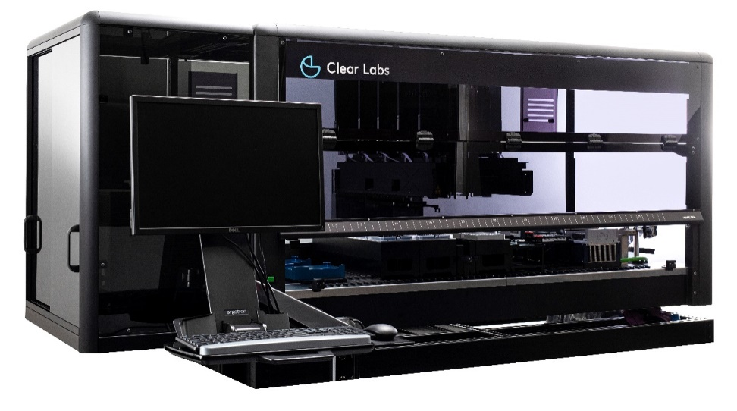
Overview
Some GenomeTrakr labs acquired Clear Labs instruments during the SARS-CoV-2 pandemic for sequencing the virus
Platform updated by the company to allow for bacterial sequencing, leaving labs wondering if they could use the platform for GT sequencing
Clear Dx
  Is Illumina iSeq 100-based
  Handles 2-12 isolates/batch
  Is a WGS workflow
  ~27hr -> result, including 30 min hands-on time

Slide 3
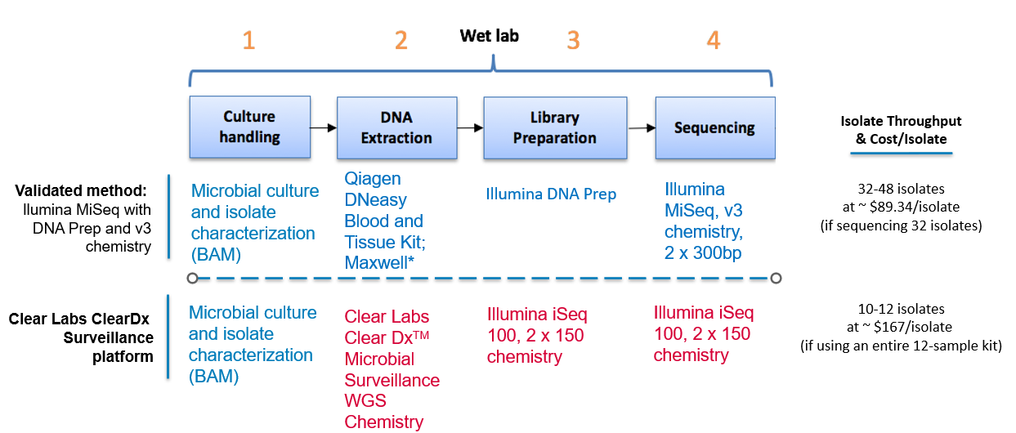
Comparison of Workflows

Slide 4
Labs & Strains
Iowa State Hygienic Lab
Nevada State Public Health Laboratory
New York State Department of Health
South Carolina Department of Health & Environmental Control
Strain ID​ | Organism​ | Target Depth​ | Purpose​ | SequencerPosition​
CFSAN000189​ | Salmonella enterica subspecies enterica Serovar Bareilly​ | >30x​ | SNP recovery​ | A1​
CFSAN000661​ | Salmonella enterica subspecies enterica Serovar Bareilly​ | >30x​ | SNP recovery​ | A2​
CFSAN000752​ | Salmonella enterica subspecies enterica Serovar Bareilly​ | >30x​ | SNP recovery​ | A3​
CFSAN002349​ | Listeria monocytogenes​ | >20x​ | SNP recovery​ | A4​
CFSAN023469​ | Listeria monocytogenes | >20x​ | SNP recovery​ | A5​
CFSAN044836​ | Listeria innocua​ | >20x​ | Org. Diversity​ | A6​
CFSAN008100​ | Listeria monocytogenes​ | >20x​ | Well-characterized strain​ | A7​
CFSAN051458​ | Escherichia coli O121​ | >40x​ | Toxin detection​ | B1​
CFSAN023465​ | Listeria monocytogenes​ | >20x​ | SNP recovery​ | B2​
CFSAN068773​ | Cronobacter sakazakii​ | >30x​ | Org. diversity​ | B3​
CFSAN076620​ | Escherichia coli O157:H7​ | >40x​ | Toxin detection​ | B4​
Sidenote: The full verification strain set, including this subset, will be available at ATCC soon!

Slide 5
Method verification:
Does the method produce data that meet the GenomeTrakr QC standards?
  Simple pass/fail QC check
Are the data generated by this method equivalent or better than our gold standard method?
  Robust statistical comparison

Slide 6
Do the data generated by the Clear Dx™ platform meet the established GenomeTrakr performance metrics?
Clear Dx™ verification runs results:
43/44 met GenomeTrakr performance metrics
A single Listeria isolate failed to meet coverage threshold
Established QC thresholds:
 | Cronobacter | E. coli | Listeria spp. | Sal. spp.
Average read quality Q-score R1 and R2 | ≥30 | ≥30 | ≥30 | ≥30
Average coverage | ≥20X | ≥40X | ≥20X | ≥30X
De novo assembly: Seq. Length (Mbp) | ~4.0-5.0 | ~4.5-5.9 | ~2.7-3.2 | ~4.3-5.2
De novo assembly: # of contigs | ≤500 | ≤400 | ≤300 | ≤300

Slide 7
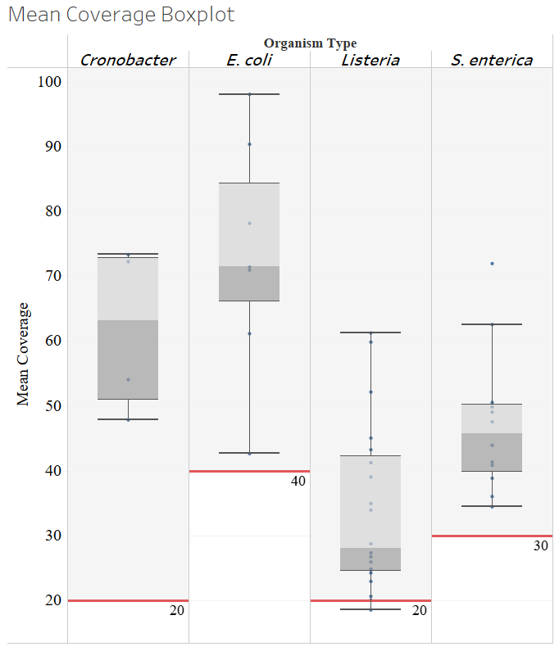
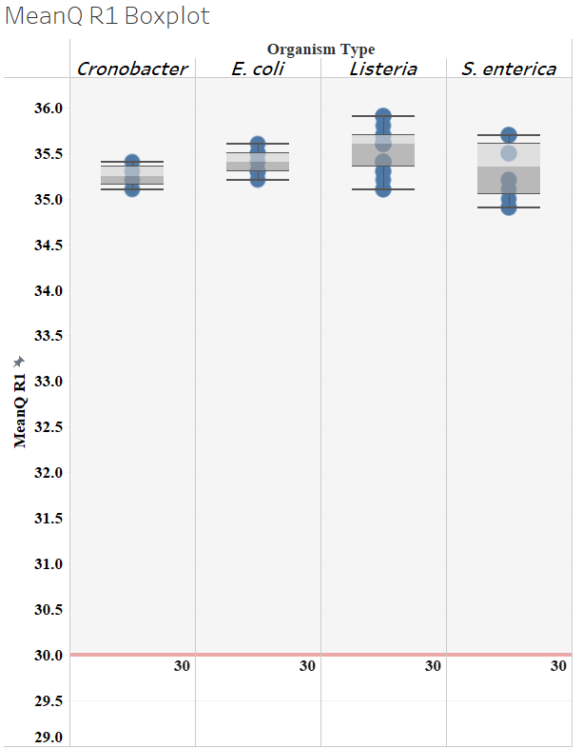
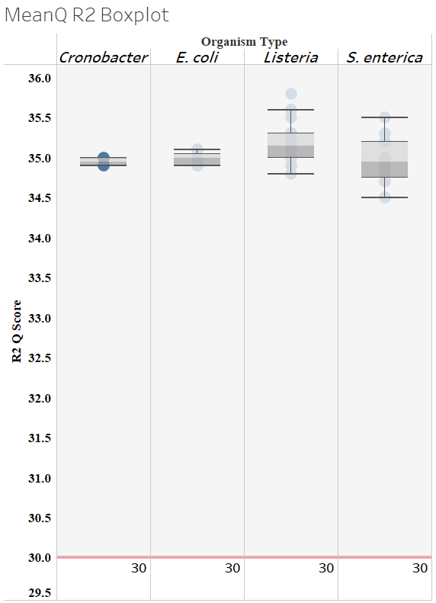
Estimated Coverage and Read Quality

Slide 8
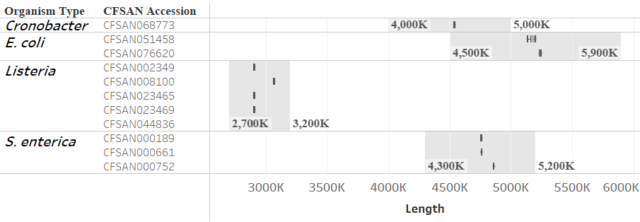
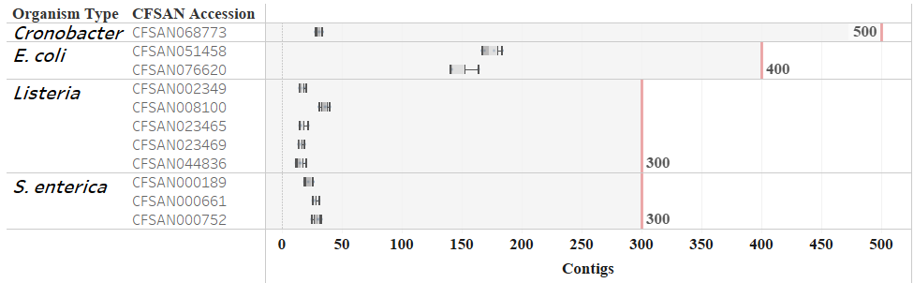
Assembly QC: Genome length and # contigs

Slide 9

Comparison to Gold-standard MiSeq Data
Mixed-methods model statistical analysis
Caveats:
Assumption that all labs are performing using the same or similar protocols with negligible differences between labs
Small sample sizes lead to limitations in statistical power

Slide 10
Estimated Coverage
Summary Statistics
Estimated Coverage | ClearLabs Dx (iSeq-based) |  | MiSeq |  | Difference |  | P-value
 | Estimated Mean | Standard Error | Estimated Mean | Standard Error | Estimated Mean | Standard Error
Cronobacter | 61.93 | 13.66 | 66.65 | 13.66 | -4.73 | 18.58 | 0.80
E. coli | 73.18 | 10.28 | 71.18 | 8.38 | 2.00 | 12.71 | 0.88
Listeria | 33.83 | 6.11 | 102.17 | 4.59 | -68.35 | 7.26 | <0.0001
S. enterica | 47.30 | 7.89 | 79.26 | 5.64 | -31.96 | 9.20 | 0.001
Take-away
Listeria spp. and S. enterica coverages were both significantly lower for CL than MiSeq. However, S. enterica coverage always met our GT QC thresholds for performance. Only the difference with Listeria was found to be practically impactful.

Slide 11
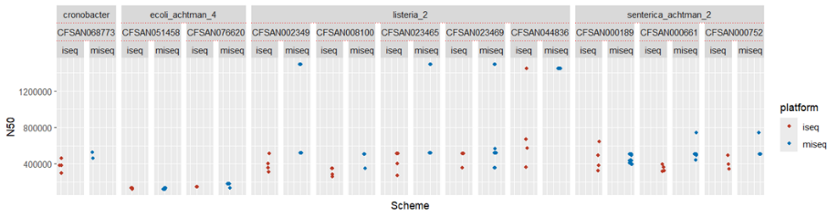
N50
Summary Statistics & Distribution
N50 | ClearLabs Dx (iSeq-based) |  | MiSeq |  | Difference |  | P-value
 | Estimated Mean | Standard Error | Estimated Mean | Standard Error | Estimated Mean | Standard Error
Cronobacter | 380,534 | 238,353 | 509,641 | 238,353 | -129,106 | 177,011 | 0.467
E. coli | 140,644 | 172,014 | 146,665 | 162,794 | -6,021.34 | 121,251 | 0.961
Listeria | 473,860 | 106,595 | 951,871 | 100,447 | -478,011 | 70,667 | <0.0001
S. enterica | 404,738 | 137,613 | 501,910 | 128,938 | -97,173 | 90,177 | 0.284
Take-away
Listeria spp. sequences also differed significantly in their N50s. Clear Dx™ sequences’ N50s were lower than MiSeq sequences’.

Slide 12
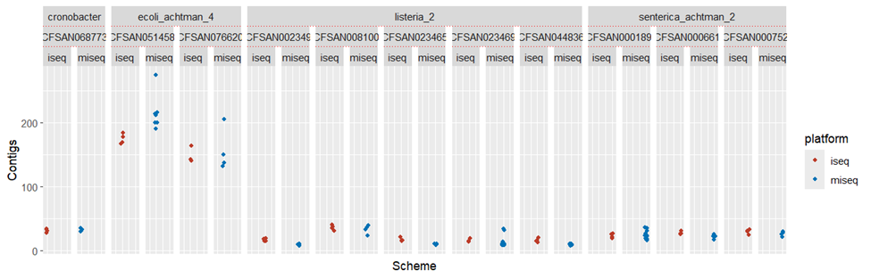
Number of Contigs
Summary Statistics & Distribution
# Contigs | ClearLabs Dx (iSeq-based) |  | MiSeq |  | Difference |  | P-value
 | Estimated Mean | Standard Error | Estimated Mean | Standard Error | Estimated Mean | Standard Error
Cronobacter | 32 | 15 | 32 | 14 | -1 | 7 | 0.919
E. coli | 160 | 10 | 188 | 10 | -27 | 5 | <0.001
Listeria | 20 | 6 | 15 | 6 | 5 | 3 | 0.086
S. enterica | 27 | 8 | 24 | 8 | 3 | 4 | 0.429
Take-away
The average number of contigs for Clear Dx™ E. coli genomes was significantly less than that of the gold-standard MiSeq genomes. Wider range of MiSeq # contig values and low sample size may enhance the appearance of a difference.

Slide 13
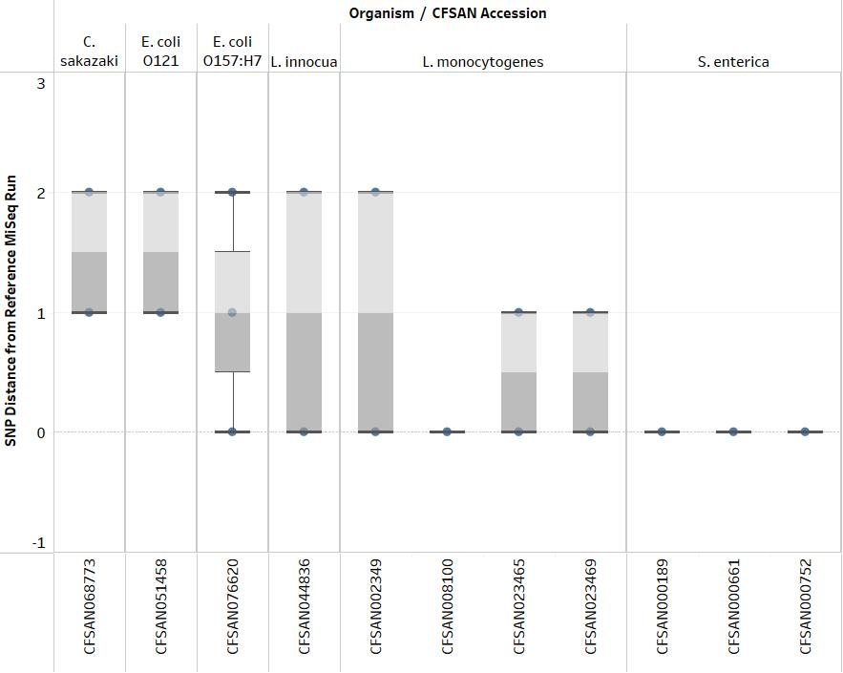
SNP Distances from Gold Standard
Take-away
All Clear Dx™ sequences were within two SNPs of their MiSeq counterparts, an outcome that does not raise any red flags.

Slide 14
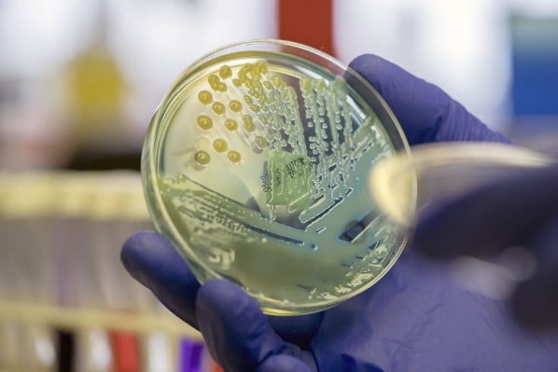
Recommendations from GenomeTrakr:
Overall recommendation:
We consider Clear Labs Clear Dx™ an approved platform for performing WGS workflows on common foodborne pathogens, including Salmonella, Listeria, pathogenic E.coli, and Cronobacter species, within the GenomeTrakr network laboratories.
However,
Based on 1 seq. failure and analysis of Listeria spp. genomes:
We will work with Clear Labs to optimize their loading protocol to increase average coverage of Listeria genomes.

Slide 15
Thank you!
Iowa State Hygienic Lab
Nevada State Public Health Laboratory
New York State Department of Health
South Carolina Department of Health & Environmental Control
Dr. Lanlan Yin
Kathryn Judy
CFSAN/HFP OMICS Tag Team
GenomeTrakr Team: Dr. Ruth Timme, Maria Balkey, Tina Pfefer, and Dennis Huang

