Slide 1

Regulatory Genomics
James Pettengill
Director Division of Surveillance and Data Integration
Office of Surveillance Strategy and Risk Prioritization
Human foods Program

Slide 2
Outline
Regulatory genomics – what is it and how do we ensure it?
Research update: Prospective modeling and epidemiologically informative match rate

Slide 3
Regulatory Genomics:
Application of genomics to regulatory and outbreak investigations
Two components
Regulatory Genomics
Wet-lab
Dry-lab

Slide 4
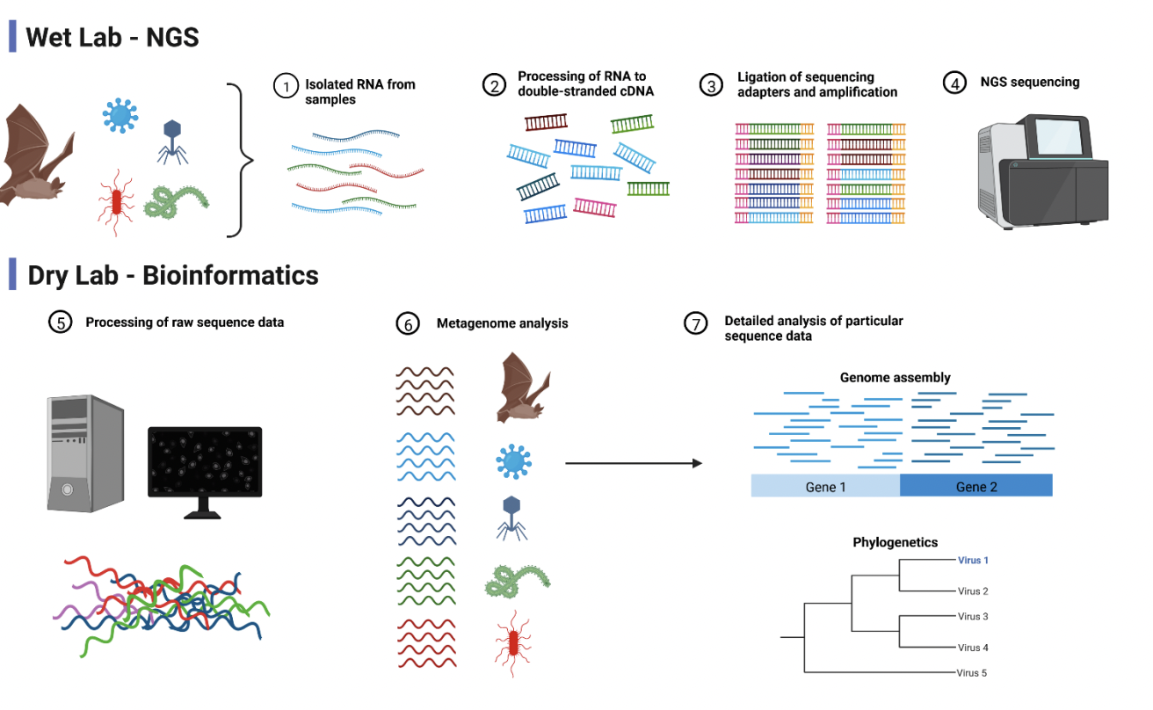
Regulatory Genomics:
Application of genomics to regulatory and outbreak investigations
Image from Muzeniek et al. 2020. https://www.biorxiv.org/content/10.1101/2022.09.21.508883v2.full.pdf

Slide 5

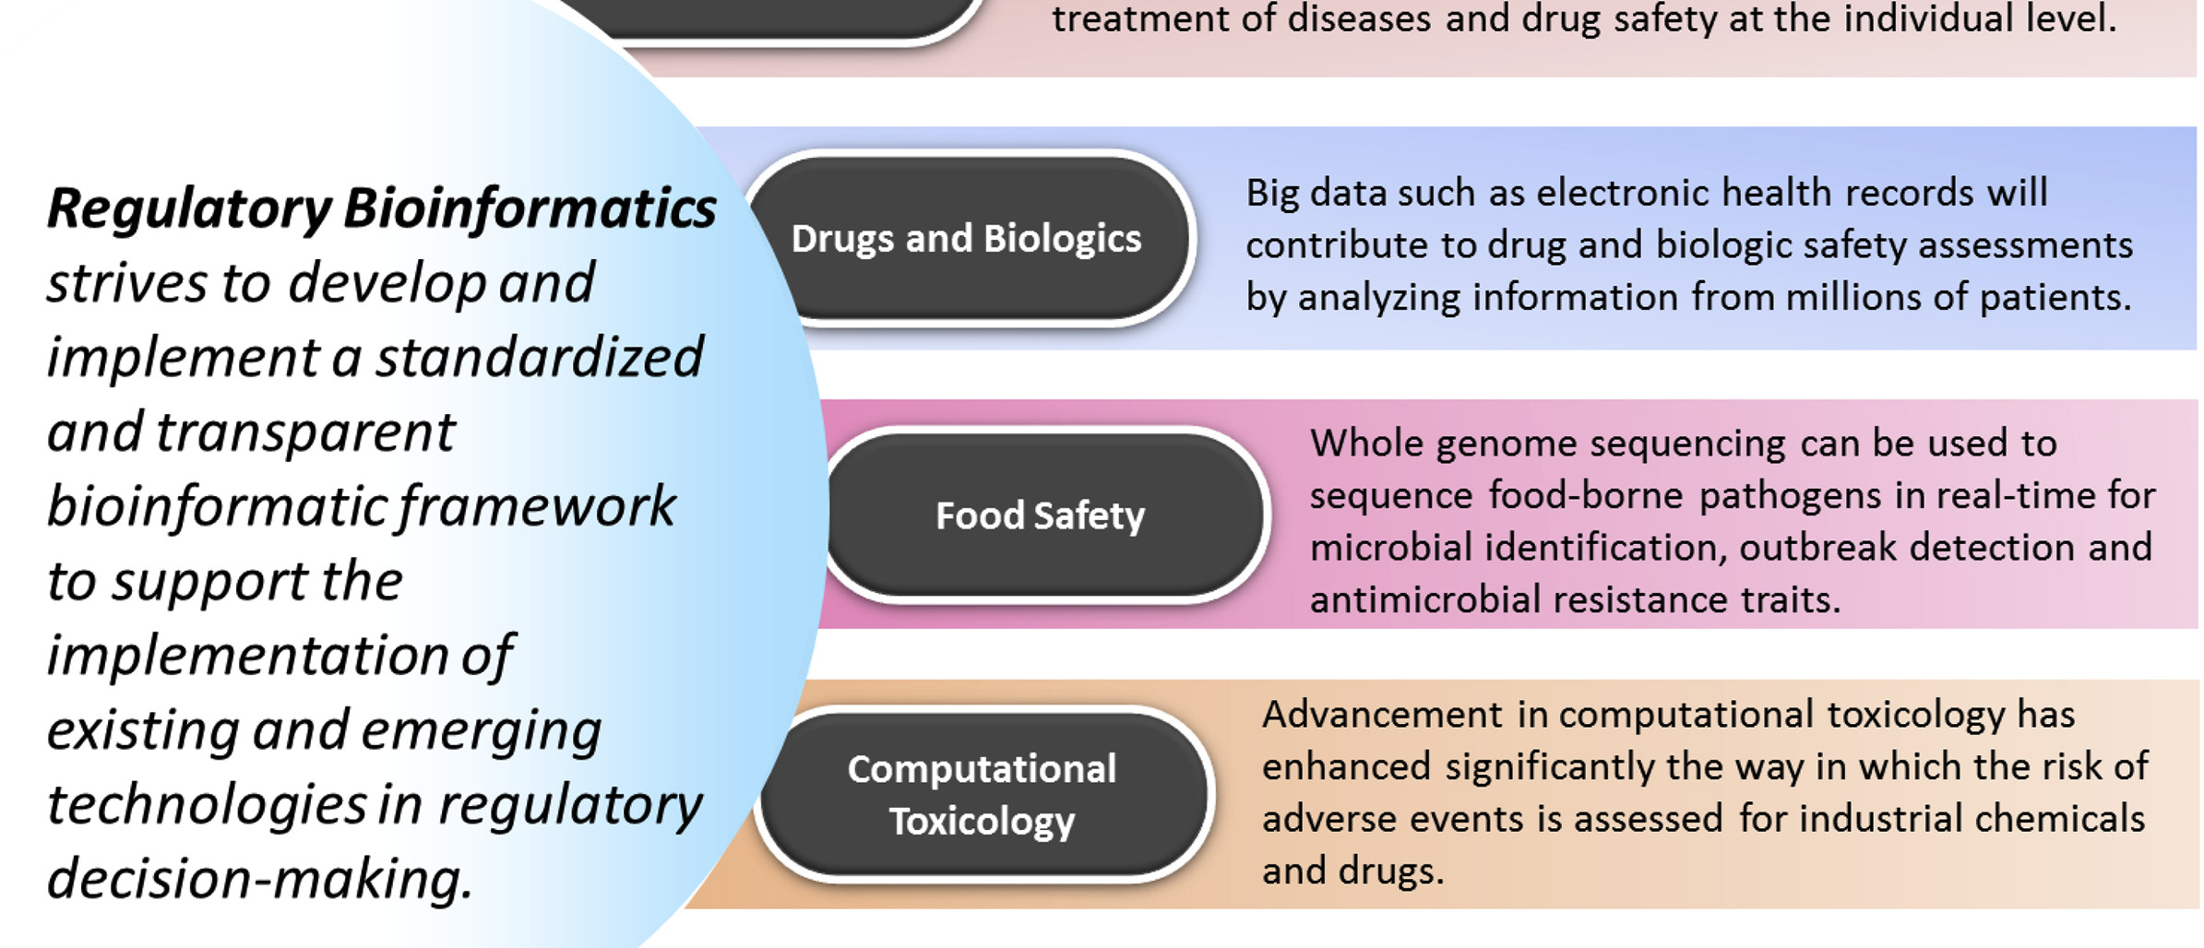
Regulatory Bioinformatics: Dry Lab Regulatory Genomics

Slide 6
Regulatory Bioinformatics: Dry Lab Regulatory Genomics
Abstract:
“Regulatory Bioinformatics” strives to develop and implement a standardized and transparent bioinformatic framework to support the implementation of existing and emerging technologies in regulatory decision-making.

Slide 7
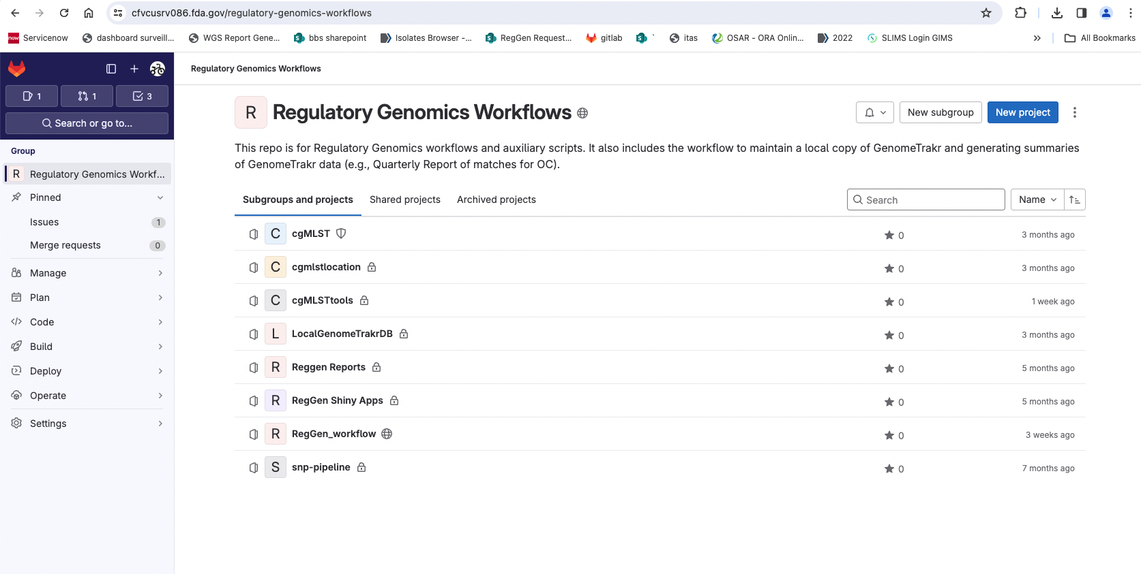
Standardized Methods
Multiple workflows written from scratch to support regulatory genomics
Stored in an internal GitLab code repository instance
Team uses the same methods

Slide 8
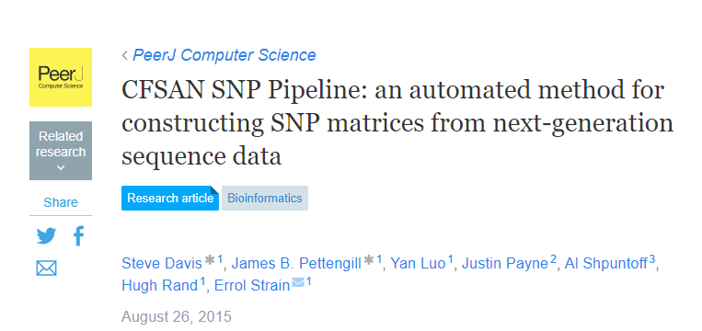
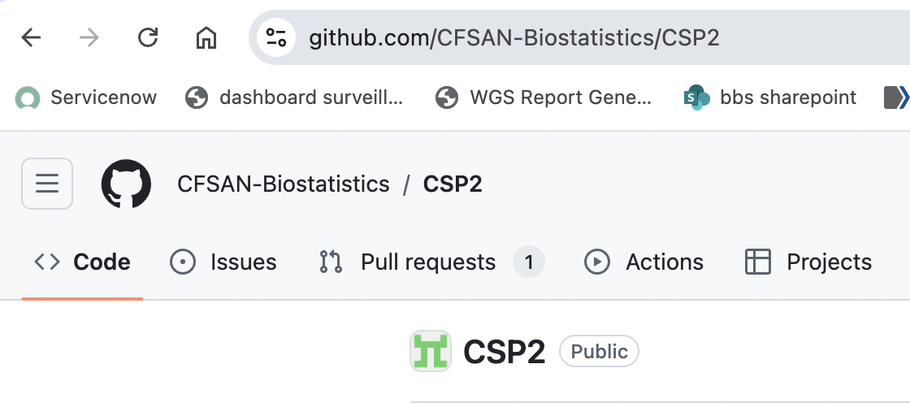

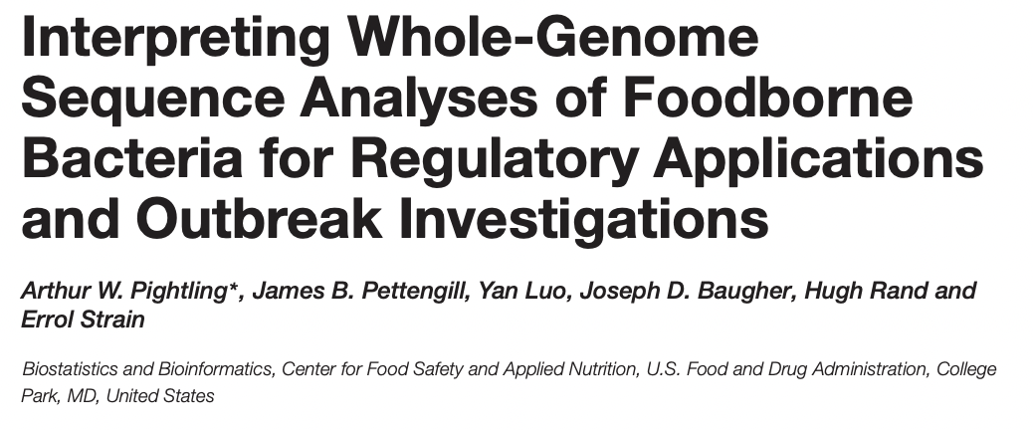
Transparent Methods
Multiple peer-reviewed publications on both the method and interpretation side
cited 269 times
cited 240 times

Slide 9











Helping to ensure standardization and transparency are open-source tools

Slide 10
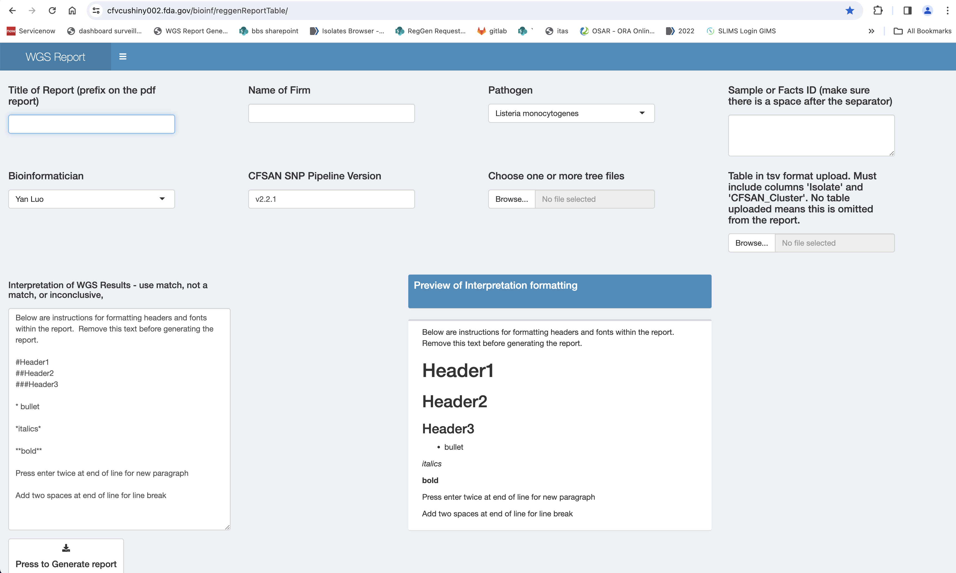
Standardized interpretation and report generation

Slide 11

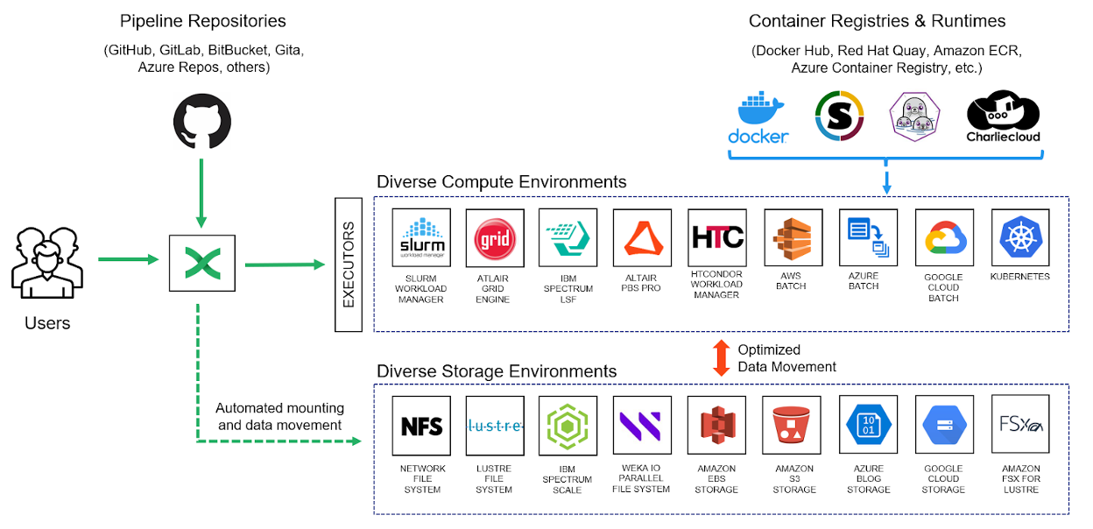

Interoperable and computationally efficient workflows
Adopt Nextflow DSL2 and containers for workflow development and deployment
Robert Literman
Image from: https://workflows.community/stories/2022/09/28/nextflow/

Slide 12
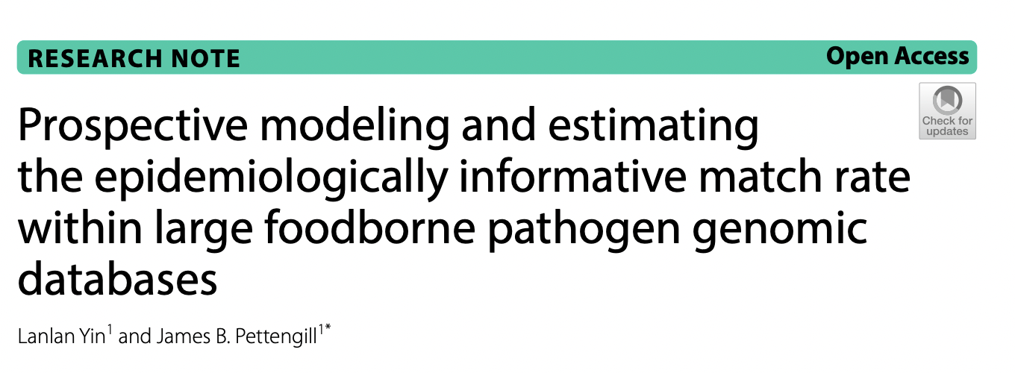
Research Update:

Slide 13
Research Update:
Prospective modeling and epidemiologically informative match rate
Premise:
Large genomic databases are promoted as beneficial to public health.
Focus is often on:
  How to increase the size of the database via facilitating access to the technology
  Promoting open sharing of the data
  Equitable data use and acknowledgement practices are followed
  Lacking is a discussion of the information content of such databases and how likely they are to return actionable information regarding new samples.
  Some understanding of this is crucial to setting expectations and identifying gaps for improvement.

Slide 14
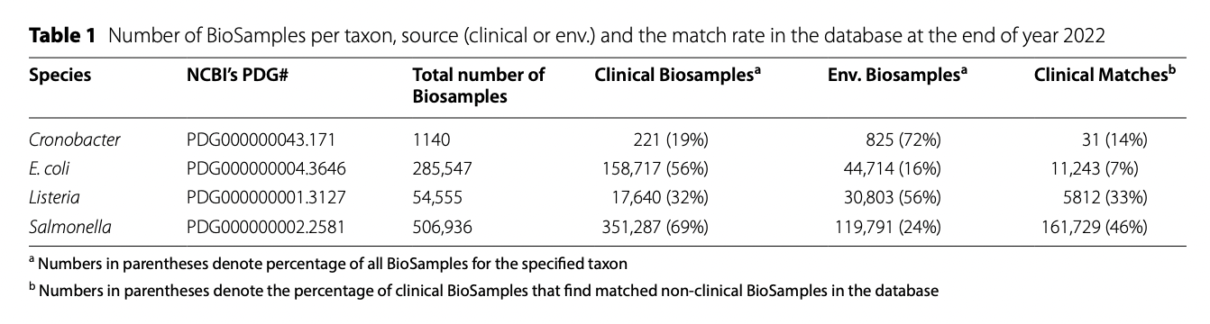
Research Update:
Prospective modeling and epidemiologically informative match rate
Data set (NCBI PD)

Slide 15
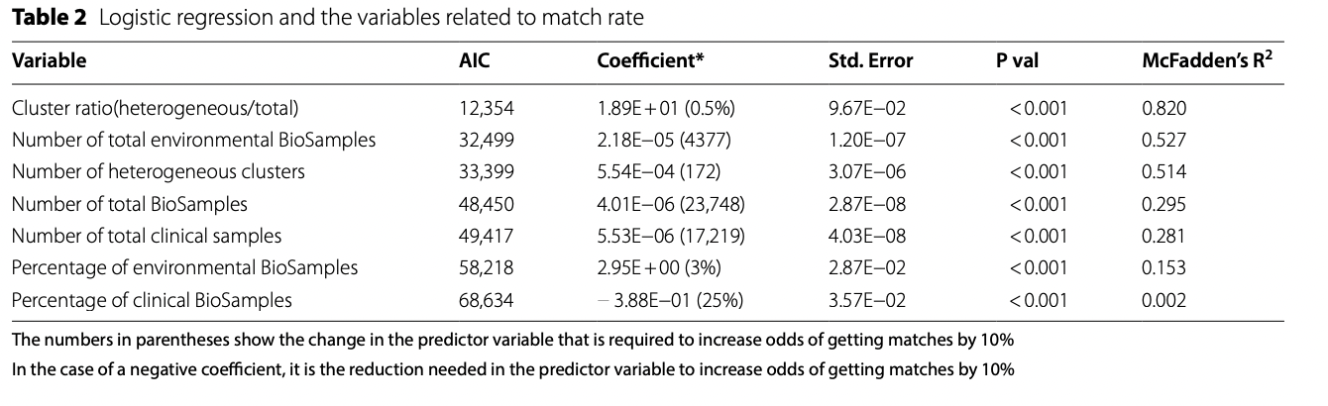
Research Update:
Prospective modeling and epidemiologically informative match rate
Because we are looking at a binary variable (is there a match to a clinical or not (20 SNPs)), simple logistic regressions were applied to explore relationship between quarterly match rate and seven database feature variables

Slide 16
Research Update:
Prospective modeling and epidemiologically informative match rate
After identifying match rate related variables through logistic regression, we built multiple logistic regression models with all pairwise possible combinations of variables.
Due to multicollinearity when adding more factors into the model, we selected the two-factor model with an interaction term as the final prediction model.
The best fitting model included database size and percentage of environmental BioSamples with a McFadden’s R squared value of 0.939, which indicates a good prediction accuracy.

Slide 17
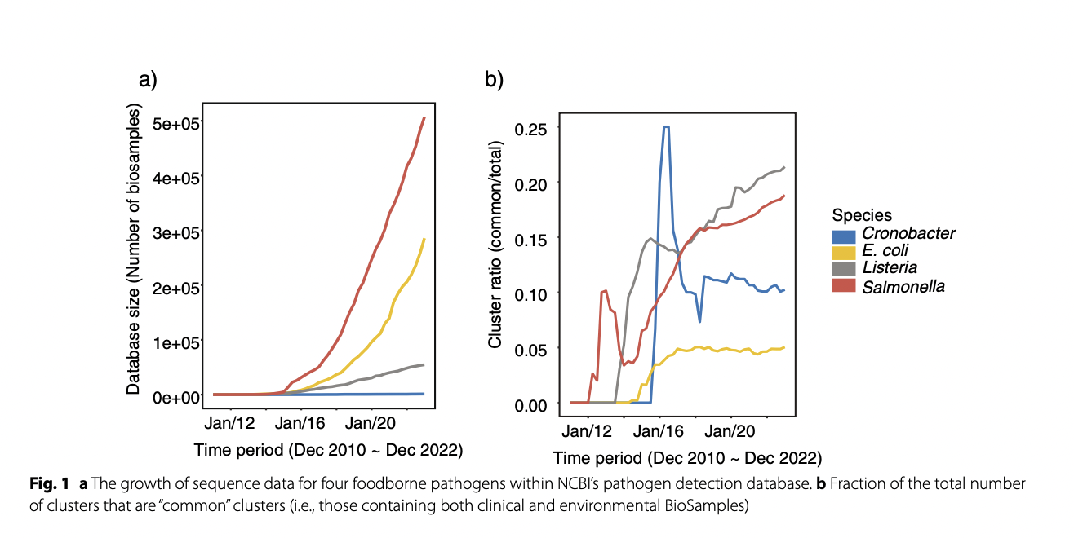
Research Update:
Prospective modeling and epidemiologically informative match rate

Slide 18
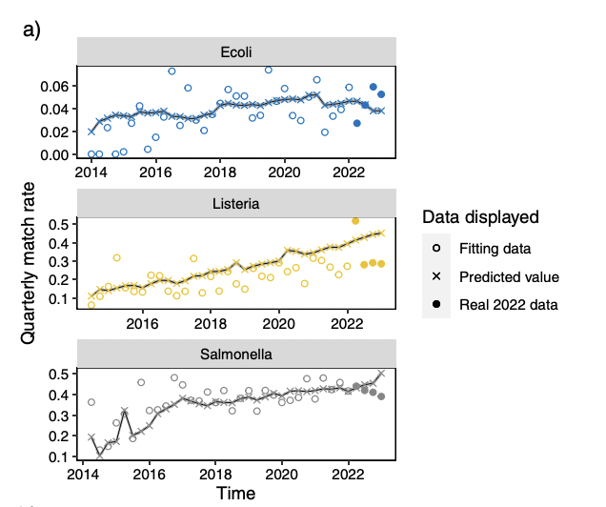
Research Update:
Prospective modeling and epidemiologically informative match rate

Slide 19
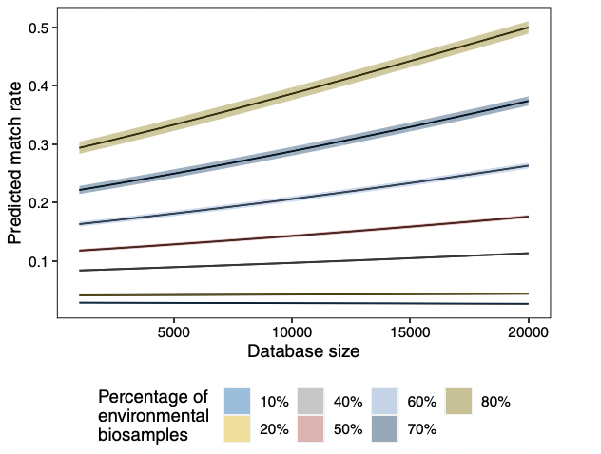
Research Update:
Prospective modeling and epidemiologically informative match rate

Slide 20
Research Update:
Prospective modeling and epidemiologically informative match rate
Conclusions:
Variability of taxa
  ‘Current’ match rate of 33% for L. monocytogenes, 46% for Salmonella, and 7% for E. coli.
A higher percentage of environmental BioSamples is associated with higher match rate.
Fluctuations make it difficult to forecast future match rate.

Slide 21
Acknowledgements
Biostatistics Team
Lanlan Yin
Bioinformatics Team
Joseph Baugher
Bob Literman
Yan Luo
Tim Muruvanda
Arthur Pightling
Yu “Fish” Wang
Jayanthi Gangiredla (acting Team Lead)
Hugh Rand (retired Team Lead)
HFP Engineering and BIS Team
The GenomeTrakr Team and associated labs
NCBI PD
All those domestic and international submitting data to the database

