Slide 1

JIFSAN Project – Salmonella in Surface Water in Latin America
Magaly Toro, PhD, MSc., DVM.
Director Food Safety Laboratory, JIFSAN
Octubre 25th, 2013
GenomeTrakr Meeting
Notes:
Introduction: Surface water is a primary source of irrigation for crops and a potential vehicle for Salmonella contamination.
Purpose: To describe the prevalence and diversity of Salmonella in surface waters from Brazil, Chile, and Mexico.
Methods: Surface waters were obtained from Chile (n=2039), Mexico (n=689), and Brazil (n=539) from 2019-2022. Samples were in-situ filtered (10L) through modified Moore Swabs and processed according to modified Salmonella FDA/BAM procedures. Genomes (1 to 10 isolates per positive sample) were sequenced at CFSAN/FDA on Illumina platforms. Genomes were analyzed for MLST/sequence type (ST) and cgMLST in Ridom Seqsphere+, and serotypes were predicted with SISTR and SeqSero. Phylogenetic relationships were visualized in a minimum-spanning tree on Ridom.
Results: Salmonella was present in 45.8% of samples (1495/3267). Brazil showed the highest prevalence (70.9%), followed by Mexico (63.4%) and Chile (33.2%). Genomes (n=1541) were selected from Mexico (n=686), Chile (n=592), and Brazil (n=263) for analysis; 156 STs were identified, and ST 32 (7.2%), 13 (5.2%), and 19 (5.2%) were the most common. Multiple serotypes (104) were identified, and 18 were common for all countries. Among them, Newport was the most frequent (15.5%;162/1541), followed by Typhimurium (7.85%; 120/1541) and Infantis (7.4%; 114/1541). Meanwhile, most Enteritidis were from Chile (95.6%; 43/45). Mexico showed the highest serotype variability (n=61), followed by Chile (n=53) and Brazil (n=49). About 60.6% (63/104) of serotypes were found in a single country; however, they only represented 20.4% of genomes (315/1541). cgMLST included 1251 genes, and genomes were grouped in 231 clusters. While most clusters (97.4%) comprised genomes of the same serotype and country, mixed-country clusters were detected for Enteritidis, Typhimurium, Agona, Soerenga, Corvallis, and Infantis.
Significance: Surface waters are important reservoirs of epidemiologically and clinically significant Salmonella serotypes in Latin America. Research is required to better understand Salmonella ecology and epidemiology in surface waters.

Slide 2
Agenda
Introduction
Methodology
Results
Summary
Microbial survey in surface waters
Aknowledgements

Slide 3
Project Origin
FDA goals:
  Broaden genomics database for Salmonella spp.
  Improve the response and prevention of foodborne diseases
  Antimicrobial resistance
  Assist in the identification and response of emerging pathogens.
JIFSAN Cooperative
Agreement

Slide 4
Salmonella in Surface water in Latin America

Slide 5
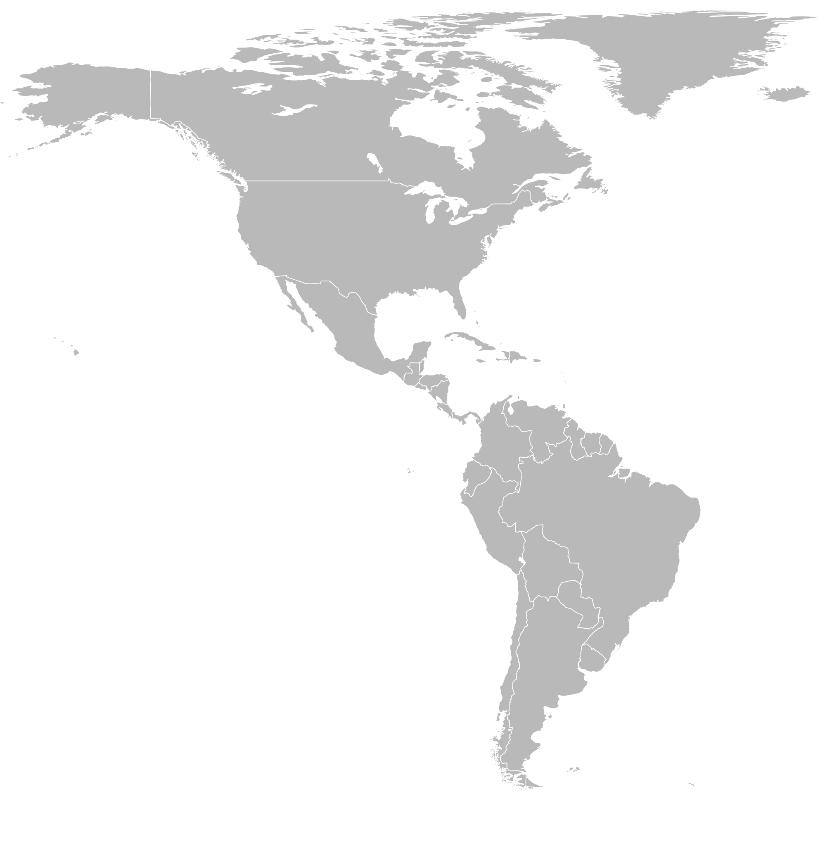
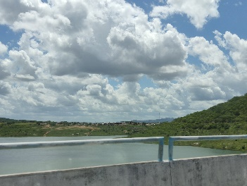
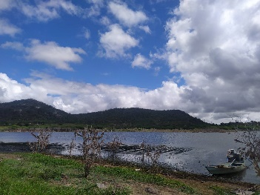
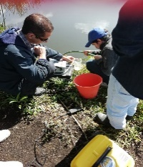


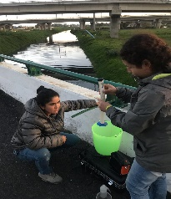
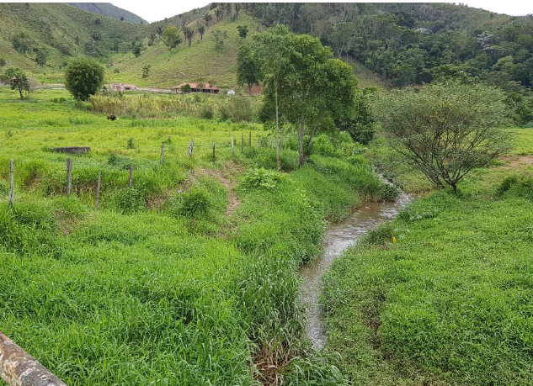
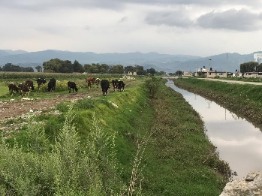
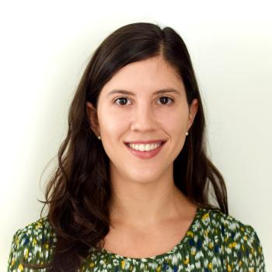


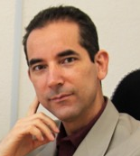
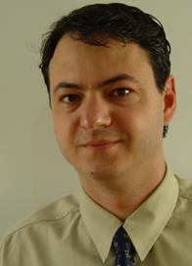


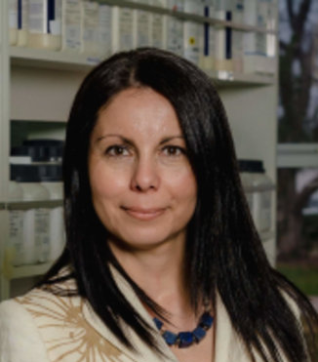
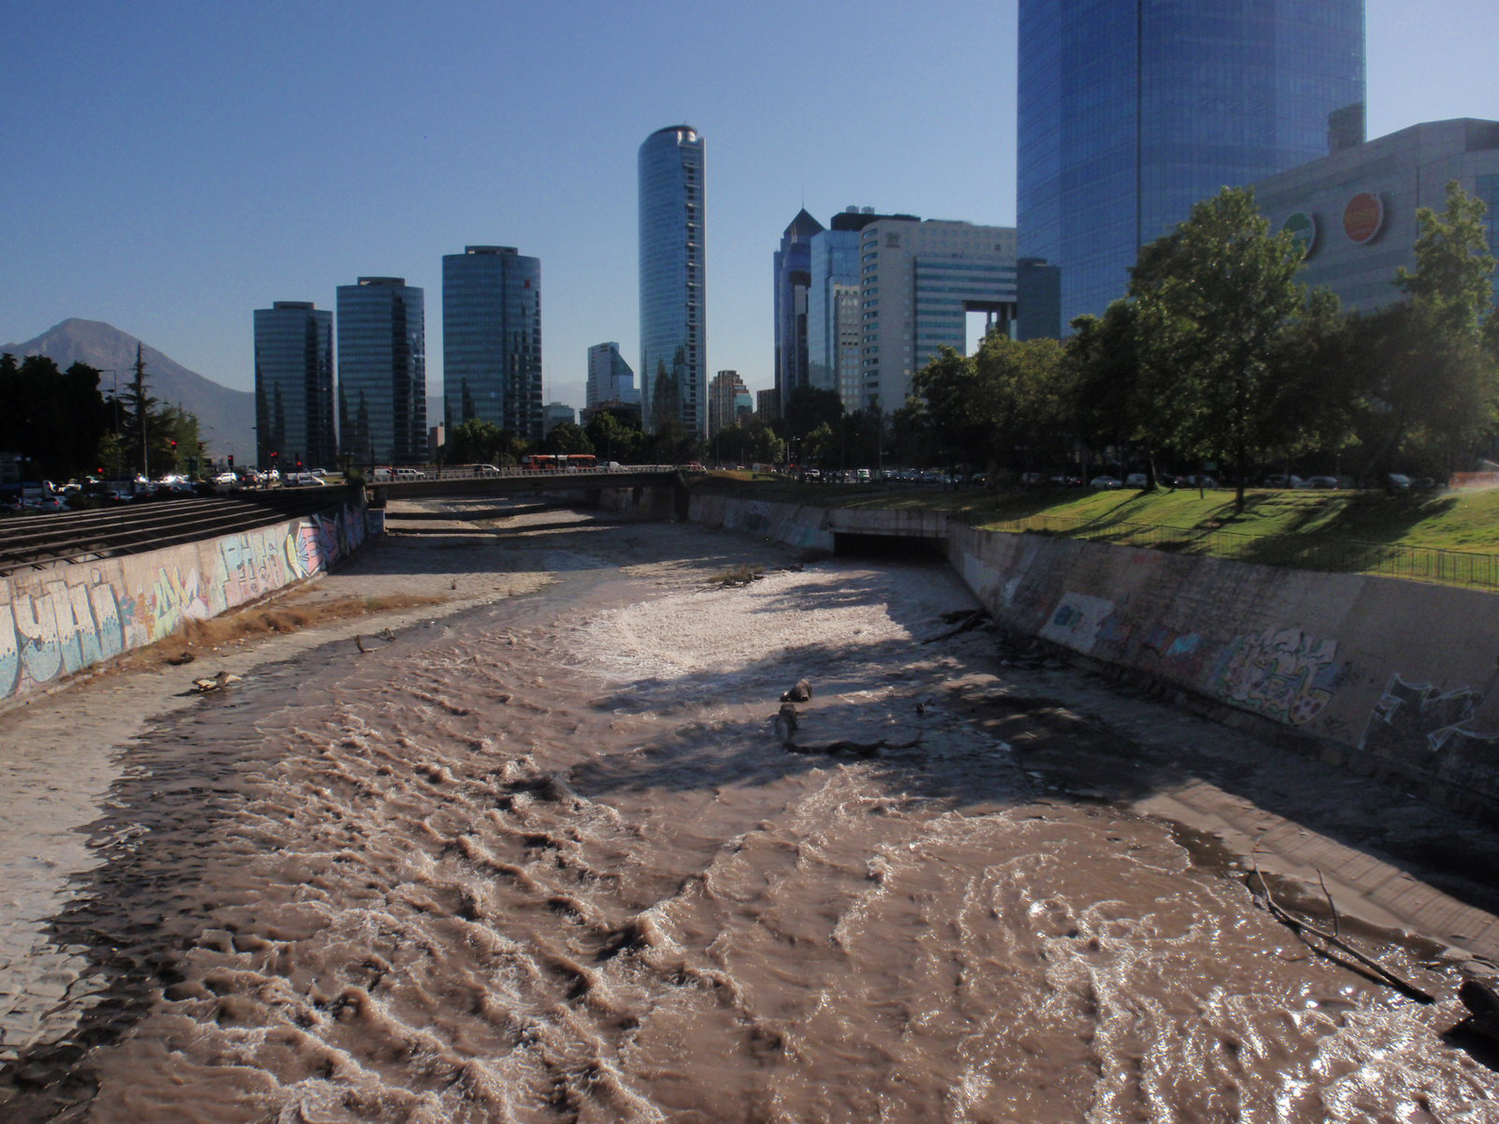
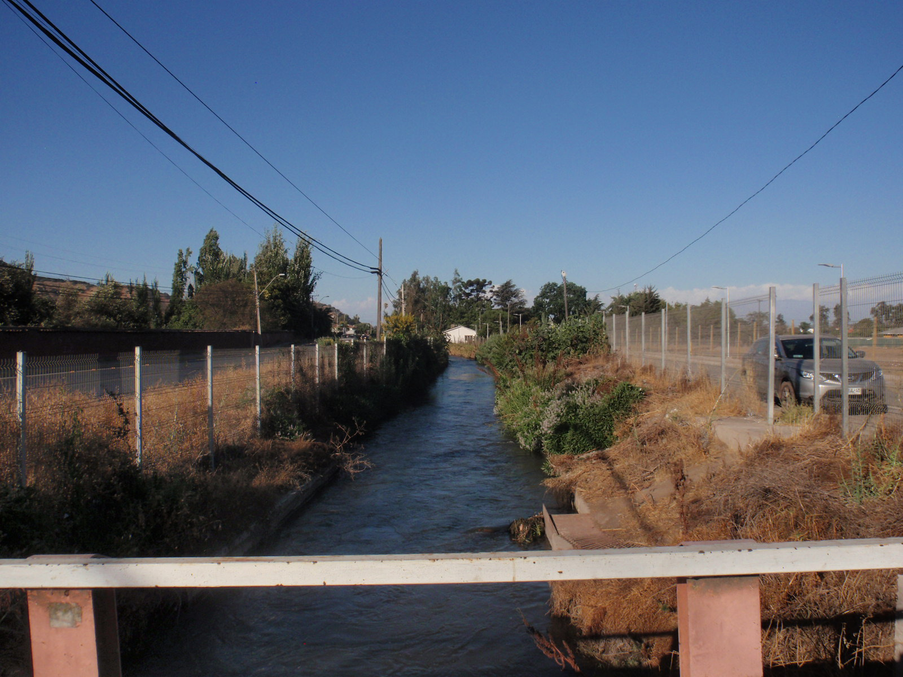



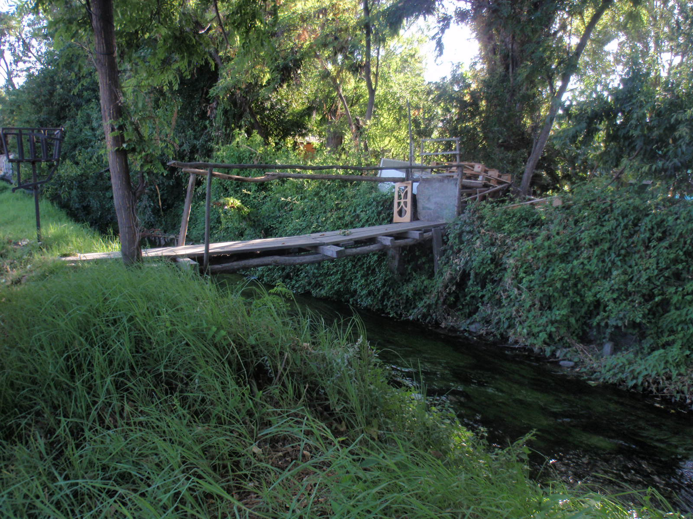
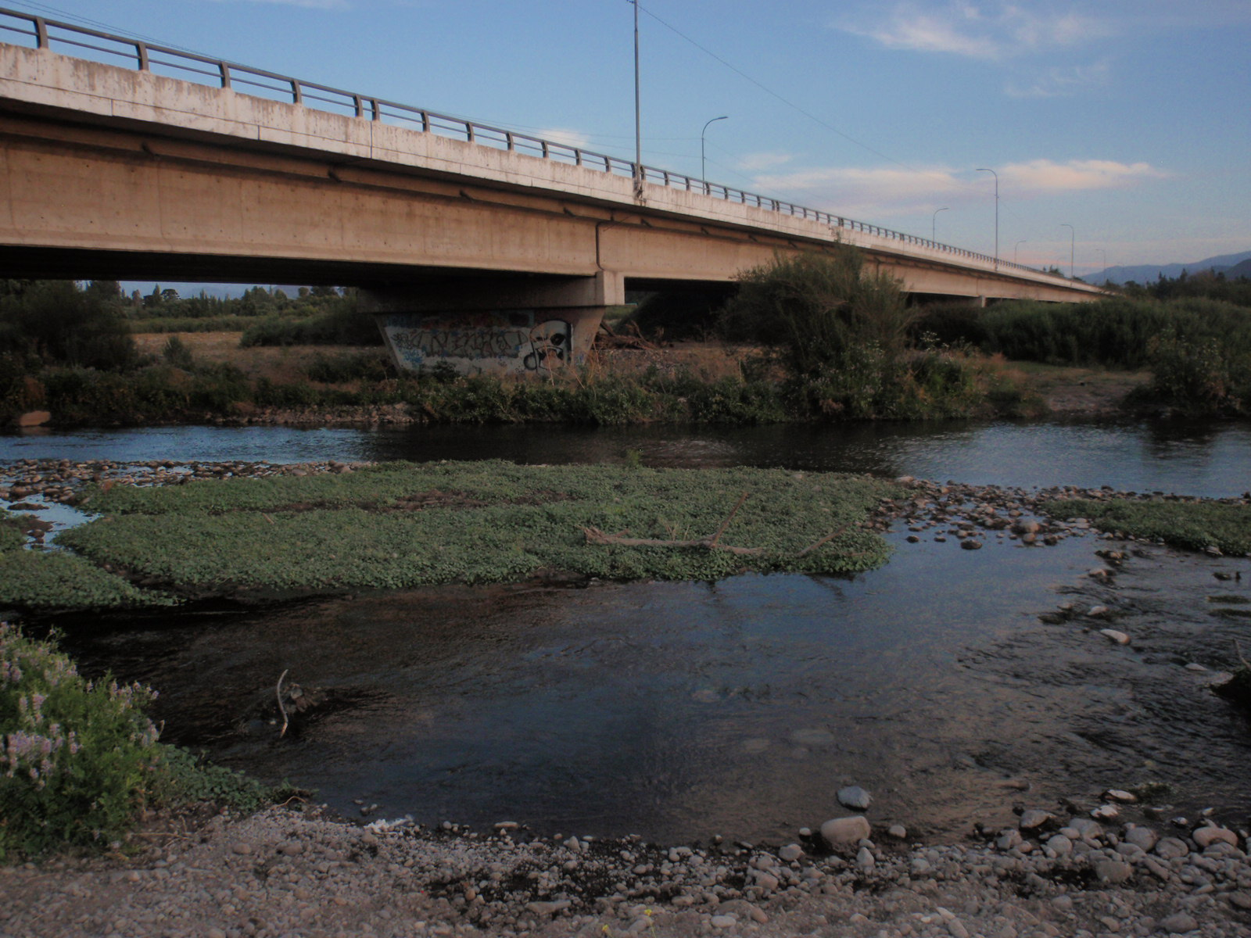
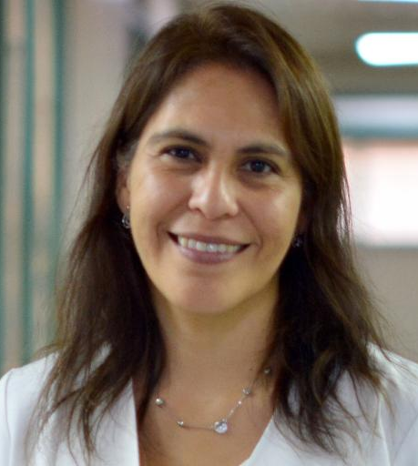
International Collaborators
Dr. Enrique Delgado Suarez,
U.N. Autónoma de México
Alejandra Huete
U. de Costa Rica
Dr. Celso Oliveira,
U.F. da Paraíba
2020
2018
Dr. Andrea Moreno Switt,
P. U. Católica de Chile
Dr. Raquel Bonelli,
U.F. Rio de Janeiro
Dr. Angelica Reyes-Jara,
U. de Chile
Notes:
Uch; University of Chile; UNAB: Andrés Bello National University; UNAM: Autonomous University of Mexico
UFRJ: Federal University of Rio de Janeiro; UFPB: federal University of Paraiba; PUC: Pontifical University of Chile

Slide 6
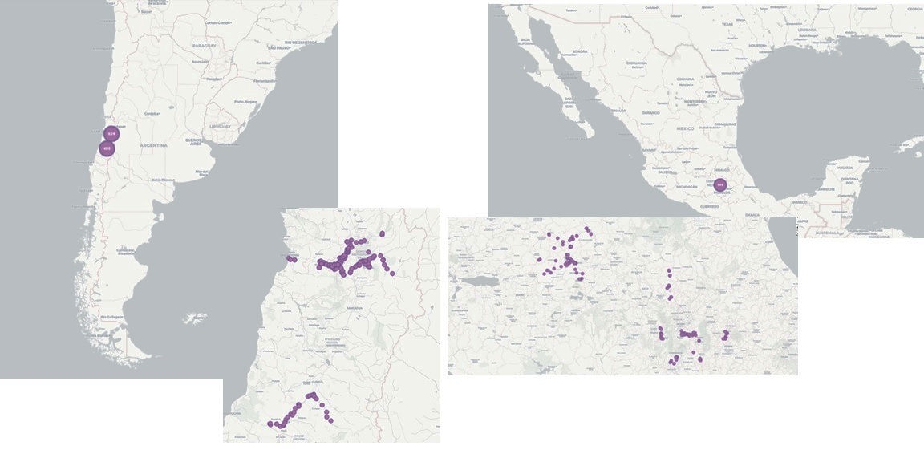

Sampling sites

Slide 7





TABLE 1: Water Surface Samples for Salmonella isolation
Sampling size | Year
 | 2019 | 2020 | 2021 | 2022 | 2023 | Total
UCh-CINUT | 300 | 240 | 240 | 240 | 180 | 1,200
UNAB/PUC | 300 | 240 | 240 | 239 | 178 | 1,197
UNAM | 195 | 185 | 116 | 200 | 274 | 970
UFPB-FADE | - | - | 167* | 78* | 120* | 365*
UFRJ-COPPETEC | - | - | 150 | 161 | 188 | 499
 | 795 | 665 | 913 | 915 | 940 | 4,231
*in triplicates

Slide 8
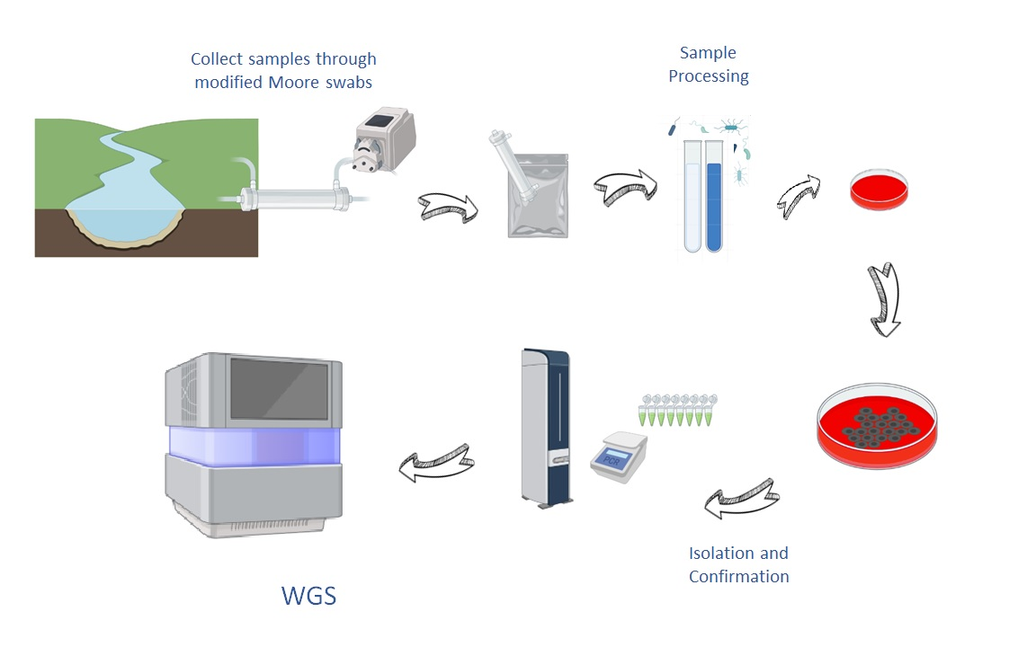
Isolation and Identification of Salmonella spp.
Longitudinal study:
30 samples/ month
Same sampling sites
Surface water related to agriculture
Local Universities
CFSAN/
USA

Slide 9
Results

Slide 10
Salmonella isolation rate by team (%)
Overall prevalence: 49.4% (2090/4321)
Brazil: 77.5%
Chile: 35.5%
Mexico: 58.7%
Percentages not comparable:
Sampling locations
Climate (arid/semi-arid, sub-tropical, tropical, temperate Mediterranean)
Seasons and hemispheres

Slide 11
Number of Salmonella spp. isolates collected from surface water (2019-2023)
Salmonella |  |  |  | Year
Country | Research Group | 2019 | 2020 | 2021 | 2022 | 2023 | Total
Brazil |  |  |  |  |  |  | 1894
 | UFPB | - | - | 534 | 304 | 486
 | UFRJ | - | - | 245 | 232 | 93
Chile |  |  |  |  |  |  | 4,035
 | UCh | 361 | 602 | 497 | 633 | 290
 | PUC | 426 | 293 | 330 | 368 | 235
Mexico |  |  |  |  |  |  | 1,323
 | UNAM | 287 | 406 | 206 | 204 | 220
 | Total | 1,074 | 1,301 | 1,812 | 1,741 | 1,224 | 7,252
Highlights:
> 7,000 Salmonella isolates obtained
> 4,000 genomes sequenced (1 to 10 per sample)

Slide 12
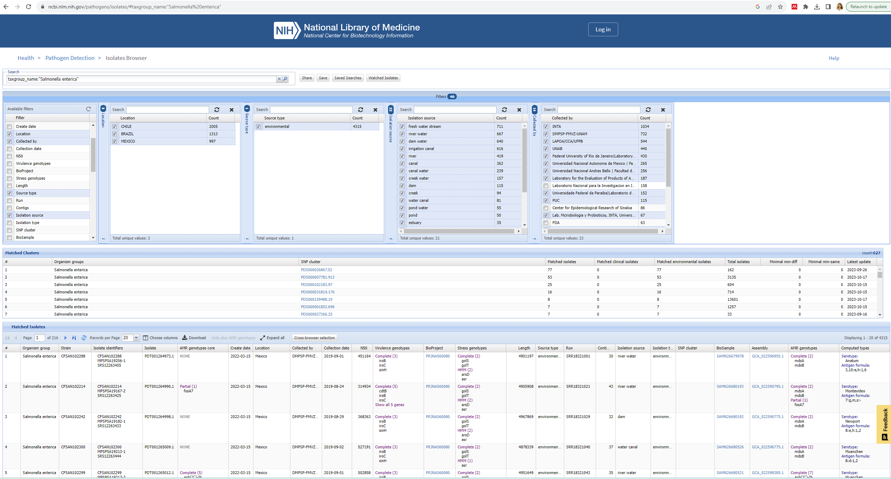
Pathogen Detection View
4,315

Slide 13
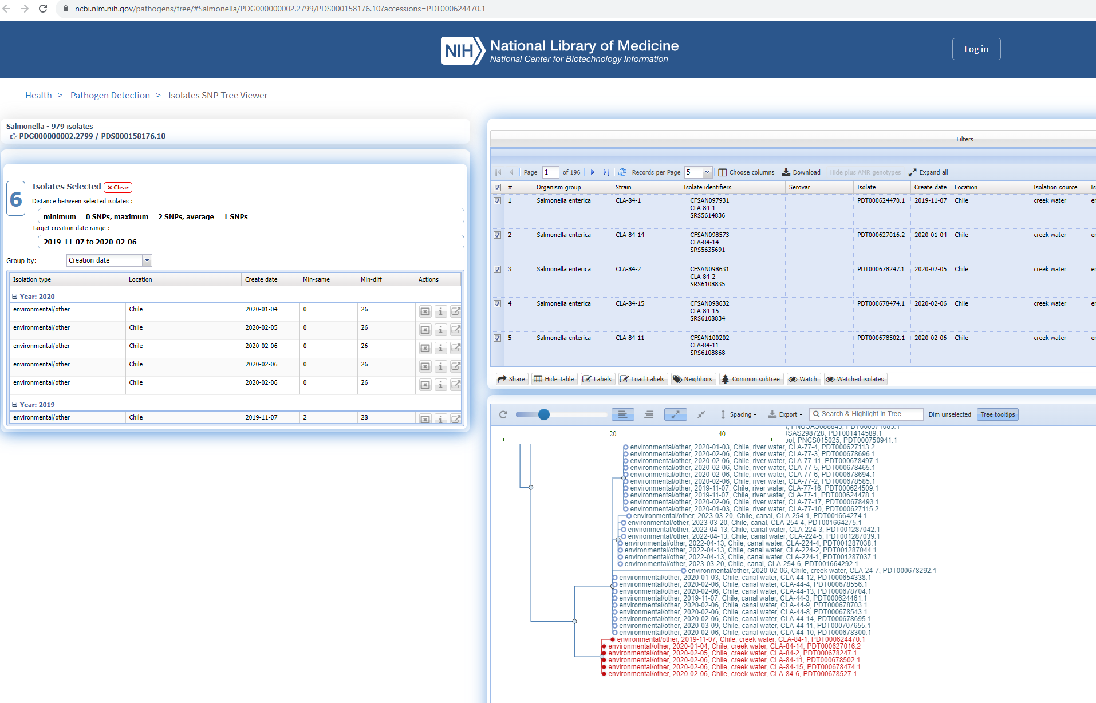
Pathogen Detection view
Clones: same sample, <20 SNP, monophyletic cluster

Slide 14
Number of serotypes per sample (%) by country
Range serotype/country:
Brazil: 1 – 8 (n=217)
Chile: 1 – 6 (n=539)
Mexico: 1 – 4 (n=420)
*Each country has a different number of samples

Slide 15
Salmonella isolates by country for Genomic Characterization
(n=1,778)
*A single clone from the same sample was selected

Slide 16
Top 10 Serotypes by country
Ranking | Brazil | Chile | Mexico
1 | Newport | Infantis | Newport
2 | Saintpaul | Typhimurium | Senftenberg
3 | Rubislaw | Newport | Anatum
4 | Infantis | Enteritidis | Agona
5 | Panama | Agona | Muenchen
6 | Corvallis | Stanley | Typhimurium
7 | Typhimurium | Senftenberg | Adelaide
8 | Javiana | Edinburg | Infantis
9 | Sandiego | Livingstone | Give
10 | Braenderup | Brandenburg | Panama
Serotypes by number of countries (n=1,778)
# Countries | # Serotypes | Genomes #
Three | 21 | 979
Two | 28 | 479
One | 75 | 320
Total | 123 | 1,778

Slide 17
Genomes (%) with AMR genes
Overall, 34.9% genomes carried AMR determinants (n=1,778)

Slide 18
AMR classes in genomes (predicted)
16.5% predicted to be MDR

Slide 19
Salmonella diversity in surface water in LA
Results

Slide 20
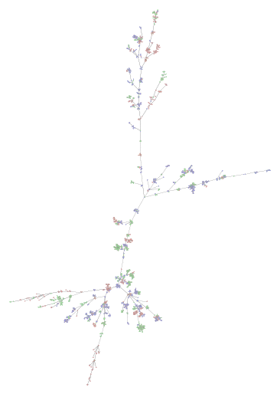
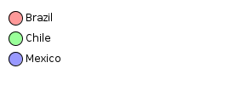
cg-MLST
Minimum Spanning tree Salmonella in surface waters
Clusters: 243 (67 – 2 genomes)
Clustering by sequence type and country
Only 12 multi country clusters were detected (4.9%)
MST Cluster distance threshold: 7
Ridom SeqSphere+ MST for 1,780 Samples based on 1201 columns, no missing values
Distance based on columns from S. enterica cgMLST (1201)
MST Cluster distance threshold: 7
Nodes colored by column: Country of Isolation
S. enterica cgMLST Complex Type / Clustering Distance: 7
Notes:
4 genomas clonales (0-3 SNP) obtenidos en el río Claro, sitio 23 el 04/17/2019 fueron clonales desde 2 a 7 SNP contra 8 genomas obtenidos en el mismo rio, pero del sitio 24 del 07/10/2019 (142 días de diferencia).
Clones mismo sitio diferentes fechas 10 genomas 0 - 4 SNP (Claro river, site 23 and 06-11-2019 respectively) and were clonal con 4 genomas (0 to 4 SNPs) mismo rio 04-17-2019 (54 dias de diferencia).

Slide 21
Multi country Clusters serotypes:
Infantis
Corvallis
Typhimurium
Soerenga
Agona
Kiambu
Mbandaka
Schwarzengrund
Enteritidis
Albany
Brazil
Mexico
Chile
4
2
4
2

Slide 22
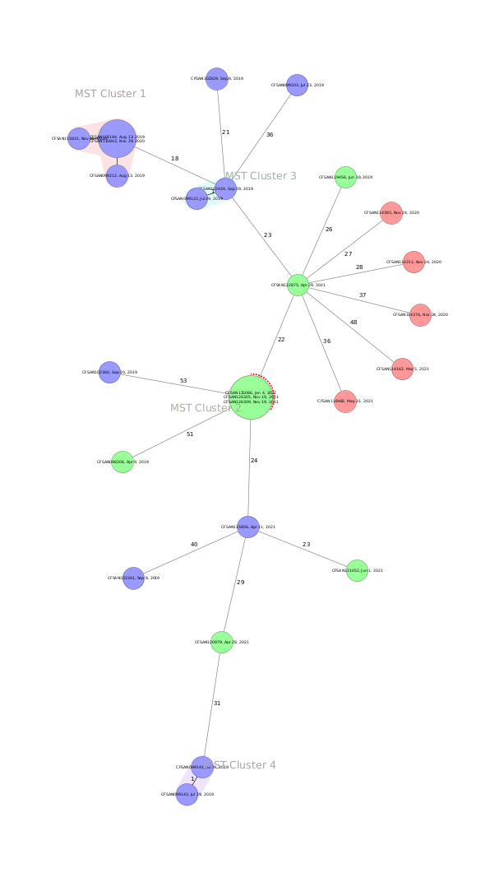
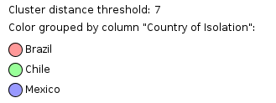
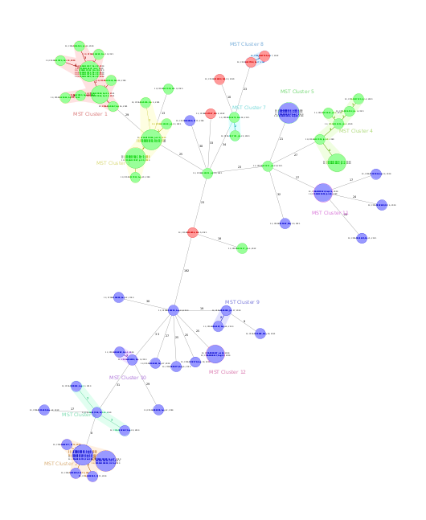
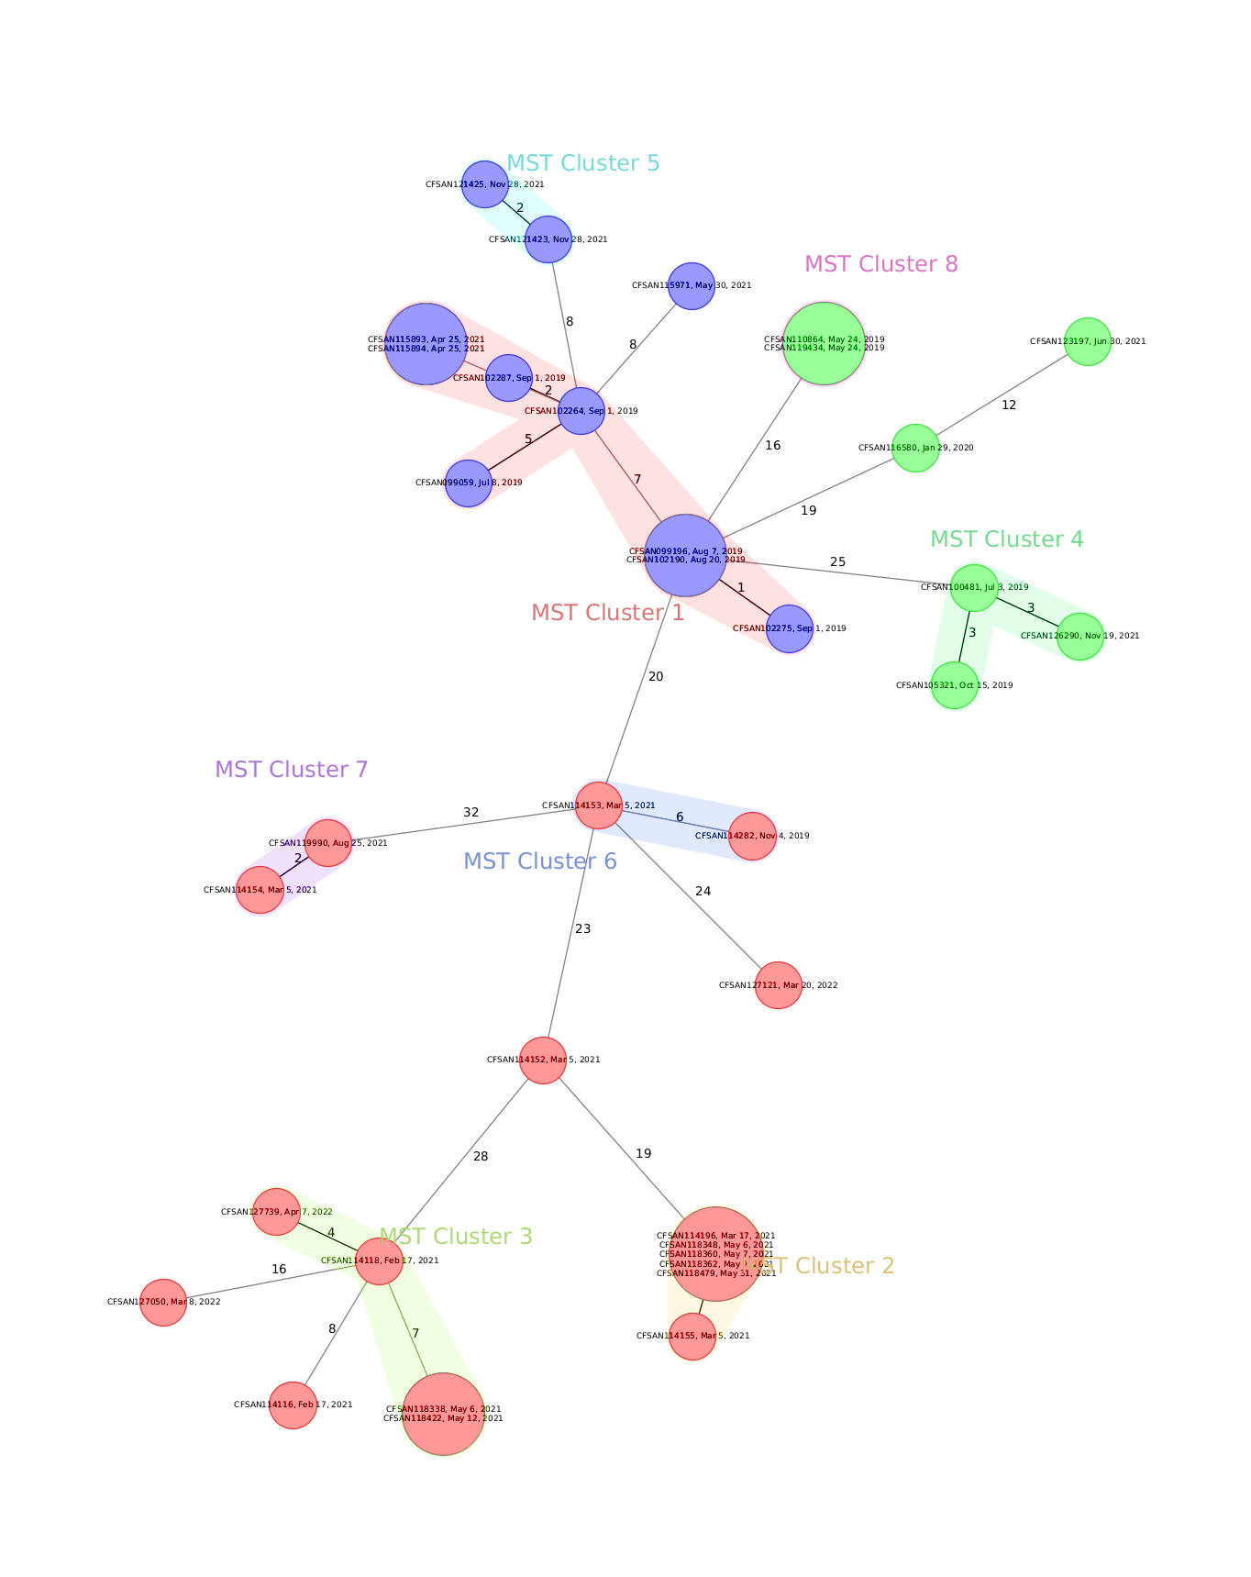
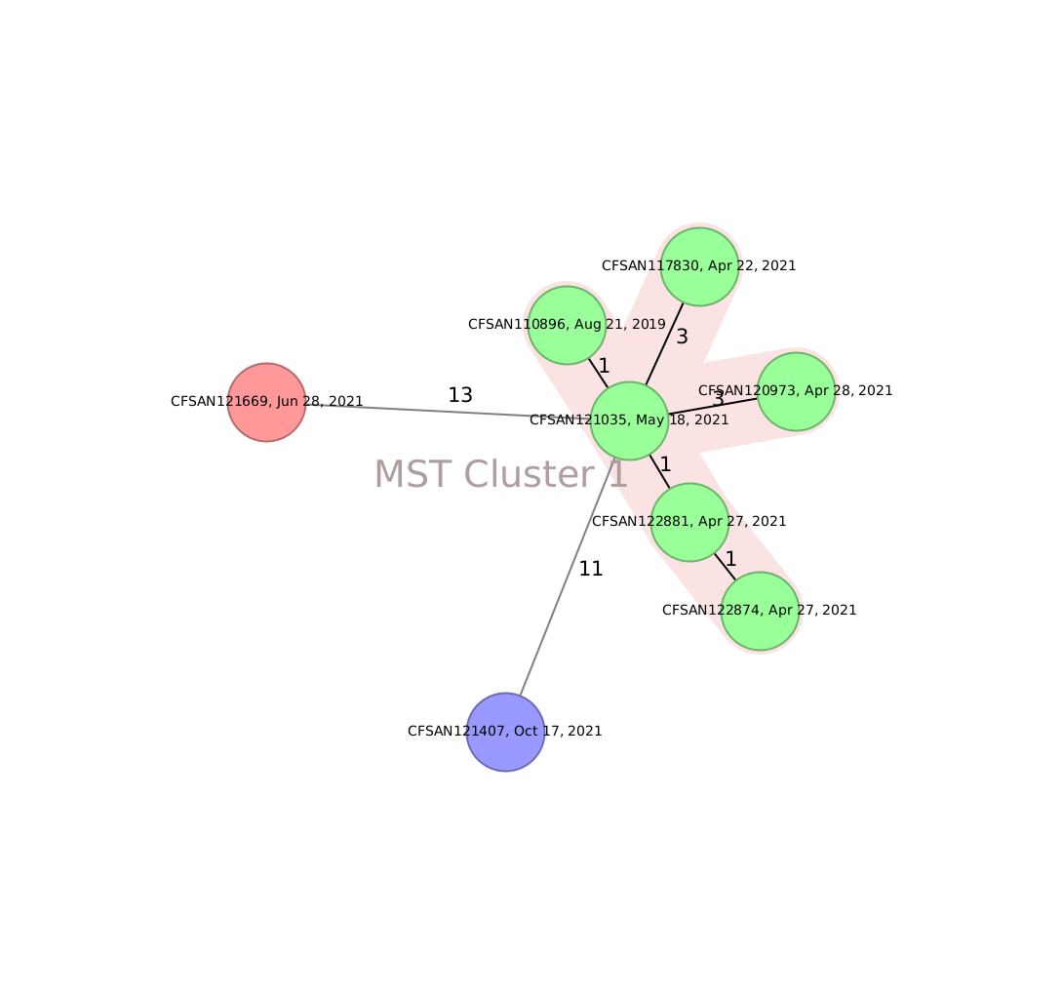
Minimum Spanning Tree by serotype
Corvallis
Soerenga
Mbandaka
Agona
cgMLST 3002 columns ignoring missing values

Slide 23
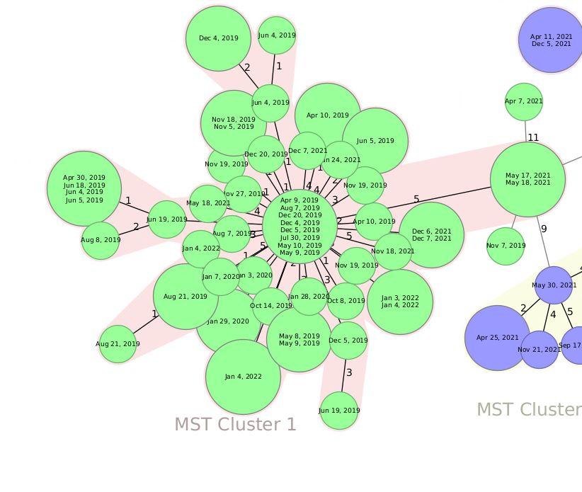



S. Infantis dissemination
Isolation year
2019
20
20
20
20
2020
20
2021
2022

Slide 24
Summary: Salmonella in surface waters
123 serotypes identified; 21 in all three countries
Top serotypes:
Newport
Infantis
Typhimurium
35% genomes carry AMR genes
Most genomes cluster with other genomes from the same isolation site/country

Slide 25
Other results
Latin American Surface Water Samples

Slide 26
Water Metagenomics: Taxonomic composition
Regional signature taxa were identified;
Stagnant water type exhibited significant difference in taxonomic diversity;
Cyanobacteria dominated stagnant water samples.

Slide 27
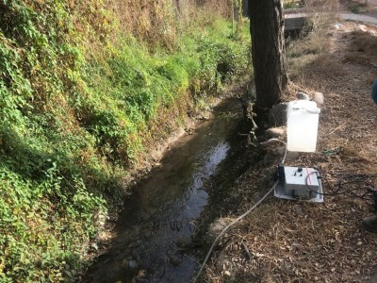
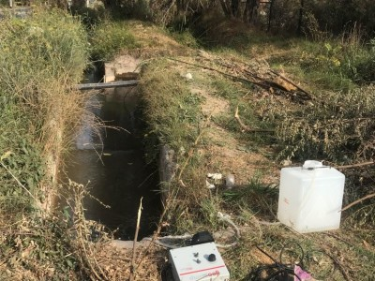
L. monocytogenes in Surface Waters in Chile
Sampling sites | Maipo (8 sampling) |  | Mapocho (10 sampling) |  | Claro (9 sampling) |  | Lontue (8 sampling)
1 | 1 |  | 0 |  | 0 |  | 0
2 | 1 |  | 0 |  | 0 |  | 0
3 | 3 |  | 1 |  | 1 |  | 1
4 | 0 |  | 4 |  | 0 |  | 2
5 | 0 |  | 0 |  | 1 |  | 1
6 | 2 |  | 1 |  | 3 |  | 1
7 | 4 |  | 0 |  | 2 |  | 0
8 | 5 |  | 1 |  | 4 |  | 0
9 | 1 |  | 2 |  | 5 |  | 3
10 | 4 |  | 7 |  | 2 |  | 2
11 | 3 |  | 3 |  | 2 |  | 6
12 | 2 |  | 5 |  | 1 |  | 3
13 | 0 |  | 2 |  | 6 |  | 2
14 | 3 |  | 3 |  | 1 |  | 5
15 | 1 |  | 1 |  | 2 |  | 4
16 | 1 |  | 1 |  | 1 |  | 1
17 | 0 |  | 1 |  | 0 |  | 0
18 | 4 |  | 3 |  | 1 |  | 1
19 | 2 |  | 4 |  | 0 |  | 1
20 | 1 |  | 0 |  | 1 |  | 0
21 | 0 |  | 3 |  | 1 |  | 0
22 | 6 |  | 0 |  | 1 |  | 0
23 | 3 |  | 6 |  | 3 |  | 1
24 | 4 |  | 4 |  | 4 |  | 6
25 | 4 |  | 1 |  | 6 |  | 1
26 | 4 |  | 3 |  | 3 |  | 0
27 | 0 |  | 4 |  | 1 |  | 0
28 | 1 |  | 2 |  | 2 |  | 1
29 | 0 |  | 3 |  | 1 |  | 2
30 | 1 |  | 4 |  | 1 |  | 4
Maipo and Mapocho: Persistant contamination with L. monocytogenes

Slide 28
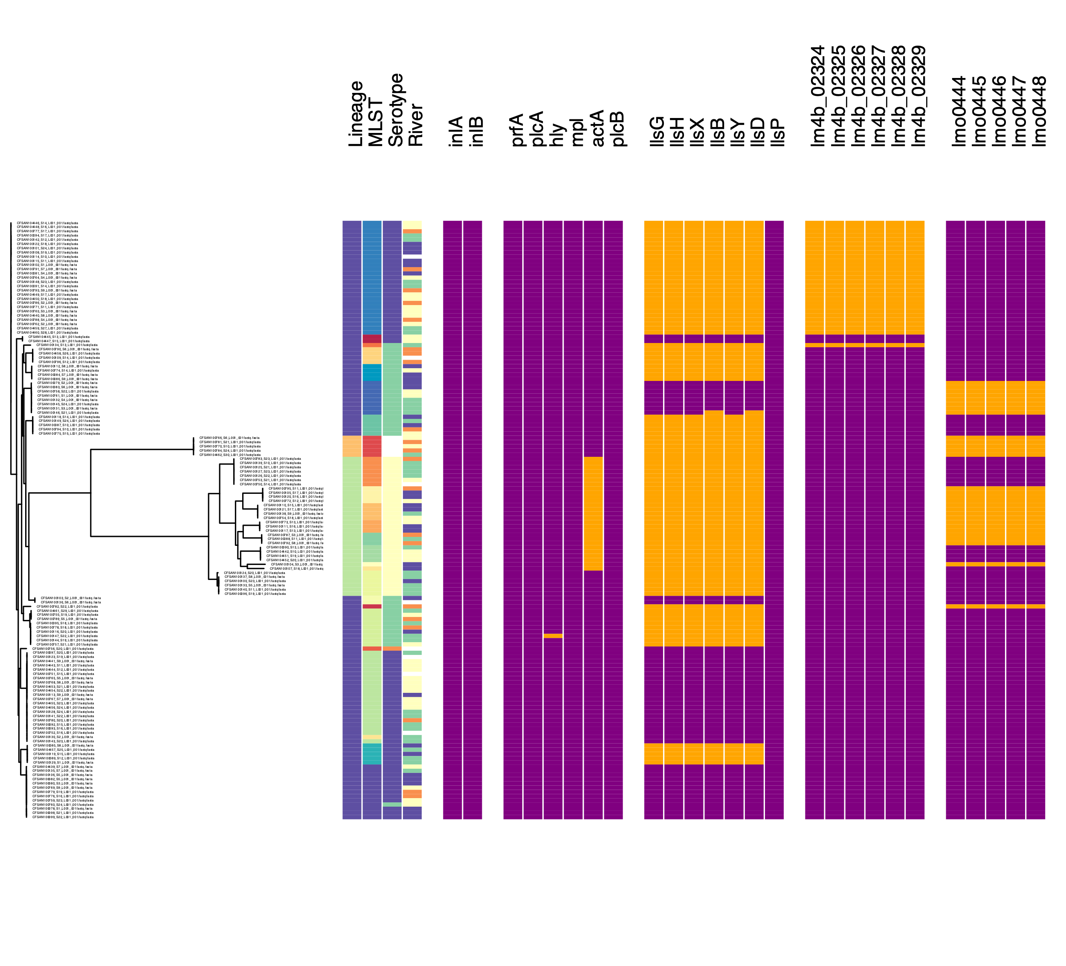
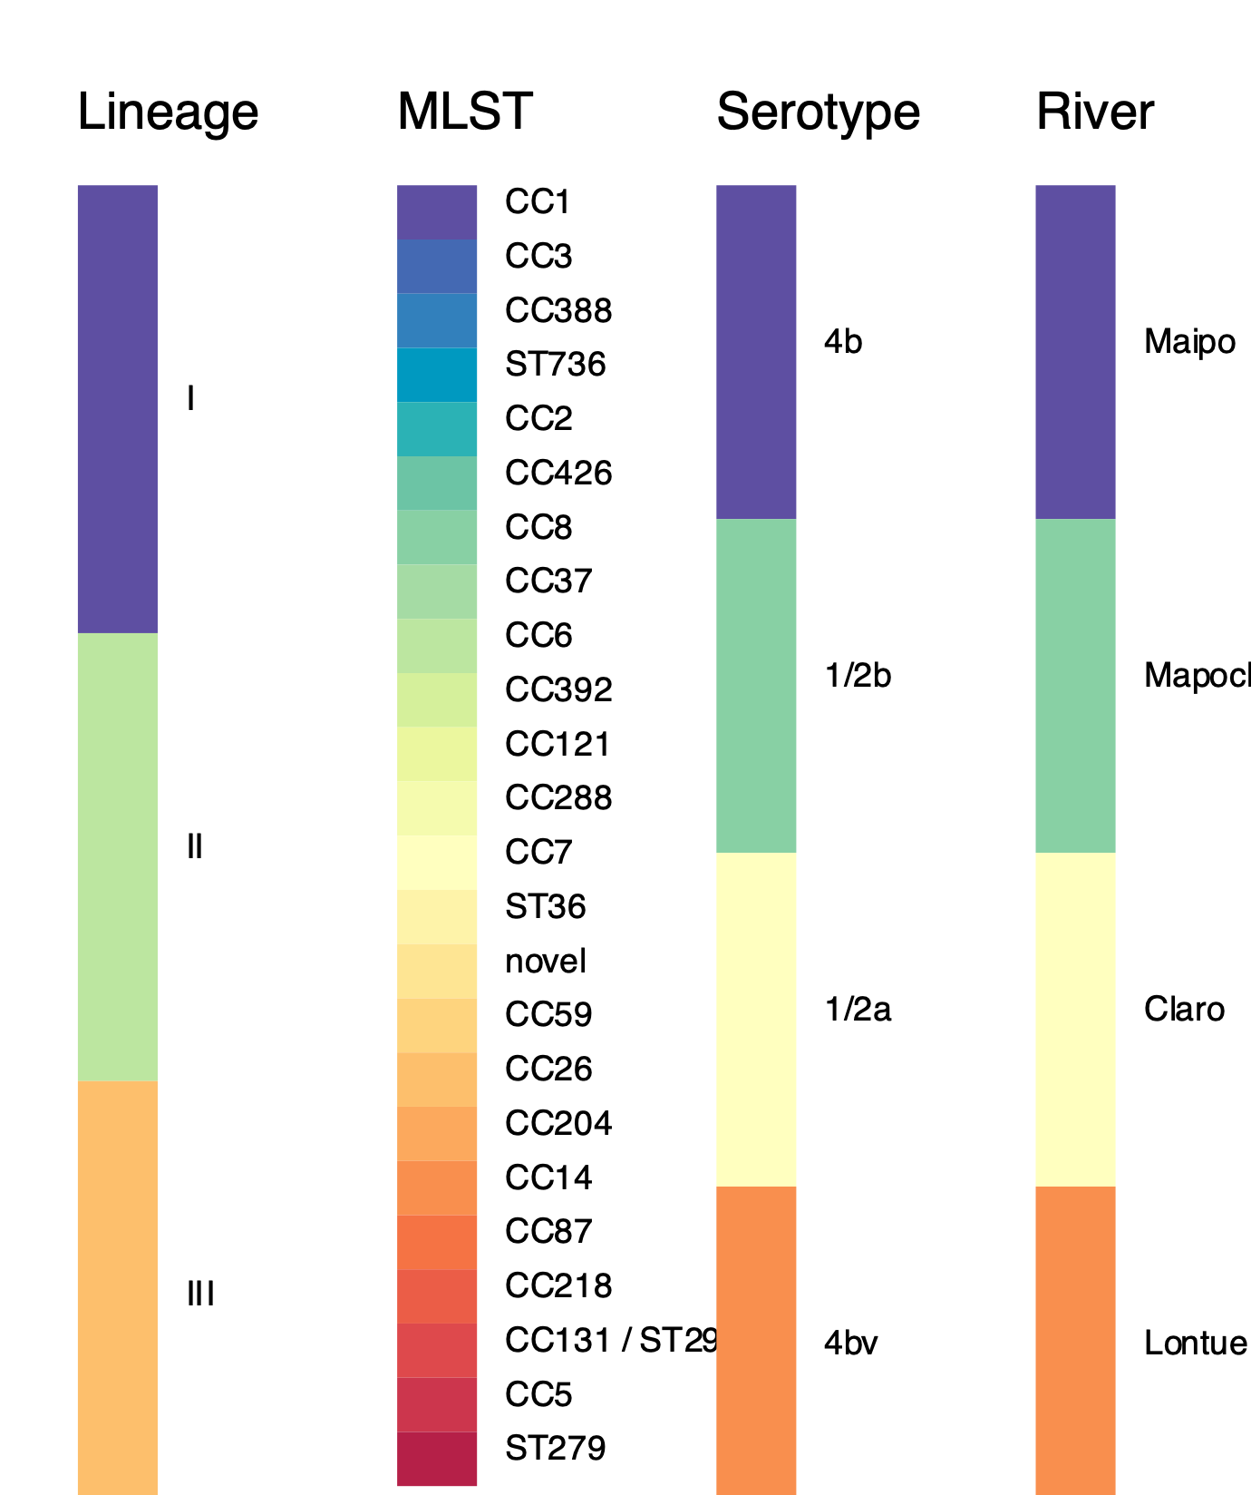
Virulencia genes in L. monocytogenes from Surface Waters in Chile
Int LIPI -1 LIPI-3 LIPI-4 SSI
IVb
IIb
IIa
Presence
Absence
Absence
Presence

Slide 29
Water Project Products

Slide 30

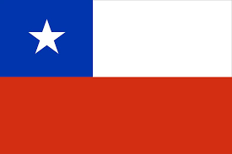
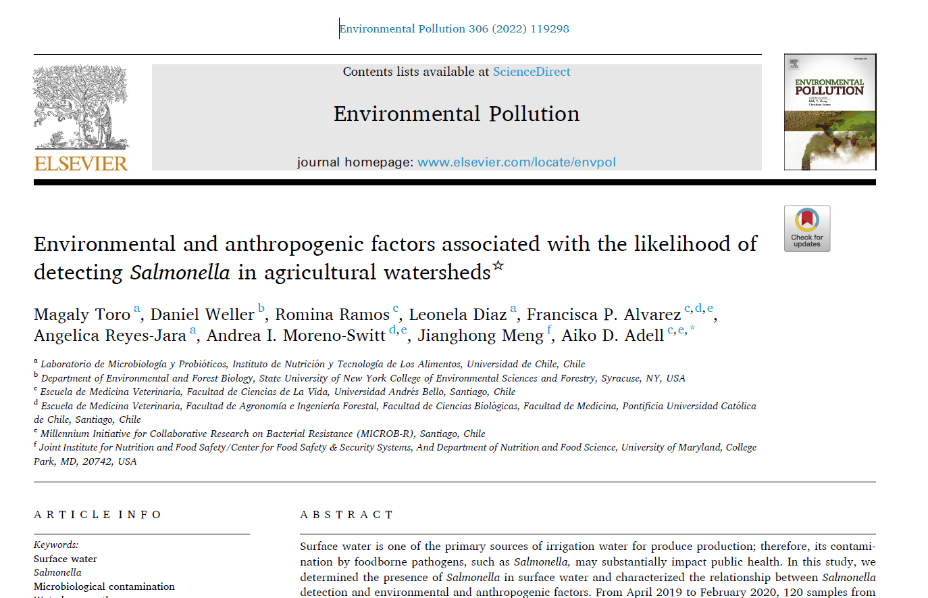
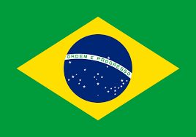
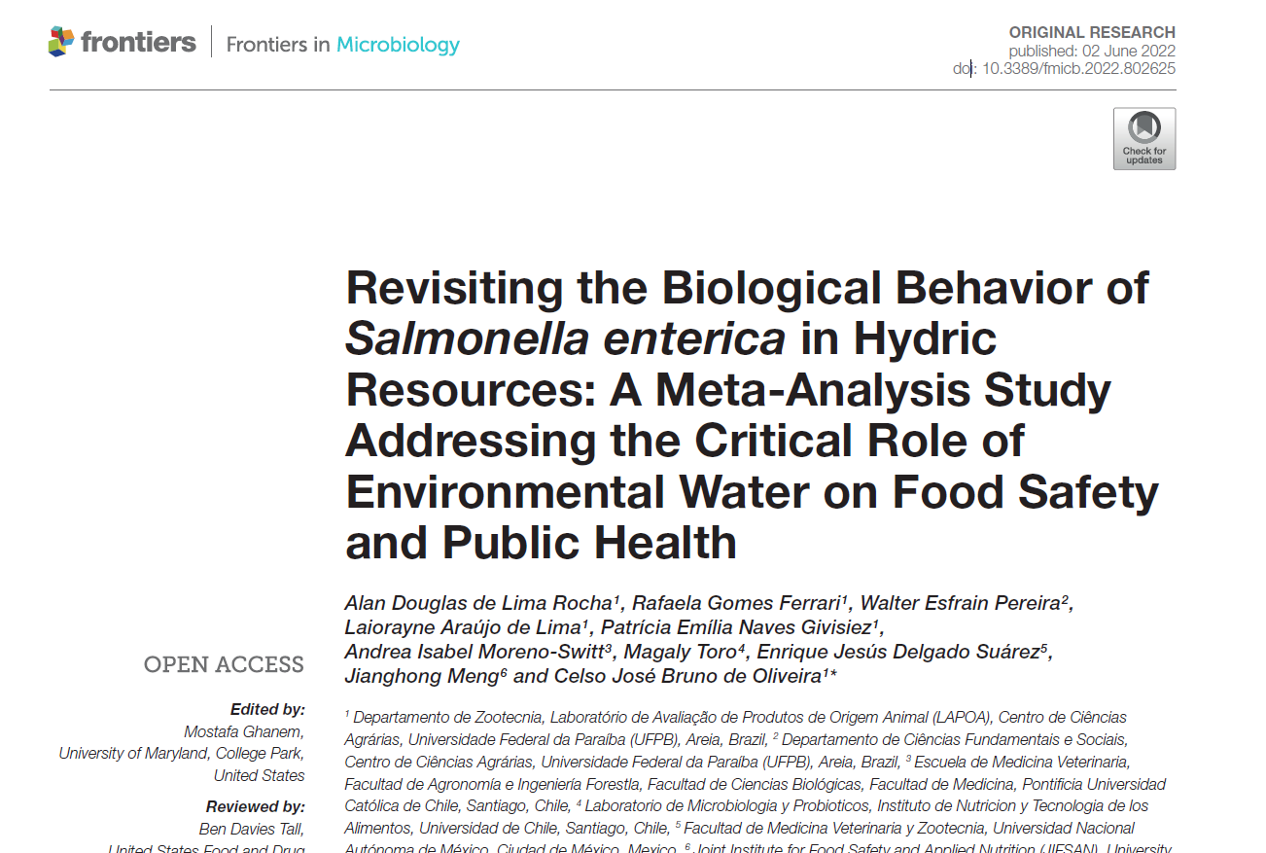
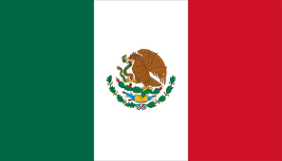
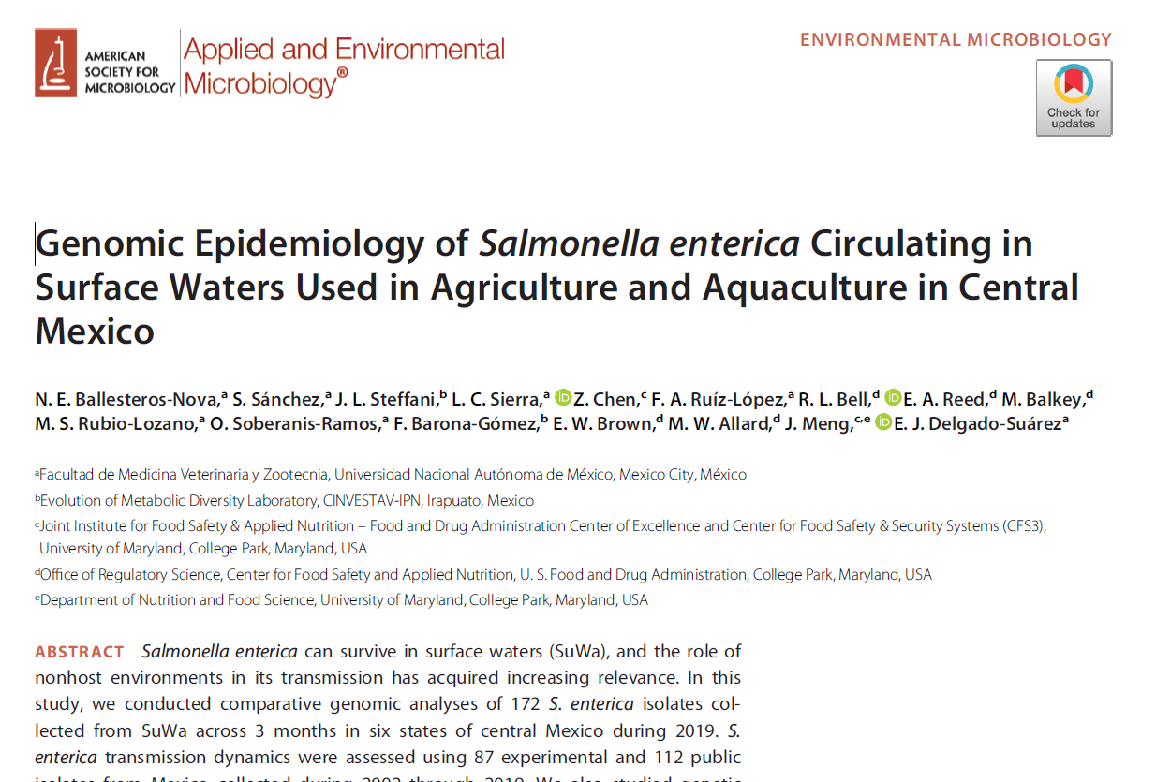
Peer review Publications
Two articles submitted for consideration in 2023 + 5 in preparation

Slide 31
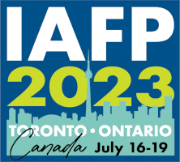

Oral Communications in Scientific Meetings 2022-23
Magaly Toro, Enrique Delgado Suarez, Angelica Reyes-Jara, Andrea Moreno Switt, Aiko Adell, Raquel Regina Bonelli, Celso José Bruno Oliveira, Zhao Chen, Xinyang Huang, Sebastian Gutierrez, Anamaria M. P. dos Santos, Brett Albee, Eric Brown, Marc Allard, Sandra Tallent, Christopher Grim, Rebecca Bell, and Jianghong Meng. Long-term surveillance shows a high prevalence and diversity of Salmonella spp. in surface waters used for food production in Brazil, Chile, and Mexico. IAFP annual meeting 2023, July 16-19, Toronto, Ontario, Canada.
Francisca P. Álvarez, Valentina Lagos-Leyton, Constanza Díaz-Gavidia, Diego Fredes-García, Patricia García, Aiko D. Adell, Magaly Toro, Angélica Reyes-Jara, Jianghong Meng, Andrea Moreno-Switt. Caracterización Microbiológica de Salmonella enterica aislada desde los ríos Maipo y Mapocho: Análisis de serotipos, determinantes de resistencia y susceptibilidad a antimicrobianos (2019-2020). XLV Congreso Chileno de microbiología, 2023, Pucón, Chile.

Slide 32
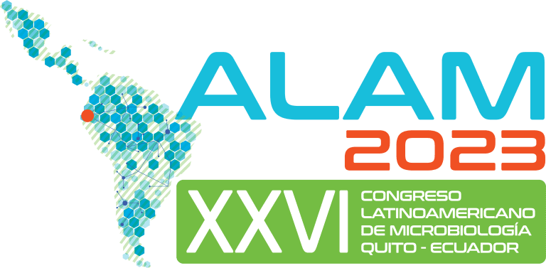

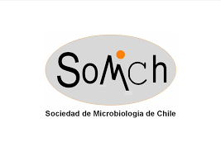
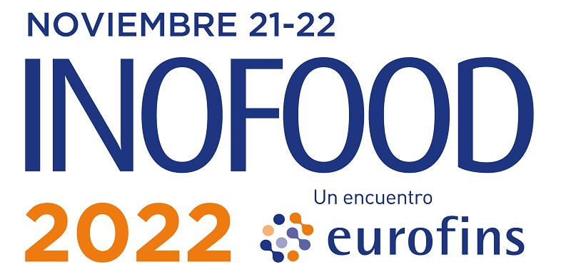


Poster Presentations 2022-23
18
ASM: 1
IAFP: 12
ALAM Ecuador: 2
INOFOOD Chile: 1
SOMICH Chile 2022: 2
Accepted:
SOMICH 2023: 2
Food Safety Laboratory, JIFSAN

Slide 33
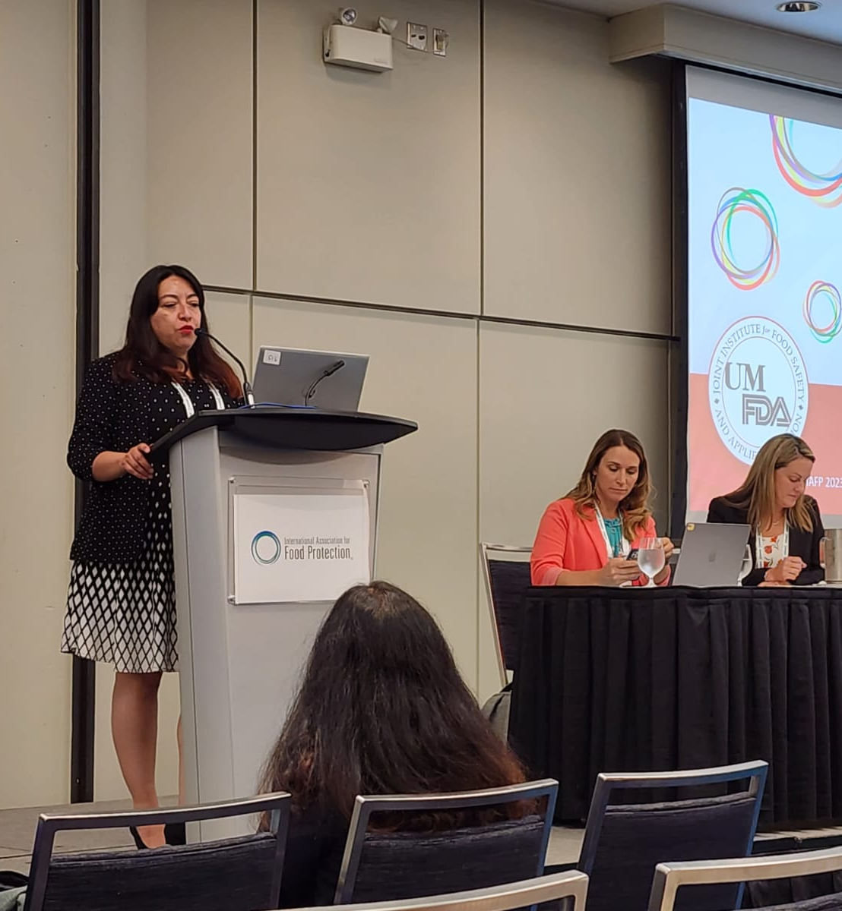
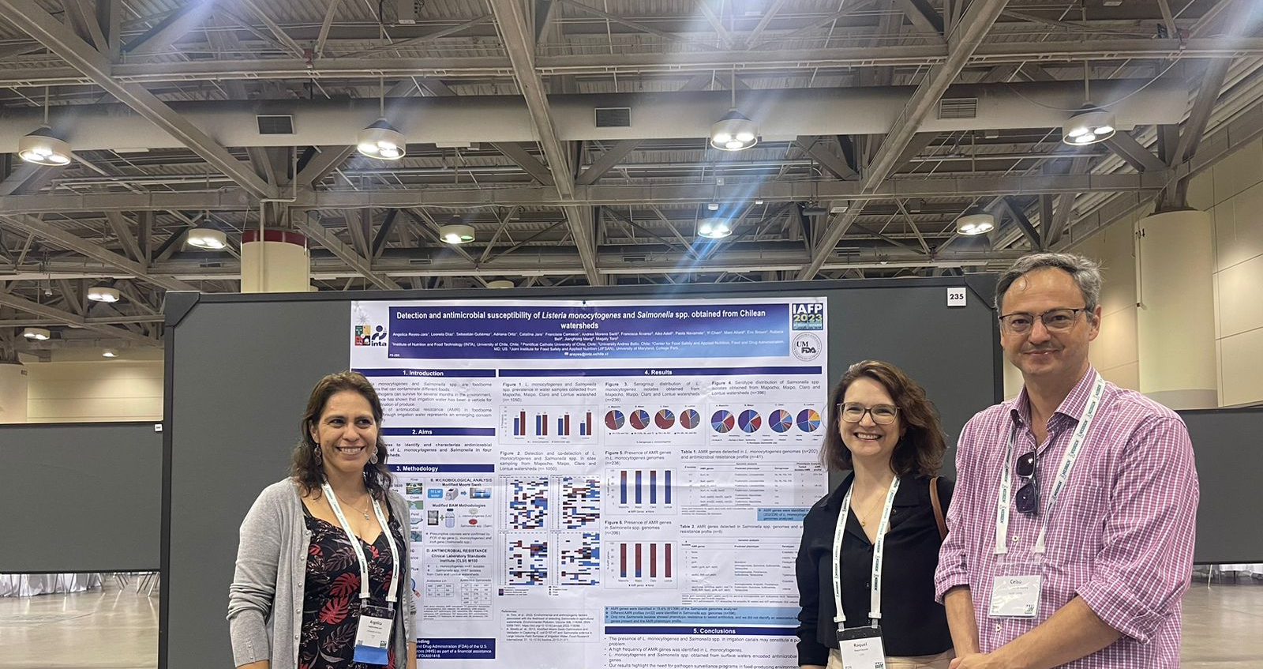
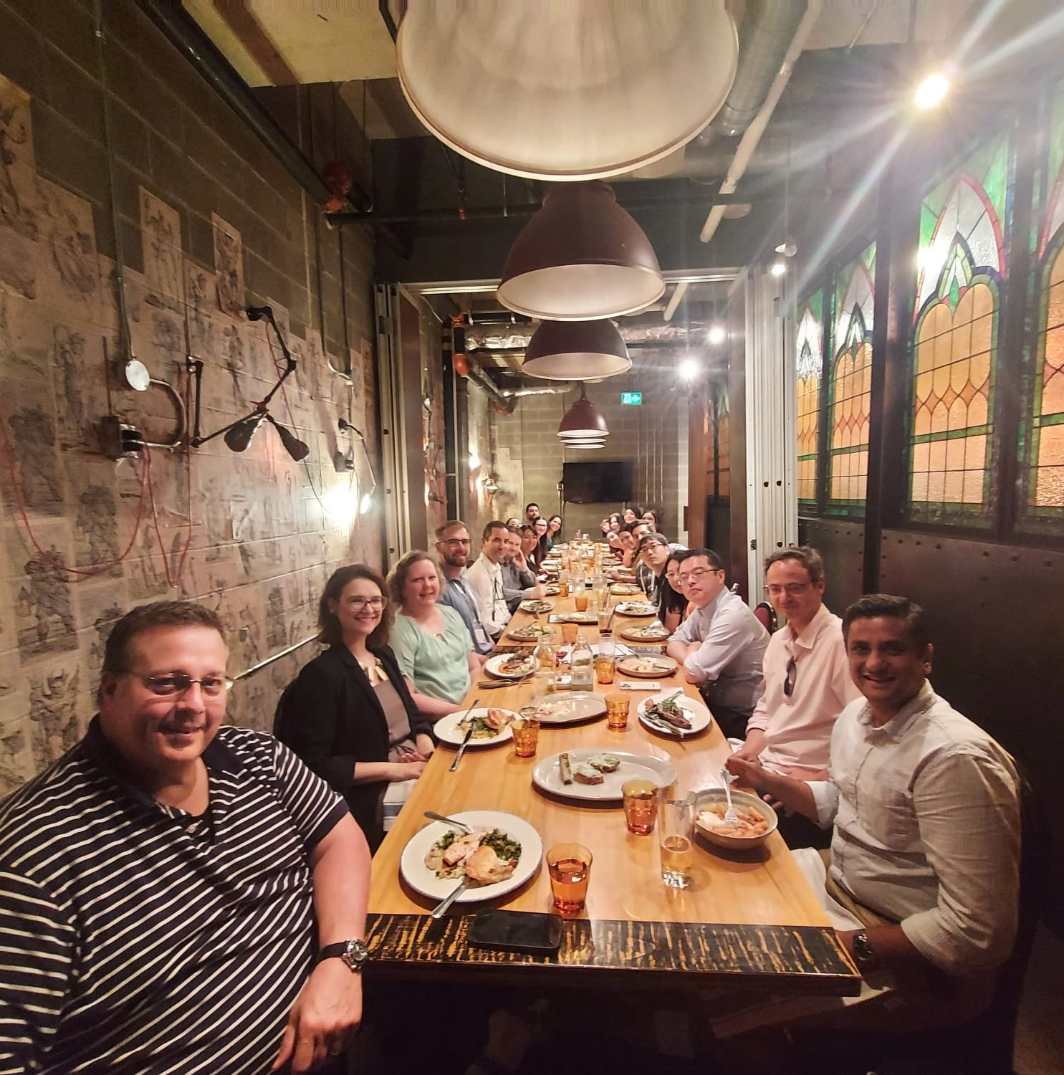
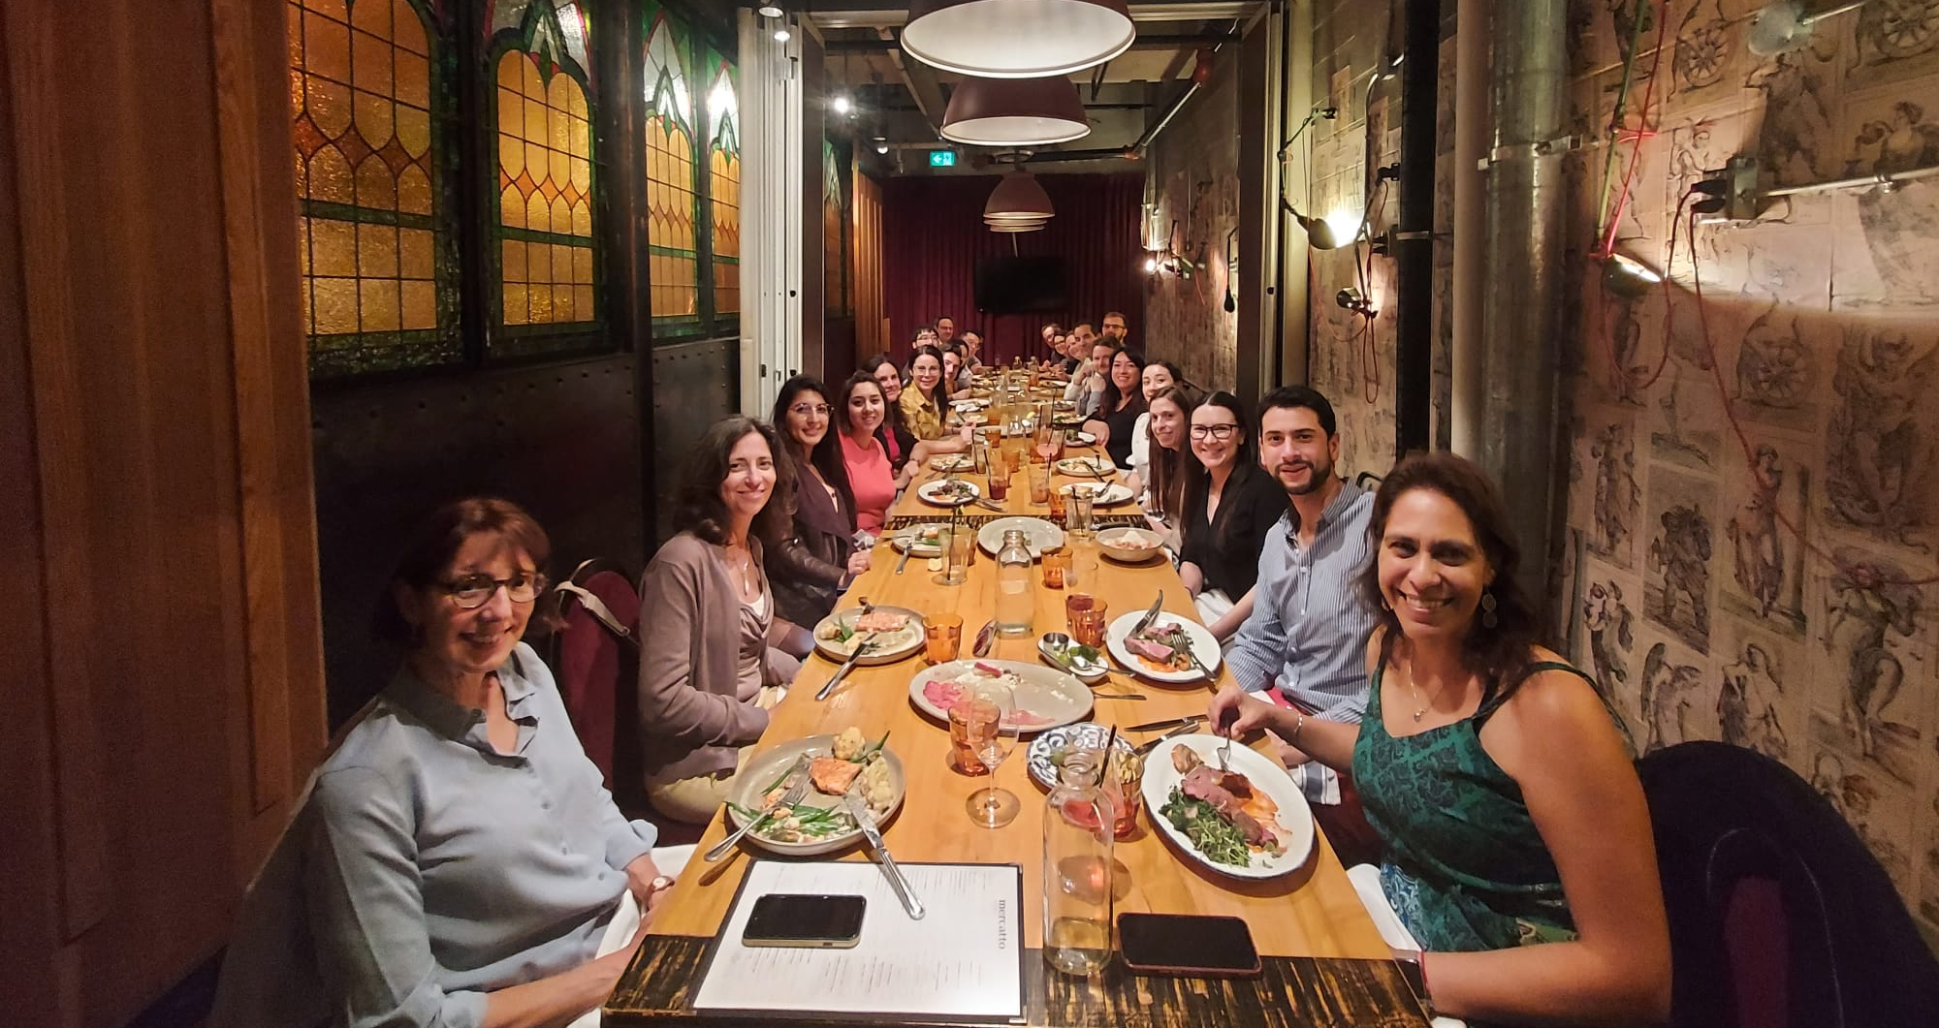
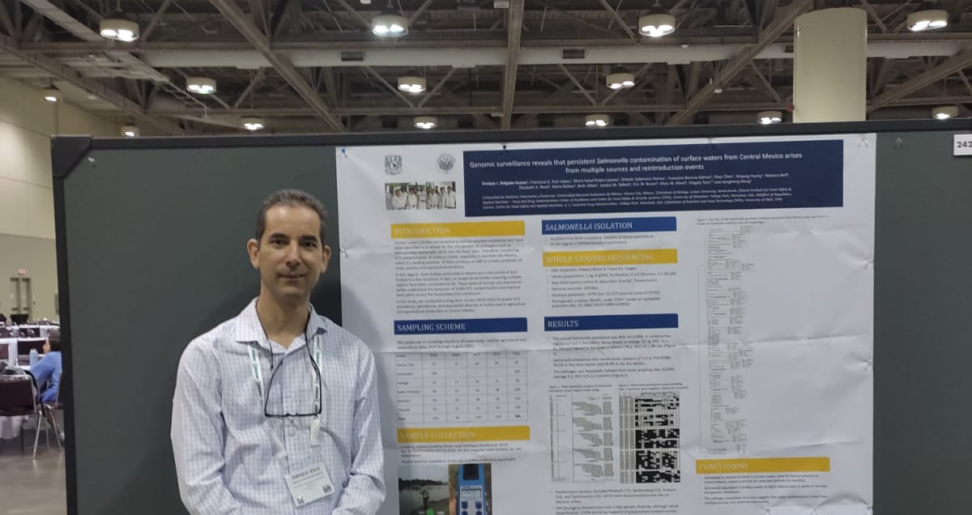
IAFP 2023 Toronto

