Slide 1
bettercallsal
Application of bettercallsal pipeline on environmental samples
Padmini Ramachandran
FDA/CFSAN
Konganti K, Reed E, Mammel M, Kayikcioglu T, Binet R, Jarvis K, Ferreira CM, Bell RL, Zheng J, Windsor AM, Ottesen A, Grim CJ and Ramachandran P (2023) bettercallsal: better calling of Salmonella serotypes from enrichment cultures using shotgun metagenomic profiling and its application in an outbreak setting. Front. Microbiol. 14:1200983. doi: 10.3389/fmicb.2023.1200983
Notes:
Good morning. I am Padmini Ramachandran and my talk is going to be on the application of bettercallsal analysis pipeline, on environmental samples. We are calling it bettercallsal as its def doing a good job of better calling of Salmonella – multiple Salmonella serotypes.

Slide 2
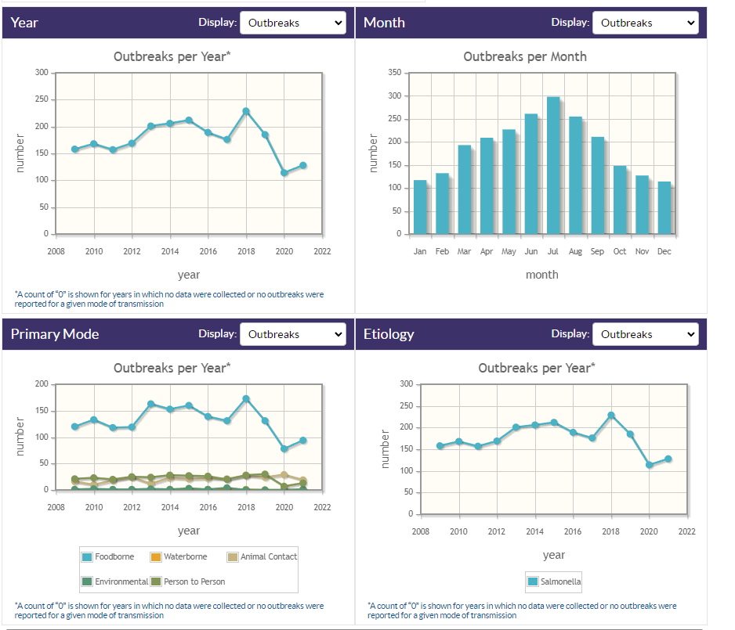
Outbreaks- Salmonella
Salmonella outbreak- one among the leading cause.
NORS – CDC – Mostly foodborne
~3% of Salmonella outbreaks are multi-serovar
https://wwwn.cdc.gov/norsdashboard/
Notes:
I am preaching to the choir here. Everyone here in this room knows Salmonella is a problem. Also important is that around ~3% of the Salmonella outbreaks are multiserovar outbreak.

Slide 3
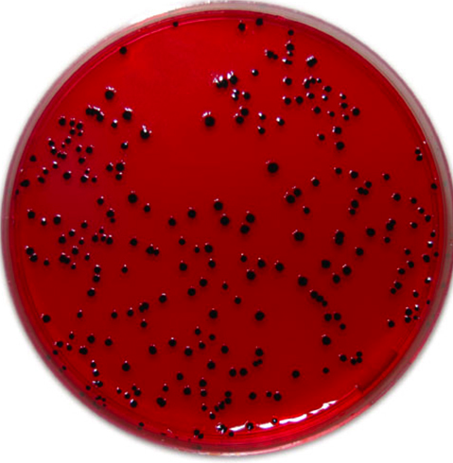
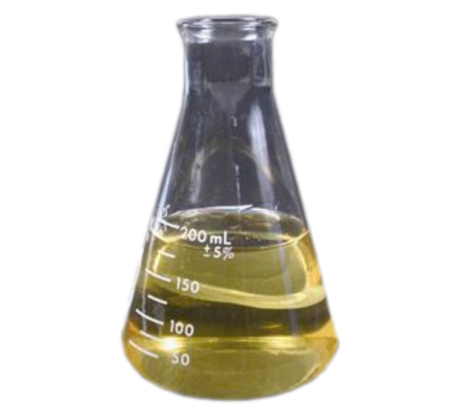
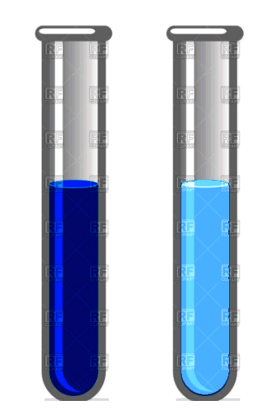
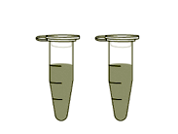
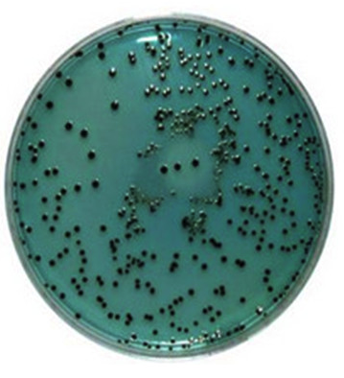
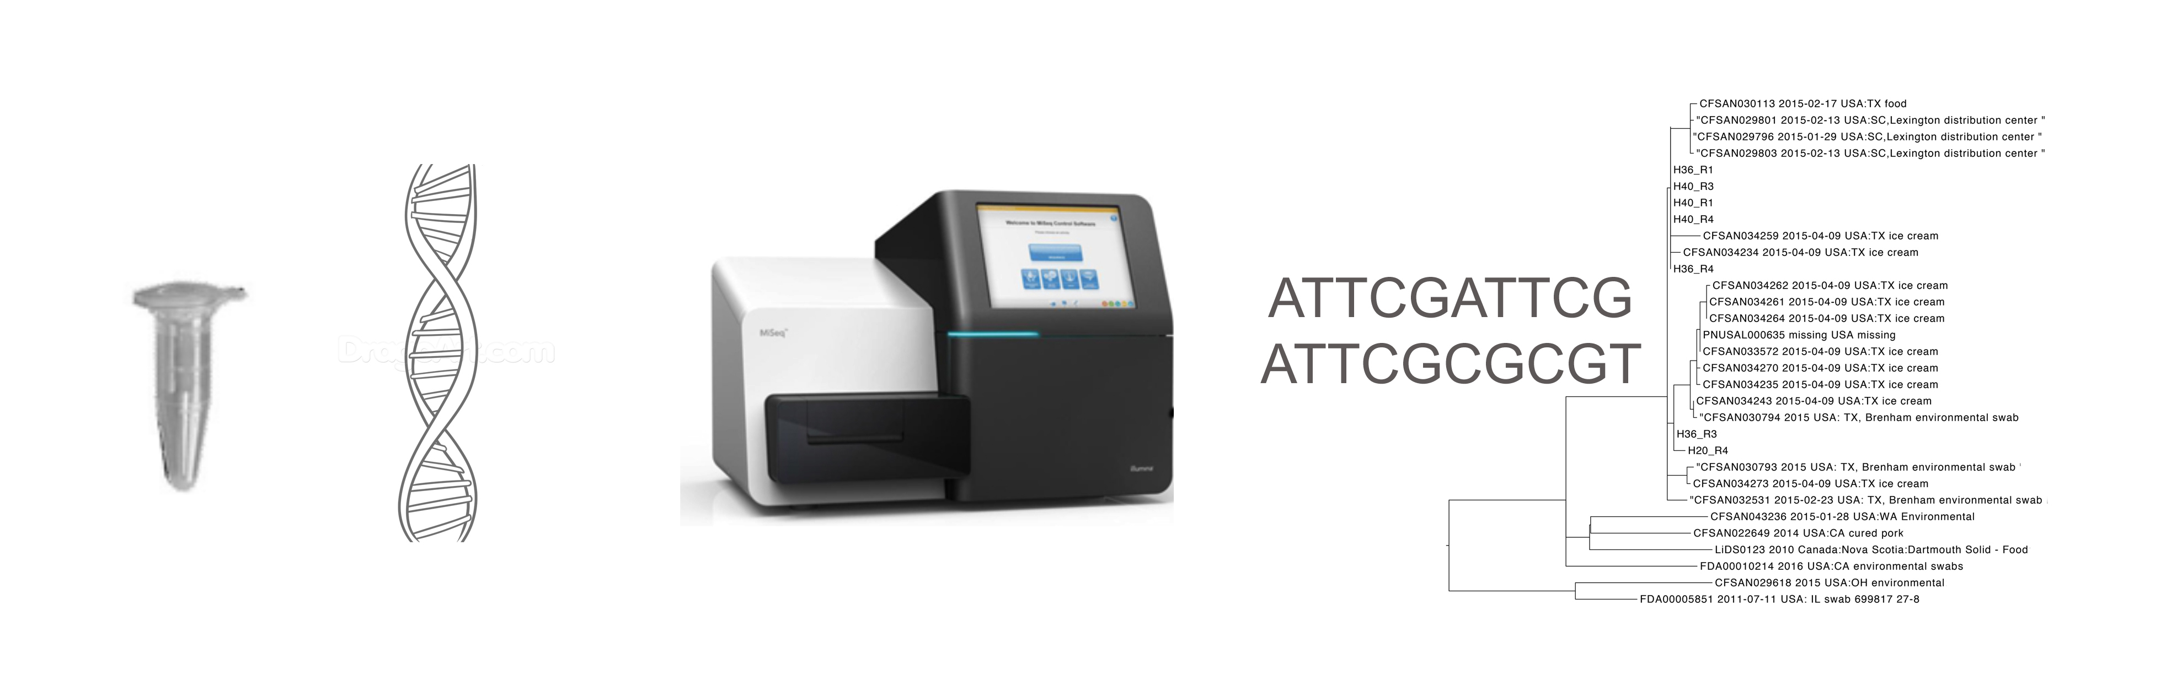
Quasi metagenomics- Microbiological steps to recover individual isolates of Salmonella
UPB, MBPW, 24 hrs
RV, TT 24 hrs
XLD, HE 24 hrs
24 hrs
130 hrs- total
180 hrs- total
Notes:
After our success with using Quasi metagenomics approach back in 2018 on Ice cream outbreak, we started using the quasi metagenomics approach for Salmonella too. What we are doing here is extracting DNA from the pre enrichment, and the selective enrichments like RV/TT and sequence them and see if it clusters with the isolate and we can get to it quicker. The library prep and DNA extraction is the same as sequencing isolate.

Slide 4
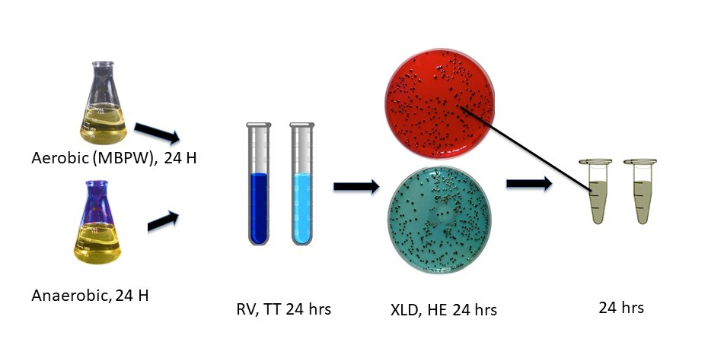
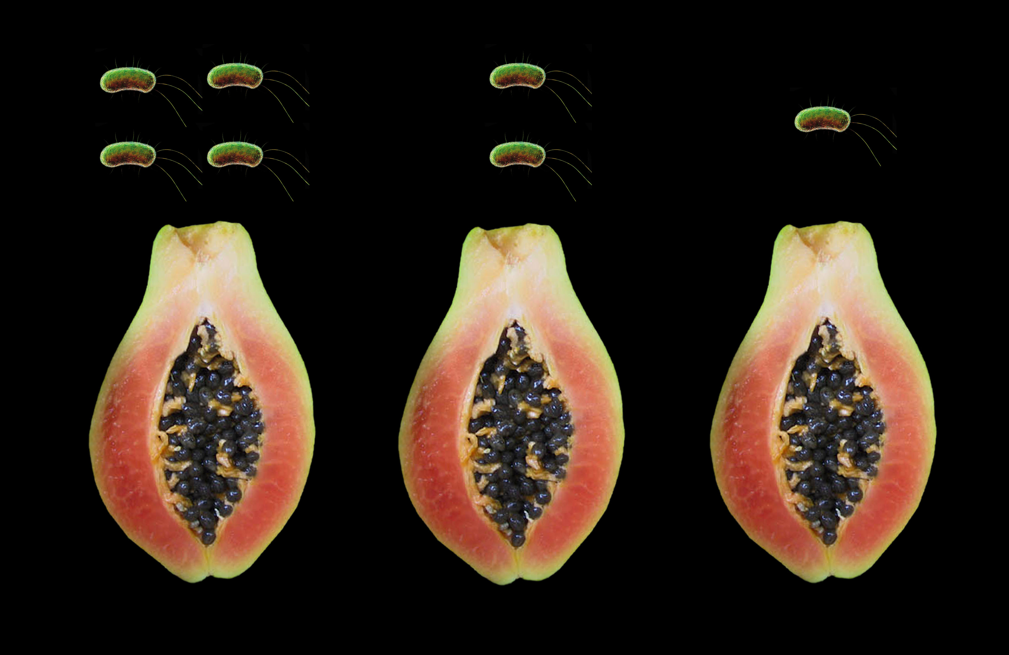
Challenges on metagenomics dataset on Salmonella serotyping
Papaya Outbreak- 2017
Thompson, Kiambu
Newport
Anatum
Senftenberg, Agona
Infantis,
Notes:
When Papaya outbreak happened, it was caused by multiple serovars of Salmonella from 3 different farms. When we did the quasi metagenomic approach on these papayas, we couldn’t assemble the metagenomic reads and place them in the cluster like we did for Listeria.

Slide 5
SERO-BLAST
Kallisto abundance
Pulling Salmonella reads -
  Assembly based approaches
  SeqSero2 on the Salmonella only reads
  SeqSero2 on the assembly
  SISTR/SRST2
  Many other tools

Slide 6
Nextflow – Domain Specific Language (BCS – HTML) Platform, portability layer between logic and execution, checkpoint tracking, execution resumed at any step.
MASH – Genome/metagenome distance estimation using MinHash, generates sketch to represent large datasets.
KMA – kmer alignment, ConClave score to address ties, reference assembly and statistics. Good for highly redundant databases.
SALMON – quantification of reads, performance superior to kallisto, G+C content and positional bias adjustment.
Notes:
We have around half a million Salmonella genomes deposited in NCBI thru genometrakr. Its 10 years since genometrakr started! We have come a long way. NCBI has developed pathogen detection and has automated Salmonella clustering. Any new Salmonella genome submitted, are analyzed and placed in cluster within 3days. We leveraged this information and created this workflow.

Slide 7
bettercallsal
Obtain precise Salmonella serotype/serovar information for each sample insilico.
Characterize presence of potential multiple Salmonella serotypes in a single sample.
Work well with both metagenomics and quasi-metagenomics (enriched) datasets. Very fast.
Leverage Salmonella WGS isolate data made available (FDA GenomeTrakr) at NCBI.
Automated workflows. v0.4.1: https://github.com/CFSAN-Biostatistics/bettercallsal
Latest version is on Galaxytrakr- bcs 0.6.0. https://galaxytrakr.org/root/login?redirect=%2F
Notes:
Advantages

Slide 8
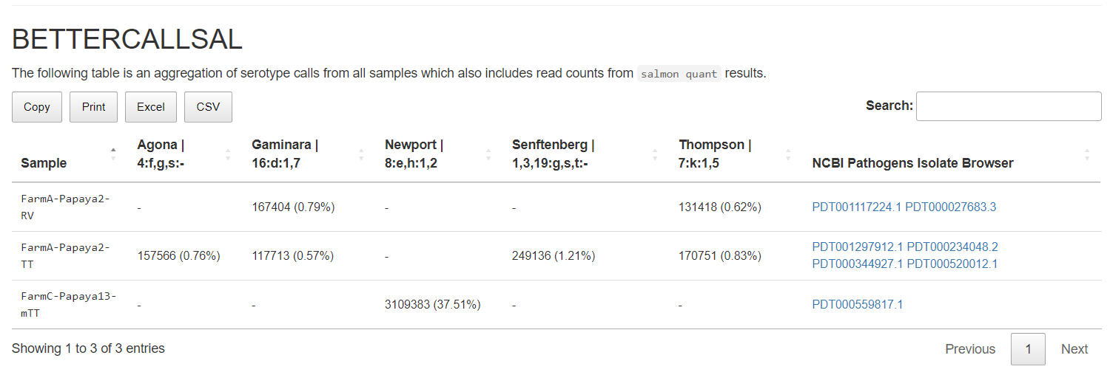
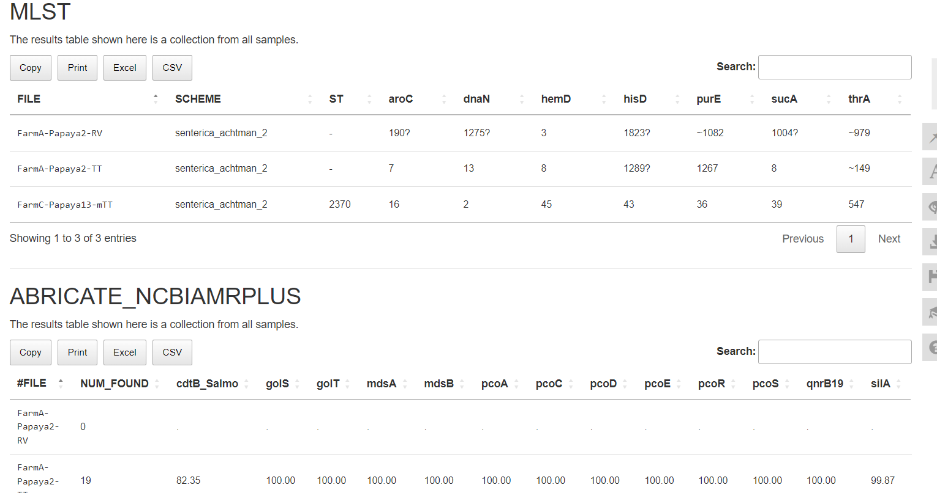
Comprehensive multiQC report

Slide 9
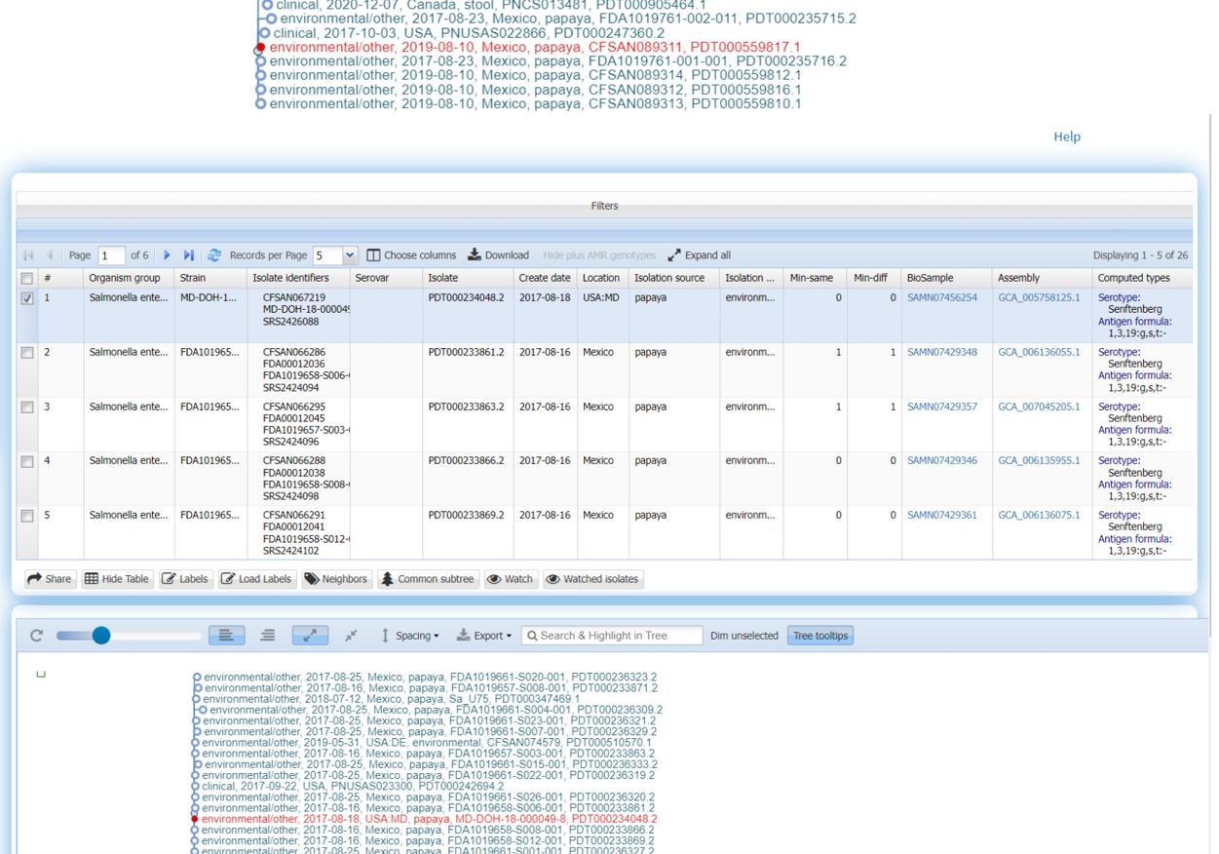
Papaya Outbreak 2017 https://cfsan-pub-xfer.s3.amazonaws.com/Kranti.Konganti/bettercallsal/manuscript/papaya_outbreak_results.html

Slide 10


Environmental sampling- application of bettercallsal
Chief Scientist Grant
CVM
Brandon Kocurek, Andrea Ottesen, and Errol Strain

Slide 11
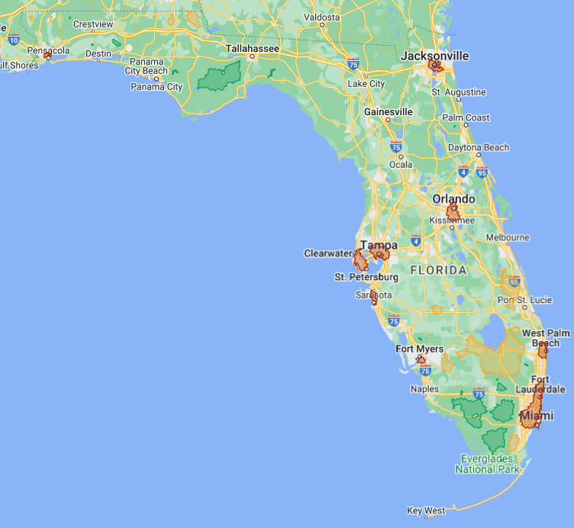
Florida
A total of 9 sites were samples across the State of Florida
Sites were selected from Developed, Agriculture & Natural hotspots
  3 Developed
  3 Agriculture
  3 Natural
3 treatment groups were collected, prepared, sequenced & analyzed:
  Culture Independent (CI)
  General Enrichment (2x BPW)
  Salmonella selective enrichment (RV/TT)
Developed
Agriculture
Natural

Slide 12
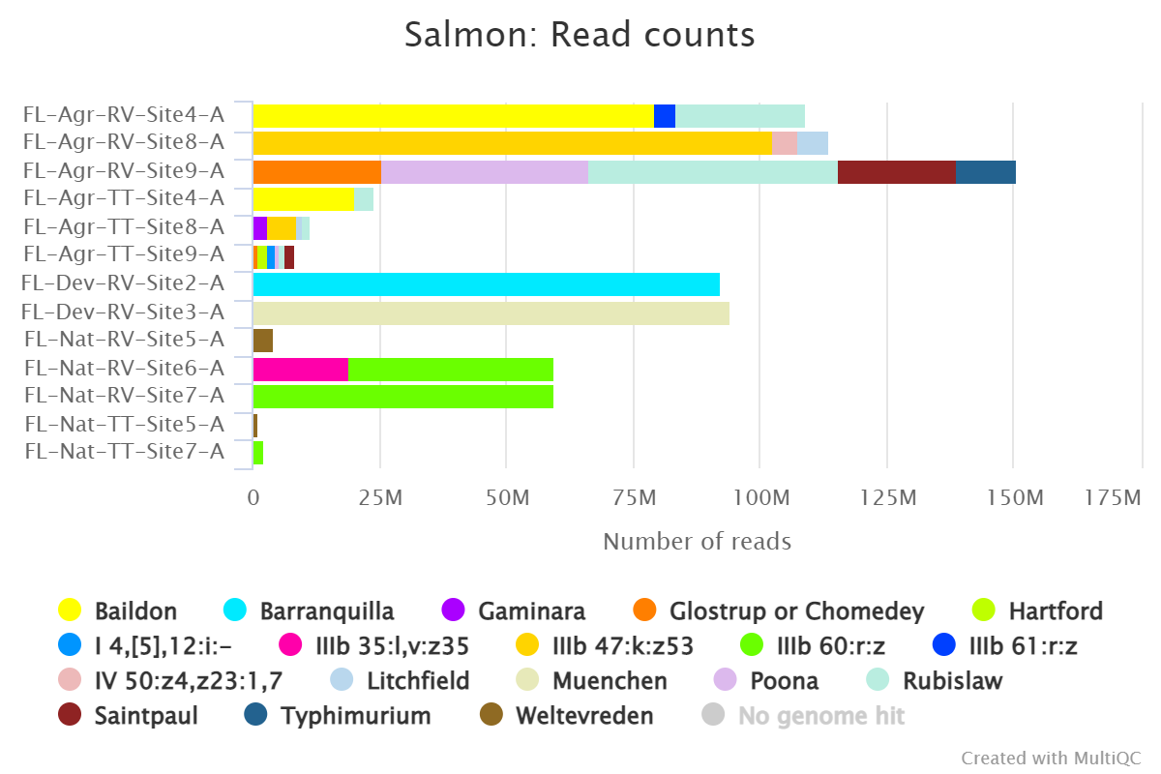

Slide 13
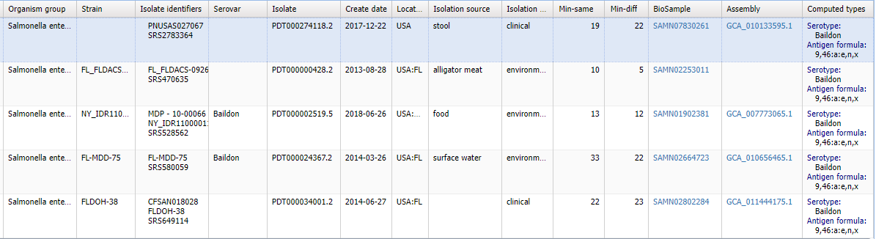
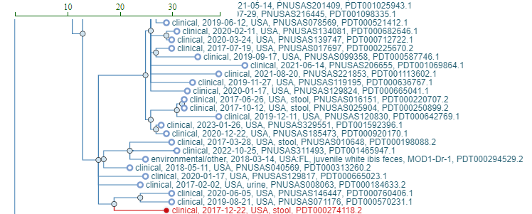
FL-Agr-RV-Site4-A
https://www.ncbi.nlm.nih.gov/pathogens/isolates/#PDT000274118.2

Slide 14
Comparing bettercallsal to WGS
Group | Site | RV/TT | Bettercallsal (RV/TT QMGS) | Isolates
Developed | 1 | RV | NA | NA
 |  | TT | NA | NA
 | 2 | RV | Barranquilla* | Gaminara
 |  | TT | Gaminara | Gaminara
 | 3 | RV | Muenchen | Muenchen
 |  | TT | Muenchen | Muenchen
Natural | 5 | RV | Weltevreden | NA
 |  | TT | Weltevreden | Na
 | 6 | RV | IIIb 35:l,v:z35 | IIIb 60:r:z | IIIb 60:r:z
 |  | TT | NA | NA
 | 7 | RV | IIIb 60:r:z | IIIb 60:r:z
 |  | TT | IIIb 60:r:z | IIIb 60:r:z
Agriculture | 4 | RV | Baildon | IIIb 61:r:z | Rubislaw | Baildon | Rubislaw
 |  | TT | Baildon | Rubislaw | Baildon
 | 8 | RV | IIIb 47:k:z53 | IV 50:z4,z23:1,7 | Litchfield | IIIb 47:k:z53
 |  | TT | Gaminara | IIIb 47:k:z53 | Litchfield | Litchfield | Gaminara | IIIb 47:k:z53 | Rubislaw
 | 9 | RV | Glostrup or Chomedey | Poona | Rubislaw | Saintpaul | Typhimurium | Rubislaw | Abaetetuba | IIIb 47:k:z53
 |  | TT | Glostrup or Chomedey | Hartford | I 4,[5],12:i:- | Poona | Rubislaw | Saintpaul | Rubislaw | Saintpaul

Slide 15
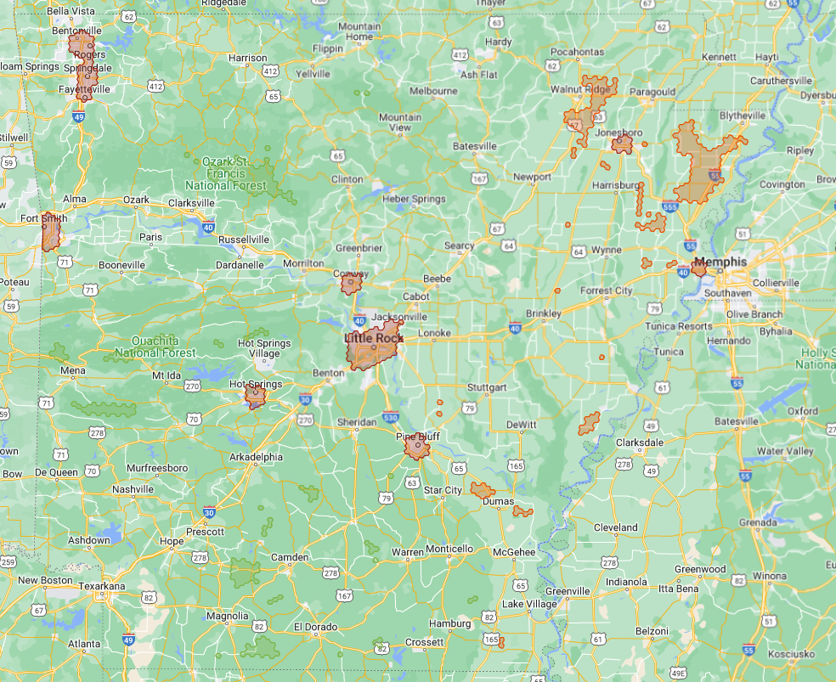
Arkansas
A total of 15 sites were samples across the State of Arkansas
Sites were selected from Developed, Agriculture & Natural hotspots
  5 Developed
  5 Agriculture
  5 Natural
3 treatment groups were collected, prepared, sequenced & analyzed:
  Culture Independent (CI)
  General Enrichment (2x BPW)
  Salmonella selective enrichment (RV/TT)

Slide 16
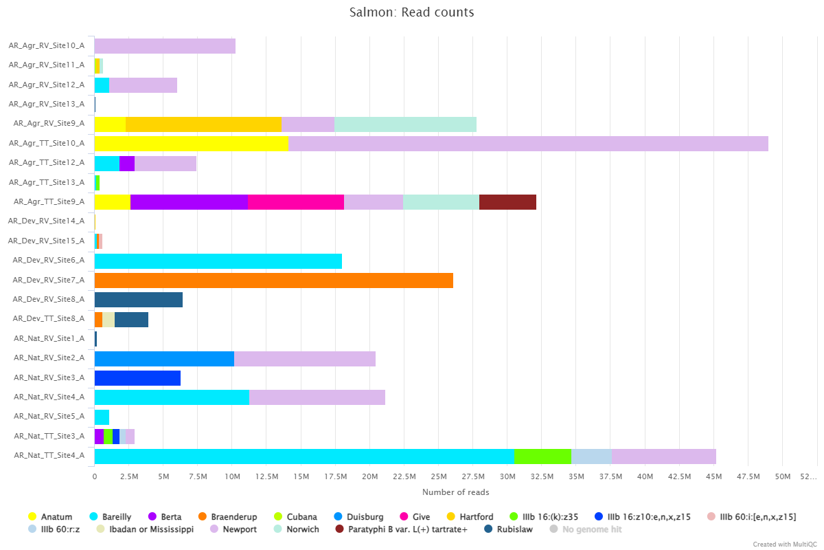
Salmonella serovars (Bettercallsal)
Culture Positive
Culture positive Salmonella found in the following sites:

Slide 17
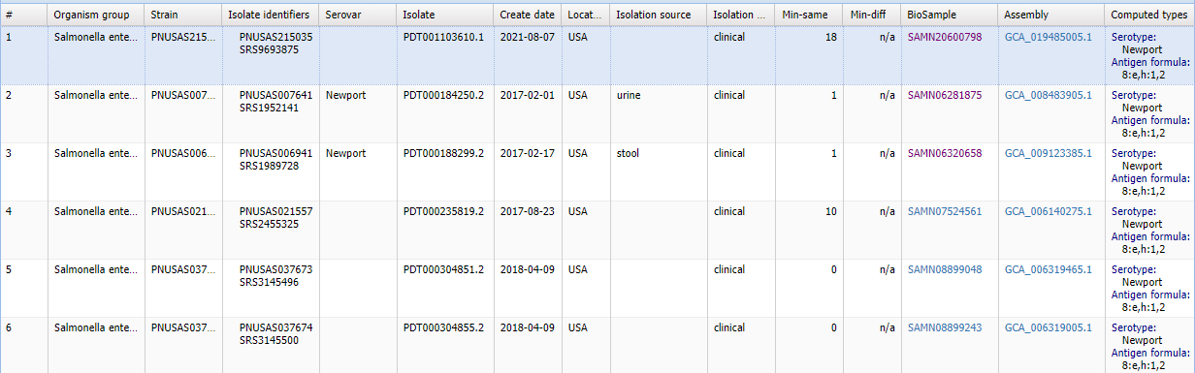
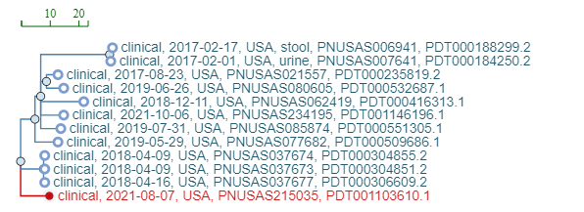
Agr RV Site10- Arkansas

Slide 18
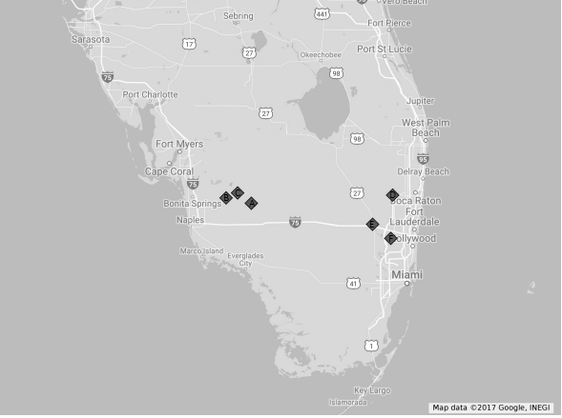
CFSAN- Florida sampling- Culture Independent
6 Sites- South Florida
Dr. Rebecca Bell and Dr Eric Brown
Samples collected- Aug 2015 to July 2016
Site | Type
A | Canal Near Agriculture
B | Canal Near Agriculture
C | Natural Swamp
D | Natural Swamp
E | Man Made Canal
F | Man Made Canal

Slide 19
Correlation of relative abundance of Salmonella to water temperature

Slide 20
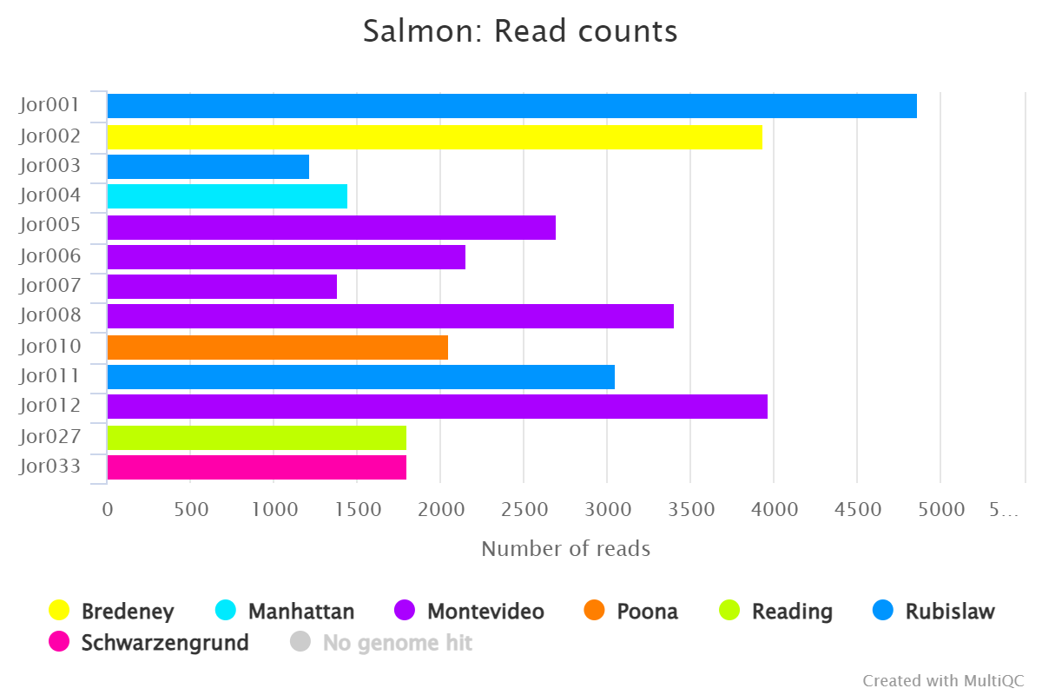
Culture independent samples- 1% genome coverage

Slide 21
Conclusions and next steps
Bettercallsal helps in detection of multi serovars of Salmonella in metagenomics dataset. Could be used in WGS when serotype information is not available.
Many check points to avoid false positives. CFSAN longitudinal study on environmental samples, we observed close to ~20% samples are dual serovars,~10% are 3 serovars
Easy to access/navigate report with Sequence typing and computed serotype information
Next steps
mashtree + iTOL for the main workflow and then gunc + checkm2 check for the db creation
Expand the workflow for other organisms. We are already working on Cronology for Cronobacter.
Use bettercallsal for WGS data and make some custom changes.

Slide 22
Acknowledgements
CFSAN
Kranti Konganti
Chris Grim
Amanda Windsor
Mark Mammel
Elizabeth Reed
Rebecca Bell
Sandra Tallent
Eric Brown
CVM
Brandon Kocurek
Andrea Ottesen
GenomeTrakr labs and NCBI PD

