Slide 1
Welcome and Overview of the Human Foods Program
Steven M. Musser, Ph.D.
Associate Commissioner for Human Foods Research
Human Foods Program
GenomeTrakr Annual Meeting, October 16, 2024

Slide 2
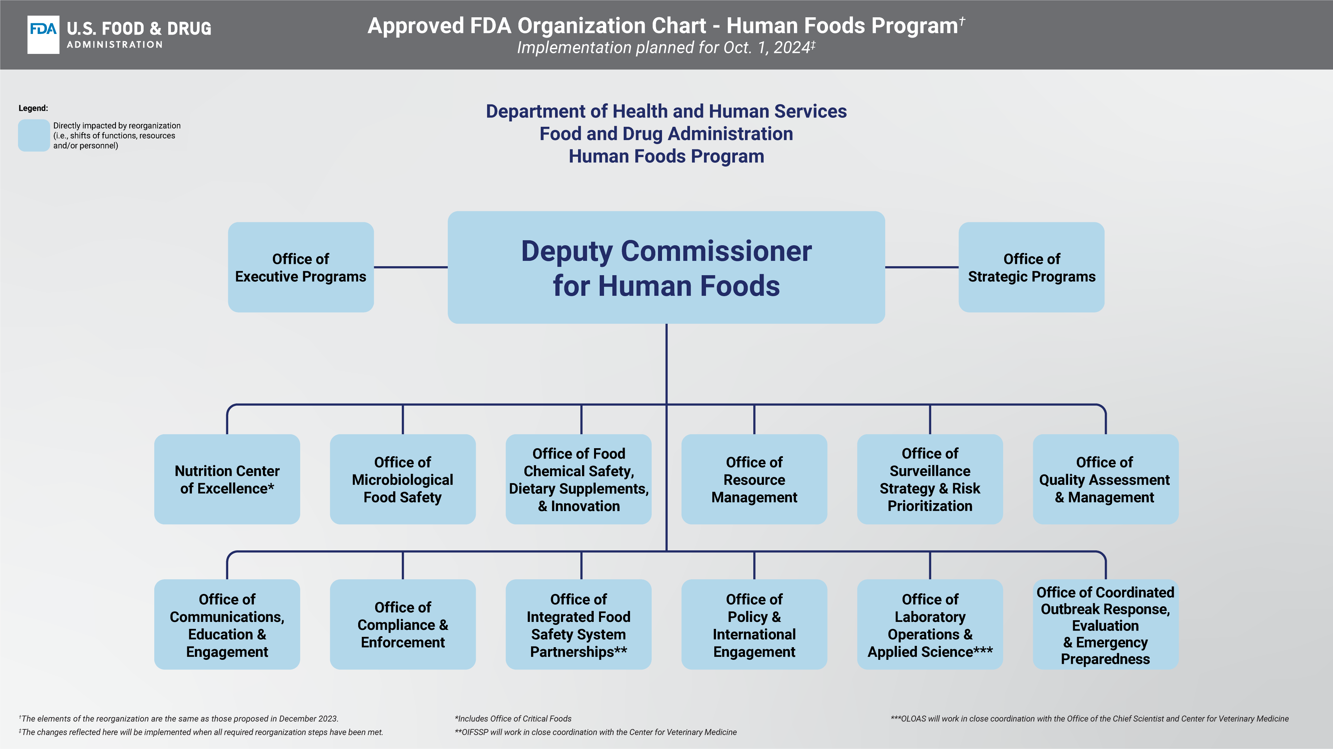

Slide 3
Unified HFP Functional Model
Risk management functions
managing public health risks through 3 areas of focus:
nutrition; microbiological food safety; and chemical safety
Strategic management functions
leveraging data to better prioritize activities and resources based on risk
surveillance strategy; risk-informed decision framework; and resource management for HFP and related field activities
Cross-cutting functions
the “tools” supporting risk management priorities
integrated food safety system partnerships; laboratory operations and applied science; compliance and enforcement; policy; and communications and engagement

Slide 4
Office of Laboratory Operations and Applied Science
Office of Regulatory
Testing & Surveillance
Office of Applied
Microbiology & Technology
Office of Chemistry
& Toxicology
Division of Analytical Chemistry
Division of Scientific Program Coordination
Arkansas HAFL
Atlanta HAFL
Division of Food and Environmental Microbiology
Office of Scientific Coordination
& Computational Sciences
Division of Food Processing Science & Technology
Division of Seafood Science & Technologies
Division of Food Safety Genomics
Denver HAFL
Irvine HAFL
Kansas City HAFL
New York HAFL
San Francisco HAFL
Seattle HAFL
Division of Bioanalytical Chemistry
Division of Toxicology
Senior Science Advisor Staff
Research Coordination Staff
GenomeTrakr
Computational Science Staff

Slide 5

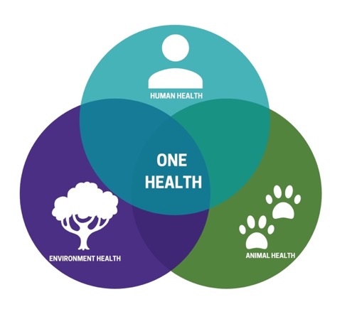
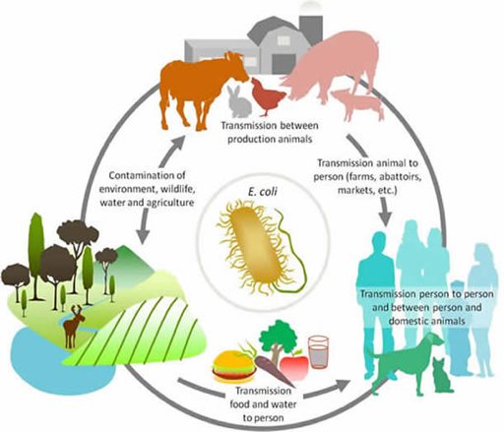


One Health Framework:
One Health Approach
Pathogen Surveillance: need to sample the full lifecycle of these pathogens (humans, animals, environment, water, air, food processing plants, food products)
Openly sharing data enables us to transverse the
One Health sphere.

Slide 6
U.S. Food and Drug Administration, Human Foods Program logo

