Slide 1


Blind Melons: How Whole Genome Sequencing opened our eyes to Salmonella in SW Indiana
Erin Jenkins
GenomeTrakr,
October 2023

Slide 2
Re-occurring, Emerging, & Persisting
Strains
Strains are escalated to a REP strain when:
Repeated outbreaks
Concerning resistance patterns
Presence of non-clinical isolates
Continued close genetic relatedness over time
Definition:
Group of bacteria, closely related by whole genome sequencing, that continue to cause illness over time

Slide 3
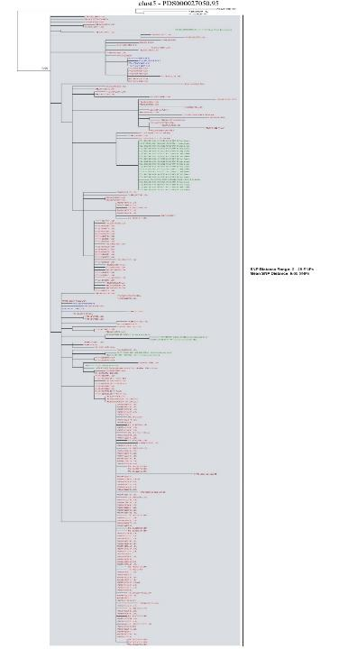
Salmonella Typhimurium
-REP code REPJPX03
-NCBI Cluster PDS 000027050
-over 232 isolates in tree, 204 clinical, 28 environmental/product
-env & product isolates all have IN connection
-tree 0-28 SNPs
Turkey FSIS 2022
2022 Environmental Samples –Grower W
2023 Environmental Sample –Grower W
Turkey Isolates (2016)
2013 Surveillance Sample
-IN Grower W -earliest sample in tree
2020 Environmental Sample –Farm F
2022 Outbreak

Slide 4

People infected with Salmonella strains related by WGS to FDA environmental isolates, by date of isolation, 2016—2020 (n=114)
Number of Isolates
Isolation Month and Year

Slide 5
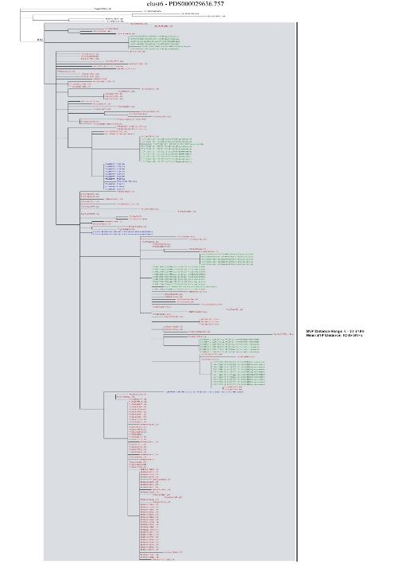
Salmonella Newport
-NCBI Cluster PDS 000029636
-REP Code REPJJP04
-over 3158 isolates, 3040 clinical, 108 environmental/product
-appears to be more widespread geographically
-diagram represents part of tree
-tree 0-28 SNPs
2016 Samples from Poultry Facility in MO
2023 Environmental Samples –Grower W
2023 Outbreak
2022 Environmental sample – Grower X
2022 Environmental Samples -Packing House A
2022 Environmental Samples –Grower V
2020 Outbreak
2023 Public Land

Slide 6

A closer look at the outbreaks
2020 Newport
2022 Typhimurium
2023 Newport

Slide 7





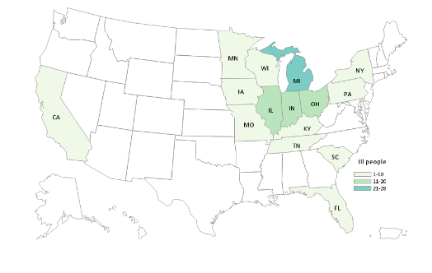


2020 Salmonella Newport Outbreak
Melon
90%
Hospitalizations
22%
80
cases
Onset Date Range
66%
15 states
Jul 7, 2020 - Oct 19, 2020
WGS Results
All isolates related 0-12 alleles
Range
4 - 96
AGE
Median
58
Notes:
In total, there were 80 cases of Salmonella Newport from 15 states. 22% of patients were hospitalized and there were no reported deaths. Illness onset dates ranged from July 7, 2020 to October 19, 2020. 66% of people were female, and ages ranged from 4-96 years with a median of 58 years. All clinical isolates were related within 0-12 alleles by whole genome sequencing. There is a map of where ill people lived. Most of the ill people lived in the upper Midwest; Michigan had 28 cases, the most of any other state.
26/29 (90%) ill people report eating any melon
17/29 (60%) ill people reported eating watermelon
60% vs. 49% (p-value<.197)
19/29 (65%) ill people reported eating cantaloupe
65% vs. 29% (p-value<.001)
7 reported only watermelon
9 reported only cantaloupe
10 reported eating both cantaloupe and watermelon

Slide 8
Cantaloupe Traceback
S. Newport 2020
Retail POS A1 (MI)
Onset: 8/28
Purchase: 8/20
Retail POS A2 (MI)- 3 cases
Onset: 8/31*; Purchases: 8/20, 8/27
Onset: 8/29*; Purchase: 8/21
Onset: 8/31*; Purchase: 8/21
Farm A (IN)
Retail Store A DC
Packing House A (IN)
Via Broker A
Farm B (IN)
Retail POS A3 ( MI)
Onset: 8/30*
Purchase: 8/21
Farm C (IN)
Retail POS A4 (MI)
Onset: 8/26*
Purchase: 8/22
Packing House B (GA)
Via Broker A
Farm D (GA)
Retail POS B1 I(N)
Onset: 7/23*
Purchase: 7/11
Retail Store B DC 1
Farm E (GA)
Retail POS B2 (OH)
Onset: 8/28
Purchases: 8/19, 8/20, 8/25
Retail Store B DC 2
Field 1 (IN)
Retail POS B3 (IN)
Onset: 8/27
Purchase: 8/23
Field 2 (IN)
Packing House C/ Farm F (IN)
Field 3 (IN)
Retail POS B4 (IN)
Onset: 9/6 *
Purchase: 8/24
Retail Store B DC 3
Field 4 (IN)
Field 5 (IN)
Retail POS C (IL)
Onset: 8/31 *
In-Store Cut, Purchase: 8/27
Retail Store C DC
* = watermelon purchase
Red Box = convergence
Field 6 (IN)

Slide 9
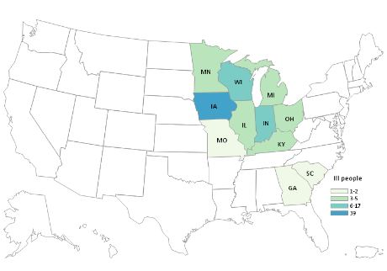
2022 Salmonella Typhimurium Outbreak
Melon
89%
Hospitalizations
44%
87
cases
Onset Date Range
67%
11 states
Jul 7, 2022 - Sept 11, 2022
WGS Results
All isolates related 0-10 alleles
Range
<1 - 93
AGE
Median
65
Notes:
In total, there were 88 cases of Salmonella Typhimurium from 11 states. 44% of patients were hospitalized and there were no reported deaths. Illness onset dates ranged from July 7, 2022 to September 11, 2022. 67% of people were female and patients ranged in age from <1-93 years with a median of 65 years. All clinical isolates were related within 0-10 alleles differences by whole genome sequencing with most related within 0-2 alleles. The outbreak was primarily focused in the upper Midwest, Iowa reported the highest case count at 39 illnesses.
42/47 (89%) people reported eating any melon
36/47 (77%) ate cantaloupe
23/47 (49%) ate watermelon
6 people reported eating only watermelon
19 people reported eating only cantaloupe
17 people reported eating both cantaloupe and watermelon
Cantaloupe was reported more frequently than expected
77% vs. 29% (p-value <.001)
Watermelon was not reported more frequently than expected
49% vs. 49% (p-value<.56)

Slide 10
Cantaloupe Traceback
S. Typhimurium 2022
POS A- Farm Stand (IA)
Onset: 7/24/22
Distributor J (IA)
Broker O (MO)
Grower S (MO)
POS B-1 - Farm Stand (IA)
Onset: 7/19/22 *
POS B-2 - Farm Stand (IA)
Onset: 7/17/22 *
POS B-3 - Farm Stand (IA)
Onset: 7/26/22
Supplier K (IA)
Grower T (IA)
POS C- Farm Stand (IA)
Onset: 7/24/22 *
POS D -Farmers Market (IA)
Onset 7/13/22
Distributor P (KY)
POS E-1 - Farm Stand (IA)
Onset: 7/19/22
Distributor L (IA)
Grower U (KY)
POS E-2 - Farm Stand (IA)
Onset: 8/3/22
POS F - Farm Stand (IN)
Onset: 7/22/22
Grower V (IN)
POS G -Farm Stand
(2 cases) *
Onsets: 7/21/22 & 7/23/22
Broker A (IN)
Packing House A (IN)
Grower W (IN)
Grower X (IN)
POS H -1 - Store (IA)
Onset: 6/25/22 *
Distributor M (IA)
POS H-2 - Store (IA)
Onset: 7/17/22 *
Supplier Y (AZ)
POS I - Store (IA)
Onset: 7/17/22 *
Distributor N (KS)
LEGEND
POS: Point of Sale
Traceback verified through records
Complete records not received

Slide 11
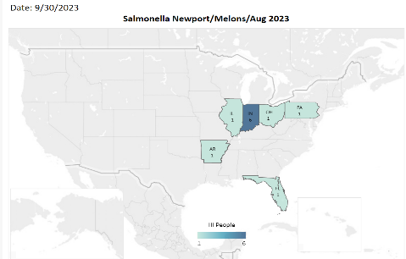
2023 Salmonella Newport Outbreak
Melon
71%
Hospitalizations
63%
11
cases
Onset Date Range
64%
6 states
Jul 9, 2023 - August 31, 2023
WGS Results
All isolates related 0-7 alleles
Range
1 - 86
AGE
Median
69

Slide 12
Cantaloupe Traceback
S. Newport 2023
POS A (IN) 2 cases
Onset 7/17 & 8/4/23
Distributor A
GA
Grower B
GA
Packing House A
IN
Grower W
IN
POS B (IN) 1 case
Onset 7/16/23
Distributor B
IN
Grower C
IN
Grower D
AZ
Grower E
AZ
POS C (IN) 1 case
Onset 7/9/23
Distributor C
IL
Distributor D
AZ
Grower F
AZ
Grower G
AZ

Slide 13
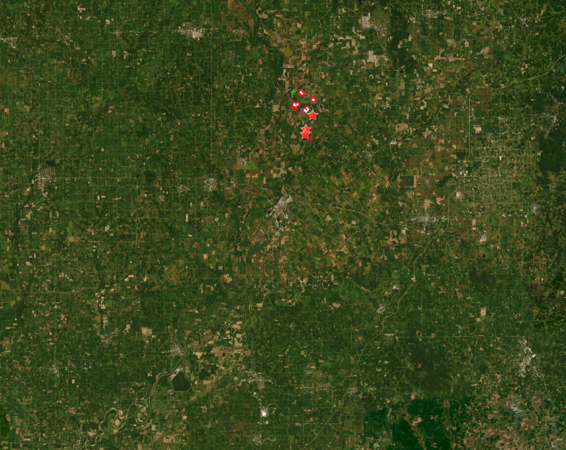
Relative Outbreak Locations:
2012 - 2020 – 2022-2023
2022 & 2023
2020
2012
6 Miles

Slide 14
Indiana Melon Outbreaks Overview
 | 2012 Typhimurium & Newport | 2020 Newport | 2022 Typhimurium | 2023 Newport
Positive Samples | Multiple matches to outbreak strains (PFGE) | No match to outbreak but recovered Typh. REP | Match outbreak strain (Typh.) & Newport REP Public Land Samples | Multiple matches to outbreak strain (Newport)& Typh. REP Public Land Samples
Firm Actions | Recall | None | None | None
FDA Actions/ CDC Actions | Warning Letter Environmental Assessment | Enhanced surveillance | OIR REP strain designation | Pending
Contamination | Likely originated at field level | Likely source farm & packing environment | Unable to verify harvesting practices | Likely originated at field level

Slide 15
Why is this happening?
Weather?
Nearby Operations?
Wildlife?
Harvesting?
Soil?
Soil Amendments?
Combination?
Previous land use?

Slide 16

Next Steps

Slide 17
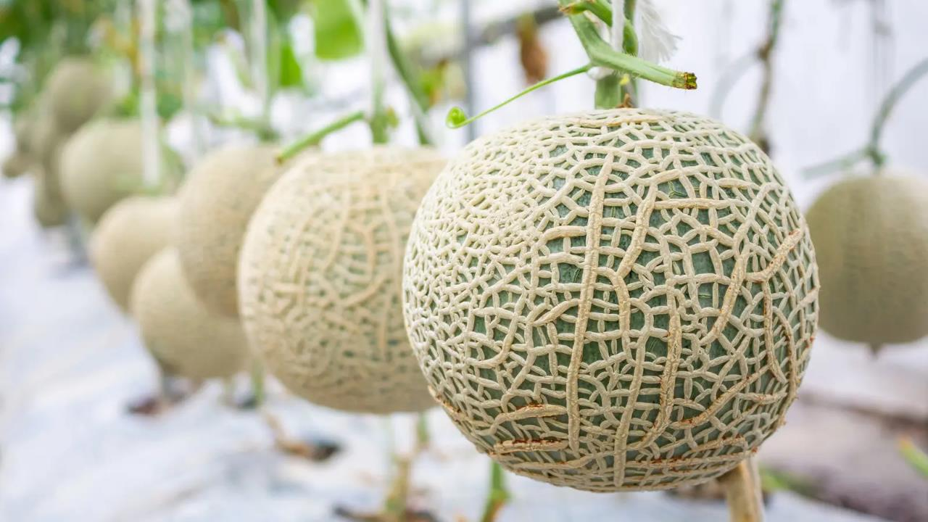
Research
Longitudinal Study
Controlled Environment Study
FDA initiated conversations with Indiana Department of Health and Purdue University to conduct longitudinal study in southwest IN melon growing region
Goals
  Better understanding of the prevalence, persistence, diversity, and seasonality of Salmonella within this region.
  Examine routes of pathogen movement from suspected sources of contamination to the melon growing field, including water, air, and wildlife.
  Work with stakeholders in region to identify best practices for prevention of contamination.
FDA examining contributions of bioaerosols/fugitive dust to contamination of cantaloupes using controlled environment (i.e. BSL-3 level greenhouse) studies.

Slide 18
Collaborative approach
Long-term research:
Review historic information
Route of the contamination
Longitudinal studies
Possible preventative measures
Actions for this growing season:
Surveillance sampling
Provide technical assistance to growers in identifying gaps
Conduct follow-up inspections
Consumer education
Notes:
Understanding that there are long history in melon outbreak in SW IN
Historic information: growing locations, growing practices, WGS results (how they are related)
Route of the contamination: Seed, Water, Soil, packing practices, Turkey farms around the growing site etc
Longitude studies: Environmental studies
Possible preventative measures:
Surveillance sampling under LFFM (on-farm and retail)
Technical assistance (Walk the field with the growers, what to do if there is a flood, review SOPs)
Conduct follow-up inspection (prior harvesting and mid-harvesting to check equipment standard)

Slide 19
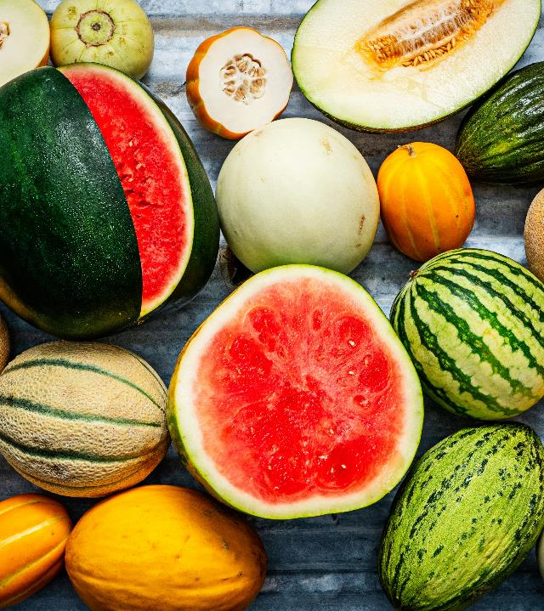
Enhanced Surveillance & Focused Questionnaire
Two REP (reoccurring) strains associated with Indiana melons
  Salmonella Newport REPJJP04 and Salmonella Typhimurium REPJPX03
States deploy focused questionnaire when case matches in these REP strains
Ask questions about purchase and exposure information for:
  Cantaloupe
  Honey rock melon
  Athena melon
  Other melon

Slide 20
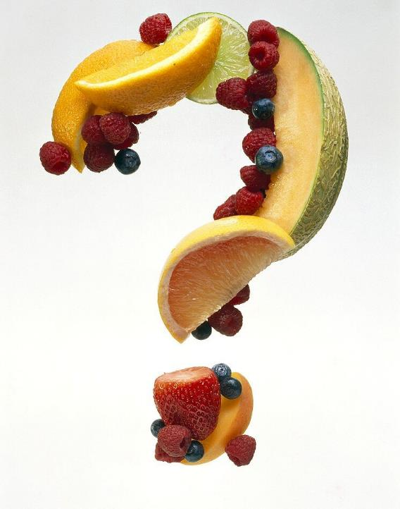
Questions?
Thank you to:
Tyann Blessington, Tracy Hawkins, Natalie Cataldo

