Slide 1

GenomeTrakr Program updates
Ruth Timme, PhD
Acting Staff Director
GenomeTrakr & Computational Science Staff

Slide 2
GenomeTrakr &
Computational Science Staff
FDA Human Foods Program
Office of laboratory Operations and Applied Science (OLOAS)
Office of Science Coordination and Computational Science
GenomeTrakr & Computational Science Staff (GTCSS)
Office of Applied Microbiology and Technology (OAMT)
Office of Regulatory Testing and Surveillance (ORTS)
Office of Surveillance and Risk Prioritization (OSSRP)
Office of Policy and International Engagement (OPIE)

Slide 3
FY24 FDA / GenomeTrakr activities
Project | Lead | Completed?
Publication: GenomeTrakr Springer Methods and Protocols chapter update (Timme et. al., 2024) | Ruth Timme + GenomeTrakr team | YES
Publication: SARS-CoV-2 Wastewater manuscript published (Timme et. al., 2024) | FDA + GenomeTrakr labs | YES
Publication: Pathogen Data Object Model | Ruth Timme, PHA4GE, INSDC | YES
Evaluation: ClearLabs Clear Dx for use by GT laboratories | Hope Bias + Ruth Timme | YES
New Protocol: PN2.0 / GenomeTrakr integration | Maria Balkey + GenomeTrakr team | 90%
METADATA: OHE package implementation | Ruth Timme + GT Team + ORA | 90%
METADATA: processing ~600K records from the 2023 MCC | Ruth Timme + GenFS metadata wg | 95%
Verification: ½ chemistry for Illumina-based WGS workflow | Julie Haendiges + Katheryn Judy | 95%
Evaluation / Validation: ONT for routine surveillance | Narjol Gonzolas / Maria Hoffmann | Active project
Capacity building: LFFM ONT development track | Narjol Gonzolas / PM Tina Pfefer | Active project
Evaluation: performance of current genomic bacterial taxonomy tools | Dennis Huang + Ruth Timme | 90%
Development/Validation: CSP2 (CFSAN SNP Pipeline) | Bob Literman + Jamie Pettengill | 90%
Laboratory capacity building: India, Indonesia | Julie Haendiges, Padmini Ramachandran, OPIE | 50%
International consortia: PHA4GE, GMI, + GSC meetings | Ruth Timme, Marc Allard, Eric Stevens, Errol Strain

Slide 4
Focus in the coming year:
Project | Lead | Expected
Development: Web-based NGS Training Platform | C. Hope Bias | Fall 2024
Publication: Enteric pathogen surveillance dashboards | Maria Balkey | FY25
METADATA: COMS for impact of 2023/2024 metadata updates | Tina Pfefer + GT staff | FY25
Program building for the GenomeTrakr & Computational Science Staff | Ruth Timme | Ongoing
Onboarding new labs: 2025 LFFM WGS-track labs | Kirsten Hirneisen + GT Staff | FY25

Slide 5

GenomeTrakr at the FDA:
OCSSC + GenomeTrakr:
Ruth Timme
Marc Allard
Maria Balkey
Tina Pfefer
David Lipman
C. Hope Bias
Paul Morin
Errol Strain
Tim Harvey
Tony Senh
OAMT
Sandra Tallent
Eric Brown
Julie Haendiges
Padmini Ramachandran
Maria Hoffmann
Narjol Gonzalez-Escalona
Leadership:
Steven Musser
ORTS / LFFM:
Kirsten Hirneisen
Evelyn Ladines
Julia Manetas
Karen Jinneman
Regulatory Analysis
James Pettengill
Jayanthi Gangiredla
Arthur Pightling
Bob Litterman
Justin Payne
Yan Luo
Yu Cao
Contact:
GenomeTrakr@fda.hhs.gov

Slide 6

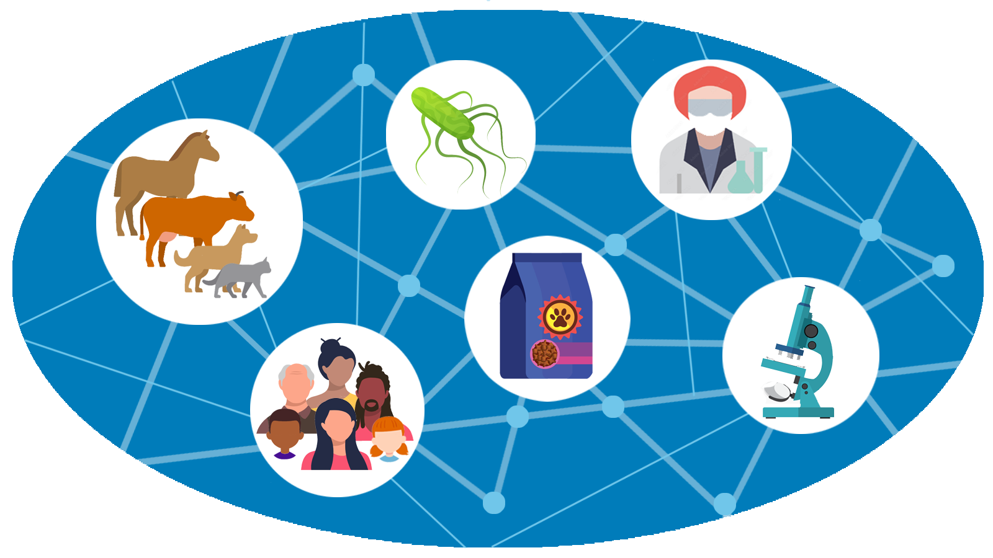
Vet-LIRN updates
Olgica Ceric, DVM, MS, PhD
US FDA/Center for Veterinary Medicine

Slide 7
WGS Testing (2017-2024)
Bacterial pathogen | AST Total | WGS Total
Salmonella enterica | 5,826 | 2,961
E.coli | 8,095 | 2,825
S. pseudintermedius | 8,058 | 2,343
AQUA | n/a | 466
E. cloacae complex | 821 | 416
K. pneumoniae | 790 | 210
Campylobacter | 116 | 80
E. faecalis/faecium | 2,411 | 150*
P. aeruginosa | 2,227 | 150*
Total | >25,000 | >9,000
WGS:
Outbreak detection
Outbreak response
Source identification
Enhance routine surveillance/monitoring including detection of emerging AMR
*sequencing in progress; AST= antimicrobial susceptibility testing

Slide 8
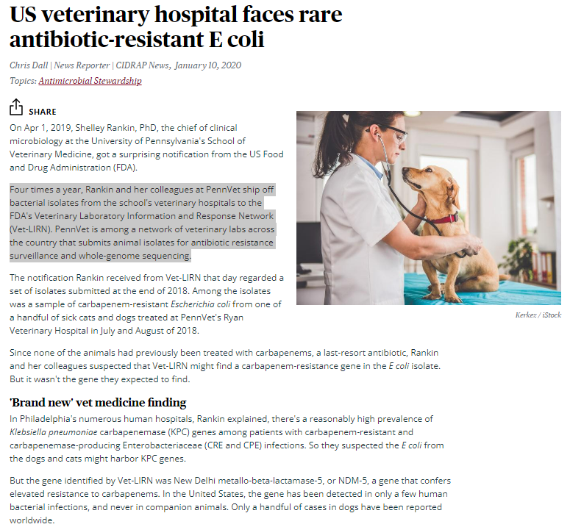
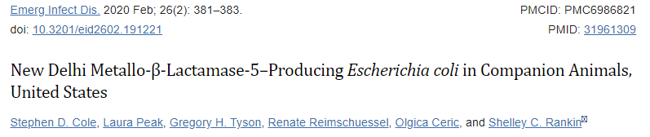
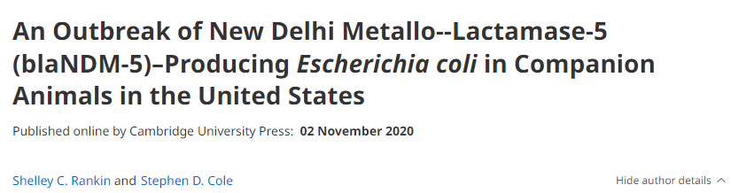

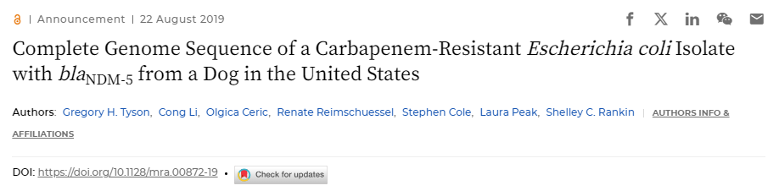
An Outbreak of bla_{NDM-5} producing E. coli in Companion Animals in the United States

Slide 9


Publications
Bacterial pathogen | Manuscripts
E.coli | Cornell (Kristina Ceres et al): Evolutionary genomic analyses of canine E. coli infections identify a relic capsular locus associated with resistance to multiple classes of antimicrobials
Aquatic isolates | Washington Animal Disease Diagnostic Lab (Chrissy D. Eckstrand et al): Genomic characterization of antimicrobial resistance in 61 aquatic bacterial isolates
K. pneumoniae | CVM, submitted (Gordon Martin et al): Genomic Snapshot of Klebsiella spp. Isolates from Clinically Ill Animals Reveal Diverse Lineages with Limited Relatedness to Human Isolates
S. pseudintermedius | Cornell, in draft (Jordan D. Zehr): Population and pan-genomic analyses of Staphylococcus pseudintermedius identifies geographic distinctions in accessory gene content and novel loci associated with AMR

Slide 10

Publications
Bacterial pathogen | Manuscripts (planned)
Salmonella enterica | Cornell
E. faecalis/faecium and P. aeruginosa | Michigan State University
E. cloacae complex | Kansas State University

Slide 11
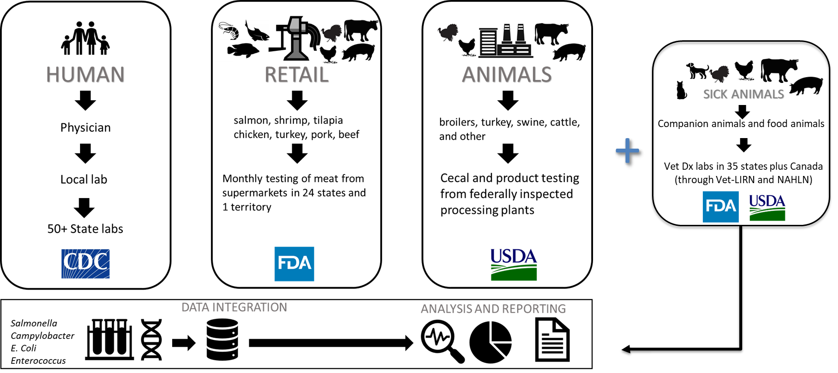
National Antimicrobial Resistance Monitoring System (NARMS) Mission
To provide scientifically reliable data to help reduce the human, animal and environmental health burden caused by antimicrobial-resistant bacteria
Notes:
From the website:
NARMS is a collaborative One Health program of state and local public health departments and universities, the Centers for Disease Control and Prevention, the FDA, and the U.S. Department of Agriculture. This national public health surveillance system tracks changes in the antimicrobial susceptibility of enteric bacteria found in ill people (CDC), retail meats (FDA), and food animals (USDA) in the US, and has been in existence since 1996.
All data are integrated and reported on a routine basis. The NARMS program helps promote and protect public health by providing information about emerging bacterial resistance, how resistant infections differ from susceptible infections, and the impact of interventions designed to limit the spread of resistance. NARMS data are used by FDA to make regulatory decisions designed to preserve the effectiveness of antibiotics for humans and animals.
Through collaborations with FDA's VetLIRN and USDA's National Animal Health Laboratory Network, NARMS has also begun to examine susceptibility data from bacteria found in sick animals.

Slide 12
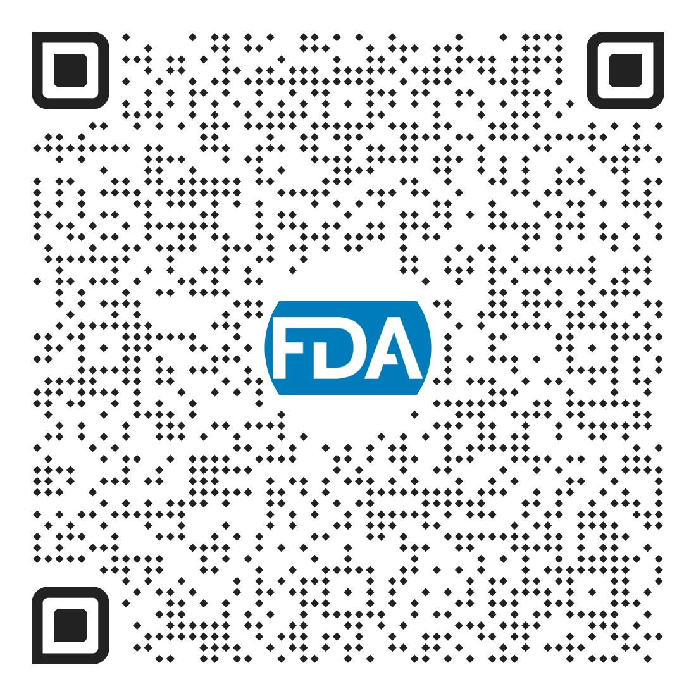
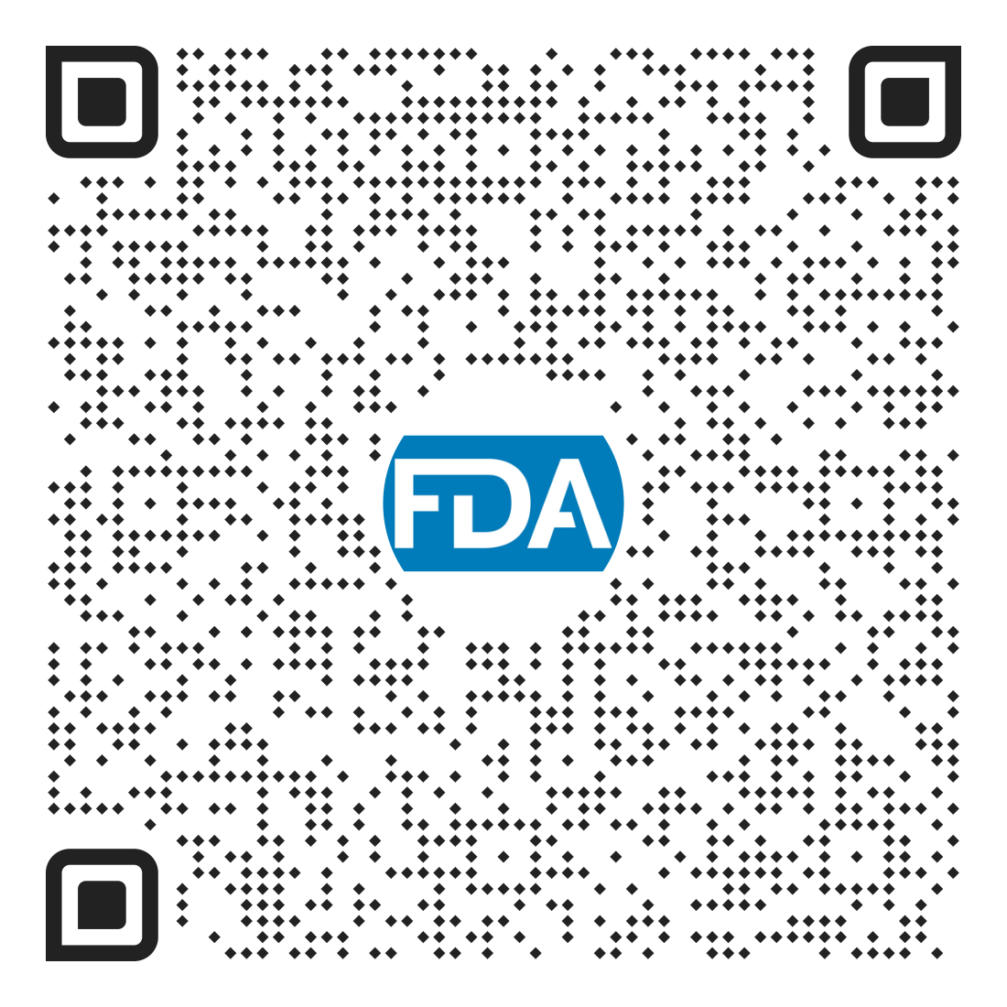
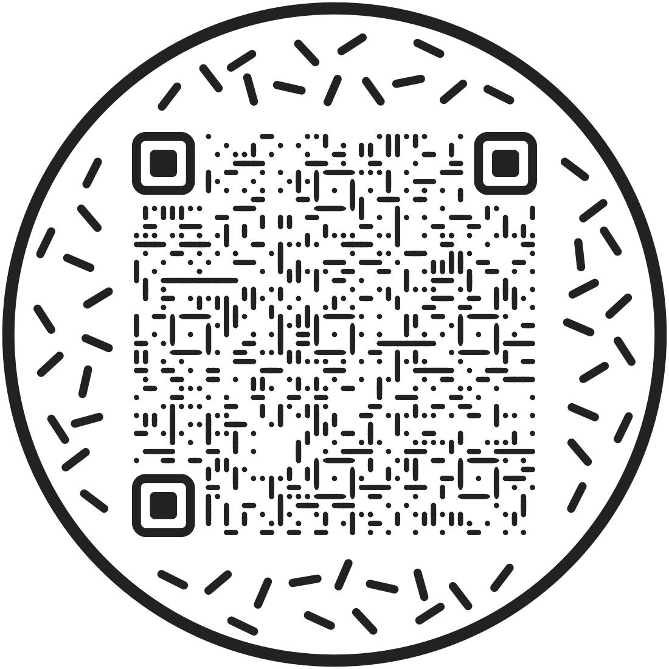
Trends in AMR
Surface Water Pilot Study
NARMS Now
In 2022, NARMS and EPA initiated a pilot study to explore monitoring of AMR in environmental surface waters, including extensive national sampling of rivers and streams and intensive watershed scale sampling
Sample collection concluded in September 2024
In May 2024, NARMS and EPA collaborators published an article describing the development of the national freshwater pilot
Paired with NARMS data, this effort will allow us to examine interconnections between humans, animals, and the environment at local, regional, and national scales
NARMS uses interactive dashboards to report, monitor and analyze AMR trends derived from whole genome sequencing data
  2024 Genome Trakr Sequences submitted as of 10/04/24
    Salmonella-145
    E. coli-379
    Campylobacter- 45
In FY24, NARMS published an interim update, alerting the public to an increase in multidrug-resistant strains of Salmonella I 4,[5],12:i:- with azithromycin resistance genes
Interim Update
A one health approach for monitoring antimicrobial resistance: developing a national freshwater pilot effort
One Health Study- Lamb and Sheep Pilot
NARMS (FDA and USDA FSIS) commenced a One Health study concurrently with the USDA APHIS National Animal Heath Monitoring System’s Sheep 2024 survey
The aim of the study is to enhance our understanding of AMR in enteric bacteria isolated from sheep and lamb at production, at slaughter, and in retail product
FDA is utilizing the Laboratory Flexible Funding Model to generate retail data for this study
Notes:
Mention that NARMS is working with GT to sequence the Salmonella, ESBL E coli, VRE isolates from the water pilot

Slide 13
CDC PulseNet Updates
Peyton Smith and Kelley Hise
Enteric Diseases Laboratory Branch, CDC
GenomeTrakr Meeting
October 2024

Slide 14
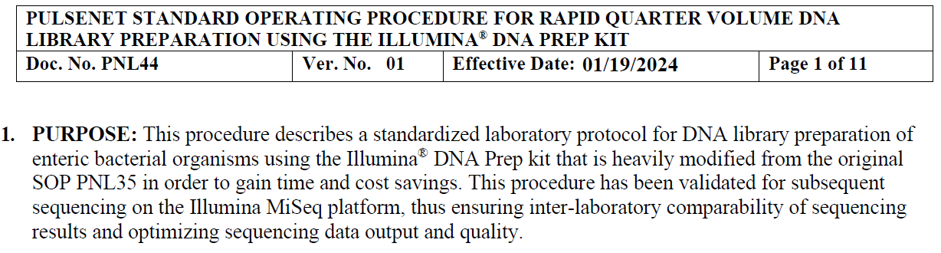
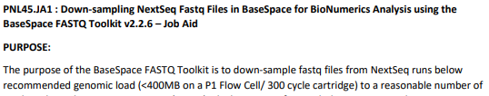
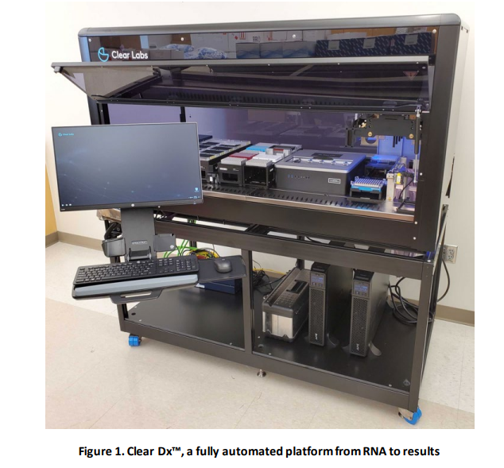
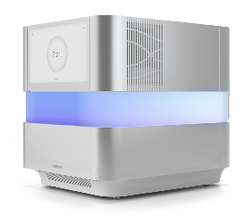
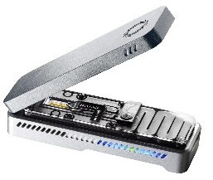


CDC PulseNet Laboratory Updates
Completed since last year
  PNL44 PulseNet Rapid Quarter Volume Library Prep
  PNL45.JA1 BaseSpace FASTQ Toolkit for Downsampling
In progress
  ClearLabs fully automated system
  C. botulinum certification
  NextSeq 1000/2000 & XLEAP chemistry (P1 flowcell)
  Oxford Nanopore Technologies
Exploring
  MiSeq i100 series
  Mixed sequencing run guidance for PulseNet + fungal pathogens

Slide 15

Agenda Template
Throughout
  Program tables: PulseNet
  Breaks for networking and program tables
Day 1
  Combined sessions in AM
  Roundtables, Demos in PM
    12 topics, ~4 per discipline
Day 2
  Discipline-Specific Sessions 8-10
  Combined session 10:30-12
  Optional Training 1:30-5
    PulseNet 2.0
    SEDRIC
3 InFORM Regional Meetings:
East – Southeast, Mid-Atlantic, Northeast
Fort Lauderdale, FL: January 28 - 29, 2025
Central – Central, Midwest
St. Louis, MO: February 11 - 12, 2025
West – West, Mountain
San Francisco, CA: February 19 - 20, 2025
Save the date will be sent out in October
Registration in early November (link to block of rooms)
https://www.neha.org/inform

Slide 16

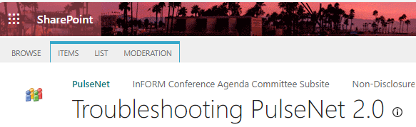

PulseNet 2.0 Communications
Bi-weekly Quick Tips
Covering the latest developments, reminders
PulseNet SharePoint Discussion Forum
  Post issues and get answers
  Get responses from other participants
Weekly office hours
  Troubleshooting
Monthly 50-state calls
  Major updates, tips
Issues/questions: email PulseNet@cdc.gov

Slide 17
PulseNet 2.0 Updates
Resolved Issues | Active Development | New Development
Updated allele codes/auto assignment | Improving sortability of Serotype_WGS in national database view | Allowing lab specific fields to be editable after publishing to the national database
Corrected Biosample submission metadata to NCBI | Improving the ability to manage large comparisons | Hiding spam error messages (failed trace status)
Improved NCBI submission pipeline and returning accession numbers | Improving the speed and response time for queries and searches | Preserving comparison layout in export
Improved metadata alignment to dendrogram | Adding a system status banner on PulseNet 2.0 landing page | Improving error messaging for easier troubleshooting
Resolved several linking issues |  | Populating experiment data for failed sequences up to the point of fail
Resolved issues for Fast Profile Matching |  | Labeling allele differences more easily in larger dendrograms
Improved pipeline failures during peak times |  | Correcting isolate form so errors do not occur like Key value is not unique or invalid form
NCBI templates are now editable |  | Improving comparison data for national and local lab data so that all samples can be viewed
 |  | Correcting metadata edits—edits will occur even in a filtered view
 |  | Removing duplicate samples in comparisons if they are added twice
 |  | Improving the ability to search and select for multiple samples

Slide 18
PulseNet 2.0: Future Developments
Improvements
  Queries, speed, processing
Future developments
  New national databases: Cronobacter, Clostridium botulinum, Yersinia
  Tools: charts and statistics
  Improvements to cluster detection
Work with users and developers
  Testing and implementation

Slide 19

Telephone: 404-639-4558
E-mail: PulseNet@cdc.gov Web: www.cdc.gov/pulsenet

Slide 20
USDA FSIS Updates
William Shaw
Executive Associate for Laboratory Service
USDA FSIS Laboratory
Athens, GA

Slide 21
National Seafood Inspection Laboratory (NSIL)
NSIL Microbiology Team:
Dr. Jon Bell, Director
Patricia Rabideau, Lead Analyst
Shannara Lynn, Lead Microbiologist
Johnathan Likens, Microbiologist
Nicole Housley, Microbiologistgist
Currently have a manuscript in progress in collaboration with Julie Haendiges Ph.D. Johnathan Likens will be presenting their work through the NOAA Omics Seminar Series on Oct. 16th .
                “Transient and resident Salmonella: A genomic approach to analyzing over a decade of genetic diversity from fish meal production and storage facilities.”
    NSIL is one of many collaborating laboratories for a NOAA Restore grant submission lead by Antarpreet Jutla Ph.D. from the University of Florida.
    Project: Building Predictive Intelligence for Climate Sensitive Coastal Pathogens for Human Well-being in the Gulf of Mexico.
    NSIL has recently collected ~50 eDNA samples in collaboration with the NOAA Southeast Fisheries Science Center to perform 16s metabarcoding analysis on water samples from areas of interest in the Gulf of Mexico.
Notes:
Can you please thank Ruth Timme Ph.D. for her letter of support for the Antar project.

Slide 22
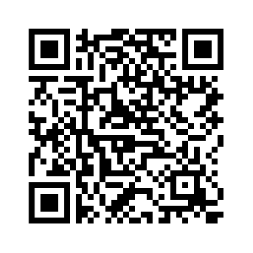
NOS/NCCOS Cooperative Oxford Laboratory
General Goals
Maintain a cross-line-office pathogens team to produce new models and products
Interagency working group participation for mutually beneficial research, most notably with FDA CFSAN
Current Projects
Ongoing pathogen forecasting model validation using water samples in Chesapeake and DE Bays, Vibrio spp. detection using qPCR
WGS and analysis of Vibrio spp. isolated from Alaskan oysters in 2018, 2022, and potentially 2026
NOAA RESTORE Grant proposal
Vibrio resubmergence project in MD waters at varying salinities
Pilot projects: fish eDNA detection, freshwater Vibrio spp. detection and sequencing, research on Vibrio spp. pathogenic to oysters, fecal coliform identification from floating cage oyster samples
Vibrio Forecasting Webpage
Core NCCOS Microbiology/pathogen forecasting team:
John Jacobs, Laboratory Director
Ava Ellett, Marine Biologist
Rose Adelizzi (CSS Inc.), Biological Research Assistant
A.K. Leight, Research Fishery Biologist
Varis Ransi, Physical Scientist
Robert Daniels (IMSG), Oceanographer NOAA/NWS/NCEP/Ocean Prediction Center
Christopher Schillaci, Research Marine Ecologist

Slide 23
Bill Klimke - FDA GenomeTrakr 2024 Update from NCBI

Slide 24
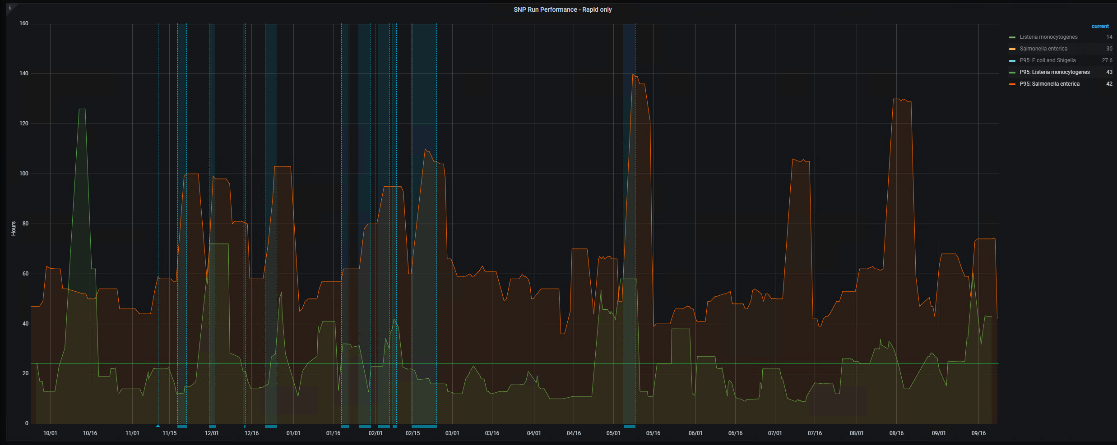
Efforts to improve turnaround time have been hampered for multiple reasons
A8 transition
Panfs transition
Multiple impacts in upstream resources

Slide 25
Potential upcoming improvements (from presentation last year)
PD turnaround
Improve data processing in SNP tree export steps
Change how files are compressed on FTP (need to inform consumers of data) - especially
older data (retained data)
Move further computational steps to the cloud
Other changes
Massive effort to update old BioSamples with OHE attributes - this will not be fast
will impact several groups at NCBI (BioSample, GenBank, Submission Portal, PD)
Engineering more robust system for addition and modification of existing organism groups
Addition of Salmonella virulence gene from GenFS working group
Modify assembly process for clean up large chromosomally assembled segments from Saute
More new organisms and organism group splits
Sequence Typing (?)
Many not done, and some not even started
In progress
Not done
In progress and
and under review
In progress
Improved
8 genes added
Not done
Not done

Slide 26
Biggest issue preventing significant improvement in Salmonella
Very large clusters are dominating
* similar problem in C. auris caused failure and stoppage
This problem is not getting solved
More radical solutions are needed
Cluster | Size | Clinical | Environmental | Serotype | Isolation_source
PDS000065758 | 34083 | 31414 | 1789 | Enteritidis | Chicken
PDS000193342 | 14652 | 4124 | 10198 | Infantis | Chicken
PDS000030237 | 13716 | 10870 | 2798 | Enteritidis | Chicken
PDS000199184 | 11783 | 9164 | 1882 | I 4,[5],12:i:- | Pork
PDS000083226 | 11200 | 9210 | 1957 | Enteritidis | Chicken

Slide 27
Possible solutions for Salmonella
change cluster threshold - decreasing sizes will only move the ball down the road
sample within largest clusters - not all comparisons are needed, but this will complicate some steps considerable
use a window of time for analysis - this heuristic is already used, but doesn't address the larger problem
Downstream impacts need to be discussed
NB: Rapid reports continues to operate and gives results usually within 60 min. after submission
and FDA released a way to access the data via GUI - https://doi.org/10.3389/fbinf.2024.1415078

Slide 28

NIAID is no longer funding Pathogen Detection!
Therefore, the future is uncertain

Slide 29
Acknowledgements
Richa Agarwala
Victor Ananiev
Azat Badretdin
Slava Brover
Joshua Cherry
Jinna Choi
Vyacheslav Chetvernin
Pavan Chilamakuri
Robert Cohen
DeAnne Cravaritis
Michael DiCuccio
Olga Ermoleava
Boris Fedorov
Mike Feldgarden
Lewis Geer
Renata Geer
Dan Haft
Lianyi Han
Avi Kimchi
Michel Kimelman
William Klimke
Alex Kotliarov
Valerii Lashmanov
Aleksandr Morgulis
Eyal Moses
Chris O'Sullivan
Arjun Prasad
Edward Rice
Kirill Rotmistrovskyy
Alejandro A. Schaffer
Nadya Serova
Sergey Shiryev
Martin Shumway
Oleg Shutov
Douglas Slotta
Alexandre Souvorov
Tatiana Tatusova
Francoise Thibaud-Nissen
Igor Tolstoy
Ed Wachtel
Lukas Wagner
Jay Worley
Hlavina Wratko
Chunlin Xiao
Alexander Zasypkin
Eugene Yaschenko
Mingzhang Yang
David Lipman
James Ostell
Kim Pruitt
Stephen Sherry
ASM
BWH
CDC
FDA/CFSAN
FDA/CVM
GenFS
USDA-FSIS
PHAC/CFIA
PHE/FERA
NIAID
Wadsworth/MDH
pd-help@ncbi.nlm.nih.gov
This work was supported in part by the National Center for Biotechnology Information of the National Library of Medicine (NLM), National Institutes of Health, as well in part by the National Institute of Allergy and Infectious Diseases,
National Institutes of Health

Slide 30
Q & A Panel with Federal Partners

