Slide 1
Multi-serotype Outbreaks: The More the Scarier
Kelley Hise, MPH
CDC
GenomeTrakr Meeting
October 2024

Slide 2
PulseNet Cluster Detection
Daily
  Respond to epi requests (e.g., FDA/USDA inquiries; requests from PHLs)
  Respond to PulseNet SharePoint posts of local clusters
Weekly
  Perform cluster searches within the past 60 days (120 for Listeria)
  Salmonella
    Data analysts are assigned most common serotypes
    One person checks all other “unassigned” serotypes
    Code clusters that meet criteria: 5-7+ human entries within 10 alleles, with 2+ within 5 alleles
    Make considerations for rare vs. common serotypes

Slide 3
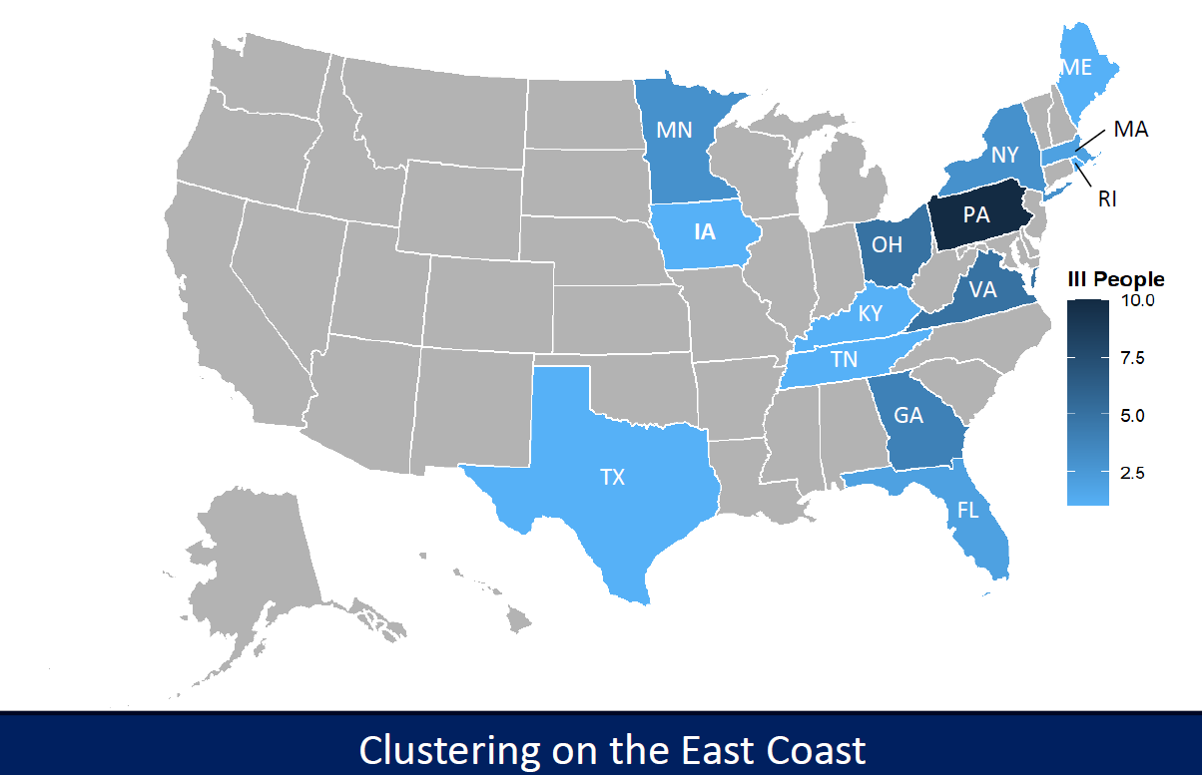
Salmonella Africana, 2404MLAFR-1
April 24, 2024
Identified during an “unassigned” serotype search
10 clinical isolates in 7 states, related within 0-1 alleles
No closely related clusters found in PulseNet national database or on NCBI
Posted to PulseNet SharePoint site and CDC epidemiologists started their investigation
May 3rd: 1st 50-state call; looking like produce
Within 2 weeks, grew to 59 cases in 18 states
Cases as of May 3, 2024

Slide 4
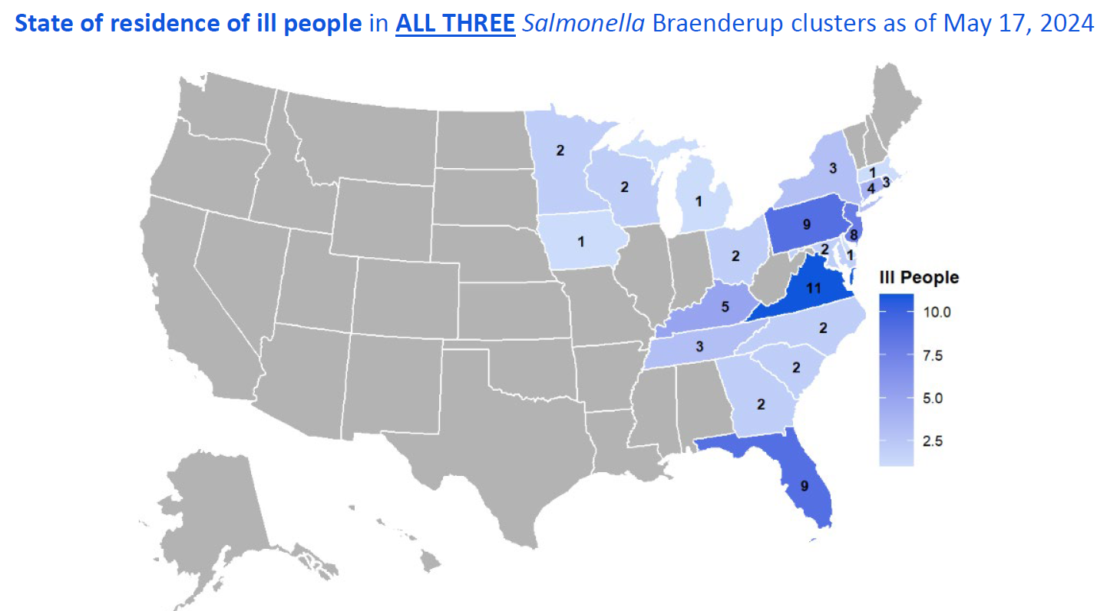
Salmonella Braenderup, 2405MLJBP-1, -2, -3
May 8, 2024
Identified cluster “-1” as a response to local VA cluster
“-2” was ID’d during regular cluster search
May 15, 2024
“-3” ID’d during regular cluster search
May 20, 2024
Combined into 1 cluster code: 2405MLJBP-1 due to geographic distribution, demographic similarities, and timeline
Started investigating all three Braenderup outbreaks as one polyclonal event
May 23, 2024
Added a 4th subcluster

Slide 5
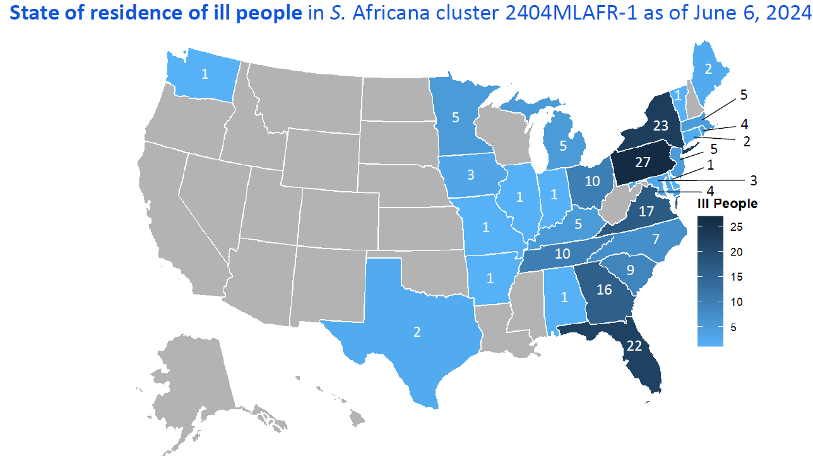
Salmonella Africana, 2404MLAFR-1
May 15: cucumbers leading hypothesis
By May 20: MN and FDA leading traceback investigations
May 23: NHGQs/open-ended interviews/focused questionnaires all pointing to cucumbers
May 31: product testing confirms positive for Salmonella; Fresh Start Produce of Delray, FL recalls whole cucumbers shipped to certain states
June 5: 1st CDC web posting
June 6: Salmonella Bareilly identified, genetically related to 2 historical clusters and a current FL resident

Slide 6
One Outbreak Code: 2404MLAFR-1
Braenderup
June 18: cucumbers above FoodNet pop survey estimates
Combining Investigations
Cucumber isolate from same farm in FL produced Salmonella Braenderup matching group 3 of 2405MLJBP-1
June 27: due to epidemiologic and sampling information collected, decision to loop both clusters into one investigation/outbreak code

Slide 7
PulseNet Outbreak Management
Line List Example
Track under one outbreak code
Keep track of different groups in WGST field (BN); for PulseNet 2.0, this will be in Code_details field
  Has worked well historically with backyard poultry outbreaks and other multi-serotype outbreaks
Salmonella positives with WGS outside the known cluster groups
  Add “INV” to code; 2404MLAFR-1INV
  87 food/environmental entries in PulseNet national database
  20+ serotypes

Slide 8
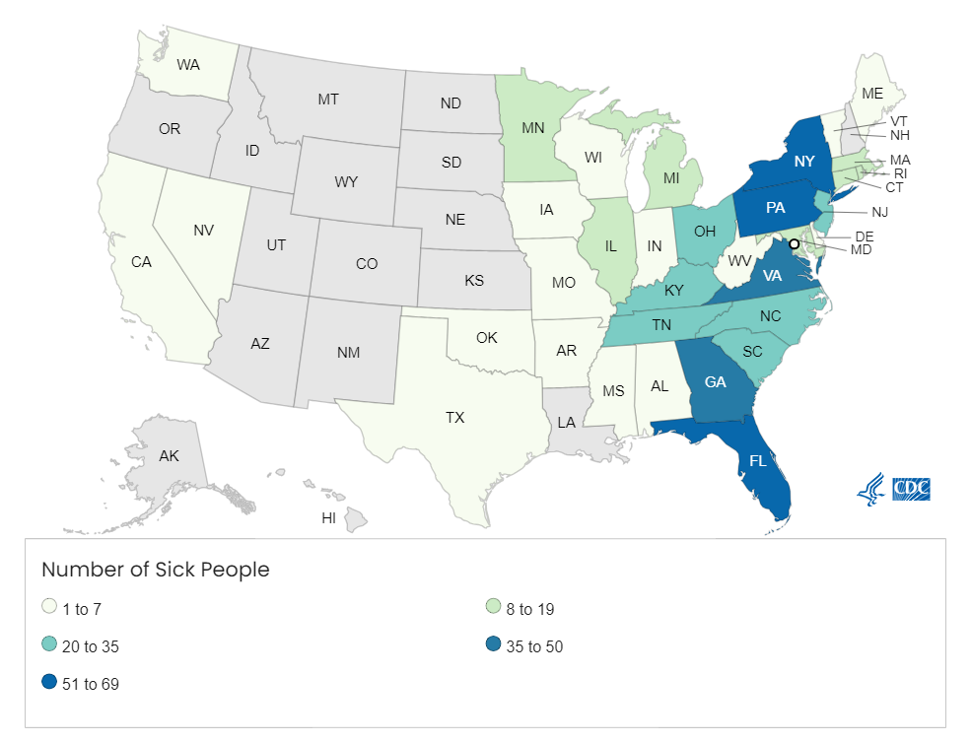
In Summary
Overall Timeline
April 24: Africana coded
April 30: NHGQ deployed
May 9: 1st Braenderup cluster coded
May 20: focused questionnaire; combined 4 groups of Braenderup into 1 investigation
May 31: recall of whole cucumbers
June 5: CDC issues food safety alert
June 27: combined Africana and Braenderup investigations
August 22: CDC closed investigation
By the Numbers
557 total isolates (551 clinical, 6 environmental) from 34 states and DC
  282 Africana, 269 Braenderup

Slide 9

Telephone: 404-639-4558
E-mail: PulseNet@cdc.gov Web: www.cdc.gov/pulsenet

