Slide 1
Promega Maxwell RSC Cultured Cells Kit for Whole Genome Sequencing DNA Extraction From Bacterial Cells
Gregory Deiulio, PhD
Food Laboratory

Slide 2
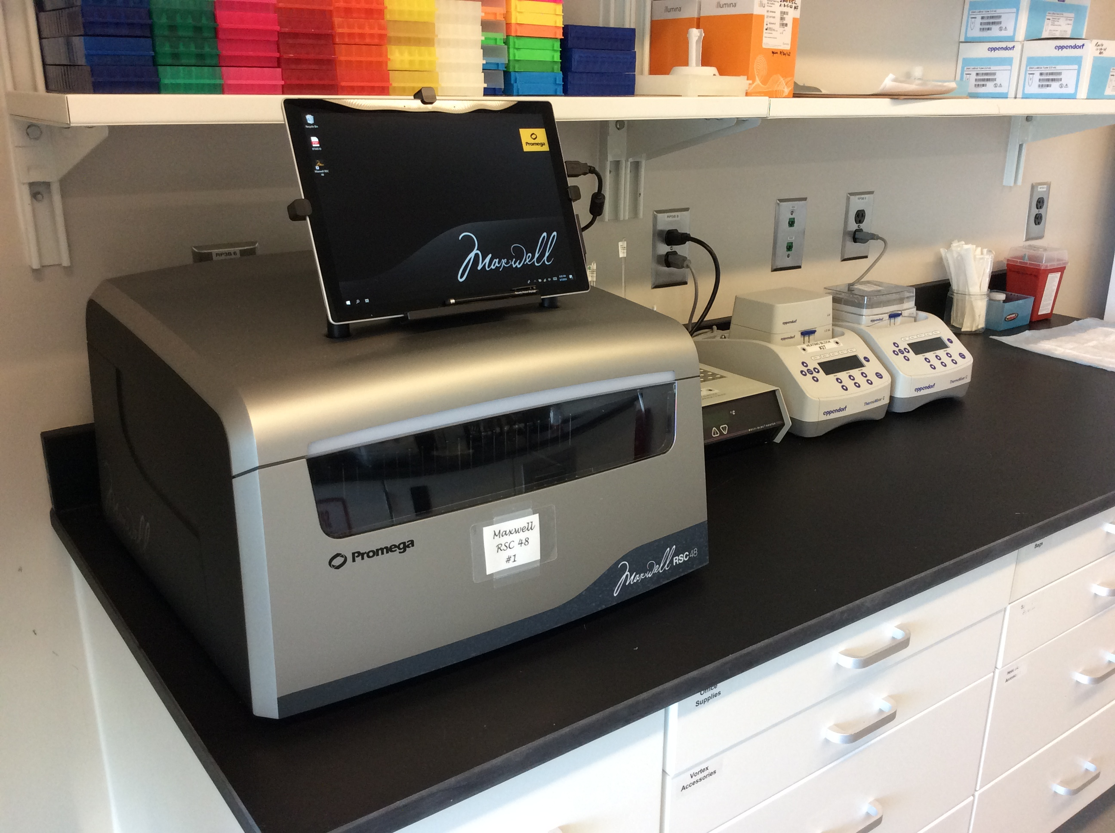
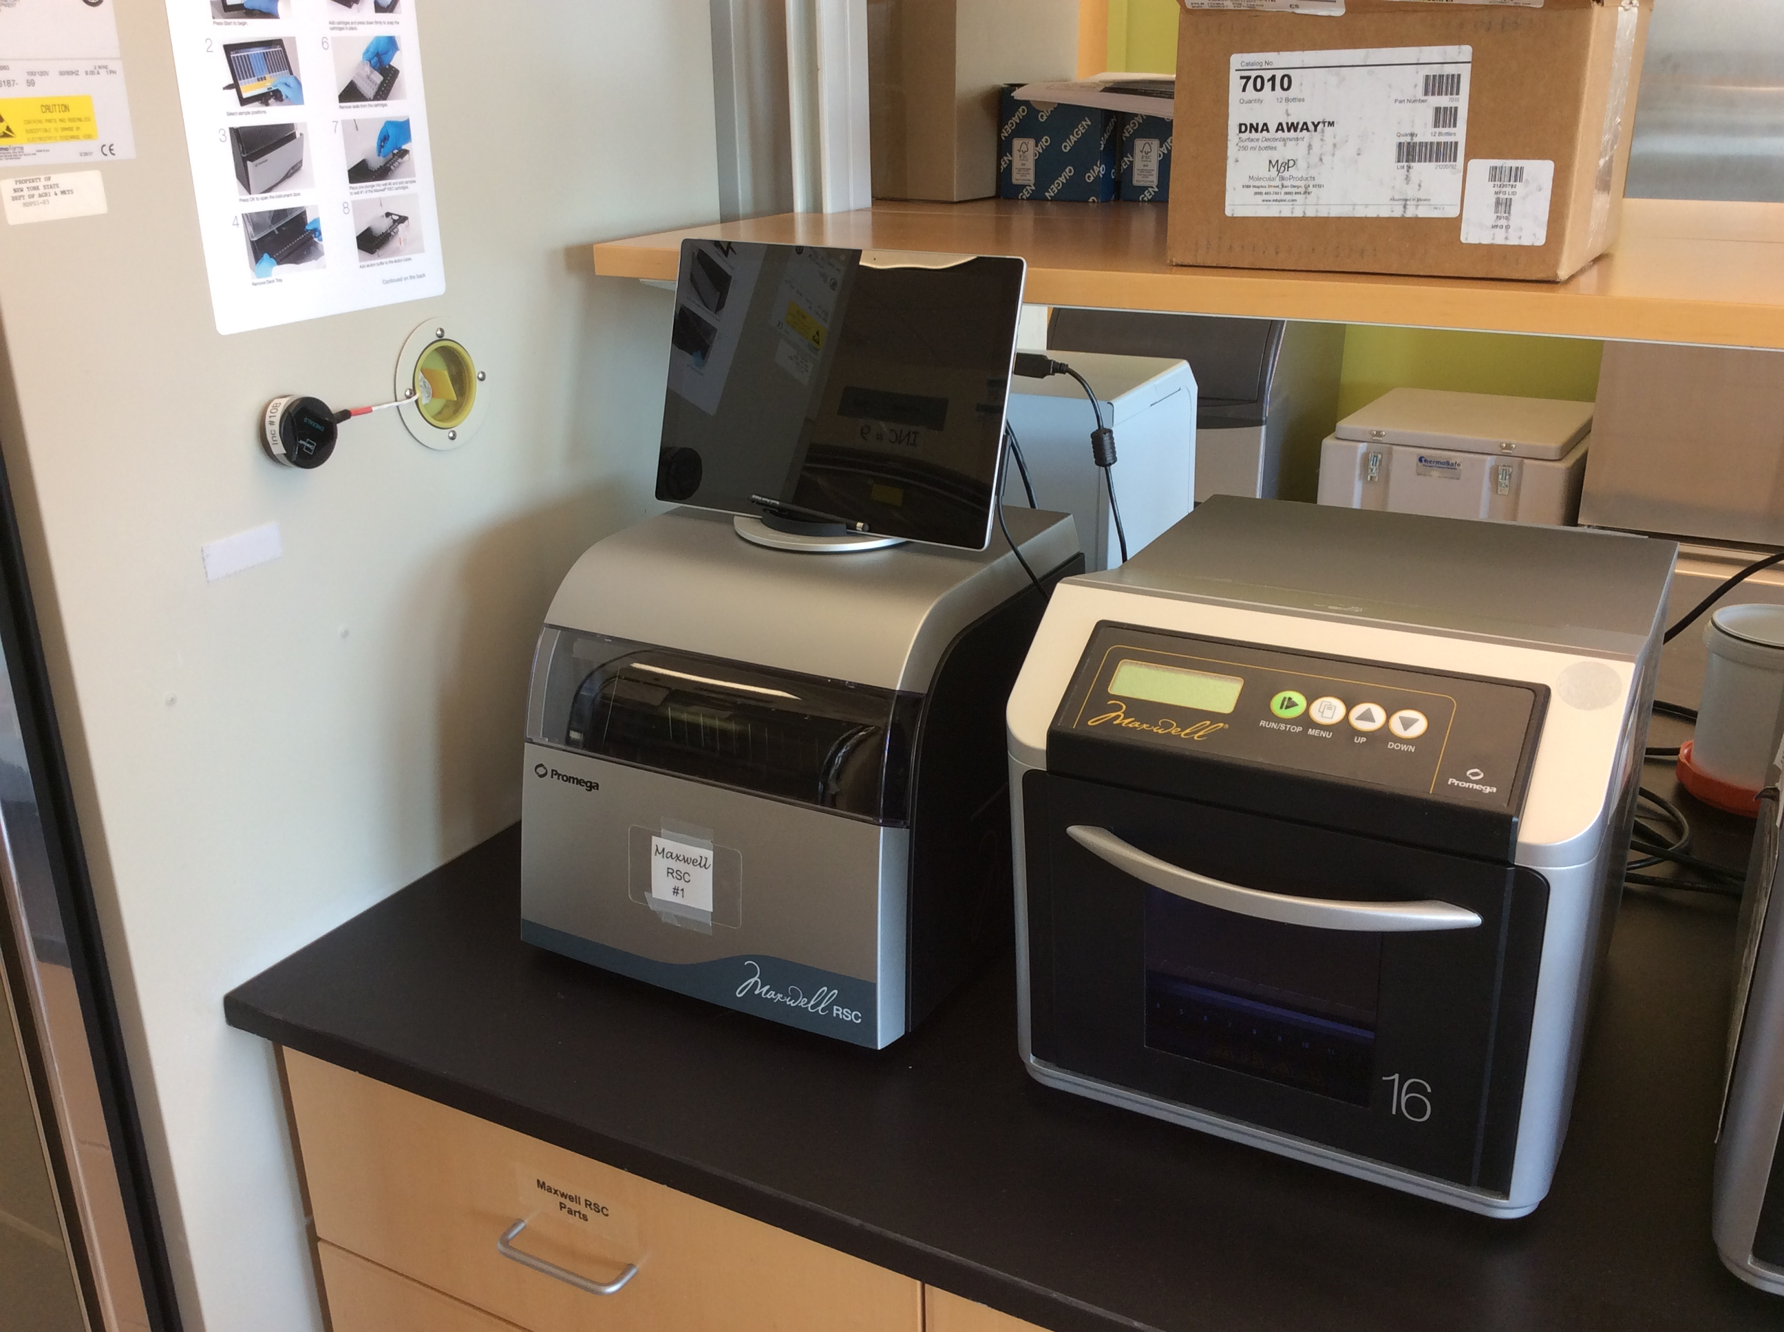
Two Maxwell RSC Instruments
Comes in the “RSC” or the “RSC 48” models
All machine controls except the on-off switch go through the tablet which runs Windows 10
The laboratory happened to have one of each from a previous iteration of routine testing DNA extraction kits
Similar to the Maxwell 16 in that magnetic plungers are moved through the cartridge wells to perform the DNA extraction
Methods for different extraction kits need to be loaded onto the tablet

Slide 3
The RSC 48 is Large

Slide 4
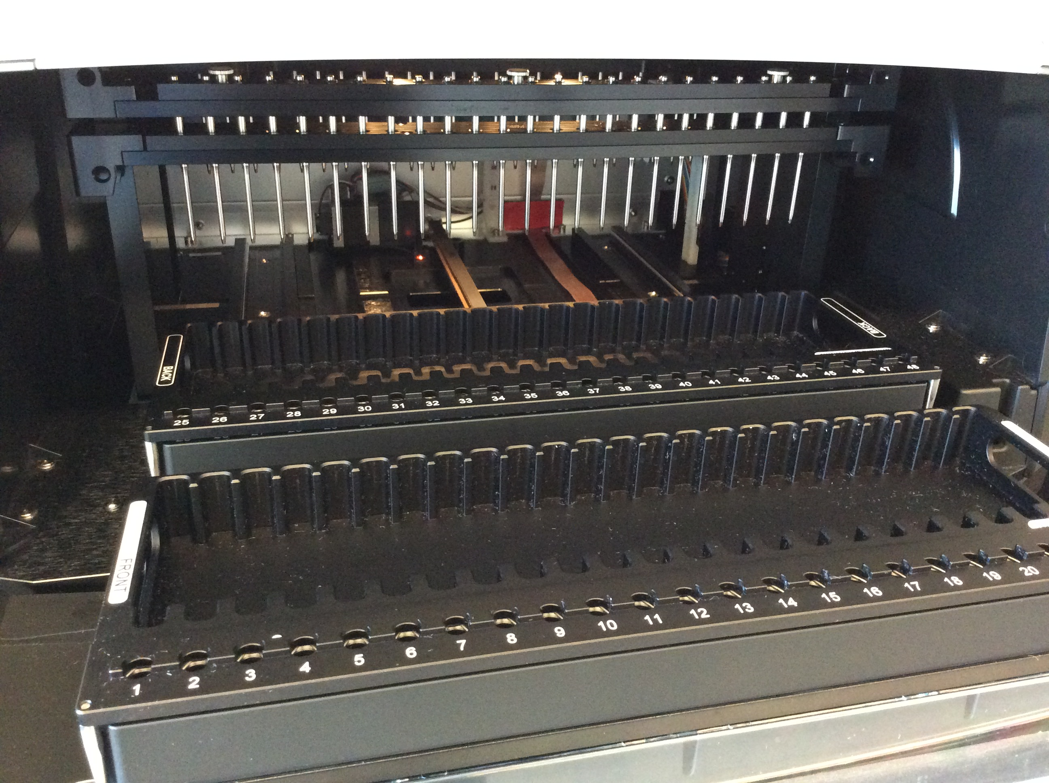
Fairly Uncomplicated Instrument Insides
Bottom platform holding trays move in and out
Silver spikes which grab magnetic plungers move up and down
Door opens and closes
No fluidics
No centrifuge

Slide 5
The Cultured Cells Kit
Kit comes with cartridges, plungers, elution buffer, and elution tubes
Handles “up to 2 x 10⁹ cells” in 400 uL (we eyeball it from plates)
Like Qiagen, Gram-Positive bacteria require 30 min lysozyme pre-treatment
RNase treatment is “Optional”
Machine run time for this kit is approximately 40 minutes

Slide 6
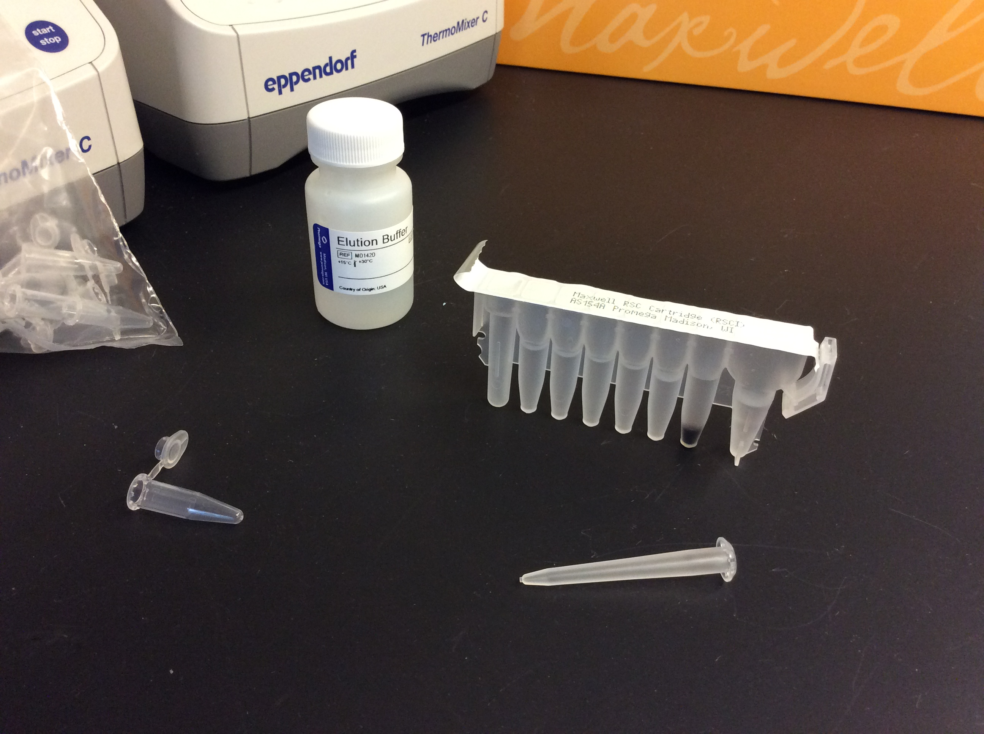
Cultured Cells Kit Components
Elution Buffer
Cartridge
Plungers
Elution Tubes

Slide 7
An Easy-to-Follow Protocol
Gram-Positive only: lyse cells for 30 min
Add RNase and incubate for 10 minutes at room temp
During all that, set up racks with cartridges
Add samples to cartridges, mix 10 times
Add plunger to each cartridge
Add Elution tubes, and Elution buffer to each tube
Place loaded racks in machine and start run
Wait

Slide 8
We Decided Against RNase A and Mixing
“In some cases, RNA may copurify with genomic DNA from cell samples. To remove copurified RNA, an RNase treatment can be performed”
We asked around and no one we talked to had a reason why we needed to add RNase (CDC said they used it because it was in the protocol, CFSAN labs were not adding RNase)
Mixing the sample into the cartridge well 10x adds a lot of pipetting which adds up if you have 48 samples
We decided to “add sample to sample well” and remove the RNase A step all together to see what would happen

Slide 9
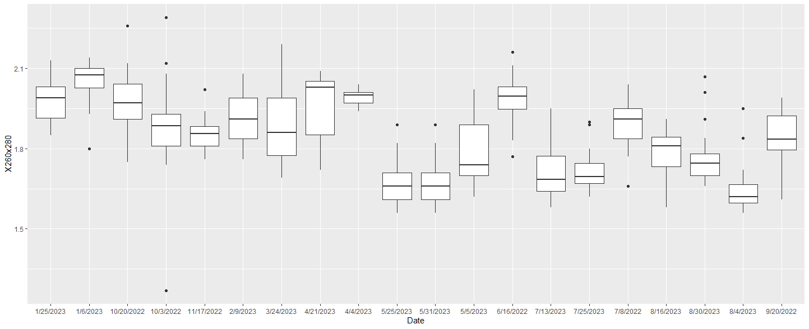
Lower 260/280 values

Slide 10
Lower 260/280 values
Qiagen Runs (Manual Extraction)

Slide 11
Lower 260/280 values
Qiagen Runs (Manual Extraction)
Maxwell without RNase A or mixing
Maxwell with RNase A
and mixing 10x

Slide 12
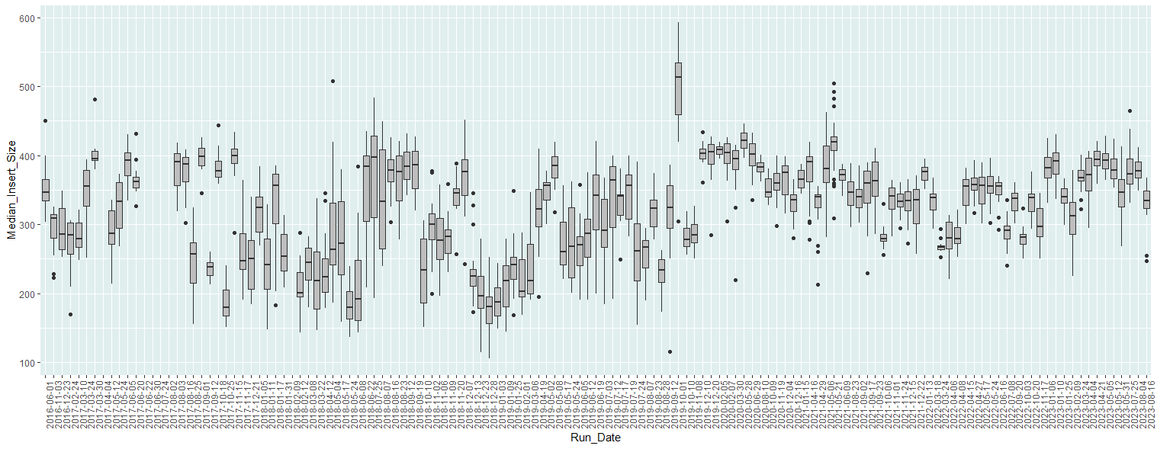
Post WGS Quality Metrics Look Good
Switch to Maxwell
Median Insert Size
WGS Run Date
Adapter1
R1
Adapter2
R2

Slide 13
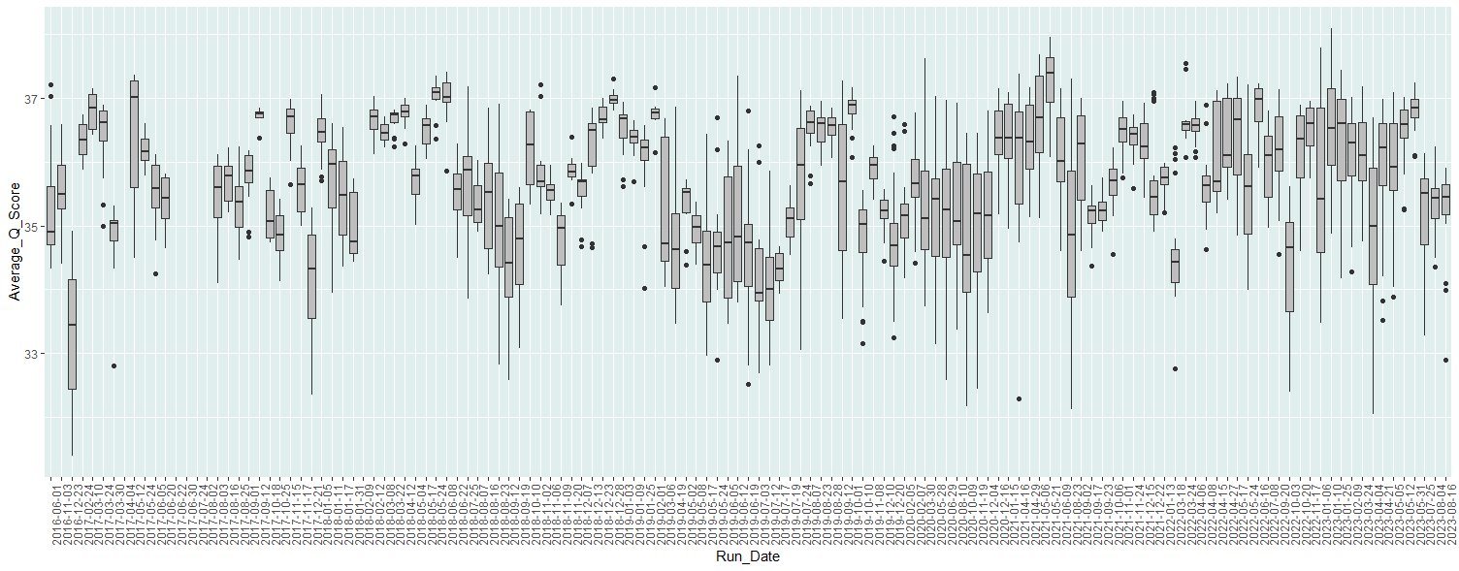
Post WGS Quality Metrics Look Good
Switch to Maxwell
WGS Run Date
Each box is a run

Slide 14
Extraction beads do not affect library prep
In some cases, beads from the extraction cartridge will end up in the DNA elution tube
Both Illumina and Promega were unsure about weather the beads would have any effect on the library prep
We did a validation for use of the kit with and without removing any left-over beads via magnet separation
No difference was seen in the post library prep QC or post sequencing QC for samples with the beads removed vs not removed

Slide 15
Three Extraction Methods
 | Maxwell RSC 48 | Qiagen Manual | QIAcube
Instrument Cost | ~ $50,000 | None | ~ $20,000
Reagent Cost | ~ $7.18 | ~ $2.70 | ~ $2.70
Total Runtime | ~ 40 minutes | ~ 1 hour | ~ 2 hours
Prep Time | ~ 1.5 hours | ~ 1.25 hours | ~ 30 minutes
Max Samples per Run | 48 | 24 | 12

Slide 16
Definite Benefits of RSC
Less opportunity for analyst error (versus manual Qiagen)
Less hands-on time per sample (versus manual Qiagen)
Can run up to 48 at once on RSC 48 instrument
40-minute “runtime” regardless of sample number
Our version of the protocol requires no RNase A
If using cells from petri dish only a heat block is needed, no centrifuge
Less complex machine than QIAcube

Slide 17
There are Drawbacks
Cost per sample
  RSC: ~ $7.18 , Qiagen: ~ $2.70 (manual & QIAcube)
A machine failure mid run results in a total run loss (like the QIAcube)
Greater possibility of cross contamination between samples
Attached tablet increases footprint
Have had to replace tablets due to connectivity issues
You have to buy the instrument $$ (more expensive than QIAcube)

Slide 18
Overall, we like it
Easy protocol
Can run anywhere from 1 - 48 samples
Gives you the 40- minute process time to do other things
Seems to produce equivalent quality WGS data to Qiagen (manual extraction)

Slide 19

Thanks!
Julie Haendiges (for their Maxwell RSC protocol)
Maria Ishida
Brian Sauders
FDA LFFM
GenomeTrakr
Organizers
Planning Committee
gregory.deiulio@agriculture.ny.gov

