Slide 1




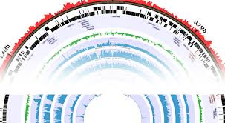


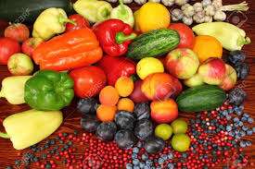



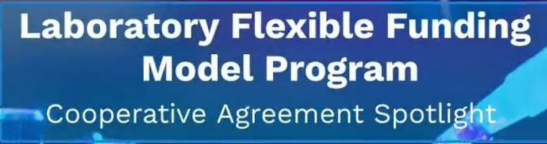


“Welcome to the 2023 Annual GenomeTrakr Meeting:
Opening Remarks”
Presented by:
Eric W. Brown, Ph.D., M.Sc., FAAM
Director, Division of Microbiology
Center for Food Safety & Applied Nutrition
U.S. Food & Drug Administration
College Park, MD 20740 USA
Notes:
1

Slide 2


“Welcome to the 2023 Annual GenomeTrakr Meeting”
Welcome to the 2023 Annual GenomeTrakr Meeting
Notes:
2

Slide 3

“Welcome to the 2023 Annual GenomeTrakr Meeting”
Welcome to the 2023 Annual GenomeTrakr Meeting
This meeting celebrates YOUR contributions and YOUR continued
commitment to this importance food safety WGS network! (State, Academic,
Federal, international partners)
Notes:
3

Slide 4
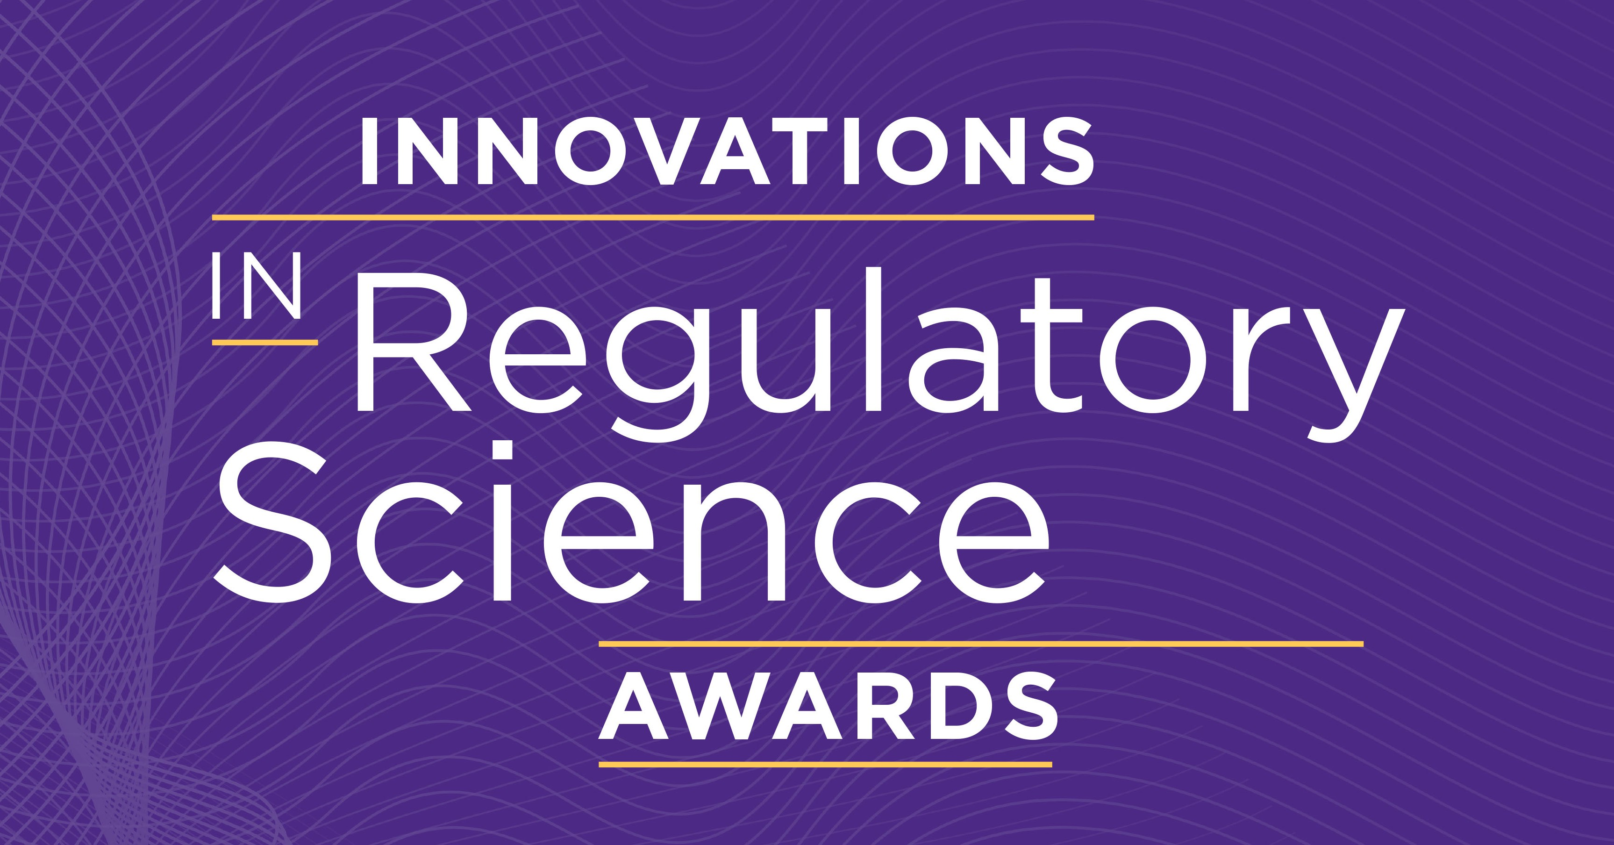

2023 Innovations in Regulatory Science Awards
Celebrating outstanding achievement in regulatory science
GenomeTrakr is an FDA initiative that is transforming food safety. By applying whole genome sequencing to food safety and publicly sharing sequencing data, the GenomeTrakr network has changed how foodborne illness outbreaks are investigated, adding speed and certainty to the investigations. To date, the genomic data gathered by the GenomeTrakr network has been used in hundreds of FDA foodborne illness investigations and numerous investigations by CDC and USDA providing expeditious leads to outbreak sources, and a means to verify the effectiveness of food safety systems in food manufacturing environments. Tapping whole genome sequencing data to advance food safety is becoming commonplace around the world, growing, in part, from the vision of FDA and its GenomeTrakr partners.
Innovation Award honors an individual, team, or organization that has improved public health through a specific innovation in regulatory issues or science.
Notes:
4

Slide 5

“Welcome to the 2023 Annual GenomeTrakr Meeting”
Welcome to the 2023 Annual GenomeTrakr Meeting
This meeting celebrates YOUR contributions and YOUR continued
commitment to this importance food safety WGS network! (State, Academic,
Federal, international partners, WGS industry partners, and FDA partners across the agency)
2023 brings new and important updates in bioinformatics and analytics, wet-lab workflow improvements, metadata advancements, and many other technical developments that you won’t want to miss.
Notes:
5

Slide 6

“Welcome to the 2023 Annual GenomeTrakr Meeting”
Welcome to the 2023 Annual GenomeTrakr Meeting
This meeting celebrates YOUR contributions and YOUR continued
commitment to this importance food safety WGS network! (State, Academic,
Federal, international partners, WGS industry partners, and FDA partners across the agency)
2023 brings new and important updates in bioinformatics and analytics, wet-lab workflow improvements, metadata advancements, and many other technical developments that you won’t want to miss
Hear and ask about novel cross-cutting scientific initiatives in env micro, agriculture, and food safety that are underpinned by WGS and the GenomeTrakr network
Notes:
6

Slide 7

“Welcome to the 2023 Annual GenomeTrakr Meeting”
Welcome to the 2023 Annual GenomeTrakr Meeting
This meeting celebrates YOUR contributions and YOUR continued
commitment to this importance food safety WGS network! (State, Academic,
Federal, international partners, WGS industry partners, and FDA partners across the agency)
2023 brings new and important updates in bioinformatics and analytics, wet-lab workflow improvements, metadata advancements, and many other technical developments that you won’t want to miss
Hear and ask about novel cross-cutting scientific initiatives in env micro, agriculture, and food safety that are underpinned by WGS and the GenomeTrakr network
Learn more about major workhorse activities for the network in outbreak support and the solving of foodborne contamination events – traceability and root cause
Notes:
7

Slide 8

“Welcome to the 2023 Annual GenomeTrakr Meeting”
Welcome to the 2023 Annual GenomeTrakr Meeting
This meeting celebrates YOUR contributions and YOUR continued
commitment to this importance food safety WGS network! (State, Academic,
Federal, international partners, WGS industry partners, and FDA partners across the agency)
2023 brings new and important updates in bioinformatics and analytics, wet-lab workflow improvements, metadata advancements, and many other technical developments that you won’t want to miss
Hear and ask about novel cross-cutting scientific initiatives in env micro, agriculture, and food safety that are underpinned by WGS and the GenomeTrakr network
Learn more about major workhorse activities for the network in outbreak support and the solving of foodborne contamination events – traceability and root cause
A very special welcome to our first-time attendees and guests from Latin America, Europe, and Asia
Notes:
8

Slide 9

“Welcome to the 2023 Annual GenomeTrakr Meeting”
Welcome to the 2023 Annual GenomeTrakr Meeting
This meeting celebrates YOUR contributions and YOUR continued
commitment to this importance food safety WGS network! (State, Academic,
Federal, international partners, WGS industry partners, and FDA partners across the agency)
2023 brings new and important updates in bioinformatics and analytics, wet-lab workflow improvements, metadata advancements, and many other technical developments that you won’t want to miss
Hear and ask about novel cross-cutting scientific initiatives in env micro, agriculture, and food safety that are underpinned by WGS and the GenomeTrakr network
Learn more about major workhorse activities for the network in outbreak support and the solving of foodborne contamination events – traceability and root cause
A very special welcome to our first-time attendees and guests from Latin America, Europe, and Asia as well as our new guests from the US and Canada
And perhaps most importantly, take the time to meet your fellow colleagues and collaborators at the social networking sessions – my favorite times…thank you APHL!
Notes:
9

Slide 10

Federal Partners (FDA, CDC, FSIS, and NCBI) and State Partners (DOHs and DAgs)
Academic and Industry collaborators both nationally and internationally
WGS Technology partners (Illumina)
International Partners (Countries and NGOs)
LFFM Coordinators (Erin, Lauren, and other LFFM leadership) & agency leadership
GT Planning and Coordination Committee
APHL (Robyn, Kirsten, Rhodel, Amy, and Shari) makes this event possible for all!!!!
AND EVERYONE ELSE WHO WORKS TO MAKE THIS NETWORK SUCH A SUCCESS!
Notes:
10

