Slide 1
Developing PulseNet 2.0
GenomeTrakr Meeting
October 2023
Steven Stroika
Centers for Disease Control and Prevention
Enteric Diseases Laboratory Branch

Slide 2
Outline
  What is PulseNet 2.0
  Status of Development
  Timeline
  System Architecture
  PulseNet 2.0 Today
  Preparing for the Transition
  Future of Data Analysis at CDC

Slide 3
What is PulseNet 2.0
PulseNet’s data analysis software, BioNumerics, is reaching the end-of-life December 2024
PulseNet is working with CDC’s Office of Advance Molecular Detection to build a new containerized and modular, open-source, cloud-based platform, for molecular surveillance
PulseNet 2.0 can take advantage of cloud strengths to improve data storage, analysis time, and data sharing
This system also provides greater flexibility to onboard new analysis workflows and have an easier way to connect other systems already in the cloud, like SEDRIC

Slide 4
Status of Development
In October 2022, contract was awarded for PulseNet 2.0, and the start of development began between PulseNet CDC and Contractors
Initial development is focused on a minimum viable product (MVP) for Salmonella data management and surveillance
Internal (CDC) User Acceptance Testing (UAT) on pieces of the MVP platform occurred June - September 2023
    11 Pilot labs have been part of the UAT office hours
September 2023: System sent for certification to open a production environment for continued development and onboarding of external users
Development and UAT is ongoing

Slide 5
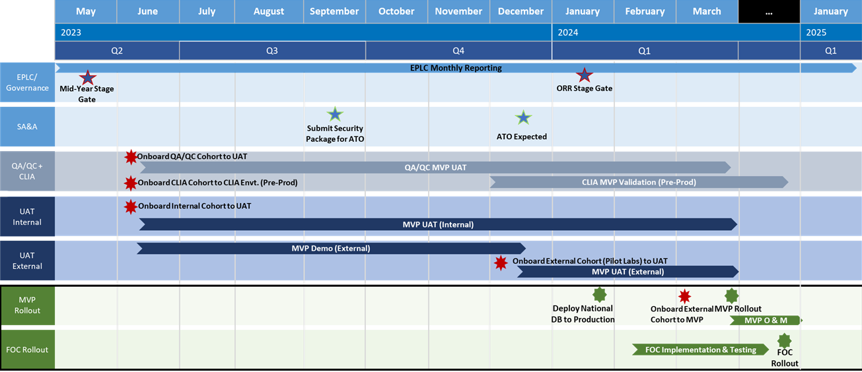
Timeline to PulseNet 2.0

Slide 6
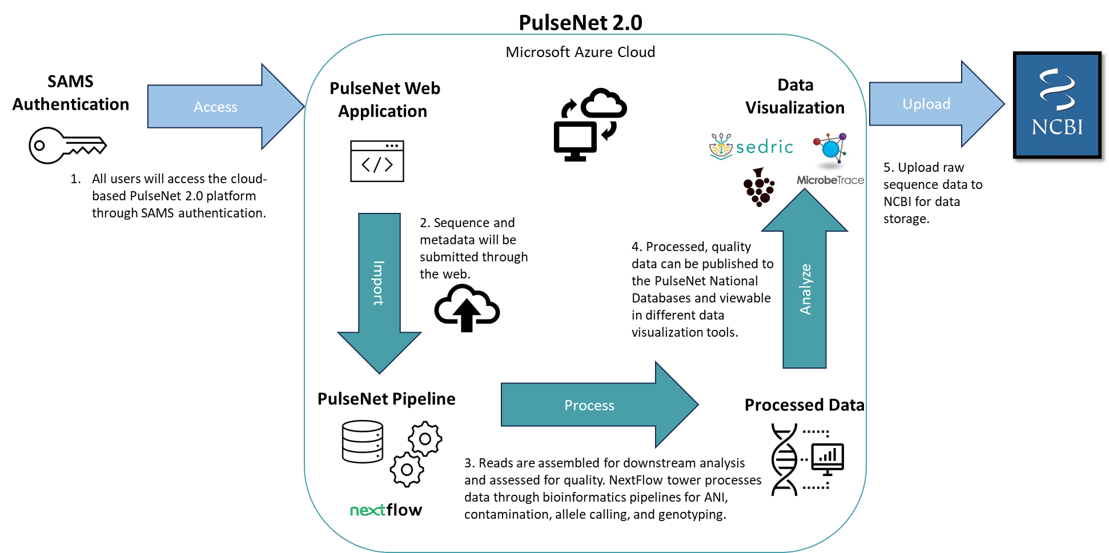
System Architecture

Slide 7
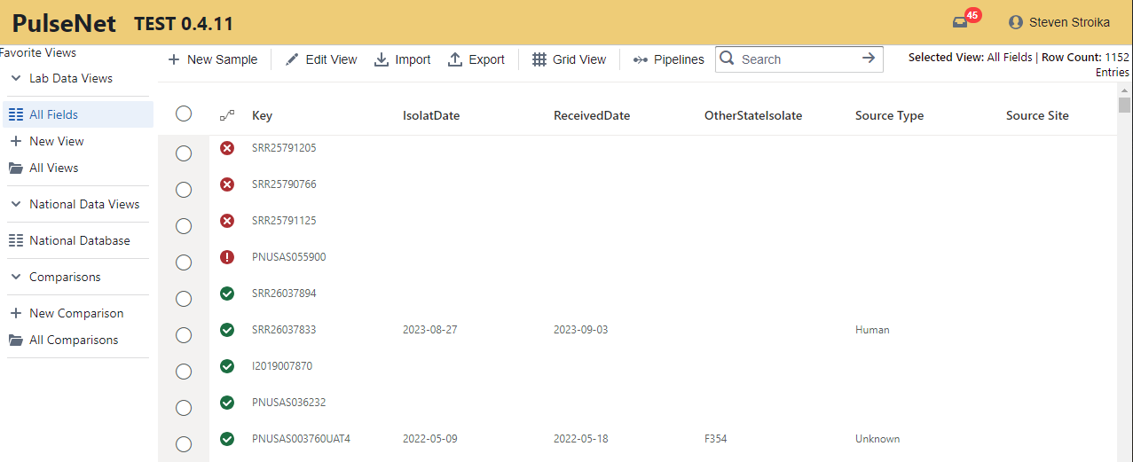
PulseNet 2.0 MVP: Database View
Menu Toolbar
Notifications
Views and Comparisons
Analysis status

Slide 8
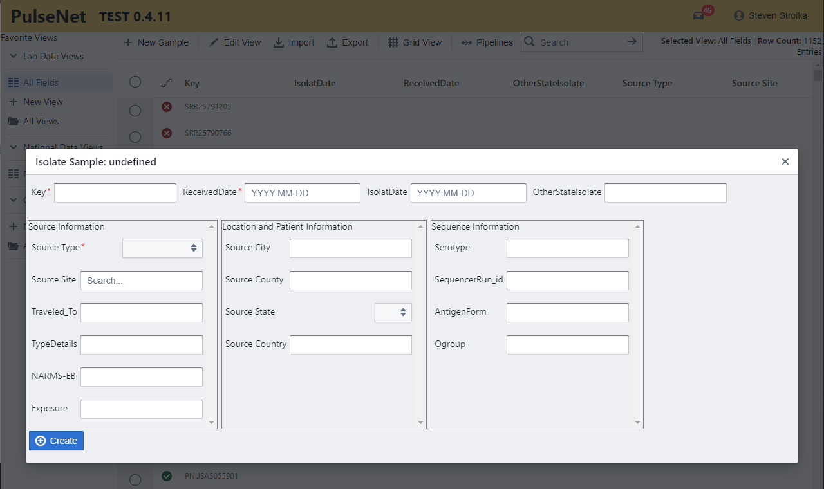
PulseNet 2.0 MVP: New Sample
*Required data and format

Slide 9
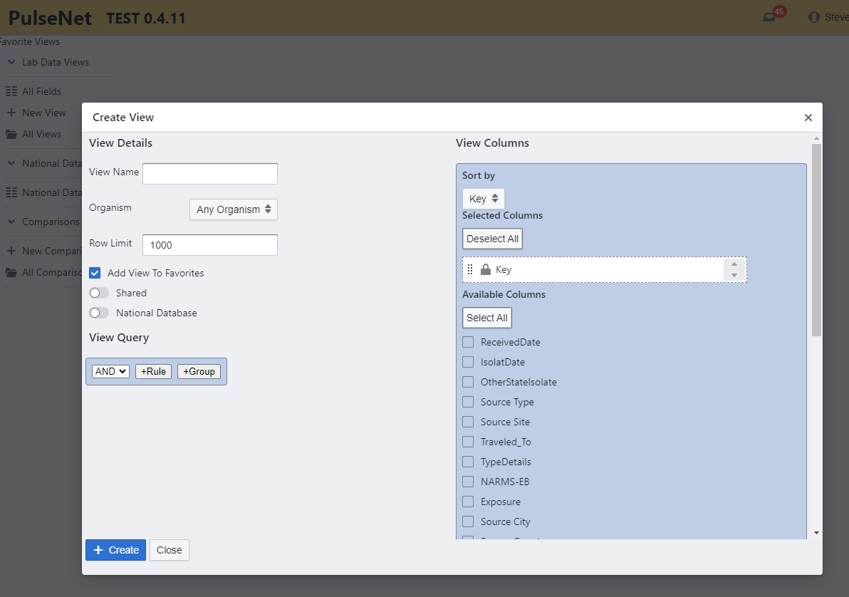
PulseNet 2.0 MVP: Creating Views
Views can be created and shared
Views can be made with query rules
  Date range
  Serotype
  Any field
Fields can be selected on/off and moved in preferred order

Slide 10
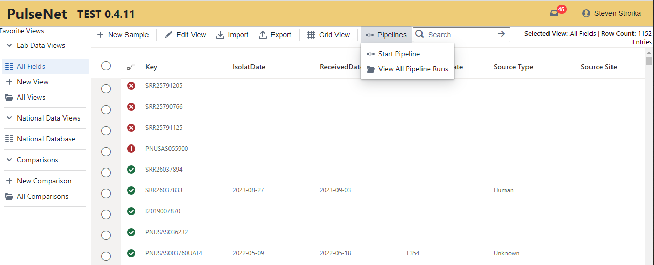
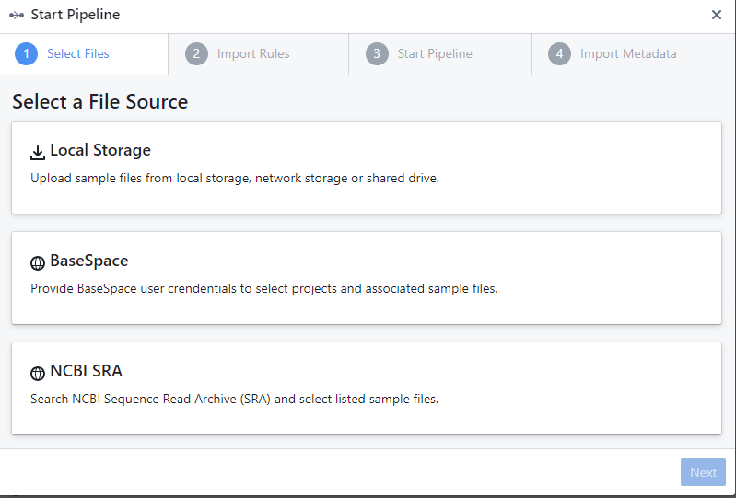
PulseNet 2.0 MVP: Starting Pipeline

Slide 11
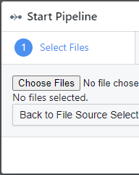
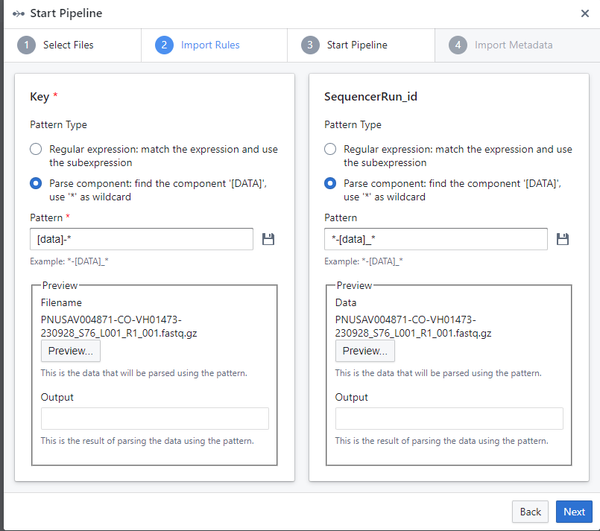
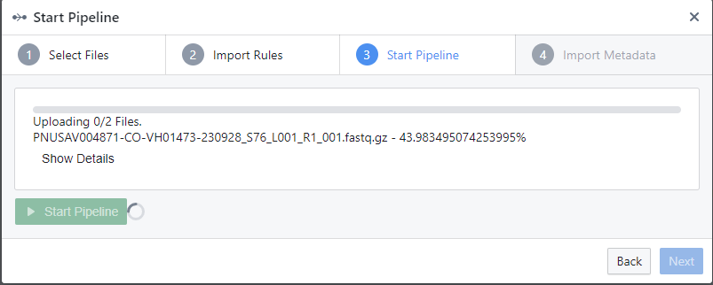
PulseNet 2.0 MVP: Starting Pipeline
Select files
Import/parse
Start pipeline
Import metadata

Slide 12
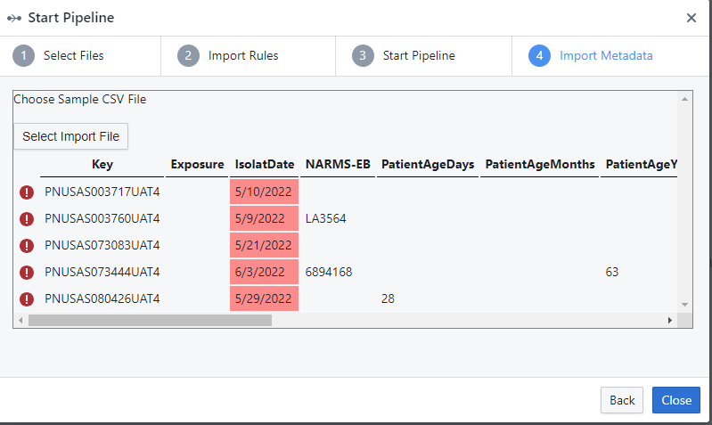
PulseNet 2.0 MVP: Importing Metadata
Entries will highlight if not formatted correctly
Must go back to spreadsheet to correct incorrect formatting
  Dates YYYY-MM-DD
  Source type
  Age
  Sex

Slide 13
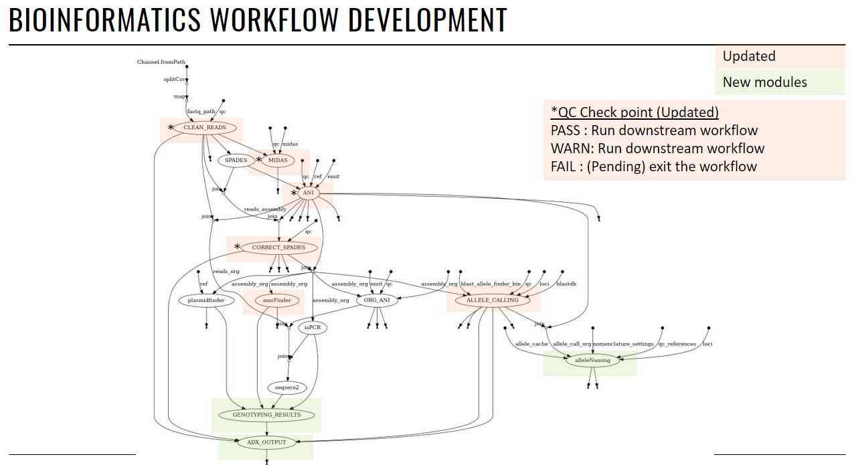
PulseNet 2.0 Pipeline

Slide 14
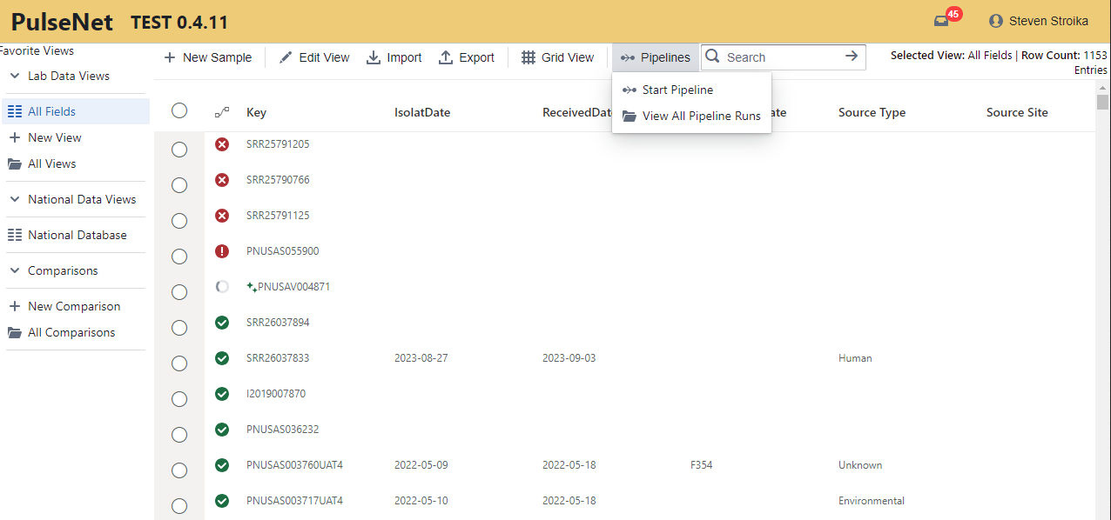
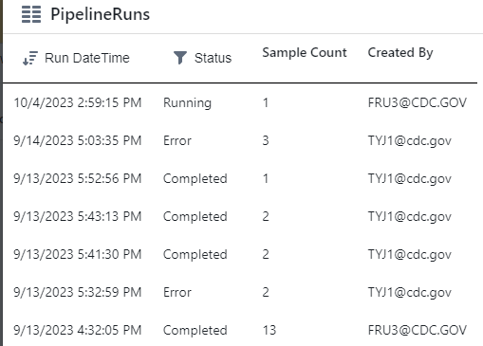
PulseNet 2.0 MVP: Viewing Pipelines

Slide 15
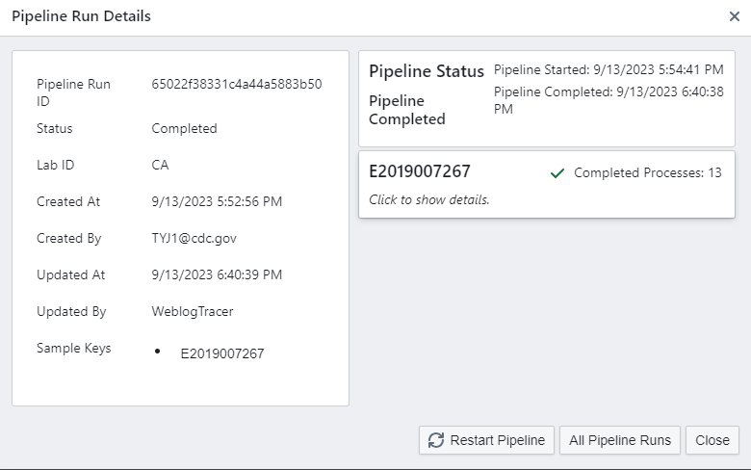
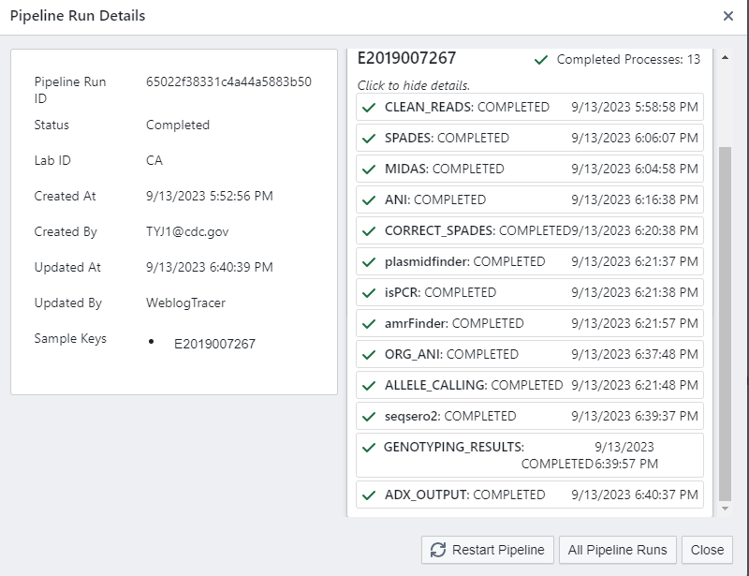
PulseNet 2.0 MVP: Pipeline Reports
PulseNet 2.0 MVP will be end-to-end workflow for job submissions
Pipeline can be stopped or restarted, if necessary
Reports can be clicked and viewed for troubleshooting, like BioNumerics entry attachments
Sample Key can be selected to view results and publish to national database

Slide 16
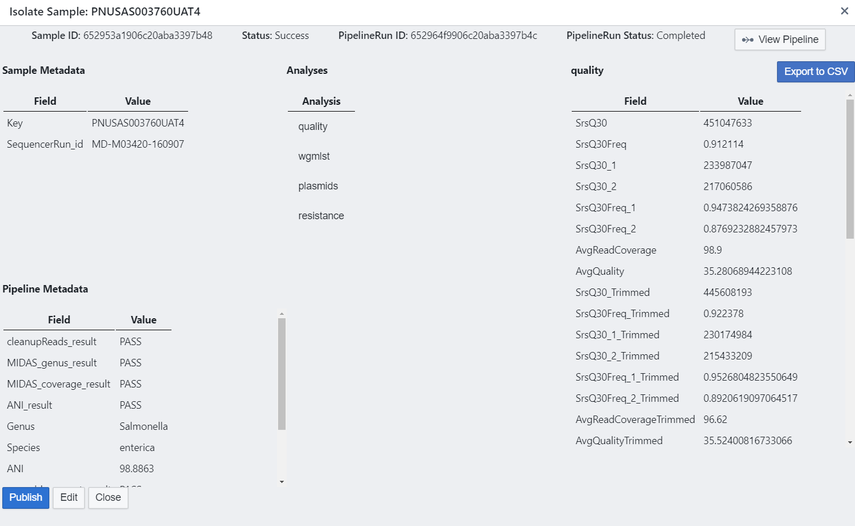
PulseNet 2.0 MVP: Isolate Sample View
Sample view allows for experiment results
Window provides a status and metadata
You can edit entry content and publish to national database if sample passes QC

Slide 17
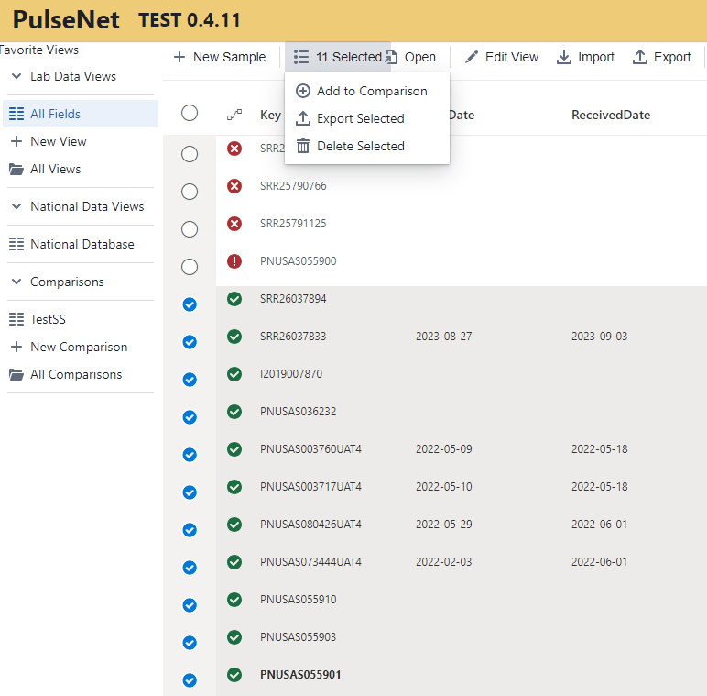
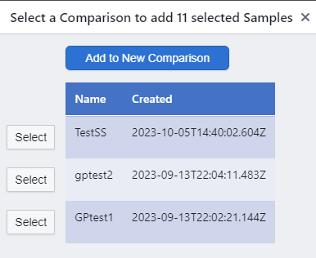
PulseNet 2.0 MVP: Comparisons
Comparisons can be saved, favorited, and used for new analyses
You can select entries and choose to create a new comparison or add entries to an existing comparison
Comparison field order and content can be customized

Slide 18
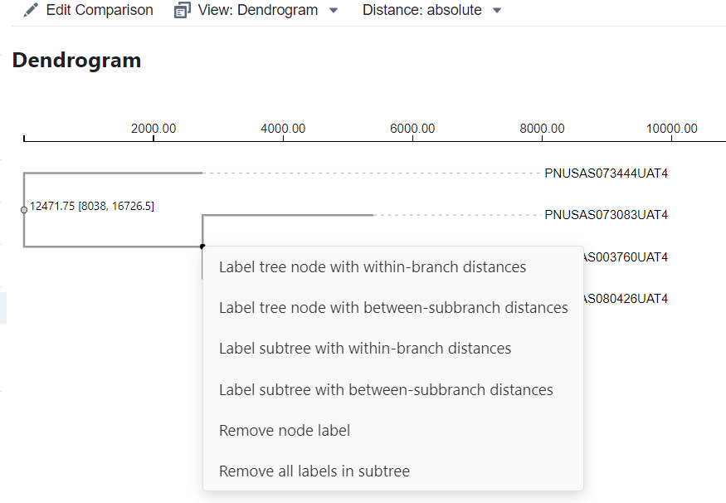
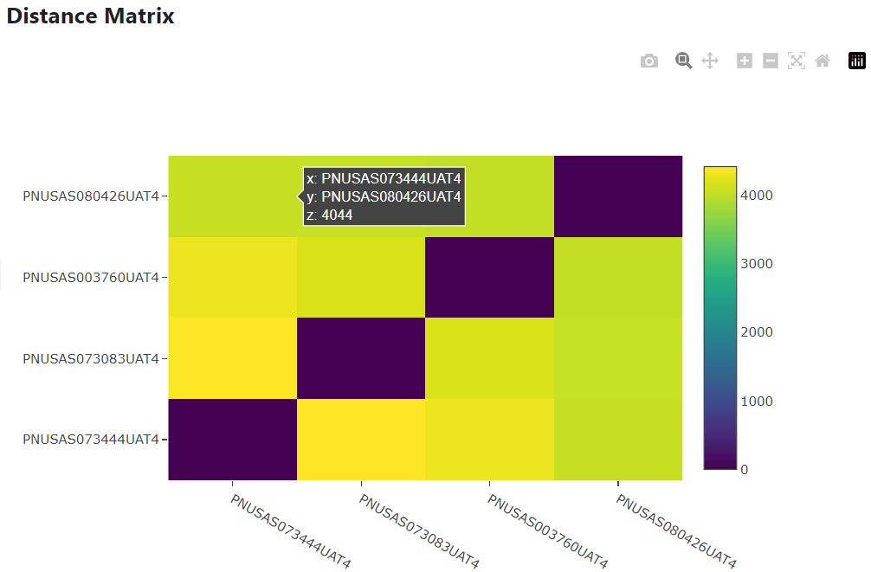
PulseNet 2.0 MVP: Analysis Tools
Results can be viewed by experiment and dendrogram, matrix, or list

Slide 19
PulseNet 2.0 MVP: Pending Development
Ad hoc comparisons
National database management
NCBI uploading
Decision on how to handle request for local only fields
One Health Enteric Package data fields
On-boarding other pathogens

Slide 20
Changes in PN2.0
Allele calling workflow
  Re-analysis of all data using only assembly-based allele calling
    Storing allele calls as hashes for future advanced analysis needs and no curator database needs
    Updated allele codes
Genotyping tooling
  AMRFinder
  SeqSero2
  KMA Escherichia serotyping
  Updated SPAdes assembler with down sampling
  Additional reference genomes for RefID workflow
Additional wgMLST schemes
  Vibrio cholerae, V. parahaemolyticus, V. vulnificus
  Cronobacter sakazakii
  Clostridium botulinum

Slide 21
Preparing for PulseNet 2.0
Provide your IT with the PulseNet 2.0 White Paper to begin assessing needs and concerns.
Member laboratories will be responsible for ensuring their surveillance data is currently uploaded to the national databases and a plan is made for other data in your BioNumerics databases that might need to be saved.
BioNumerics will no longer be supported after the transition to PulseNet 2.0. The program and analyzed data will still be accessible while you own a license to use the software. BioNumerics will no longer work for new analyses using CDC resources like the calculation engine, connection to the PulseNet national databases, or NCBI uploads.
More updates and Open Session at the InFORM 2024 Meeting.

Slide 22
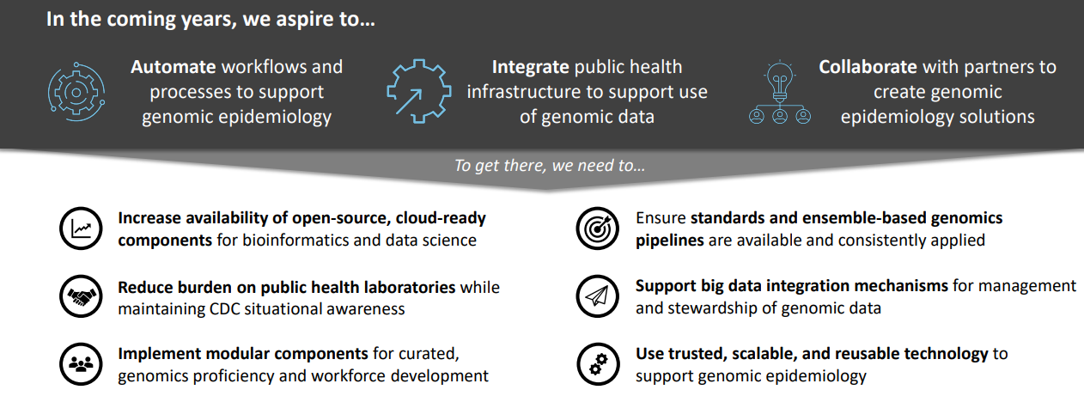
Vision for Advanced Molecular Detection at CDC
Genomic Epidemiology Platform

Slide 23
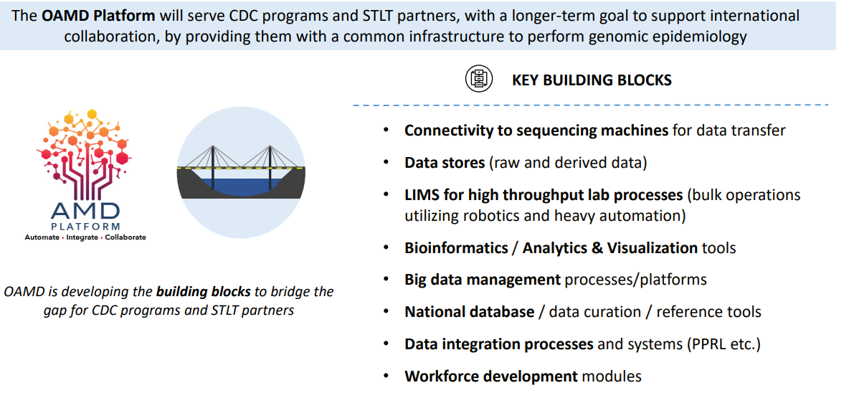
AMD Platform: PulseNet 2.0 Proof of Concept

Slide 24
Attempts at Harmonization Between PulseNet and GenomeTrakr
Streamlining as best we can NCBI submissions using PN2.0
More automated QC
One database model eliminating need to separate databases and RefID workflow
End-to-end workflows eliminating time needed to be connected and pulling back jobs
Incorporating the One Health Enteric package in PulseNet 2.0 to assist in standardization of data in NCBI
Faster updates due to cloud-based platform and not a distributed software product

Slide 25
Data Sharing

Slide 26
BEAM (Bacteria, Enterics, Ameoba, Mycotics) Dashboard
  DFWED is in the process of increasing the visibility of its data
  The BEAM Dashboard is an interactive tool to access and visualize data from PulseNet and the System for Enteric Disease Response, Investigation, and Coordination (SEDRIC)
  Currently, the dashboard focuses on data for Salmonella, Shiga toxin-producing E. coli (STEC), Shigella, Campylobacter, and Vibrio bacteria, and multistate outbreaks
  Eventually, the dashboard could include epidemiologic data from outbreak investigations and AST data
Notes:
One of the main informatics problems we were facing was the large number of data requests our division was receiving because our data was not accessible to the interested parties in a timely manner.
Following the CDC’s broader vision to make its data more accessible, our division is in the process of modernizing and making our data transparent and more visible.
Our team conducted informal, open-ended discussions with over thirty individuals representing a range of partners, including academics, regulatory partners, industry, trade associations, retail companies, and consumer groups, informing a multiphase plan for dashboard development.
We categorized partner needs in to these 6 categories:
data linkages with automated analytics - this includes pathogen, serotype, and resistance by time, region, and epidemiological data
data downloads
user training
customized programmable alerts
direct application programming interfaces (API) with industry to inform prevention efforts (preemptive environmental assessments, early identification of food vehicles, early market withdrawals, and traceback efforts)
future linkages with any available regulatory data to support farm-to-fork analyses.

Slide 27
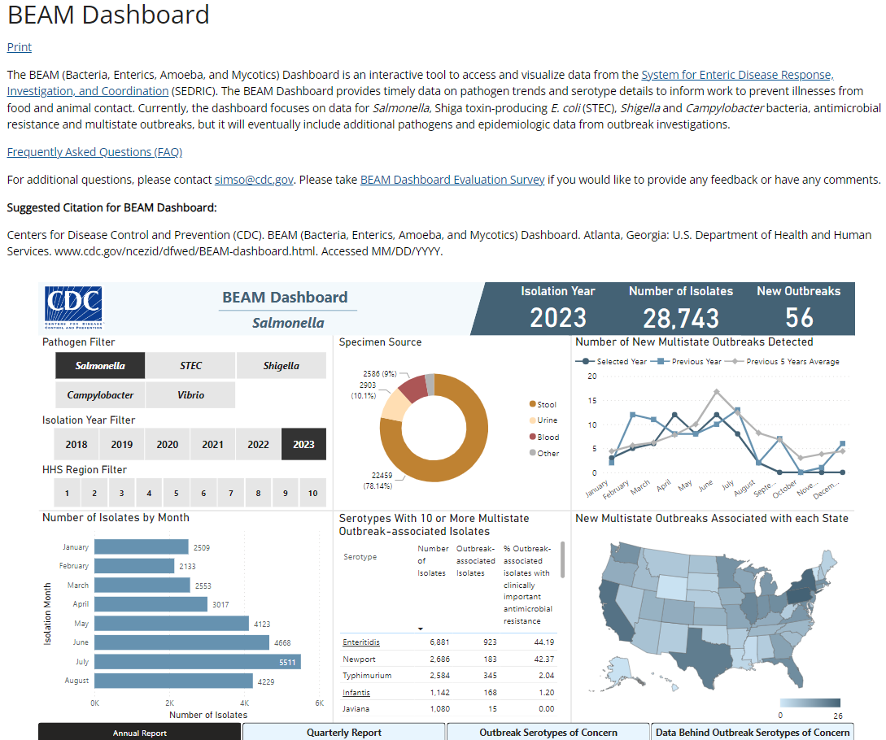
Navigating BEAM
  Filter by pathogen and year
  View submissions by month broken out by state/HHS region
  View common outbreak serotypes
  View trends in data
  Report sections include Annual, Quarterly, Outbreak Serotypes of Concern, and Data Behind Outbreak Serotypes of Concern
https://www.cdc.gov/ncezid/dfwed/beam-dashboard.html

Slide 28
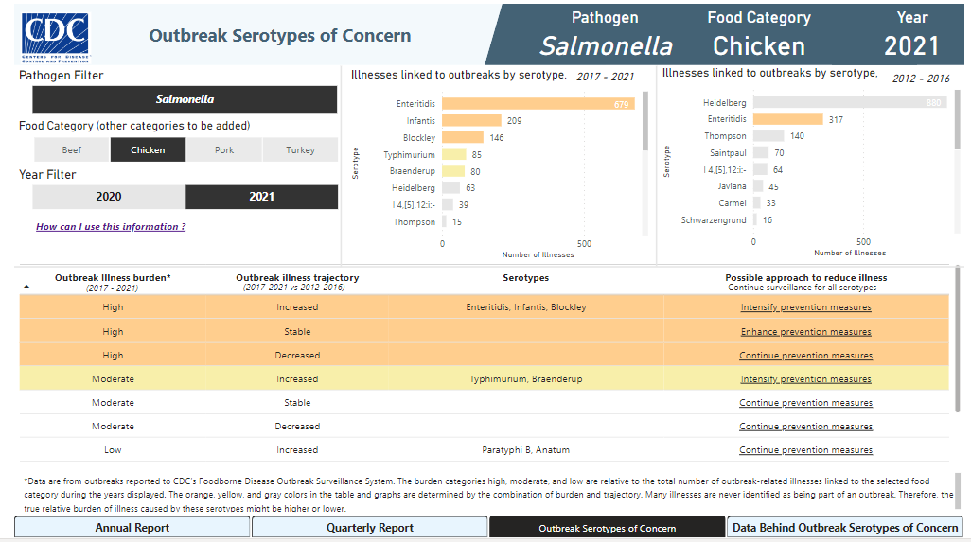
Navigating BEAM

Slide 29

Future Roadmap for BEAM
  Integrate antimicrobial resistance data from NARMS
  Add FDA & USDA non-clinical data
  Provide closer to real-time data, currently only monthly updates

Slide 30
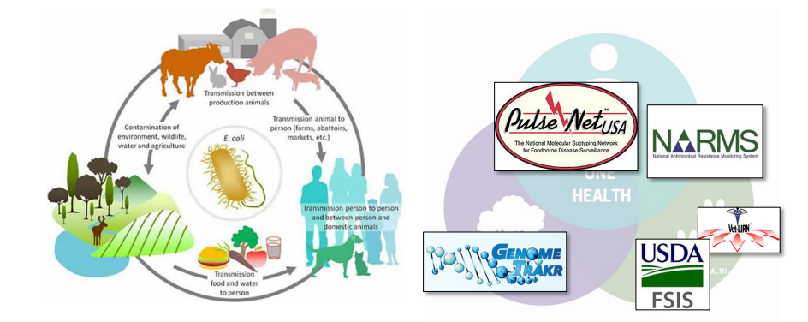
One Health Enteric Package and Data Fields in PulseNet 2.0
PulseNet 2.0 platform will have greater flexibility for adding database fields
    Currently reviewing requested fields to see how to manage and implement
Updates to the NCBI Uploader plugin include some attributes to help implement package – distributed to GenomeTrakr labs September 2023
MVP platform will only include necessary fields for PulseNet work but work will be continuing on the fully functional BioNumerics replacement that could include additional data fields

Slide 31


Thank you!
#PulseNet
Telephone: 404-639-4558
E-mail: PulseNet@cdc.gov Web: www.cdc.gov/pulsenet
#PulseNet

