Slide 1


Christian Vinueza PhD.
Central University of Ecuador

Slide 2

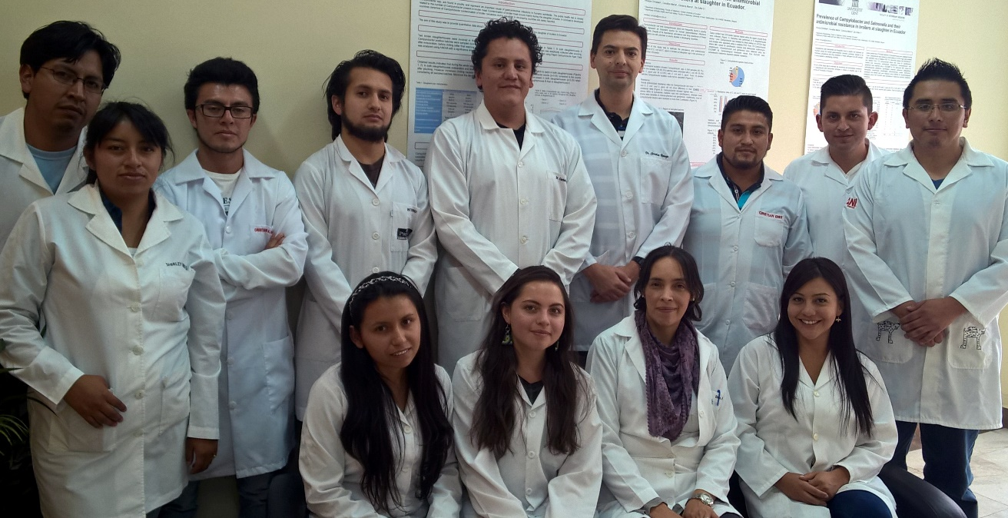





Research unit of foodborne diseases and antimicrobial resistance
Research
Education
Industry support

Slide 3
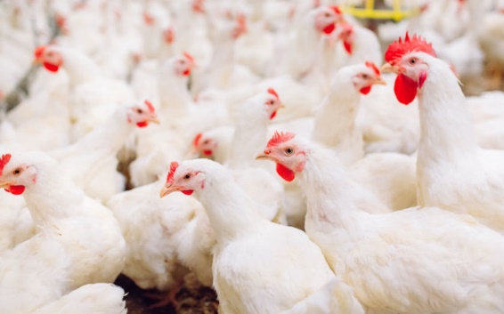
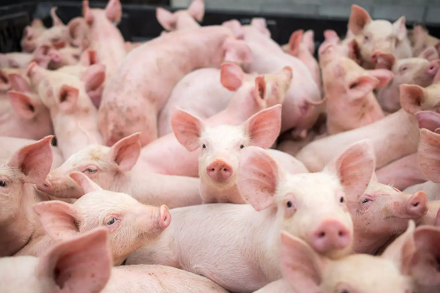

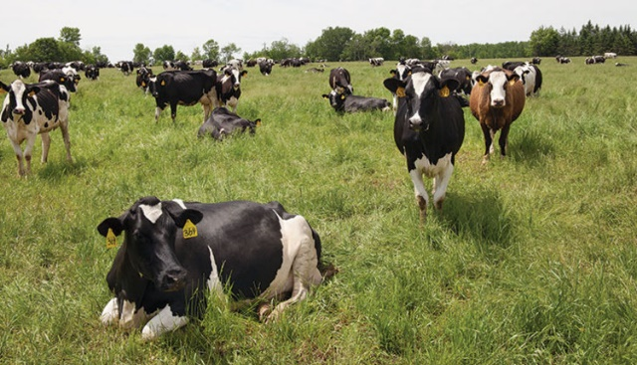
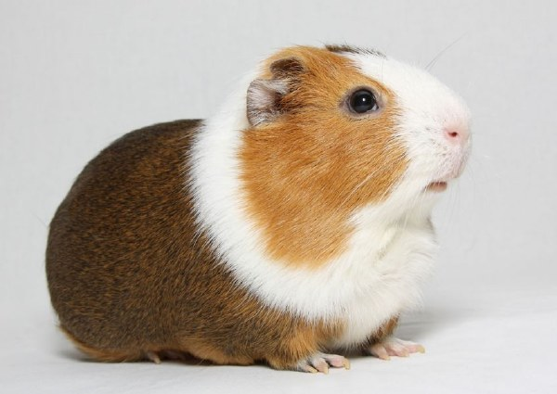
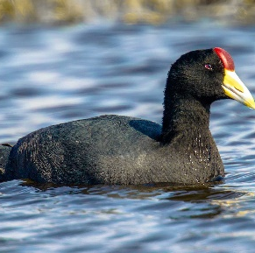
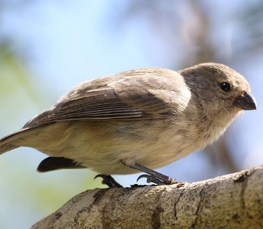
Sample sources
Fulica ardesica
Darwing´s finches
.

Slide 4


International colaboration
Start: 2018
Pathogen | No. Of WGS isolates
Salmonella | 553
E. coli | 136
Listeria | 26
Campylobacter | 84
New York State Department of Agriculture and Markets
Notes:
Eight hundred isolates

Slide 5
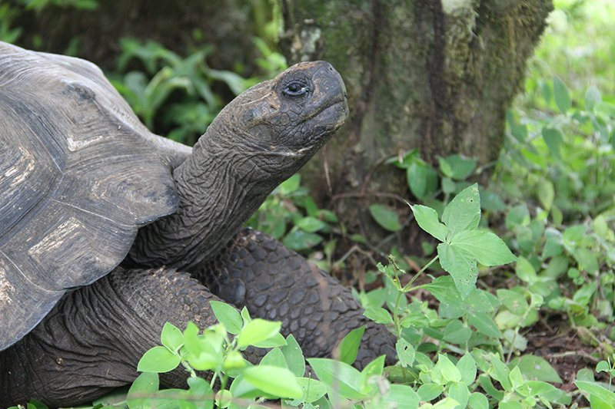
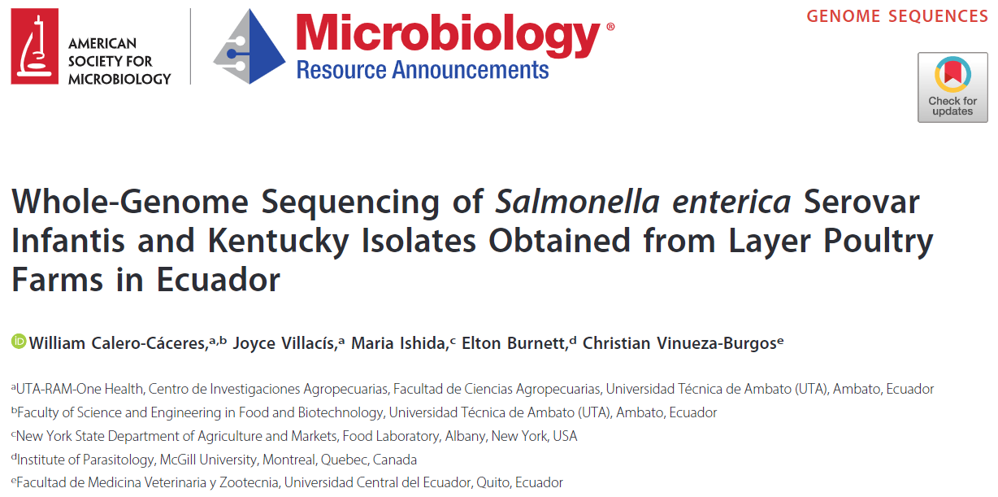
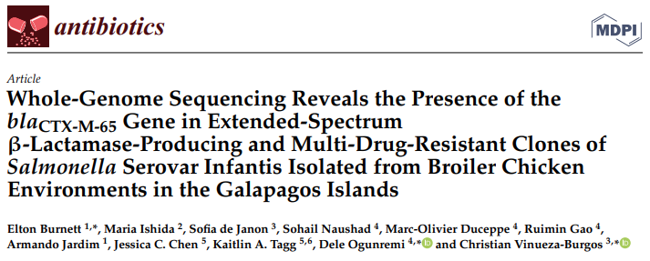
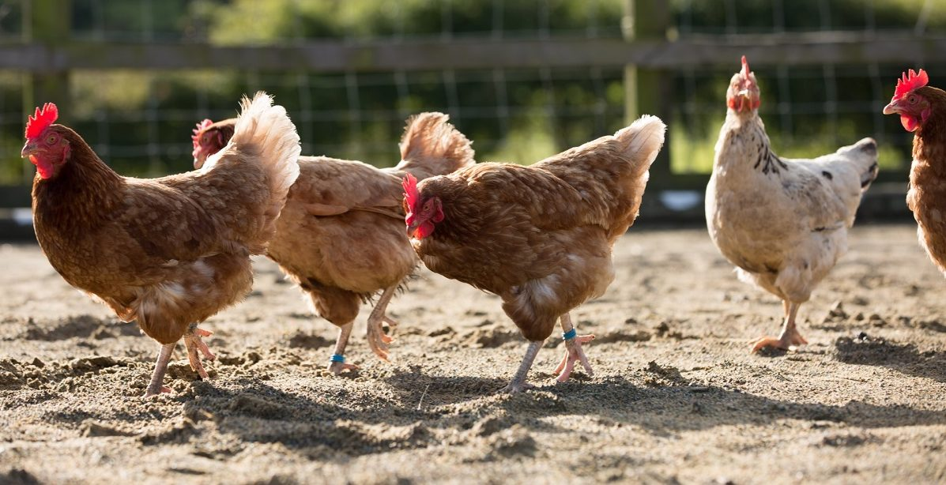

Slide 6
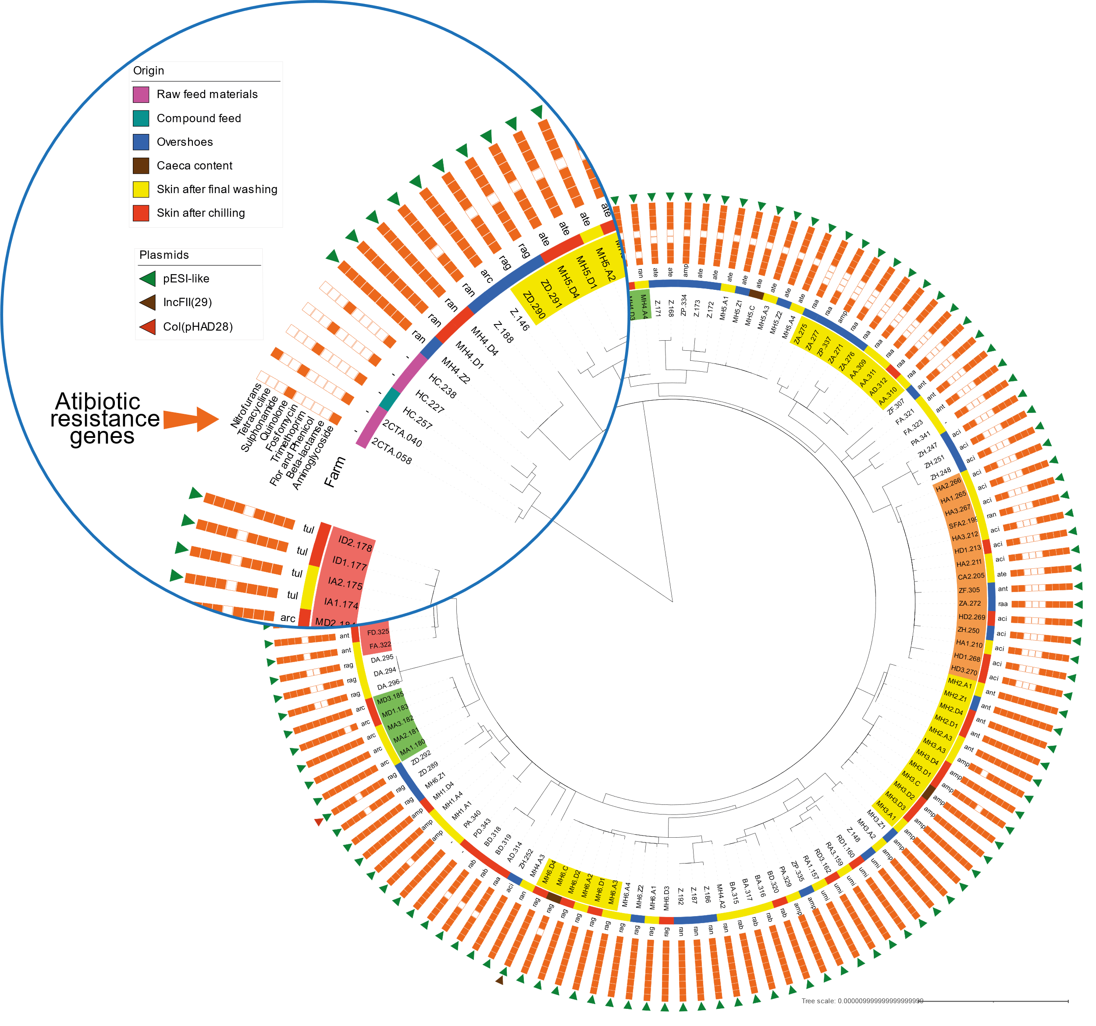
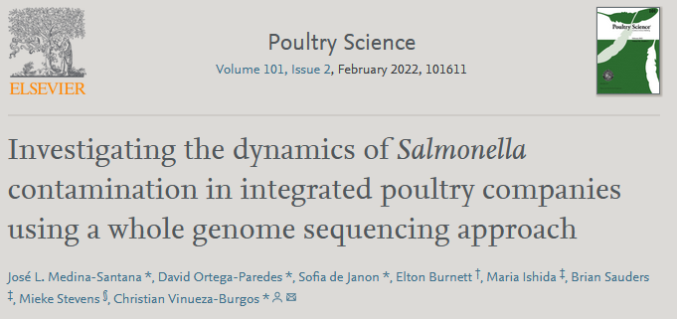
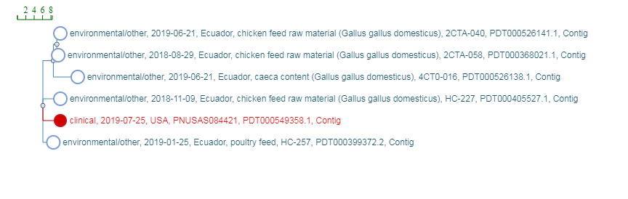

Slide 7
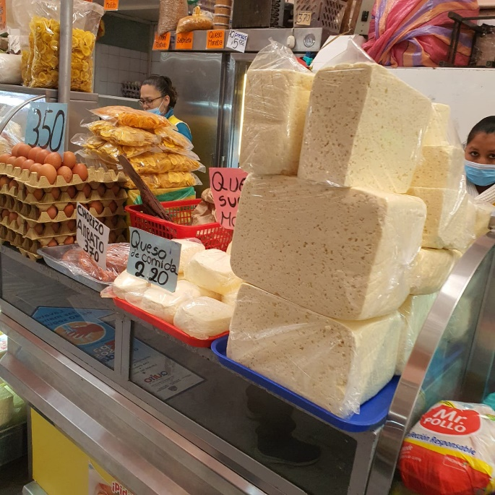
Listeria case
Samples collected from different retail levels in the frame of a project in food safety and antimicrobial resistance research.
Strains isolated in April 2021.
Isolate from fresh cheese.
Cheese acquired from traditional markets.
This kind of cheese is traditionally made (raw milk).
The cheese is stored at room temperature and sold in bulk.
Normally consumed after heat treatment.

Slide 8
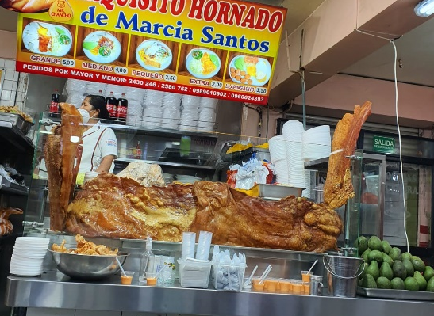
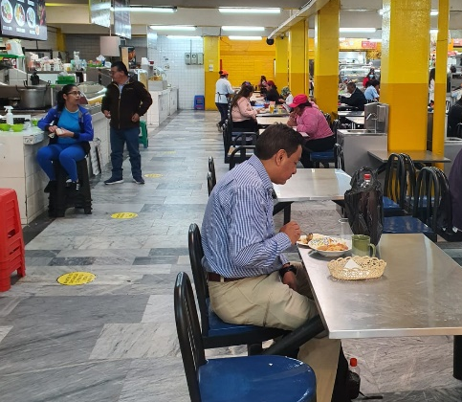
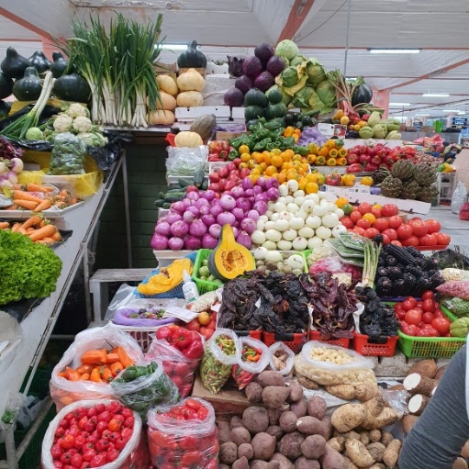
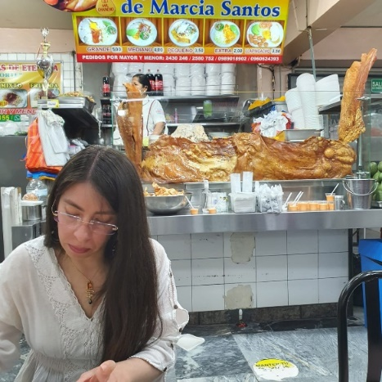
Traditional Markets

Slide 9
THANK YOU

Slide 10
Retrospective Whole Genome Sequencing (WGS) of
Listeria monocytogenes from Ecuador
GenomeTRAKR Annual Conference
October 20, 2022
Brian Sauders, PhD
Food Laboratory

Slide 11
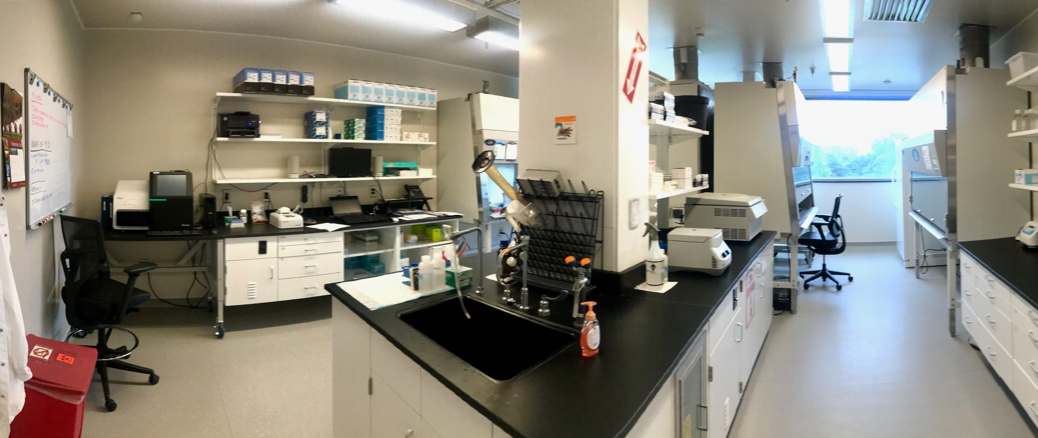
FDA GenomeTRAKR
  AGM joined FDA GenomeTRAKR in 2014
  DNA Extraction Methods
    Qiagen DNEasy Blood and Tissue Kit (24 samples/batch)
  Library Preparation and Sequencing Chemistry
    Nextera XT (2015-19)
    Switched to DNA Prep/FLEX (2019)
    MiSeq 500 cycle V2 (24 samples/run, 48/run for Campylobacter spp.)
  Initial submissions brokered by FDA to NCBI
    2019 started submitting data to PulseNet and GenomeTRAKR via Bionumerics
  External collaborations for isolates with:
    USDA Food Safety Inspection Service (FSIS)
    “Unidad de Investigación de Enfermedades Transmitidas por Alimentos y Resistencia a los Antimicrobianos” (UNIETAR) located in Quito, Ecuador

Slide 12


PulseNet/GenomeTRAKR Data Analysis
Initial evaluation of MiSeq QC metrics
Bionumerics: Multistep process, public health metadata reside on CDC server with access limited to certified participants, wgMLST based, allele code nomenclature
  REFID
  Allele calls
  PulseNet Submission
  NCBI Submission
NCBI Pathogen Detection Browser: Publicly available, SNP-based comparisons minimal metadata

Slide 13
Listeria monocytogenes from Ecuador (n=23)

Slide 14
Listeria monocytogenes from Ecuador (n=23)
B
A

Slide 15
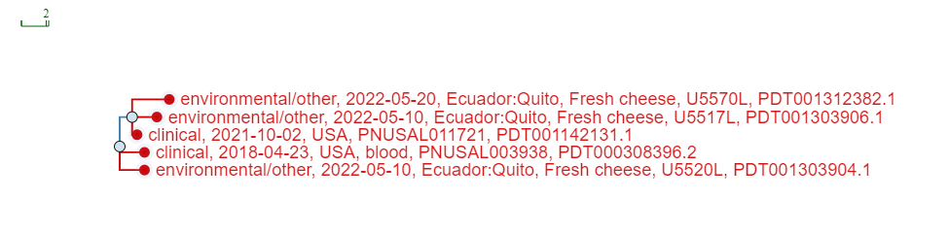
“Group A” - NCBI Pathogen Detection
NCBI PDG000000001.2952 / PDS000096788.3
Three Listeria monocytogenes isolates from Ecuador isolated May 2021
  5 SNPs from each other
Two clinical cases from US (2018 and 2022)
  2 SNPs from each other
  2-4 SNPs from the cheese isolates
https://www.ncbi.nlm.nih.gov/pathogens/tree/#Listeria/PDG000000001.2952/PDS000096788.3?accessions=PDT001303906.1

Slide 16
“Group A” – PulseNet (Bionumerics, wgMLST, SEDRIC)
Three Listeria monocytogenes isolates from fresh cheese (Ecuador) isolated May 2021
  0-2 alleles from each other
Two clinical cases from US;
  0-1 alleles different from cheese isolate U5517L
  1-2 alleles different from cheese isolates U5520L and U5570L
  FL (4/2018), NYC (9/2021)
  No travel history information available

Slide 17
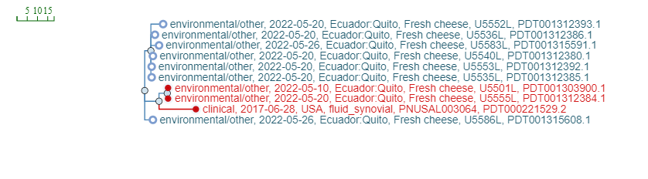
“Group B” - NCBI Pathogen Detection
Nine Listeria monocytogenes isolates from Ecuador isolated from April-June 2021
  0-7 SNPs from each other
Two fresh cheese isolates of Listeria monocytogenes were 22 SNPs different from a single human clinical case (US, June 2017)
  Additional 7 Listeria monocytogenes isolates from Ecuador 28-34 SNPs different from clinical case
  Single US case reported travel to Ecuador, cheese consumption history unknown
NCBI Cluster PDG000000001.2952 / PDS000109302.4
https://www.ncbi.nlm.nih.gov/pathogens/tree/#Listeria/PDG000000001.2952/PDS000109302.4?accessions=PDT001312385.1

Slide 18
“Group B” – PulseNet (Bionumerics, wgMLST, SEDRIC)
Nine Listeria monocytogenes isolates from fresh cheese (Ecuador) isolated April-June 2021
  0-2 alleles from each other
Two clinical cases from US;
  15 alleles different from fresh cheese isolates
  NJ (9/2016), OR (6/2017)
  No travel or food history information available for NJ case
  OR case reported travel to Ecuador; no food history available

Slide 19
“All the Rest” - Unique Listeria monocytogenes
11 isolates divided into 3 smaller groups with small differences of SNPs (0-10) within each group
No additional isolates from any source within 60 SNPs in NCBI or within 50 alleles in PulseNet US database matching any of the additional cheese isolates
Despite no remotely similar sequences identified in NCBI or PulseNet, this data could assist in future research studies or investigations.

Slide 20
Summary
Whole genome sequencing of pathogen isolates from food and food environments from international sources can provide a broader picture of genetic diversity to aid in source tracking food contamination events.
As more isolates are sequenced from international sources, real-time analysis of historical isolates may provide useful clues to the origins of various foodborne pathogens, including Listeria monocytogenes.

Slide 21

Questions?

