Slide 1
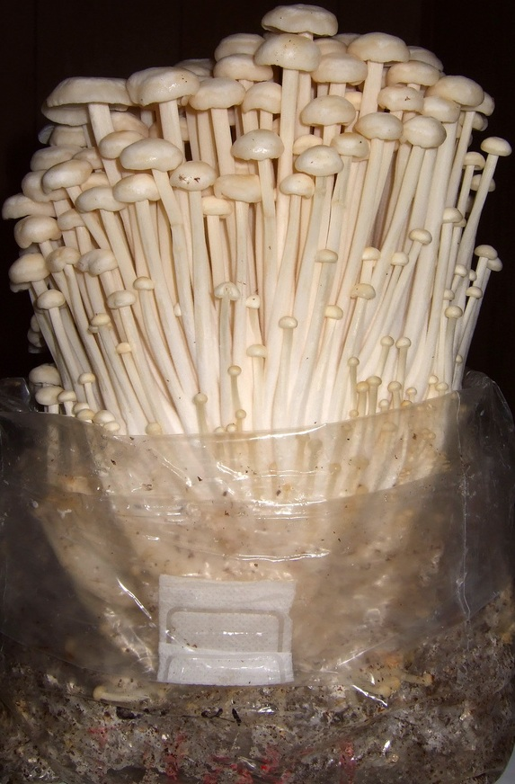
Listeria monocytogenes Evolution of a WGS Signal and Outbreak Linked to Enoki Mushrooms
James Pettengill, PhD
Director Biostatistics and Bioinformatics Staff
Center for Food Safety and Applied Nutrition
US Food and Drug Administration
https://en.wikipedia.org/wiki/Flammulina_filiformis

Slide 2
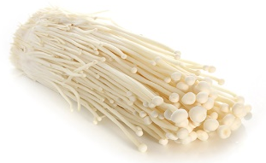
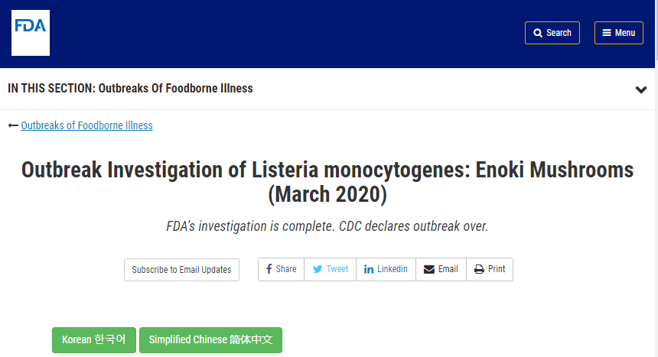

Slide 3
Timeline
2019: A cluster contained 36 clinical isolates
  a suspected food vehicle could not be identified

Slide 4
Timeline
2019: A cluster contained 36 clinical isolates
  a suspected food vehicle could not be identified
February 2020: the Canadian Food Inspection Agency (CFIA) uploaded whole-genome sequencing data for a 2016 isolate
  This matched the outbreak cluster.
  Another Canadian isolate from an imported enoki mushroom sample was uploaded that matched the outbreak cluster.
  First evidence of what contaminated food might be causing human illnesses and deaths.

Slide 5
Timeline
2019: A cluster contained 36 clinical isolates
February 2020: Canadian Food Inspection Agency (CFIA)
February to early March, 2020, US state and federal partners collected enoki mushroom product samples, which yielded 12 isolates
  They matched the outbreak cluster

Slide 6
Timeline
2019: A cluster contained 36 clinical isolates
February 2020: Canadian Food Inspection Agency (CFIA)
February to early March, 2020, US product samples, which yielded 12 isolates
March, 2020, learned via the EU Epidemic Intelligence Information System that French authorities had collected five LM isolates from enoki mushrooms originating from South Korea in 2017.
  These isolates were highly related to the outbreak
  Sequence data was made publicly available in December 2021

Slide 7
Timeline
2019: A cluster contained 36 clinical isolates
February 2020: Canadian Food Inspection Agency (CFIA)
February to early March, 2020, US product samples, which yielded 12 isolates
March, 2020, learned via the EU Epidemic Intelligence Information System that French authorities had collected five LM isolates from enoki mushrooms originating from South Korea in 2017.
  These isolates were highly related to the outbreak
  Sequence data was made publicly available in December 2021
In late March, 2020, further testing by the CFIA identified five samples of enoki mushroom that was a match to the outbreak cluster.
Additionally, through the Food and Agriculture Organization and WHO International Food Safety Authorities Network, US federal officials were notified of six clinical isolates collected in Australia between October, 2017, and March, 2020.
In April, 2020, US identifies additional LM positive imported enoki mushrooms from South Korea
  They matched the outbreak.

Slide 8
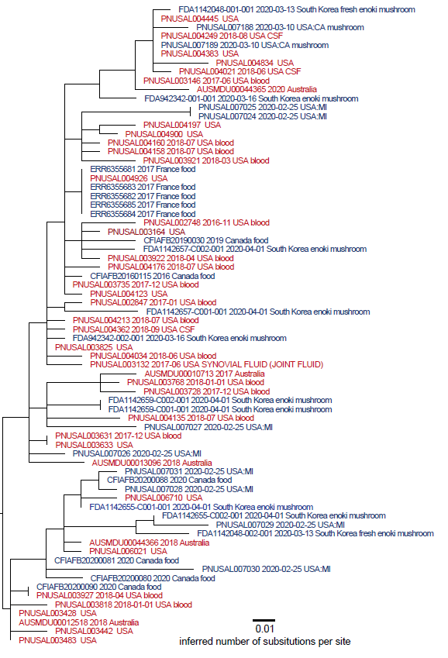
Phylogeny
minimum = 0 SNPs
maximum = 23 SNPs
average = 10 SNPs

Slide 9
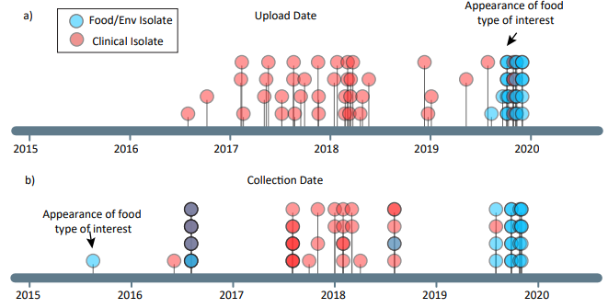
Timeline
When isolate sequence data was uploaded to NCBI Pathogen Detection database
Actual date of isolate collection

Slide 10
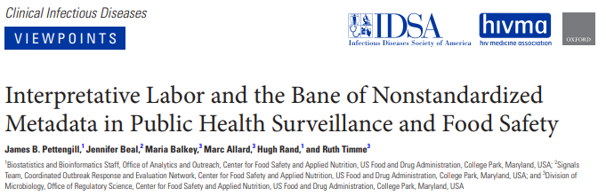
Conclusions:
International sharing of WGS and detailed metadata can be crucial to resolving outbreaks
Real-time data sharing may help detect and solve outbreaks sooner
“The willingness to share already exists, as illustrated in the often post hoc disclosure of additional information about microbiological samples from foods and food production environments that occurs upon inquiry. “

Slide 11
Acknowledgements:
NCBI Pathogen Detection
Michigan Department of Health and Human Services
California Department of Public Health
U.S. Centers for Disease Control & Prevention
U.S. Food and Drug Administration
Public Health Agency of Canada,
Canadian Food Inspection Agency
French Ministry for the Economy and Finance, General Directorate for Competition Policy, Consumer Affairs and Fraud Control
Australian OzFoodNet

Slide 13
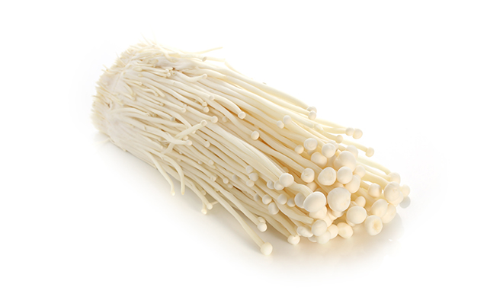
Listeria monocytogenes Outbreak Linked to Enoki Mushrooms
Evelyn Pereira, MPH
U.S. Food & Drug Administration

Slide 14



Epidemiologic Overview
Country | Canada | USA | Australia
Illnesses | 12 | 36 | 6
Isolation Dates | 8/2016-2/2019 | 11/2016-12/2019 | 10/2017-3/2020
Early epidemiologic signal for Asian-style foods including fresh product items.

Slide 15
Overview of Sampling
U.S. States: conducted targeted retail sampling
FDA: targeted sampling of all mushroom varieties imported into the USA from Republic of Korea (ROK) manufacturers of interest
Only enoki mushroom samples were positive for Listeria
Other Listeria spp. were also identified
Sample # | Collection Country | Collection Year | Collection Site | Enumeration (CFU/g)
1 | USA (MI) | 2020 | Retail | 9.0x10³
2 | USA (MI) | 2020 | Retail | 8.0x10⁵
3 | USA (CA) | 2020 | Retail | -
4 | USA (FDA) | 2020 | Import | >1.1x10³
5 | USA (FDA) | 2020 | Domestic Import | >1.1x10³
6 | USA (FDA) | 2020 | Import | -
7 | USA (FDA) | 2020 | Import | -
8 | USA (FDA) | 2020 | Import | -
9 | Canada | 2019 | Import | -
10-11 | Canada | 2020 | Retail | -
12-14 | Canada | 2020 | Import | -
15-16 | Australia | 2020 | Retail | -
17 | France | 2017 | Distributor | -

Slide 16
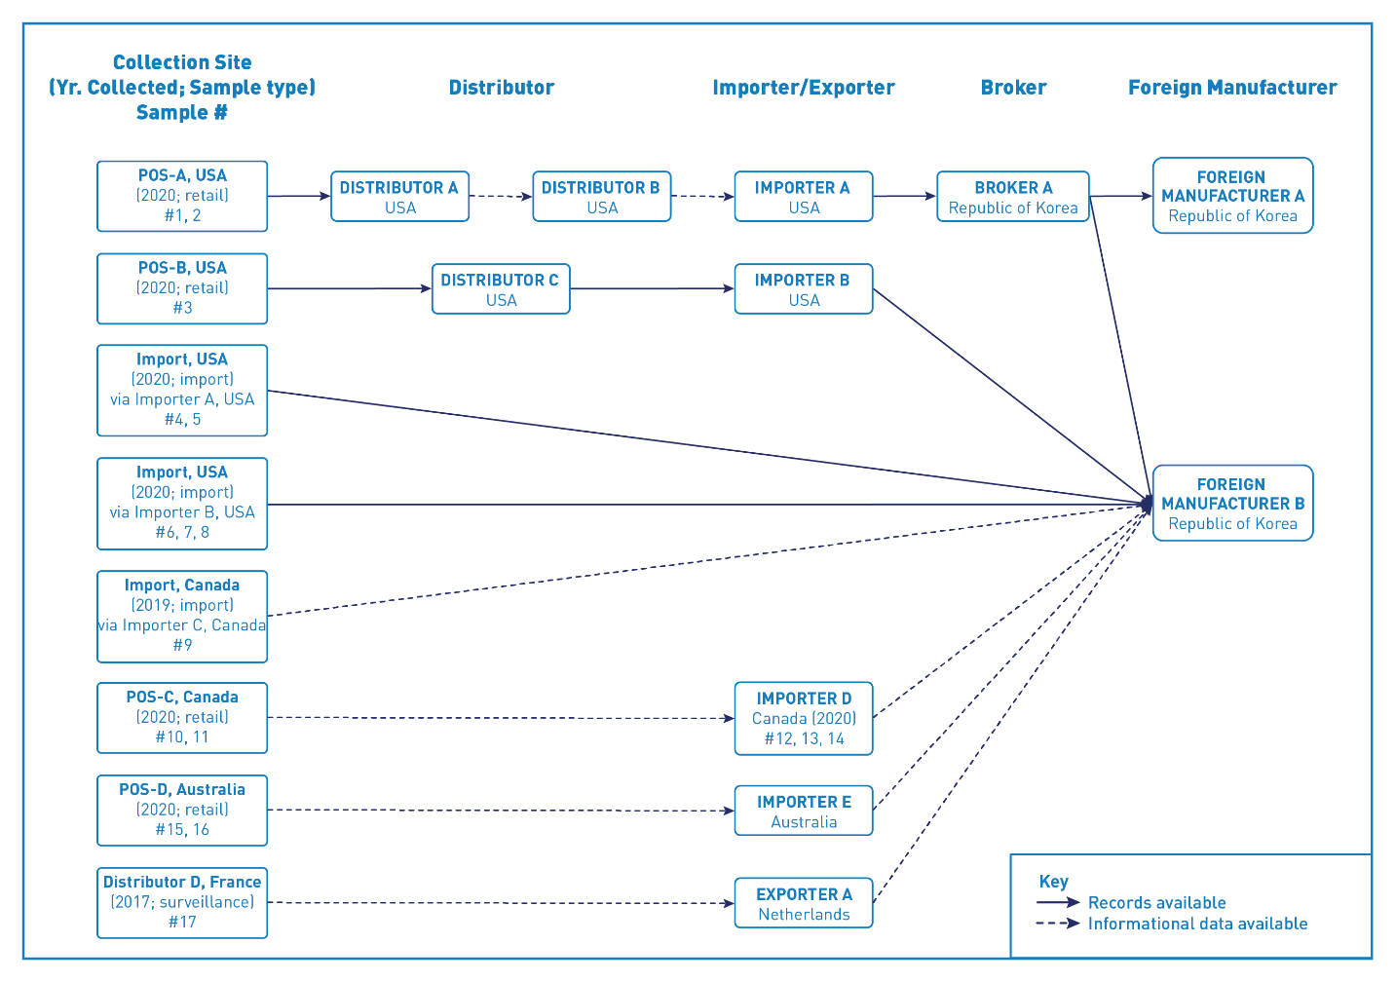
Traceback

Slide 17
Public Health & Regulatory Actions DURING the Outbreak
Foreign Supplier Verification Program (FSVP) inspections were conducted at three importers. Three Warning Letters were issued.
International Food Safety Authorities Network (INFOSAN) Alert issued in April 2020.
Recalls initiated in the U.S., Canada, and Australia for enoki mushrooms manufactured by the ROK firm.
ROK manufacturer placed on two FDA Import Alerts:
  Import Alert 99-23: Detention Without Physical Examination of Produce Due to Contamination with Human Pathogens
  Import Alert 99-35: Detention Without Physical Examination of Fresh Produce that Appears to Have Been Prepared, Packed, or Held Under Insanitary Conditions.

Slide 18
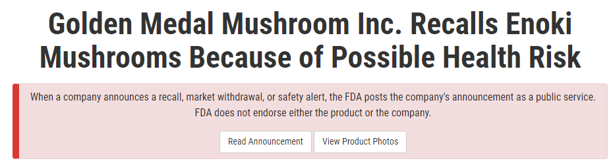
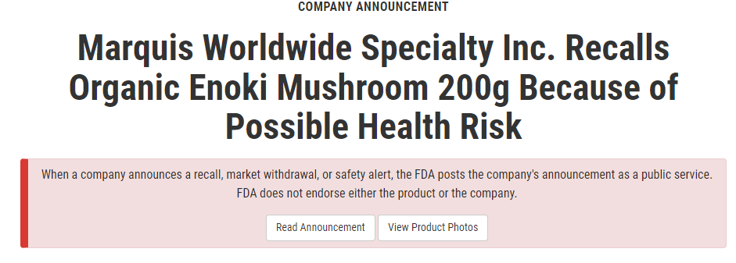
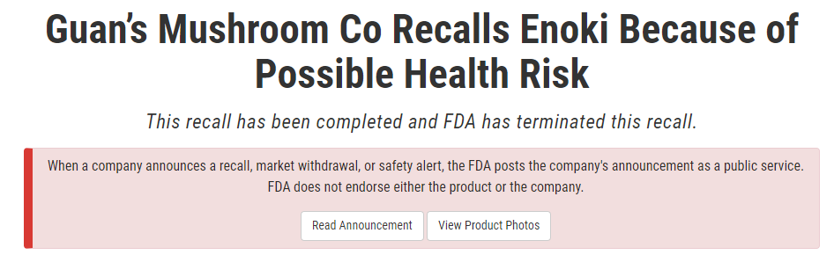
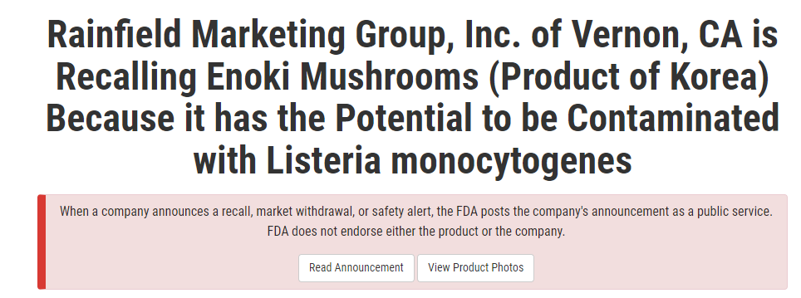
Public Health & Regulatory Actions AFTER the Outbreak
Recalls in the U.S. and Canada
Surveillance sampling of enoki mushrooms revealed that 43% of enoki mushrooms sampled from the ROK were contaminated with Listeria monocytogenes.
FDA established Import Alert #25-21, “Detention Without Physical Examination of Enoki Mushrooms from Korea (the Republic of) due to Listeria monocytogenes.”
FDA released its Strategy to Help Prevent Future Outbreaks linked to Imported Enoki Mushrooms

Slide 19
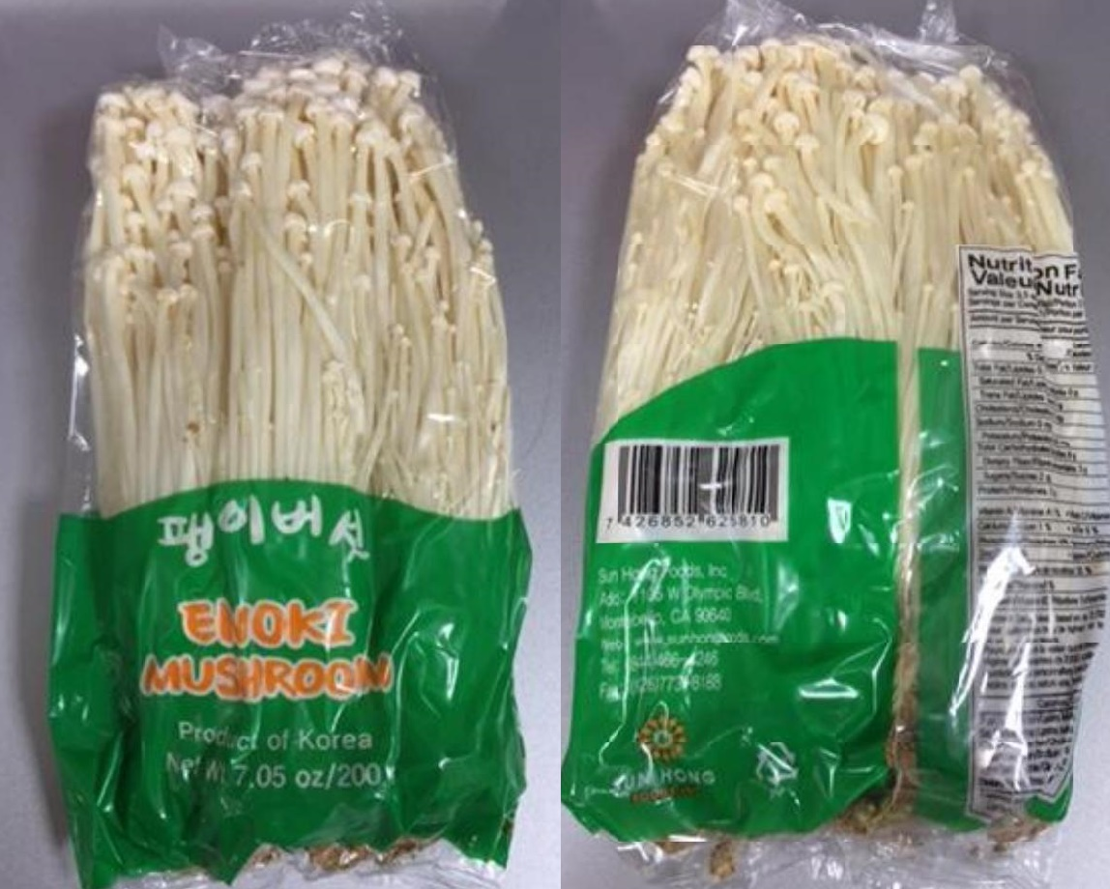
Final Thoughts
First multistate outbreak of Listeria monocytogenes linked to fresh mushrooms
Outbreak occurred over many years
Encourage data sharing among states
Encourage routine communication with international partners
  Confidentiality commitments
  Data sharing regarding investigations/firm practices
  Uploading isolates to NCBI
  Recalls of imported product

Slide 20
Acknowledgements
Michigan Department of Health and Human Services
California Department of Public Health
Centers for Disease Control & Prevention
Public Health Agency of Canada
Canadian Food Inspection Agency
French Ministry for the Economy and Finance, General Directorate for Competition Policy, Consumer Affairs and Fraud Control
Australian OzFoodNet

Slide 21



A brief history of AusTrakka
Torsten Seemann & Clare Sloggett
AUSTRALIA

Slide 22
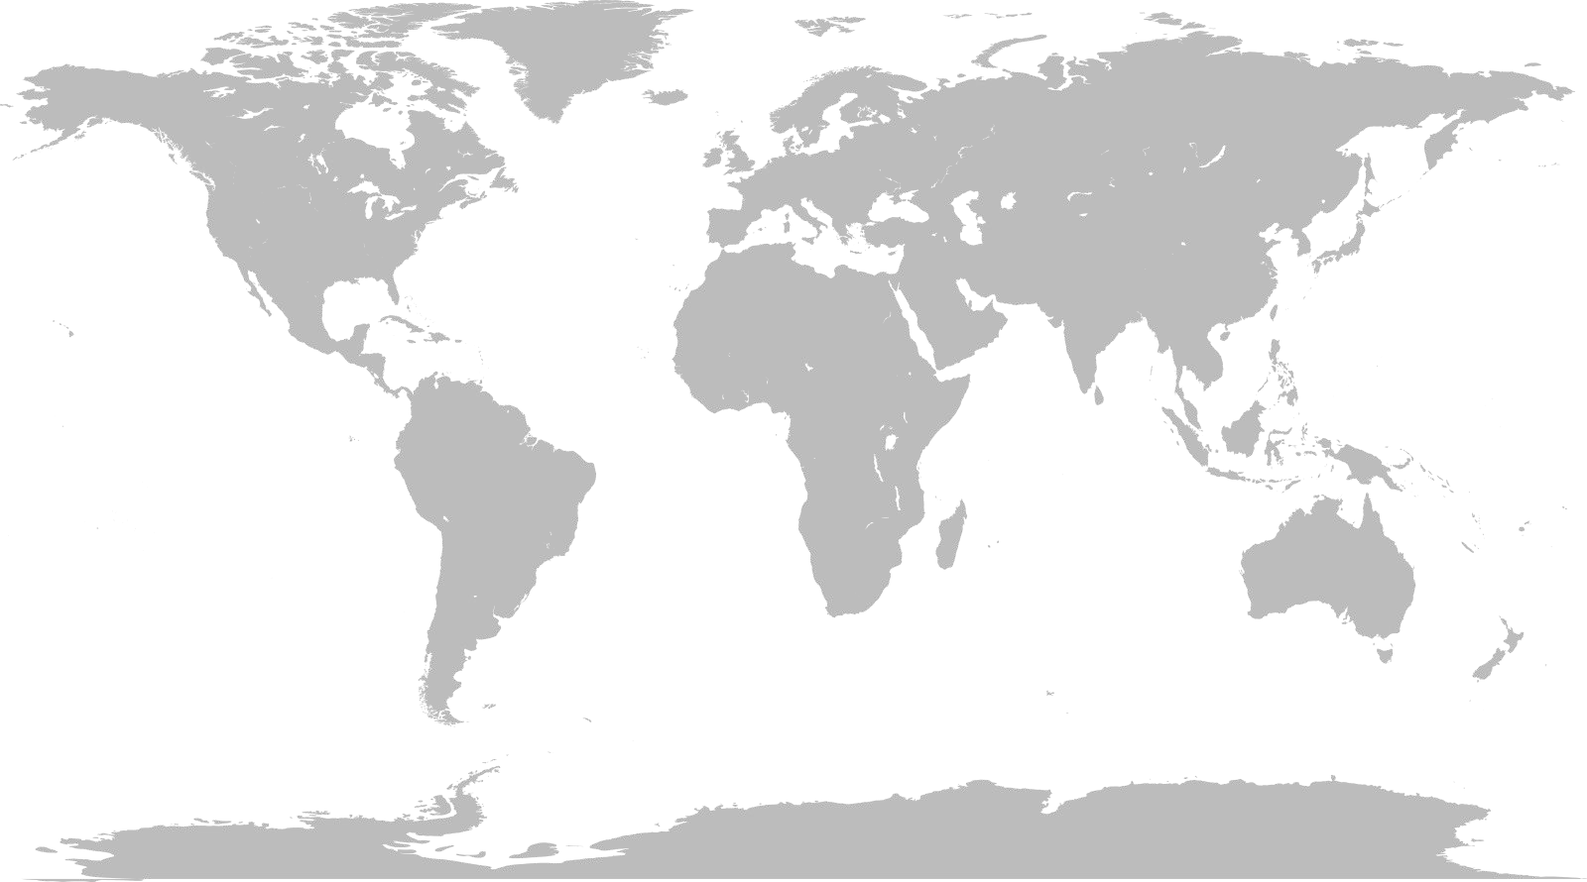


Slide 23

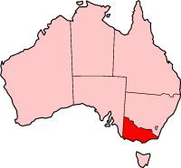


Public Health in Australia - we have no CDC/FDA
State-based health system
Public Health Unit (PHU)
Public Health Lab (PHL)

Slide 24



“Immunity and infection”
Research
Teaching
Public health and reference labs
Diagnostic services
Clinical care in ID and immunity

Slide 25


ABPHM - 2013 - Hinxton, UK
Eric Brown (FDA)
Steve Musser (CDC)

Slide 26




7th GMI - 2014 - York, UK
Marc Allard (FDA)
Ruth Timme (FDA)
Bill Klimke (NCBI)
Martin Shumway (NCBI)

Slide 27


ASM NGS + GenomeTrakr - 2015 - Washington
“We promise to submit some Listeria genomes to GenomeTrakr within a year”
Errol Strain (FDA)

Slide 28

ASM NGS + GenomeTrakr - 2015 - Washington
“We promise to submit some Listeria genomes to GenomeTrakr within a year”
Errol Strain

Slide 29
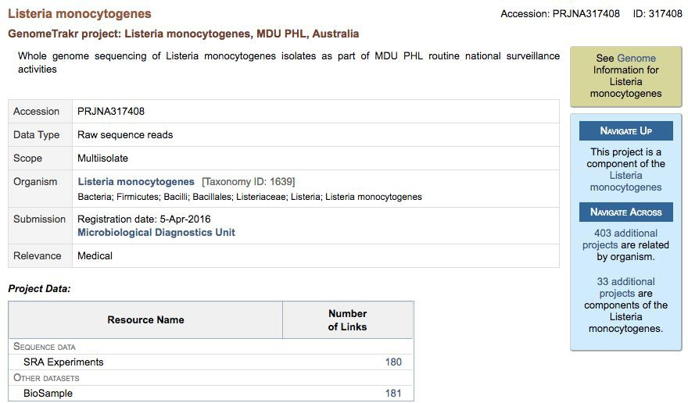

Slide 30
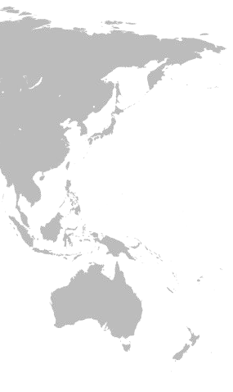
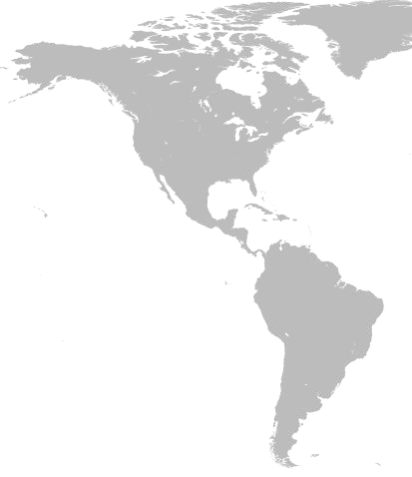

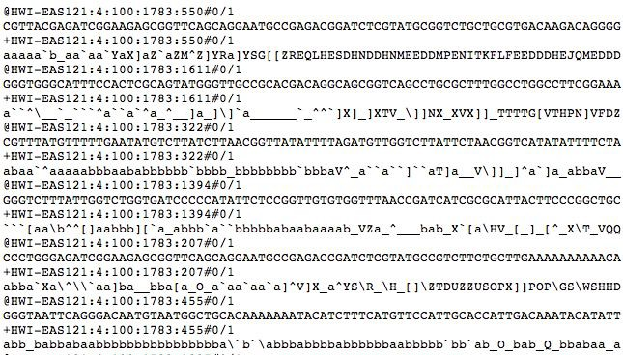
180 x Listeria monocytogenes

Slide 31
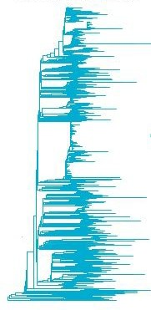


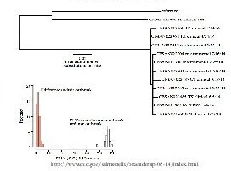



Nightly updates to ﬁnd new matches
Errol Strain (CFSAN)

Slide 32
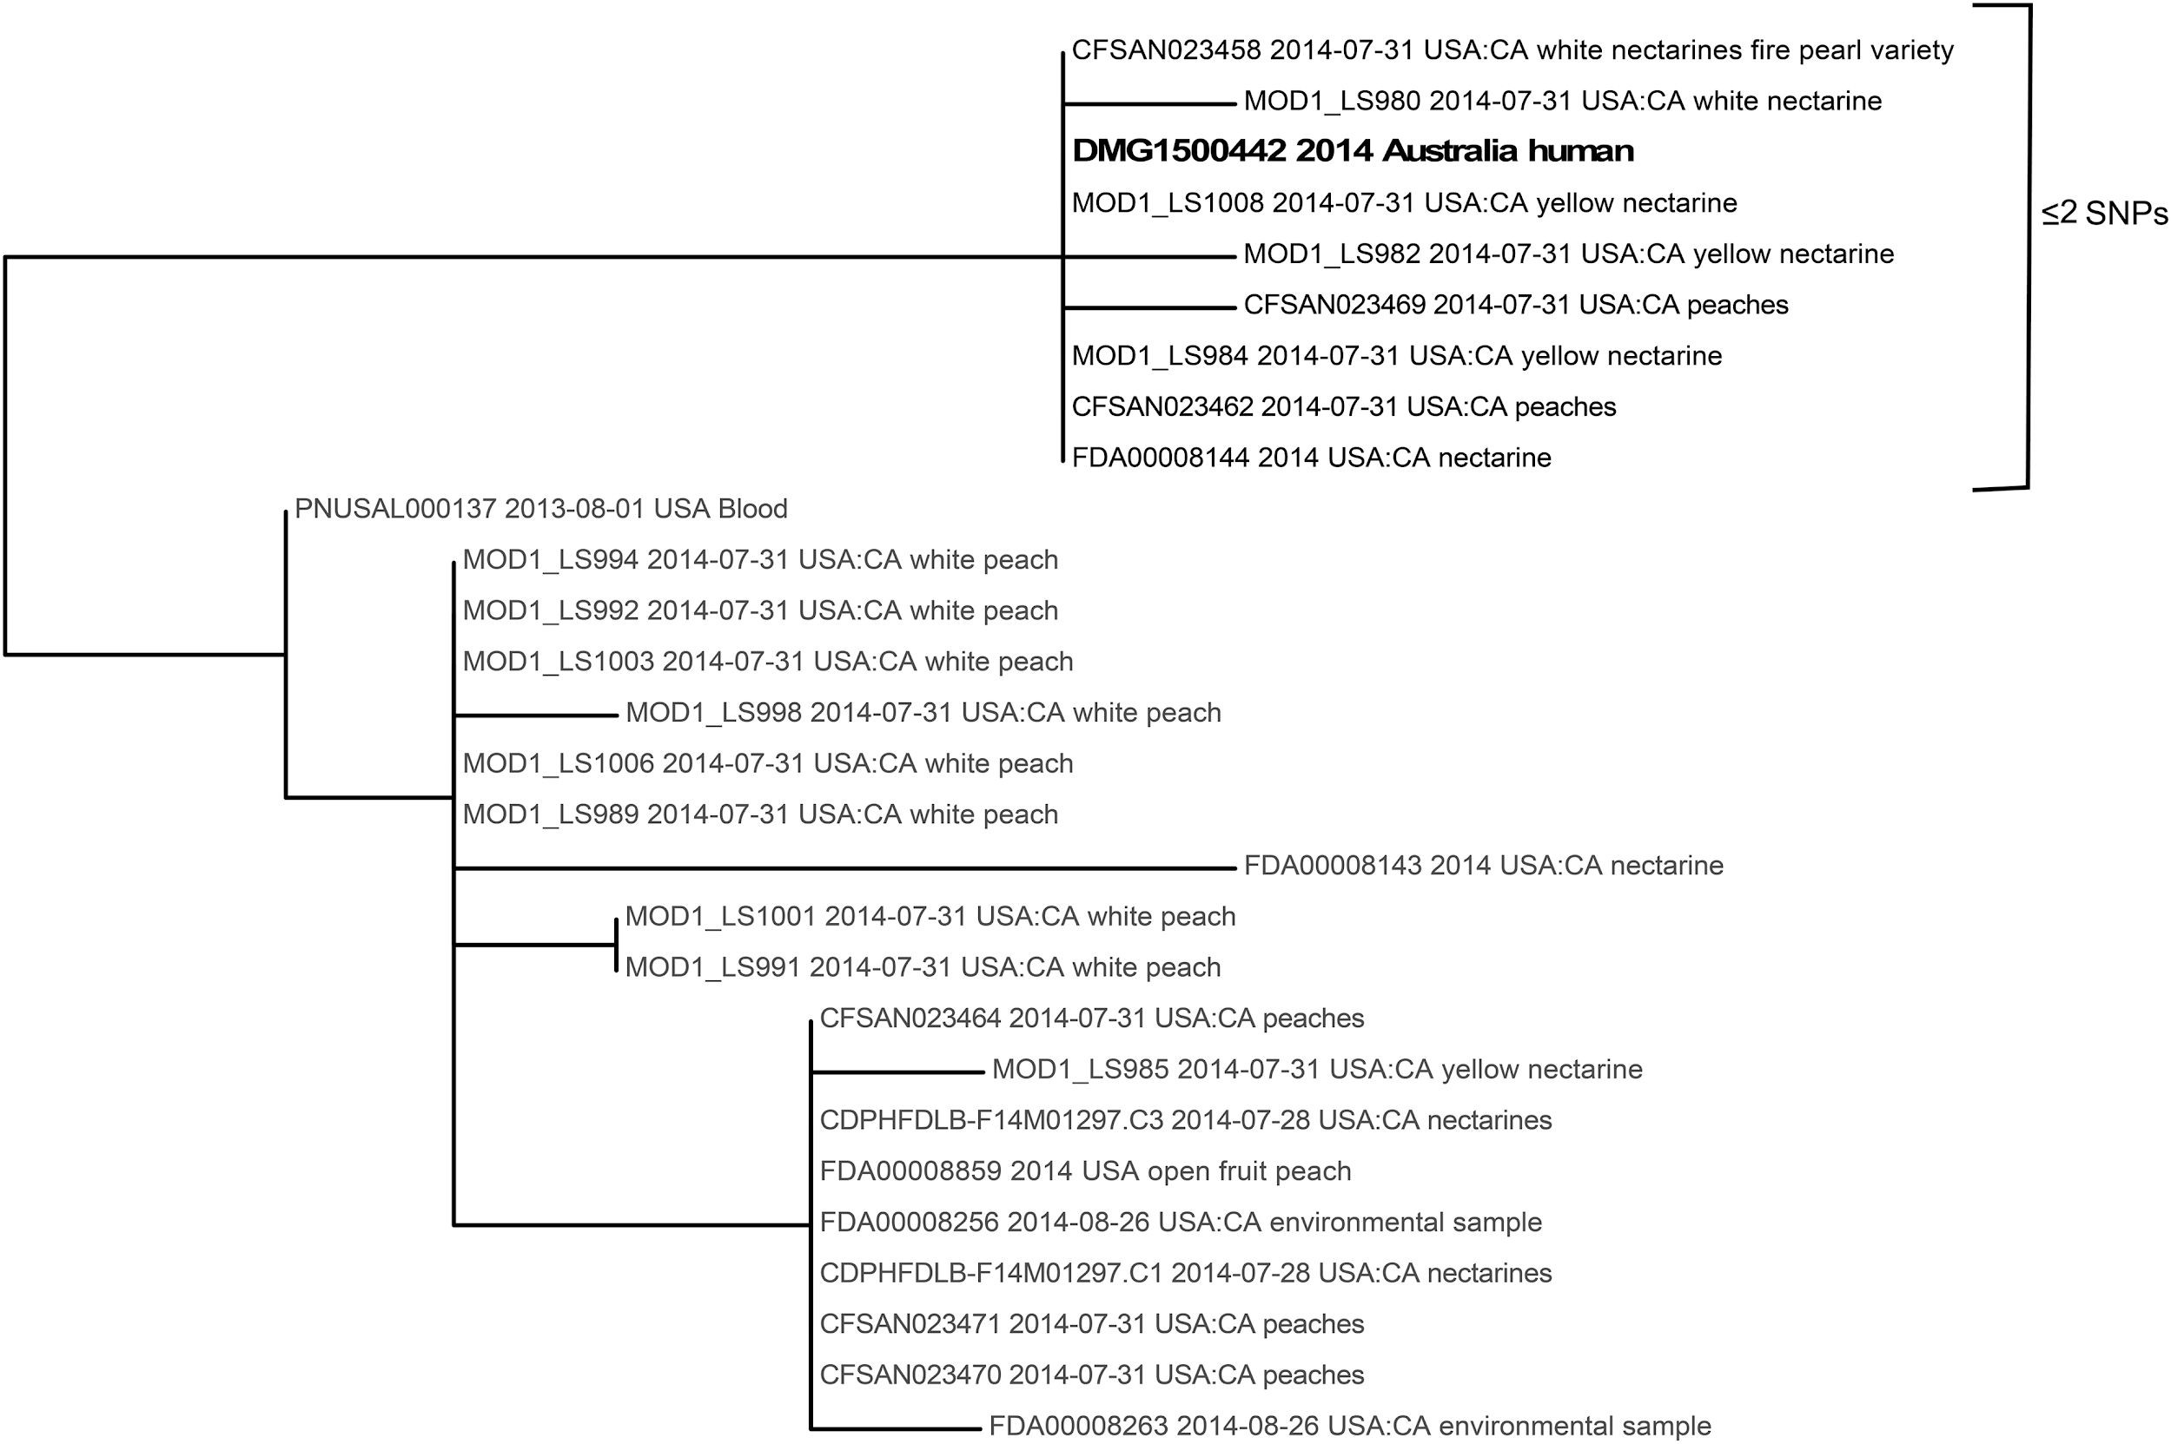

Slide 33
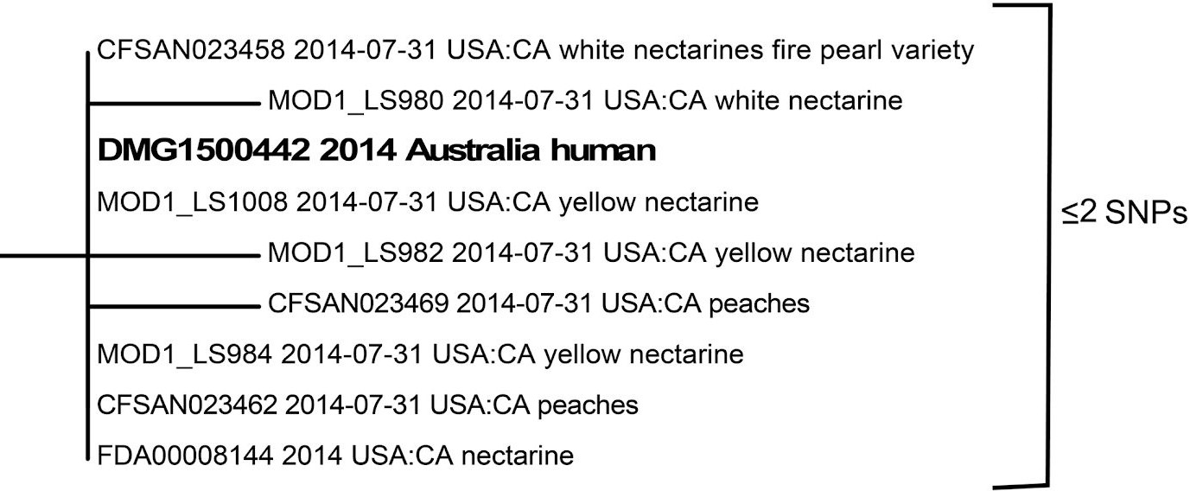

Slide 34
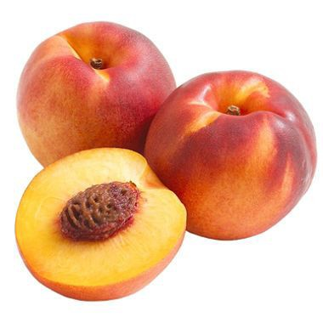


Slide 35


Slide 36
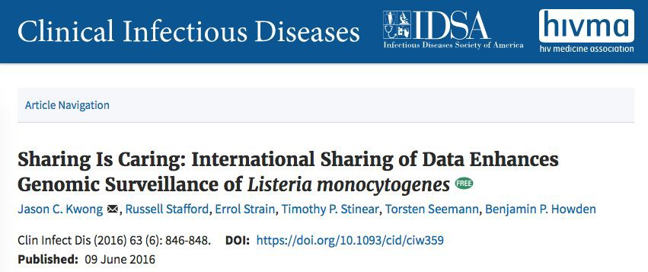
❖ FIXME

Slide 37
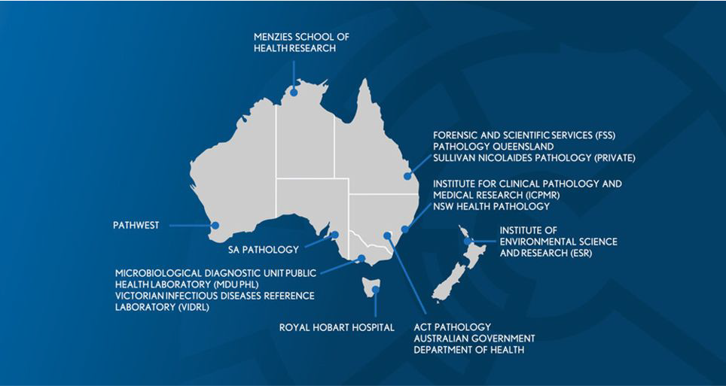
Communicable Genomics Disease Network

Slide 38

AusTrakka - initial concept
A national version of GenomeTrakr
Private to network members
Upload isolate sequence data
Consistent bioinformatic analysis
QC, typing & relatedness
Web based real-time reporting

Slide 39

YEARS
of hard yakka

Slide 40
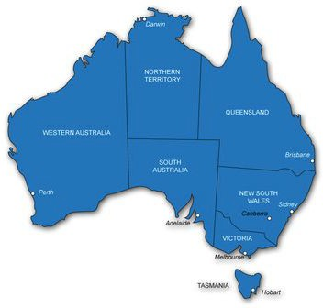

Data sharing agreement for Australia !
2019

Slide 41
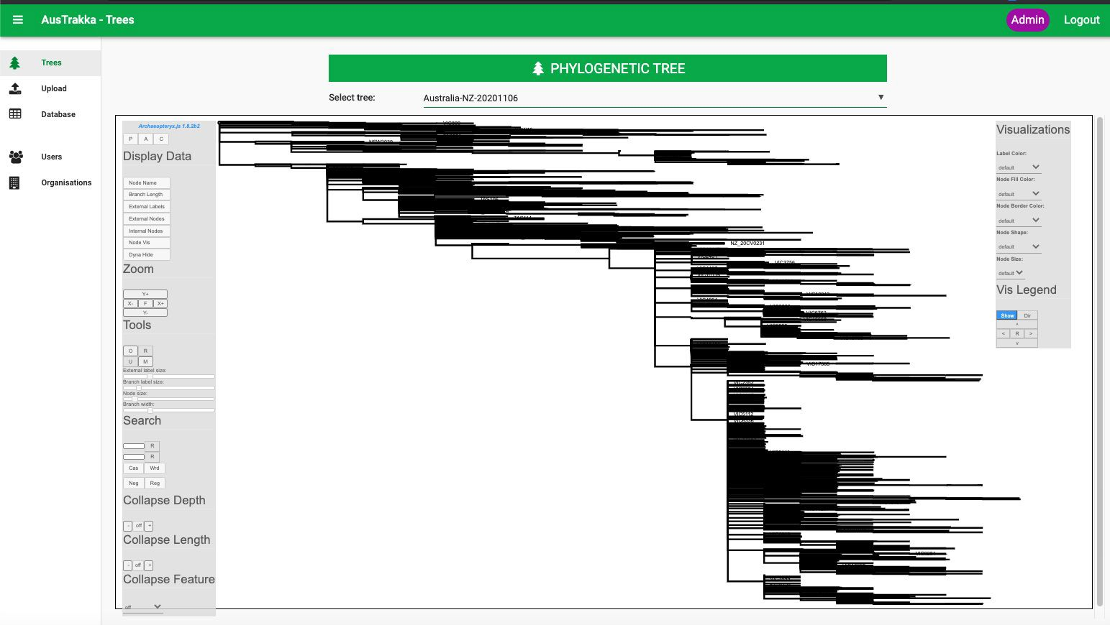

Slide 42
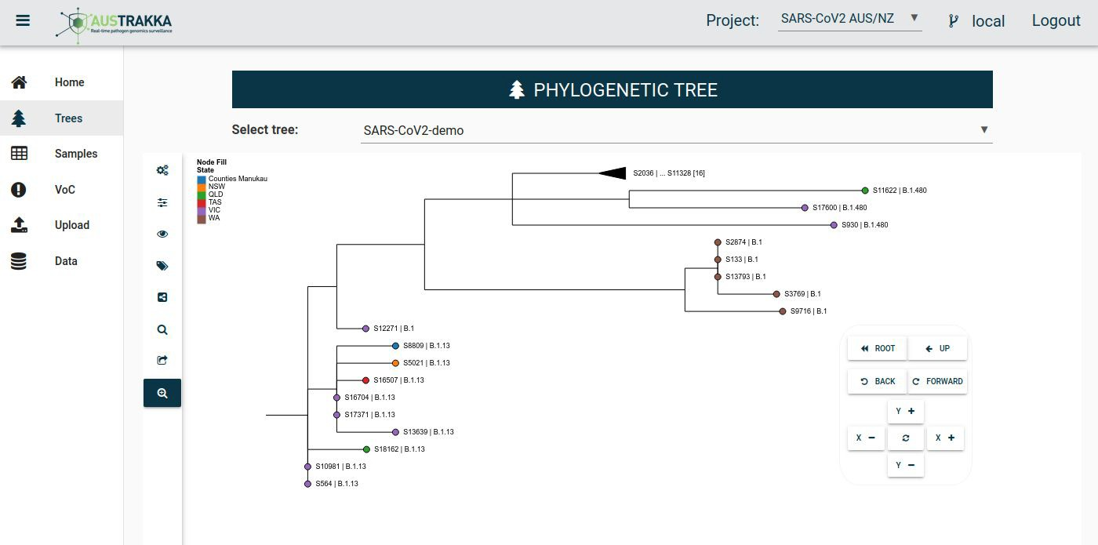

Slide 43
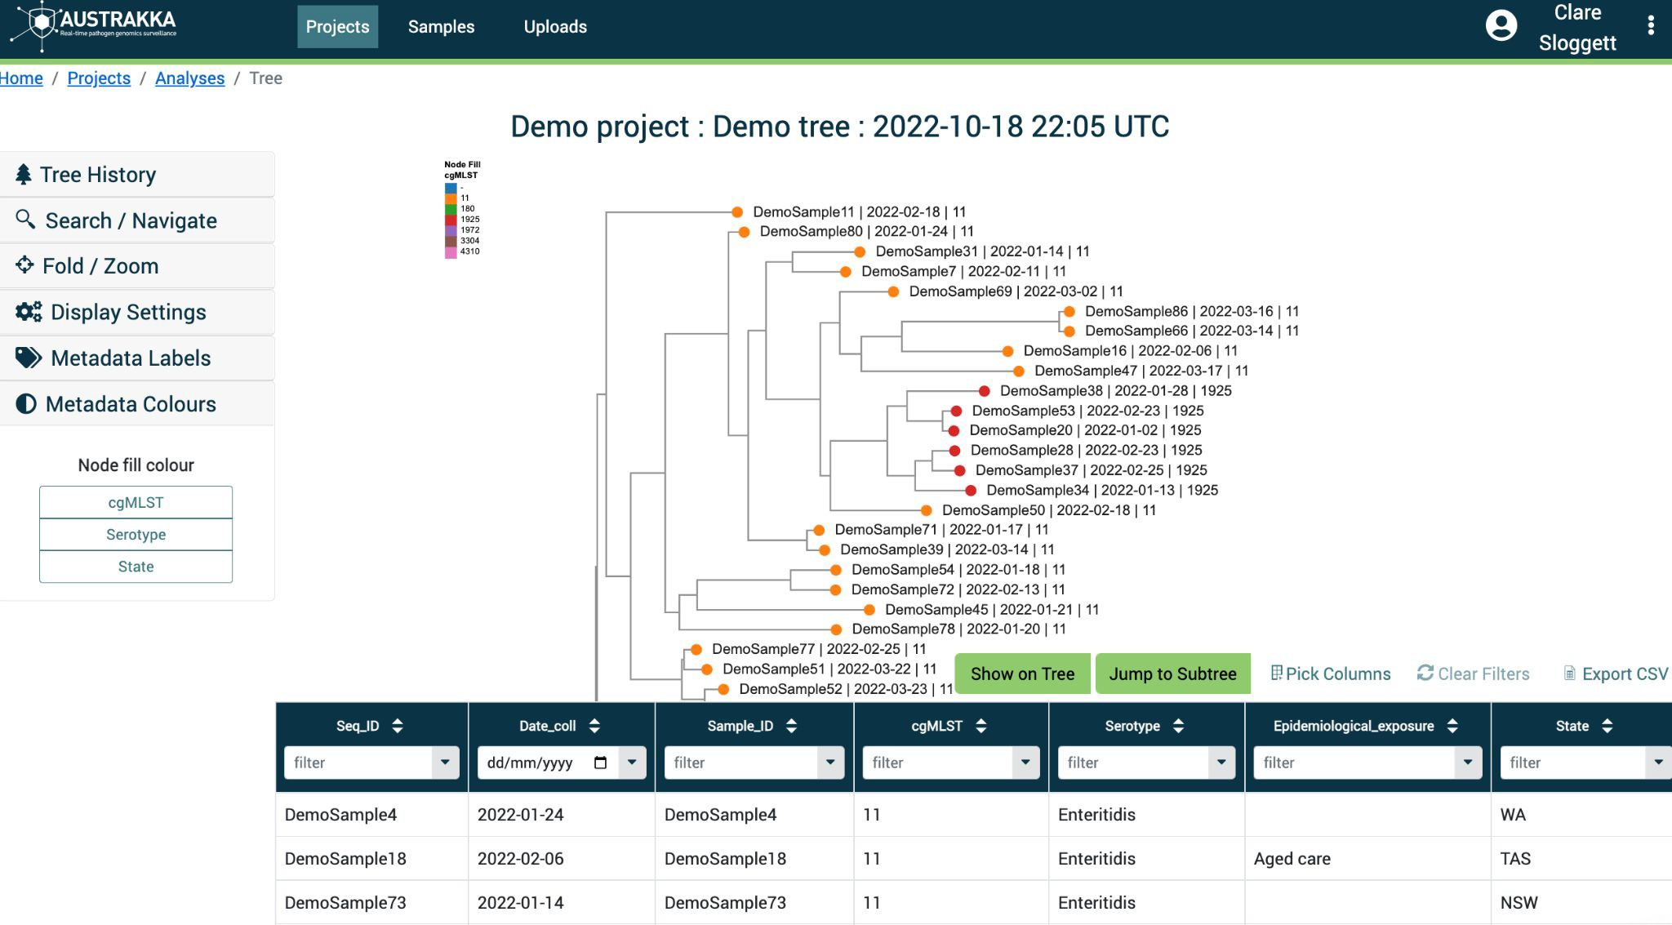
23

Slide 44








Architecture
Command Line
Browser
API Gateway Load Balanced
API
Server
File storage
Identity Server
Database
Background analysis tasks
24

Slide 45














The AusTrakka team
AusTrakka Advisory Group
Prof Ben Howden (VIC)
A/Prof Amy Jennison (QLD)
Prof Vitali Sintchenko (NSW)
A/Prof Torsten Seemann (VIC)
Amy Black (Commonwealth)
Tuyet Hoang (Program manager)
AusTrakka National Analysis Team
Mathilda Wilmot
Dr Patiyan Andersson
Dr Connie Lam
Dr Son Nguyen
Dr Alicia Arnott
AusTrakka Development Team (University of Melbourne)
A/Prof Torsten Seemann
Dr Anders Goncalves da Silva
Dr Clare Sloggett
Samuel Carswell
Vi Phu
25

Slide 46





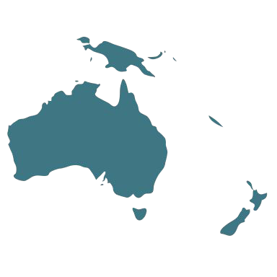

AusTrakka aligns with GenomeTrakr
Australia’s national real-time genomics surveillance platform
A secure genomic data sharing, analysis and visualisation platform
Nationally agreed system for data sharing and analysis
Provide bioinformatics and analysis capacity to public health labs
Genomic outbreak investigation tool
Community for building pathogen genomics capacity for public health
26

Slide 47

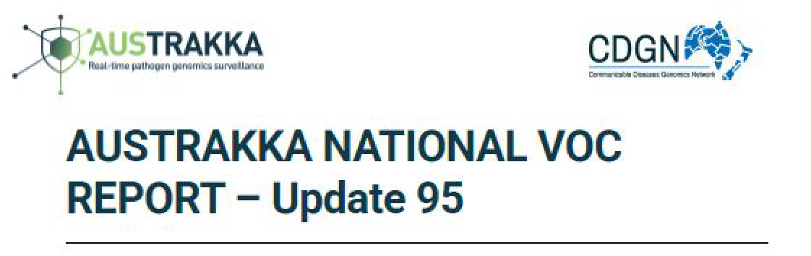

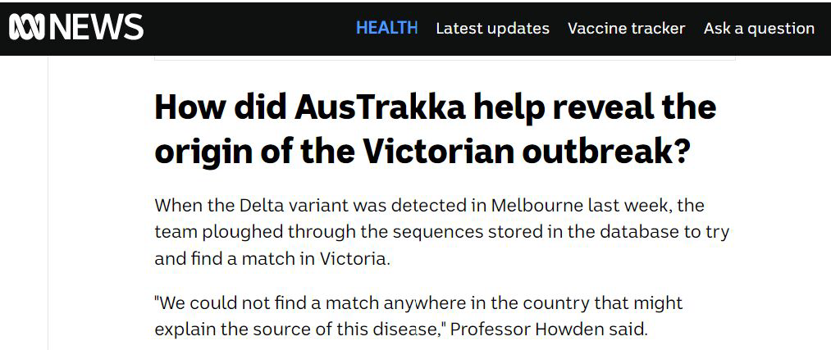

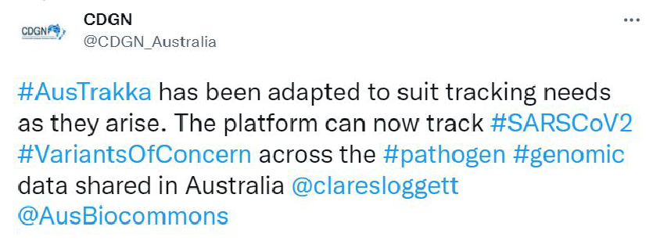

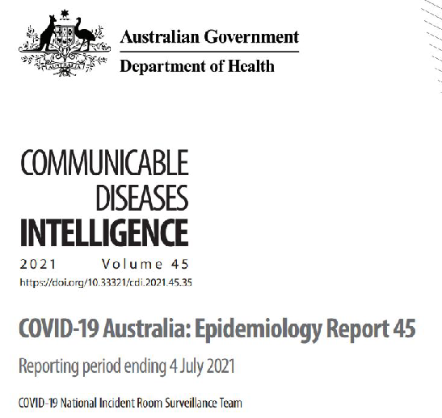

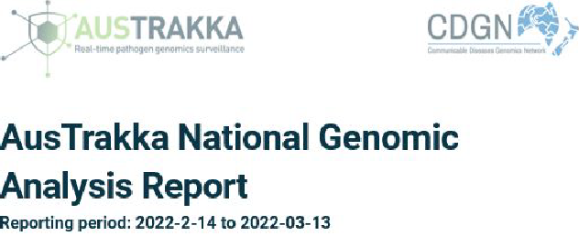

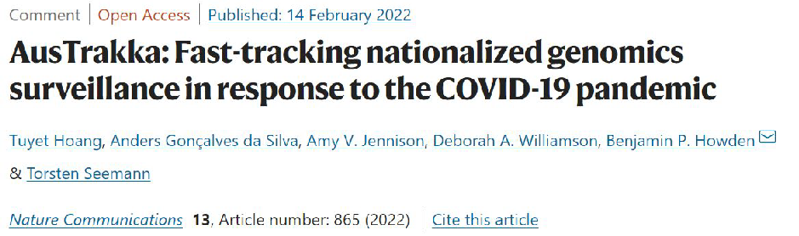
What are the outputs?
27

Slide 48

Uploading to GenomeTrakr
We fell behind but ﬁxing this now!
  5500 Salmonella
  130 Listeria
  Getting permission for more species
Regular upload schedule
Goal: Upload from AT to GT for all States
28

Slide 49


















Acknowledgements
AusTrakka development team
AusTrakka community
AusTrakka funders
Meeting organisers

Slide 50

THANK YOU
CONTACT US
E: team@austrakka.net.au

