Slide 1


Using Whole Genome
Sequencing Data
to Inform Food Safety
Actions
Kristina Barlow and Meryl Silverman
Genome Trakr Meeting
October 20, 2022
Notes:
Abstract
Introduction: The Food Safety and Inspection Service (FSIS) analyzes whole genome sequencing (WGS) data from ready-to-eat (RTE) meat and poultry establishments to inform food safety actions.
Purpose: This study describes the results from the WGS analysis FSIS has performed from July 2020 to September 2021 in RTE establishments and describes how the agency has used this data to inform Public Health Risk Evaluations (PHREs) and Food Safety Assessments (FSAs).
Methods: FSIS analyzes RTE product, food contact, and non-food contact samples WGS data from Listeria monocytogenes (Lm) positive isolates. The Agency uploads the sequences from the isolates to the National Center for Biotechnology Information (NCBI) database. FSIS then analyzes the data to determine if the isolates are part of a cluster containing clinical isolates uploaded within the last two years. The Agency also considers whether there are multiple isolates from other sources in the same NCBI cluster to determine if and how the information should be used to inform the PHREs and or FSAs performed by FSIS.
Results: During the study time-period, 76 sampling events occurred where one or more FSIS Lm isolates were sequenced. Of these, five isolates were part of a cluster with one or more human illness isolates, and WGS analyses for two of the FSIS Lm isolates supported investigations. In one analysis, an isolate from a RTE product at one establishment was found to be closely related to a RTE product from another establishment. Investigations identified product commonalty, and clinical isolates were later identified, leading to an outbreak investigation and an Agency recommendation to recall the product.
Significance: FSIS utilizes the results from WGS analyses to inform PHREs/FSAs and to identify information for outbreak investigations and potential recalls. Analyzing this information helps FSIS protect public health by identifying adulterated product and removing it from the marketplace.

Slide 2




Using Whole Genome Sequencing (WGS) at the Food Safety and Inspection Service (FSIS)
What?
How?
Why?
FSIS inspectors collect samples and communicate with the
establishment
We protect public health by:
Tracing foodborne outbreaks to FSIS regulated food products
Identifying harborage and cross-contamination in FSIS regulated facilities
Sharing data with public health partners
Enforcement Actions
FSIS laboratories perform WGS, analyze and upload data, and monitor isolates
Inform Policy
FSIS investigators monitor and investigate isolates
FSIS analysts use data for reporting
Grow Partnerships
FSIS policymakers integrate WGS into policies
Notes:
FSIS uses WGS in a number of ways that touches across all of our various offices. WGS informs our food safety actions as well as our policy development and partnerships.

Slide 3
Listeriosis Outbreaks Associated with Meat and Poultry Products and WGS
FSIS transitioned fully to WGS in January 2018.
Since then, we have investigated seven listeriosis outbreaks; three were linked to FSIS regulated products:
  2018 cooked country-cured ham outbreak (4 cases, 1 death)
  2018 pork roll outbreak (4 cases, 0 deaths)
  2021 ready-to-eat (RTE) chicken outbreak (3 cases, 1 death)
FSIS routine sampling and WGS are critical to generating hypotheses and informing outbreak investigations.
3
Notes:
WGS has definitely had an impact on how we investigate and solve outbreaks. One thing we have found with Listeria in particular due to the challenges with investigating listeria outbreaks is that FSIS routine sampling and WGS of isolate collected from those samples is critical to generate hypotheses and inform outbreak investigations. Since we transitioned to WGS in January of 2018 we have investigated seven listeriosis outbreaks with three linked to FSIS regulated products. Routine and investigational testing by FSIS was critical to solving these outbreaks.

Slide 4
Listeria monocytogenes (Lm) WGS Data Sharing
FSIS routinely collects and analyzes RTE product, food contact, and non-food contact samples for Listeria monocytogenes (Lm).
FSIS sequences each isolate and uses WGS to determine whether there is potential for harborage or cross-contamination when there are multiple isolates collected from the same establishment.
FSIS also uploads the sequences from the Lm isolates to the National Center for Biotechnology Information (NCBI) database and determines whether there are closely related clinical isolates (human listeriosis) uploaded within the last 2 years and when an illness investigation is not triggered.
This WGS information is shared with FSIS’ district offices (DO) in a WGS report.
Notes:
I mentioned routine sampling has been critical to generate hypotheses and inform outbreak investigations. We also routinely collects and analyzes RTE product, food contact, and non-food contact samples for Listeria monocytogenes (Lm). The primary purpose of that sampling is to verify compliance with the Listeria rule and HACCP requirements.
FSIS sequences each isolate and uses WGS to determine whether there is potential for harborage or cross-contamination when there are multiple isolates collected from the same establishment.
FSIS also uploads the sequences from the Lm isolates to the National Center for Biotechnology Information (NCBI) database and determines whether there are closely related clinical isolates (human listeriosis) uploaded within the last 2 years and when an illness investigation is not triggered.
This WGS information is shared with FSIS’s District Offices in a WGS report.

Slide 5
Establishment | Field | Isolate Results
Establishment Number | FormID
 | Collect Date
 | Allele Code
 | MLST ST
 | Project
 | FSIS Identifier
 | NCBI Accession Number
 | NCBI SNP Cluster (retrieve date)
 | Min Food Env (SNP)
 | Indicative of Potential Harborage | Yes/No
 | Indicative of Cross- Contamination | Yes/No
 | Min Clinical (SNP)
 | Potentially related to a clinical isolate | Yes/No
Lm WGS Reports
After WGS is complete, a report is sent to the appropriate DO.
This report is also sent to the Food and Drug Administration if it is a dual-jurisdiction the establishment (DJE).
If “yes,” FSIS provides another report to the DO with more detail (“Triage Team Report”).
Notes:
After WGS is complete, a report is sent to the appropriate District Office (DO).
The report has the information shown on this slide and also lets the field know whether it is the establishment’s first positive or not.
This report is also sent to the Food and Drug Administration (FDA) if the establishment is Dual-Jurisdiction. We recently started a more formal collaboration to more routinely share this WGS information.
If, “yes”, FSIS provides another report to the DO with more detail (“Triage Team Report”).

Slide 6

Public Health Risk Evaluations (PHRE)
In response to pathogen positive RTE results, the district office schedules a Public Health Risk Evaluation (PHRE).
Establishments are evaluated on:
  Noncompliance history
  Recall history
  Performance standard categorization
  Sampling history
  WGS findings
PHREs may lead to a comprehensive in-plant assessment, or food safety assessment (FSA), that may include sampling.
Harborage
Cross-contamination
If the isolates are part of a cluster containing clinical isolates
Notes:
In response to pathogen positive RTE results, the District Office schedules a Public Health Risk Evaluation (PHRE).
Establishments are evaluated on:
Noncompliance history
Recall history
Performance standard categorization
Sampling history
WGS findings
In terms of WGS findings – we consider whether the establishment has had a history of harborage, cross-contamination and if the isolates are part of a cluster containing clinical isolates. This is when we share that Triage Team report I just mentioned and as part of that the Agency also considers whether there are multiple isolates from other sources in the same NCBI cluster to determine if and how the information should be used to inform the Public Health Risk Evaluations and or Food Safety Assessments (FSAs) performed by FSIS. This context is shared with the District Offices in a Triage Team Summary Report.
PHREs may lead to a comprehensive in-plant assessment--Food Safety Assessment (FSA) that may include sampling.

Slide 7
Purpose: To describe the results from the Lm WGS analysis FSIS has performed in RTE establishments and how the agency has used this data to inform its food safety actions.
Triage Team Activity Analysis
From July 2020 through June 2022, there were 135 Listeria monocytogenes positive sampling events with sequenced isolates available for analysis.
  Of the 135 positive samples events, 69 (51%) were the establishment’s first positive reflecting the sporadic nature of Lm contamination and the need for comprehensive sampling to help FSIS verify Lm control.
  In addition, 15 of the 135 positive samples events (11%) met FSIS’ Triage Team criteria (were part of a cluster containing clinical isolates uploaded to NCBI in the last two years).
    Of the 15 isolates that met FSIS’ Triage Team criteria, 12 (71%) were the establishment’s first positive result from FSIS testing.
    Of the 15 isolates that met FSIS’ Triage Team criteria, 2 (13%) were associated with potential harborage within the establishment.
Notes:
The purpose of this analysis was to describe the results from the Lm WGS analysis FSIS has performed in RTE establishments and how the agency has used this data to inform its food safety actions.
We also set out to identify the number of times this triage team criteria was met and to determine if there were any trends in establishments that met our criteria.
From July 2020 through June 2022, there were 135 Listeria monocytogenes positive sampling events with sequenced isolates available for analysis.
Of the 135 positive samples events, 69 (51%) were the establishment’s first positive reflecting the sporadic nature of Lm contamination and the need for comprehensive sampling to help FSIS verify Lm control.
In addition, 15 of the 135 positive samples events (11%) met FSIS’ Triage Team criteria (were part of a cluster containing clinical isolates uploaded to NCBI in the last two years).
Of the 15 isolates that met FSIS’ Triage Team criteria, 12 (71%) were the establishment’s first positive result from FSIS testing.
Of the 15 isolates that met FSIS’ Triage Team criteria, 2 (13%) were associated with potential harborage within the establishment.

Slide 8
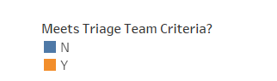
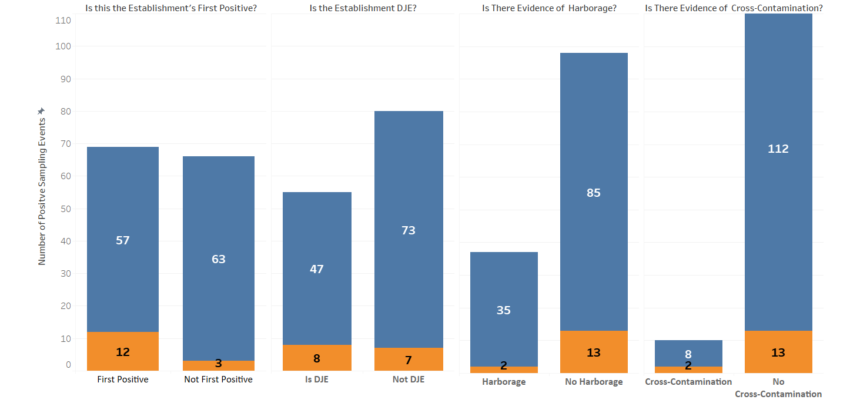
What Cases Met Triage Team Criteria?*
(July 2020 through June 2022)
^
^
**
  *Is closely related to ≥ 1 clinical isolate (human listeriosis) in the NCBI within the last 2 years and when an illness investigation is not triggered.
  **Thirteen establishments had two positives, two establishments had three, and one had four during the analysis period. Two establishments met the Triage Team criteria twice.
  ^Five sampling events indicated both potential harborage and cross-contamination.
Notes:
This figure shows the cases that met our triage team criteria and some basic descriptive information.
The orange bars show the establishments that met our triage team criteria.
Again on the far left chart you can see that for almost all of the establishments that met our criteria it was the establishments first positive. Interesting more than half of the time during a sampling event it is the establishments first positive.
More than half the positive sampling event were at FSIS only establishments but about half of those that met the Triage Team criteria were DJEs.
We also rarely found cross-contamination but we also collect multiple samples in a sampling event less frequently.

Slide 9
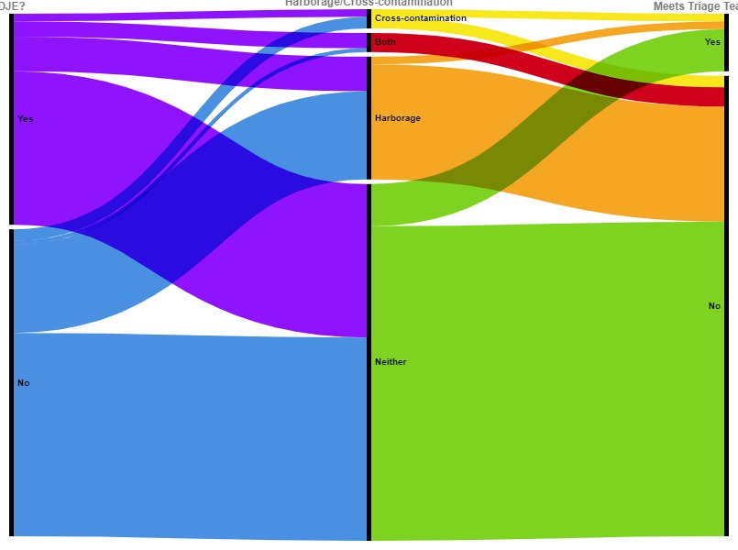
Triage Team Reports
In 5, only cross-contamination
In 5, both
In 15,
a Triage Team
report was sent
55 DJE
establishments
In 32,
only potential harborage identified
In 120,
a Triage Team
report was not sent
In 93,
neither potential harborage or
cross-contamination identified
80 FSIS only
establishments
DJE or FSIS only
Potential harborage, cross-contamination,
both or neither
Triage Team report
sent or not
RAWGraphs 2.0 beta
Notes:
Through this alluvial chart you can see how these different variables relate to each other.
So, we start on the left with the DJE establishments. Less than half of the establishments where we had positives were DJE.
Of those you can then see the positives where harborage, cross-contamination, both or neither were identified based on the WGS. You can see a larger percentage of FSIS only had evidence of potential harborage.
From there we move to those that met the Triage Team criteria. You can see about an equal percentage of DJE and FSIS only met the Triage Team criteria but most interesting to us was that in the majority of cases that met the Triage Team criteria – again this is where the isolate was closely related to a clinical isolate uploaded to NCBI in the last two years - the establishment did not have a history of harborage and really most times it was their first positive. This really shows to us the value of routine sampling because Lm contamination is sporadic.

Slide 10
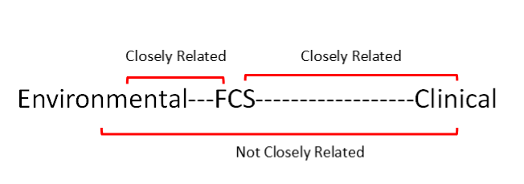
FSIS Actions when Triage Team Criteria Met
Reports were sent following each isolate that met the Triage Team’s criteria (n=15).
  Reports represented 15 positive sampling events at 13 separate establishments.
  Of these, WGS analyses for 7 of 15 (40%) sampling events supported further consideration because:
    There were no other isolates from other sources in the same NCBI cluster,
    Other isolates that were in the cluster had a potential relationship to the FSIS isolate, or
    The FSIS isolate and clinical isolates were determined to be more closely related than other isolates from other sources in the SNP tree.
  Reports also provided an opportunity to explain complex WGS findings to inspection personnel.
FSIS completed intensified verification testing (IVT) at 9 of the 13* establishments.
In most cases (7/9), follow-up IVT testing was negative.
*Two establishments had positives in June, so follow-up testing had not been completed by the time of this analysis.
Notes:
Reports were sent following each isolate that met the Triage Team’s criteria (n=15).
Reports represented 15 positive sampling events at 13 separate establishments.
Of these, WGS analyses for 7 of 15 (40%) sampling events supported further consideration because:
There were no other isolates from other sources in the same NCBI cluster,
Other isolates that were in the cluster had a potential relationship to the FSIS isolate, or
The FSIS isolate and clinical isolates were determined to be more closely related than other isolates from other sources in the SNP tree.
Reports also provided an opportunity to explain complex WGS findings to inspection personnel.
FSIS completed intensified verification testing (IVT) at 9 of the 13* establishments.
In most cases (7/9), follow-up IVT testing was negative.
*Two establishments had positives in June, so follow-up testing had not been completed by the time of this analysis.

Slide 11
Other WGS Findings of Interest
Two cases where imported product was determined to be closely related to clinical isolates outside of the U.S., the Triage Team did not develop a report but shared the information with international staffs for coordination with foreign Central Competent Authorities.
Two cases where RTE product from one establishment was closely related to another RTE product from another establishment but neither was closely related to clinical isolates at the time of upload.
  In one case, no connection was identified between the two RTE product positives.
  In another case, a connection between the two RTE product positives was identified. Three clinical isolates were identified later which led to an outbreak investigation and recall.
Notes:
We have also had some cases outside of our scope but where we have been able to share some information.
Two cases where imported product was determined to be closely related to clinical isolates outside of the U.S. Triage Team did not develop a report but shared the information with international staffs for coordination with foreign Central Competent Authorities (CCAs).
Two cases where RTE product from one establishment was closely related to another RTE product from another establishment but neither was closely related to clinical isolates at the time of upload.
In one case, no connection was identified between the two RTE product positives.
In another case, a connection between the two RTE product positives was identified. Three clinical isolates were identified later which led to an outbreak investigation and recall.

Slide 12
Dual Jurisdiction Establishments
As of February 25, 2022, FSIS and FDA began sharing WGS information.
  Sharing this information will permit more efficient use of resources and contribute to improved public health protection.
Results are being shared for Lm isolates collected from DJE. Harborage and cross contamination information is also being discussed.
By sharing this information on a routine basis, the agencies can better work together to inform sampling priorities and food safety actions.
The information is being shared according to a MOU between the two agencies.

Slide 13






Conclusions
Take Away
FSIS uses WGS in many ways to protect public health.
FSIS routinely collects and analyzes RTE meat and poultry products for Lm. WGS is critical to hypothesis generation during outbreaks and informs food safety actions.
Subtitle
Subtitle
All establishments are required to implement corrective actions in response to positives and FSIS verifies corrective actions using sampling as one tool.
Add Text
Add Text
Add Text
In most cases, positive results matching a clinical isolate were an establishment’s first positive (no history of harborage), supporting the value of routine sampling because Lm contamination is sporadic.
Using WGS to identify establishments with closely related clinical isolates helps FSIS prioritize in-plant food safety assessments and determine whether additional sampling is warranted.
FSIS verifies corrective actions using sampling as one tool.
Notes:
To summarize (read slide)

Slide 14


fsis.usda.gov

