Slide 1


Christian Vinueza PhD.
Central University of Ecuador

Slide 2

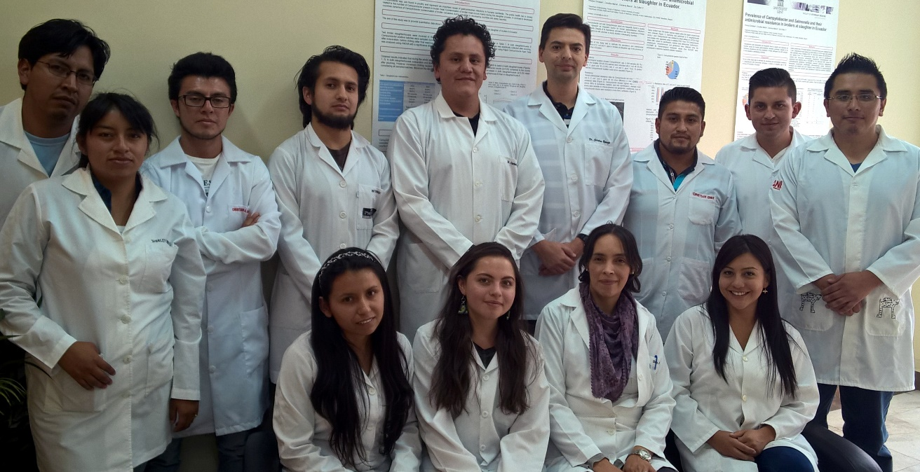





Research unit of foodborne diseases and antimicrobial resistance
Research
Education
Industry support

Slide 3
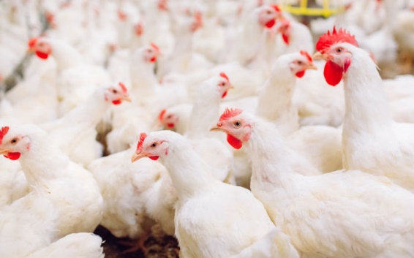
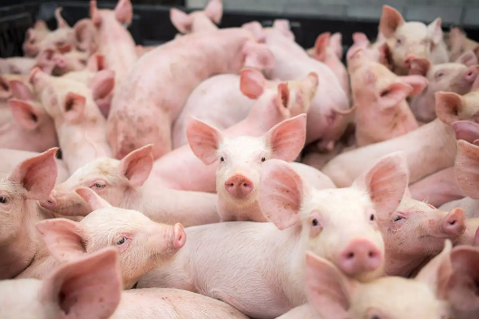
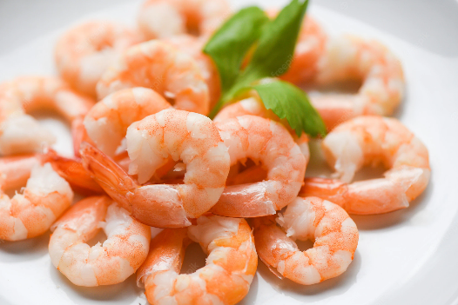
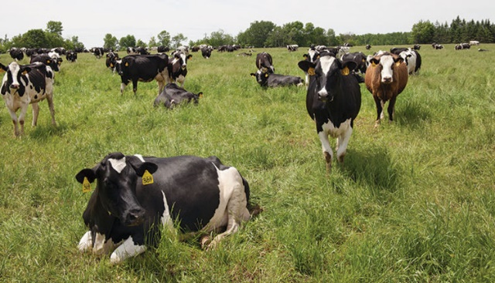
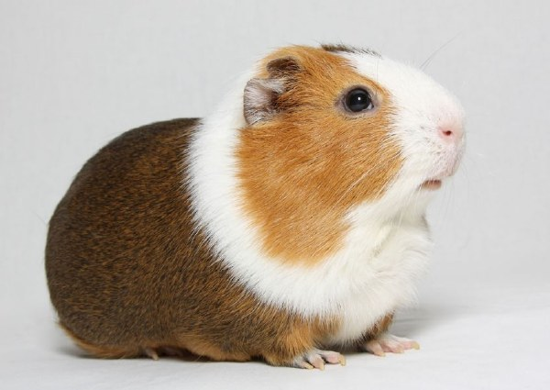
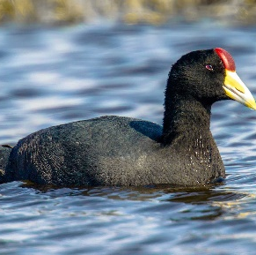
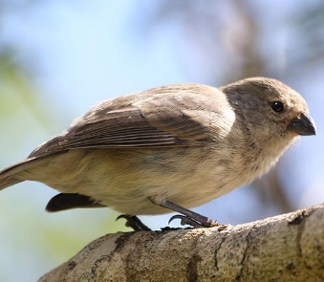
Sample sources
Fulica ardesica
Darwing´s finches
.

Slide 4


International colaboration
Start: 2018
Pathogen | No. Of WGS isolates
Salmonella | 553
E. coli | 136
Listeria | 26
Campylobacter | 84
New York State Department of Agriculture and Markets
Notes:
Eight hundred isolates

Slide 5
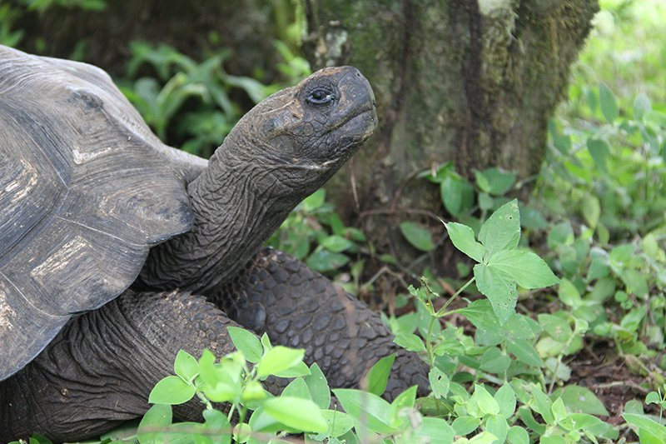
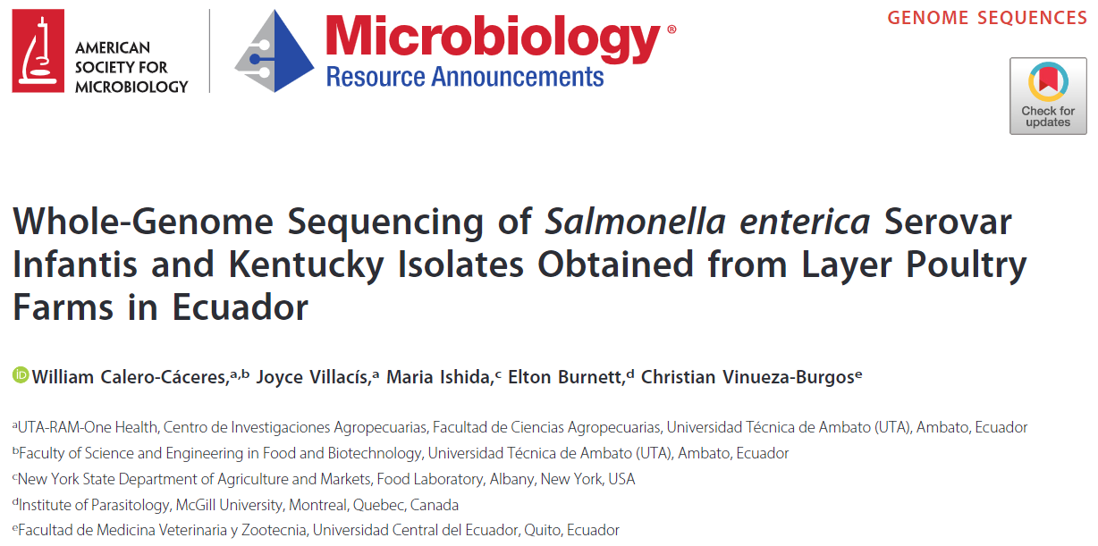
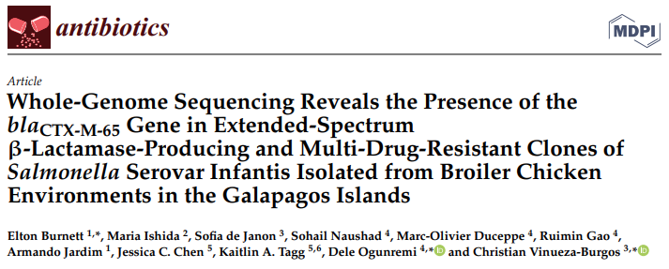
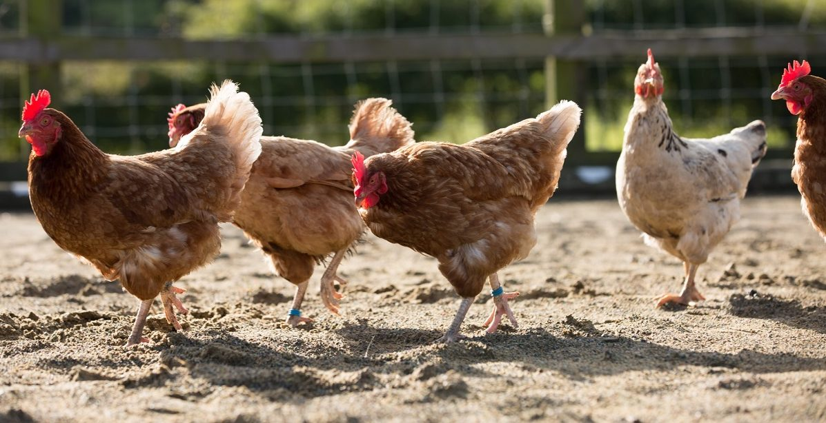

Slide 6
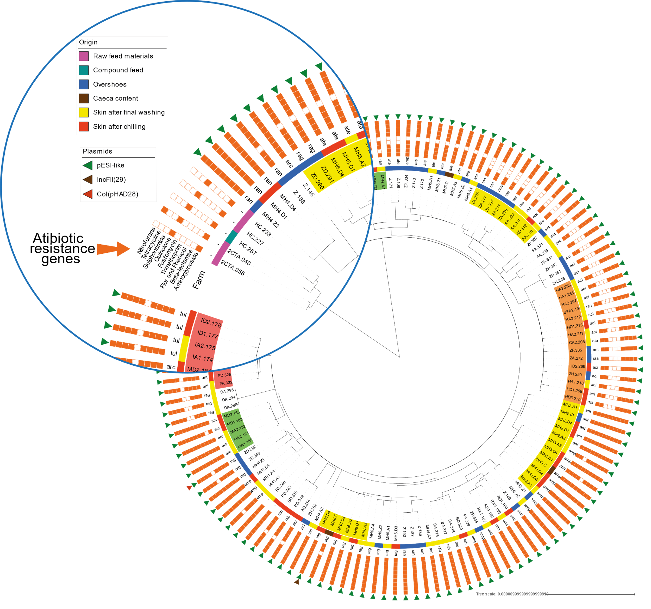
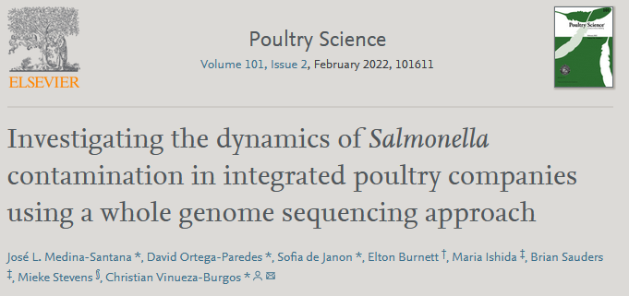
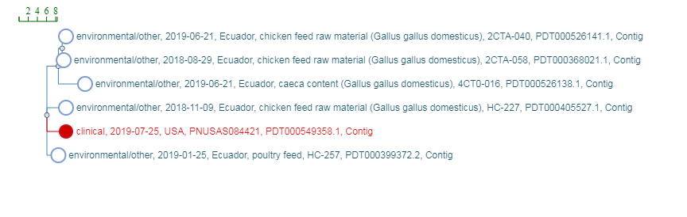

Slide 7
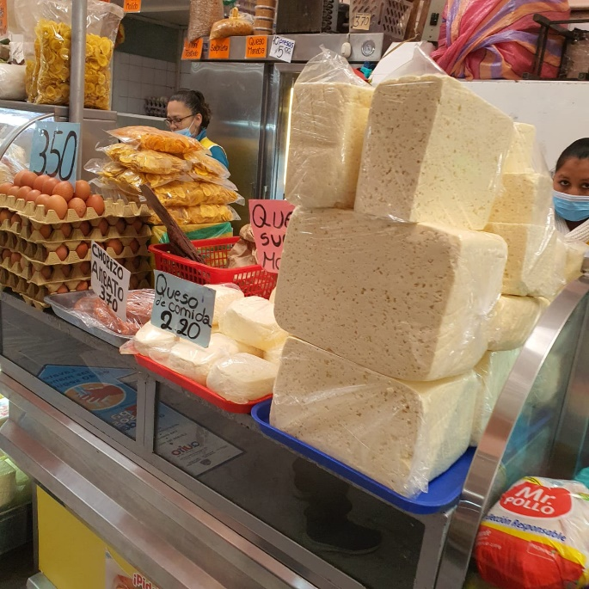
Listeria case
Samples collected from different retail levels in the frame of a project in food safety and antimicrobial resistance research.
Strains isolated in April 2021.
Isolate from fresh cheese.
Cheese acquired from traditional markets.
This kind of cheese is traditionally made (raw milk).
The cheese is stored at room temperature and sold in bulk.
Normally consumed after heat treatment.

Slide 8
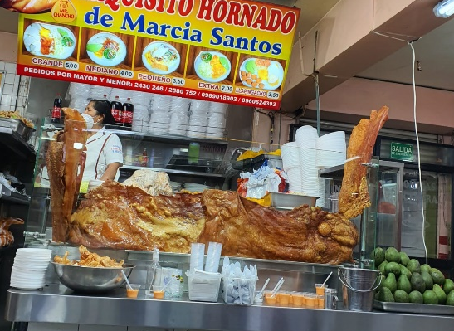
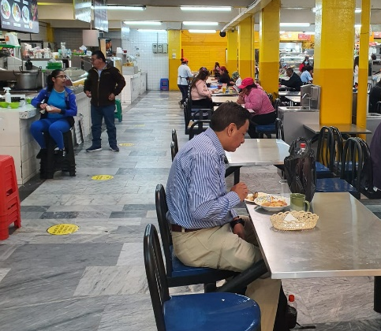
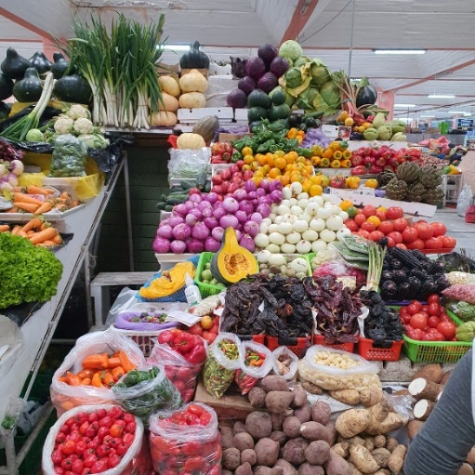
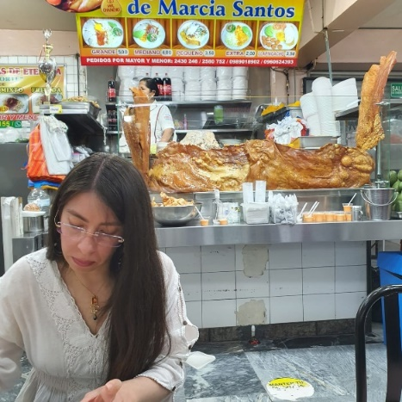
Traditional Markets

Slide 9
THANK YOU

