Slide 1
The Element AVITI: Democratizing access to affordable, highly accurate DNA sequencing

Slide 2
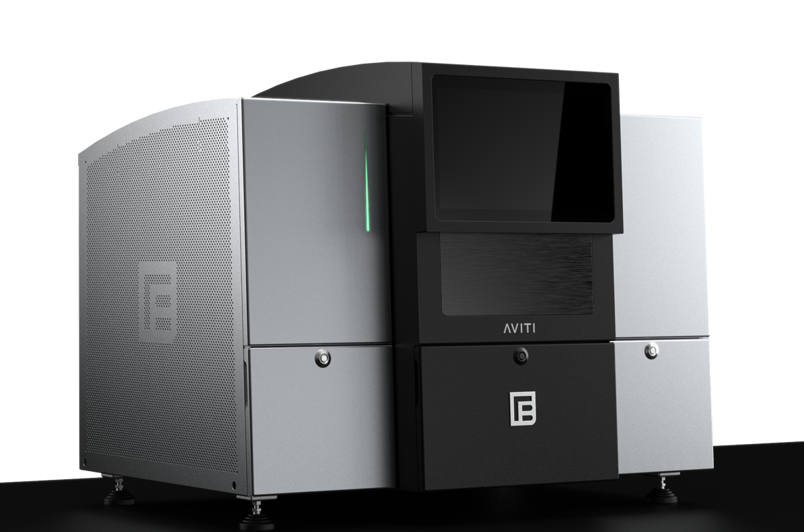
Element is democratizing access to high quality DNA sequencing
Accelerate your science with the AVITI system
The most accurate data available today with >90% Q30 data
Dual flow cells that can be operated completely independently to deliver up to 300 Gb each
The lowest cost/read available today, at $1/million PE reads
Guaranteed reagent costs for the life of the instrument
Compatibility with existing library prep and data analysis workflows
Notes:
…then pivot into the details of how we are going to do that.
Good points to hit:
2 random access flow cells. Each can be used entirely independently from the other without compromise, which is like having 2 sequencers in one.
This feature gives you flexibility to pair different applications per run, start each flow cell independently when you wish, or run the same application in parallel to maximize your output per hour.”
“Each flow cell yields 1B+ reads per run for up to 300Gb+ output with best in class %Q30 data quality >90 in a benchtop instrument.”
(Be aware that very high Q30 is not as relevant in counting assays like RNA sequencing, where cost, output and flexibility are more important.)

Slide 3
The AVITI platform has industry leading cost, flexibility, and data quality
 | Element | Illumina | Illumina | MGI | Singular
 | AVITI | NextSeq 2000 | NovaSeq (S4) | DNBSEQ-G400 | G4
Data Quality | >90% Q30 | >85% Q30 | >85% Q30 | >75% Q30 | >70-90% Q30
Output (Reads) | 2 FCs x 1,000M | 1 FC x 1,000M | 2 FCs x 8-10B | 2 FCs x 1,800M | 4 FCs x 150M/300M
Price / Gb | $5.60 | $20 | $5-7 | ~$7 | ~$20
Read Length | 2x150 PE | 2x150 PE | 2x150 PE | 2x150 PE | 2x150 PE
CapEx (List) | $289K | $335K | $1M | ~$360K | $350K
Run Time | <48 hr | 48 hr | 44 hr | <66 hr | 16-19 hr
Notes:
Pick any one or two comparisons to emphasize in this table – don’t overwhelm the audience with data, Some options:
“The AVITI has the highest accuracy data of any sequencing platform on the market today”
“The AVITI cost per Gb is on par with NovaSeq, but you don’t need to fill 8-10 billion reads of capacity to get that price”

Slide 4
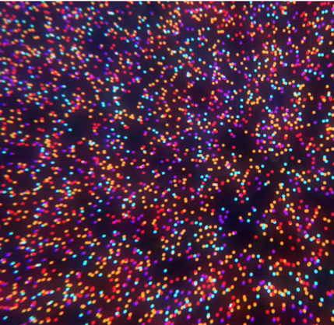
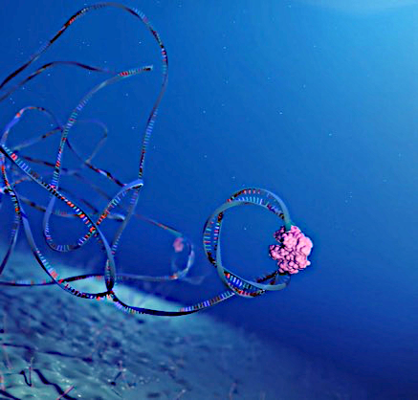
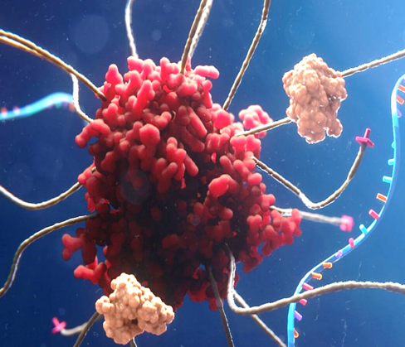
Element has invented a completely novel technology, Avidity Sequencing
Low background
Element’s patented low binding surface chemistry makes signals pop.
Low noise drives high accuracy, even at high polony density
No on-instrument PCR
Element uses rolling circle amplification for polony generation, reducing PCR error by only ever copying from the original
Two jobs, two solutions
Detection and synthesis steps are separated, such that complex stability is the sole requirement during detection.
Dye-labelled Avidites covered in dNTPs, highly engineered polymerases, and DNA bind very tightly during imaging, enabling dramatically lower reagent concentrations (and costs).
Notes:
How are we able to deliver such higher value? Element sequences DNA in a completely novel way.
For these, I suggest getting comfortable with the verbiage above, or your version of it. I myself found it hard to describe Avidity sequencing on the fly clearly, without running on and on.
…If you find the talk is too long, I would cut this slide.

Slide 5
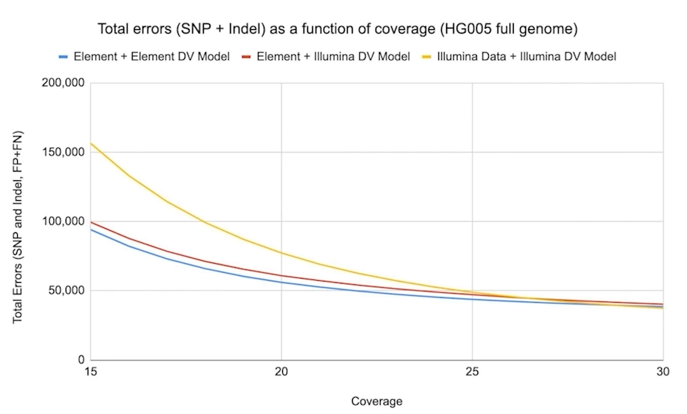
The AVITI system produces industry leading accuracy, with >90% of reads >Q30
The accuracy of AVITI data was assessed by the Google Deep Variant team using widely-sequenced NIST human reference standards
Element data has fewer errors at lower coverage than Illumina data
“Looking at human reference genome data there is a cleanness in the Element data from reduced error rates in difficult contexts, which especially improves analysis at low sequencing depth.”
Andrew Carroll, PhD
Product Lead, Google Health
Notes:
But you don’t have to trust us regarding our accuracy claims…
The Deep Variant Team at Google Health evaluated AVITI data and found that even using an un-optimized error model, AVITI made fewer SNP and indel errors when calling variants in the HG005 human control sample against the human reference genome.
During his AGBT talk, Andrew Carroll, the project lead for DeepVariant, noted “(read quote)…”
Graph details:
“Element + Element DV model” = variants called from Element data using the the Deep Variant model trained on Element data (blue)
“Element + Illumina DV model” = variants called from Element data using the the Deep Variant model trained on Illumina data. (red)
“Illumina + Illumina DV model” = variants called from Illumina data using the the Deep Variant model trained on Illumina data (yellow)
Typically, people will use Deep Variant using the error model trained specific for that data type, as this produces the best result.

Slide 6
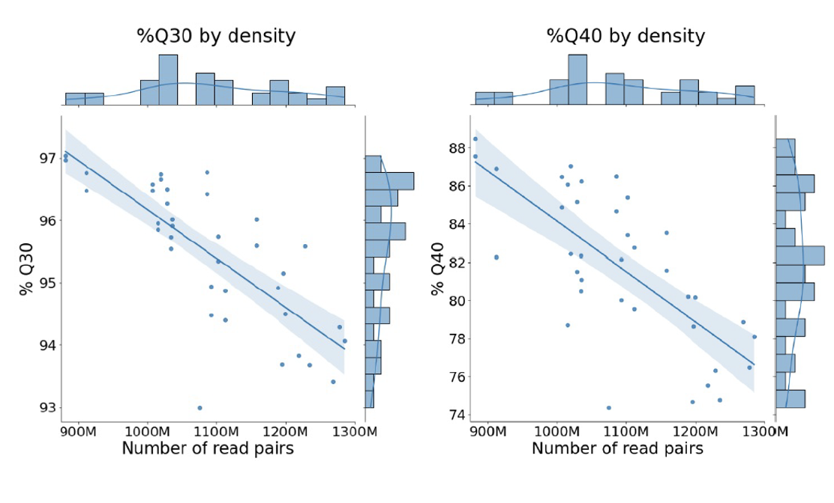
Even at high density, AVITI data easily exceeds 90% Q30
At our 1 billion PE reads / flow cell standard performance spec, 2x75 PE sequencing costs just $1 per million reads
At very high density, 2x150 PE reads cost ~$4.3 / Gb, even less than on a NovaSeq S4, while maintaining superior accuracy
$1/ M PE reads
$4.3 / Gb
$1/ M PE reads
$4.3 / Gb
Notes:
Bets of all, our accuracy is very robust even at high density, and that translates into real savings while actually upleveling the quality of your data.

Slide 7
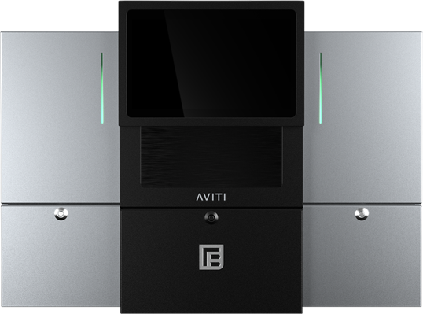
Compatibility with existing library prep solutions makes it easy to get started
Prepare Sample
Create Library
Circularize
Sequence
Analyze
Adept
Workflow
DNA
or
RNA Input
Adept Library Compatibility Kit
(No additional PCR)
FASTQ
Files
Third-Party Kit*
Elevate
Workflow
DNA
or
RNA Input
Third-Party
Kit*
Elevate Indexes
& Adapters
Elevate Circularization
(No additional PCR)
FASTQ
Files
* Visit go.elembio.link/compatible for an up-to-date list of compatible third-party kits

Slide 8
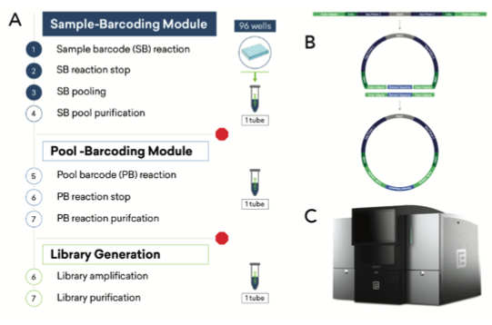

Microbial WGS is accurate and affordable on the Element AVITI system, and has been verified with a range of library prep partners, including seqWell
384 microbial samples were prepared with plexWell auto-normalizing transposase-based multiplexing solution
Up to 96 samples can be pooled into one tube early in library prep
Circularization with the Adept Compatibility Kit prepares the library for sequencing on the AVITI system

Slide 9
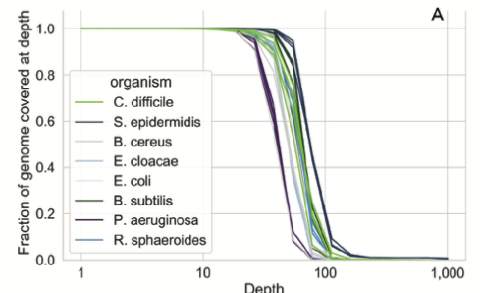
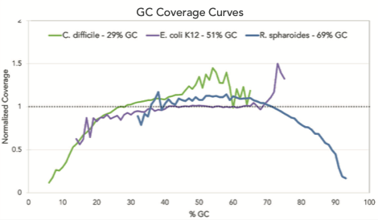
seqWell facilitates even pooling at high multiplex, and more even coverage at high or low GC than other transposase-based methods

Slide 10
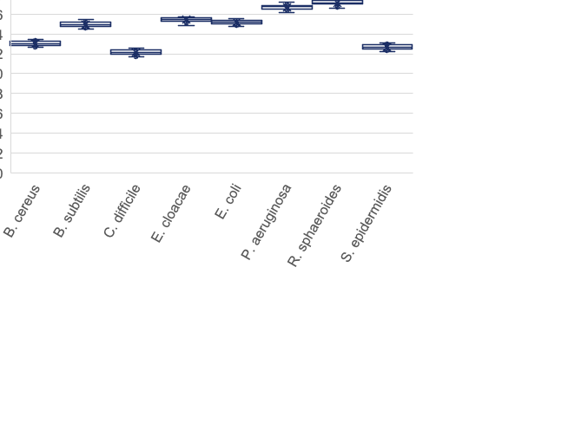
Element technology produces highly accurate assemblies at an affordable price
The AVITI system’s low cost /Gb makes microbial WGS highly affordable, even at low multiplex
 | 24-plex | 48-plex | 96-plex | 384-plex
seqWell library prep (384-kit) | $13.70 | $13.70 | $13.70 | $13.70
Adept circularization | $0.21 | $0.11 | $0.05 | $0.01
Sequencing | $70 | $35.00 | $17.50 | $4.40
Cost / microbe | $83.91 | $48.81 | $31.25 | $18.11
384 multiplexed samples were aligned against the ATCC reference for each sample
All replicates had mean quality score >40

Slide 11
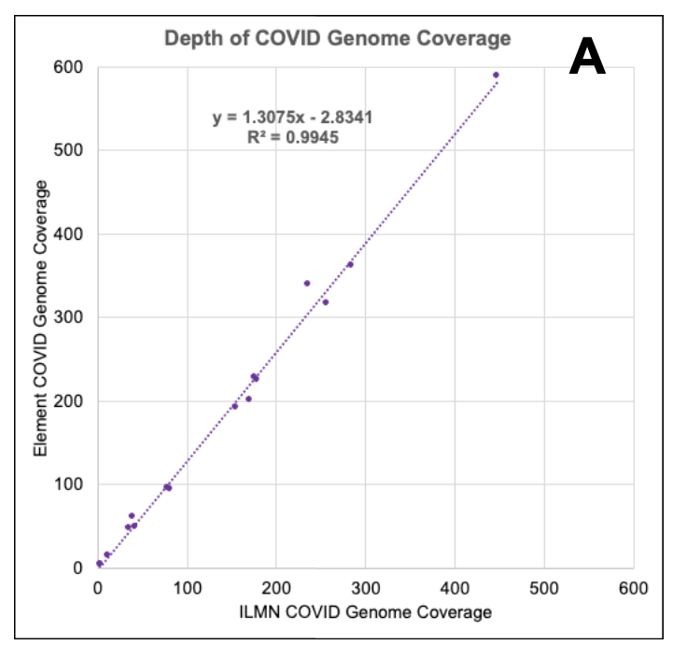
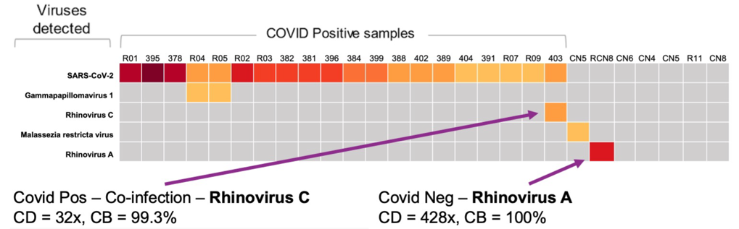

Beyond COVID surveillance: Shotgun RNA-Sequencing as a method for a universal infectious disease surveillance assay
Samples were processed with JumpCode CRISPRclean Plus workflow to delete high abundance host and bacteria rRNA
STAR/ GATK was used to align data against the SARS-CoV-2 reference
COVID genome coverage depth was equivalent on both Illumina and Element platforms
In several cases, the method was able to detect co-infection with additional viruses
Notes:
Left: enriched results in a 6-fold increase in SARS-COV-2 coverage
Right:

Slide 12
The Element AVITI offers an economical option for COVID surveillance using the commonly used ARTIC primer set
With 1 B PE reads / flow cell and minimal PhiX requirements, the AVITI can sequence a high volume of samples on each of 2 dual flow cells
Our broad NGS ecosystem compatibility means you can use your existing library prep workflow
The low cost of sequencing on the AVITI system means even lower throughput runs are affordable
Samples / flow cell | Sequencing cost / sample (2x75 bp)
96 | $11.64
192 | $5.81
384 | $2.90
960 | $1.16
Calculation excludes cost of PCR (~$16) but includes library prep and sequencing
Notes:
$37 for Elevate library prep and circularization
$1,080 for sequencing

Slide 13
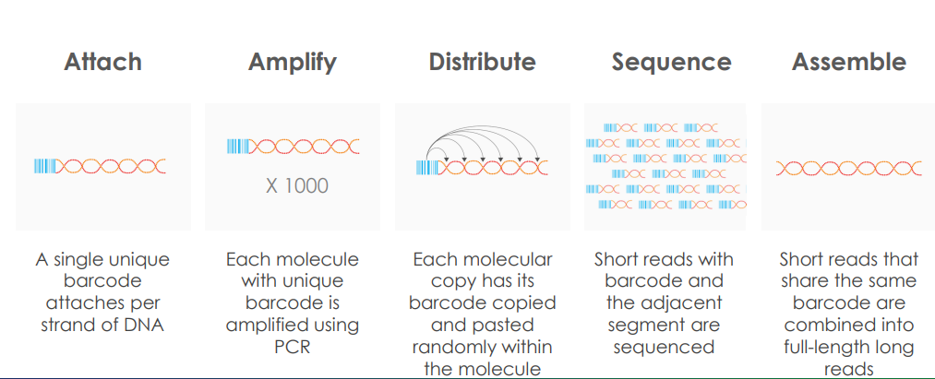
LoopSeq enables long-read amplicon sequencing on the AVITI system, without the CapEx expense or extra space needed for another system

Slide 14
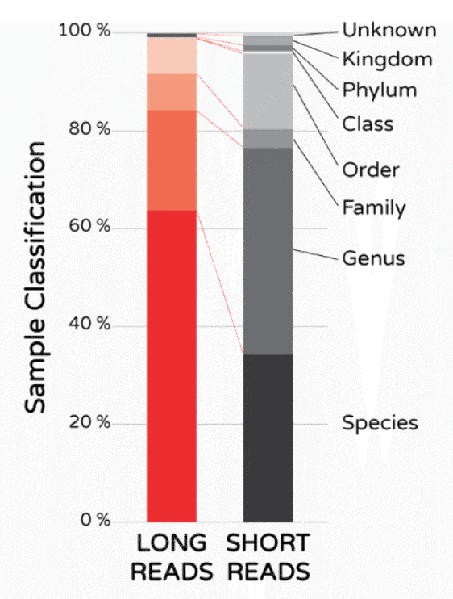
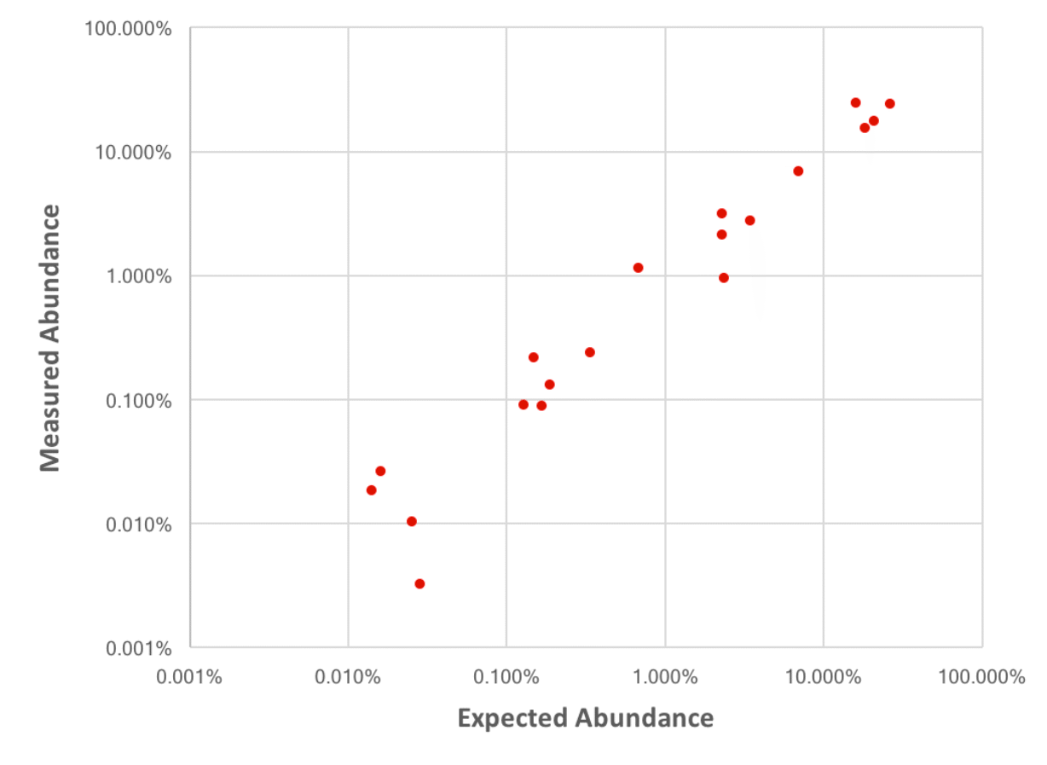
LoopSeq 16S sequencing
A complex soil sample using short-read sequencing versus LoopSeq full-length 16S
The LoopSeq Microbiome method classified >99% of the unique 16S molecules down to the species or genus level,
Only ~65% of unique 16S molecules are resolved down to the species or genus level with short read V3 and V4-V5
LoopSeq also enhances accurate quantification by leveraging UMIs to remove PCR duplicates
Element LoopSeq 16S kits are coming soon

Slide 15
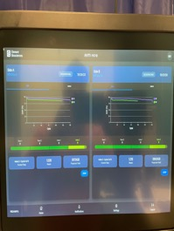
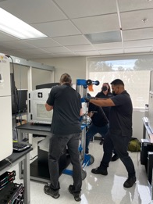
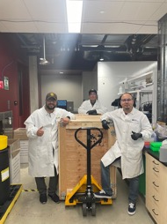
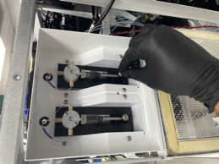
We have a highly trained FSE team to install, verify, and maintain your instrument
Instrument is Shipped to Customer
Within 1 week
FSE Performs Operational System Testing
Site & Training Prep
Instrument Ship
Uncrate/ Install
System Verification
Performance Verification
FSE Schedules Meeting with Customer to Review Site Prep Guide
1-2 weeks prior to instrument ship
FSE Travels to Customer Site to Unpack Instrument
~ 2 hours
FSE sets performance Run to Test System Performance
Notes:
Move through this very fast – 15s. This audience doesn’t need details right now, they just need to know we have a process.
We are a young company, but we have fully staffed field organization committed to your success
“We have highly trained FSE team to do site prep, install and verify your instrument”

Slide 16
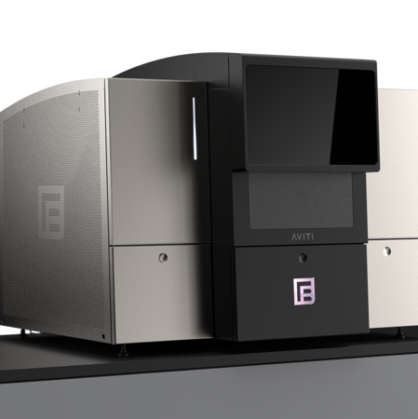
Field Application Scientist: Scientists Supporting Scientists
With you throughout your Journey with the AVITI system
Training
Sample & Library Prep
  Customized training onsite
  Product updates
  Compatibility questions
  Experimental design
  QC
Voice of Customer
Sequencing
  Run preparation
  Optimizing loading
  Review runs
  Maintain instrument
  Customer feedback
  Identifying workflow blockers
  Bridge to R&D
Analysis
  Connectivity
  Bases2fastq
  Enable analysis pipelines
Notes:
FAS removes technical barriers the customer may encounter.
Review aspects of the workflow and where the FAS can help
With sales as the main account manager, FAS is the technical account manager
**NOT EVERYTHING IS POSSIBLE. As with all technology there are scientific, biological or even commercial limitations

Slide 17


We are bringing down the barriers to pursuing groundbreaking science.
Join us.
“Element Biosciences was founded to enable scientists to do more with their resources. The AVITI is bringing us into a new era of sequencing – one where labs of all sizes and budgets can produce their own high-quality data,”
- Molly He, PhD, Founder and CEO

