Slide 1

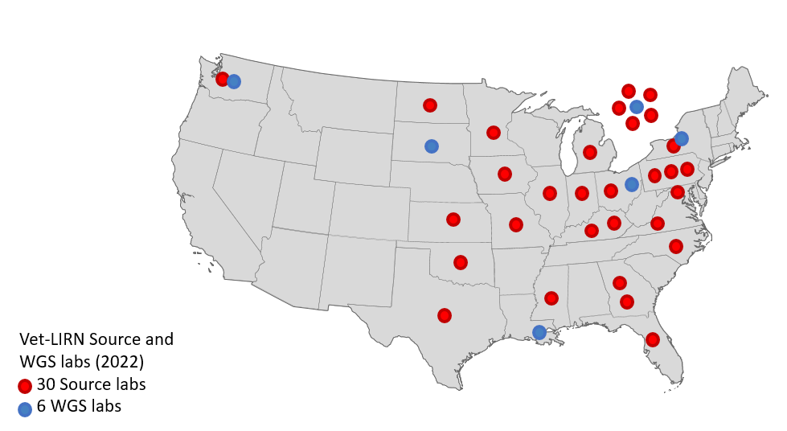
Vet-LIRN
AMR Monitoring Program: WGS updates
Participating Laboratories
Olgica Ceric, DVM, MS, PhD
October 2022
2022 GenomeTrakr Meeting

Slide 2
FDA Center for Veterinary Medicine (CVM)
Structure and Organization
Director
Steven M. Solomon, DVM, MPH
Reports to the FDA Commissioner
Office of Management
Office of New Animal Drug Evaluation
Office of Minor Use and Minor Species
Office of Surveillance and Compliance
Office of
Research
Associate Director
Roxanne K. Schweitzer
Director
Matthew A. Lucia, DVM
Director
Margaret R. Oeller, DVM
Director
Timothy C. Schell, PhD
Director
Regina L. Tan, DVM, MS

Slide 3
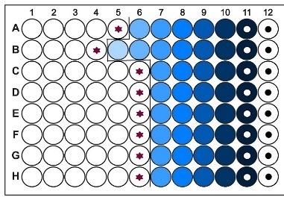



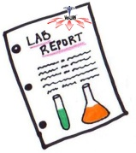

General Plan
Test/Plates
Sequence
01
02
03
04
INFOGRAPHIC
INFOGRAPHIC
Upload Data to NCBI
Veterinary Diagnostic Labs
Cases
Select Bacterial Pathogens
Report/Standardize
Notes:
This is the flow diagram describing the process: (1) Vet-LIRN laboratories collect animal clinical isolates, they are select pathogens routinely isolated by veterinary clinics and diagnostic laboratories; (2) Antimicrobial susceptibility testing is completed using a commercially available testing platform and plates; (3) Data is reported and standardized; (4) Laboratories sequence a subset of isolates and submit WGS data to NCBI

Slide 4



Select Bacterial Pathogens
Bacterial pathogen | N⁰ of isolates/month | Animal host | AST | WGS
Salmonella enterica (SAL) | 4 | any animal host | yes | yes
Escherichia coli (ECOL) | 4 |  | yes | yes
Staphylococcus pseudintermedius (SPSE) | 4 |  | yes | yes
Klebsiella pneumoniae/variicola Pseudomonas aeruginosa Enterococcus faecalis or faecium | 4 | any animal host | yes | Klebsiella pneumoniae/variicola
Enterobacter cloacae complex | 4 |  | yes | yes
Campylobacter coli Campylobacter jejuni Campylobacter fetus | 4 | swine, poultry, cattle, small ruminants, dogs, cats | no | yes
AQUA labs: any bacterial pathogen | 4 |  | yes | yes

Slide 5
Antimicrobial Susceptibility Testing/Whole Genome Sequencing 2017-2021
Bacterial pathogen | AST | WGS
SAL | 3,635 | 1,657
SPSE | 4,751 | 1,355
ECOL | 4,750 | 1,378
K. pneumoniae | 355 | 200
P. aeruginosa | 780 | /
E. faecalis/faecium | 822 | /
Campylobacter | 10 | 10
E. cloacae complex | 201 | pending
All fish pathogens | ~200 | 60
Total | >15,000 | >4,000

Slide 6
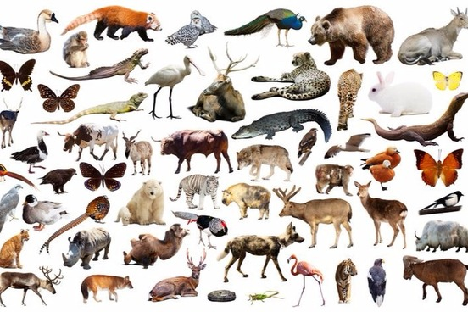

Vet-LIRN-Pathogen Projects-NCBI
Salmonella enterica (SAL)
PRJNA316452: Vet-LIRN-Sal-OH
PRJNA316457: Vet-LIRN-Sal-SD
PRJNA324570: Vet-LIRN-Sal-NY
PRJNA324575: Vet-LIRN-Sal-LA
PRJNA481328 :Vet-LIRN-Sal-WA
PRJNA503850 : Vet-LIRN-Sal-GU
Escherichia coli (ECOL)
PRJNA318589: Vet-LIRN-E. coli -OH
PRJNA318591: Vet-LIRN-E. coli -SD
PRJNA324565: Vet-LIRN-E. coli -NY
PRJNA324573: Vet-LIRN-E. coli -LA
PRJNA481346: Vet-LIRN-E. coli -WA
PRJNA503851: Vet-LIRN-E. coli -GU
Staphylococcus pseudintermedius (SPSE)
PRJNA318593 : Vet-LIRN-Staph-OH
PRJNA318594 : Vet-LIRN-Staph-SD
PRJNA324567 : Vet-LIRN-Staph-NY
PRJNA324579 : Vet-LIRN-Staph-LA
PRJNA481347 : Vet-LIRN-Staph-WA
PRJNA503853 Vet-LIRN-Staph-GU
Vet-LIRN Umbrella Project: https://www.ncbi.nlm.nih.gov/bioproject/314609

Slide 7
WGS 2017-2021 Program Highlights-in progress
Characterization of the E. coli and S. pseudintermedius pan-genome in dogs in comparison with humans and analysis of genetic components of isolates from dogs, correlated with AMR.
Continue to monitor carbapenem-resistant E. coli (bla _{NDM-5}) in companion animals after 2019 outbreak
Collaboration with various groups (FDA, CDC, USDA) on multiple clusters related to Salmonella isolates

Slide 8
WGS (Aquatic pathogens) 2019-2021
Most common AMR Genes:
-ampC, blaOXA (BETA-LACTAM)
-aph(3'')-Ib, aph(6)-Id (AMINOGLYCOSIDE)
-floR (PHENICOL)
-sul2 (SULFONAMIDE)
-tet (A) (TETRACYCLINE)
-cphA (CARBAPENEM)
  appears to be common
    >135 Aeromonas hydrophila currently in the NCBI browser and only 5 isolates lack this gene
    Production of the CphA enzyme is not able to confer a carbapenem-resistant phenotype
Sequenced all 2019 isolates (~60)
  NCBI-Vet-LIRN PRJNA481355
  NCBI Vet-LIRN PRJNA481358
  NCBI Vet-LIRN PRJNA481353
Currently sequencing 2020 isolates
NCBI added Aquatic pathogens to Pathogen Browser
Notes:
-Important note for clinicians: Production of the CphA enzyme is not able to confer a carbapenem-resistant phenotype on the original Aeromonas strain unless a very large bacterial inoculum is used (Massidda O, Rossolini GM, Satta G. The Aeromonas hydrophila cphA gene: molecular heterogeneity among class B metallo-beta-lactamases. J Bacteriol. 1991 Aug;173(15):4611-7. doi: 10.1128/jb.173.15.4611-4617.1991. PMID: 1856163; PMCID: PMC208136.)
https://pubmed.ncbi.nlm.nih.gov/1856163/

Slide 9
WGS 2017-2021 (Klebsiella, Animal Hosts)
NCBI Vet-LIRN:
  200 animal clinical isolates sequenced (2019 and 2020)
  ~90 from urine
  https://www.ncbi.nlm.nih.gov/pathogens/isolates/#PRJNA325243%20
NCBI:
  10220 Klebsiella isolates from USA total (clinical+ environmental)
    528 environmental
      includes animal feed/food, hospital waste-water, sink water, retail meat,
      ~263 animal clinical total!

Slide 10
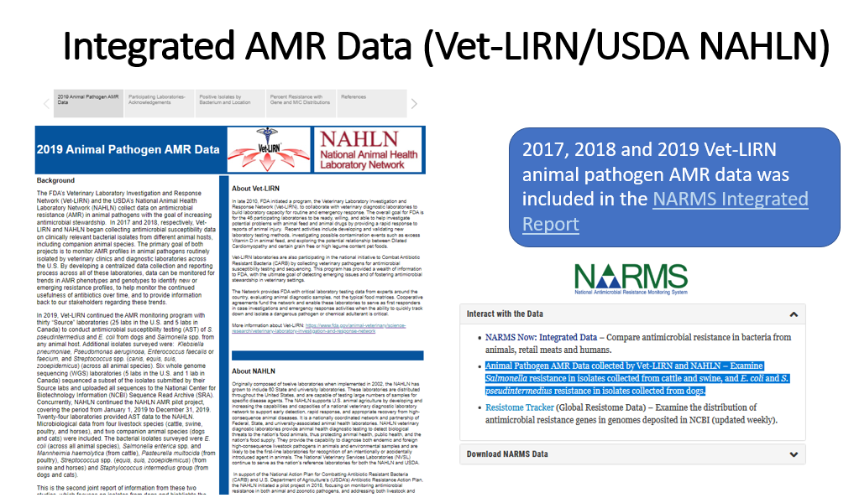

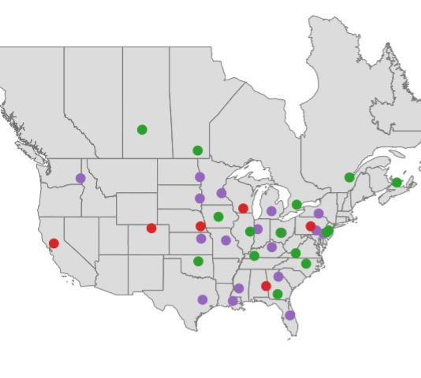
Integrated AMR Data Dashboards
(Vet-LIRN/NAHLN/NARMS)
Notes:
A cross-agency collaborating group was formed to develop a centralized data collection and reporting process across participating laboratories from both networks. The group consists of members from FDA’s Vet-LIRN and NARMS, and USDA’s NAHLN. More than 40 laboratories from Vet-LIRN and NAHLN provided antimicrobial susceptibility test (AST) data on Escherichia coli, Salmonella spp., and Staphylococcus intermedius group species in dogs, using a commercially available testing platform. Laboratories sequenced a subset of isolates and submitted the whole genome sequencing data to NCBI. Both networks followed Clinical and Laboratory Standards Institute (CLSI) AST testing methods. Dashboards include resistance mechanisms from genomics data, along with the percent resistance and MIC distributions for each of the antibiotics included in the panels.

Slide 11
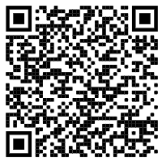
Vet-LIRN/NAHLN Integrated Animal Pathogen AMR Data
DEMO
https://www.fda.gov/animal-veterinary/national-antimicrobial-resistance-monitoring-system/2019-animal-pathogen-amr-data
Notes:
This slide includes a demo of integrated dashboards. Dashboards can be accessed using provided link or QR code.
By developing a centralized data collection and reporting process across laboratories from FDA and USDA networks, data can be monitored for trends in AMR phenotypes and genotypes to identify new or emerging resistance profiles, to help monitor the continued efficacy of antibiotics over time, and to provide information to all stakeholders regarding these trends.

Slide 12


Acknowledgements
NARMS
Amy Merrill
Claudine Kabera
Gordon Martin
Vet-LIRN/NAHLN Participating Laboratories
USDA APHIS
Beth Harris
Jennifer Rodriguez
Christina Loiacono
Christine Foxx (ORISE)
Vet-LIRN
Sarah Peloquin
Jake Guag
Gregory Tyson
Notes:
I would like to acknowledge all Vet-LIRN/NAHLN participating laboratories as well as the members of the working group. From NAHLN: Beth Harris, Jennifer Rodriguez, Christina Loiacono; from ORISE: Christine Foxx; from NARMS: Amy Merrill and Claudine Kabera; from Vet-LIRN: Sarah Peloquin, Jake Guag, Gregory Tyson

Slide 13
Questions?
Contacts:
Gregory.Tyson@fda.hhs.gov
Olgica.Ceric@fda.hhs.gov

