Slide 1

Empowering Fully Automated Whole Genome Sequencing
Charles Vaske, PhD
Head of Bioinformatics, Clear Labs
Thursday, October 20, 2022

Slide 2
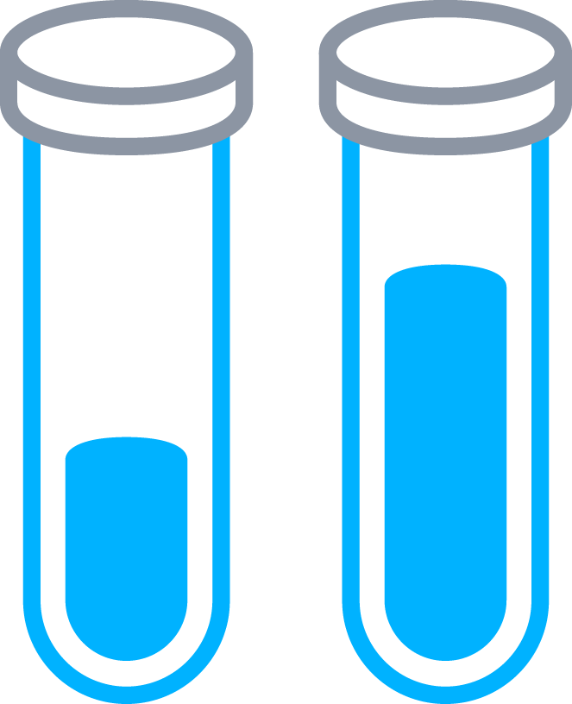
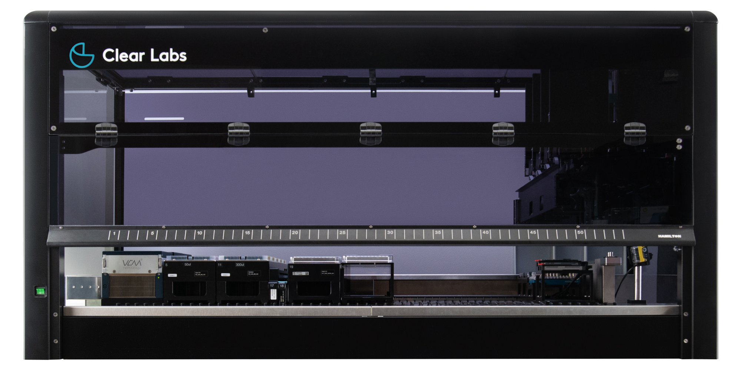


Sample In, Insight Out
Turnkey End-to-End Genomics Solution: Beyond Hardware & Reagents
Samples
Interpreted Results
Reagents

Slide 3


Product Portfolio
Automated Workflow Solutions
Clear Safety™
Salmonella and Listeria
Targeted sequencing of up to 192 food/environmental samples from enrichment broth within approximately 10-12 hours.
Clear Dx™
WGS SARS-CoV-2
Whole genome sequencing of up to 32 samples of extracted SARS-CoV-2 RNA and generate FASTQ, FASTA, and intermediate files within approximately 20 hours.
Future Product Considerations
Microbial Surveillance
Whole genome sequencing from an isolate or pure microbial culture. Generates FASTQ, FASTA, and intermediate files.

Slide 4
Product Portfolio
Automated Workflow Solutions
Clear Safety
Salmonella and Listeria
Targeted sequencing of up to 192 food/environmental samples from enrichment broth within approximately 10-12 hours.
Clear Dx
WGS SARS-CoV-2
Whole genome sequencing of up to 32 samples of extracted SARS-CoV-2 RNA and generate FASTQ, FASTA, and intermediate files within approximately 20 hours.
Future Product Considerations
Microbial Surveillance
Whole genome sequencing from an isolate or pure microbial culture. Generates FASTQ, FASTA, and intermediate files.

Slide 5
Clear Safety:
Beneficiary of GenomeTrakr Data
Pre-Genomic Era
Post-Genomic Era
Hygiena BAX®
Merck Assurance® GDS
Bio-Rad iQ-Check®
bioMérieux GENE-UP®
3M MDS
Hygiena BAX®
Real-Time
Roka Atlas®
GenomeTrakr
Launched in 2014
Currently 325,000 samples,
each with 3M+ building blocks
2002
2003
2004
2005
2006
2007
2008
2009
2010
2011
2012
2013
2014
2015
2016
2017
2018
Thermo Scientific SureTect™
Dates based on AOAC Salmonella certification

Slide 6
NGS-Based Applications
Microbial Surveillance
Clear Safety
Non-targeted sequencing
Isolate-based
Turnaround: 1-3 days
Cost more than PCR
Limited to pure samples
Targeted sequencing
Isolate-independent
Turnaround: ~ half a day
Same cost as PCR
Applicable to complex samples

Slide 7


Assay design is driven by whole genome sequencing
Assay is tunable for resolution vs. speed
Simultaneous Detection and Typing
Enteritidis
Typhimurium
Newport
Javiana
Infantis
Montevideo
Heidelberg
Muenchen
Saintpaul
Oranienburg
Braenderup
Paratyphi B var. L(+) Derby
Agona
Thompson
Kentucky
Salmonella
enterica / bongori
Detect up to 63 unique serotypes
monocytogenes
innocua
ivanovii
welshimeri
Seeligeri
marthii
grayi
Listeria

Slide 8
Clear Safety:
Environmental Monitoring
1
Screen for Listeria
Map to Plant
Similarity Analysis
Add Metadata
Track the Flow
2
3
4
5

Slide 9
Clear Safety:
Environmental Monitoring
Screen for Listeria
Map to Plant
Similarity Analysis
Add Metadata
Track the Flow
2
3
4
5

Slide 10
Listeria Type 1
Listeria Type 2
Listeria Type 3
Clear Safety:
Environmental Monitoring
Screen for Listeria
Map to Plant
Similarity Analysis
Add Metadata
Track the Flow
3
4
5
Notes:
MF

Slide 11
Clear Safety:
Environmental Monitoring
10/18/2018
07:59:00
11/02/2018
09:01:13
Screen for Listeria
Map to Plant
Similarity Analysis
Add Metadata
Track the Flow
10/25/2018
01:3546
10/25/2018
01:32:45
10/31/2018
13:32:45
4
5
10/30/2018
14:21:46
11/02/2018
07:21:46
Notes:
MF

Slide 12
Clear Safety:
Environmental Monitoring
10/18/2018
07:59:00
11/02/2018
09:01:13
Screen for Listeria
Map to Plant
Similarity Analysis
Add Metadata
Track the Flow
10/25/2018
01:3546
10/25/2018
01:32:45
10/31/2018
13:32:45
5
10/30/2018
14:21:46
11/02/2018
07:21:46
Notes:
MF

Slide 13
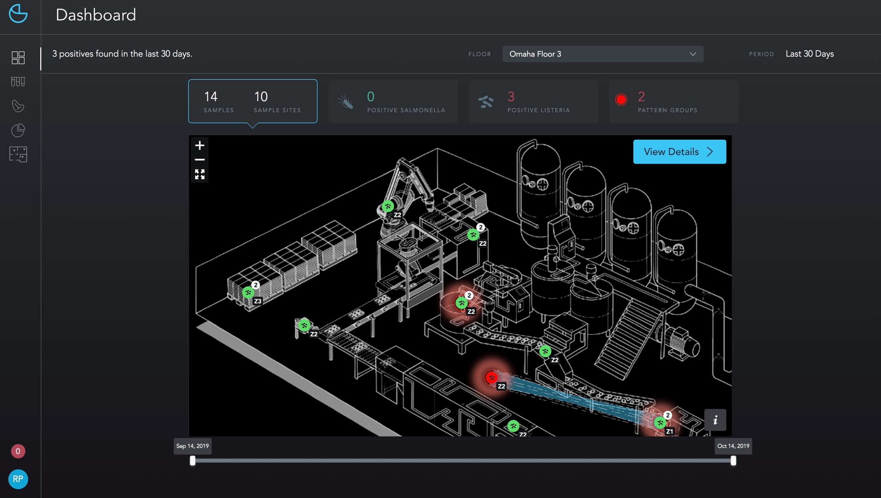
Environmental Mapping Interface
Notes:
MF

Slide 14
Tunable Serotyping
Balancing resolution versus sequencing speed
Multi-locus sequence typing (MLST)
Loci pin all strains
Consistent typing for any sample
Markers - signature loci
Present in a small number of strains
Allows addition of strains difficult to characterize by MLST
Simple strain co-detection

Slide 15
Product Portfolio
Automated Workflow Solutions
Clear Safety
Salmonella and Listeria
Targeted sequencing of up to 192 food/environmental samples from enrichment broth within approximately 10-12 hours.
Clear Dx
WGS SARS-CoV-2
Whole genome sequencing of up to 32 samples of extracted SARS-CoV-2 RNA and generate FASTQ, FASTA, and intermediate files within approximately 20 hours.
Future Product Considerations
Microbial Surveillance
Whole genome sequencing from an isolate or pure microbial culture. Generates FASTQ, FASTA, and intermediate files.

Slide 16

Workflow on Clear Labs Platform
Sample Registration
Library Preparation
cDNA synthesis
Amplification of targets
Indexing
Nucleic acid clean-up
Sample Collection
RNA Extraction
Sequencing
Automated Bioinformatics
Reporting
& Analytics
Fully automated on Clear Dx
Not covered by Clear Dx

Slide 17
Why Clear Dx WGS?
A Workflow Comparison
 | Clear Dx | Legacy
Time to Results
Approximate Hands-On Time
Human Touch Points
20 Hrs
4-10 Days
Less than 1 Hr
9-10 Hrs
10+
1
More than
80 steps
*Source: Chan Zuckerberg Biohub presentation to CA PHLs, July 2020

Slide 18
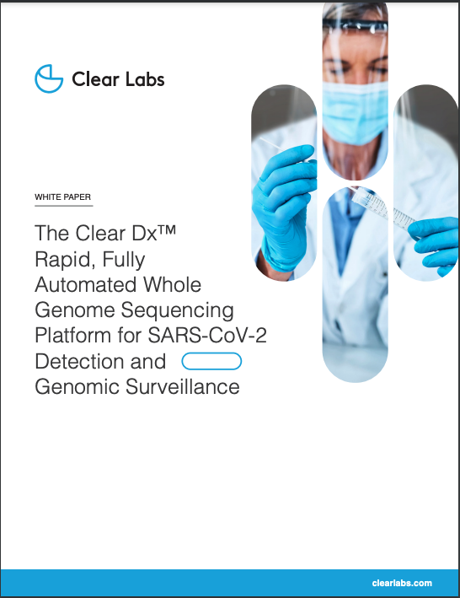
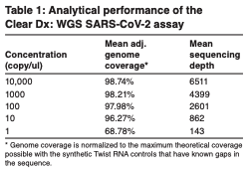
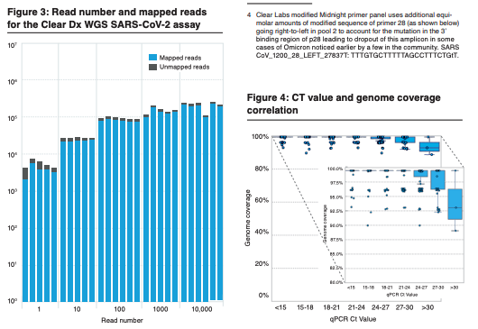
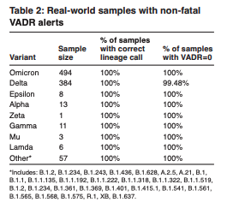
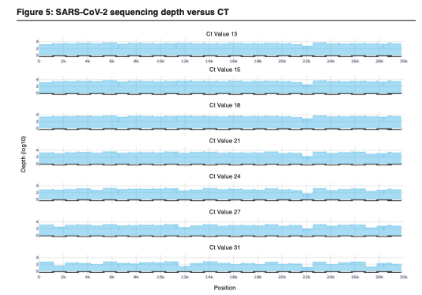
Clear Dx WGS SARS-CoV-2 Performance*
* https://www.clearlabs.com/cleardx/#resources

Slide 19
Product Portfolio
Automated Workflow Solutions
Clear Safety
Salmonella and Listeria
Targeted sequencing of up to 192 food/environmental samples from enrichment broth within approximately 10-12 hours.
Clear Dx
WGS SARS-CoV-2
Whole genome sequencing of up to 32 samples of extracted SARS-CoV-2 RNA and generate FASTQ, FASTA, and intermediate files within approximately 20 hours.
Future Product Considerations
Microbial Surveillance
Whole genome sequencing from an isolate or pure microbial culture. Generates FASTQ, FASTA, and intermediate files.

Slide 20
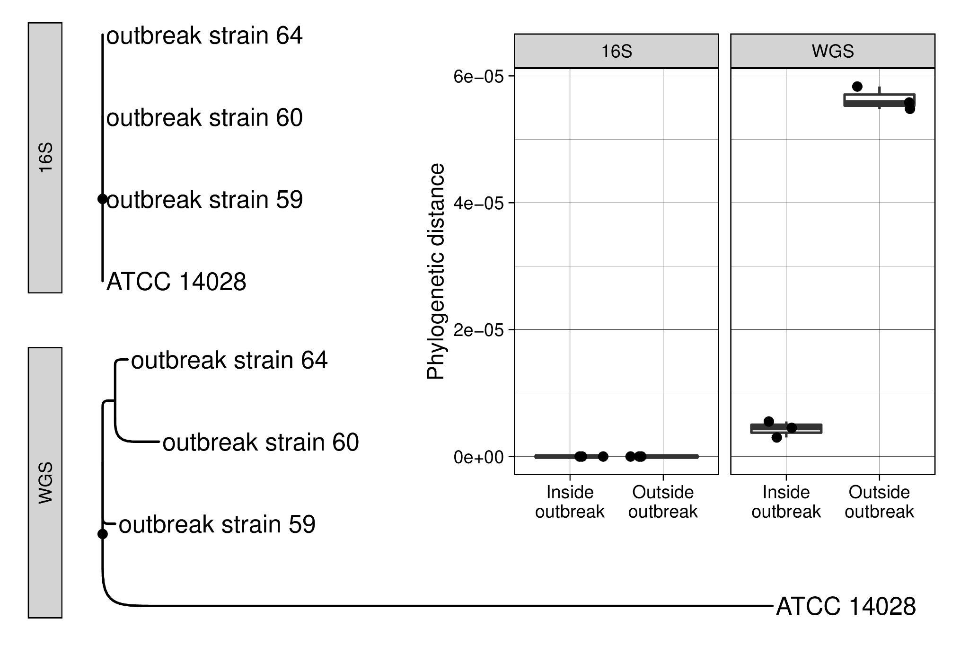



Turnkey Bacterial Isolate WGS
BioNumerics

Slide 21
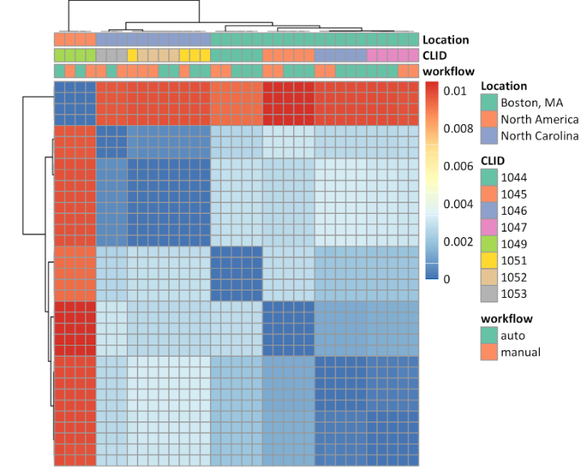
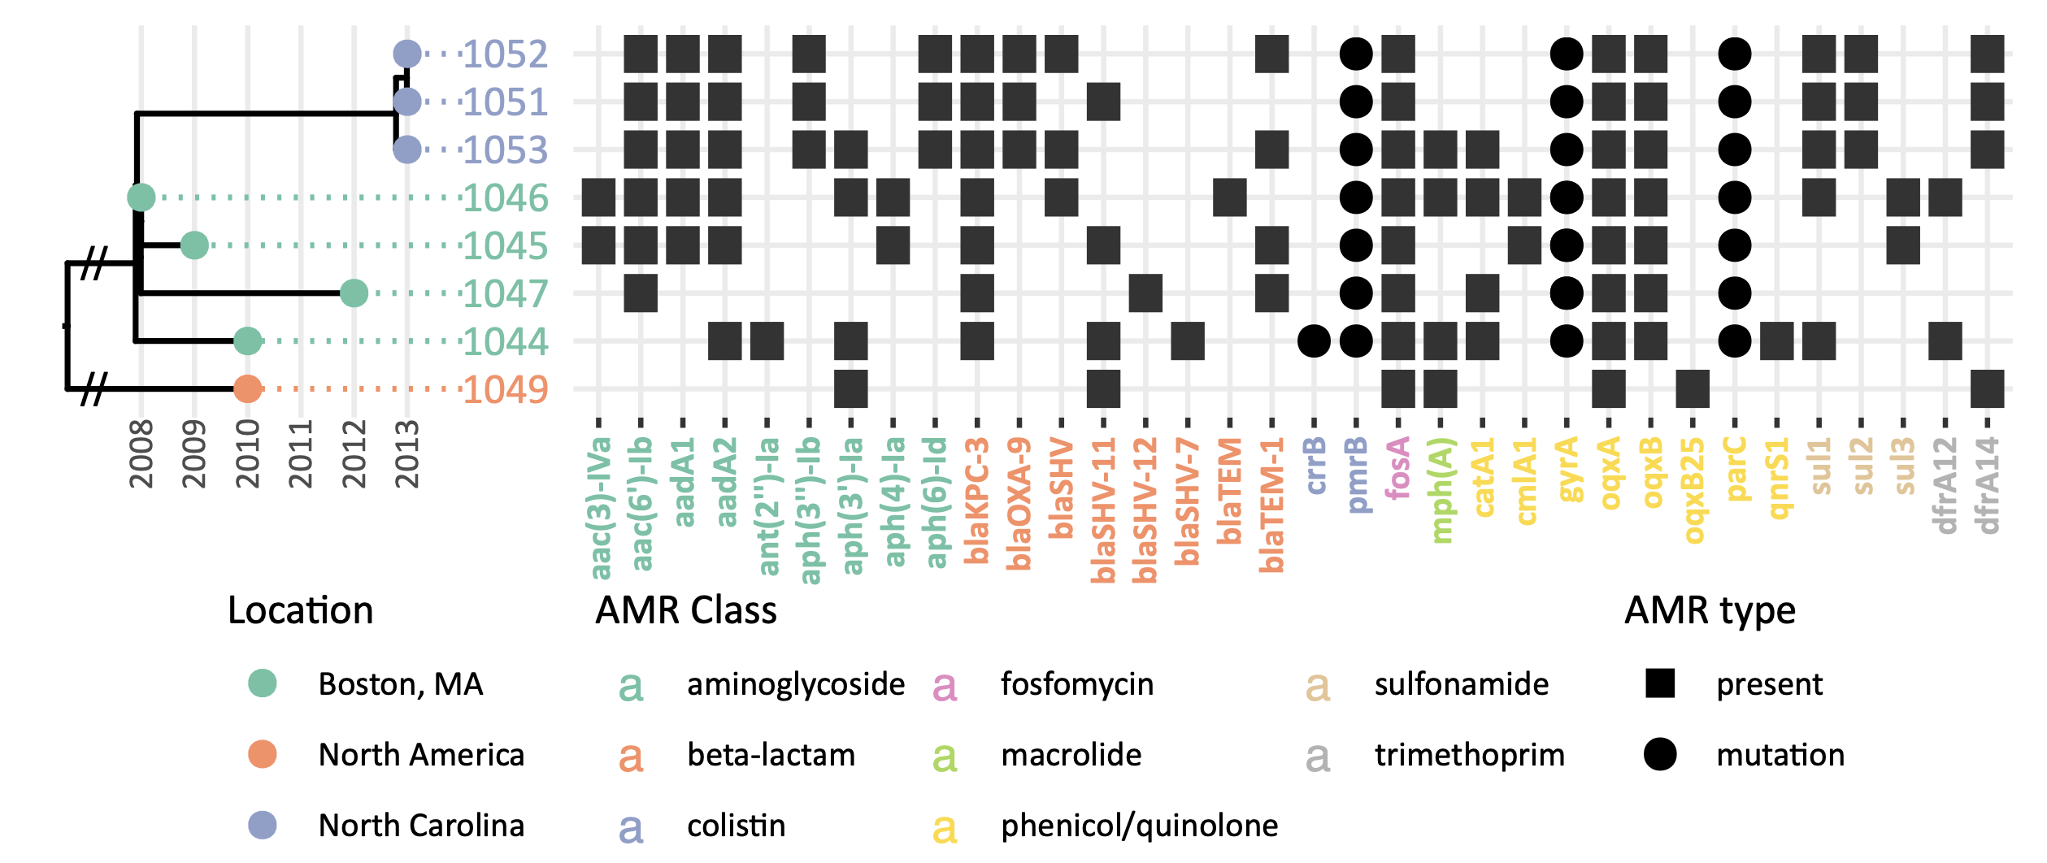
Turnkey Bacterial Isolate WGS
Healthcare associated infection setting: Klebsiella pneumoniae
SNP-phylogeny on left, detected antimicrobial resistance genes on the right
Equivalence of manual & automated sequencing

Slide 22
Summary
Clear Labs Automated Workflows
Barriers
Solution
Clear Safety
Salmonella and Listeria
Staffing Constraints
Time to Result
Cost
Bioinformatics Resources
Computing Infrastructure
Automation
Clear Dx
WGS SARS-CoV-2
Integrated Analysis
Cloud-based Solution
Future Product Considerations
Microbial Surveillance

Slide 23
charles.vaske@clearlabs.com
clearlabs.com

