Slide 1
Update from the National Antimicrobial Resistance Monitoring System
Patrick McDermott, MS, Ph.D., D(AAM)
Director, The National Antimicrobial Resistance Monitoring System
Food & Drug Administration
Center for Veterinary Medicine
Office of Research
Laurel, MD
GT 2022

Slide 2
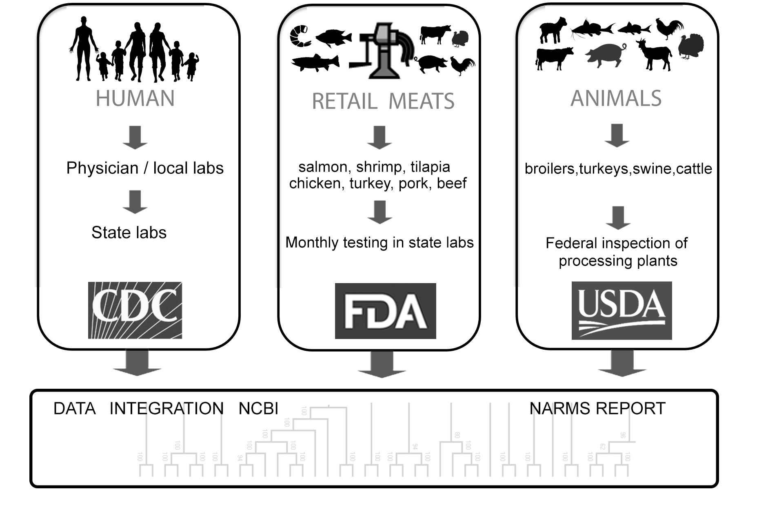
The NARMS Mission
To provide scientifically reliable data to help reduce the human, animal and environmental health burden caused by antimicrobial-resistant bacteria
Watch: Monitor trends in antimicrobial resistance among enteric bacteria from humans, retail meats, and animals at slaughter;
Search: Conduct research to better understand the emergence, persistence, and spread of antimicrobial resistance;
Share: Disseminate timely information to stakeholders to promote interventions that reduce resistance;
Support: Provide timely antimicrobial resistance data for outbreak investigations; and
Decide: Provide data that assist the FDA in making decisions related to the approval of safe and effective antimicrobial drugs for animals

Slide 3
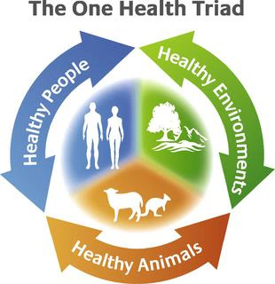
Integrated surveillance of antimicrobial resistance: Zoonotic foodborne bacteria
The Evolution of One Health Integrated AMR Monitoring
One Health surveillance of antimicrobial resistance: Human, animal, plant environment
The coordinated sampling and testing of bacteria from food animals, foods, and clinically ill humans; and the subsequent evaluation of antimicrobial resistance trends throughout the food production and supply chain using harmonized methods.*
Collaborative, multisectoral, and transdisciplinary approach — working at the local, regional, national, and global levels — with the goal of achieving optimal health outcomes recognizing the interconnection between people, animals, plants, and their shared environment+
Burden of
Illness
Attribution
Mitigation
Baseline
Trends
Spread
Burden of
Illness
Attribution
Mitigation
Baseline
Trends
Spread
*WHO Advisory Group on Integrated Surveillance of AMR (AGISAR)
+CDC One Health Office, 2009.

Slide 4
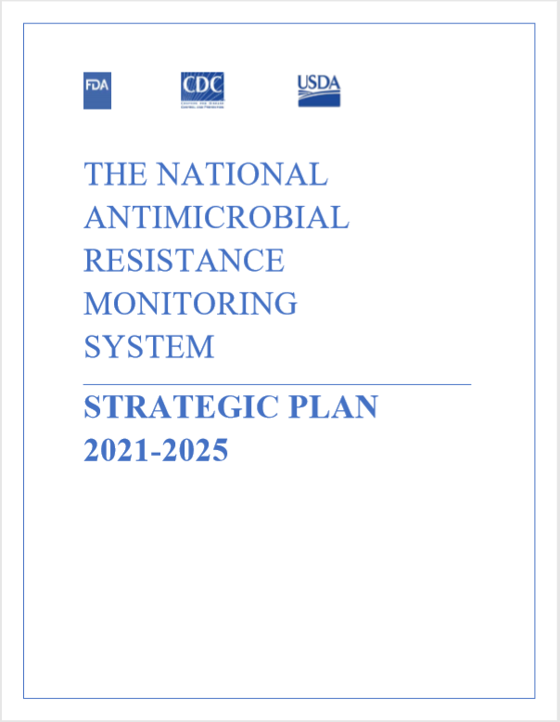
GOAL 1: ENHANCE SAMPLING FOR FOODBORNE PATHOGENS WITHIN A ONE HEALTH FRAMEWORK
Objective 1.1: Enhance and maintain routine resistance monitoring in select pathogens causing illness in food-producing and companion animals
Objective 1.2: Implement geographically-representative monitoring including surface waters to establish baseline AMR data in aquatic ecosystems
Objective 1.3: Initiate an AMR testing program for animal feed and pet food, including their ingredients, and share data in an integrated database and in NARMS reports
Objective 1.4: Add routine testing of seafood products and imported foods and conduct pilots to explore other possible sources of resistant bacteria affecting health such as minor food-producing animal species, produce, and wildlife
Objective 1.5: Expand NARMS to explore the diversity of antimicrobial resistance in other foodborne microorganisms

Slide 5
Structure of NARMS, 2021
 | Humans | Retail Meats | Food-Producing Animals | Animal Pathogens | Environment | WGS Data Repository
Agency | Centers for Disease Control and Prevention (CDC) | U.S. Food and Drug Administration (FDA) | United States Department of Agriculture (USDA) | FDA and USDA | Environmental Protection Agency (EPA) FDA, USDA, CDC, | National Institutes of Health (NIH)
 | Health departments in 50 states | Health departments in 16 states | Food Safety and Inspection Service (FSIS) | Veterinary Laboratory Investigation and Response Newwork (Vet-LIRN) | Environmental Protection Agency Office of Water | National Center for Biotechnology Information (NCBI)
 |  | Institutions of higher education in 8 states | Agricultural Research Service (ARS) | USDA National Animal Health Laboratory Nework (NAHLN) | Agricultural Research Service (ARS)
 |  |  | Animal Plant Health Inspection Service (APHIS) | Vet Dx Labs in 45 States
Source | Ill persons | Grocery stores | Ceca and regulatory samples | Ill Animals | Pilot Studies | Submitted Genomes
 |  | Chicken | Chickens | Dogs | Method dev. (2021-2) | AMRFinderPlus
 |  | Ground Turkey | Turkeys | Cats | Watersheds (2022)
 |  | Ground Beef | Cattle | Cattle | Nat’l survey (2023-4)
 |  | Pork | Swine | Pigs
 |  | Shrimp | Veal | Poultry
 |  | Tilapia | Lamb | Other
 |  | Salmon | Goat
 |  | Pilot surveys (veal, giblets) | Catfish
Bacteria | Salmonella | Salmonella | Salmonella | Salmonella | Salmonella
 | E. coli 0157 | Escherichia coli | Escherichia coli | Escherichia coli | Escherichia coli
 | Shigella | Enterococcus | Enterococcus | Enterococcus | Enterococcus
 | Campylobacter | Campylobacter | Campylobacter | S. pseudintermedius
 | Vibrio | Vibrio |  | Other | Metagenome
 | Typhi | Aeromonas
For Salmonella, isolates from human infections are compared with those from 18 food and animal sources

Slide 6
NARMS One Health: Surface Water Testing
For environmental monitoring, what constitutes the best sampling points will be refined over time. Surface waters as confluence points of ecosystems differentially affected by built environments is a starting point.”
NARMS Strategic Plan 2020-2025
Surface waters receive human, agricultural, and wildlife input and are water sources for humans, agricultural, and wildlife.

Slide 7




Analytical Targets
Culture
  Enterococcus, E.coli: Links to existing water quality methods
    Will quantify and determine resistance to specific antibiotics (cefotaxime, vancomycin, tetracycline)
  Salmonella: Links to food cycle & NARMS
    Presence/absence, WGS of isolates
Targeted Gene Analysis
  Defined panel of antibiotic resistance genes important to human, animal, and environmental health, including fecal source trackers (~90-100 genes)
Metagenomics +/- Enrichment
  Define environmental resistome in surface waters
  Determine new genes to quantify via targeted gene analysis

Slide 8
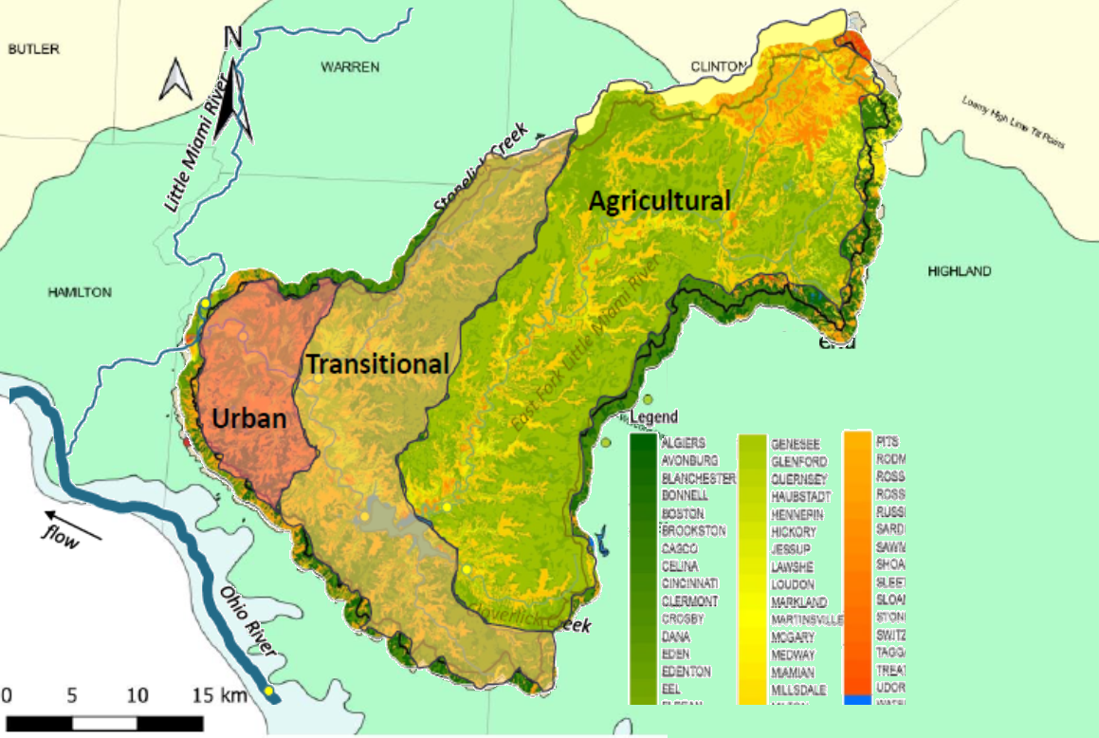
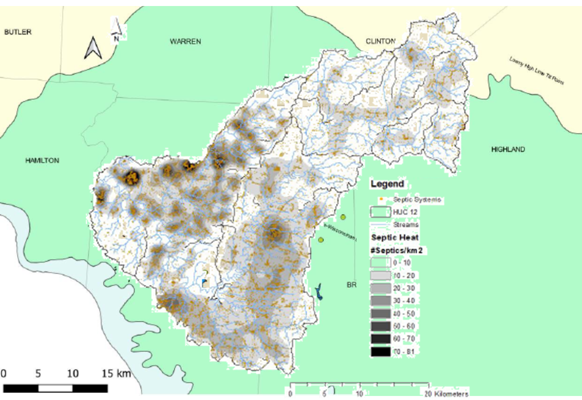
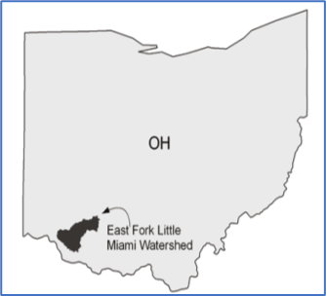
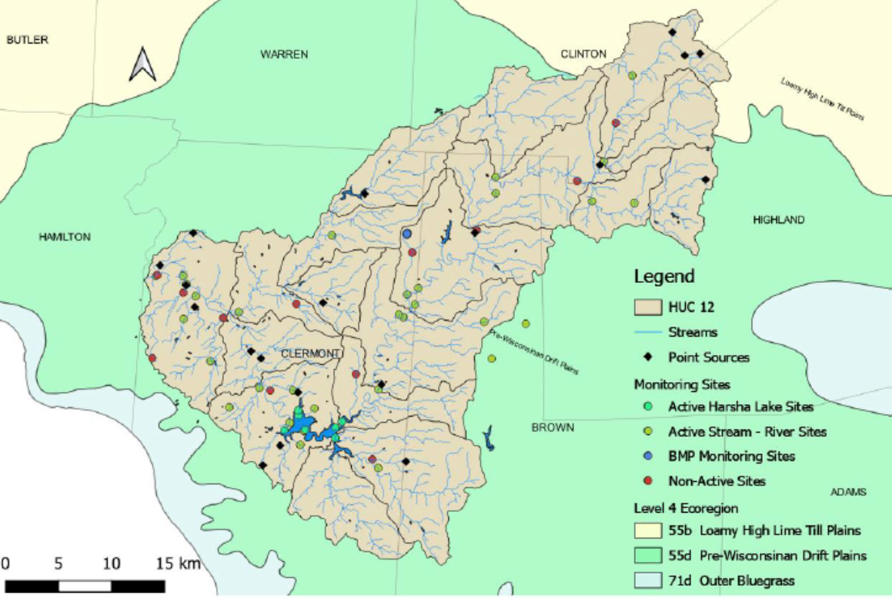
East Fork Little Miami Watershed AMR Pilot
Urban- Ag transition
12K septic systems mapped
Will determine minimum reporting and data quality objectives for comparisons to NRSA and future watershed studies
Additional watershed studies needed:
High livestock inputs
Highly urbanized systems
Regional variation
Point sources and rec waters in relation to sample sites

Slide 9
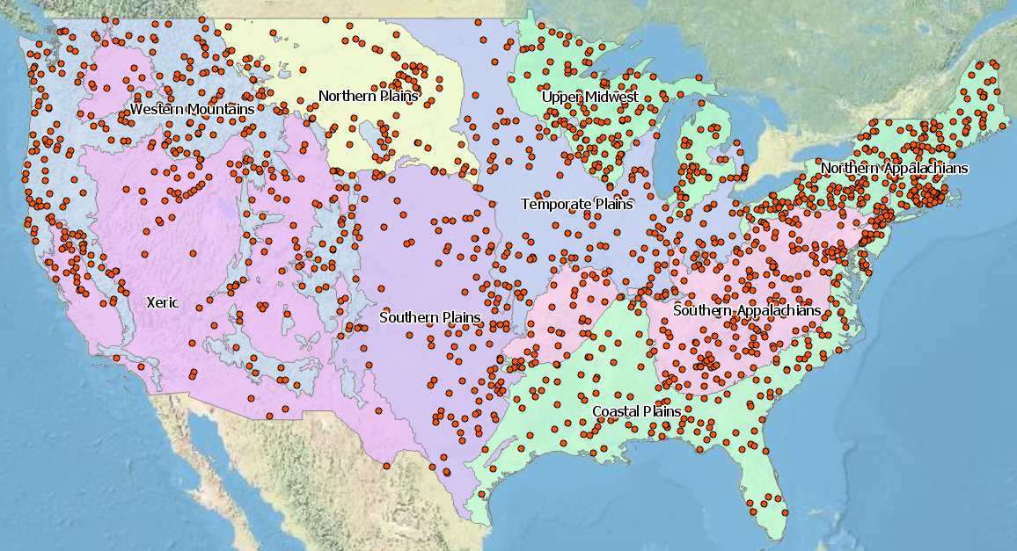
Leveraging EPA Programs – NRSA 2023
Map of National Rivers and Streams Assessment
(ECO9 Regions Shown)

Slide 10
Goal 2: Employ advanced technologies to better understand the evolution and spread of resistance among FOODBORNE pathogens
Objective 2.1: Apply predictive resistance analytics, machine learning, and other bioinformatics tools to NARMS-related data to better understand the mechanisms, sources, and spread of resistance.
Objective 2.2: Optimize in vitro antimicrobial susceptibility testing to identify new resistance mechanisms.
Objective 2.3: Develop metagenomic approaches to characterize the resistome of animals, humans and environmental samples and to link resistance genes to their microbial source.
Objective 2.4: Employ long-read DNA sequencing methods to establish a reference database of fully characterized strains and their plasmids.
Objective 2.5: Conduct research to understand concomitant adaptive microbial features that might contribute to the persistence and spread of resistance (e.g., colonization, stress tolerance) under different selection pressures (e.g., heavy metals, antiseptics, etc.).

Slide 11
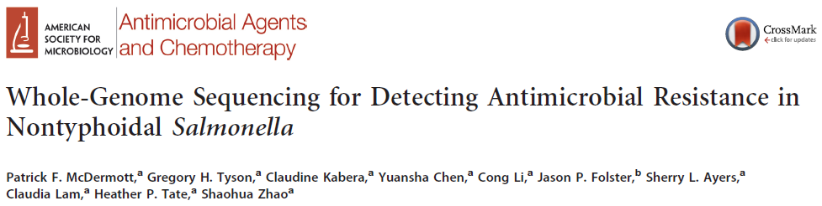
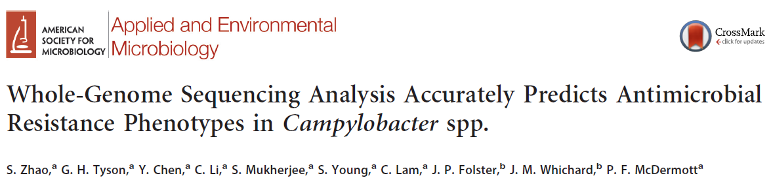
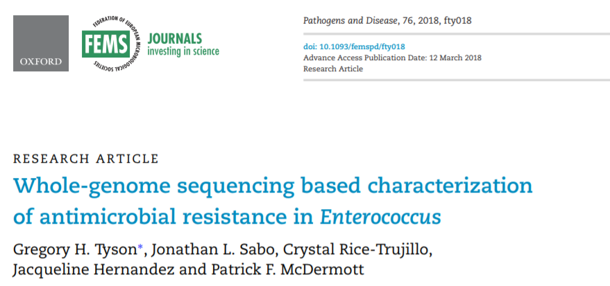

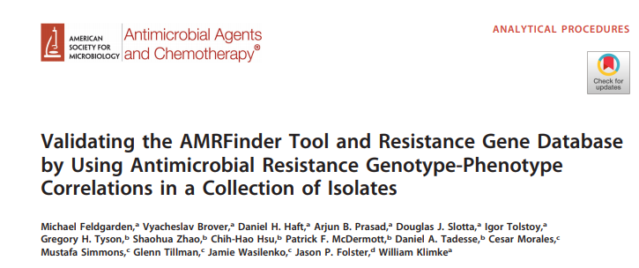
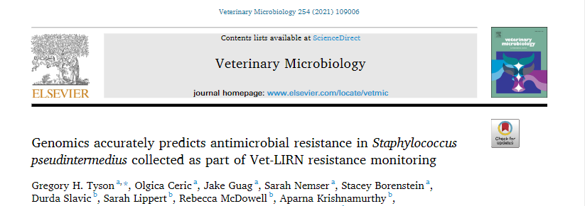
Genotype-Phenotype Correlations

Slide 12
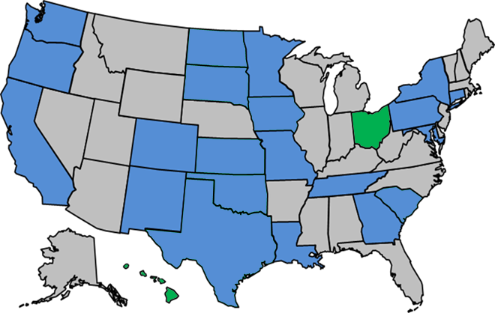
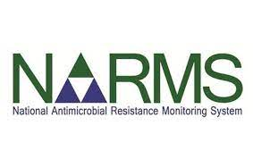


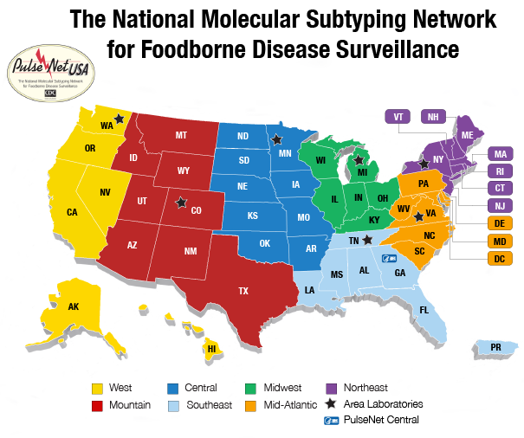
NARMS Data Flow
FDA NARMS Labs
NARMS Now & ResistomeTrakr
Log Sheets & Isolates
WGS
WGS
WGS
Integrated Reports & Summaries
CDC

Slide 13
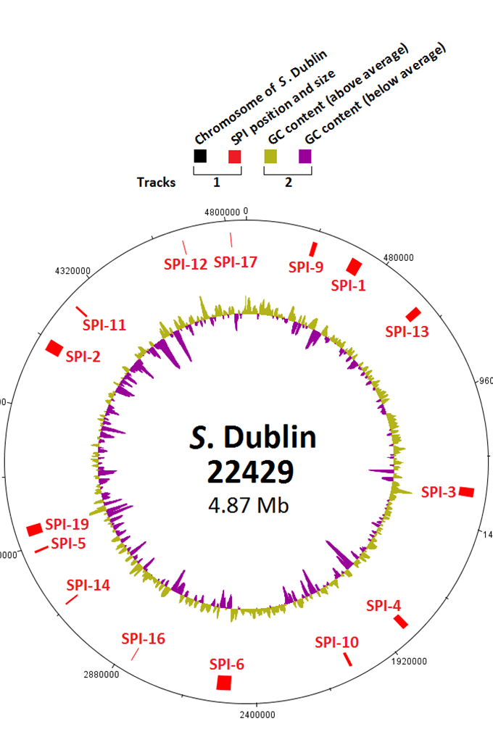
Long Reads: Plasmid Subtyping
Hsu CH, Li C, Hoffmann M, McDermott P, Abbott J, Ayers S, Tyson GH, Tate H, Yao K, Allard M, Zhao S. Comparative Genomic Analysis of Virulence, Antimicrobial Resistance, and Plasmid Profiles of Salmonella Dublin Isolated from Sick Cattle, Retail Beef, and Humans in the United States. Microb Drug Resist. 2019 Oct;25(8):1238-1249.

Slide 14
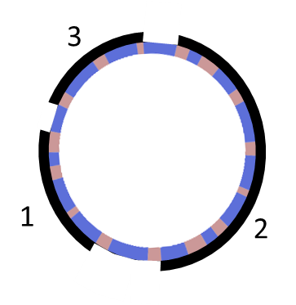
Long Reads: Plasmid Subtyping
plasmid fragments
  Create analogue of a core genome multilocus sequence type schema for existing plasmid types
  Identify which loci of the plasmid MLST schema are co-inherited in conserved regions of sequence
  Numerically codify conserved regions of sequence into ‘plasmid fragments’
  Subtype plasmids on criteria of
    sequence of plasmid loci
    composition of plasmid fragments
    order of genetic elements
    distance between plasmid fragments
15
14
1
16
2
3
17
4
18
5
6
7
plasmid loci
19
8
10
20
order of elements:
9,12,11,10,8,7
21
11
12
22
9
23
24
26
25
bp 1
distance between fragments

Slide 15
Goal 3: Improve data sharing, communication, and collaboration
Objective 3.1: Deposit microbiological data into public databases and post timely web-based updates that describe emergent resistance phenomena for timely response by all stakeholders.
Objective 3.2: Engage with outside partners (e.g., WHO, Clinical and Laboratory Standards Institute, TATFAR, industry) to determine how resistance, whole genome sequence, and metagenomic data can be interpreted for appropriate responses.
Objective 3.3: Work with international partners to establish data quality standards, analytical protocols, and reporting formats for resistance and genome sequence information.

Slide 16
NARMS Data Flow
FDA NARMS Labs
Weekly Updates
NARMS Now & ResistomeTrakr
Log Sheets & Isolates
WGS
WGS
WGS
Integrated Reports & Summaries
CDC
Predicted AST available 1-2 days after submission
Tri-Agency reports may take 10-24 months?

Slide 17
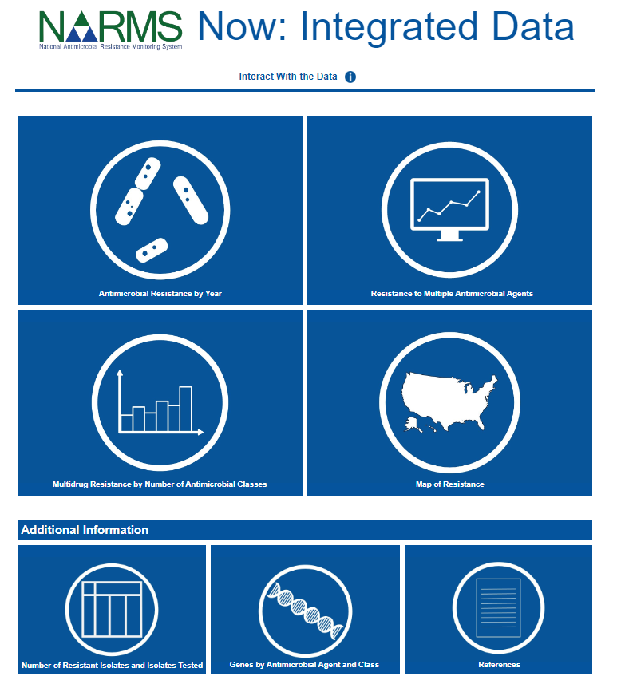
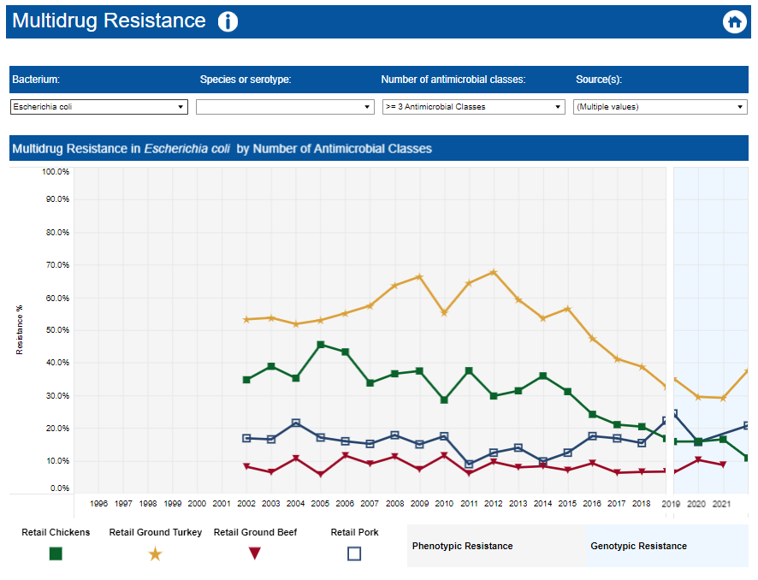
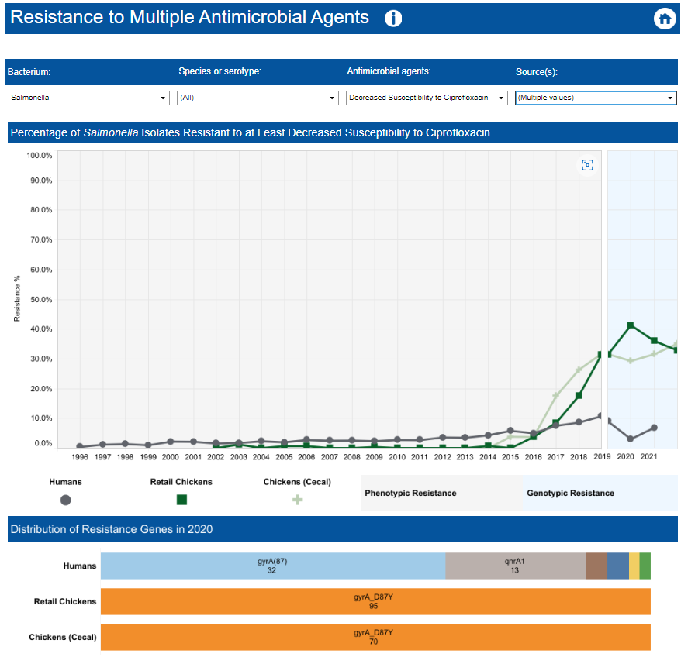
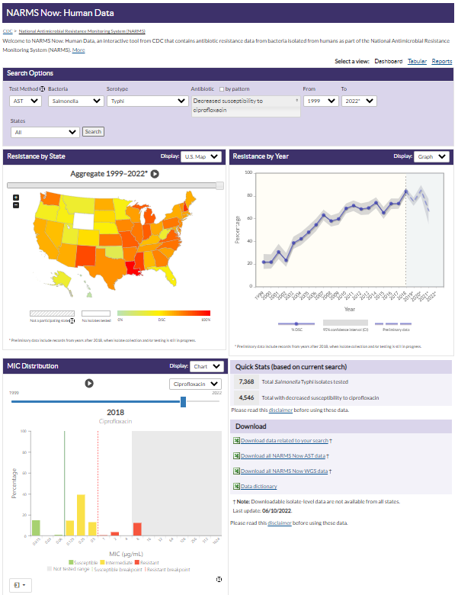
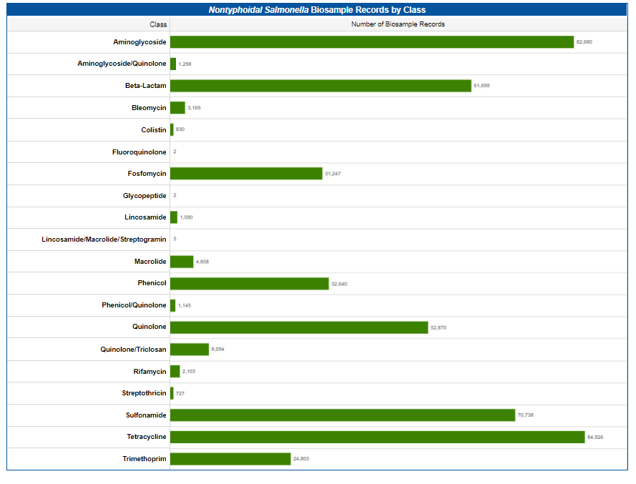
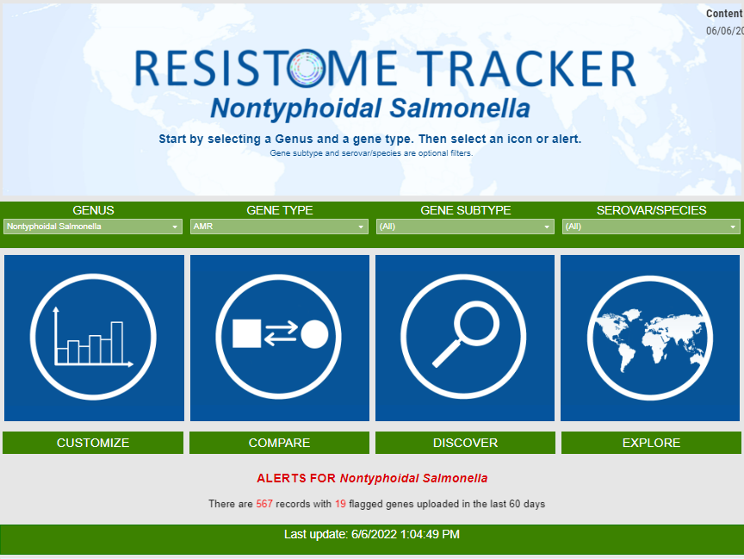

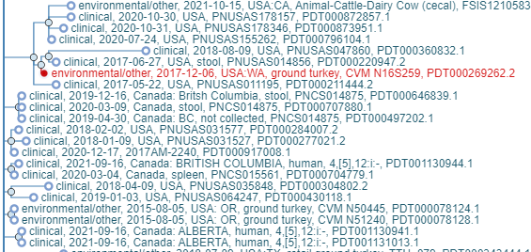
Data Sharing through Interactive Dashboards
NARMS Now Human Data

Slide 18
NARMS Strain Explorer
Strain Explorer is a data tool that allows users to look at emerging resistances.
  It looks at SNP Clusters from NCBI where isolates from at least two different NARMS sources exhibited one or more resistances of interest. An isolate is considered to exhibit a resistance of interest if it contains genes that confer resistance to one of the following:
    For Salmonella:
      Azithromycin (decreased susceptibility)
      Ciprofloxacin (decreased susceptibility)
      Ceftriaxone
      Meropenem
      Colistin
    For Campylobacter:
      Azithromycin
      Erythromycin
      Ciprofloxacin
      Meropenem
Notes:
The second Tableau dashboard I am going to demo is the Strain Explorer. The Strain Explorer is a new data tool that allows users to explore emerging resistances. This tool is not publicly available yet, we are still working on fine tuning it and figuring out the best vehicle for publication. The Strain Explorer uses the same data as the genotypic resistance data in NARMS Now, so it is also updated on a weekly basis. It at the different SNP Clusters in NCBI and pulls the ones where there are isolates from at least two different NARMS sources that exhibit one or more resistances of interest. An isolates is considered to exhibit a resistance of interest if it contains genes that confer resistance to one of the clinically important antimicrobial agents. The Strain Explorer currently only includes Salmonella and Campylobacter. The clinically important antimicrobials for Salmonella are Azithromycin, Ciprofloxacin, Ceftriaxone, Meropenem, and Colistin. And for Campylobacter they are Azithromycin, Erythromycin, Ciprofloxacin, and Meropenem.

Slide 19
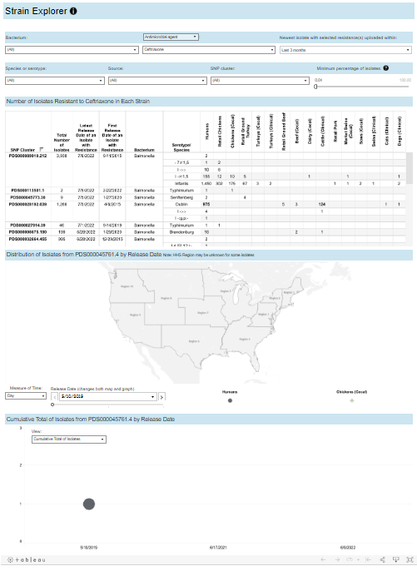
NARMS Strain Explorer Features
Main Page includes:
  a table of SNP Clusters that meet criteria laid out on previous slide.
  a map that allows users to see where in the U.S the isolates were discovered.
  a graph that shows either the number of isolates submitted over time or the running sum of those isolates.
Second Page includes:
  A table of isolate level details for a selected SNP cluster
  Relevant links to NCBI
Notes:
The Strain Explorer consists of two pages. The main page includes a table of SNP clusters that meet the criteria I just spoke about. It includes a map that allows users to see where in the U.S the isolates were discovers. This map is broken into the 10 HHS regions. Under the map there is also a graph that users can toggle between showing the number of isolates submitted over time or the running sum of the isolates. The second page is just a table of the isolate level details for a selected SNP cluster. There are also some direct links NCBI.

Slide 20
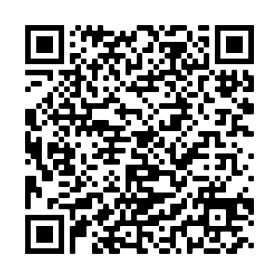
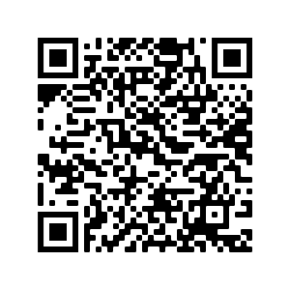
Links
Integrated Reports/Summaries
Strain Explorer
Email questions or feedback: Amy.Merrill@fda.hhs.gov
Notes:
Here are the links to what I discussed today. As I said Strain Explorer is not publicly available, you need the direct link to it. If you would like to see the beta version, you can use the QR code here or feel free to reach out to me. Also please feel free to reach out to me with any questions or feedback.

Slide 22
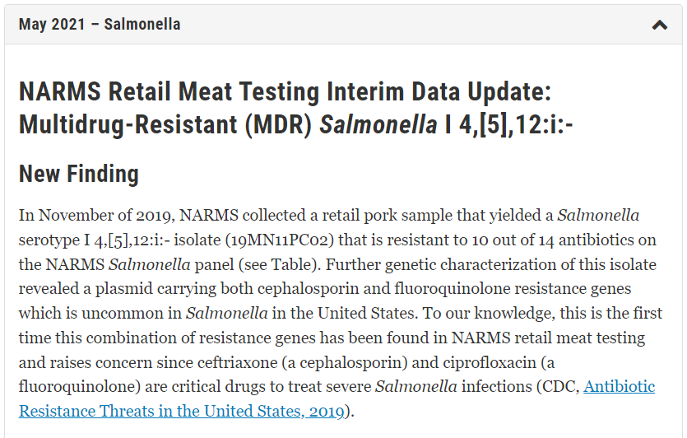
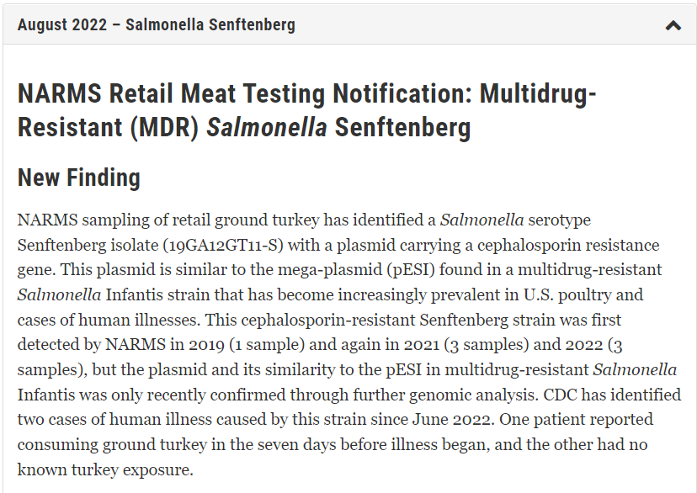
NARMS Interim Updates
Goal 3: Improve data sharing, communication, and collaboration
Summarize recent unusual or concerning antimicrobial resistance findings found through surveillance of retail meats. These updates are based upon WGS analysis to screen for bacterial genes associated with resistance to one or more medically important antibiotics. Findings that would lead to a data update include but are not limited to:
Resistance to antimicrobials typically used to treat infections in humans (e.g., ceftriaxone and ciprofloxacin for treatment of severe Salmonella infections),
Resistance to antimicrobials used as last-resort treatments (e.g., colistin), and
Emergence of extensively drug-resistant clones.

