Slide 1
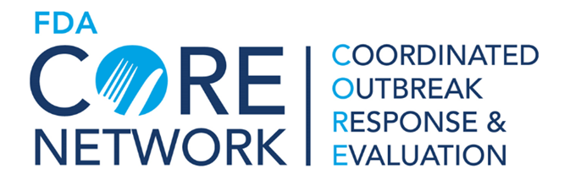
Listeria monocytogenes infections linked to Brand A Packaged Salads: FDA investigation
Asma Madad, MS MPH CPH
Coordinated Outbreak Response and Evaluation (CORE) Network
2022 GenomeTrakr Meeting
10/20/2022

Slide 2
Jan 2019 Investigation
5 cases from 5 states: IA, MD, OH, PA, TX
  Isolation dates 8/16/2014 – 1/23/2019
  Isolates within 0-11 alleles by wgMLST
**Clinical case from 2014 not included in timeline
Number of cases**
Notes:
This investigation was first opened by CDC on 1/28/2019; upon investigation closure, there was a single case each from 5 states: IA, MD, OH, PA, and TX.
Isolation dates ranged from 8/16/2014 to 1/23/2019. All isolates were related within 0-11 alleles by wgMLST
Exposure information was limited and no potential vehicles were identified prior to closure
A 6th case on the timeline shown with isolation date in March of 2019 was uploaded just after cluster investigation was closed

Slide 3
Jan 2019 Investigation
5 cases from 5 states: IA, MD, OH, PA, TX
  Isolation dates 8/16/2014 – 1/23/2019
  Isolates within 0-11 alleles by wgMLST
**Clinical case from 2014 not included in timeline
Number of cases**
Notes:
This investigation was first opened by CDC on 1/28/2019; upon investigation closure, there was a single case each from 5 states: IA, MD, OH, PA, and TX.
Isolation dates ranged from 8/16/2014 to 1/23/2019. All isolates were related within 0-11 alleles by wgMLST
Exposure information was limited and no potential vehicles were identified prior to closure
A 6th case with isolation date in March 2019 was uploaded just after CDC cluster investigation was closed

Slide 4
Dec 2019 Investigation
9 cases from 8 states: IA, MD, NC, OH (2), OR, PA, TX, and WI; 2 related cases also identified in Canada
  Isolation dates from 8/16/2014 – 11/20/2019
  Isolates within 0-14 alleles by wgMLST
**Clinical case from 2014 not included in timeline
Number of cases**
Notes:
Investigation was reopened by CDC 12/10/2019 after PulseNet identified 4 additional illnesses. The outbreak now totaled 9 cases from 8 states and isolation dates extended to 11/20/2019.
All isolates were related within 0-14 alleles. There was also one reported death that was attributed to listeriosis
Two 2019 Canadian cases were identified and related to the outbreak strain.
Leafy greens were identified as the suspect vehicle, but both FDA and state inspectional and/or leafy green retail sampling did not yield any Lm positive samples; inspections were conducted at Brand A facilities based on available case exposure information

Slide 5
Dec 2019 Investigation
9 cases from 8 states: IA, MD, NC, OH (2), OR, PA, TX, and WI; 2 related cases also identified in Canada
  Isolation dates from 8/16/2014 – 11/20/2019
  Isolates within 0-14 alleles by wgMLST
**Clinical case from 2014 not included in timeline
Second CDC investigation closed
2/10
Number of cases**
Notes:
Investigation was reopened by CDC 12/10/2019 after PulseNet identified 4 additional illnesses. The outbreak now totaled 9 cases from 8 states and isolation dates extended to 11/20/2019.
All isolates were related within 0-14 alleles. There was also one reported death that was attributed to listeriosis
Two 2019 Canadian cases were identified and related to the outbreak strain.
Leafy greens were identified as the suspect vehicle, but both FDA and state inspectional and/or leafy green retail sampling did not yield any Lm positive samples; inspections were conducted at Brand A facilities based on available case exposure information

Slide 6
Nov 2021 Investigation
16 cases from 13 states: IA (2), ID, MD, MI, MN, NC, NV, OH (2), OR, PA, TX (2), UT, and WI
  Isolation dates from 8/16/2014 – 10/17/2021
  Isolates related within 0-18 alleles by wgMLST
7 total patients reported prepackaged salads
**Clinical case from 2014 not included in timeline
Number of cases**
Notes:
The investigation was opened yet again by CDC on 11/1/2021 after PulseNet identified 7 additional illnesses since the previous investigation closure. There were now 16 cases across 13 states, isolation dates extended to 10/17/2021 and all isolates were related within 0-18 alleles. An additional death was also attributed listeriosis
Two additional ill people reported consuming prepackaged salad, making a total of 7 overall, with one ill person specifically reporting a Brand A prepackaged salad mix. The second ill person reported an unknown brand of prepackaged spring mix.

Slide 7
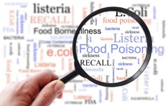
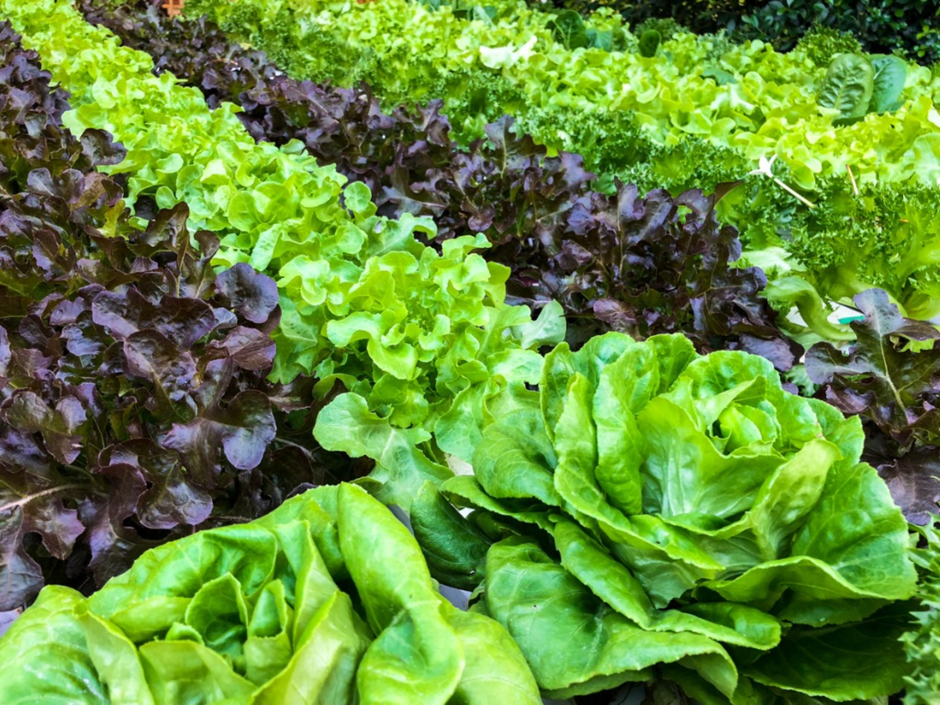
2021 Investigation Breakthrough
WGS of a GDA surveillance sample was identified as the outbreak strain
Listeria monocytogenes findings in sample led to limited recall of Brand A prepackaged salads prior to WGS analysis
**Clinical case from 2014 not included in timeline
Number of cases
Notes:
Prior to CDC reopening the third investigation and unrelated to outbreak activities, the Georgia Department of Agriculture (GDA) conducted routine retail sampling and found Lm in a bag of Brand A garden salad.

Slide 8
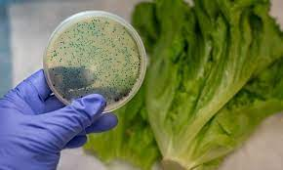
…another State Breakthrough
Request was made to state partners with recent cases to consider retail sampling of prepackaged Brand A leafy greens
MDARD pursued retail sample collection; in December 2021, a sample of Brand A prepackaged lettuce was found positive for L. monocytogenes
WGS of this sample identified the outbreak strain and Brand A issued a recall
**Clinical cases prior to Jan 2021 not included in timeline
Number of cases**
Notes:
In response to the GA sequencing results, The Michigan Department of Agriculture and Rural Development (MDARD) collected retail samples on December 7. On December 20, MDARD confirmed that a bag of Brand A shredded lettuce was positive for Lm. WGS was available on December 22 and was highly related to the outbreak strain. Based on the GA Department of Agriculture and MDARD WGS results, Brand A issued a voluntary recall that same day.

Slide 9
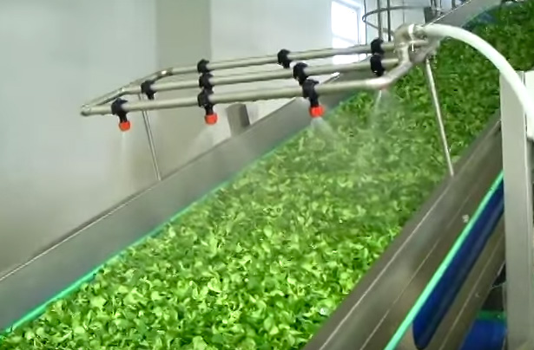

FDA Activities
Concurrent on-site inspections and sample collection conducted by FDA at multiple Brand A facilities
  50+ product, water and/or environmental samples collected by from multiple processing facilities; no L. monocytogenes detected
Number of cases**
**Clinical cases prior to Jan 2021 not included in timeline
Notes:
Case distribution not aligned with any single processing facility
Field investigation team included several HAF divisions (HAF3E, HAF5E, HAF4W, HAF5W) and state partners

Slide 10
Brand A Activities
Brand A initiated their own investigation and shared findings, product samples, isolates, and other data with FDA
  L. monocytogenes detected by Brand A on processing/harvesting equipment and in recalled finished product; isolates shared with FDA matched the outbreak strain
**Clinical cases prior to Jan 2021 not included in timeline
Number of cases**
Notes:
Continued investigation conducted by Dole detected the presence of Listeria on a piece of equipment in their Yuma, AZ, facility. FDA conducted WGS analysis of an isolate shared by Dole, and the results confirmed that this isolate of Listeria matched the strain causing illness in this outbreak and also matched the strain of Listeria found in a positive product sample collected by the Michigan Department of Agriculture and Rural Development, as reported by FDA on December 23, 2021. Dole decommissioned and later dismantled this piece of equipment.
Dole detected the presence of Listeria monocytogenes on equipment used in the harvesting of the iceberg lettuce that was also used in finished products processed in the Dole Springfield, OH, and Soledad, CA, facilities.
FDA analyzed the positive samples collected by Dole from the harvesting equipment. Results from FDA’s Whole Genome Sequencing (WGS) analysis showed that the strain of Listeria found on the harvesting equipment matched the strain causing illnesses in this outbreak. Dole decommissioned the harvester and it was later dismantled. Product on hold that was included in the December 2021 recall was later tested by Dole and tested positive for the strain of Listeria monocytogenes that caused illnesses in this outbreak.

Slide 11
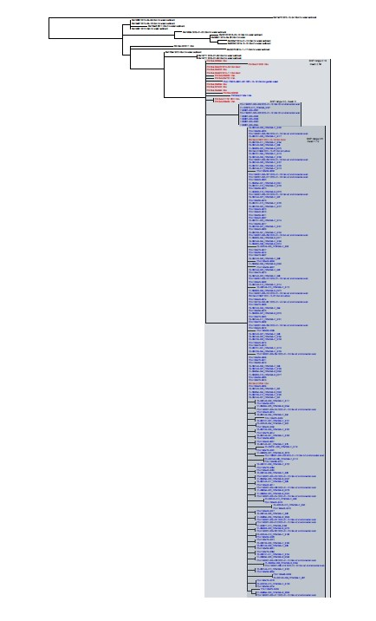
…A Whole Lot of Sequencing Going On…
Main Outbreak Clade 0-13 SNPs (mean 2.58)
~60 product isolates
~31 environmental isolates
Raw sequencing data also provided by Brand A
Notes:
Other Clades also identified, but with no/few clinical isolates
Brand A not only shared product, non-clinical isolates, but also shared raw sequencing data – very large volume of data was successfully shared
Note that due to tandem sequencing efforts by Brand A and FDA, outbreak clade included more than one isolate per sample in some cases

Slide 12
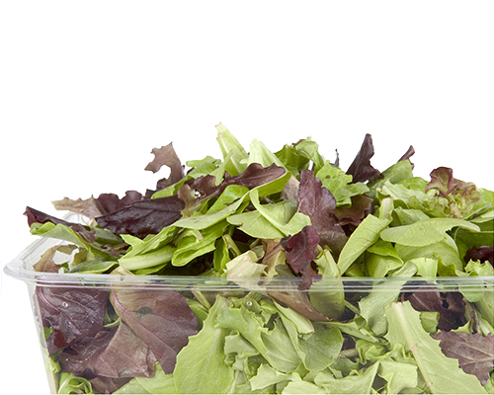

Conclusions/Outcomes
Cases ranging several years, limited exposure history impacted traceback
Routine and outbreak-directed state sampling provided key pieces of evidence
Cooperation and information sharing with Brand A assisted investigation progress
Two processing facilities temporarily ceased operations for additional cleaning and sanitization
Notes:
State partners attempted to obtain shopper card records when possible but were unsuccessful
Note that other state partners besides GA, MI collected retail samples; could not advise targeting product processed at particular facilities due to limited exposure info (suggested representative of what was on store shelves)
- Often fresh produce outbreak is over before identification of convergence/completion of traceback, limiting timeliness of next steps; this is even more challenging with long timeframe associated with listeriosis outbreaks
Dole cooperated with FDA inspectors, undertook a root cause analysis, and shared results of its root cause analysis with FDA. FDA plans to continue to work with industry, federal partners, state and local regulators, academia, and others to address the safety of leafy greens by advancing work in prevention, response, and addressing knowledge gaps.
During the investigation, operations at the Bessemer City, NC, and Yuma, AZ, facilities were temporarily halted for deep cleaning, sanitization, and verification swabbing, and have since resumed.

