Slide 1


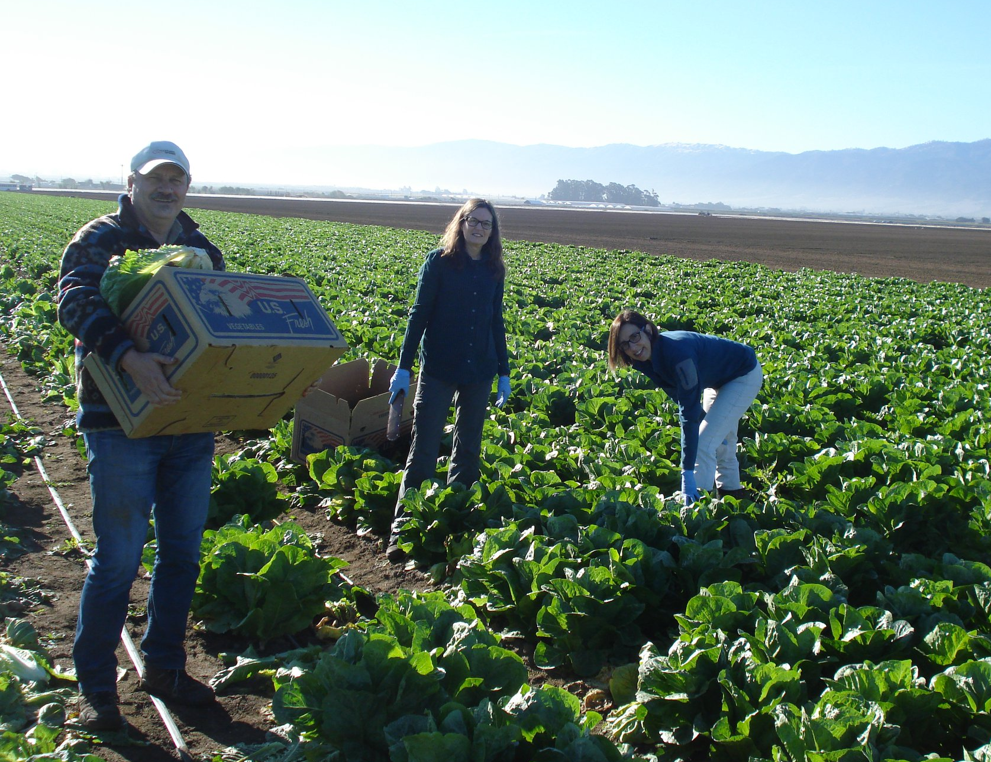

Seasonality of the romaine lettuce phyllosphere microbiome is correlated with E. coli O157:H7 survival in modified atmosphere packaged lettuce during cold storage
Susan R. Leonard, PhD
Mark K. Mammel, MS
Taylor K. S. Richter, PhD
Solomon T. Gebru, PhD
Mary E. Torrence, DVM, PhD
Maria T. Brandl, PhD
Ivan Simko, PhD
2022 GenomeTrakr Meeting
October 20, 2022

Slide 2

The role of the plant microbiome in the microbial safety of fresh produce is largely unexplored
What are the reservoirs for lettuce phyllosphere microbiota and to what extent is the phyllosphere microbiome influenced by lettuce cultivar, weather factors, and agricultural practices?
Lettuce leaf lesions enhance the survival of E. coli O157:H7
  Physical cutting of lettuce alters the physicochemical environment
  Presence of microbes with the ability to enzymatically macerate the plant cell wall may contribute to lettuce decay
Determine correlations between various factors to understand the impact on STEC survival/growth in modified atmosphere packaged cut romaine lettuce:
  Lettuce microbiome
  Lettuce cultivar
  Harvest season
  Decay rate of MAP cut lettuce
  Survival/growth of E. coli O157:H7

Slide 3
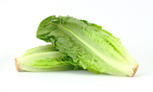
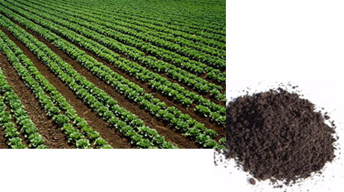
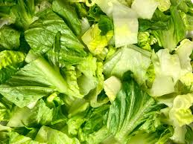
Project workflow: sample and data collection
Lettuce cultivation, harvest, and storage
Romaine lettuce cultivars DA and TT
Experimental field (USDA)
    Fall 2017
    Spring 2018
    Fall 2018
Conventional field (Grower)
    Spring 2018
    Fall 2018
  Collection of lettuce and soil
    Outer leaves removed from lettuce plant
    Composite soil samples
  Lettuce was cut, washed, rinsed
  Sealed in modified atmosphere packaging and inoculated with E. coli O157:H7
  Stored at 6°C and 24°C
Pre-processing
Lettuce head microbiome
Soil microbiome
Weather data
Post-processing
Decay rating
E. coli O157:H7 enumeration
Percent CO₂ and O₂ in bag
MAP lettuce microbiome

Slide 4

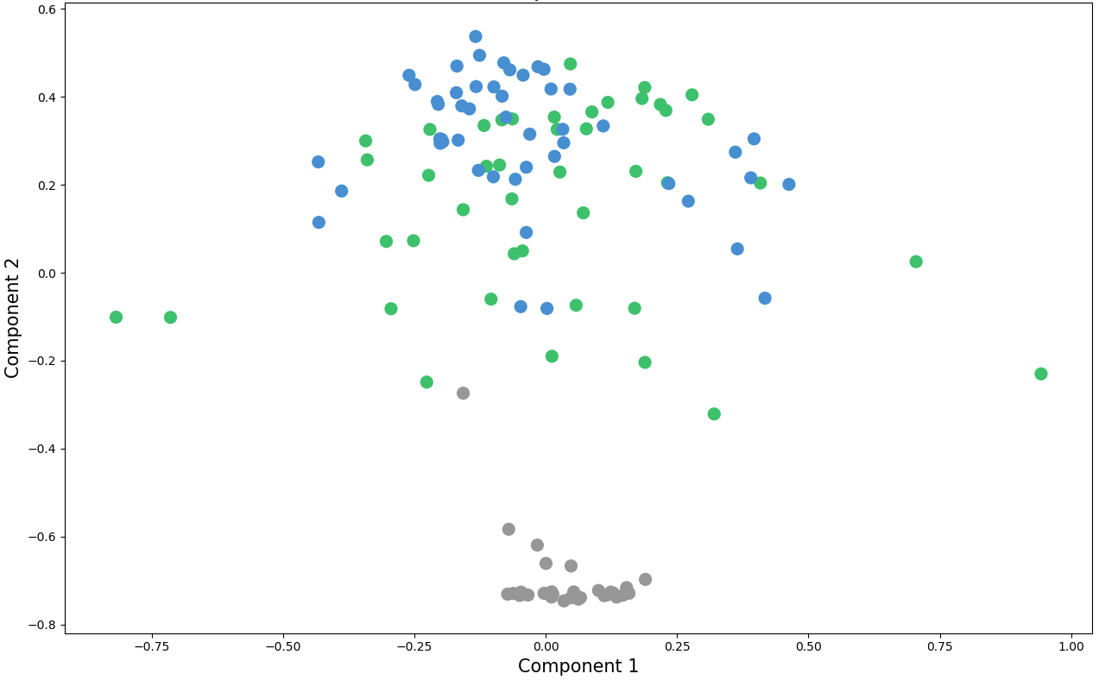
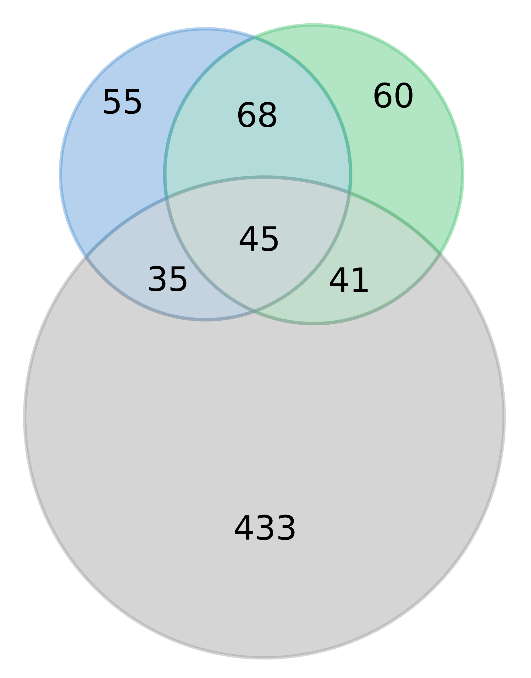
Change in bacterial communities during processing
Bacterial community beta diversity
Overlap of bacterial species in the three sample types
Species are included if the average relative abundance for the sample type is ≥ 0.02%
Processed lettuce
Harvested lettuce
Surface soil
Harvested lettuce
Time zero MAP lettuce
Surface soil
Wide variation in bacterial communities among harvested lettuce heads
Cutting and washing lettuce in chlorine significantly shifts the bacterial community (PERMANOVA, P = 0.0001)

Slide 5
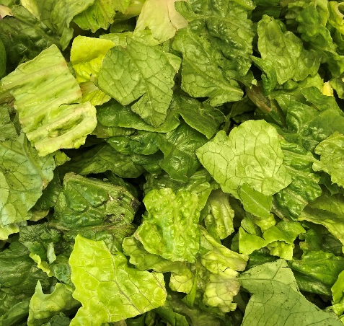
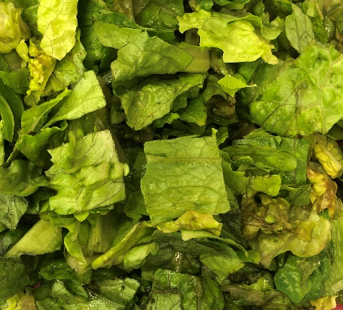
Lettuce deterioration and E. coli O157:H7 population dynamics on MAP lettuce during storage
Bacterial communities of processed lettuce stored at 6°C
Lettuce deterioration
Cultivar DA
Cultivar TT
E. coli O157:H7 survival
5
DA
TT
4
Relative abundance
Log (CFU/g)
3
pre-storage
midpoint
endpoint
Endpoint
DA
TT
Midpoint
Midpoint
Endpoint
Pre-storage
Pre-storage
The microbiome of processed MAP romaine lettuce shifts extensively during storage
During cold storage, there was a 5-fold decline on average (range 1.3 to 52-fold), with a 1.6 times greater decrease on cultivar DA
E. coli O157:H7 population dynamics were not correlated with the presence of bacterial plant pathogens

Slide 6
Harvest season was identified as an important factor associated with greater E. coli O157:H7 survival in cold stored MAP lettuce
Classification tree based on recursive partitioning to determine independent variables predicting change in EcO157 population size
(P < 0.01)
∆Log (EcO157 CFU/g)
n = 90
Variables included:
Field (conventional, experimental)
Season (spring, fall)
Cultivar (DA, TT)
Storage temperature (6°C, 24°C)
Bag atmosphere (%O₂, %CO₂, %N₂)
Decay rating
Alpha diversity (species richness, Shannon Index)
6°C
24°C
Spring
Fall
CO₂
<16.24%
CO₂
>16.24%
12.9-fold decline
2.3-fold decline
Decay
<15%
Decay
>15%
Exp. field
Conv. field
Exp. field
Conv. field
spp. richness <88
spp. richness >88

Slide 7
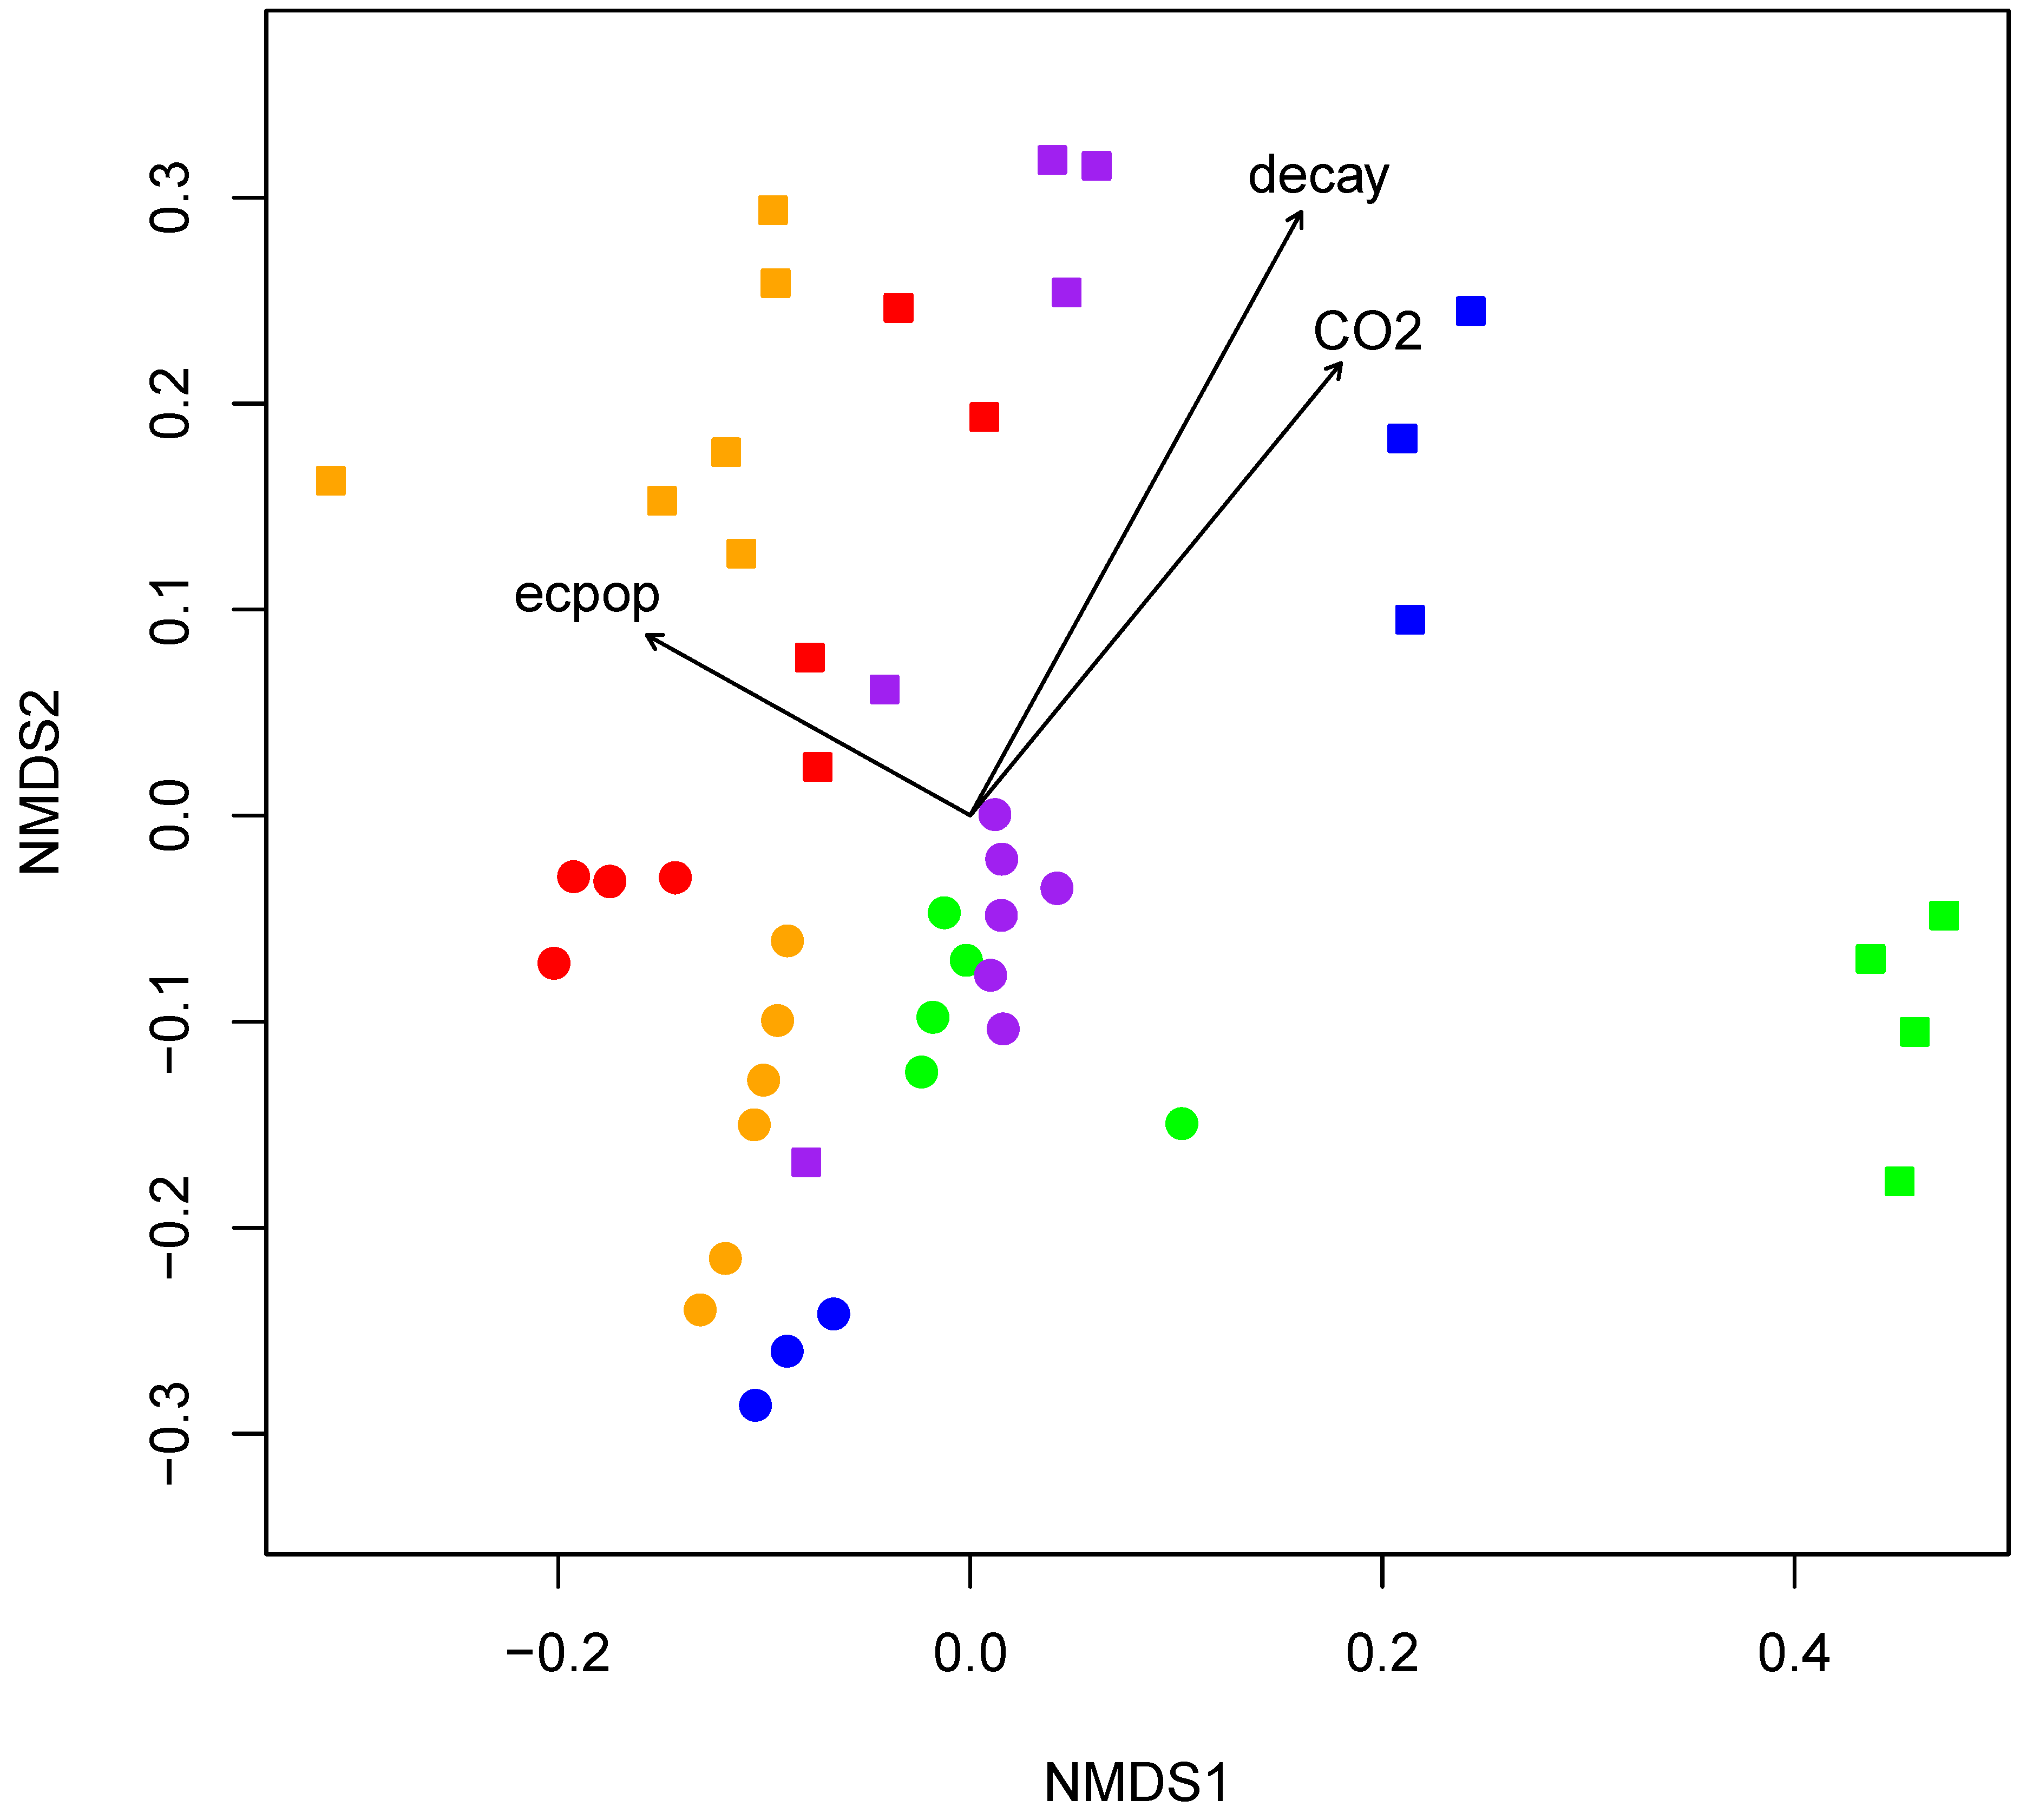
Microbiome on cold stored MAP lettuce harvested in the fall is correlated with greater E. coli O157:H7 survival
Bacterial communities of cold-stored lettuce differ by harvest season (PERMANOVA, P = 0.0001)
Bacterial community beta diversity
6°C
Correlations between variables and bacterial community composition
decay
CO₂
Variables included:
Bag atmosphere (%O₂, %CO₂)
Decay rating
Change in E. coli O157:H7 population size
ΔEcO157
Correlations:
Decay (P = 0.0001, R² = 0.76), vector → TT microbiomes
CO₂ (P = 0.0001, R² = 0.55), vector → TT microbiomes
ΔEcO157 (P = 0.0055, R² = 0.22), vector → fall microbiomes
EF
EF
CF
ES
CS
DA
TT

Slide 8
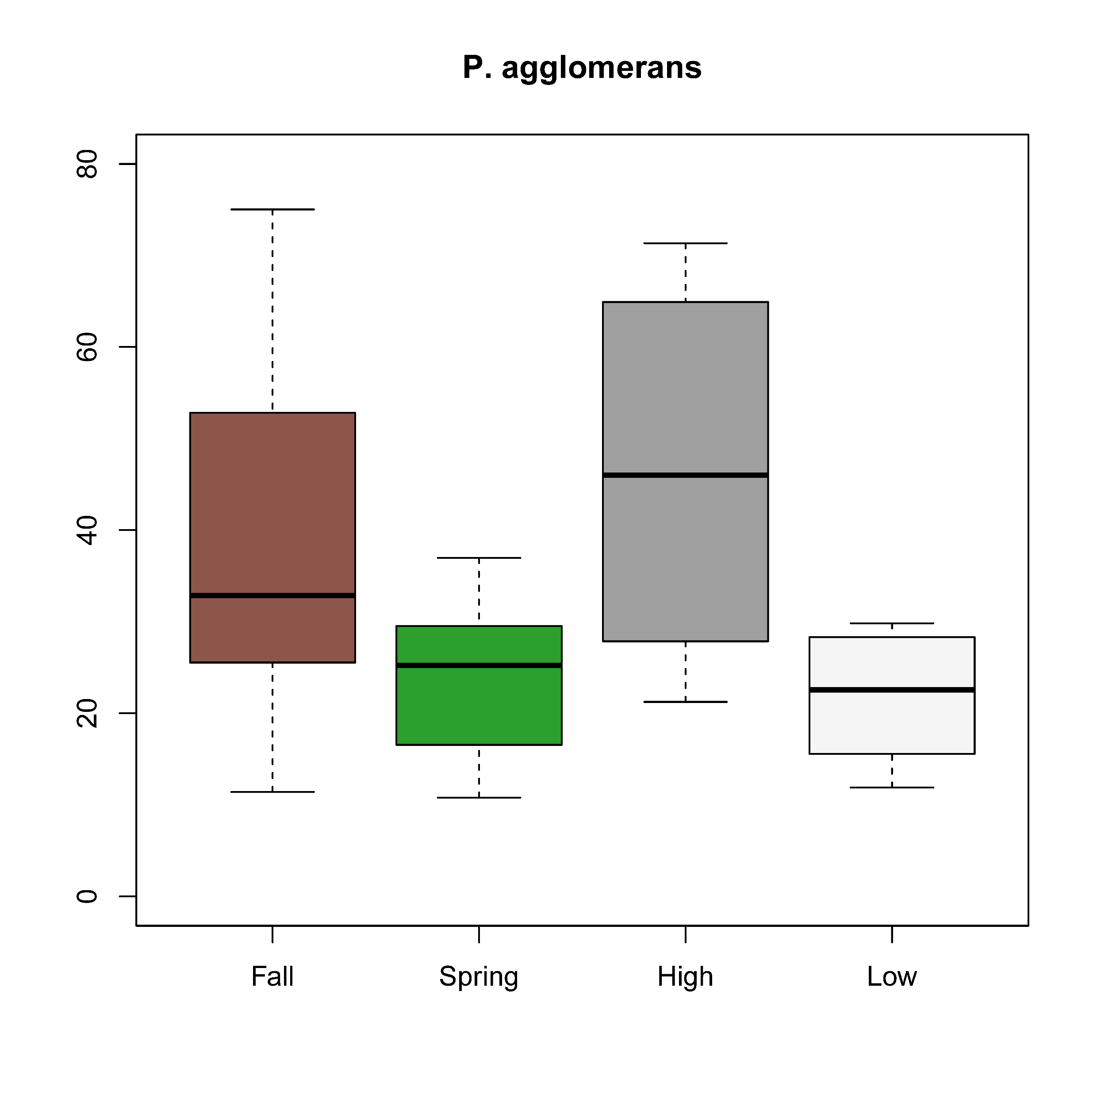
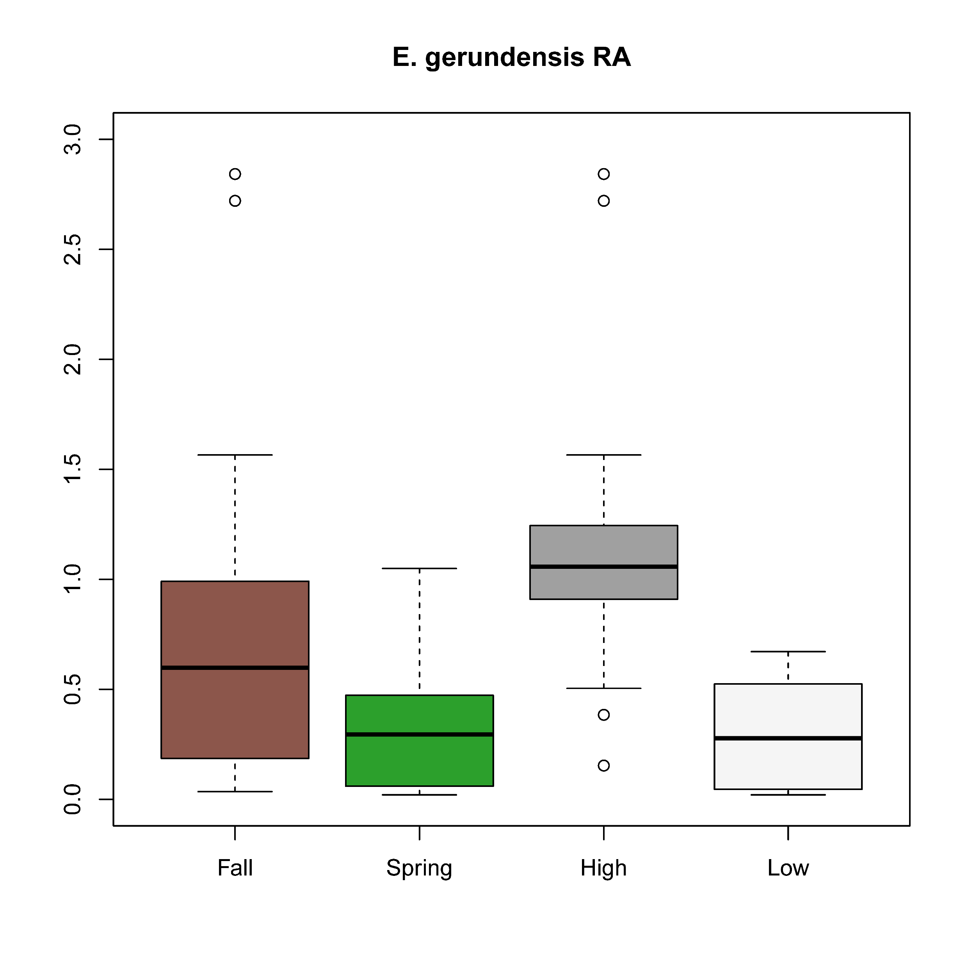
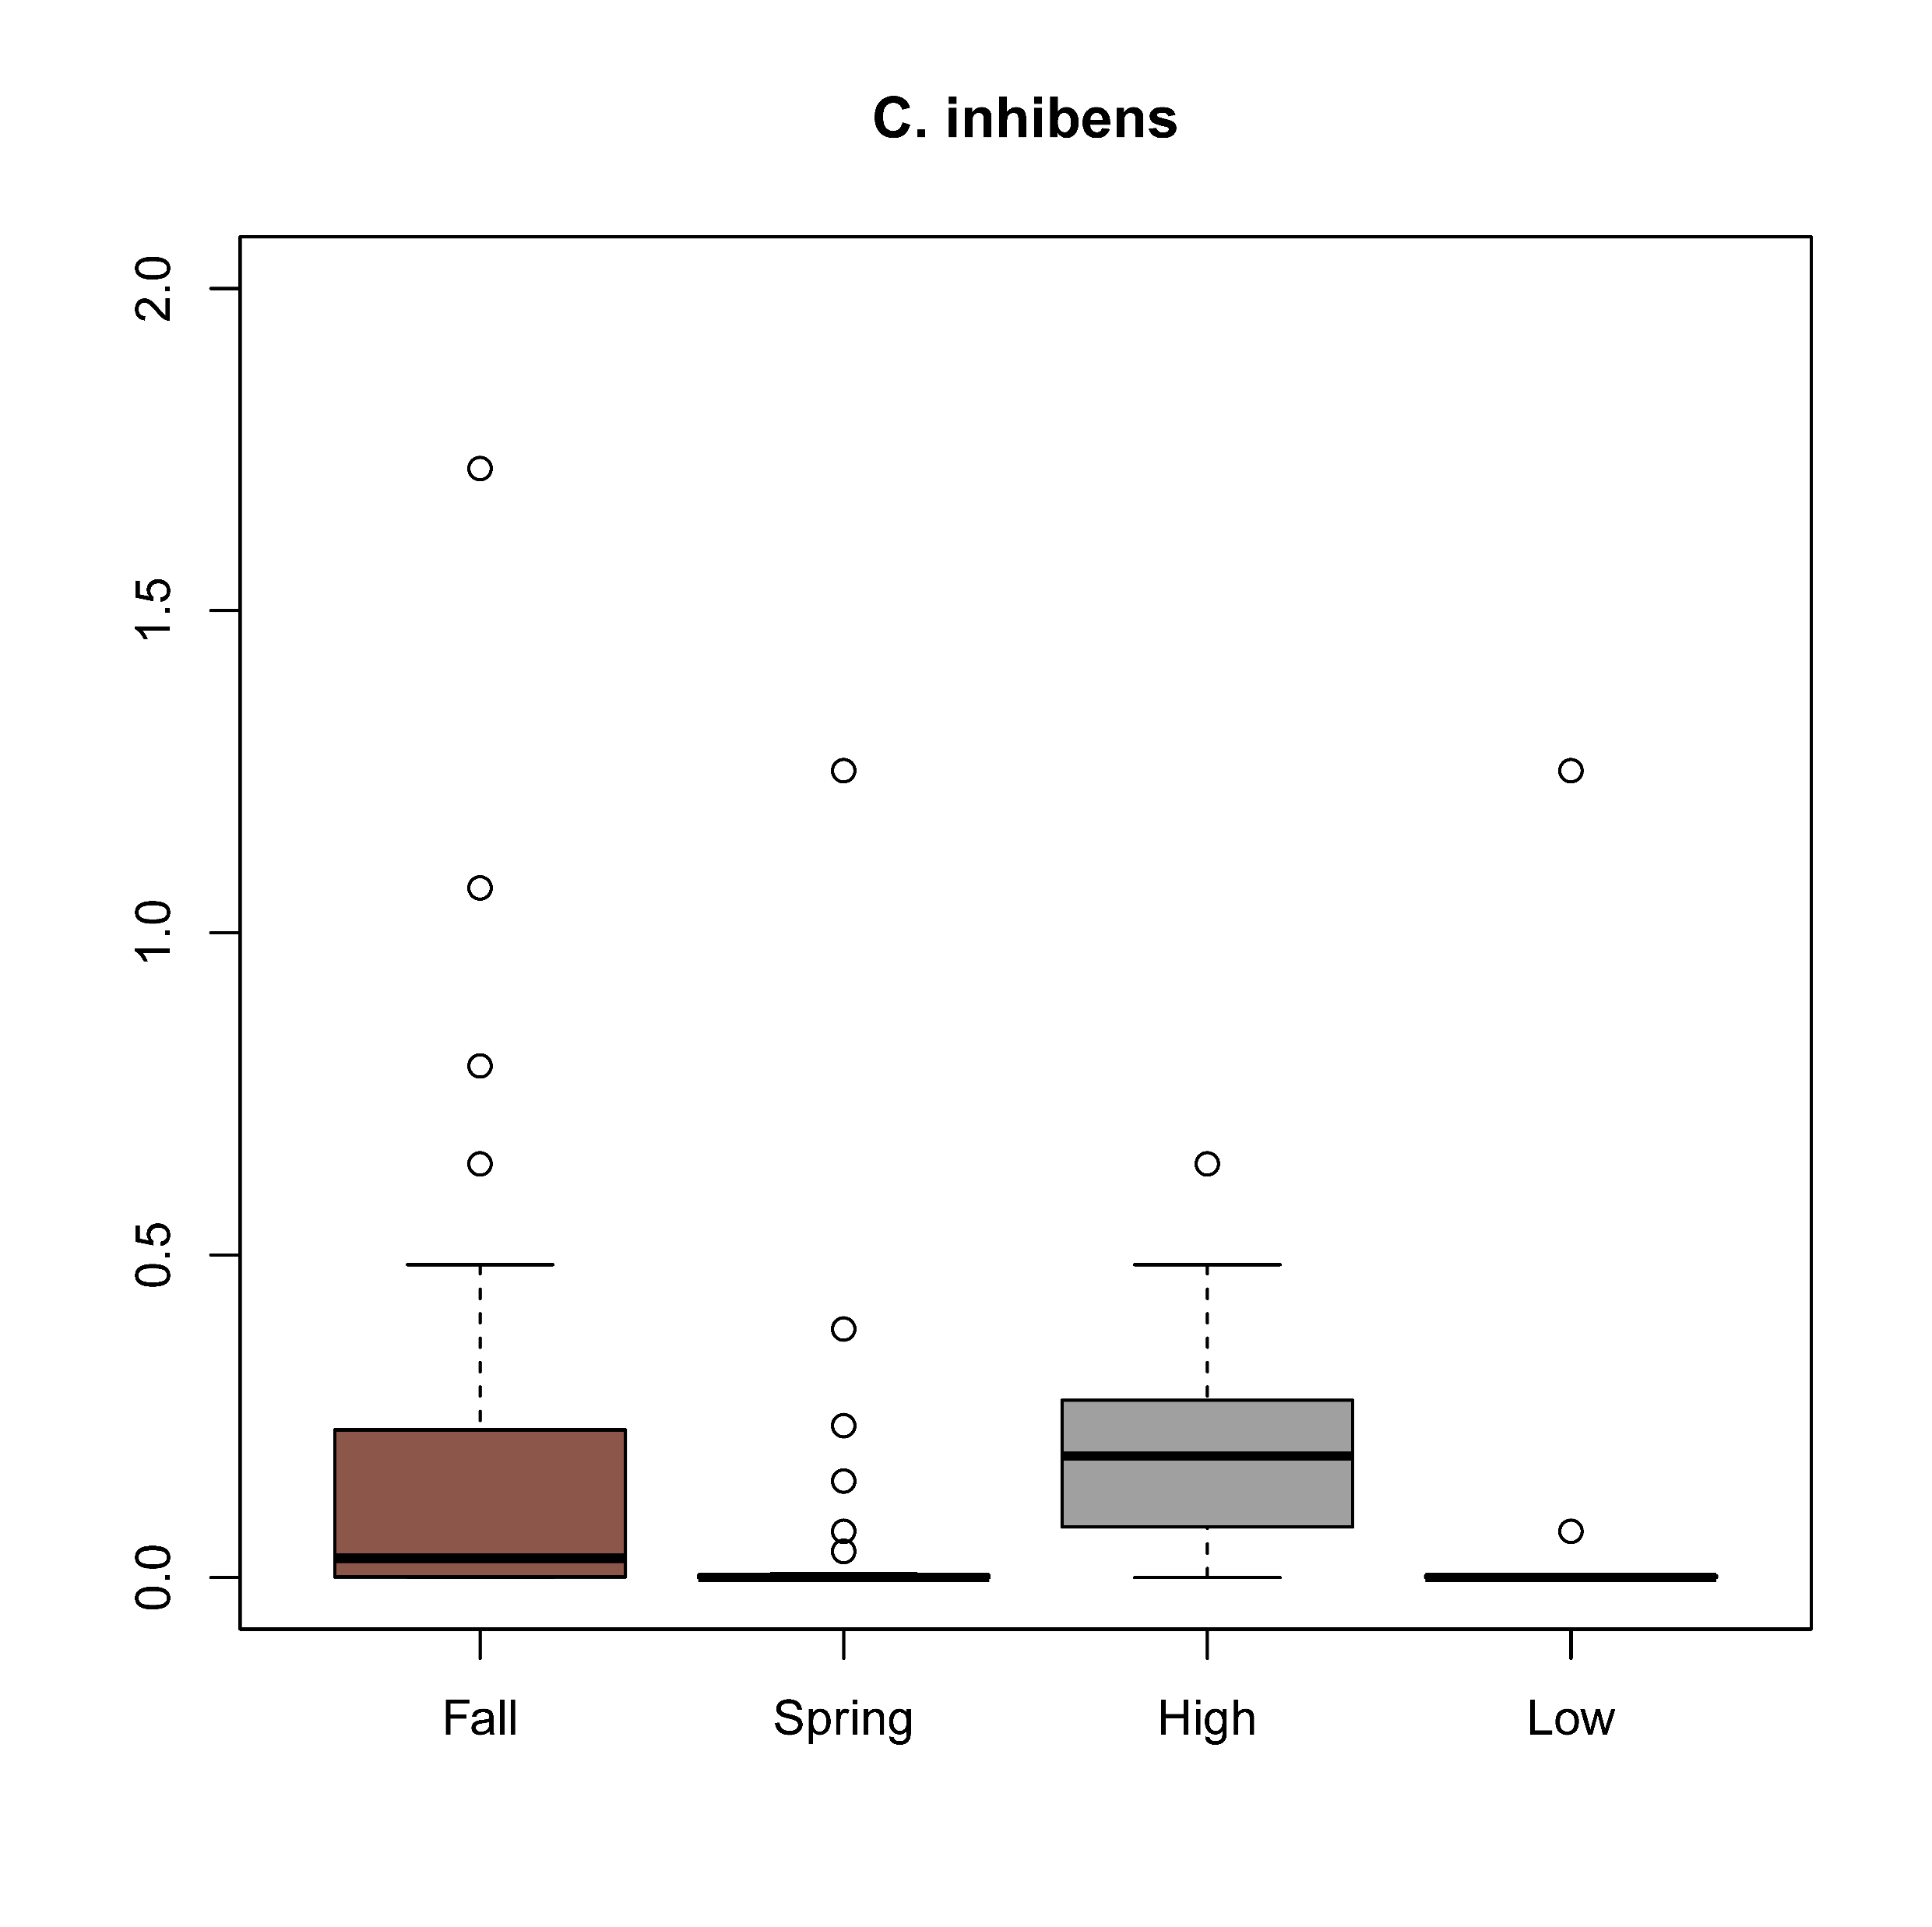
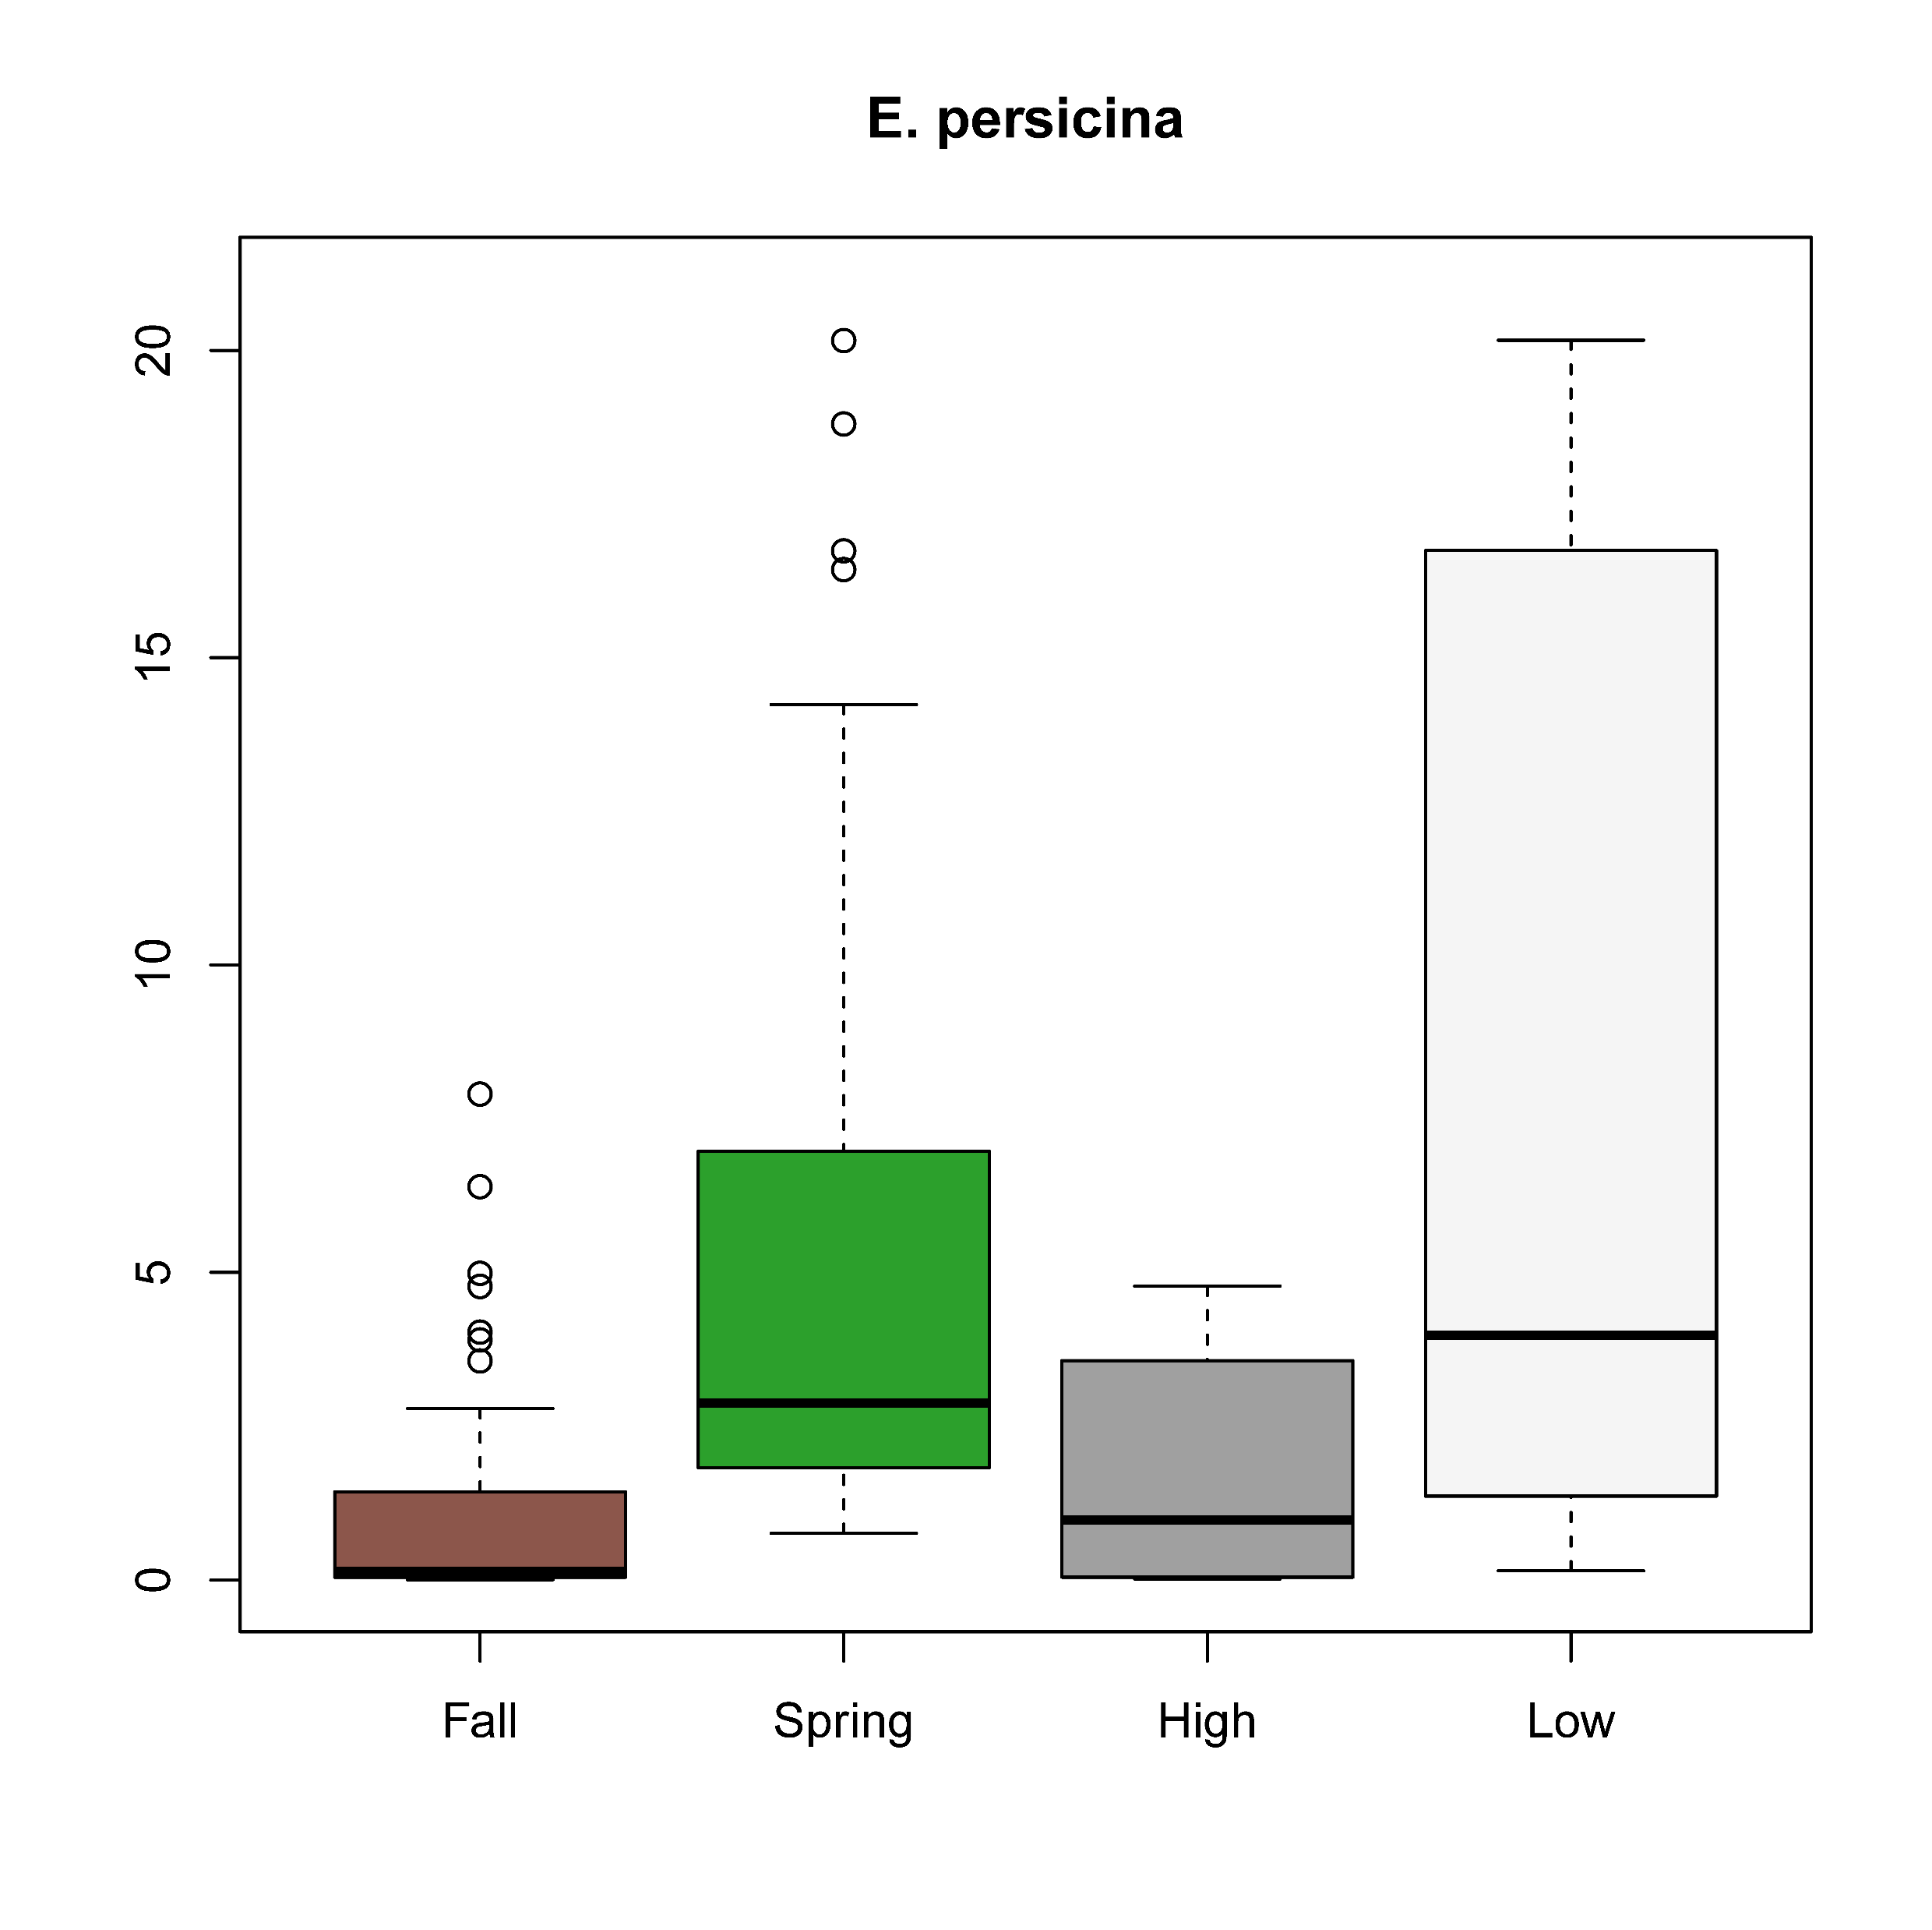
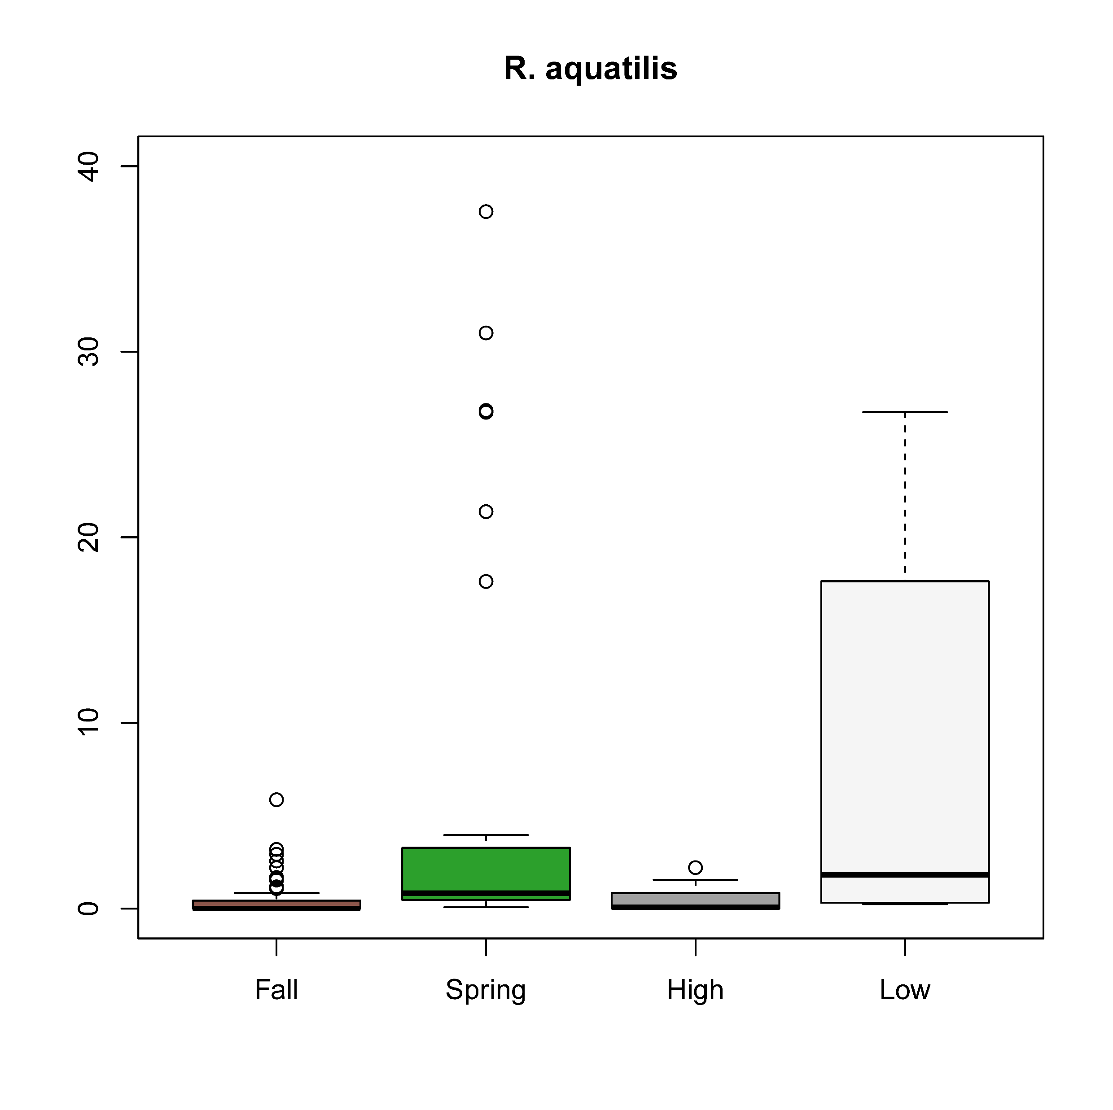
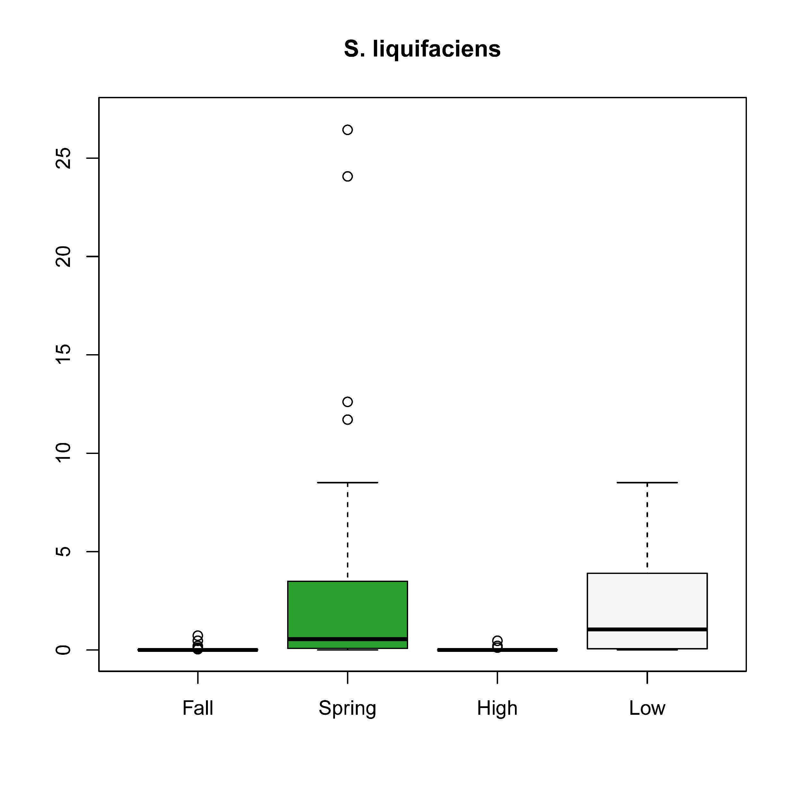
Comparison of groups of lettuce microbiomes reveals biomarkers associated with both harvest season and E. coli O157:H7 survival in MAP lettuce stored at 6°C
Pantoea agglomerans
Erwinia gerundensis
Carnobacterium inhibens
High representation of Pantoea agglomerans (>30% RA) is a predictor of fall microbiomes, lettuce deterioration, and enhanced E. coli O157:H7 survival at 6°C.
Relative abundance
Fall
Spring
High
Low
Fall
Spring
High
Low
Fall
Spring
High
Low
P = 0.0003
P = 0.0020
P = 0.0007
P = 0.0006
P = 0.0007
P = 0.0078
Erwinia persicina
Rahnella aquatilis
Serratia liquefaciens
Presence of Serratia liquefaciens is indicative of lower E. coli O157:H7 survival and spring microbiomes.
Relative abundance
Fall
Spring
High
Low
Fall
Spring
High
Low
Fall
Spring
High
Low
P < 0.0001
P = 0.0065
P < 0.0001
P = 0.0021
P < 0.0001
P = 0.0009

Slide 9
Unprocessed lettuce and soil microbiomes differ by harvest season
Fall harvest
Spring harvest
Lettuce microbiomes are highly variable even among romaine lettuce heads in close proximity in a field
    Proportion of fungi + oomycetes to bacteria
    Fungal species relative abundances
    Bacterial species relative abundances
Higher relative abundance on average of Enterobacteriaceae in the spring-harvested lettuce
Higher relative abundance on average of several Pseudomonas species in the fall-harvested lettuce
Relative abundance
Experimental field
Fall 2017
Experimental field
Fall 2018
Conventional field
Fall 2018
Experimental field
Spring 2018
Conventional field
Spring 2018
P-values resulting from bacterial and fungal metagenome comparisons determined using PERMANOVA based on Bray-Curtis dissimilarity matrices
Comparison | Bacteria and fungi |  | Bacteria |  | Fungi
 | Lettuce | Soil | Lettuce | Soil | Lettuce | Soil
Cultivar (DA vs. TT) | 0.5221 | 0.5405 | 0.2001 | 0.5362 | 0.9806 | 0.5370
Season (S vs. F) | 0.0001 | 0.0002 | 0.0009 | 0.0004 | 0.0001 | 0.0243
Field type (C vs. E) | 0.0001 | 0.0001 | 0.0001 | 0.0001 | 0.0001 | 0.0006

Slide 10
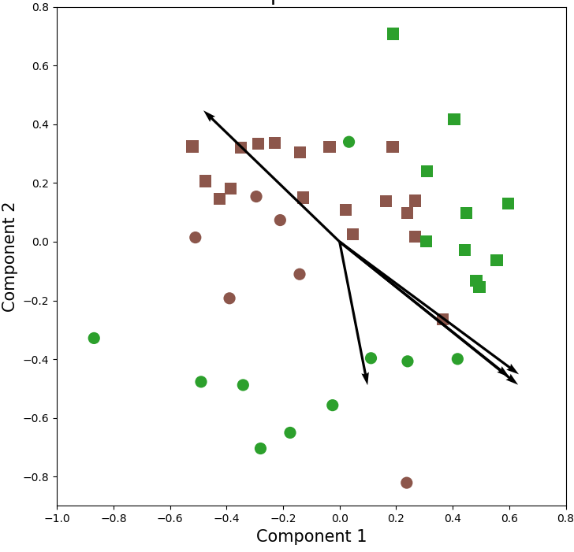
Harvested lettuce microbiome is correlated with weather parameters
Microbiome beta diversity
(Combined bacterial and fungal communities)
Weather parameters
Mean of the daily average over the 4 weeks preharvest
Vector | Factor | Correlation (r²) | P
1 | Air temperature | 0.246 | 0.0018
2 | Evapotranspiration | 0.343 | 0.0002
3 | Wind speed | 0.361 | 0.0001
4 | Solar radiation | 0.325 | 0.0004
5 | Relative humidity | 0.147 | 0.0411
1
2
5
4
3
Fungal community of the harvested lettuce head is more highly correlated with the weather parameters than the bacterial community
Soil bacterial community is highly correlated with the five weather factors and with soil temperature
F S
Conventional field
Experimental field

Slide 11


Cross-kingdom co-occurrence networks reveal many bacterial-fungal correlations
Higher density in the spring network than in the fall network at harvest
Bacterial-fungal correlations make up 40% (fall) and 41% (spring) of the total correlations in the networks
Greater number of b-f correlations are negative, and greater number of either f-f or b-b correlations are positive
Core bacterial species in the lettuce phyllosphere, Pseudomonas fluorescens and Pantoea agglomerans, which have high relative abundances, are not important hub species, rather important hub species often have low relative abundance
Seven of the ten species with highest hub or betweenness centrality scores are fungi in both the fall and spring networks, but most of these species are different in the two seasons
E. coli, present in the spring network, shares 19 positive and 12 negative edges with other species
Co-occurrence networks of bacterial (blue) and fungal (orange) communities on harvested lettuce
Fall harvest
Spring harvest

Slide 12
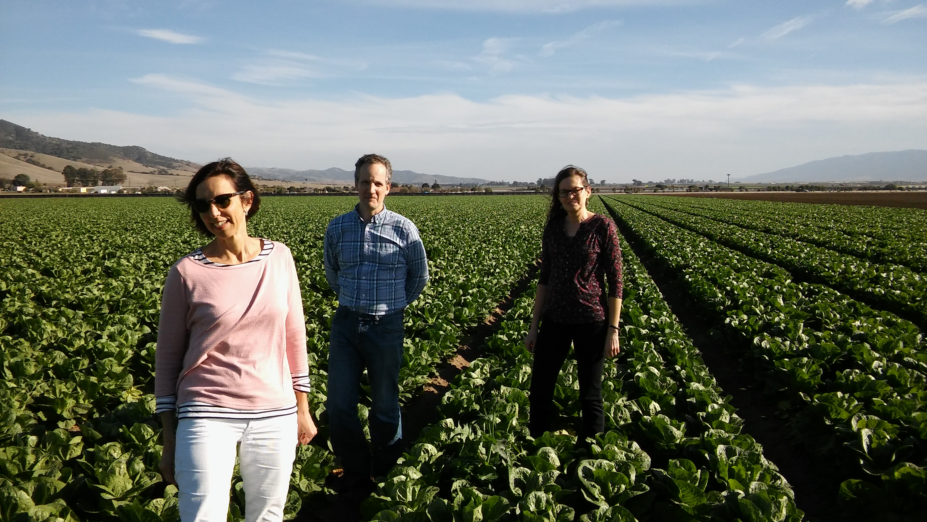
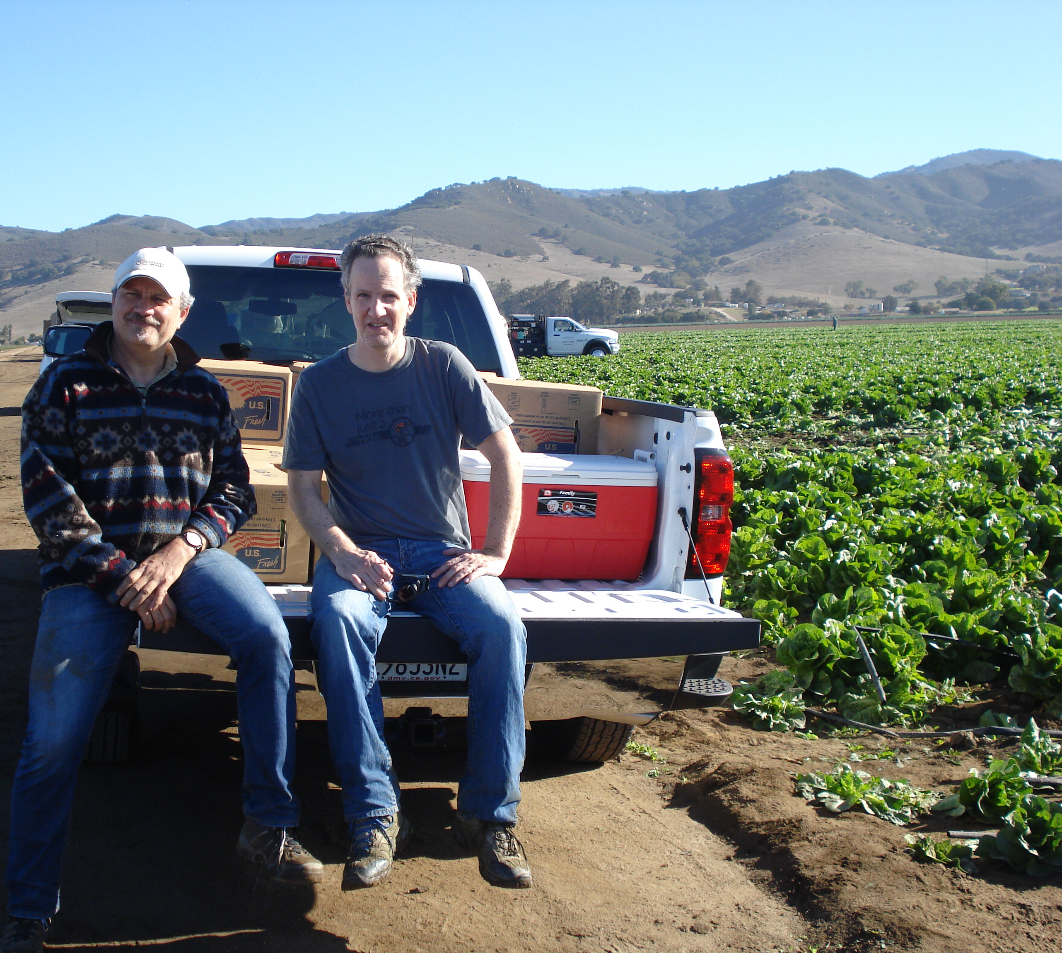
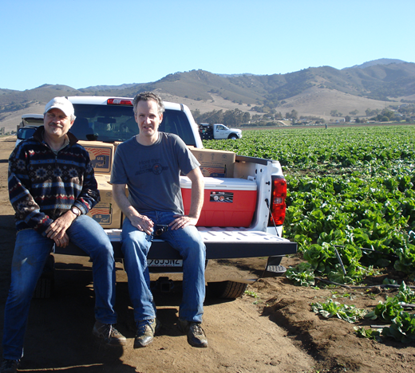
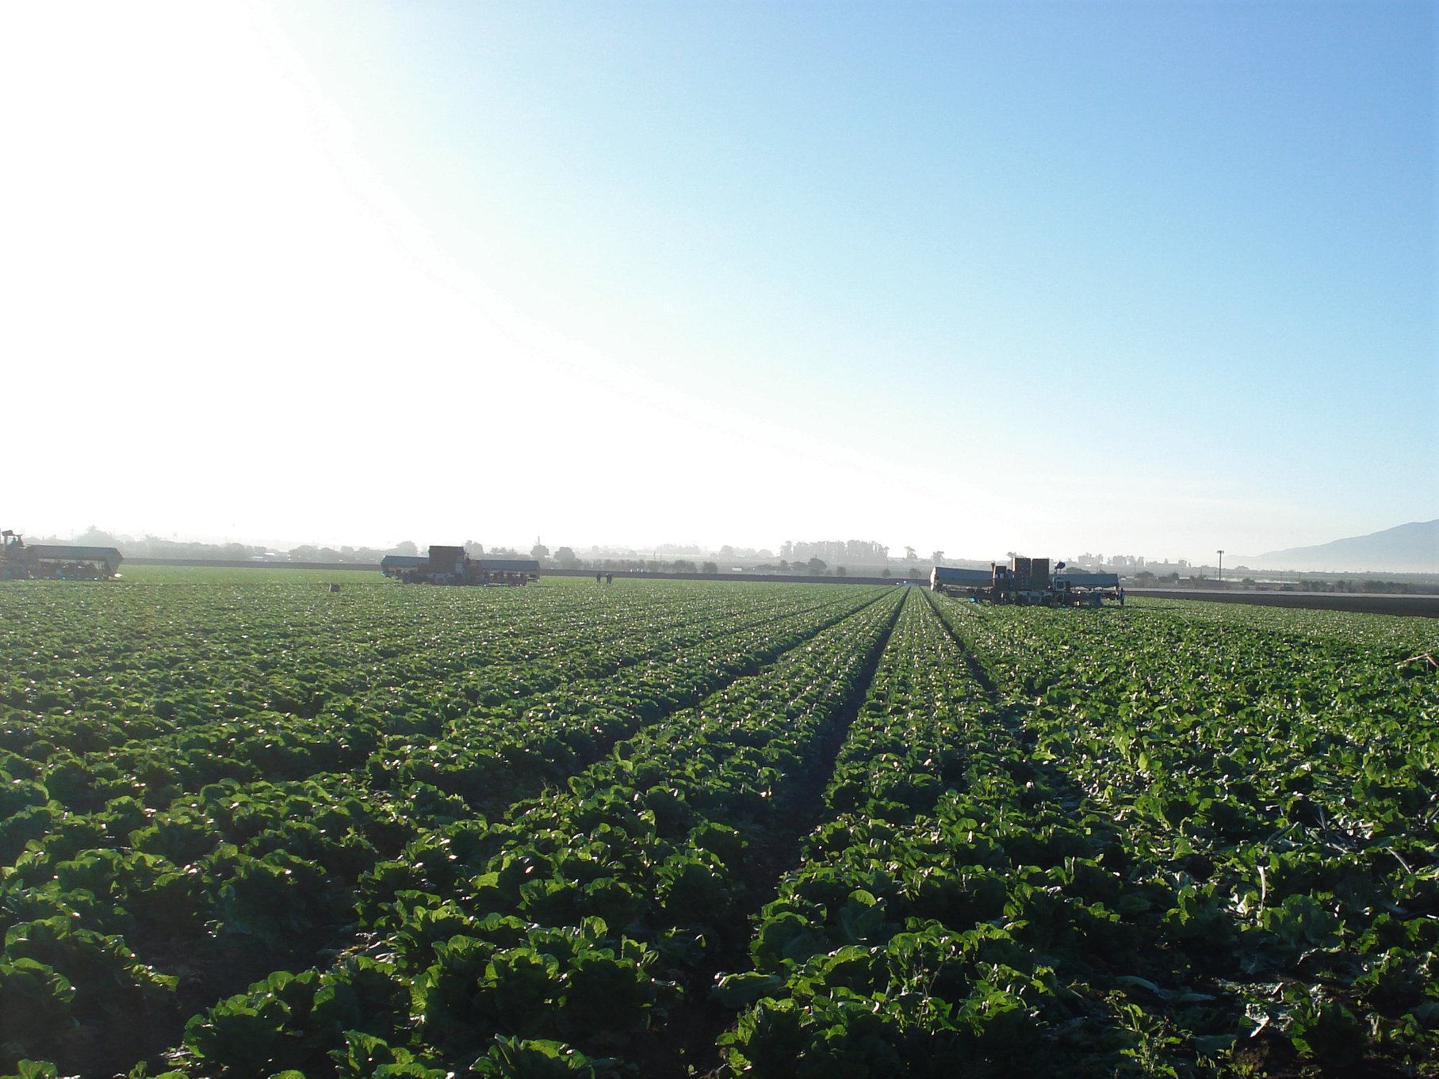
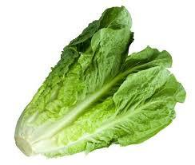
Questions?
Leonard, S.R., et al. 2021. Environmental Microbiome

