Slide 1

GenomeTrakr updates from FDA-CFSAN
Oct 19, 2022
GenomeTrakr annual meeting
Ruth Timme, PhD
GenomeTrakr Program Lead
FDA Center for Food Safety and Applied Nutrition
ruth.timme@fda.hhs.gov
@doctorRuth
Notes:
GT has become a global WGS network for foodborne pathogen traceback.

Slide 2
GenomeTrakr goals for FY22
Build GenomeTrakr data dashboard
Implement and publish the One Health Enteric package
  Harmonize with BioNumerics through Gen-FS
Expand GenomeTrakr metadata validation system
  BioNumerics
  One Health Enteric Package
Enable ontology-aware metadata queries (topic of Wednesday’s talk)

Slide 3


GenomeTrakr goals for FY22
Build GenomeTrakr data dashboard
Implement and publish the One Health Enteric package
  Harmonize with BioNumerics through Gen-FS
Expand GenomeTrakr metadata validation system
  BioNumerics
  One Health Enteric Package
Enable ontology-aware metadata queries
** Talks by Kirsten Hirneisen
and Maria Balkey on Thursday

Slide 4
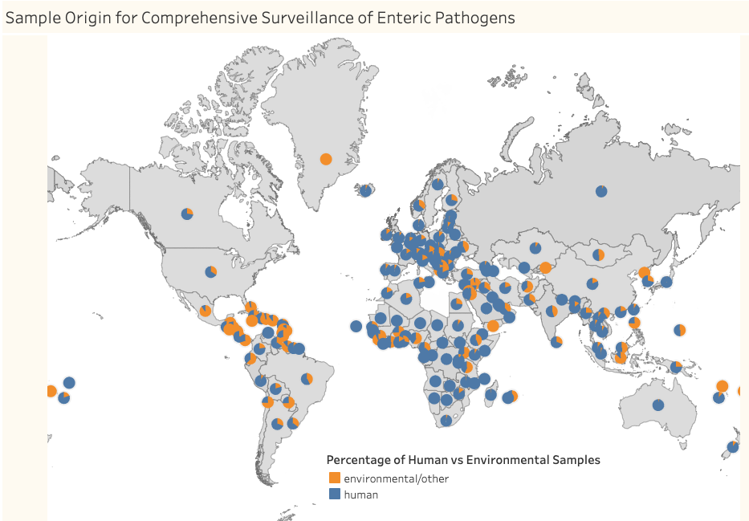
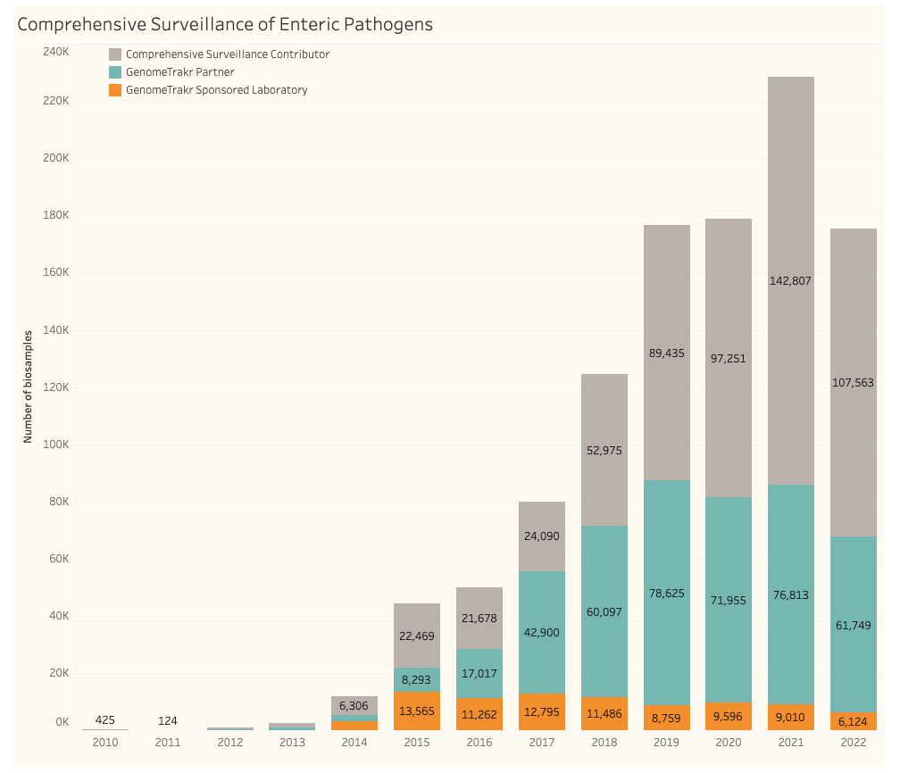
INSDC submissions of enteric pathogens
“GenomeTrakr” data
Partners + collaborators
Direct funding

Slide 5
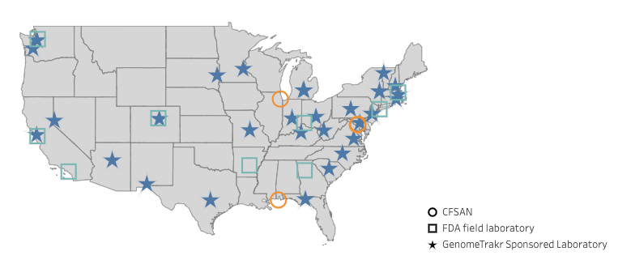
2022: GenomeTrakr’s actively funded labs:
FDA labs
8 US FDA/ORA Labs
3 CFSAN labs
LFFM WGS track funding (31 labs)
18 US public health laboratories (PulseNet)
6 academic labs
8 US Department of Agriculture laboratories
Congressional Shrimp mandate funds
Expansion for 3 international labs that export shrimp to the US
Contract agreements
Private labs
NEW

Slide 6
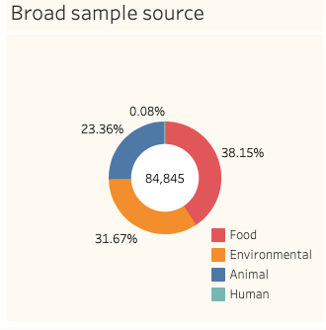
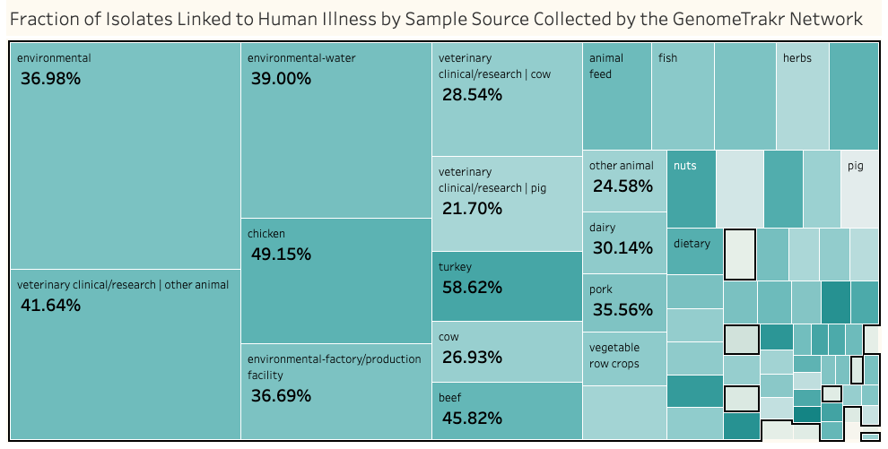
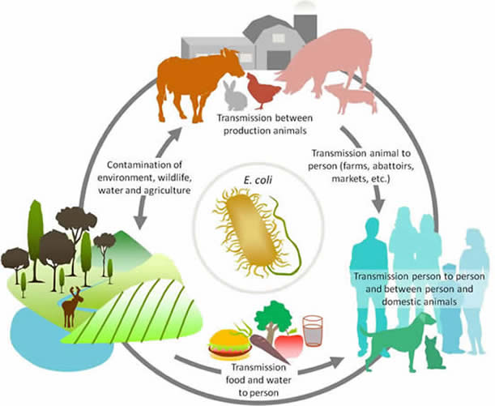
Data collected through directly-funded labs:
GenomeTrakr stats:
43 contributing labs
15 enteric pathogen species
Sampling mission:
To capture genomic diversity of enteric pathogens in food, food processing facilities, and environmental spaces

Slide 7
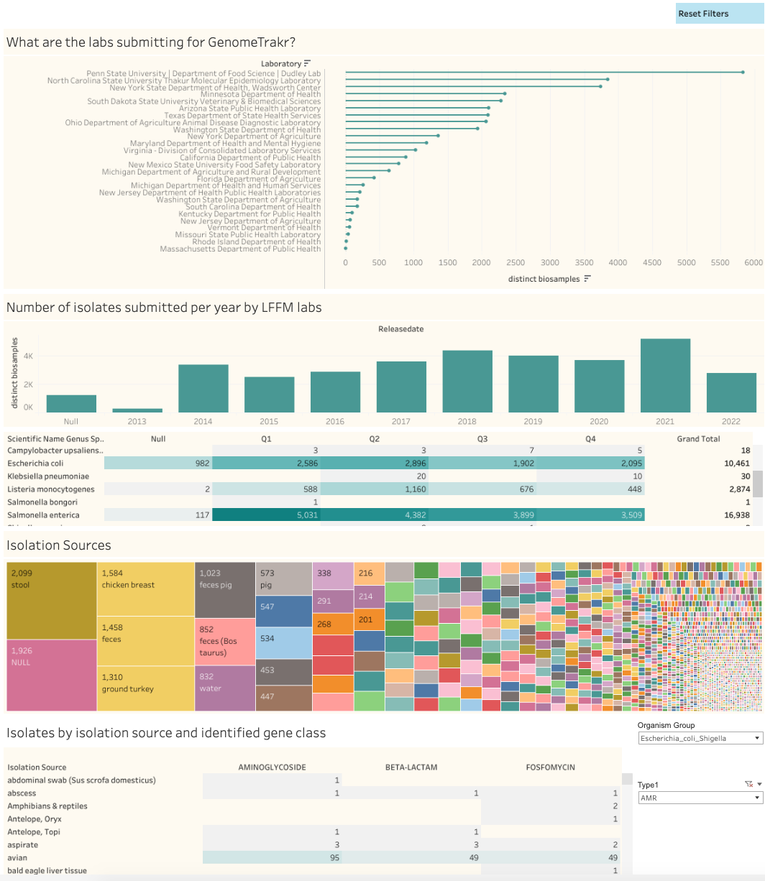
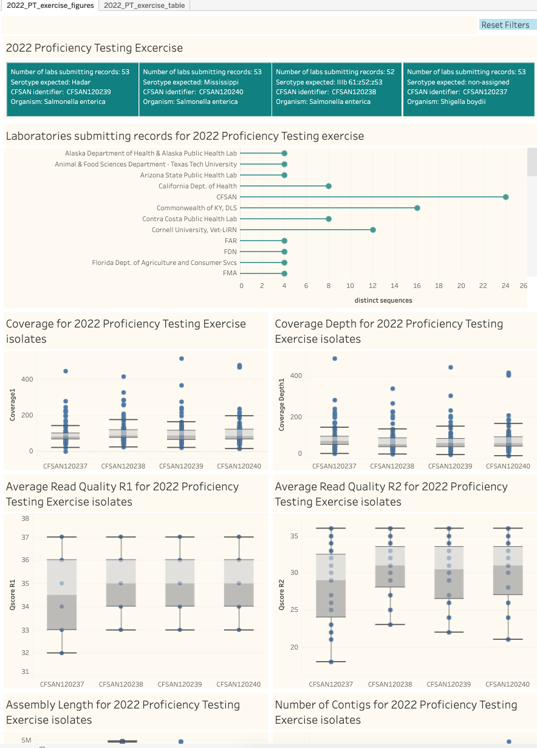
Internal Dashboards for better data tracking:

Slide 8
Other projects in 2022:
2021 Congressional Shrimp mandate
  w/ laboratory expansion funds
Established SARS-CoV-2 variant/sub-lineage surveillance in wastewater

Slide 9
Congressional Shrimp mandate, 2021:
The U.S. Congress Consolidated Appropriations Act 2021, Sec. 787. (a) required the HHS and and FDA to develop and implement formal seafood arrangements with three largest exporting countries of shrimp into the US. FDA obligated funds from this mandate to build genomic capacity in these countries for improved pathogen surveillance prior to export.
  Indonesia
    Fish Quarantine Inspection Agency (FQIA), Standard Testing Lab, Jakarta, Indonesia
    Feasibility assessment done
  India
    Marine Products Export Development Authority (MPEDA), Kochi, India
    Feasibility assessment done
  Ecuador
    Agency/Lab TBD

Slide 10
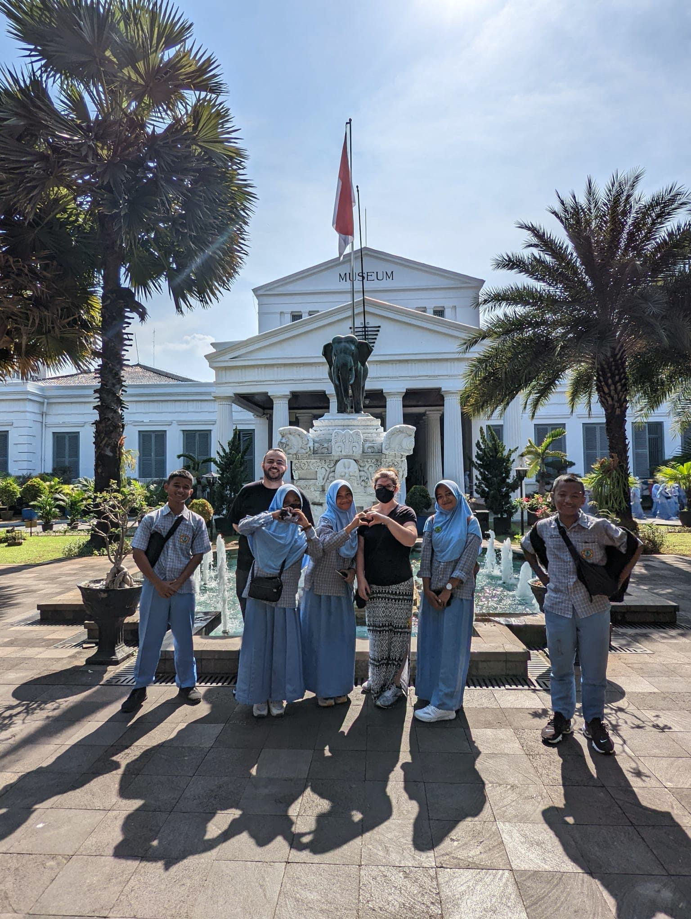
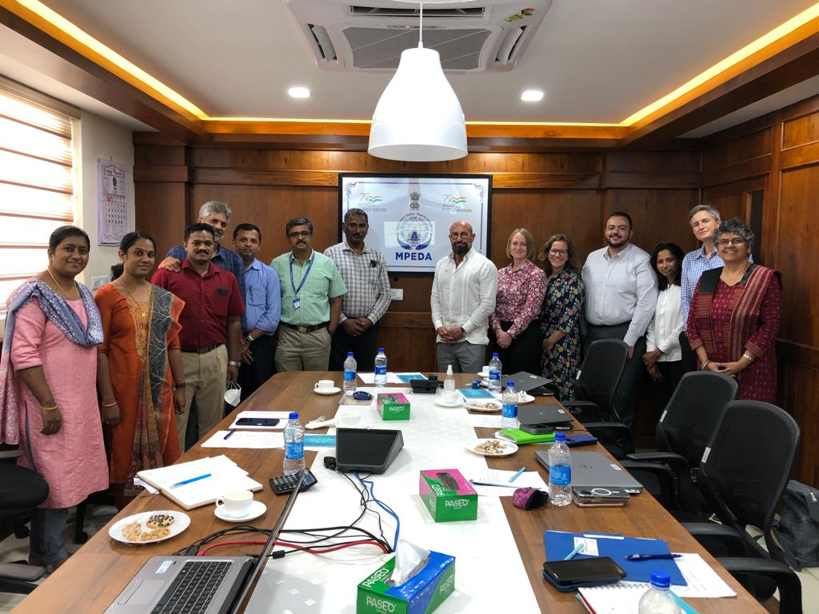
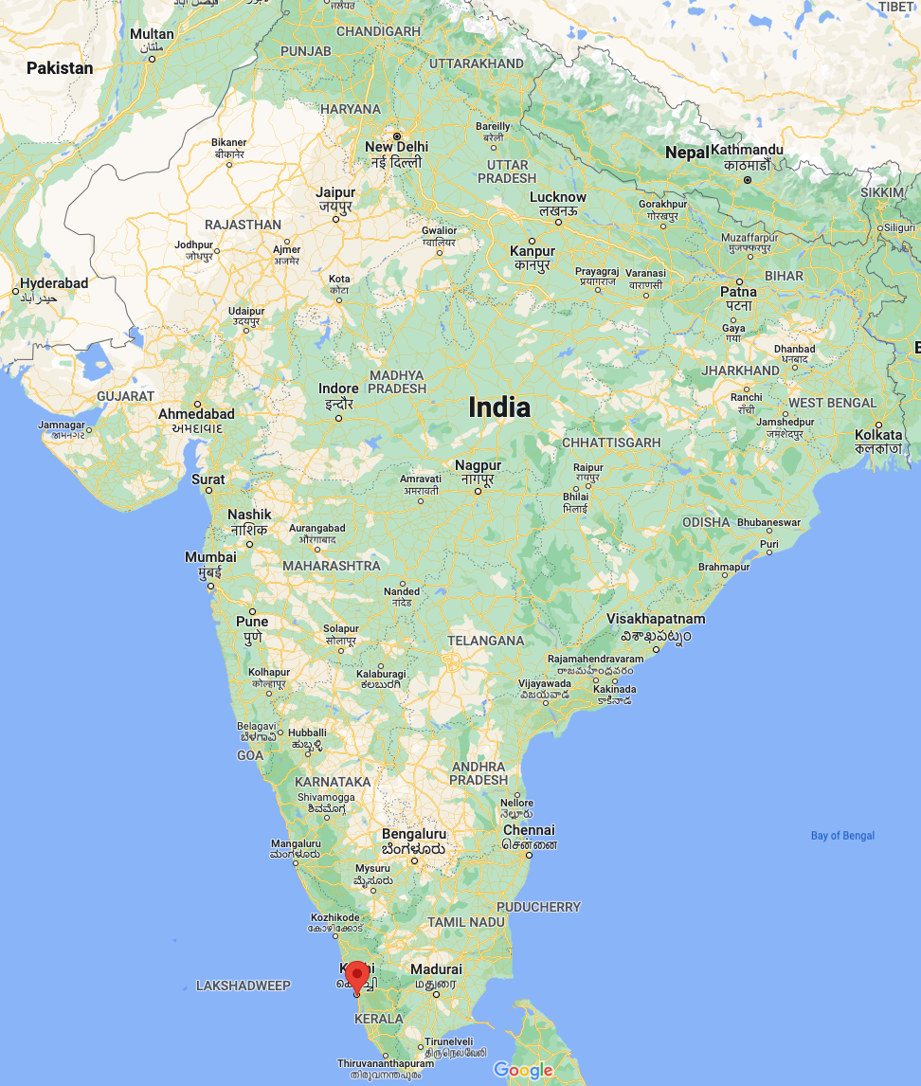
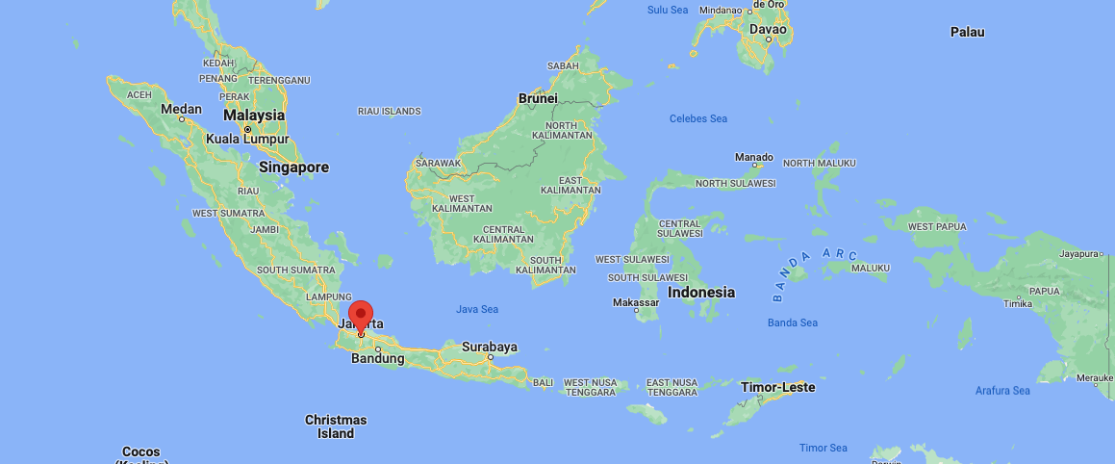
Two feasibility assessments done, in partnership with CFSAN, Office of International Engagement
MPEDA, Kochi, India

Slide 11
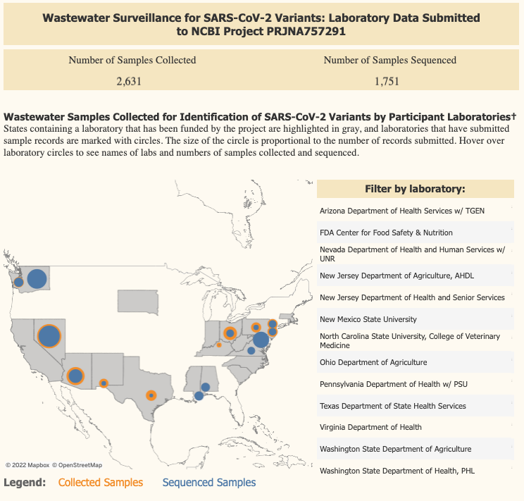
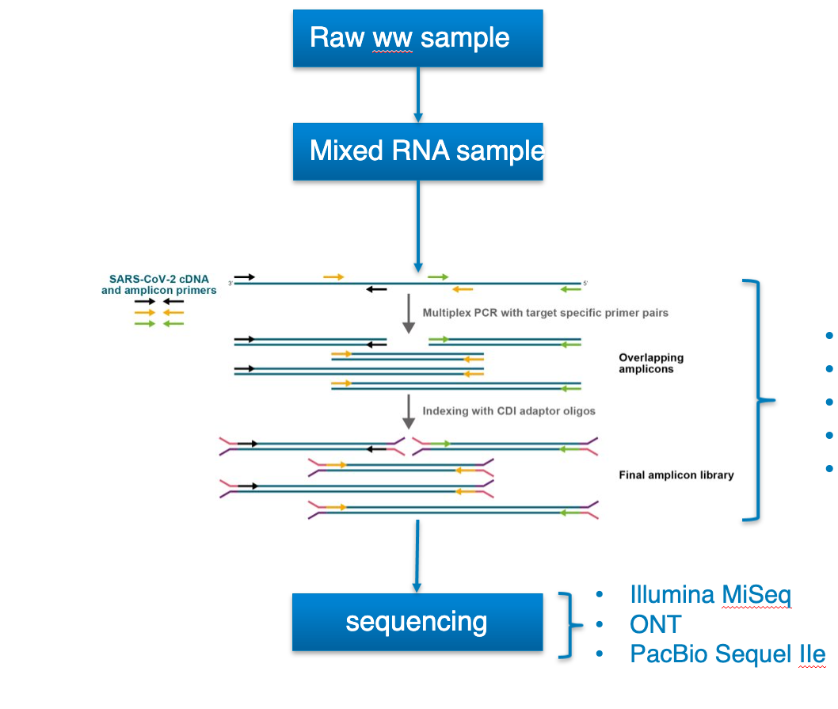
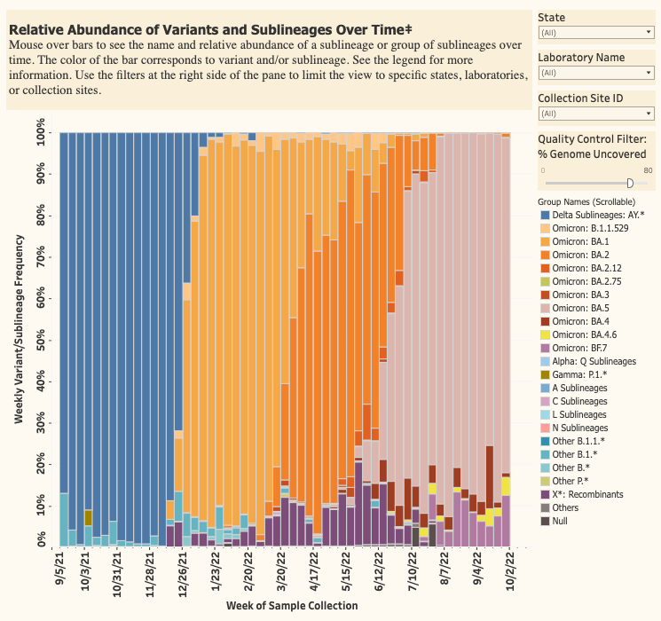
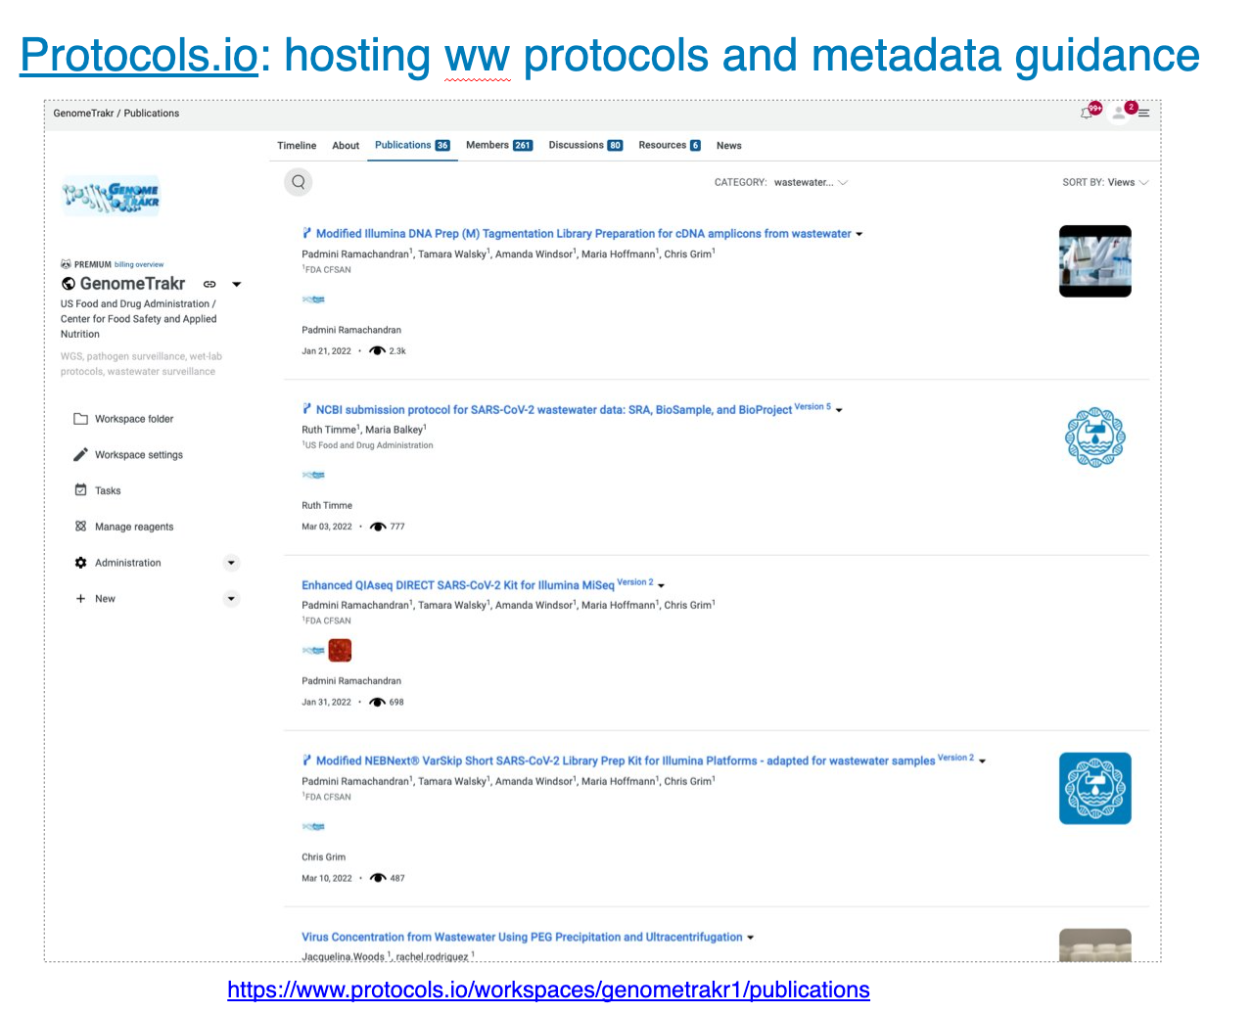
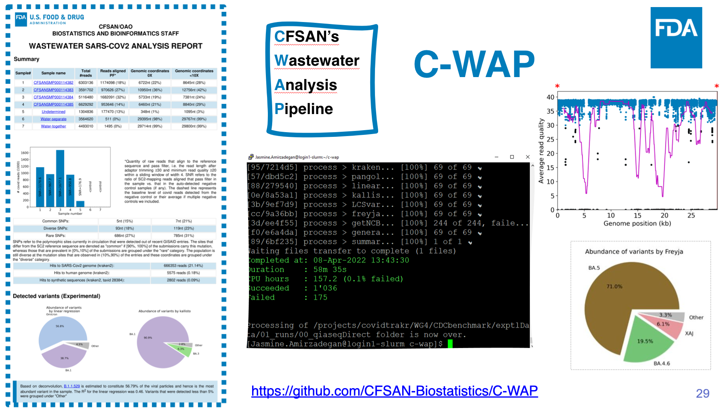
GenomeTrakr’s wastewater project:
Fund 20 laboratories:
Test/develop and publish methods
Visualize data:
Develop new analysis pipeline:
**Catch Maria Hoffmann’s talk tomorrow

Slide 12
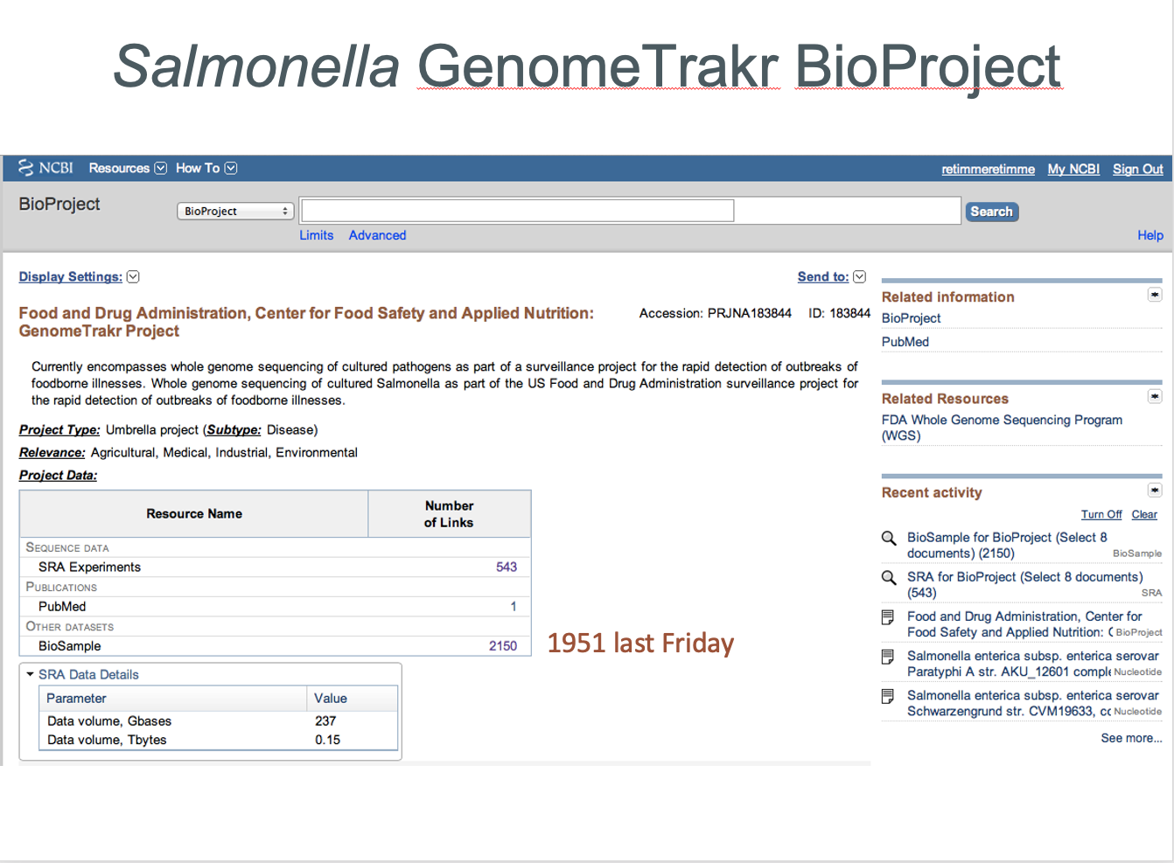
10-year anniversary of GenomeTrakr!
Fall 2012:
Submitted first BioSamples + raw sequence data to SRA and linked to a BioProject set up for the .
A look back with two stories:
Spring 2013:
First presentation of project at GMI – data structure defined.
2013/2014:
Power of environmental reference database highlighted when we sequenced the spicy tuna outbreak Salmonella enterica subsp. enterica serovar Bareilly
summarizing data from FDA + 4 state labs

Slide 13
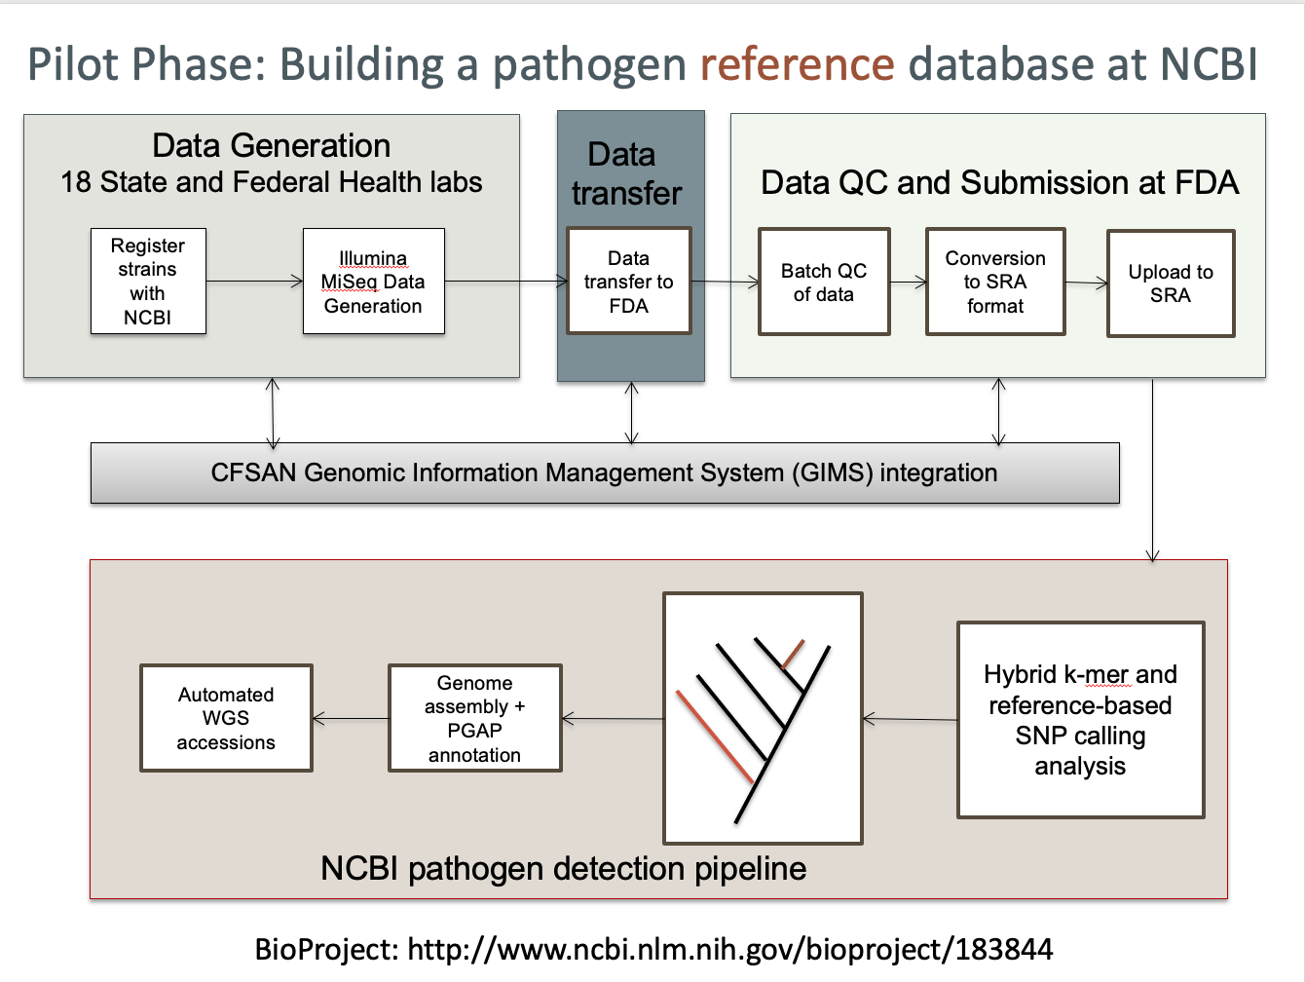
Notes:
Retrospective studies like these prompted us to realize we needed a good reference genome database with good spacial and temporal strain diversity. We bought 15 MiSeqs and placed them in State and federal health labs – in exchange we are asking each lab to pull environmental from their freezers, sequence them, and contribute to a public pathogen reference database at NCBI. During this pilot phase of building the reference databese . . .

Slide 14
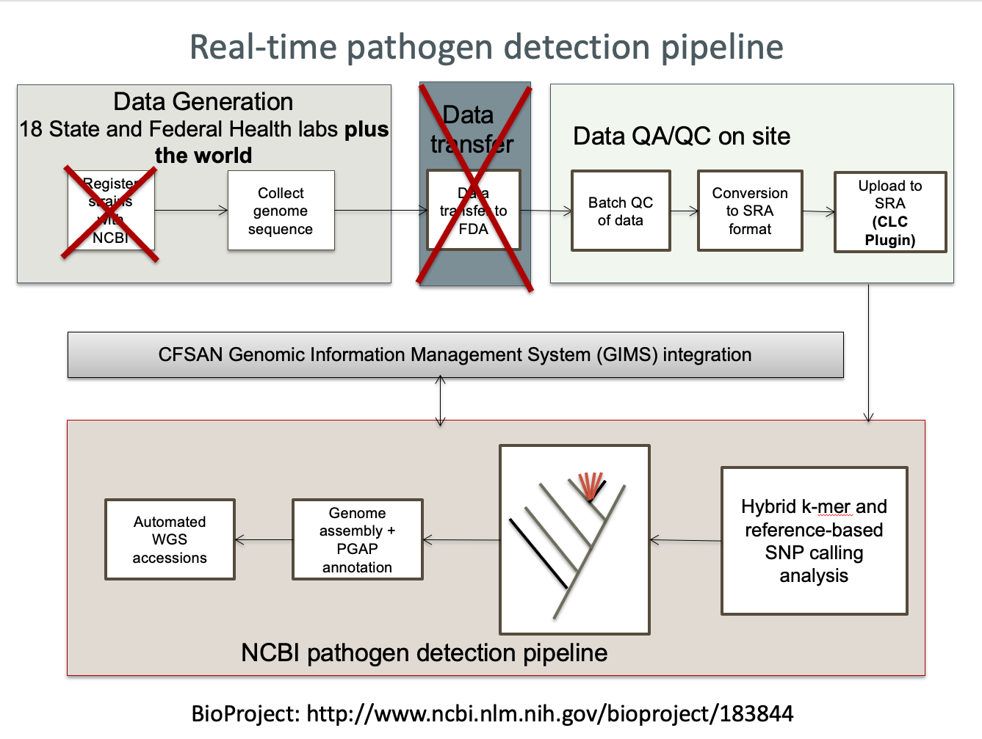
Notes:
We’re expecting over 10,000 reference strains for salmonella – once we have this phase completed we will open this BioProject to submitters from anywhere in the world.

Slide 15

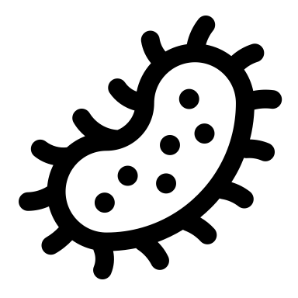


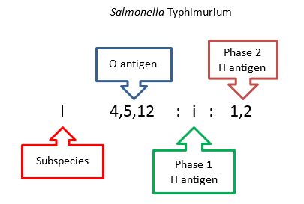

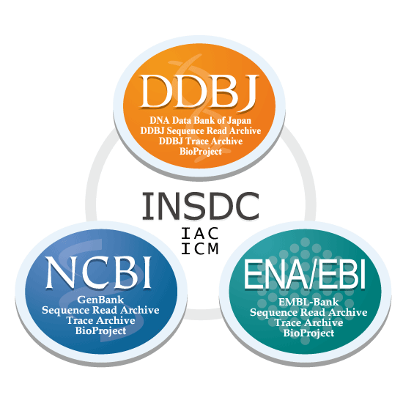





“Pathogen data object model”, Initial GT data structure now recommended for all pathogens:
Genotyping assays
Antibiotic resistance
Serotyping / sequence type
virulence predictions
stress tolerance
genotype screening
Academia
INSDC
Government
research
Phylogeny / phylodynamics
wgMLST Clustering
phylogenetic tree inference
molecular evolution / selection
new variant/lineage identification
BioProject
  BioSample
    raw reads
    assembly
Public Health
agencies
+
contextual
data
API
Hospitals
Public Health/clinical applications:
technology and lab/analysis methods
geographic distribution
Data curation
baseline surveillance vs targeted sampling
Antibiotic resistance
Therapeutics
Diagnostics
New vaccine formulation
Veterinary
clinics
Industry
**PHA4GE data structures working group now formalizing this structure for all pathogens

Slide 16
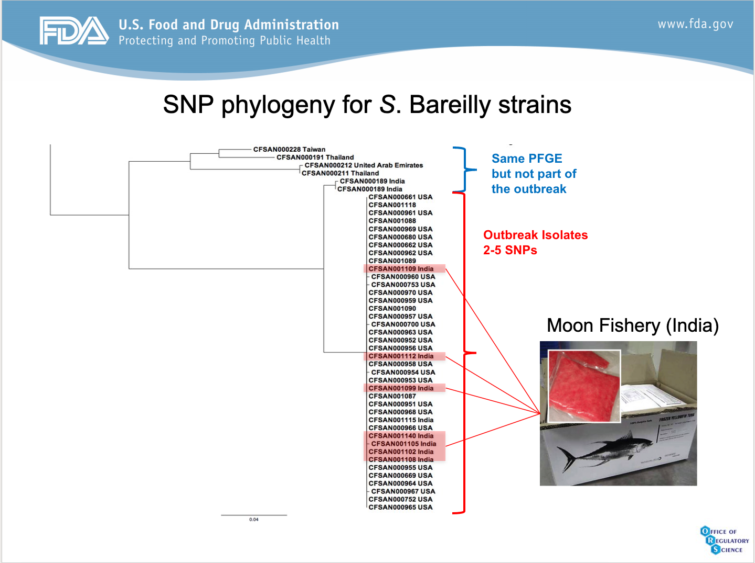
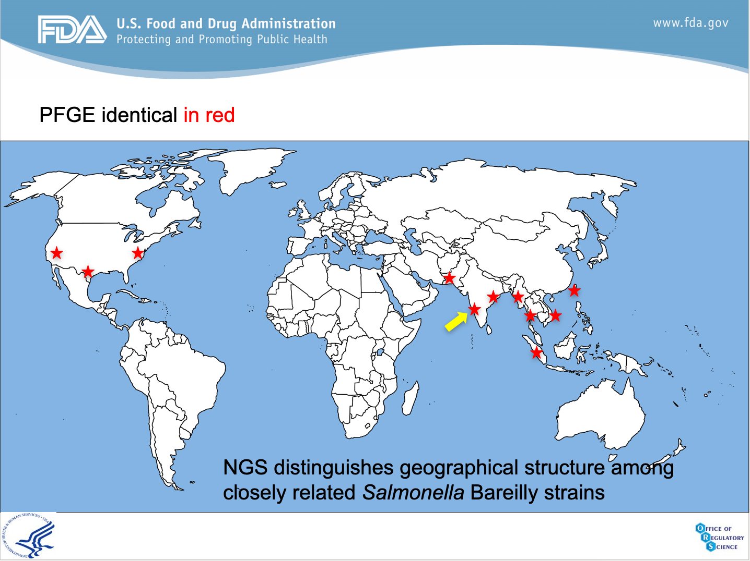
Salmonella ser. Bareilly story
Frozen raw
shrimp
Tuna scrape

Slide 17
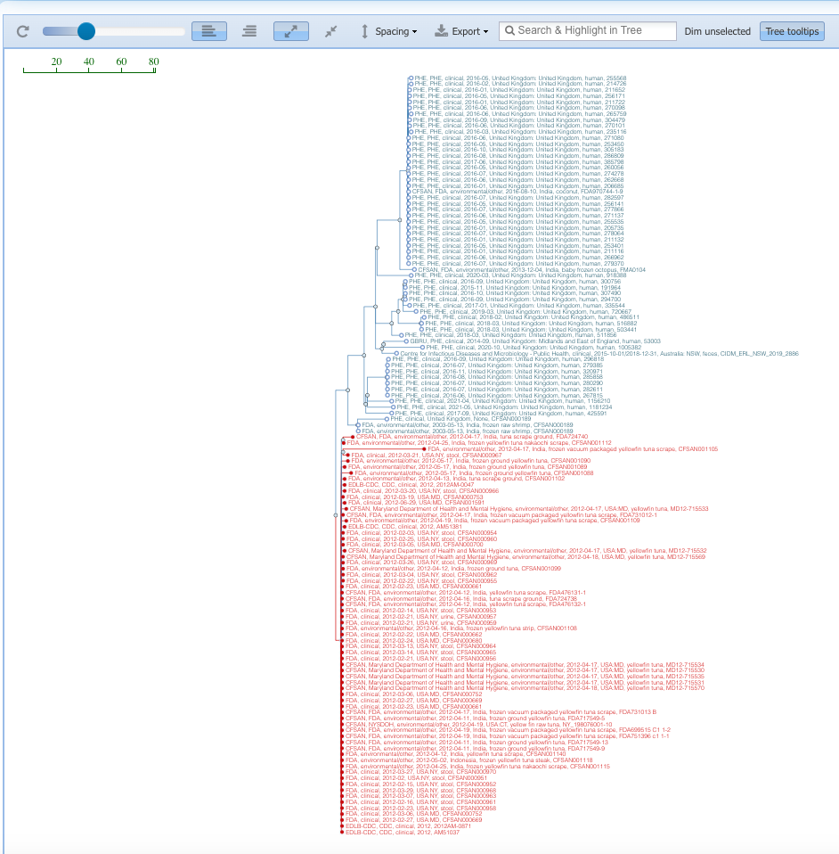
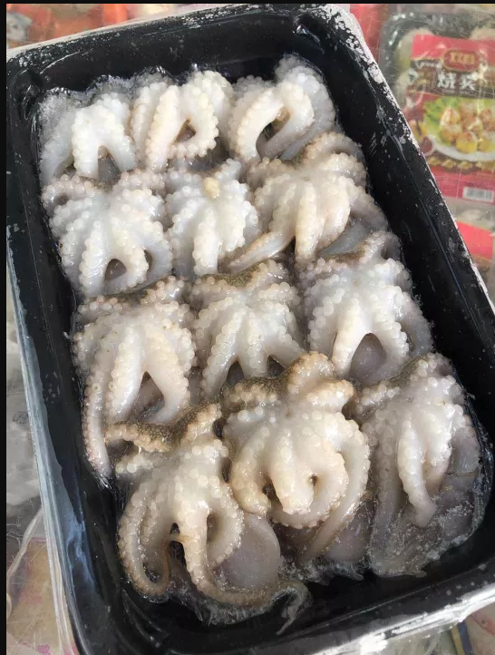
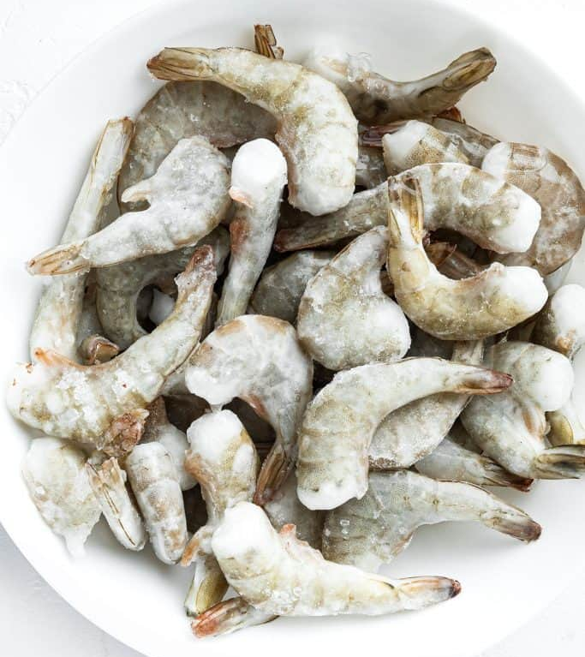
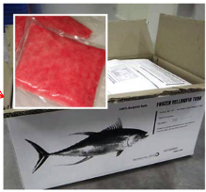
Current Salmonella ser. Bareilly cluster: PDS000032405.17
UK clinicals
2016-2021
**New Kochi lab will populate the database with isolates collected from shrimp farms and processing plants across India.
US Spicy tuna outbreak, 2012

Slide 18
GenomeTrakr goals for 2023
Publish external GenomeTrakr dashboards
Implement expanded OHE metadata (FDA and GT network)
Onboard and train new labs in India, Indonesia, and Ecuador
Explore culture independent sequencing of enteric pathogens from water samples

Slide 19

Current GenomeTrakr team:
GenomeTrakr Team:
Ruth Timme (Lead)
Marc Allard (senior scientist)
Maria Balkey (Data curator)
Tina Pfefer (Project manager)
Julie Haendiges (laboratory method development)
C. Hope Bias (ORISE dashboard developer)
Bioinformatics/analytics:
James Pettengill
Hugh Rand
Arthur Pightling
Bob Litterman
Justin Payne
Yan Luo
Yu Cao
Supervisors / leadership support:
Sandra Tallent
Eric Brown
V. Kelly Bunning
John Callahan
Steven Musser
David Lipman

Slide 20
Acknowledgements
GenomeTrakr-funded Laboratories
  Animal Disease Research and Diagnostic Laboratory (ADRDL), South Dakota
  Animal Diseases Diagnostic Laboratory (ADDL) at the Ohio Department of Agriculture
  Arizona State Public Health Laboratory, Tgen
  Colorado State Department of Public Health and Environment
  Florida Department of Agriculture and Consumer Services
  Indiana State Department of Health
  Kentucky State Cabinet for Health and Family Services
  Maryland Department of Health
  Massachusetts State Department of Public Health
  Michigan Department of Agriculture and Rural Development
  Michigan State Department of Health and Human Services
  Minnesota State Department of Health
  New Hampshire State Department of Health and Human Services
  New Jersey State Department of Agriculture
  New Jersey State Department of Health and Senior Servces
  New Mexico State University -Food Safety Laboratory
  New York State Department of Agriculture & Markets
  New York State Department of Health - Wadsworth Center
  North Carolina Department of Agriculture and Consumer Services
  North Carolina State University, College of Veterinary Medicine
  Pennsylvania State University. Dudley's Lab
  Rhode Island Department of Health
  South Carolina Department of Health and Environmental Control
  Texas A&M University
  Texas Department of State Health Services
  University of Nevada - Reno
  Vermont State Agency of Human Services
  Virginia Division of Consolidated Laboratory Services
  Washington State Department of Agriculture
  Washington State Dept of Health
  West Virginia Department of Agriculture
U.S Food and Drug Administration (FDA)
  CFSAN
    ORS, OAO, OARSA, OFS, OIE
  Office of Regulatory Affairs
    ORA field labs, ORS
  Center for Veterinary Medicine
    Vet-LIRN, NARMS
National Institute of Health (NIH)
  National Center for Biotechnology Information (NCBI)
Centers for Disease Control and Prevention (CDC)
  PulseNet, AMD
US Department of Agriculture (USDA)
  Food Safety and Inspection Service (FSIS)
  Agriculture research service (ARS)
  Animal and Plant Health Inspection Service (APHIS)

