Slide 1
Pathogen Detection
2022 GT Update - William Klimke

Slide 2


Slide 3





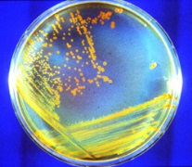

Real-time surveillance of foodborne pathogens
for outbreak detection and investigations
Academic, AgriculturaI, International Labs
Sampling of clinical/human, food, animal, and environmental bacterial isolates
FDA GenomeTrakr
USDA-
FSIS
State Labs
Ag, Academic, other Labs
CDC PulseNet
raw sequence data
PulseNet National Database
(protected metadata)
NCBI Submission Portal
Minimal metadata, everything publically accessible
https://www.ncbi.nlm.nih.gov/pathogens/

Slide 4
Pathogen Detection Pipeline
SRA
Assembly
Annotation
GenBank
Clustering
AMRFinderPlus
Trees
Goal <24 hours

Slide 5
Pathogen Detection Analysis goals
Are these isolates clonally related?
What is the anti-microbial resistance, stress response, and virulence gene repertoire of this isolate?
Results presented in easy to use web-interface

Slide 6
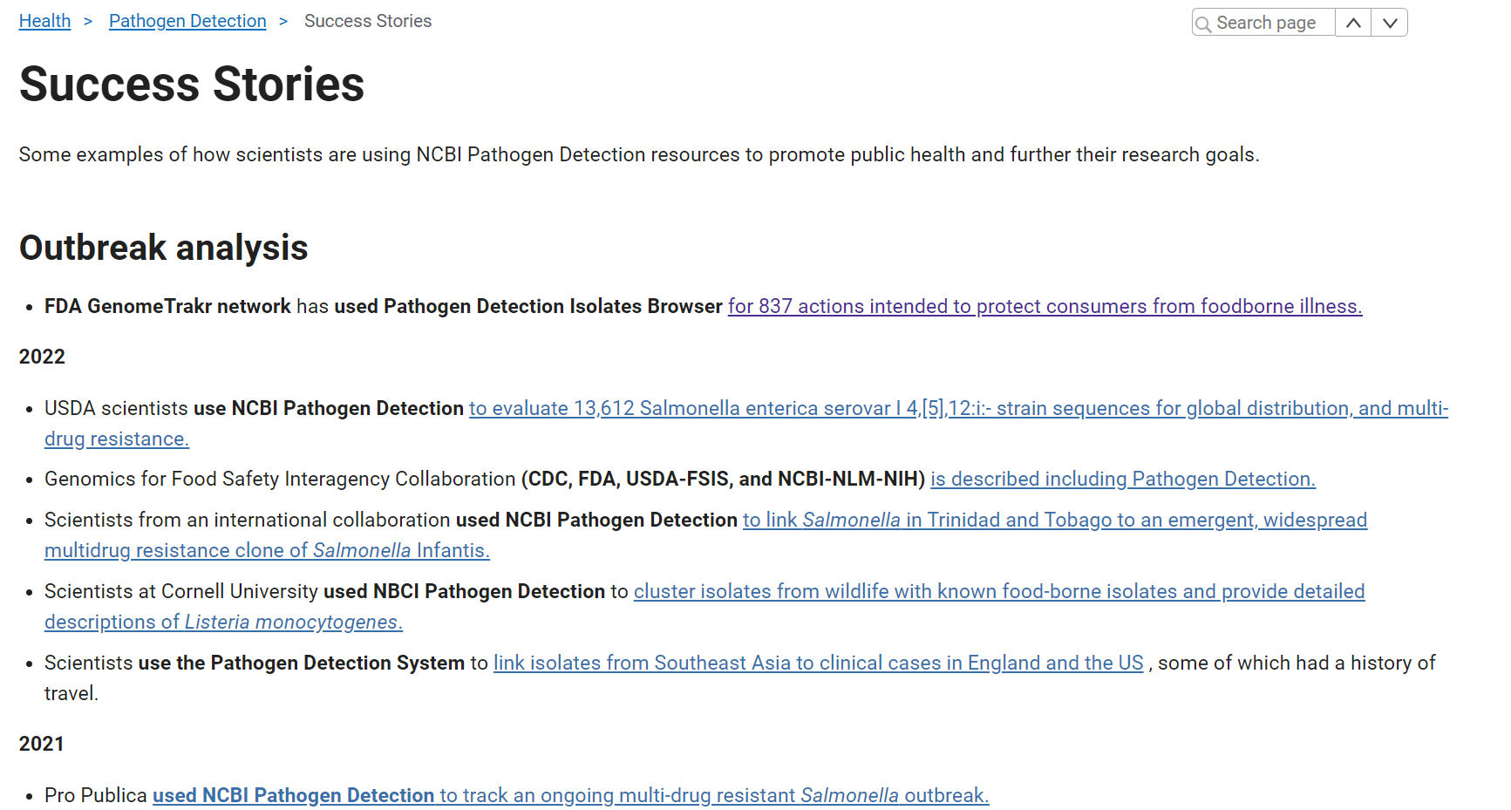
Numerous published studies showing successful use of Pathogen Detection results and resources

Slide 7
Numerous published studies showing successful use of Pathogen Detection results and resources
Clonal relationship of isolates
  Successfully used to identify outbreaks/sources
  Integrated into other pipelines tools
  Contributes to reduced illnesses/economic affects
  Used in clinical labs for cluster identification

Slide 8
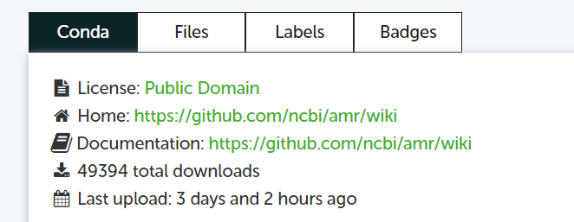
Numerous published studies showing successful use of Pathogen Detection results and resources
Identification of antimicrobial resistance genotypes
  Declared institute for nomenclature assignment for most beta-lactamases
  Results used for evaluation of
    conserved regions of particular AMR proteins
    sequence diversity/frequency to target drug development
  AMRFinderPlus validated for clinical use in Australia
  Downloaded ~50K times
  NIAID agreed to continue funding through FY202…
    but asked for additional work

Slide 9


Slide 10
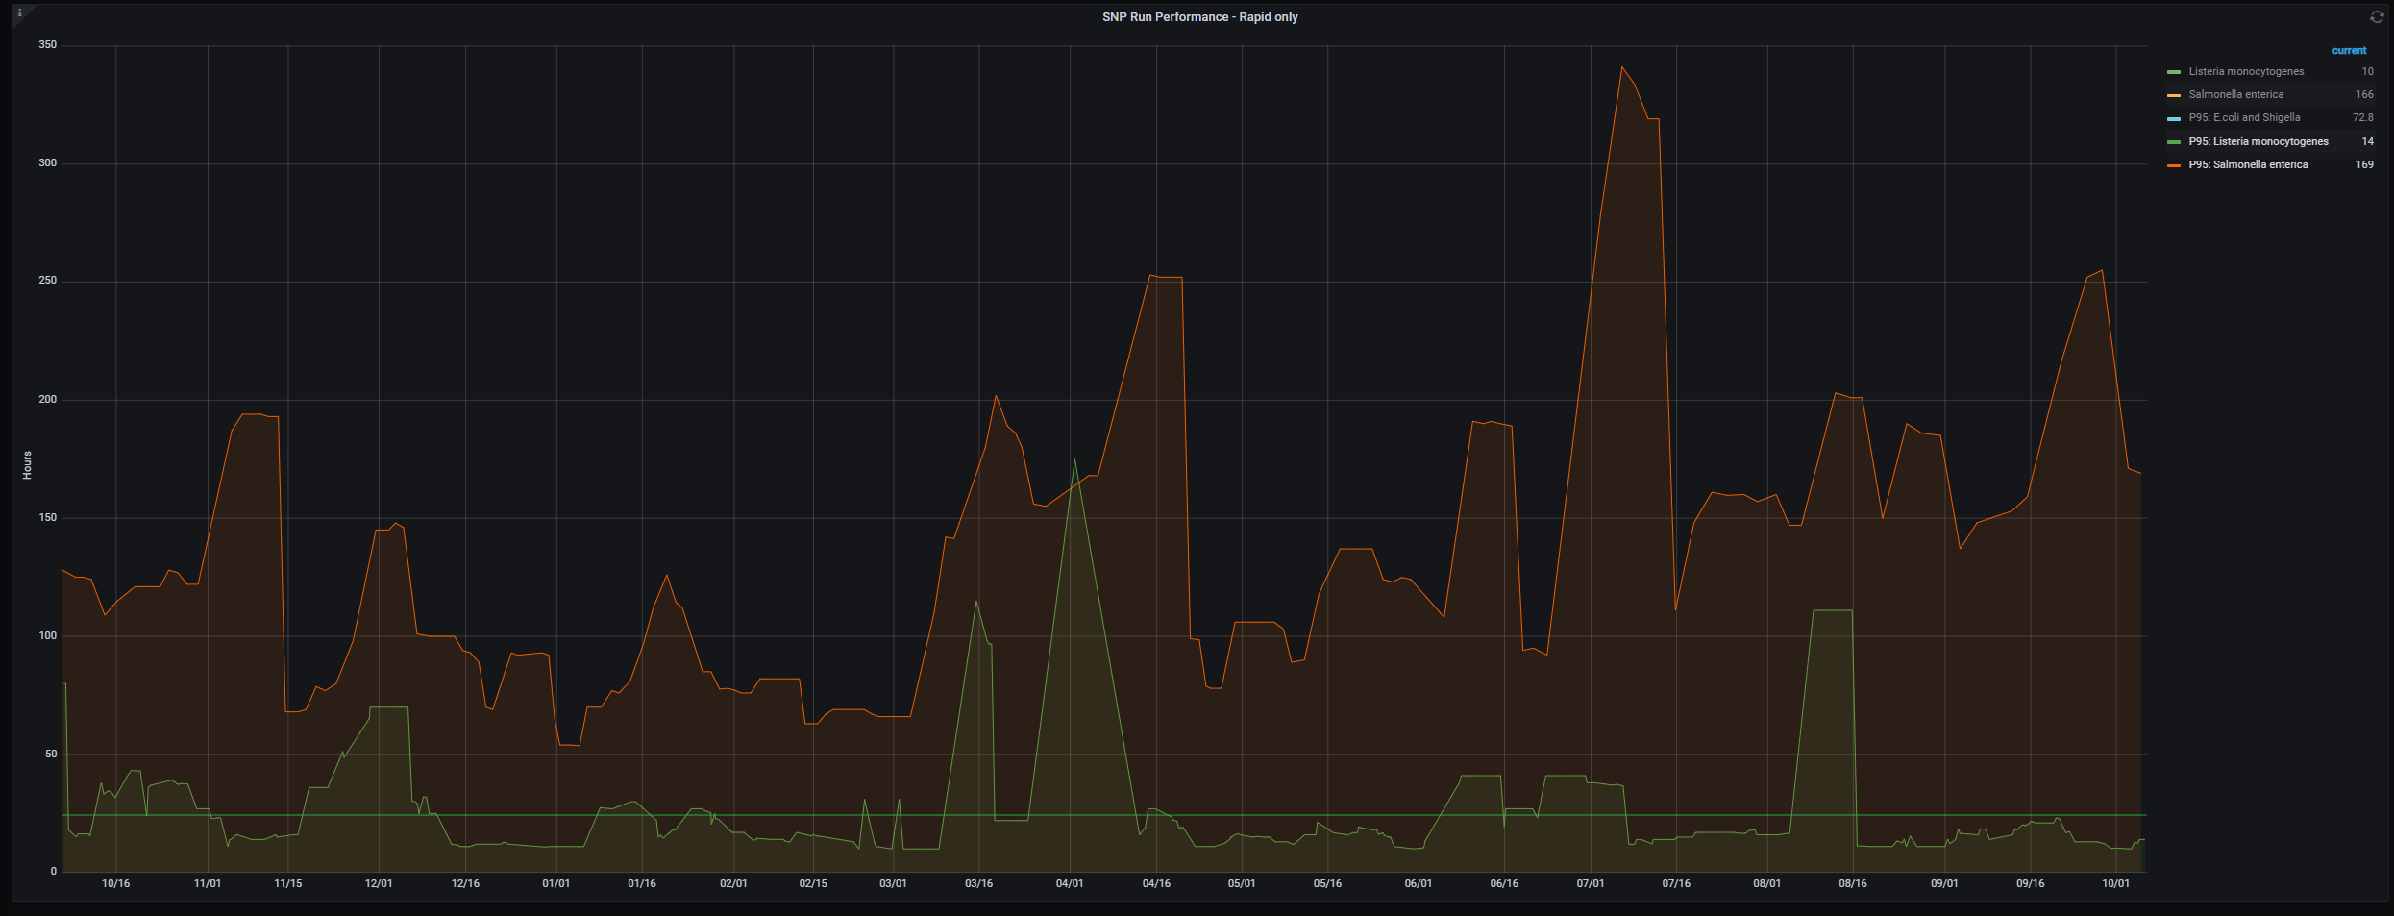
Turnaround time (95th percentile) -> increasing delays
Hours (linear) ->
24 hrs
Date ->

Slide 11
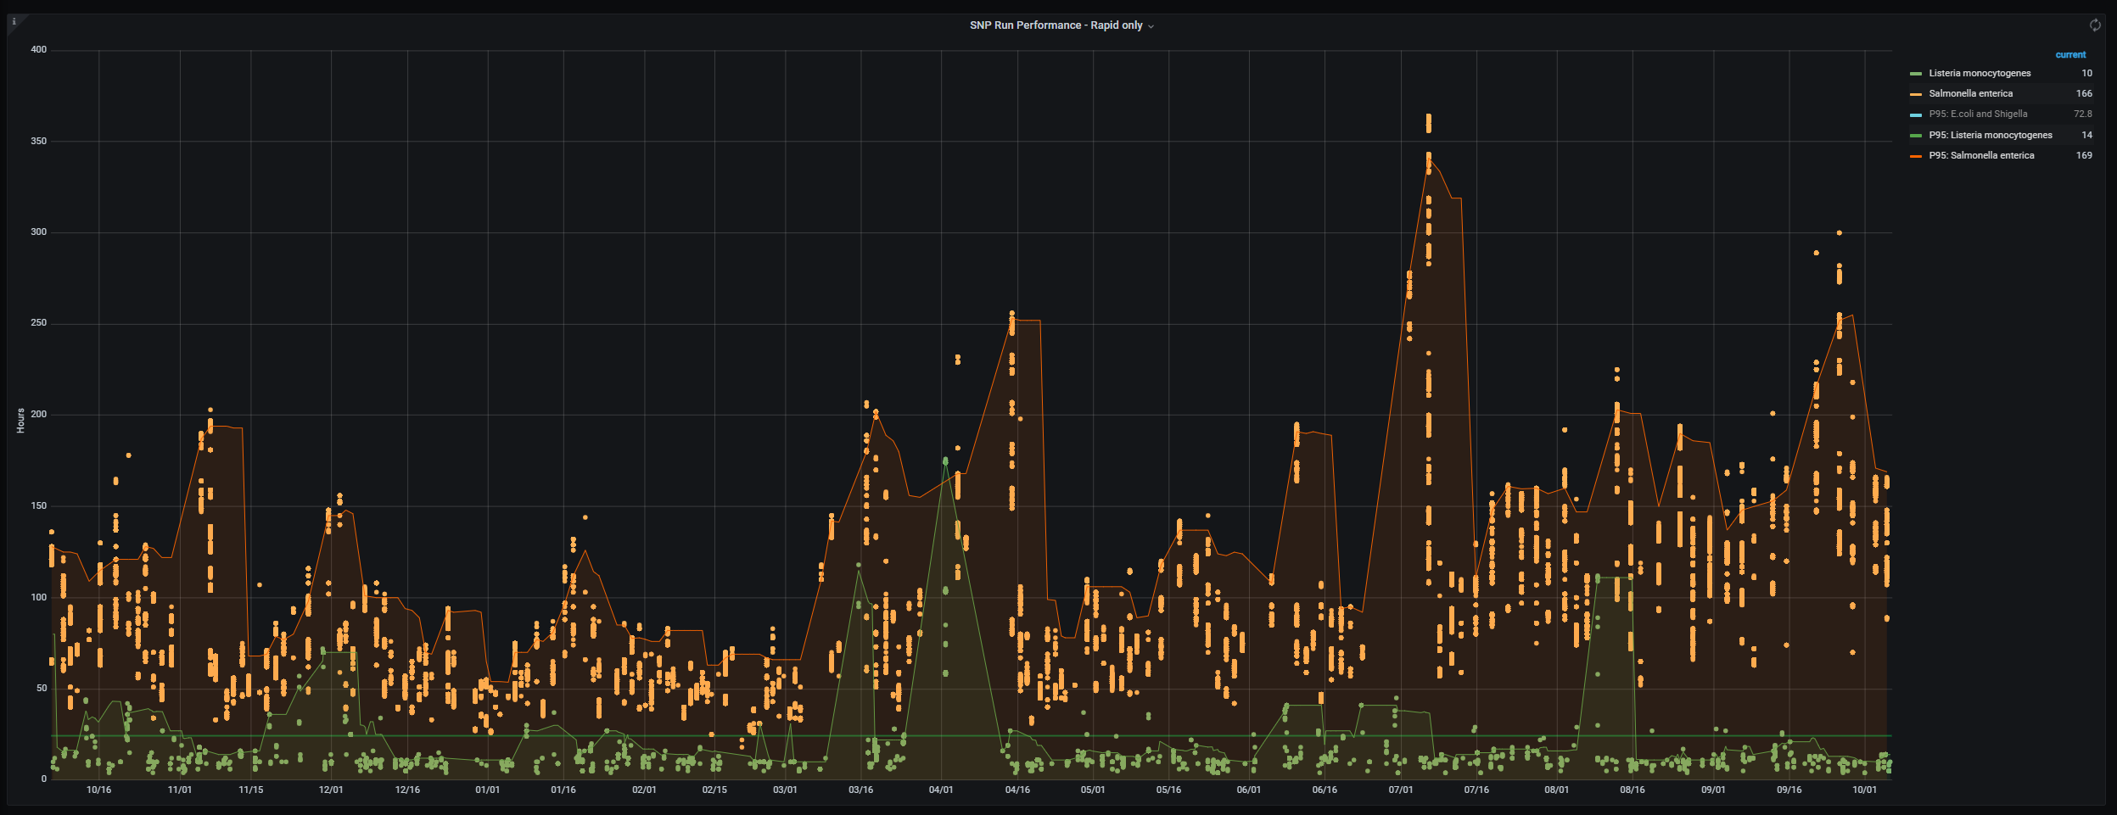
Multiple failures
In processes ->
required manual
restart
SNP processing turnaround time (95th percentile) -> increasing delays
Issue with SRA file copying and linking
overlapped
planned outage of
Db maintenance
Begin switch
to new file system
Grid engine
Maintenance
Overlapped
SRA processing
issues
File system
failures ->
required manual
restarts
Hours (linear) ->
24 hrs
Date ->
Compute farm
issues

Slide 12
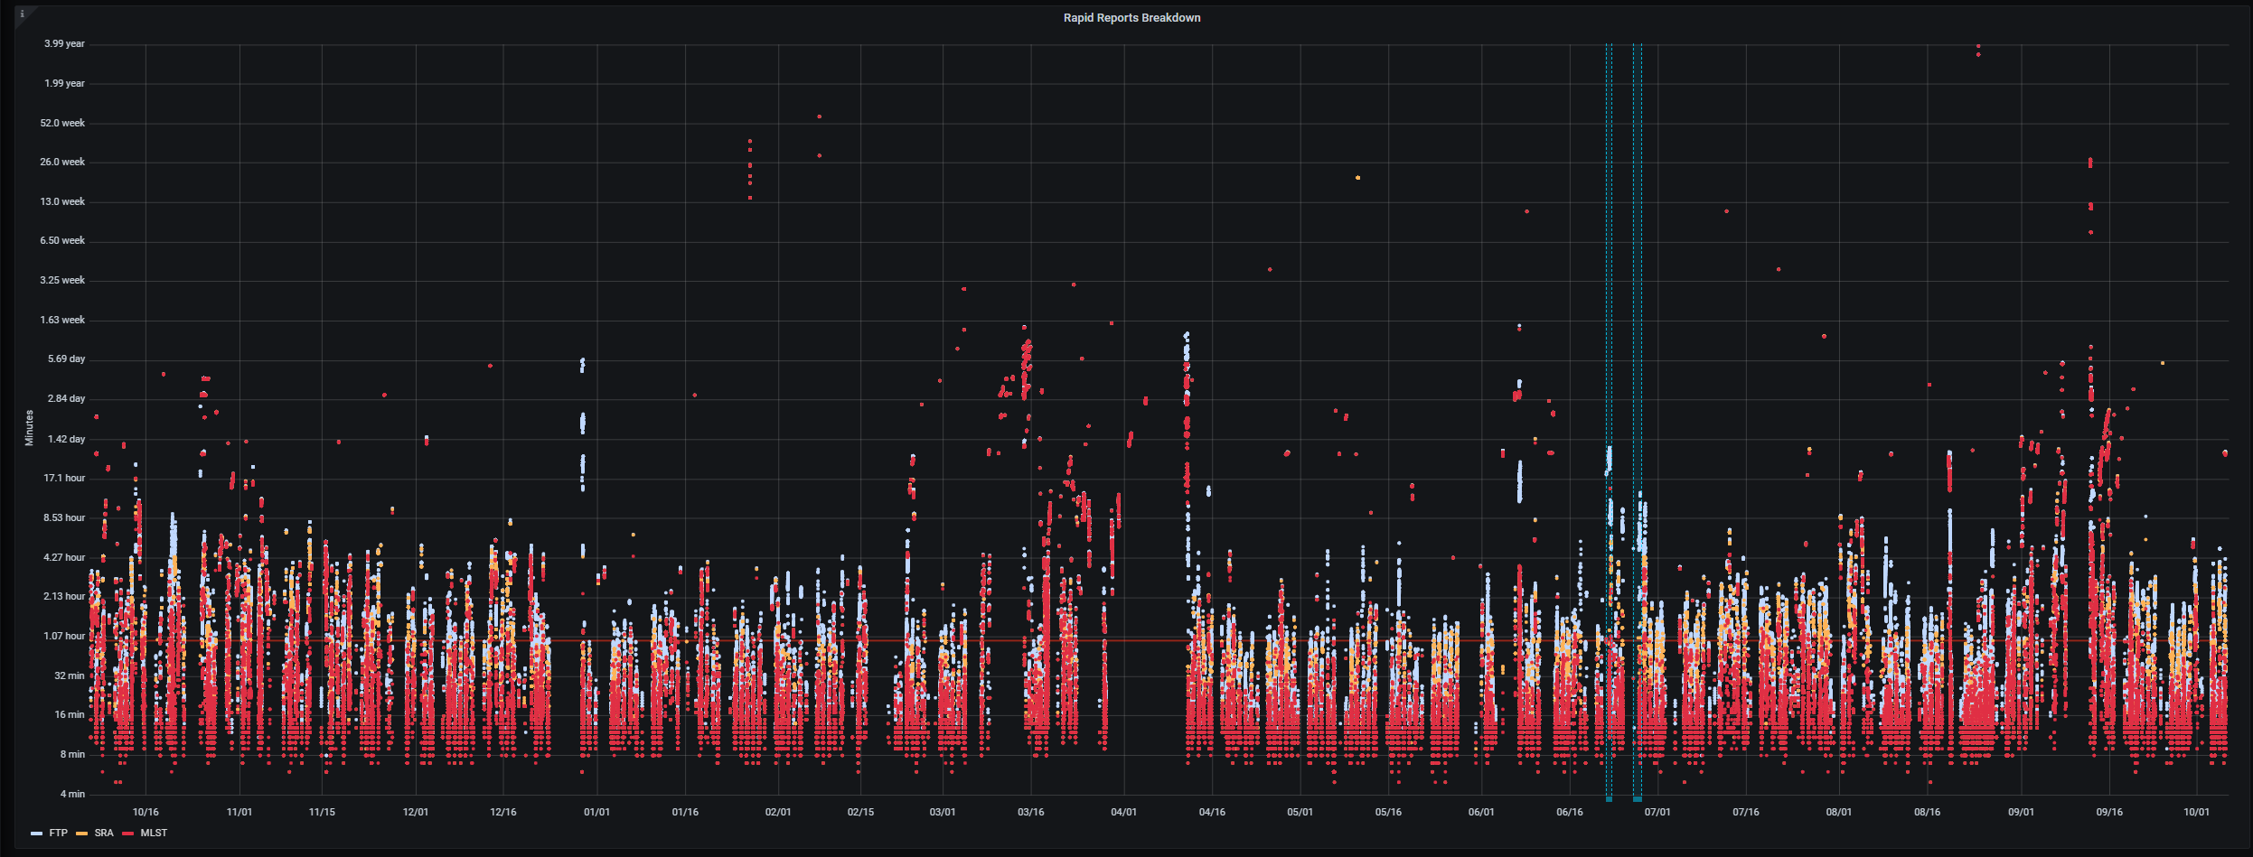

Issue with SRA stat
interfering with data
access overlapped
grid engine upgrade
Rapid reports (was supposed to work when normal
SNP processing does not)
Issue with
Data access
In SRA
Issue with
SRA data release overlapped data center maintenance
Issue with SRA file copying and linking
overlapped
planned outage of
Db maintenance
Hanging process in SRA
Minutes (lexponential) ->
Slowdown in
multiple
places
60
min.
Date ->
Compute farm
issues
Unexplained
slowdown

Slide 13
Numerous issues/outages, a significant number are SRA operations, especially overlapping
Maintenance timeouts
But…there are also linear increases in turnaround time due to the scale of data….

Slide 14
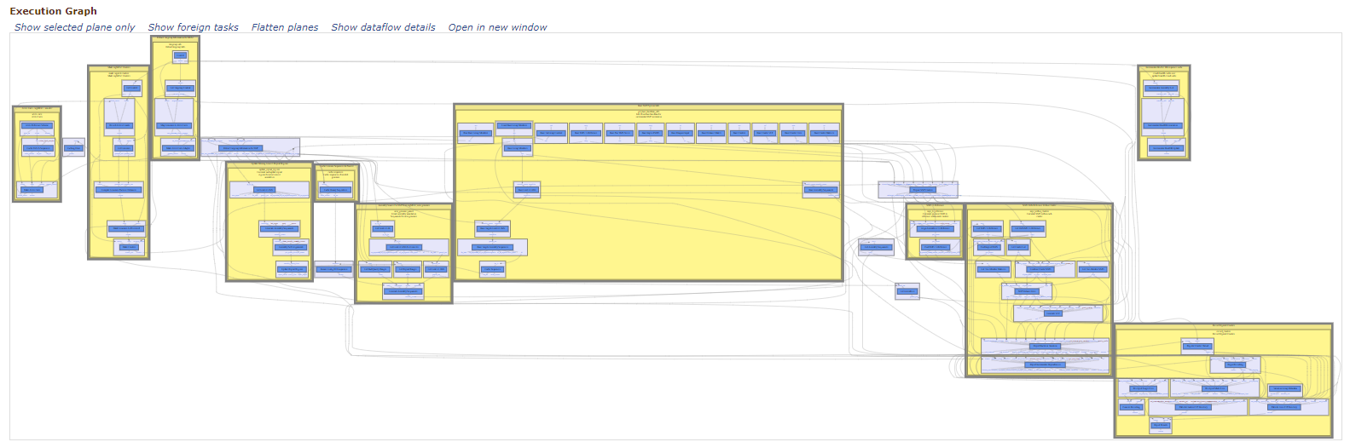
SNP processing pipeline
Complicated process – numerous steps - evaluated turnaround time in each part…

Slide 15
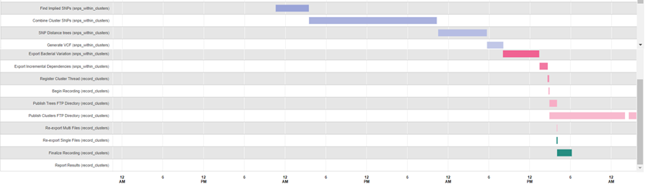
Step | Minutes
Compute Genomes Pairwise Distances | 1037
Make Clusters | 119
Combine Cluster SNPs | 1140
Export Bacterial Variation | 322
Find Implied SNPs | 294
Generate VCF | 144
SNP Distance trees | 430
Finalize Recording | 130
Publish Clusters FTP Directory | 668
Variation Group Metadata | 210
Publish Clusters FTP Directory | 83
These processes require previous steps to finish before proceeding – there are significant timesinks

Slide 16
Reasons
SRA processing is not dedicated to PD and competes with other outcomes (ex: Sars-Cov2)
  Numerous SRA issues especially when maintenance is ongoing
PD processing competes with above
On prem compute resources have decreased in capacity – less machines need to do more as data increases
Switch to using cloud computing is taking longer
  Learning as we go – guidance is discovery
  Frequent requests to change direction due to security restrictions
Frequent outages require manual intervention – take away from new developments
Largest clusters consume most of the time
NIAID requests related to antimicrobial resistance means less time can be spent on existing project

Slide 17
What is being done
Dedicate majority of pipeline development FTEs to improving the turnaround time
This will come at a cost – new feature development will be put on back burner
  New organisms
  New genes
  New features in the browser
New algorithmic improvements
  Some currently being investigated for SNP processing
New engineering improvements
  Some already done (a few hours shaved off)
  Some under investigation
Moving more processing to cloud
  No longer competing against existing on-premise processing

Slide 18
Acknowledgements
Richa Agarwala
Victor Ananiev
Azat Badretdin
Slava Brover
Joshua Cherry
Jinna Choi
Vyacheslav Chetvernin
Pavan Chilamakuri
Robert Cohen
DeAnne Cravaritis
Michael DiCuccio
Olga Ermoleava
Boris Fedorov
Mike Feldgarden
Lewis Geer
Renata Geer
Dan Haft
Lianyi Han
Avi Kimchi
Michel Kimelman
William Klimke
Alex Kotliarov
Valerii Lashmanov
Aleksandr Morgulis
Eyal Moses
Chris O'Sullivan
Arjun Prasad
Edward Rice
Kirill Rotmistrovskyy
Alejandro A. Schaffer
Nadya Serova
Sergey Shiryev
Martin Shumway
Oleg Shutov
Douglas Slotta
Alexandre Souvorov
Tatiana Tatusova
Francoise Thibaud-Nissen
Igor Tolstoy
Ed Wachtel
Lukas Wagner
Jay Worley
Hlavina Wratko
Chunlin Xiao
Alexander Zasypkin
Eugene Yaschenko
Mingzhang Yang
David Lipman
James Ostell
Kim Pruitt
Stephen Sherry
ASM
BWH
CDC
FDA/CFSAN
FDA/CVM
GenFS
USDA-FSIS
PHAC/CFIA
PHE/FERA
NIAID
Wadsworth/MDH
pd-help@ncbi.nlm.nih.gov
This work was supported in part by the National Center for Biotechnology Information of the National Library of Medicine (NLM), National Institutes of Health, as well in part by the National Institute of Allergy and Infectious Diseases,
National Institutes of Health

