Slide 1
HiFi Sequencing for Highly Accurate Microbial Genomics

Slide 2
The HiFi Advantage
The importance of high quality closed microbial genomes for infectious disease and pathogen genomics
Accurately detect and characterize complex microbial populations with 16S and shotgun metagenomics
Notes:
Focus of my talk will be to describe…
How the combination of long and accurate HiFi reads is helping microbiome researchers to…
Describe how PacBio’s technology is advancing P&A sciences by…

Slide 3




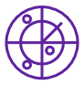
The Sequel IIe system is a powerful tool for understanding microbial genomics
Whole genome sequencing
Accurately assemble
gold-standard microbial
genomes
Bacteria
Eukaryotes
Viruses
Metagenomics
Comprehensively
characterize metagenomes
Targeted Sequencing
High resolution taxonomic profiling and track viral evolution
For Research Use Only. Not for use in diagnostic procedures.
Notes:
The Sequel IIe system is a powerful tool for understanding microbial genomics whether it’s single microbes to community microbes
We are able to interrogate all microbes including Bacteria, eukaryotes, and viruses through the various applications you see here.
With PacBio you can do microbial WGS to accurately assemble reference grade genome to investigate food outbreaks or monitor/track antimicrobial resistance.
You can also use pacbio for Metagenomics to comprehensively characterize metagenomes
Targeted sequencing to profile bacteria and/or track viral evolution
A key advantage for customers iworking in microbiology is that they can perform all these applications and get better data all from one system

Slide 4
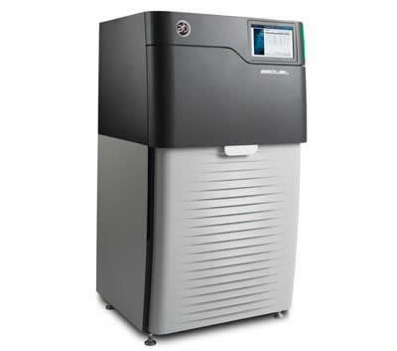
















PacBio Sequencing is a vital part of major global infectious disease programs
Bacterial
Foodborne
Vector-borne
Vaccine Preventable
Environmental Exposure
Healthcare Associated Infections
Influenza and other Respiratory Infections
HIV and other STDs
Hepatitis
Tuberculosis
Notes:
Our technology is certainly not new to infectious disease, in fact our technology is being used in major public health institutions like CDC, public health England, large contracted commercial labs, and the NIH for a broad breadth of infectious disease applications. And the reason why these folks have been involved with us has been the accuracy and also the scalability of our platforms.

Slide 5
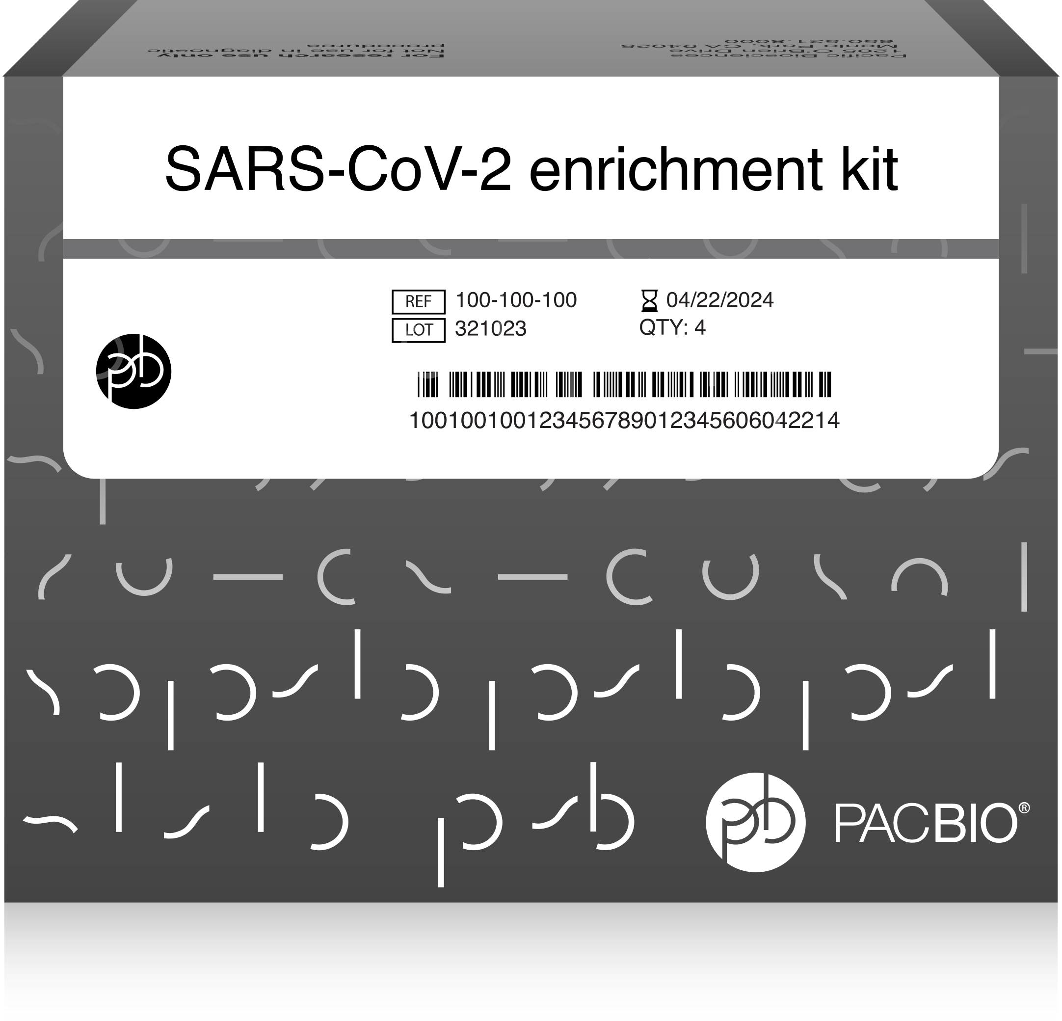
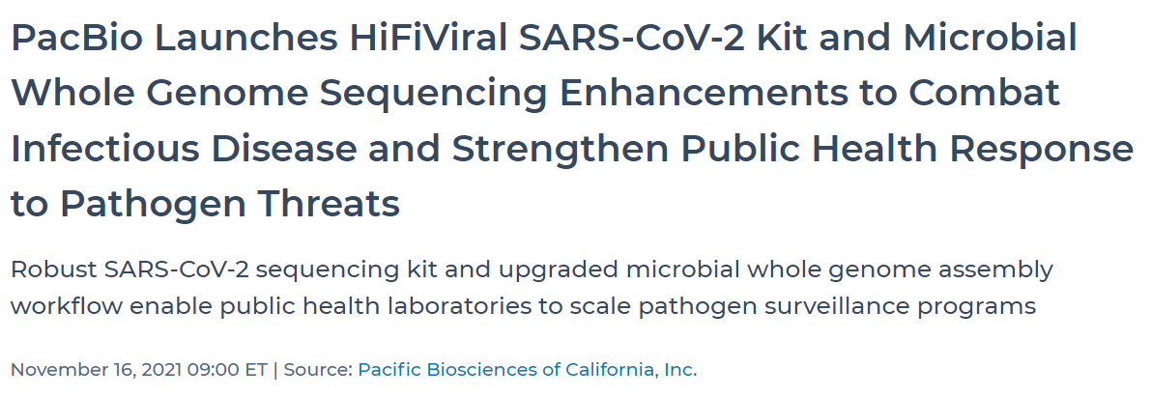
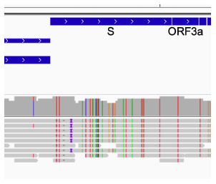
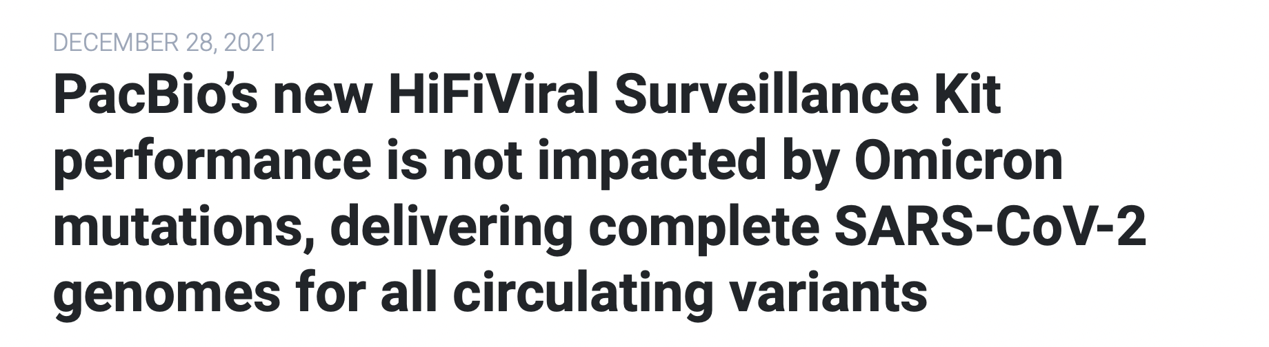
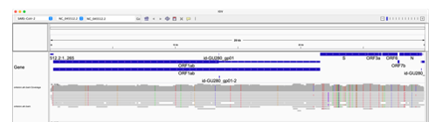
HiFiViral SARS-CoV-2 kit
Quickly and efficiently scale genomic surveillance by sequencing with an accurate and robust solution that captures all variants
Notes:
Last year we introduced a fully kitted solution for sequencing SARS-CoV-2 to help public health with monitoring of new covid19 variants
Differentiated technology that is robust to new emerging variants, including omicron
LabCorp uses technology which earned another round of funding from CDC.
DNA Link uses kit and collaborating with Korea CDC to sequence banked covid positive samples to study disease progression in patients
We’ve been looking at changing some of the components of the kit so that it can be used for surveillance of COVID-19 in wastewater

Slide 6
  The COVID-19 pandemic has shown everyone the value of complete genomic information for public health decision-making
Closed bacterial genomes matter
  Draft mis-assemblies and truncations compromise gene finding
  Missing plasmids limit our ability track outbreaks
  Missing plasmids blind us to gene transfer among bacteria
Barloy-Hubler et. al. (2018) Genomic repeats, misassembly and reannotation: a case study with long-read resequencing of Porphyromonas gingivalis reference strains. BMC Genomics. 19:54. doi: 10.1186/s12864-017-4429-4
Notes:
But what the COVID-19 pandemic has really shown everyone is that having a complete genome is critical to public health decision-making and a draft genome alone is not going to cut it.
If you have a poor quality assembly, you’re not going to be find genes as well
If you miss plasmids, you’re going to miss detection of AMR genes because a lot of AMR travels on plasmids and a lot of outbreaks are linked to the spread plasmids across different bacterial hosts
To help prevent the next pandemic or move sequencing further into the clinic, you need a high quality genomes to populate databases that are being used for public health and/or clinical applications.

Slide 7
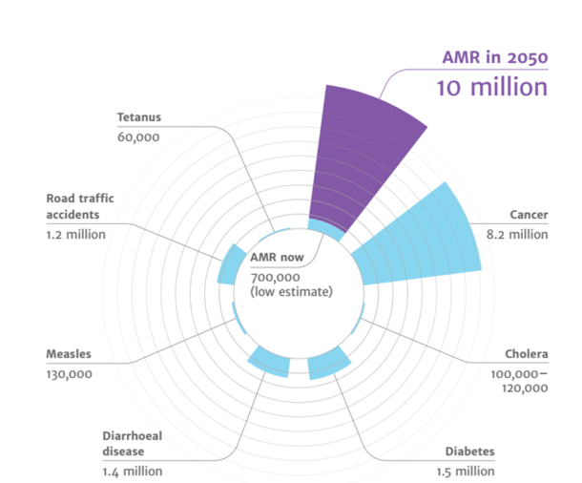
Antimicrobial resistance (AMR)
Antimicrobial resistance is a global health concern
By 2050, estimated deaths associated with AMR will rise to 10 million, exceeding cancer
In the US, AMR causes 2 million infections per year costing the healthcare system more than $20 billion
International and national plans in place to combat antibiotic resistant bacteria
Source: Review on Antimicrobial Resistance
PacBio sequencing can identify strain characteristics, AMR genes, and mobile vectors mediating spread all from a single cell
Significant threat to human and animal health
Notes:
And by having high quality databases, we will be able to address some of the bigger and more urgent problems such as Antimcrobial resistance.
AMR is a global health concern and a significant threat to human and animal health
There is an urgency to address AMR globally which many organizations have laid out plans to combat AMR (WHO, Nationa action plan for combatting AMR bacteria (Whitehouse 2015)
Pacbio sequencing is a key tool in this effort, to help institutions sequence and understand the entire microbial genome.
Because if you’re not able to see everything that you’re sequencing, you won’t have information you need to prevent the spread of AMR and inform judicious use of antibiotic.

Slide 8

HiFi Microbe delivers a FAR superior result than short reads
  96 SMRTbell libraries were made from 24 distinct bacteria relevant to food safety, HAI, and infectious disease, encompassing a range of GC content, genome size and complexity.
  Without any manual curation, nearly all the assemblies yield closed chromosomes
Notes:
So how good is PacBio for assembling whole microbial genomes? VERY good.
We are the gold standard for microbial WGS
In this figure we ran a 96-plex SMRT library with 14 microbes relevant to food safety, HAI, and infectious diseases. Microbes selected also had a wide range of GC content, genome size and complexity.
Pacbio sequencing closed almost all of these genomes - a near perfect picture of how we can sequence with High accuracy and be able to close these genomes.

Slide 9
HiFi Microbe genomes are THE gold standard for accuracy!
Accuracy of representative examples from the previous 96-plex sequencing run
Notes:
Here’s another 96-plex run looking at the same 24 samples as the previous slide and what you see here is that the average mean assembly of 4 samples represented by each purple bar were all above Q40 (>99.99%) and a few above Q50 (>99.999%)

Slide 10





HUMAN GENOMICS
ONCOLOGY
EMERGING MARKETS
MICROBIAL GENOMICS
PLANT + ANIMAL
Microbial WGS
16S/Metagenomics

Slide 11

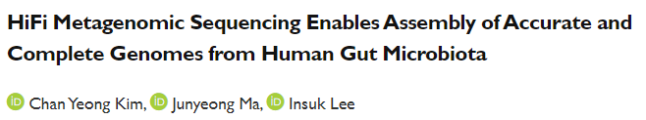
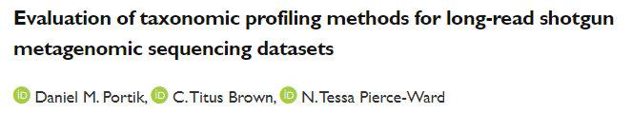


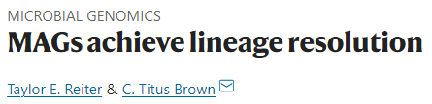


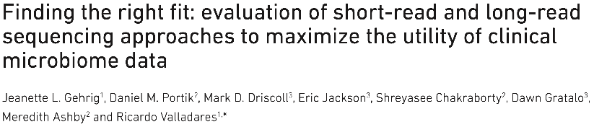
PacBio HiFi sequencing is setting a new gold standard in
16S and metagenomics
https://www.nature.com/articles/s41587-021-01130-z; https://www.nature.com/articles/s41587-021-01130-z; https://www.nature.com/articles/s41564-021-01027-2; https://www.genomeweb.com/sequencing/tech-boosted-genome-assembly-helps-resolve-closely-related-microbes-metagenomic-sample; https://www.tandfonline.com/doi/full/10.1080/19490976.2021.2021790; https://www.biorxiv.org/content/10.1101/2022.01.31.478527v1?ct=; https://www.biorxiv.org/content/10.1101/2022.02.09.479829v1; https://www.nature.com/articles/s41592-022-01478-3; https://pubmed.ncbi.nlm.nih.gov/35302439/
Notes:
high accuracy, full characterization, and species level resolution are why PacBio HiFi sequencing is setting a new gold standard.
Here are a few publications in just the last 6 months that have talked about the true power of PacBio sequencing for metagenomics/microbiome studies.

Slide 12
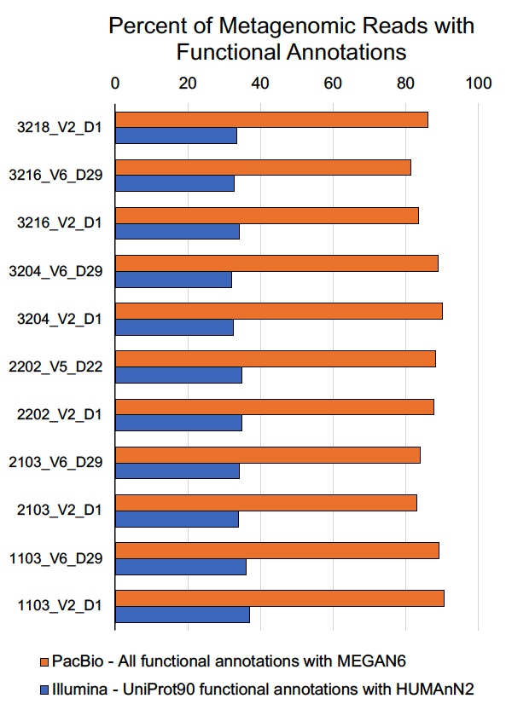
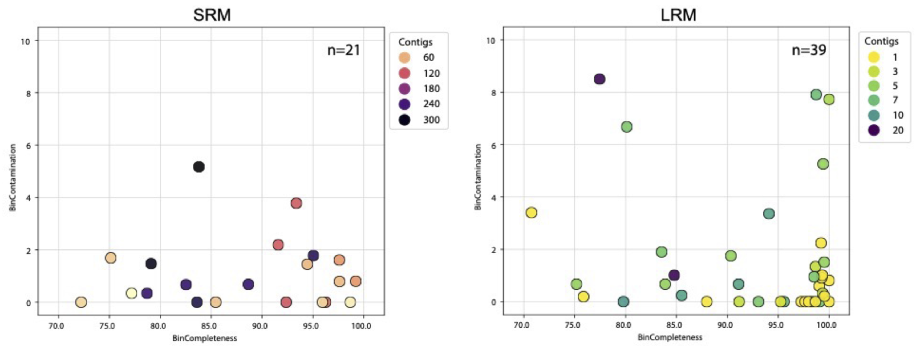
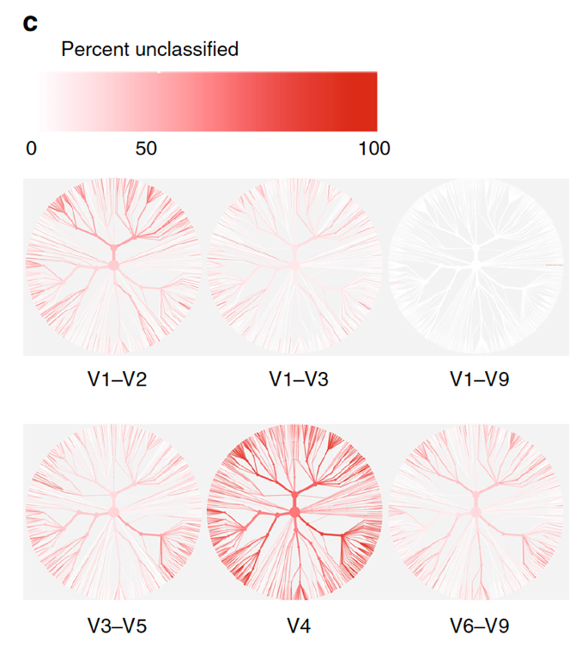
HiFi is the best technology for metagenomics and microbiome studies
Full-length 16S sequencing
Full-length marker genes result in better taxonomic resolution and classification than short reads
Shotgun metagenome profiling
80-90% of HiFi reads have at least 1 functional annotation, and typically 4, whereas only ~1/3 of short reads can be annotated even once
Shotgun metagenome assembly
MAGs generated from PacBio HiFi have, on average, larger genome sizes, higher N50 values, and are less fragmented and there are more MAGs with fewer contigs and single contig MAGs
Lefoulon, Truchon, et. al. (2021) Greenhead (Tabanus nigrovittatus) Wolbachia and Its Microbiome: A Preliminary Study. Microbiology Spectrum. https://doi.org/10.1128/Spectrum.00517-21
Gehrig, J. et al. (2022) Finding the right fit: evaluation of short-read and long-read sequencing approaches to maximize the utility of clinical microbiome data. Microbial Genomics. doi: https://doi.org/10.1099/mgen.0.000794
Notes:
Full-Length 16S Sequencing
With ILMN, Can’t do full-length marker gene sequencing (16S/18S/ITS), 1-3 variable regions is all that is doable. Full-length yields more in-depth taxonomic classification with little to no unclassified taxa at multiple taxonomic levels with the ability for species and strain level classification.
Shotgun Metagenomics Profiling
Much lower percentage of functional annotations for shotgun metagenomics data with Illumina than PB. Each HiFi read typically has 8 intact genes per read, providing richer information about genes that co-occur in a single microbe, and may be co-expressed
80-90% of HiFi reads have at least 1 functional annotation, and typically 4, whereas only ~1/3 of short reads can be annotated even once
Shotgun Metagenomics Assembly
Snapshot of single sample (participant 5 baseline)
SRM: 21 MAGs passing filtering, 2 >98% complete, 0 single contig, 1 <20 contigs
LRM: 39 MAGs passing filtering, 18 >98% complete, 8 single contig, all <20 contigs
Illumina doesn’t currently have a single platform that is capable of performing both amplicon sequencing and shotgun metagenomic sequencing at appropriate throughputs for both and/or cycles (bp). The same goes for adding microbial isolate WGS as well.

Slide 13
Summary
The combination of long and accurate reads enables scientists to detect emerging public health threats
Exceptional performance in 16S and metagenomic applications enables scientists to advance microbiome studies
PacBio is the gold standard for plant and animal sciences and is supporting important environmental initiatives
  Pacbio is being utilized by scientists globally to expand applications into new emerging areas such as gene therapy, microbiome therapeutics, and infectious diseases in animals
Notes:
The combination of long and accurate reads enables scientists to detect emerging public health threats
Pacbio is the gold standard for microbial assembly – closed genomes with 99.99% accuracy
Exceptional performance in 16S and metagenomic applications to advance microbiome studies
Achieve accurate and high-resolution taxonomic classification, increased annotation without assembly, and dramatic increases in MAG assembly
PacBio is the gold standard for plant and animal sciences and supports important environmental initiatives
Gives insights into the true biology of these genomes can inform important agriculture, conservation, and ecology initiatives.
Pacbio is being utilized by scientists globally to expand applications into new emerging areas such as gene therapy, microbiome therapeutics, and infectious diseases in animals

