Slide 2


A preliminary survey of wastewater for Escherichia coli identifies a multidrug resistant pandemic lineage associated with extraintestinal disease
Edward G. Dudley, Ph.D
Professor and Director of E. coli Reference Center
dudley@psu.edu
http://sites.psu.edu/gutbugs
@microdudley @PSU_EcoliRefCtr

Slide 3
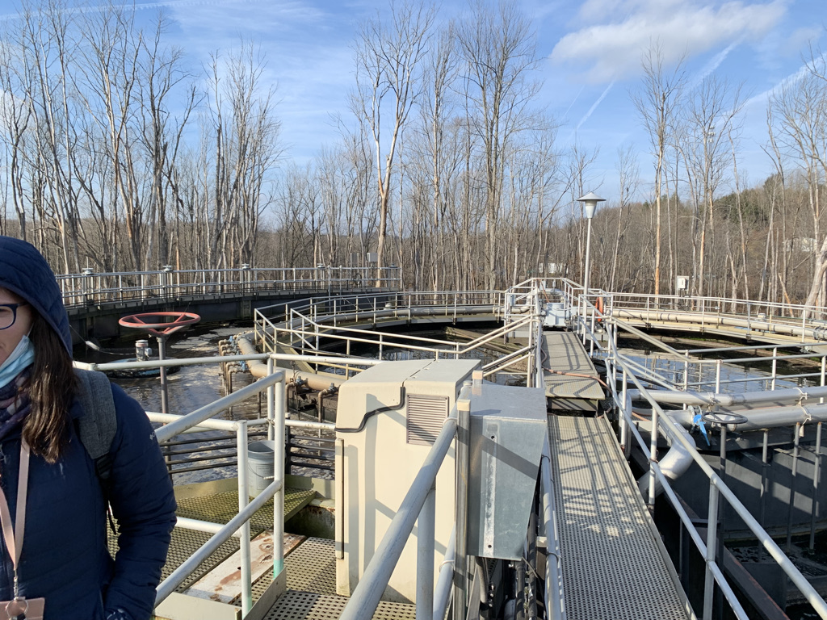

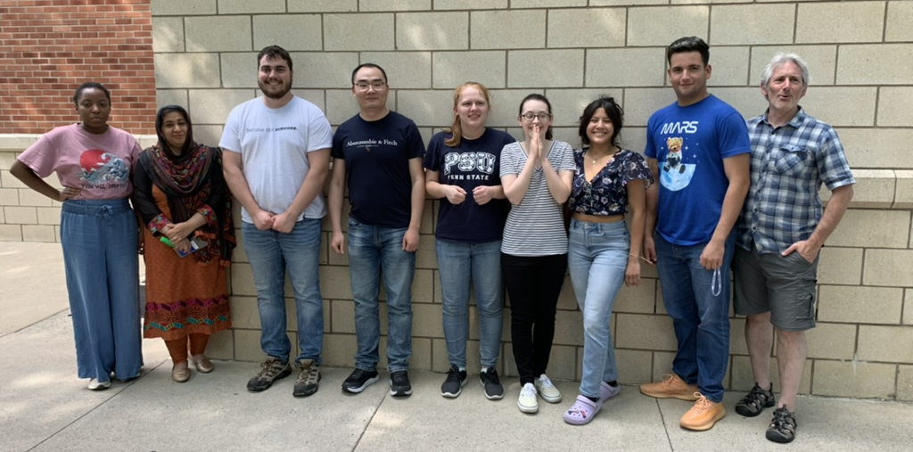




Slide 4
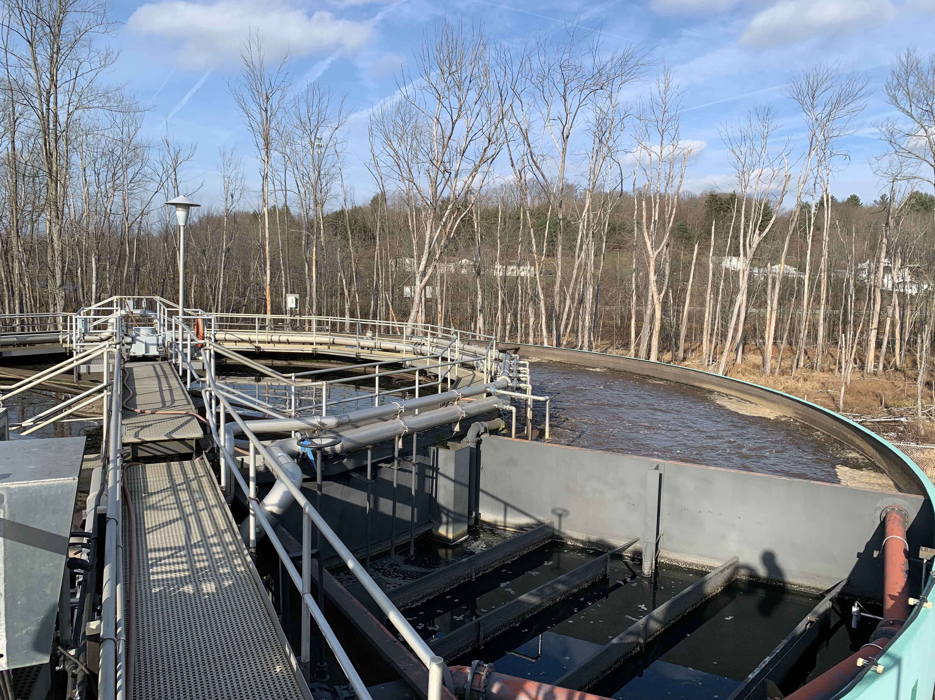
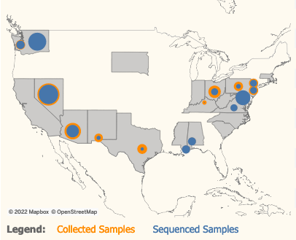
Background to wastewater project
Samples collected bi-weekly from two facilities from January through June

Slide 5
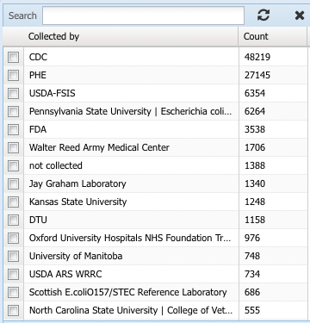
Rationale for identifying E. coli in wastewater
Add wastewater E. coli to Penn State E. coli Reference Center;
Questions to address:
  Are wastewater E. coli populations dominated by certain lineages?
  Can we identify pathogenic E. coli in wastewater?
  Can such analysis infer anything about community health and well-being?

Slide 6
Pathotypes of Escherichia coli
E. coli
“commensal”
diarrheagenic
Enterohemorrhagic (EHEC)
Shiga-toxigenic (STEC)
Enteropathogenic (EPEC)
Enteroaggregative (EAEC)
Enterotoxigenic (ETEC)
Enteroinvasive (EIEC)
Diffusely adherent (DAEC)
extraintestinal (ExPEC)
Uropathogenic (UPEC)
Neonatal meningitis (NMEC)
Sepsis-associated (SEPEC)

Slide 7
Extraintestinal Escherichia coli (ExPEC)
UPECs responsible for ~150 million uncomplicated urinary tract infections worldwide per year
Second leading cause of neonatal meningitis
Leading cause of hospitalization due to sepsis in US
Difficult to define by gene presence
Complementary tools such as sequence typing often used
Extraintestinal (ExPEC)
Uropathogenic (UPEC)
Neonatal meningitis (NMEC)
Sepsis-associated (SEPEC)
doi: 10.1016/s1286-4579(03)00049-2
doi:10.1001/jamanetworkopen.2020.6004

Slide 8

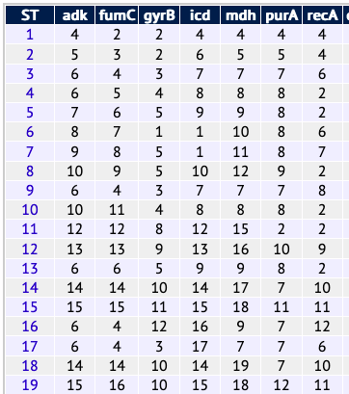
E. coli multilocus sequence typing (ST)
Achtman and Pasteur
>13,000 STs for E. coli in PubMLST/Enterobase
Can be informative for identifying virulent strains. “All” O157:H7’s are ST11
ST used commonly by ExPEC field especially for identifying pandemic lineages
DNA sequence alignment

Slide 9
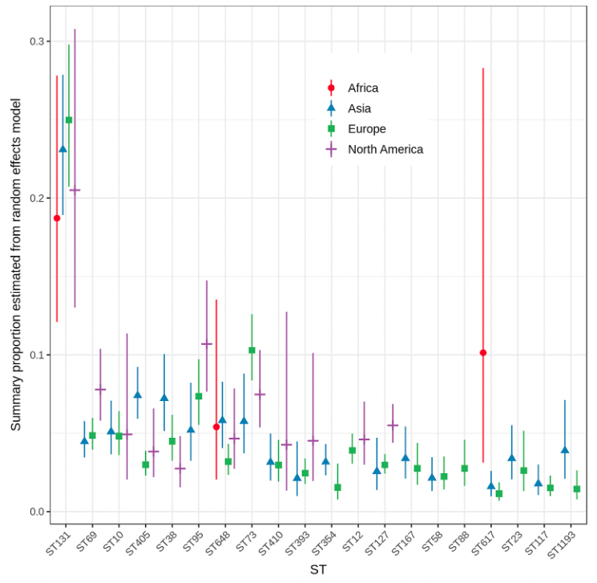
STs associated with human ExPEC isolates
Ten most frequent ExPEC STs worldwide:
ST131
ST69
ST10
ST405
ST38
ST95
ST648
ST73
ST410
ST393
Manges et al., Clin. Microbiol. Rev. 2019
Notes:
https://doi.org/10.1128/CMR.00135-18
217 studies between 1995 and 2018 reviewed
Found 215 STs total, but summary is in chart on slide
Summary proportions were calculated across multiple, diverse studies,including very different study populations, multiple specimen types, and clinical outcomes and should notbe interpreted as population-level estimates of an individual ST’s contribution to the global burden ofinfection.

Slide 10
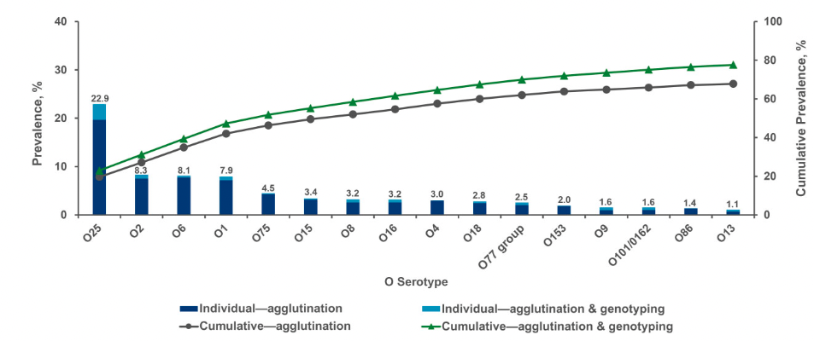
Sepsis ExPECs are limited number of serogroups
Weerdenburg et al. Clin. Infec. Dis., 2022
Notes:
3,217 blood isolates from patients >60 yrs, across 5 surveillance studies in Europe, North America, Asia-Pacific, South America, between 2011-2017

Slide 11
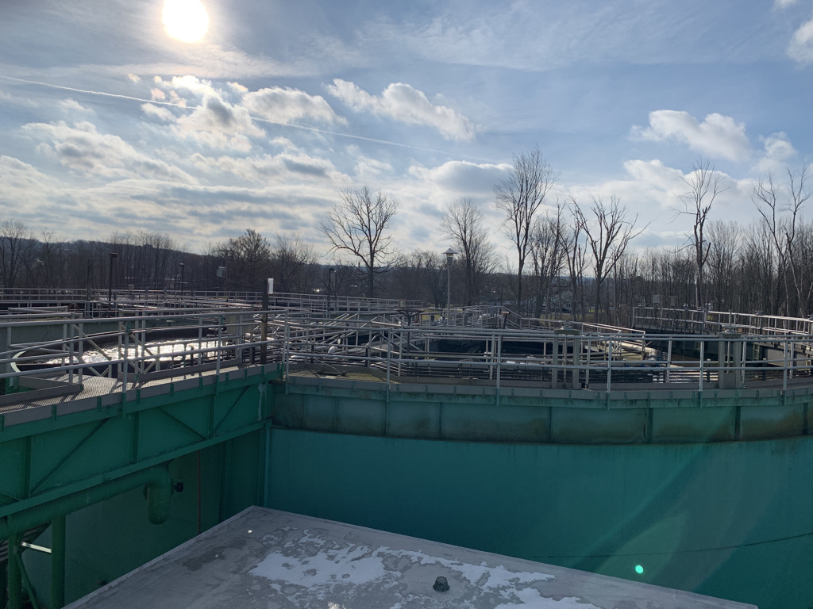
Experimental design
Biweekly, Jan 17 – June 29th
Two facilities serving 4,800 and 5,000 people
Streak directly onto MacConkey, confirm with Simmons Citrate and indole tests, freeze at least 3 colonies per water sample
Confirm with uidA PCR
112 total isolates, 57 sequenced
GalaxyTrakr and other online tools

Slide 12
28% of wastewater isolates are top ExPEC ST’s
Sequence types | Number (percentage)
131 | 5 (9%)
607 | 5 (9%)
127 | 4 (7%)
69 | 4 (7%)
10 | 3 (5%)
372 | 3 (5%)
58 | 3 (5%)
399 | 2 (3.5%)
73 | 2 (3.5%)
95 | 2 (3.5%)
Ten most frequent ExPEC STs worldwide:
ST131
ST69
ST10
ST405
ST38
ST95
ST648
ST73
ST410
ST393
Notes:
Yellow, one of the top 10 ExPECs. In green, another ST identified in other studies as a common strain circulating

Slide 13
28% of wastewater isolates are top ExPEC ST’s
Sequence types | Number (percentage)
131 | 5 (9%)
607 | 5 (9%)
127 | 4 (7%)
69 | 4 (7%)
10 | 3 (5%)
372 | 3 (5%)
58 | 3 (5%)
399 | 2 (3.5%)
73 | 2 (3.5%)
95 | 2 (3.5%)
Ten most frequent ExPEC STs worldwide:
ST131
ST69
ST10
ST405
ST38
ST95
ST648
ST73
ST410
ST393
Notes:
Yellow, one of the top 10 ExPECs. In green, another ST identified in other studies as a common strain circulating

Slide 14
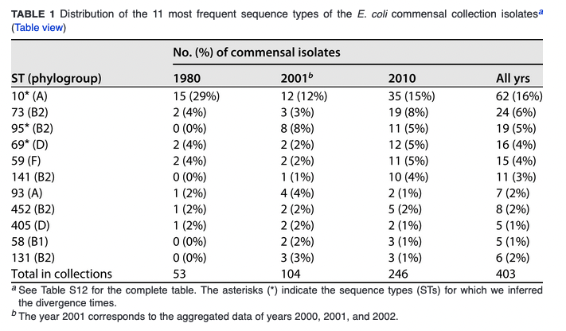
Marin et al., Appl. Environ. Microbiol. 2022
Notes:
https://doi.org/10.1128/aem.00664-22
403 fecal isolates from healthy people in France, 1980 through 2010

Slide 15
Marin et al., Appl. Environ. Microbiol. 2022
Notes:
https://doi.org/10.1128/aem.00664-22
403 fecal isolates from healthy people in France, 1980 through 2010

Slide 16
ST131 is a recently emerged pandemic lineage
Multi-drug resistant, today is most common lineage in ExPEC infections
FimTyper – H22, H41, H30
H30R [fluoroquinolone], H30Rx [fluoroquinolone + bla_{CTX-M-15}]
Preliminary work with Pakistan: 5 of 18 UTI E. coli are ST131-H30Rx
  Two are identical, and are 30 SNPs separated from 2014 clinical from Norway
Isolate | Location | Date | ST | Serotype | FimH-type | AMR genotypes
PSU-5339 | Clearfield | June 15 | 131 | O25:H4 | H30R | 15
PSU-5340 | Philipsburg | June 15 | 131 | O25:H4 | H22 | 6
PSU-5341 | Clearfield | April 6 | 131 | O25:H4 | H22 | 7
PSU-5342 | Clearfield | June 15 | 131 | O25:H4 | H30R | 15
PSU-5343 | Philipsburg | April 18 | 131 | O25:H4 | H30R | 13
*
*
Notes:
H22 and H41 are ancestral to H30
ST131 of O16 have been reported, O25:H4 seems to be most common though
AMR genotypes are those identified in Pathogen Detection, not necessarily number of antibiotics resistant to

Slide 17
Conclusions
ExPEC are common E. coli in wastewater
No diarrheagenic E. coli were identified
Several ExPEC STs associated with human illness were readily recovered
ST131-H30R and ST131-H22 were identified
Most STs identified in wastewater are expected; unclear (to me) what is carriage rate of ST131 in healthy individuals
* Ten of 57 wastewater E. coli carried 5 or more AMR genes

Slide 19
Serogroups
23 distinct, 6 in our top 10 from septicemia study
Serogroup | Number
Untypeable | 17
O25 | 5
O15 | 4
O6 | 4
O8 | 4
O18 | 3
O21 | 3
O9 | 3
O2/O50 | 2
O36 | 2

