Slide 1

GenomeTrakr project for SARS-CoV-2 variant tracking
2022 GenomeTrakr meeting
October 20, 2022
Ruth Timme
FDA/CFSAN/Office of Regulatory Science
ruth.timme@fda.hhs.gov
Notes:
GT has become a global WGS network for foodborne pathogen traceback.

Slide 2


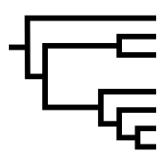
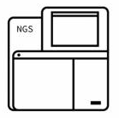
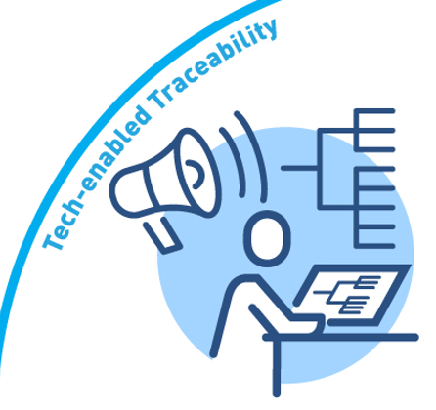


CFSAN ww team members:
WG1 OFS/DSST
  Jessica Jones, Ph.D.
  Jackie Woods, Ph.D.
  CAPT Kevin Calci
  Liz Leard
  Rachel Rodriguez
  Candace Barnes
WG2 OARSA/DMB
  Haifeng Chen, Ph.D.
  Mark Craven, Ph.D.
  Cameron Boerner
WG3 ORS/DM
  Maria Hoffmann, PhD
  Chris Grim, PhD
  Padmini Ramachandran
  Amanda Windsor, PhD
  Tamara Walsky
WG4 OAO
  James Pettengill, PhD
  Hugh Rand, PhD
  Tunc Kayikcioglu, PhD
  Tim Muruvanda
  Jasmine Amirzadegan, PhD
WG5 ORS/DM
  Ruth Timme, PhD
  Marc Allard, PhD
  Maria Balkey
  C. Hope Bias
  Tina Pfefer
  Sandra Tallent, PhD
  Eric Brown, PhD

Slide 3
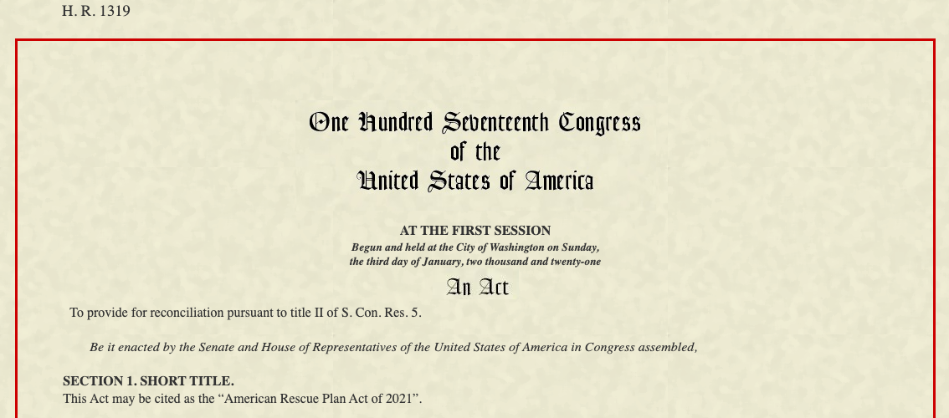
American Rescue Plan Act
March 2021: FDA received funds from the American Rescue Plan Act to leverage GenomeTrakr network for sequencing SARS-CoV-2.

Slide 4
Steps to Adapt GenomeTrakr for SARS-COV-2
Fund laboratories across the US
Develop methods and standards for sequencing population-level SARS-CoV-2 from wastewater samples: Protocols.io
1
2
3
Write new analysis tool:
raw sequence data -> variant proportions.
4
Define data structure within public database
Build dashboards that summarize data collection over time.

Slide 5
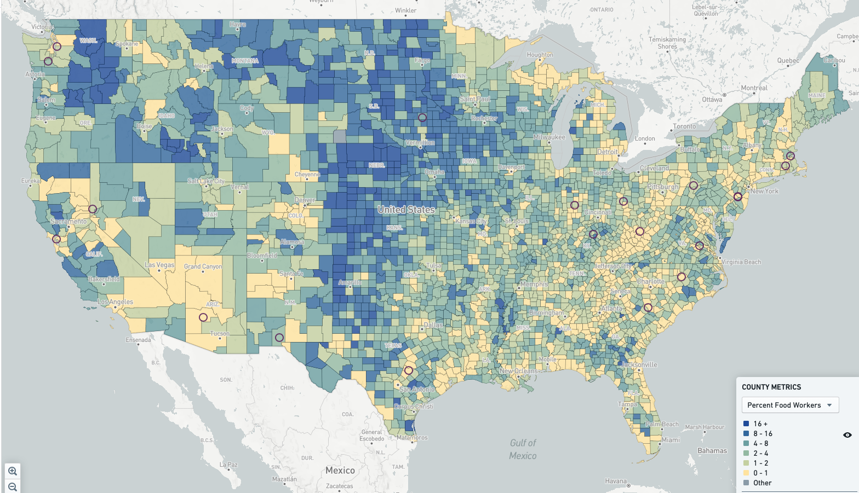
20 Laboratories funded through LFFM + FDA-CFSAN
Arizona State Department of Health Services
California Department of Public Health
Indiana State Department of Health
Kentucky State Cabinet for Health and Family Services
Massachusetts State Department of Public Health
New Jersey State Department of Agriculture
New Jersey State Department of Health and Senior Servces
New Mexico State University - Las Cruces
North Carolina State University - Raleigh
Ohio State Department of Agriculture
Pennsylvania State University - University Park
Rhode Island Department of Health
South Carolina Department of Health and Environmental Control
South Dakota State University
Texas Department of State Health Services
University of Nevada - Reno
Virginia Division of Consolidated Laboratory Services
Washington State Department of Agriculture
Washington State Department of Health
West Virginia Department of Agriculture
FDA-CFSAN, Dauphin Island

Slide 6
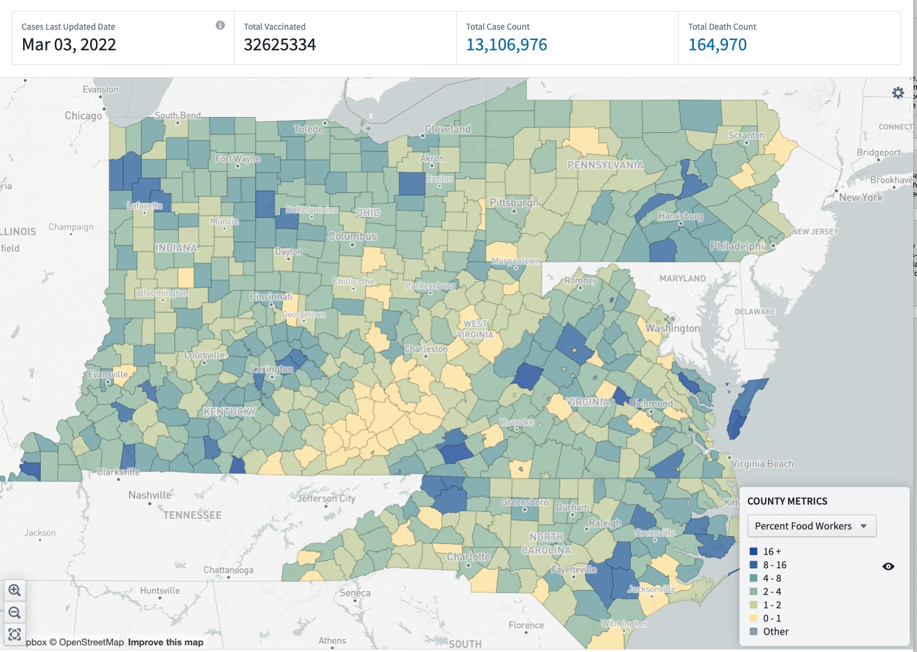
Select sites in regions with high agriculture / food worker populations
COVID-19 caused food supply chain interruptions due to high percentage of food workers becoming ill at the same time.
21FORWARD: FDA platform for identifying where interruption risks are highest across the US.
*not funded with ARP or COVID Supplemental funding.
Our sites are largely in populations with high percentages of food and agriculture workers
focuses in more rural areas not covered initially by other USG efforts
Identifying trends in the sequence data (SARS-CoV-2 variants and/or specific mutations) unique to these populations might alert FDA to potential risk of illness.
= wastewater surveillance sites near populations with high % food/ag workers (dark blue counties)

Slide 7
Steps to Adapt GenomeTrakr for SARS-COV-2
Fund laboratories across the US
Develop methods and standards for sequencing population-level SARS-CoV-2 from wastewater samples: Protocols.io
1
2
3
Write new analysis tool:
raw sequence data -> variant proportions.
4
Define data structure within public database
Build dashboards that summarize data collection over time.

Slide 8
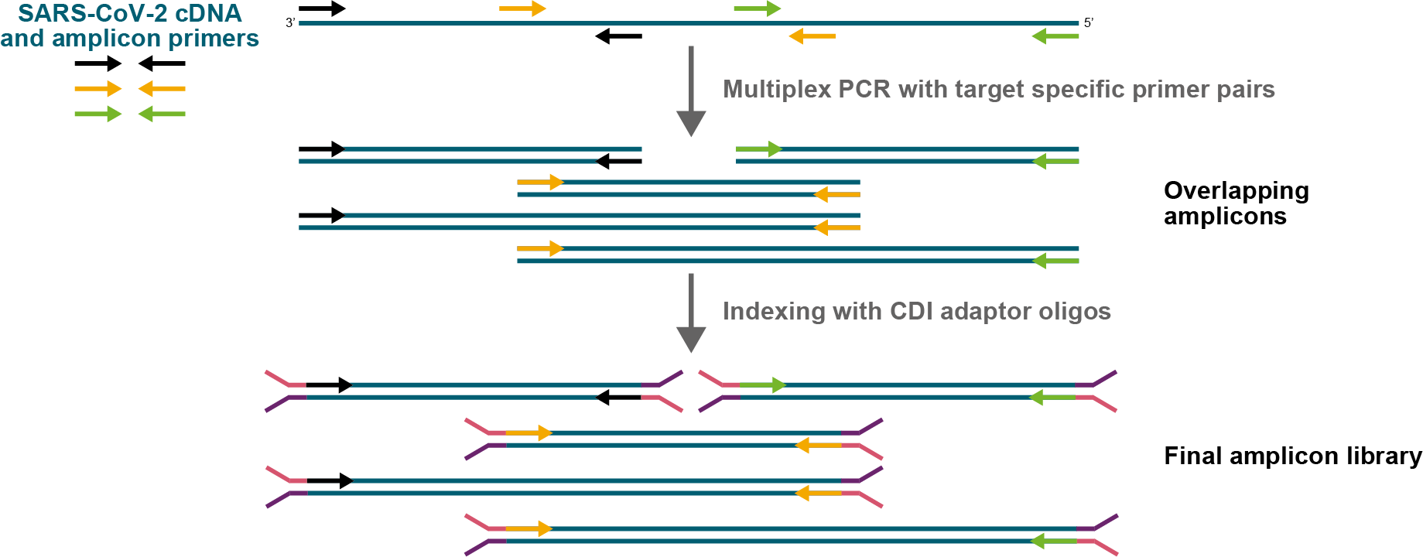
Method development, targeted amplicon strategy:
Raw ww sample
RNA/TNA extraction
Amplicon approaches + primer schemes
NEBNext VarSkip
QIAseq DIRECT
CovidSeq
SNAP
Arctic V3, V4, V4.1
Illumina MiSeq
ONT
PacBio Sequel IIe
sequencing

Slide 9
CFSAN WW protocols
Tested and recommended | protocols.io link | Published
sample collection | Collection from Wastewater Treatment Plant, Transportation, and Storage of Raw Wastewater | V1
virus concentration | Virus Concentration from Wastewater Using PEG Precipitation and Ultracentrifugation | x
RNA extraction | RNA Extraction from Wastewater Concentrates Using RNeasy and Zymo Kits | x
RNA extraction | RNA Extraction with Zymo Environ Water RNA Kit | V1
RT-qPCR test for SARS-CoV-2 | RT-qPCR Detection of SARS-CoV-2 from Wastewater Using the AB 7500 (protocols.io) | V2
RT-qPCR test for controls | RT-qPCR Detection of Process Controls (Murine noroviurs and crAssphage) from Wastewater using AB 7500 | V2
QIAseq SELECT | Enhanced QIAseq DIRECT SARS-CoV-2 Kit for Illumina MiSeq (protocols.io) | V4
NEB VarSkip Short | Modified NEBNext® VarSkip Short SARS-CoV-2 Library Prep Kit for Illumina Platforms - adapted for ww samples Modified NEBNext® VarSkip Short SARS-CoV-2 Enrichment and library prep for Oxford Nanopore Technologies- adapted for wastewater samples Modified Illumina DNA Prep (M) Tagmentation Library Preparation for cDNA amplicons from wastewater | V3, V2, x
sequence QC | Wastewater QC workflow in GalaxyTrakr (SSQuAWK4) (protocols.io) | V9
Share via BaseSpace | Pilot Exercise: Generating the Illumina SampleSheet and sharing data via BaseSpace | V3
NCBI submission | NCBI submission protocol for SARS-CoV-2 wastewater data: SRA, BioSample, and BioProject NCBI Data curation protocol | V8, V2
Shipping ww to CFSAN | Shipping wastewater samples to FDA-CFSAN (protocols.io) | V4
RT-qPCR test for SARS-CoV-2 using Promega | RTqPCR of SARS-CoV-2 N1 Target on ABI 7500 Fast Using Promega GoTaq Enviro Wastewater SARS-CoV-2System V1 | V1
TNA Extraction- Promega | Extraction of Total Nucleic Acid from Wastewater Using the Promega Wizard Enviro Total Nucleic Acid Kit | V1
Tested:
SNAP library prep + sample sheet generation | Library Construction and Sequencing for SARS-CoV-2 from Wastewater using the Swift Normalase Amplicon Panels (SNAP) Workflow

Slide 10
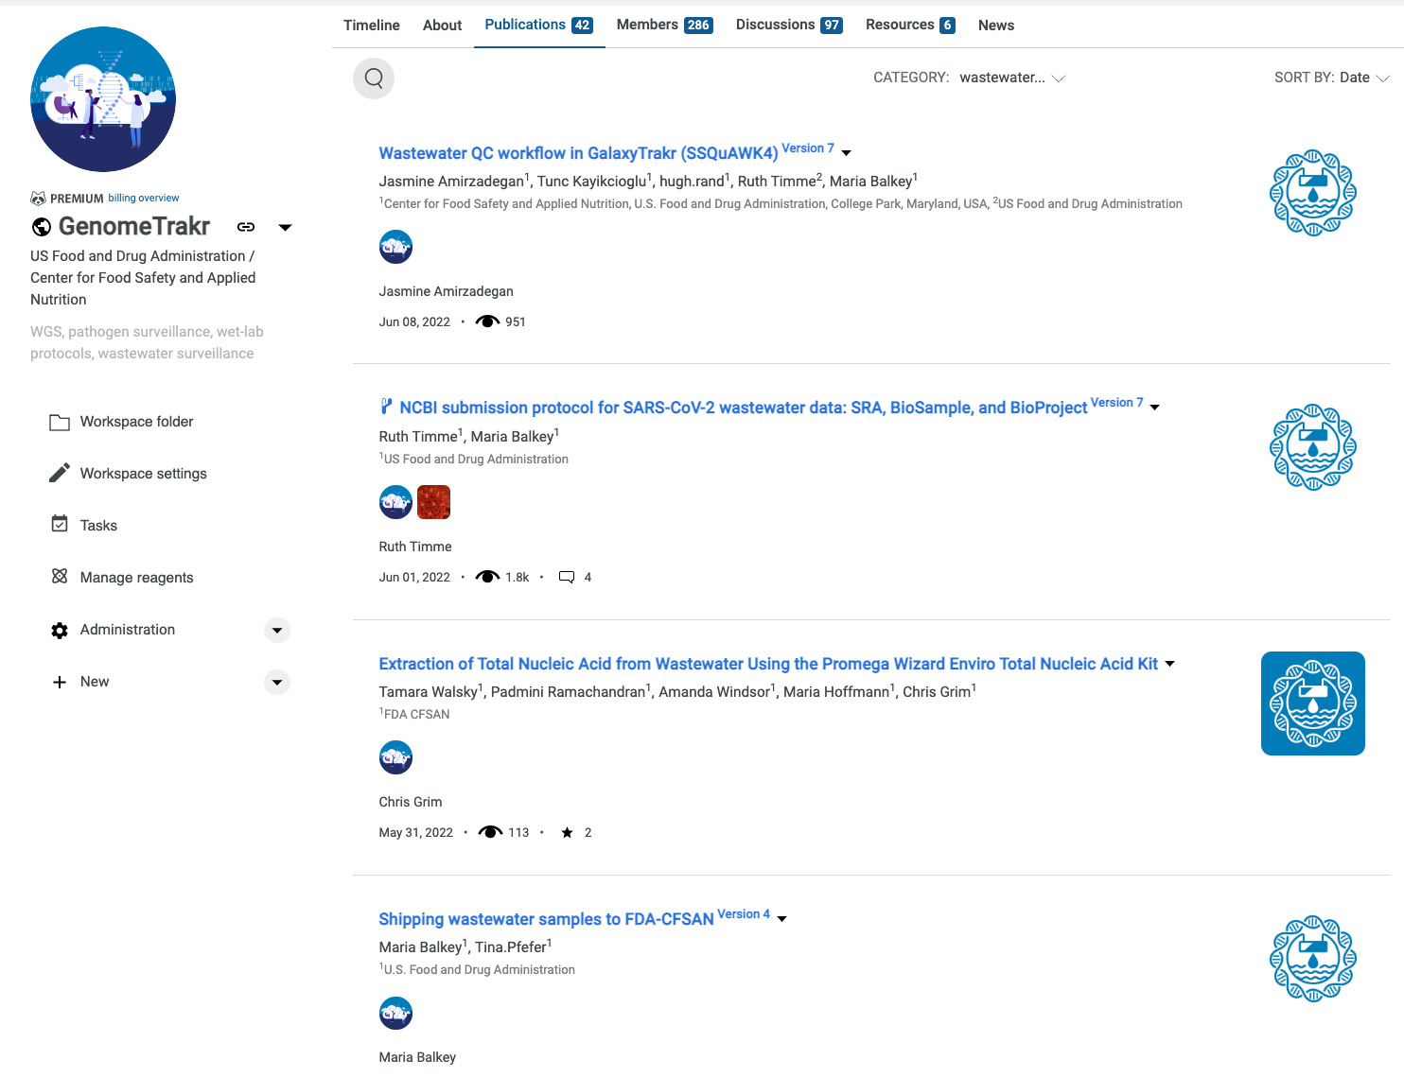
Method development + Protocols.io
https://www.protocols.io/workspaces/genometrakr1/publications

Slide 11
Steps to Adapt GenomeTrakr for SARS-COV-2
Fund laboratories across the US
Develop methods and standards for sequencing population-level SARS-CoV-2 from wastewater samples: Protocols.io
1
2
3
Write new analysis tool:
raw sequence data -> variant proportions.
4
Define data structure within public database
Build dashboards that summarize data collection over time.

Slide 12
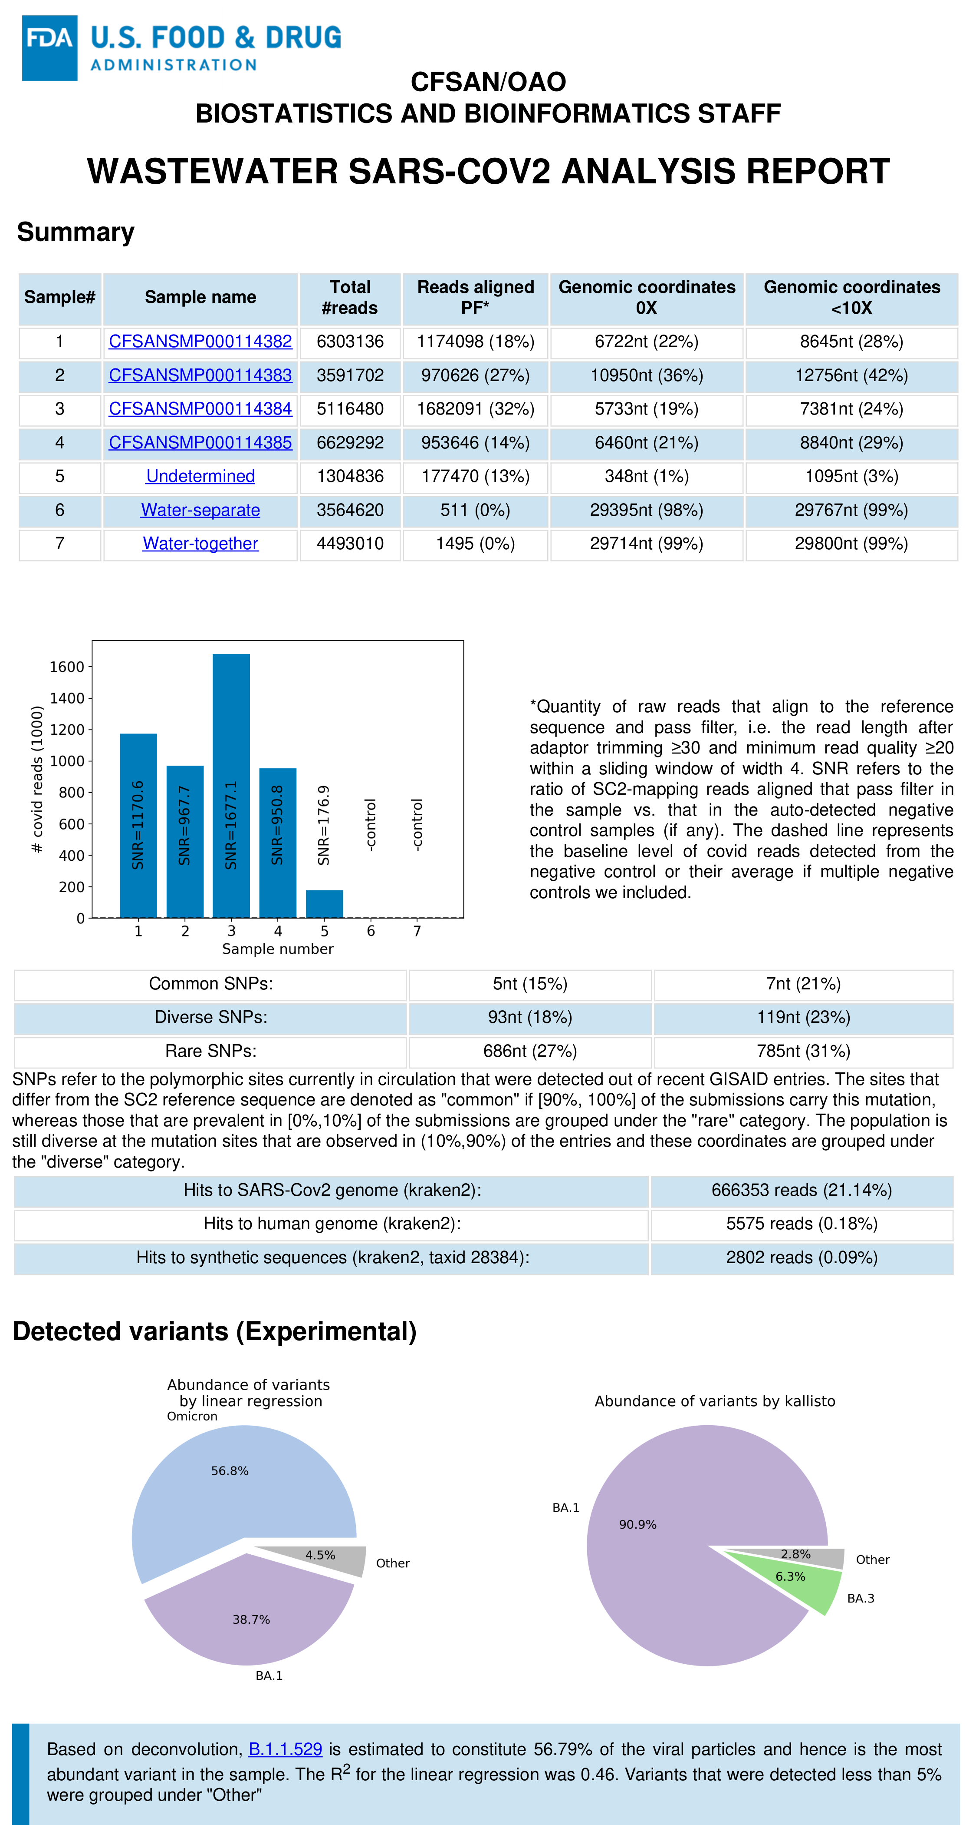
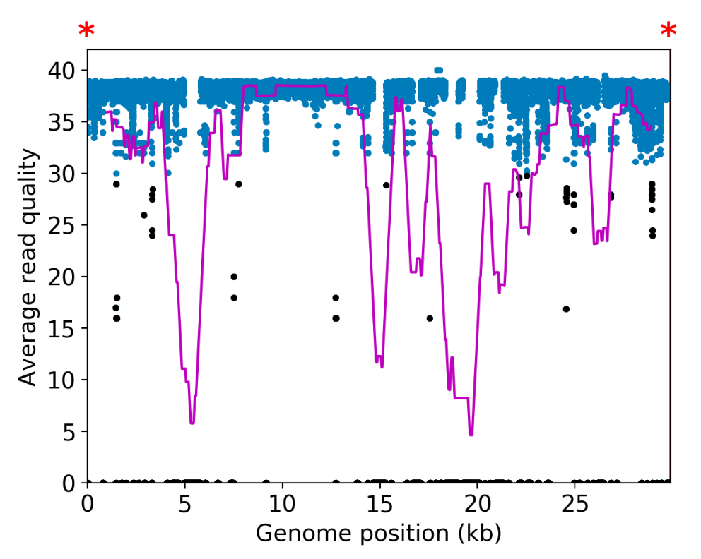
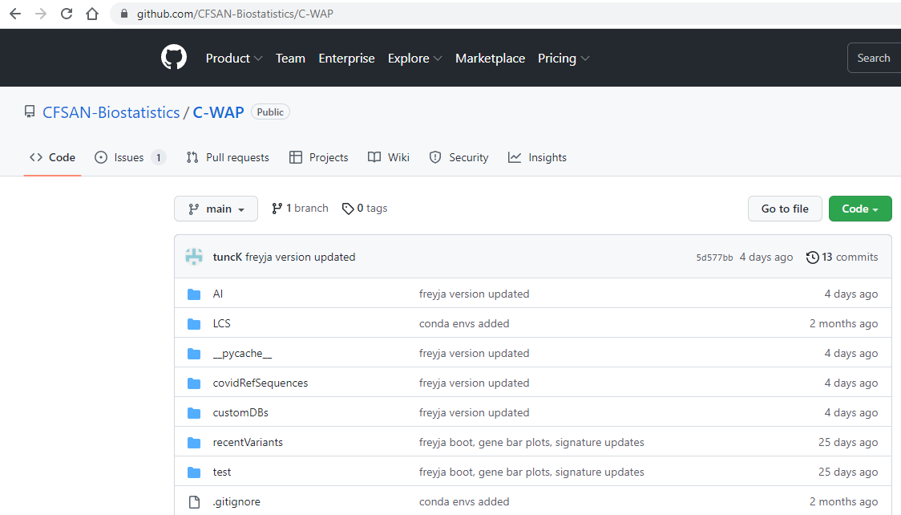
CFSAN’s
Wastewater
Analysis
Pipeline
C-WAP
https://github.com/CFSAN-Biostatistics/C-WAP
Notes:
2 tools help labs determine if ready for NCBI submission
SSQuAWK
Hosted on GalaxyTrakr, CFSAN’s custom Galaxy instance online
Participating labs can run the ssquawk workflow with a click of a button
Single table results for sequence quality metrics, no variant estimation
CWAP
Users with more computational resources who are more comfortable can run CWAP from the command line for more intricate results, including variant estimation!

Slide 13
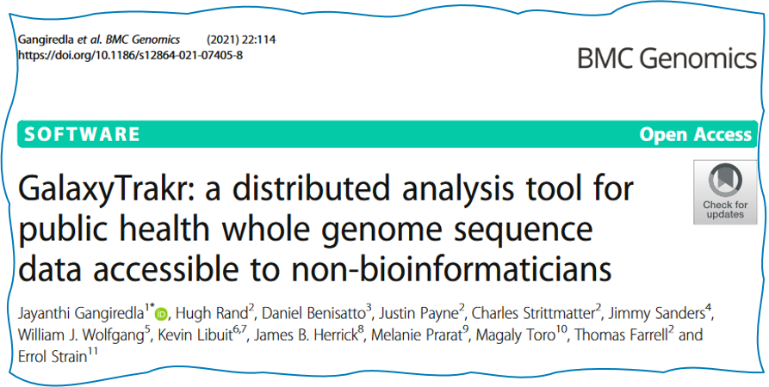
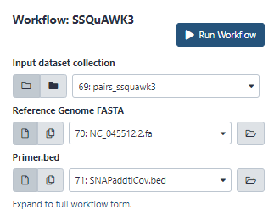
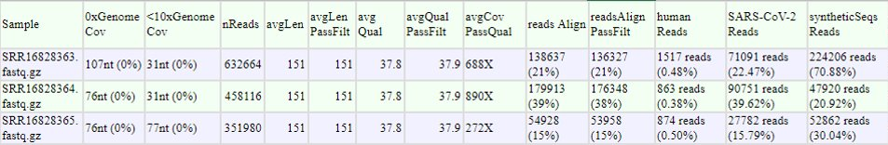
SSQuAWK

Slide 14
Steps to Adapt GenomeTrakr for SARS-COV-2
Fund laboratories across the US
Develop methods and standards for sequencing population-level SARS-CoV-2 from wastewater samples: Protocols.io
1
2
3
Write new analysis tool:
raw sequence data -> variant proportions.
4
Define data structure within public database
Build dashboards that summarize data collection over time.

Slide 15
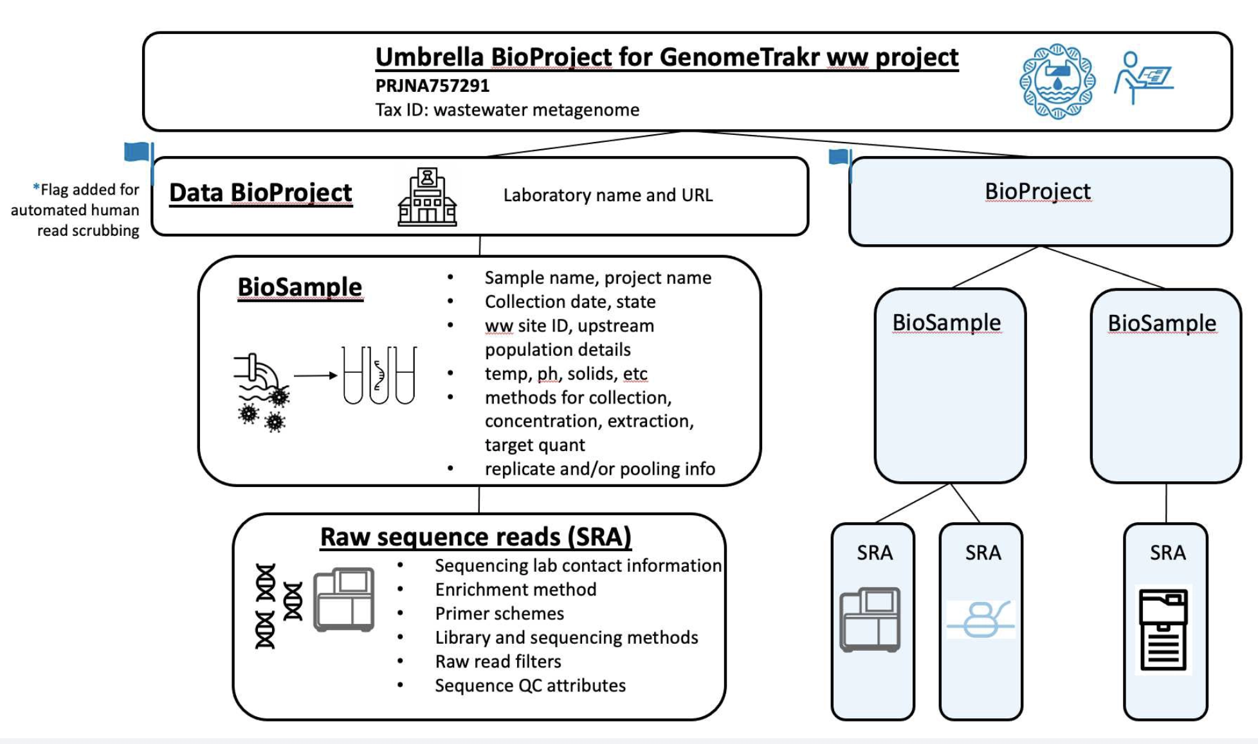
Wastewater NCBI “data object model”

Slide 16
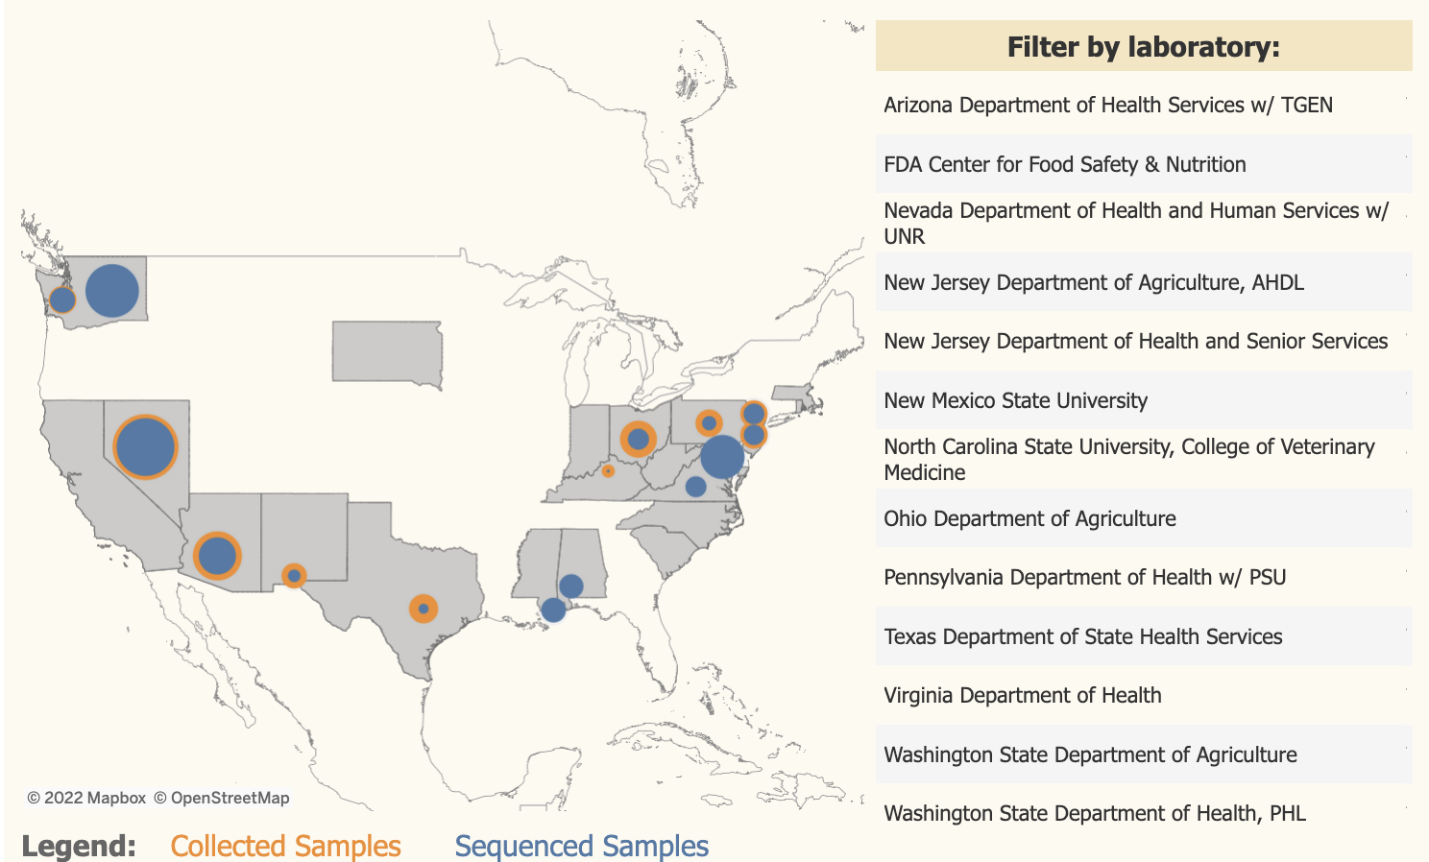
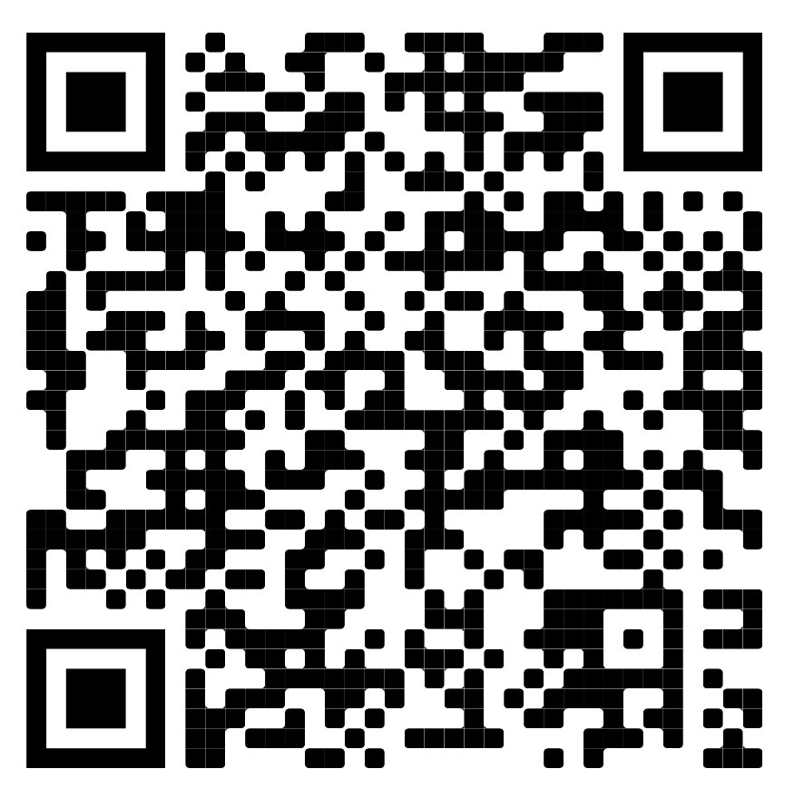
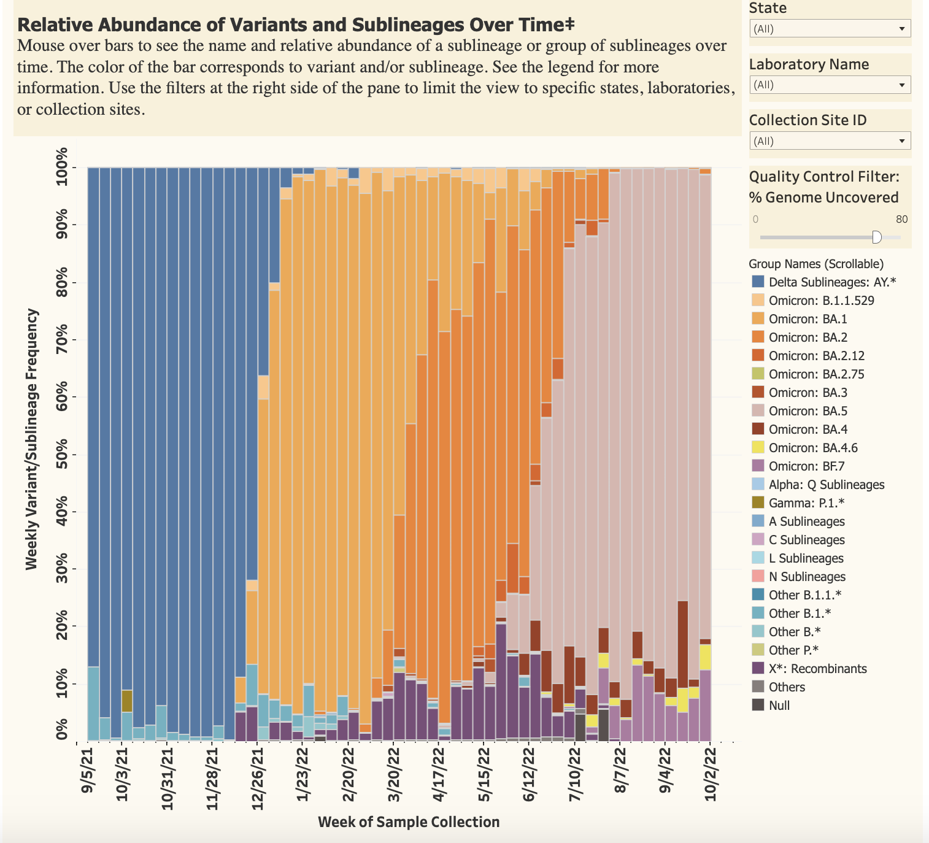
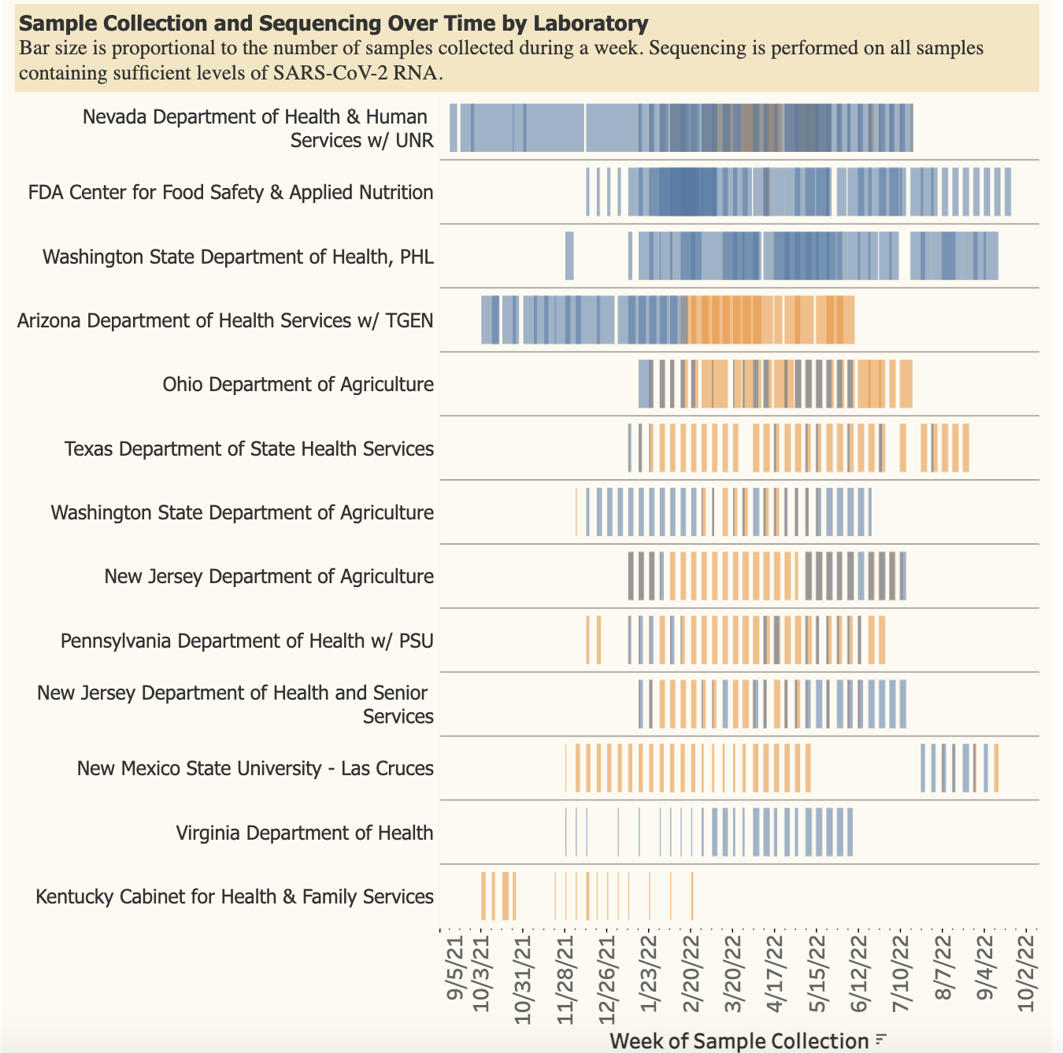
Public data release + dashboard:
2600 wastewater samples have been collected
12 labs + CFSAN have submitted sequence data

Slide 17
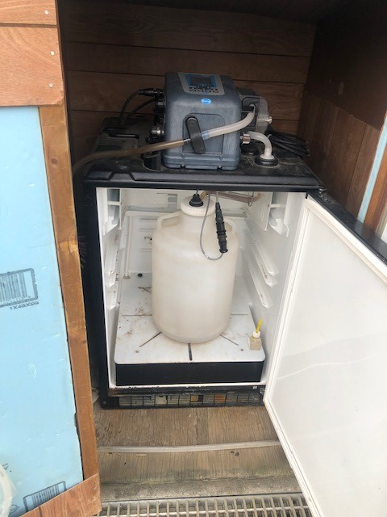
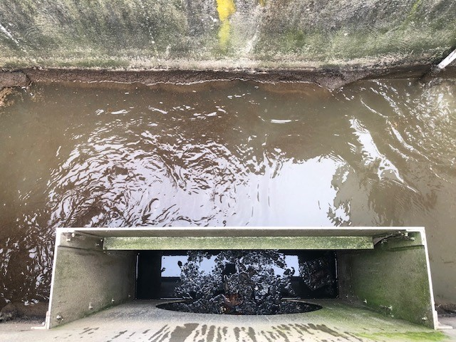
Three Wastewater Treatment Plants
Alabama, Mississippi,
  Raw ww grab collection w/ two biological replicates
Maryland
  Composite collections
  2 biological replicates, 3 technical replicates
Raw Wastewater
Composite

Slide 18
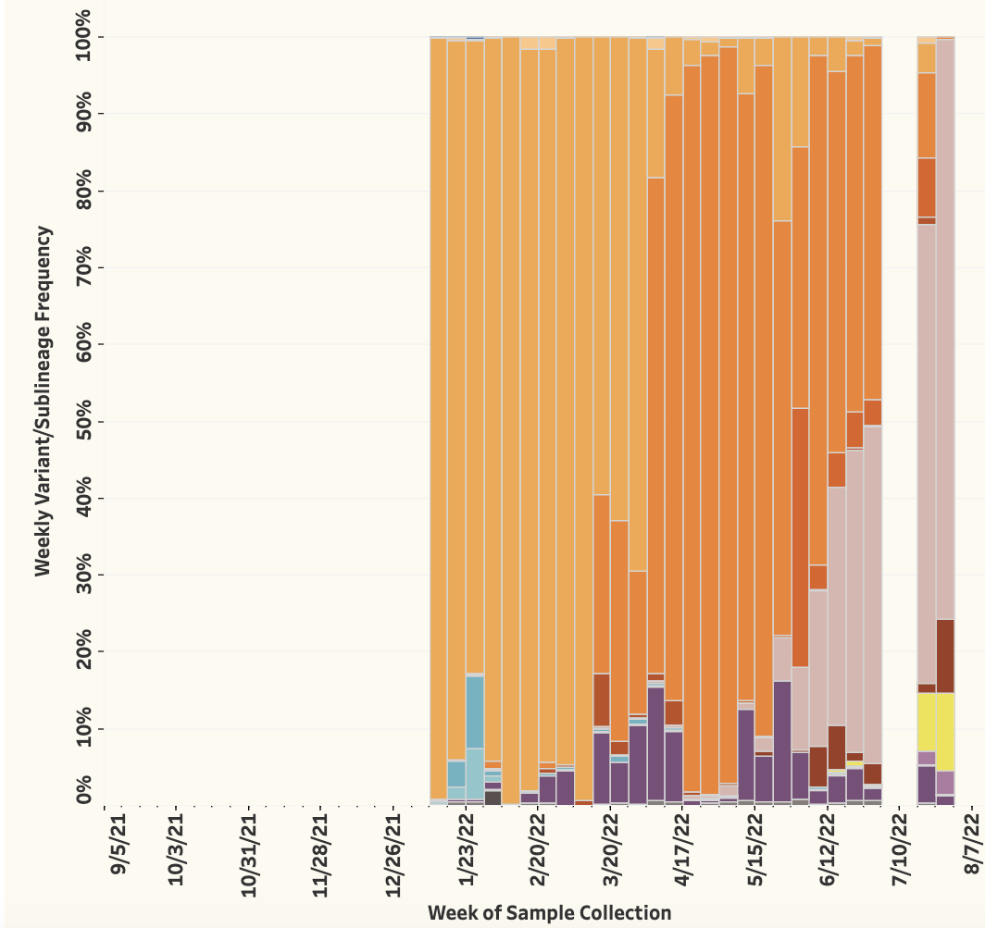
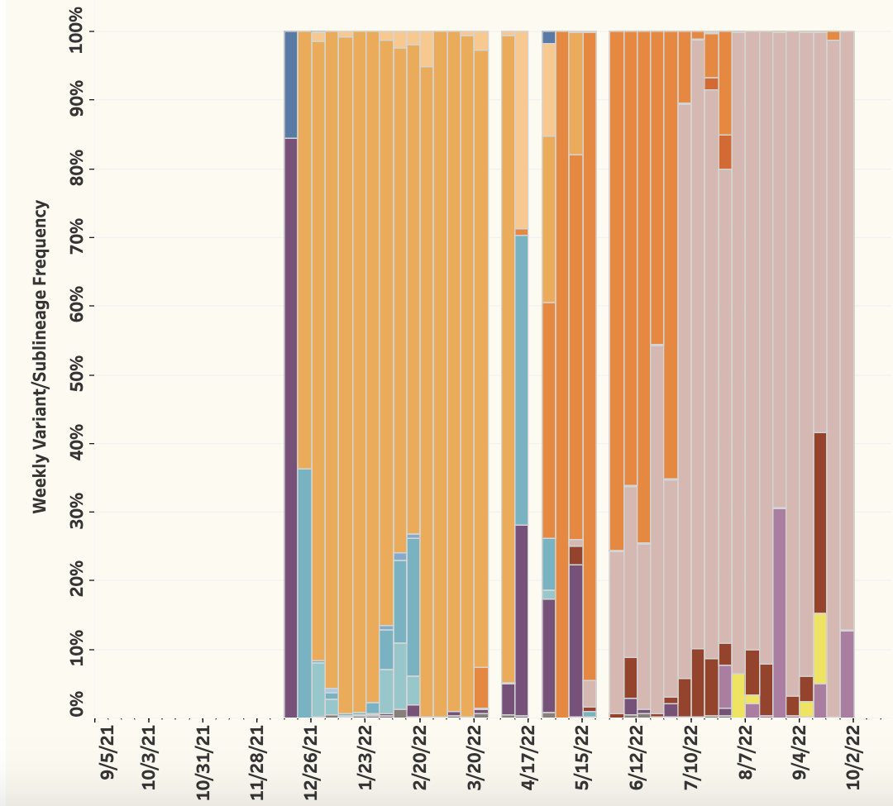
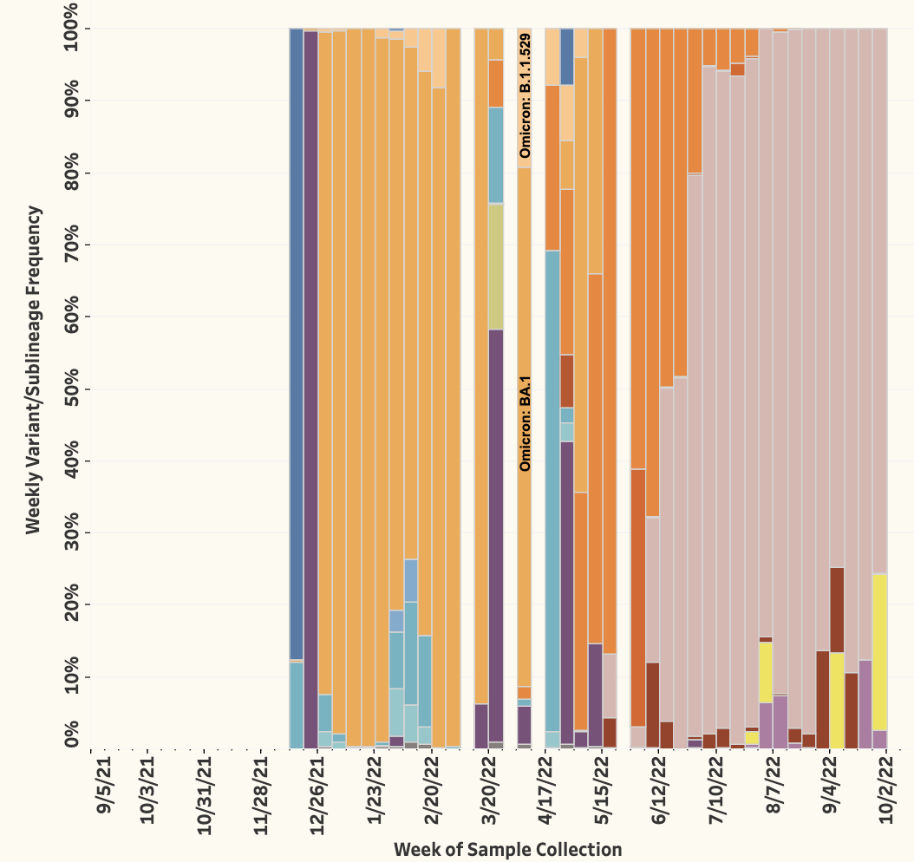
CFSAN’s three sites:
Maryland
Alabama
Mississippi

Slide 19
Summary:
Data generated from this project were/are public and timely!
  Raw data, variant analysis dashboard, protocols, analysis pipeline
Need to constantly adapt methods to keep up with evolving virus
What’s next:
Apply lessons-learned for GenomeTrakr enterics
  Extend SC2 methods for routine, culture-independent surveillance of enteric pathogens
  Expanded sequence-level metadata for WGS submissions
    Better sequence methods
    QC attributes

Slide 20
CFSAN ww team members:
WG1 OFS/DSST
  Jessica Jones, Ph.D.
  Jackie Woods, Ph.D.
  CAPT Kevin Calci
  Liz Leard
  Rachel Rodriguez
  Candace Barnes
WG2 OARSA/DMB
  Haifeng Chen, Ph.D.
  Mark Craven, Ph.D.
  Cameron Boerner
WG3 ORS/DM
  Maria Hoffmann, PhD
  Chris Grim, PhD
  Padmini Ramachandran
  Amanda Windsor, PhD
  Tamara Walsky
WG4 OAO
  James Pettengill, PhD
  Hugh Rand, PhD
  Tunc Kayikcioglu, PhD
  Tim Muruvanda
  Jasmine Amirzadegan, PhD
WG5 ORS/DM
  Ruth Timme, PhD
  Marc Allard, PhD
  Maria Balkey
  Tina Pfefer
  C. Hope Bias
  Sandra Tallent, PhD
  Eric Brown, PhD

Slide 21
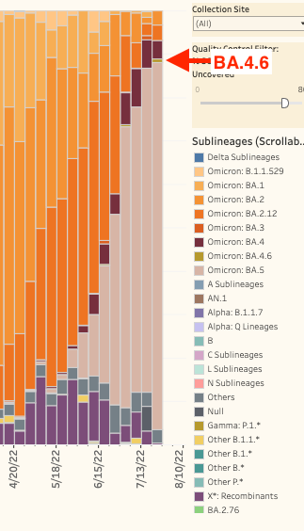
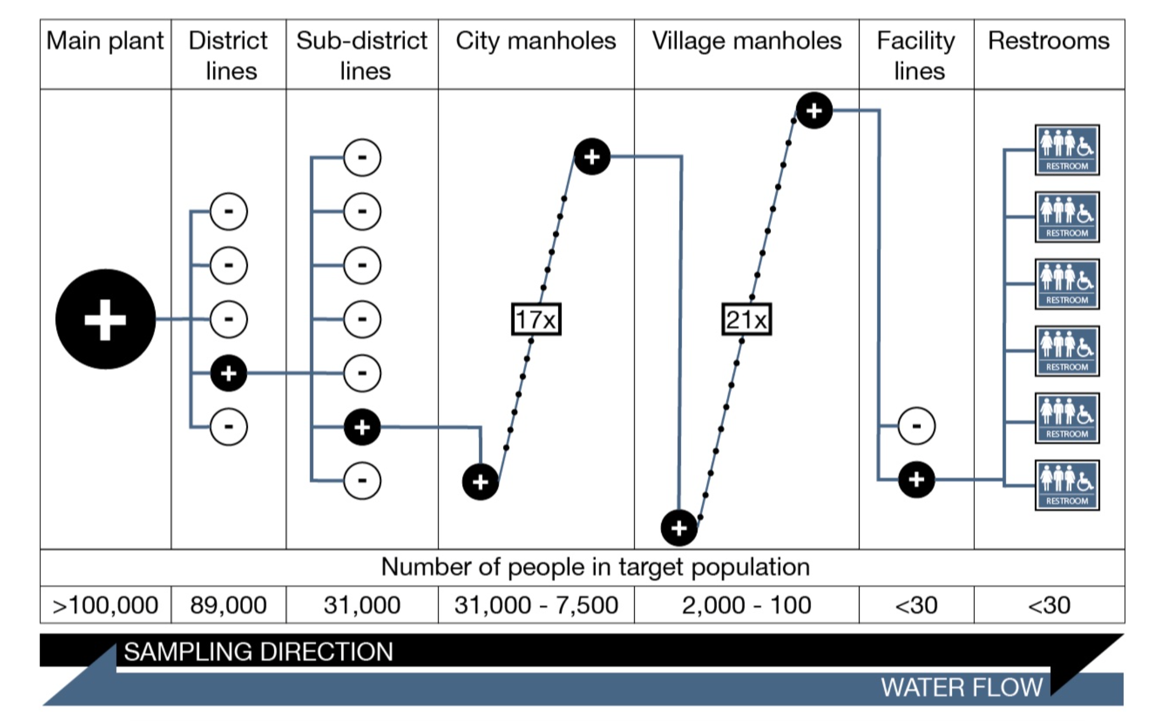
Outcome 1: Monitor mutations and emerging variants/sublineages
Potential use of data collected from this project:
Un-biased, population-level monitoring provides an independent source of genomic data for validation:
  Vaccines, treatments and diagnostics platforms must be re-validated as new variants/sublineages emerge, carrying new mutations, or combinations of mutations.
Monitor persistent mutations not seen in clinical samples
  potential reservoirs of Covid-19 in animal populations (e.g. white tailed deer)
  Tracking cryptic SARS-CoV-2 lineages
Marc Johnson, Figure

