Slide 1
OP Updates
presented to
GenomeTrakr Annual Meeting 2022
Written by: Christina Chrysogelos and Mei-Ying Li
Office of Partnerships
Investments & Agreements (DPIA)
Laboratory, Medical Products, & Innovation (LMPI) Branch
Presented by: Kirsten Hirneisen, PhD
October 19, 2022

Slide 2
OP Y3 LFFM Updates
Project period for Y3 is July 1, 2022 – June 30, 2023.
NOAs have all been issued (in eRA Commons):
  31 of 55 LFFM labs were awarded WGS funding
    Over $2.8M awarded for WGS track
    Over $24M awarded in total for all tracks

Slide 3
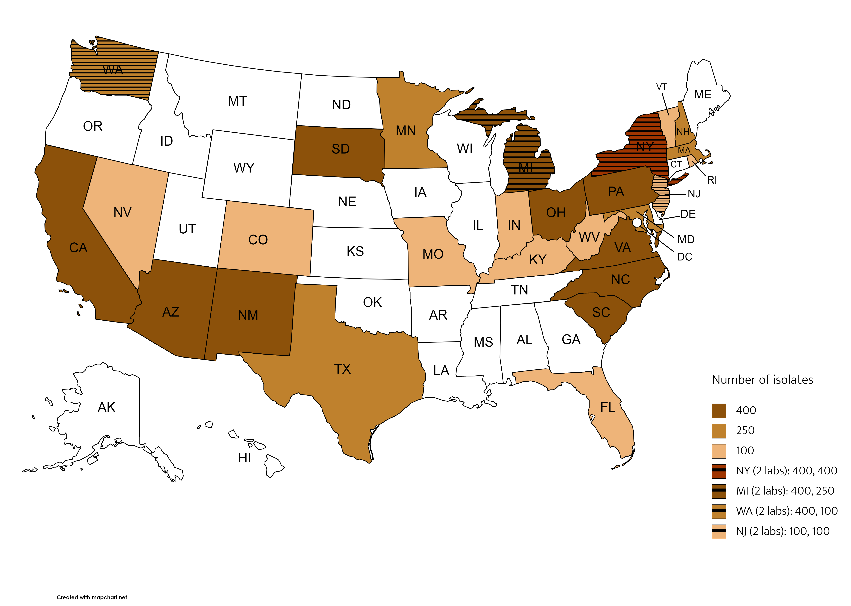
31 Labs in WGS Track

Slide 4
Upcoming Requirements
LFFM face-to-face meeting:
  Occurring Nov. 15–17, 2022 in St. Louis, MO
  Some labs have been exempted to coming to this meeting if their only track is WGS and they attended this GT meeting. If you have questions, contact your OP project manager.
Midyear report:
  Due January 15, 2023
  Reporting template is undergoing OMB review. We will update labs on template usage for reporting. PIs/PDs will receive communication from OP/OAGS for the midyear report.

Slide 5
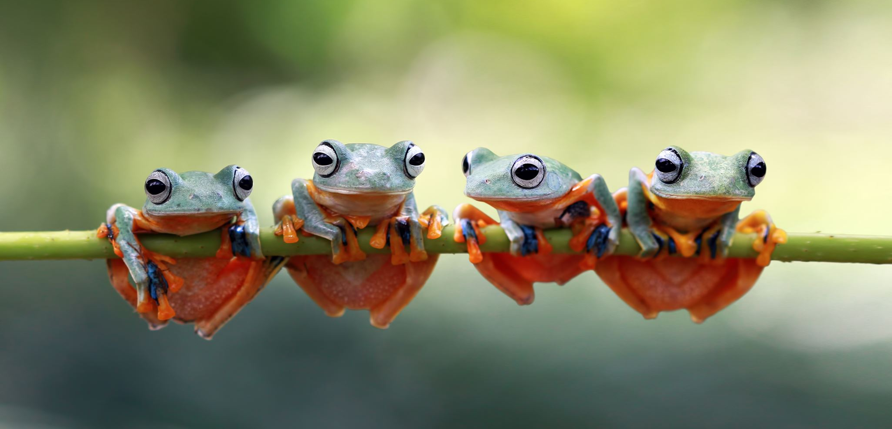
ORA Office of Partnerships
Division of Partnership Investments & Agreements (DPIA)
Erin Woodom-Coleman,
Chief
Erin.Woodom-Coleman@fda.hhs.gov
Ronald Winter,
Project Manager
Ronald.Winter@fda.hhs.gov
Janna Hutchinson,
Project Manager
Janna.Hutchinson@fda.hhs.gov
Christina Chrysogelos,
Project Manager
Christina.Chrysogelos@fda.hhs.gov
CAPT. Mei-Ying Li,
Project Manager
Meiying.Li@fda.hhs.gov
Laboratory, Medical Products, & Innovation (LMPI) Branch
LFFM Team:
OP welcomes your feedback: OP.Feedback@fda.hhs.gov
Notes:
The Laboratory, Medical Products, and Innovation Branch was created in 2019. Erin Woodom-Coleman is our branch chief and your contacts relevant to the LFFM. The newest member to join as a Project Manager is Captain Mei-Ying Li. Janna Hutchinson is transitioning from a Project Manager to Program Management. Ron Winter and I are the other two project managers. We’ve all come from various divisions in FDA.

