Slide 1
Partner Perspective:
How PulseNet participants are helping inform PulseNet 2.0 development and PulseNet 2.0 Development
Evonne N Woodson, PhD
Data Modernization Fellow, Laboratory
Heather Carleton, MPH, PhD
Chief, Enteric Diseases Laboratory Branch
Division of Foodborne, Waterborne, and Environmental Diseases
GenomeTrakr 2022

Slide 2
Objectives
IT System Requirements
Requirements gathering sessions
Major Takeaways
Barriers & Solutions

Slide 3
IT System Requirements
Technical
Functional
Hardware
Software
RAM/space
Internet speed
Tools
Functions
Capabilities
Notes:
2 camps
Technical: infrastructure
Functional: all about the user

Slide 4
What do end users want/need for PulseNet 2.0?
Notes:
Inform functional requirements for the new system

Slide 5

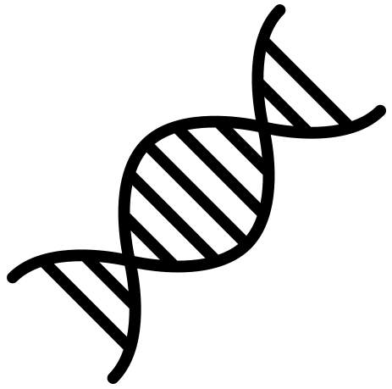


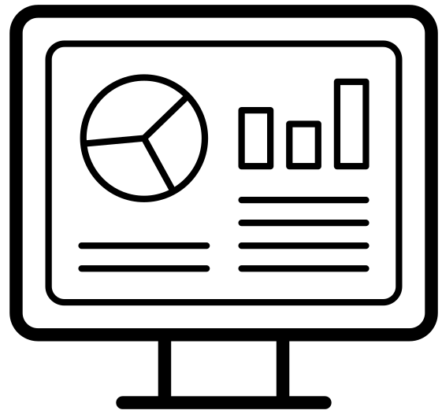
PN workflow has 4 major functions
Data generation
Data management
Data analysis
Data viz & Reporting
Notes:
We would specifically focus on the major functions/domains of the current PN system: data generation, data management, data analysis, data visualization and reporting and thus any question that we asked would center around these functions.

Slide 6

Notes:
To begin understanding the future needs of PulseNet end-users, we started with a survey (simple web-based survey, 27 questions of multiple question types (e.g. multiple choice, Likert scale, open ended, etc.)). Thus, in late 2021, we sent out a survey to 23 current and former steering committee representatives. The survey was web-based. And we got a response rate of 75% - which is pretty good for a first pass.
A wide, not deep approach as the first pass to gather partner feedback about the current PN system (1) and obtain a wishlist for PN 2.0 (2).

Slide 7
Survey Takeaways
Data generation
Data management
Data analysis
Data viz & Reporting
Other sequencers (esp. long read)
Satisfied
Satisfied
Automation
Export for ad-hoc analyses
Most dissatisfied (reporting)
Export for additional data viz and reporting
Notes:
Overall, I got the sense that people do like parts and pieces of BioNumerics, but they want a faster, more streamlined/efficient system that requires less hands on input and is a part of a larger one-stop shop where they’d perform genome analysis and be able to submit sequences for surveillance for all CDC-sponsored programs

Slide 8

Notes:
In addition, more recently at InFORM 2022, we utilized the polling feature in the virtual conference platform to administer a short 10-minute survey (all multiple choice). there was a median of 62 responses per question and this ranged anywhere from 59 – 127.

Slide 9
Virtual Polls Takeaways
Data generation
Data management
Data analysis
Data viz & Reporting
Other sequencers (compatibility with ONT, ClearLabs)
Satisfied
Less satisfied
Automation
Export for ad-hoc analyses
Most dissatisfied (reporting)
Export for additional data viz and reporting

Slide 10

Notes:
Finally, focus groups…an effort to drill down into some of those questions that needed more detail. As well as ask questions about foreseeable barriers and challenges to adopting the proposed cloud-based, open-source infrastructure for PN 2.0. These groups were held virtually via MS Teams. Groups were organized by APHL and CDC and facilitated by a third party. We had 3 affinity groups (8-12 people per group for a total of 29) – technical, leadership, mix (historical knowledge). Based on that, we tailored the questions to ensure they were most relevant for that group.

Slide 11
Focus Group Takeaways
Data management
Data analysis
Data viz & Reporting
Pros: Ease of import/export, LIMS-like
Cons: formatting quirks, split db (“the worse feature”)
Insights: Satisfaction varies by lab resources
Top concerns: Protection of PII
Wish list: Integration across platforms, sequencers, LIMS, etc.
Pros: Fast wgMLST matching (locally)
Cons: manual inputs, unused tools and outputs
Insights: Allele codes not useful for real-time cluster detection
Top concerns: Rigid and manual
Wish list: hqSNP, in-house pipelines, built-in workflows & automation (“Terra.bio”); metagenomics
Pros: Dendrograms and allele matrices
Cons: A lot “not working or missing”
Insights: Excel most helpful; matrices for epis
Top concerns: N/A
Wishlist: “Tableau, Terra.bio” capabilites; better tree software; QA/QC dashboard; real-time viz
Notes:
From the survey + polls…we had a good idea of where folks land with data generation, so for FG, we focused on data management, data analysis, and viz/reporting.
Although survey and polls would have us to believe that folks LOVED data management capabilities in BN, satisfaction was likely linked to current LIMS.
Focus groups: highlighted things we need to keep (there are key functions that labs depend on for surveillance), identify areas of improvement, and how to build future forward systems

Slide 12
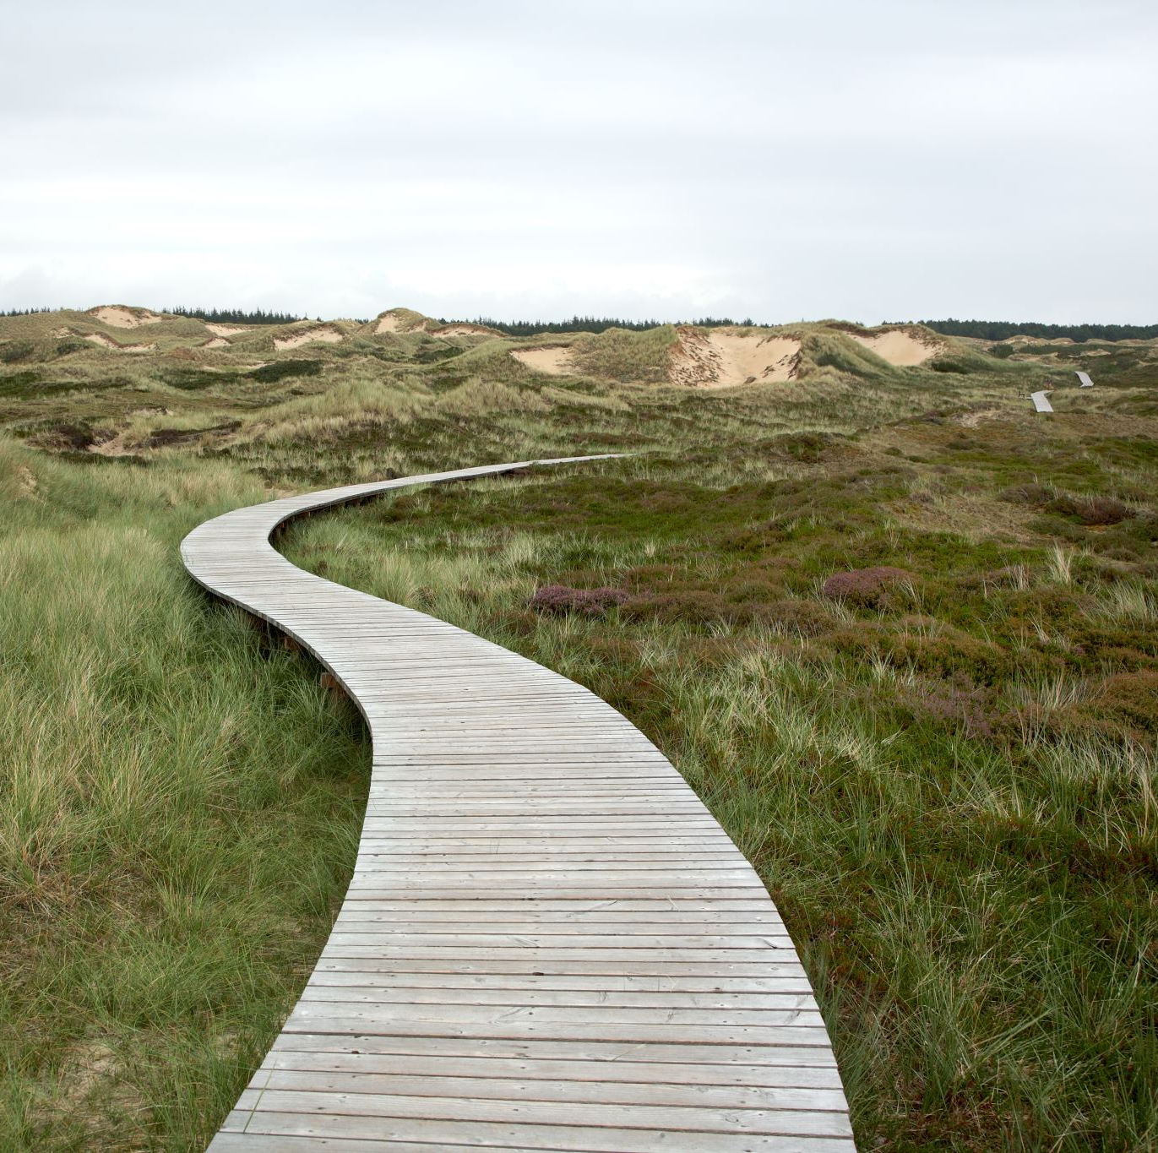
PulseNet 2.0:
The path forward
Information gathering for PulseNet 2.0 platform
  Analysis of alternatives
  Feasibility studies
    Feedback from federal partners
  Planning for the future – new visualization tools
Kick off for PulseNet 2.0 platform

Slide 13
Building PulseNet 2.0 – how do we get there
PulseNet Technical Requirements Gathering
Aug-Sept 2021
Analysis of Alternatives for PulseNet system
Sept-Nov 2021
Feasibility Studies
Dec-Jan 2021-2022
Contract awarded Sept 2022
Approval of proposed architecture from CDC IT governance board March 2022
Requirements gathering from other BioNumerics users at CDC (March-April 2022)
SEDRIC genomic data visualization project (March-August 2022)

Slide 14
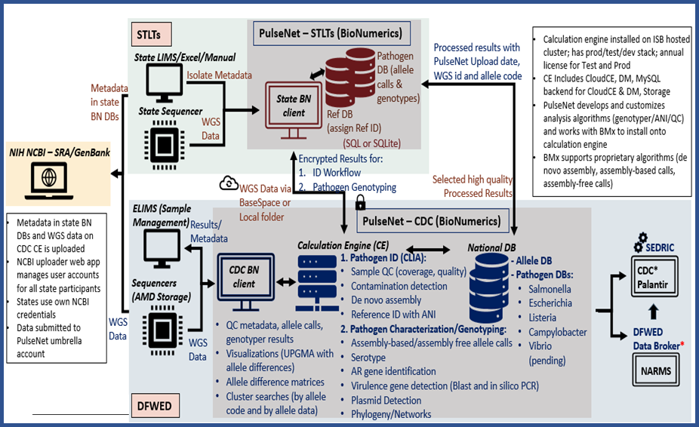
Technical Requirements for PulseNet 2.0
Set of requirements across multiple dimensions:
  Data transfer and sharing
  Calculation/bioinformatics engine
  security
  storage
  genomics analysis capabilities
  data visualization capabilities

Slide 15
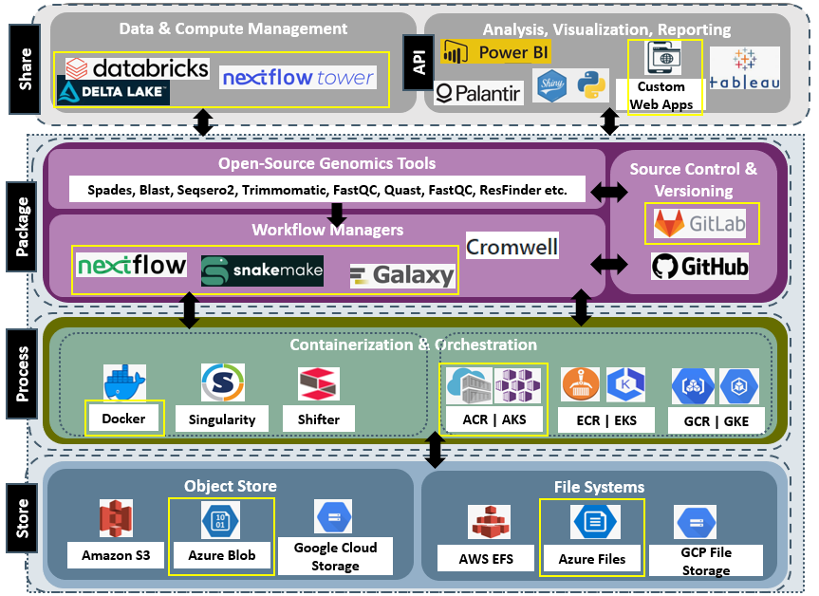
Feasibility Studies
Deployed the potential solutions in a CDC environment
Ran existing PulseNet workflows
Evaluated the solutions holistically (deployment, performance, etc.)

Slide 16
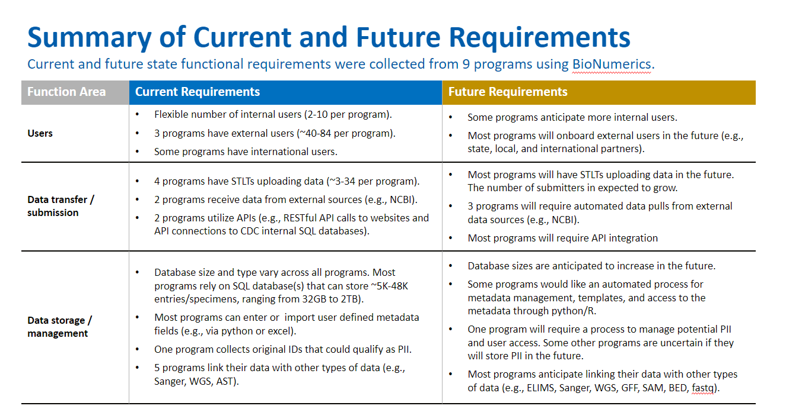
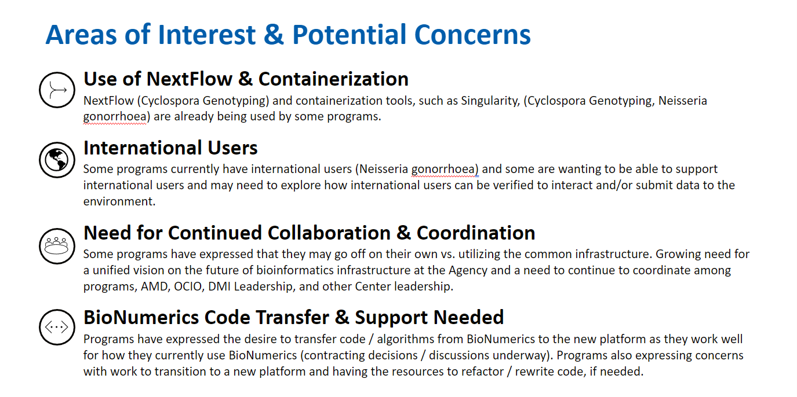
Collect use cases from other programs at CDC
PulseNet led a requirements gathering effort with other BioNumerics users in April 2022
A survey was developed and distributed to BioNumerics programs to gather input across both current state and future state requirements across multiple functional domains (e.g., users, data transfer / submission, data storage / management, calc engine, external user needs, bioinformatics analysis, data analysis and viz, and security)
Requirements have been incorporated into a broader AMD Platform Requirements Dashboard

Slide 17

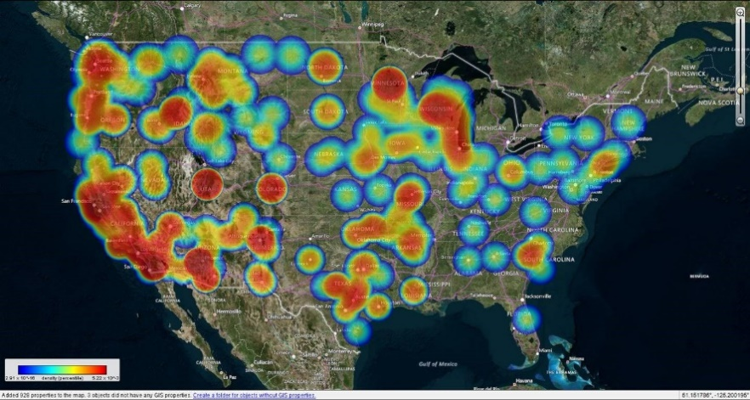



Data visualization in SEDRIC
Data visualization project:
-ways to interact with NCBI SNP trees in SEDRIC
-From allele calls to trees workflow in SEDRIC

Slide 18
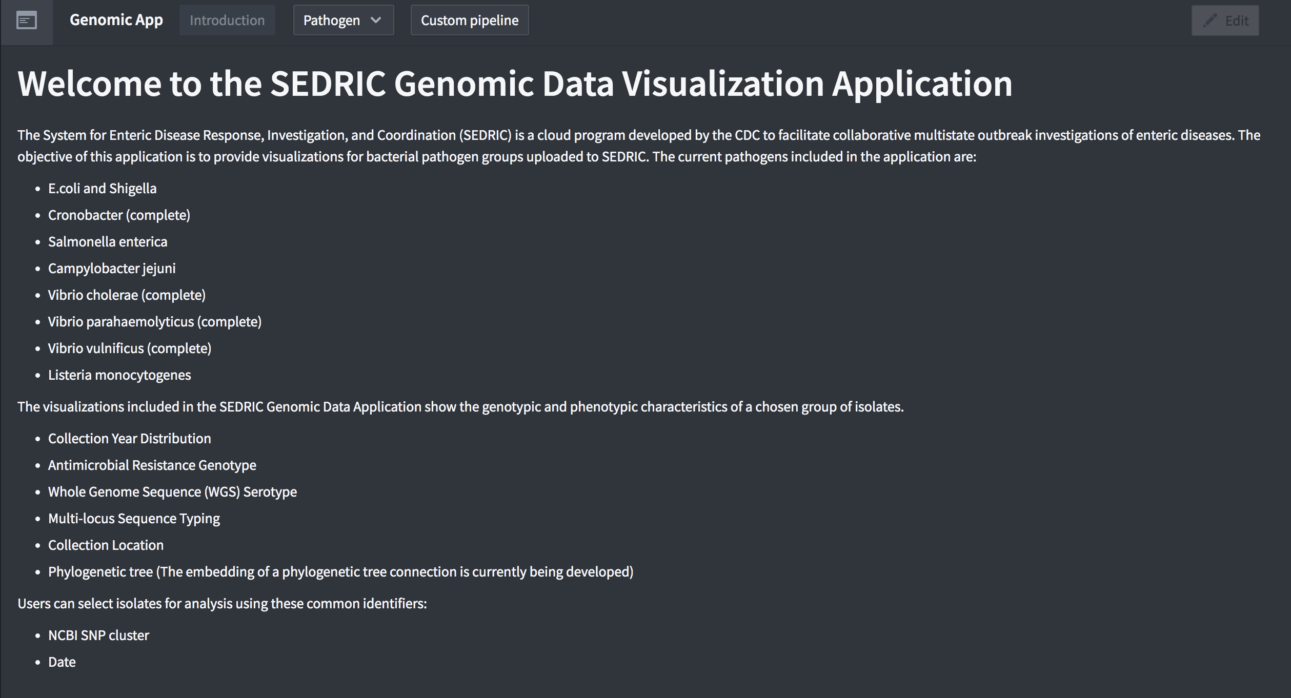
Workshop application overview

Slide 19
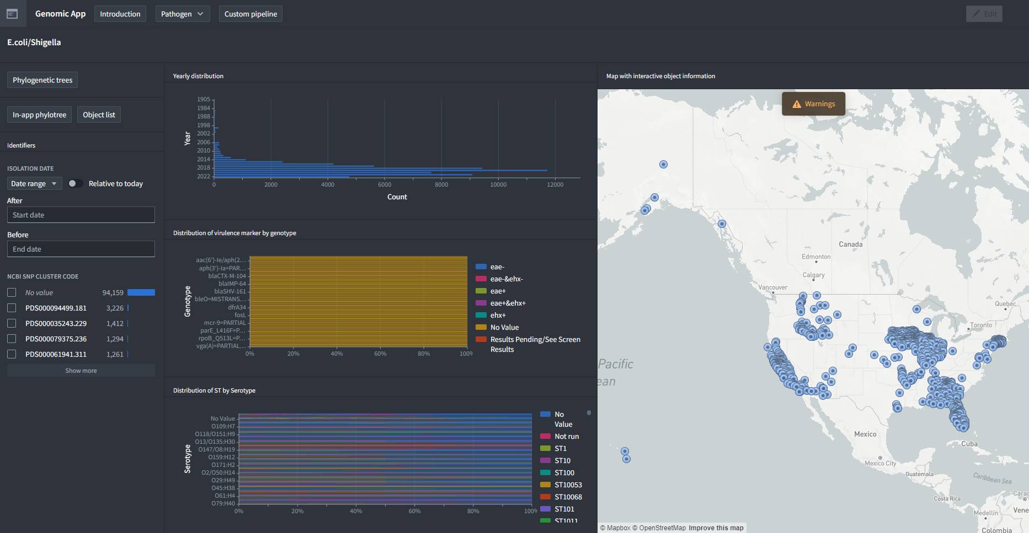
Workshop application overview
g. Button to results for custom pipeline dashboard
a. Buttons to home & different pathogens
c. Button to three tree visualizations
b. Button to in-app trees and trigger drawers
d. Date and SNP cluster filter
e. Genomic data connected to filters
f. Map with dots showing object description

Slide 20
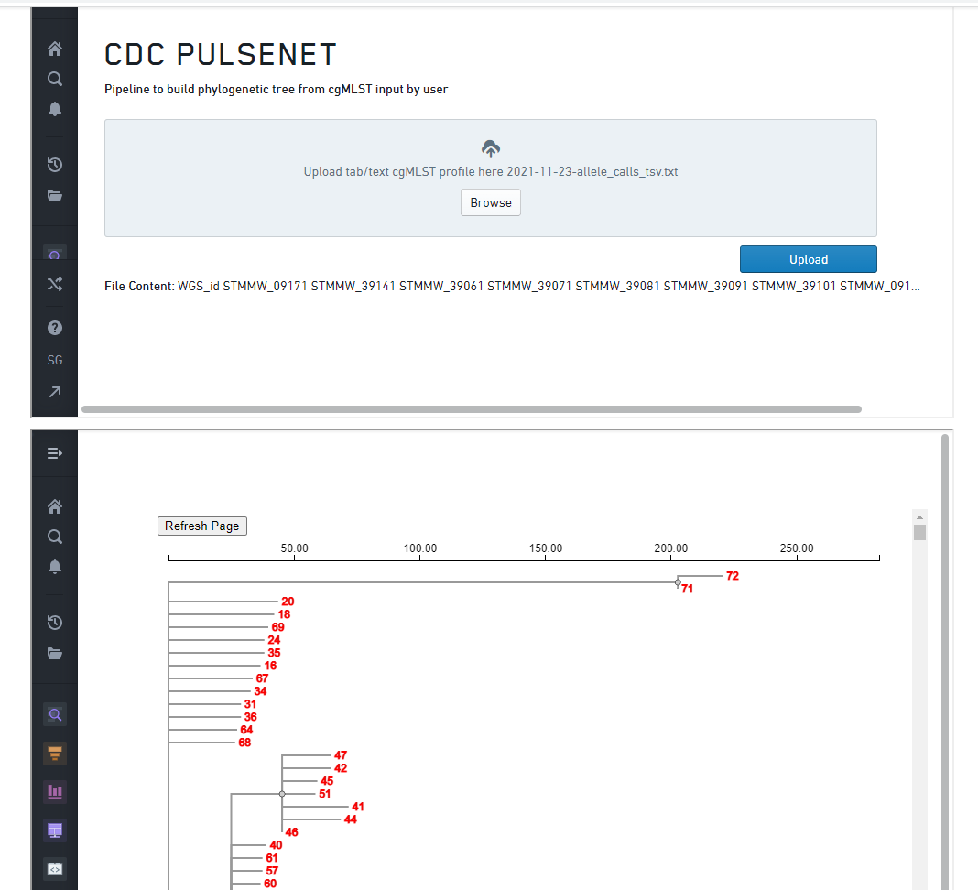
Custom pipeline for cgMLST profiles (current)
cgMLST to Phylotree pipeline
This pipeline will be triggered on user upload of cgMLST profile. ​
Generates Newick file than can be visualized in multiple tree visualization programs

Slide 21
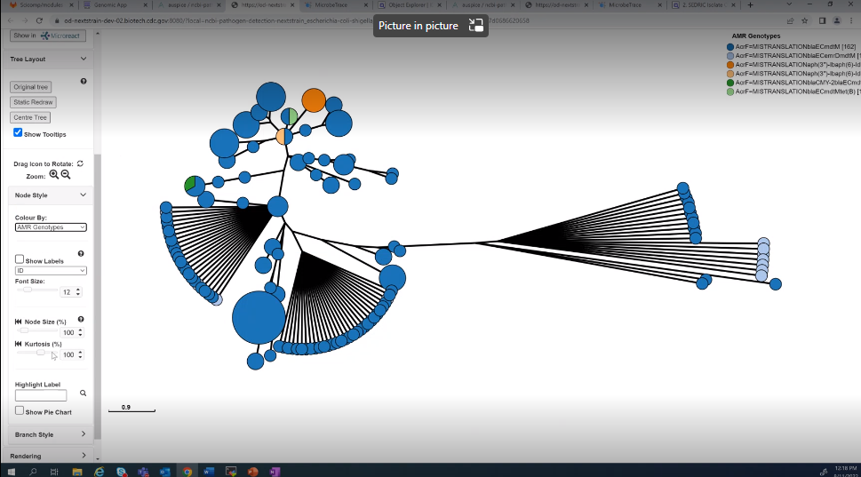
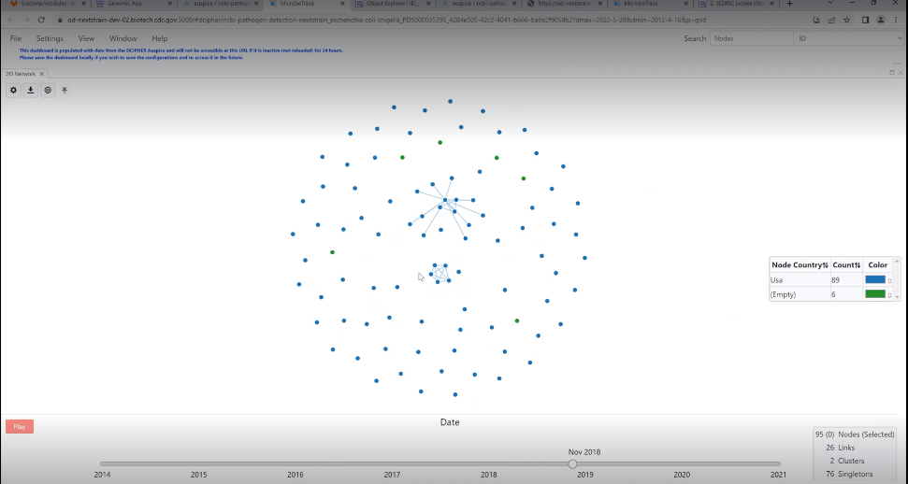
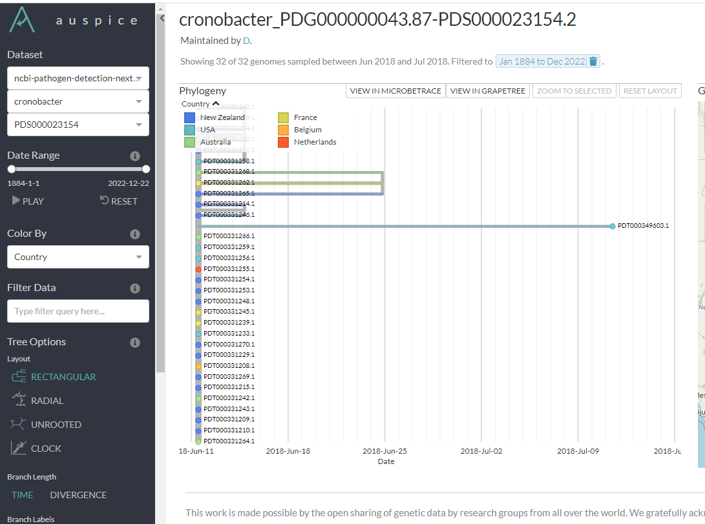
Tree Visualizations
GrapeTree
MicrobeTrace
NextStrain

Slide 22

PulseNet 2.0 Kick off

Slide 23
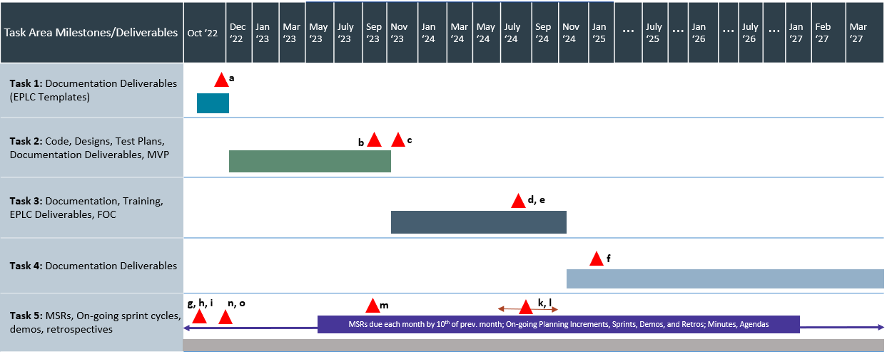
PulseNet 2.0: Milestone CHART
MVP
FOC
A- Solution Requirements, Systems Architecture Design document, Data Architecture Design document, Detailed System Design document, Detailed Application Design document, Database standards/Dictionary, System Security Plan, Requirements for Cloud infrastructure, Agile Implementation Plan, Roadmap to MVP B - Cloud Infrastructure design, source code for software integration, database design document, data migration plan, MVP test plans, ATO documentation. D - Release management plan, release documentation, data migration plan, user training and PulseNet EPLC artifacts F - O&M run book, Release Management documents per EPLC, User Support documentation. G, H, I – KickOff Items K, L – MSR, Meetings Minutes/Agendas M – Transition In/Out Plans N, O – IMS and PMP

Slide 24
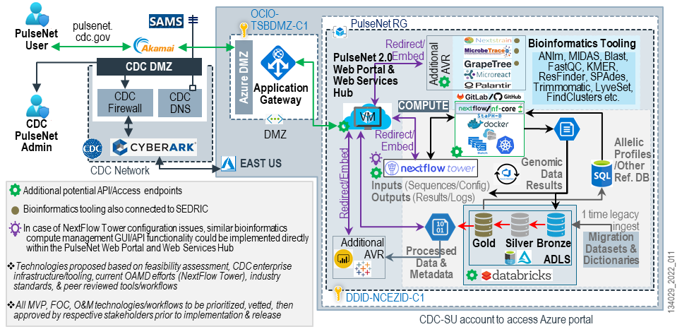
Proposed System architecture - DRAFT

Slide 25
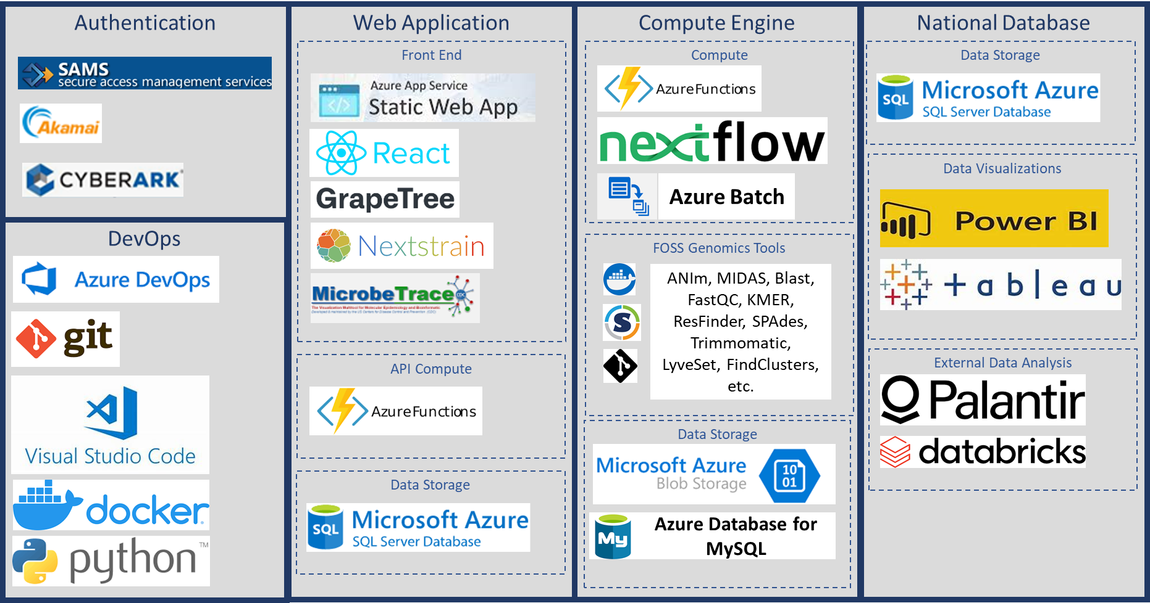
Proposed solution- main technologies

Slide 26
PulseNet 2.0: Integration in overall AMD platform
AMD genomics epidemiology platform
“Cloud-based, open-source,
modular”
TB
Flexibility
Automation
Future forward
PulseNet 2.0
CaliciNet
Bi-weekly planning calls between OAMD, EDLB, and DMI
Notes:
Flexibility: Organism (broad species ID), Tech/method, Architecture, Analyses (obviously still have standardized analysis pipelines, but also ability to perform adhoc analyses), Sample type, Throughput/capacity, Skill level (a need to cover the spectrum),
Automation
Future forward: also speaks to flexibility, but easily adaptable to future tech revolutions – also need for continual improvement/R&D (ability to digest, process, and analyze different data types or easy to swap/switch to be able to adapt)

Slide 27




Potential Barriers for PulseNet 2.0 onboarding
IT
System longevity
Cost
Workforce
Notes:
But labs have identified some potential obstacles in getting there…

Slide 28
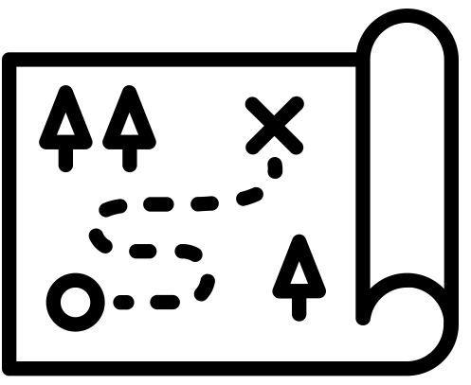


A way forward: Overcoming barriers
Roadmap
Clear vision
Timeline
Deadlines
Resources
White paper(s)
Guidance docs
Training
Phased implementation
Protocols
Many training options – e.g., in-person, virtual, webinars
Notes:
Here’s how they suggest we get there and some of the things we are currently doing to respond to those requests

Slide 29
Acknowledgements
PulseNet 2.0 Survey, virtual polls, FG respondents
Food Safety (APHL)
*Kristy Kubota
*Adom Yusef (APHL)
Enteric Diseases Laboratory Branch
*DMI Advisory committee
Surveillance, Information Management, Statistics Office (DFWED)

Slide 30

Thank you!

