Slide 1
CDC/PulseNet Updates
Kelley B. Hise
PulseNet Outbreak, Detection and Surveillance Unit
PROST/EDLB/DFWED
2022 GenomeTrakr Meeting
October 19, 2022

Slide 2
Overview
Wet Lab Updates, Questions
  CIDT Update
  HMAS Update
  Cartridge Capacity
Metadata Updates and Data Sharing
  Accuracy, detail
  NCBI Uploader updates
    Linking data to NCBI in BioNumerics
  PulseNet International: Workflows and Linkages

Slide 3
CIDT, HMAS, Cartridge Capacity

Slide 4
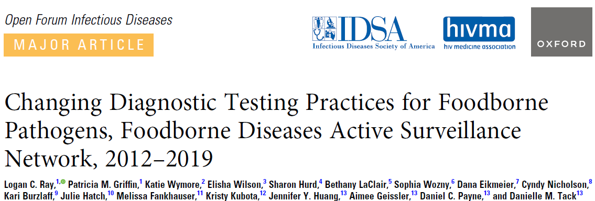
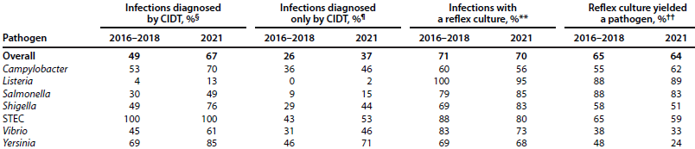
CIDT Landscape
Notes:
CIDTs continue to be a major issue affecting foodborne disease surveillance. A recent FoodNet study comparing CIDT usage from 2016-8 to 2021 illustrates clinical labs are using CIDTs to diagnose GI illnesses more frequently, putting a greater burden on PHLs to perform reflex culture. Point out that Salmonella CIDT usage has increased from 30% in 2016-18 to 49% in 2021.
In addition, new CIDT methods have been developed that are not compatible with culture, making it necessary for public health to create subtyping methods that do not require culture.

Slide 5
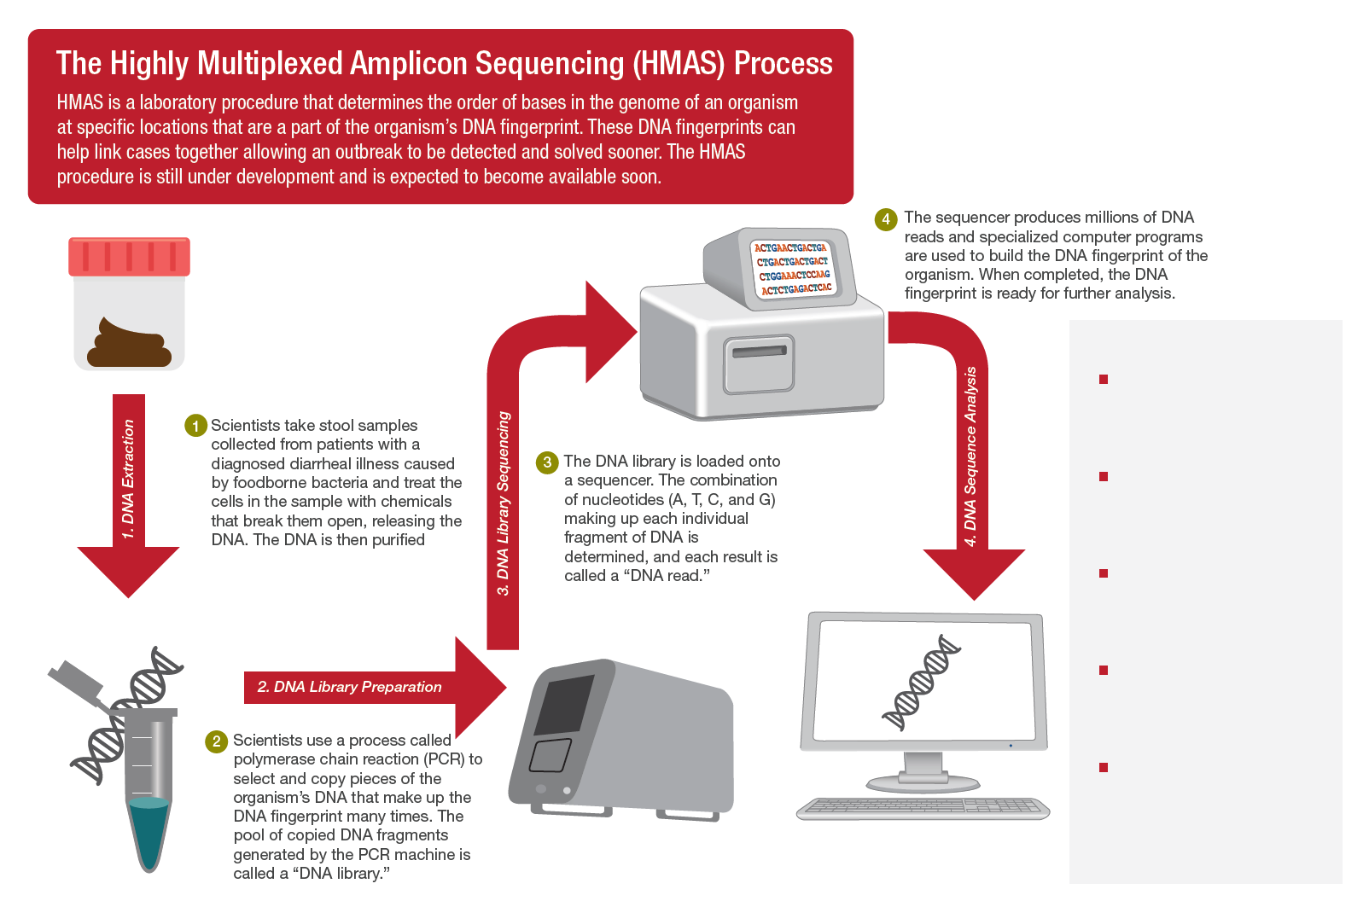
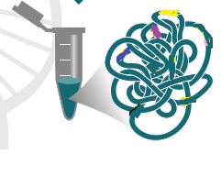

Skip the isolation step
Remove days from turnaround times by starting with stool DNA instead of isolate DNA
Sequence only what you need
Detect outbreaks by only sequencing a few thousand pieces of the pathogen genome rather than the whole genome
Process more samples together
HMAS has higher throughput than WGS
Notes:
HMAS, or Highly Multiplexed Amplicon Sequencing uses the DNA directly from stool. This skips the isolation step and can remove days from turnaround times by starting with stool DNA rather than isolate DNA.
The whole genome is not sequenced, instead only a few thousand pieces of the pathogen genome are sequenced.
Amplicon sequencing allows you to sequence targets ranging from a few to hundreds of genes in a single run. Libraries can be prepared in as little as 5–7.5 hours and sequenced in 17–32 hours.
Amplicon sequencing enables a wide range of research applications for the discovery, validation, or screening of genetic variants. (from Illumina website)
HMAS also has a higher throughput than WGS

Slide 6
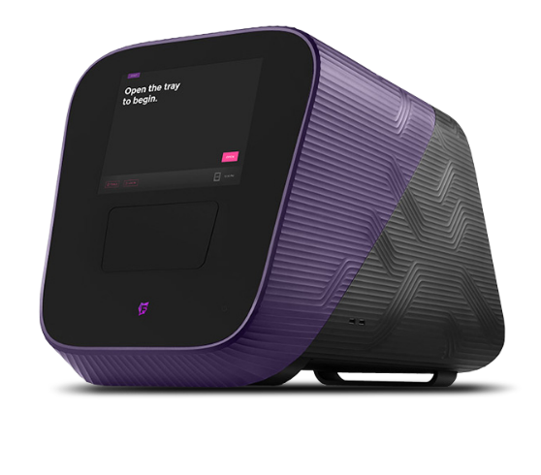
HMAS Pilot: Junos in CO and MN
MN and CO setting up pilot sites now
Testing workflow, protocols, compatibility with PHL needs
First assay: Salmonella subtyping
Future assays
  Other PulseNet pathogens
  Undiagnosed Diarrheal Illness panel
  Waterborne pathogen subtyping
Fluidigm Juno Microfluidic Thermocycler
Product names are informational only and do not imply endorsement.
Notes:
The HMAS pilot has started. Minnesota and Colorado are setting up their pilot sites. They will be testing workflow, protocols and the compatibility with PHL needs.
The first assay will be for Salmonella subtyping
Future assays will include other PN pathogens, an undiagnosed diarrheal illness panel and waterborne pathogen subtyping

Slide 7
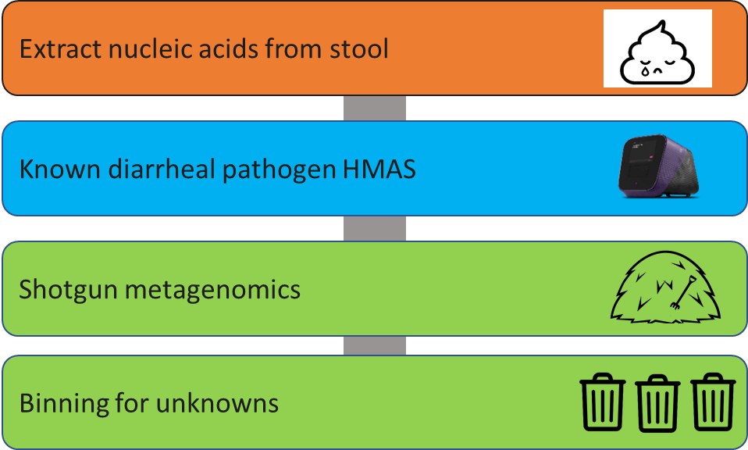
Outbreaks of Undiagnosed Diarrheal Illness (UNDIS)
>25%
of foodborne disease outbreaks without an identified etiology
Notes:
Short short version:
Metagenomic methods are also an opportunity to solve outbreaks of undiagnosed diarrheal illnesses (UNDIs), where no etiology is confirmed. These account for more than 25% of foodborne disease outbreaks. We are developing and deploying a two-tiered pipeline to discover novel foodborne pathogens found in common among samples from outbreaks of unknown etiology (OUE).
More details:
The two-tiered protocol consists of
(1) a targeted HMAS panel for known and suspected diarrheal pathogen identification to be run on suspected outbreak samples
(2) metagenomic shotgun sequencing with binning bioinformatics to identify novel pathogens for those outbreak samples that aren’t positive for a known pathogen
We have begun design and testing work on a known and suspected diarrheal pathogen HMAS panel, and we have previously shown proof-of-concept for using shotgun metagenomic sequencing of diarrheal stools for pathogen discovery. We will be piloting a deployment of these approaches in 2024.

Slide 8
Recommended Minimum Genome Loads for the Illumina Sequencers with the DNA Prep Libraries
Sequencing Kit/Target Coverage¹ | DNA Load (Mb) | Example Runs
MiSeq
v2 300/40x | 90 | 18 Salmonella/E.coli | 56 Campy
v2 500/40x | 100 | 20 Salmonella/E.coli | 62 Campy
v3 600/30x | 200 | 40 Salmonella | 30 Salmonella & 31 Campy
v3 600/40x | 175 | 35 E. coli | 25 E. coli & 31 Campy
Micro 300/30x | 35 | 7 Salmonella | 11 Listeria
Micro 300/40x | 30 | 6 E.coli | 4 E.coli & 6 Campy
Nano 500/40x | 13 | 2 Salmonella & 1 Listeria | 8 Campy
Nano 300/30x | 13 | 2 Salmonella & 1 Listeria | 8 Campy
Nano 300/40x | 10 | 2 E. coli | 6 Campy
iSeq
v2 300/40x | 25 | 5 E. coli | 2 E. coli & 5 Listeria
v2 300/30x | 35 | 7 Salmonella | 4 Salmonella & 9 Campy
NextSeq 500/550²
Mid output 300/40x | 400 | 80 Salmonella/E.coli | 65 Salmonella/E.coli & 46 Campy
¹Higher coverage requirements for E. coli/Shigella/Vibrio
²NextSeq 1000 P1 300 cycles will be tested soon, should be similar to 500/550 mid output
Notes:
Runs with 40x target coverage requirements contain E. coli/Shigella/Vibrio
Because most PN labs perform mixed organism runs it is important to communicate the DNA load/capacity in mega bases and NOT as number of isolates. It is two completely different things to run 40 Salmonellas than it is to run 40 Campys
PulseNet DOES NOT accept data below 300 cycles at any circumstances. Therefore, the lowest capacity flow cell/sequencing kit combination for NextSeq 1000/2000 acceptable to PN is P1 300 cycles. There are lower capacity kits but they produce sequencing lengths below 150 bp.

Slide 9
Minimum Loading Capacity – Things to Consider
Choose the sequencing cartridge that is appropriate for the number of mega bases included in the run. DO NOT UNDERLOAD!
  Best per sample cost
  Too much coverage (>100x) almost as detrimental to downstream analysis as too little coverage
Laboratories with efficient and consistent library preps may be able to exceed minimum loading capacities
  In PulseNet PT, points are deducted if a run is loaded ≥ 5 Mb below the minimum loading capacity. No penalty for exceeding the minimum capacity.
Notes:
What constitutes too much coverage depends somewhat on organism too. In Salmonella, coverage already between 100-200x causes problems with secondary species abundance (false contamination signals) whereas Campylobacter tolerates pretty well coverages of up to 200x but then above that starts having problems in allele detection because of amplified sequencing errors.
Our recommended minimum loading capacities have been designed to be pretty conservative, i.e., most laboratories should easily be able to reach the target coverage for all isolates in a run by following the DNA loading guidelines. Laboratories with consistently high library concentrations have been able to exceed our minimum recommendations by 10-20 MB.

Slide 10
v3 Chemistry – Run at 500 Cycles (Not 600)
Better quality, particularly for the R2 reads
  Poor quality bases will be trimmed off as part of the quality-based trimming before assembly
  For downstream analysis, the extra ~20-40 bp in read length does not make any difference
500c runs much faster, yet the loading capacity is the same
PulseNet and Illumina SOPs for DNA Prep not optimized for 600c runs
  Illumina SOP generates ~500 bp fragments – optimal for 300c chemistry
  PN SOP generates ~800-1000 bp fragments – optimal for 500c chemistry
Notes:
With the old Nextera XT kit the read length mattered so much in the downstream analysis that we did not even accept 300 cycle data for E. coli but with the DNA Prep kit there really are no good reasons to run 600 cycles to get 300 bp reads. Besides the read quality towards the end of the reads is so bad that you would never get even close to 300 bp anyways.

Slide 11
Metadata Updates and Data Sharing

Slide 12
Metadata Accuracy and Detail
Metadata accuracy has always been a priority in PulseNet
This will continue to be a priority with PN 2.0
Steps taken now
Ask PHLs to use standardized metadata requirements
CDC database managers spend a lot of time curating the data, especially with lots of turnover (Covid, staffing issues, etc.)
Training and retraining PHLs
Data in our national databases get copied to other systems such as SEDRIC
We also get many requests for metadata for special studies, etc., and would not be able to provide these data if metadata accuracy and sharing were not a priority
Notes:
I guess I’d just say that while there are no new specific strategies being pursued, metadata accuracy, detail and sharing has always been a priority and will remain so even with the transition to 2.0.

Slide 13
Improving Metadata: WGS Analysis Certification Submission Template Updates
Section III: NCBI Metadata Check
  Multiple choice selection of the correct submission settings templates (Human and Environmental)
  Multiple choice selection of what information should NOT be shared on NCBI (ex. Allele codes/Outbreak codes)
Section IV: Metadata Clean-up in BioNumerics (*NEW*)
  Review incomplete/incorrectly entered metadata that needs to be corrected. Please refer to Appendix PND05-2 and QT 20210727 on SharePoint for guidance (ex. SourceType must be filled in as Animal, Food, Human, Environmental, or Unknown).

Slide 14
Enhanced Metadata Project
Being pushed onto NCBI in collaboration with the Gen FS Metadata Workgroup
  Includes various things such as IFSAC categories
Working on standardizing the metadata on NCBI so that it can be searchable
Github describing the One Health Enterics Package is here: https://github.com/CFSAN-Biostatistics/One_Health_Enteric_Package
  A link on this page goes to NCBI, where users can download the package in Excel format
Notes:
It looks like there is a whole talk on metadata harmonization (Thurs)

Slide 15
NCBI Hot Fix and PulseNet WGS Tools and NCBI Uploader Plugin Updates
Issues with linking to SRA/SAMN accession from BioNumerics
This has been resolved and patches sent to FDA and USDA
Any PHL experiencing issues can download the patch from here: https://www.bionumerics.com/knowledge-base/hotfix-importing-sequence-read-sets-ncbi
By early 2023—updates distributed all at once
wgMLST Vibrio scheme (V. cholera, V. parahaemolyticus, V. vulnificus)
  Development/validation ongoing for genotyping tools
Updates to both the NCBI Uploader and PulseNet WGS Tools plugin
  Additional fields for GenomeTrakr added to template to upload via BioNumerics
Updates to the ANI references for RefID
Switch over to SeqSero2 and updated Genotyper tools
Switch over to KMA for STEC O and H typing
Validation has also started on a Cronobacter spp. wgMLST scheme
Notes:
Linking issue “hot fix” will also be part of plugin update

Slide 16
PulseNet International: Workflows and Linkages
PulseNet Canada: routine workflow for exchanging data/outbreak queries
Check NCBI’s Pathogen Detection Pipeline for international/non-PNUSA sequences that are closely related when coding new clusters
PulseNet International (PNI) Coordinator facilitates regular communication with international partners for outbreak investigations
  FWD-Europe’s EpiPulse platform
  Communications with PNI Regional Coordinators/other contacts looking for closely related sequences
PNI Steering Committee, co-chaired by the US and Canada, includes representatives from all 7 regions, and has quarterly calls and annual in person meetings
Implementation of WGS as the standardized surveillance method in the PNI network
  Virtual and in-person WGS trainings (Georgia, PulseNet Middle East)
  Technical assistance with regional bioinformatics workflow in PulseNet Latin America
  Terra.bio software feasibility study with Theiagen, APHL, and PulseNet Asia Pacific
  Upcoming training with PulseNet Asia Pacific planned for early 2023
APHL launched new PNI website: https://www.aphl.org/programs/food_safety/Pages/PulseNet-International.aspx
Notes:
PulseNet database team has a routine workflow for exchanging representative sequence data and outbreak queries with partners in PulseNet Canada (i.e. emailing fasta files, sharing NCBI accessions) and checks NCBI’s Pathogen Detection Pipeline for international/non-PNUSA sequences that are closely related when coding new clusters
PulseNet International (PNI) Coordinator facilitates regular communication with international partners for outbreak investigations
Accesses FWD-Europe’s EpiPulse platform weekly and checks PulseNet national databases for sequences closely related to outbreaks posted by other countries
Works with ORPB epidemiologists and PulseNet database team to post US investigations and representative sequences on EpiPulse
Reaches out to PNI Regional Coordinators and other contacts to request querying their databases for closely related sequences
PNI Steering Committee is co-chaired by the US and Canada, includes representatives from all 7 regions, and has quarterly calls and annual in person meetings to set priorities for the network, develop partnerships, and exchange information to improve global surveillance
Implementation of WGS as the standardized surveillance method in the PNI network includes addressing such key barriers as training (both wet lab and data analysis) and the development of an open-source, validated, all-in-one software platform
Virtual and in-person WGS trainings (Georgia, PulseNet Middle East)
Technical assistance with regional bioinformatics workflow in PulseNet Latin America
Terra.bio software feasibility study with Theiagen, APHL, and PulseNet Asia Pacific using the TheiaProk workflow
Upcoming training with PulseNet Asia Pacific planned for early 2023

Slide 17


Acknowledgements
Thank you
For Slides and Information
Dave Boxrud,
Andrew Huang, Jo Williams,
Eija Trees, Angela Poates, Rebecca Lindsey,
Lavin Joseph, Jennifer Adams,
Steven Stroika,
Morgan Schroeder
Telephone: 404-639-4558
E-mail: PulseNet@cdc.gov Web: www.cdc.gov/pulsenet
#PulseNet

