Slide 1
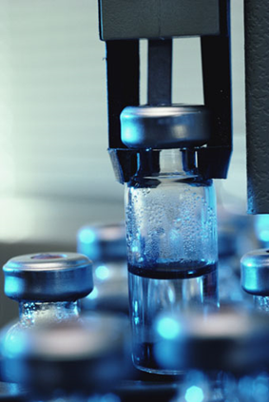
Equipment and Calibration
ISO/IEC 17025:2005

Slide 2
Terms & Acronyms
Calibration-the comparison of two measurement devices or systems (one of known uncertainty (your standard) and one of unknown uncertainty (your test equipment)
Quality Critical Equipment-Those items of equipment necessary to perform a test and which have a significant effect on the uncertainty of measurement of test results
SOP-Standard Operating Procedure
Traceability-the property of a measurement result whereby the result can be related to a reference through a documented unbroken chain of calibrations, each contributing to the measurement uncertainty
Traceability to the SI (International System of Units)-metrological traceability to a measurement unit of the International System of Units
  Test equipment calibration is not traceable to the US National Institute Standard of Technology (NIST), but to the SI through NIST

Slide 3
Some distinctions
Policies
“What we do”
Processes “How it happens”
Procedures and Job Aids
“How to do it”
Forms & Records “What happened”

Slide 4
Methods
The laboratory shall use appropriate methods that meet the needs of the customer and use procedures for all tests that should include these items:
Sampling
Handling
Transport
Storage
Sample Preparation
Estimation of measurement uncertainty
Statistical techniques for analysis

Slide 5
Equipment: Software (Control your Data!)
Calculations (manual and electronic) and data transfers shall be subject to appropriate checks in a systematic manner
When computers or automated equipment are used for the acquisition, processing, recording, reporting, storage, or retrieval of data the laboratory shall ensure that:
  Computer software developed by the user is documented in sufficient detail and is suitably validated as being adequate for use
    Excel spreadsheets with calculations only (documents)—Lock the formula cells
    Excel spreadsheets with results after calculations (records)—pdf the record so no changes can be made

Slide 6
Protect Your Data!
Establish and implement procedures to protect your data’s
  integrity
  confidentiality
  storage
  transmission
  processing
Commercial software (e.g., word processing, database, statistical programming) is considered sufficiently validated
Laboratory software and modifications to commercial software must be validated before use

Slide 7
Quality Critical Equipment
Those items of equipment necessary to perform a test and which have a significant effect on the uncertainty of measurement of test results
The laboratory shall furnish equipment needed to perform Quality Critical Testing for:
  Sampling
  Measurement
  Processing
  Analyzing test data
Equipment & Software:
  Capable of achieving accuracy
  Complies with specifications relevant to tests
  Calibrated & checked prior to placing into service
    Meets specification requirements
    Complies with standard specifications
    Records must be kept

Slide 8

Who should operate equipment?
Equipment shall be operated by authorized personnel using up-to-date manuals containing:
  Instructions for use and maintenance
  Procedures for safe handling, transport, storage, use and planned maintenance to ensure proper functioning and to prevent contamination or deterioration
Please see your Equipment SOPs for further guidance

Slide 9
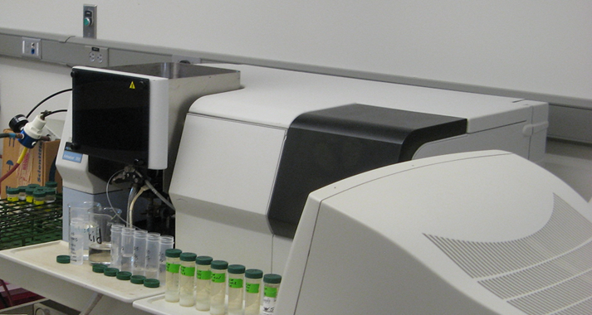
Equipment Needs & Documentation
All measurement and testing equipment have a significant effect on the validity and accuracy of test results
All equipment that requires calibration shall be labelled, coded, or otherwise identified to indicate the status of calibration, including the last date of calibration and date of expiration or due date of next calibration
Equipment sent out of the laboratory must be recalibrated or checked and shown to be satisfactory before placing into service

Slide 10
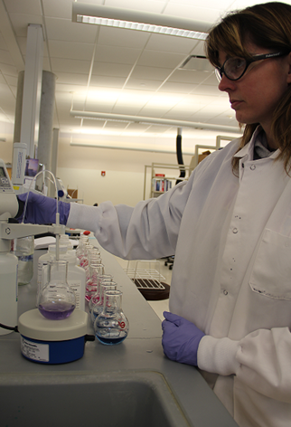
Equipment Needs & Documentation
Intermediate checks (verifications) shall be carried out according to a defined procedure
When calibrations show the need for correction factors, the laboratory should have procedures to show that copies (e.g., computer software) are correctly updated
Hardware and software must be safeguarded from tampering that would invalidate the test results
Calibration and verification takes place at specified intervals through the use of traceable standards or appropriate reference materials or reference cultures

Slide 11
Keep Records
Records shall be maintained for each item of equipment & software significant to the tests and contain
Identity
Manufacturers' name
Serial number
Current location
Dates, results, and copies of
Or other unique ID
Records
Checks that the equipment complies with specifications
Manufacturer’s instructions (manuals)
Reports
Calibrations
Adjustments
Acceptance criteria
Date of next calibration
Any damage, malfunction, modification or repair

Slide 12
Defective Equipment
Defective equipment
taken out of service
Equipment that has been mishandled, gives suspect results, is defective, or gives suspect results shall be taken out of service and clearly marked as being out of service until it has been repaired & recalibrated.
The laboratory shall determine if there has been an effect on previous test results and perform Corrective Action.

Slide 13
Measurement Traceability & Equipment
All measurement and testing equipment that has a significant effect on the validity and accuracy of test results should be calibrated or verified at specified intervals through the use of
  traceable standards
  or appropriate reference materials
  or reference cultures
Traceability applies to measuring and test equipment unless you can prove that it is a minor component of measuring uncertainty. In this case, you must provide the uncertainty of the instrument.
Stock Solution
Result
Secondary reference standard
Working solution
Reference to NIST or SI
Primary reference standard

Slide 14
What is Calibration?
A response to a known value which establishes a relationship between the known value and an indicator and established tolerance
I have the result, I know what it should be—what is my answer in relation to the known value and how much can I tolerate the difference?
Tolerance (+ or -)
Known Value
End result
Measured value with some Uncertainty
Measured again with some Uncertainty

Slide 15
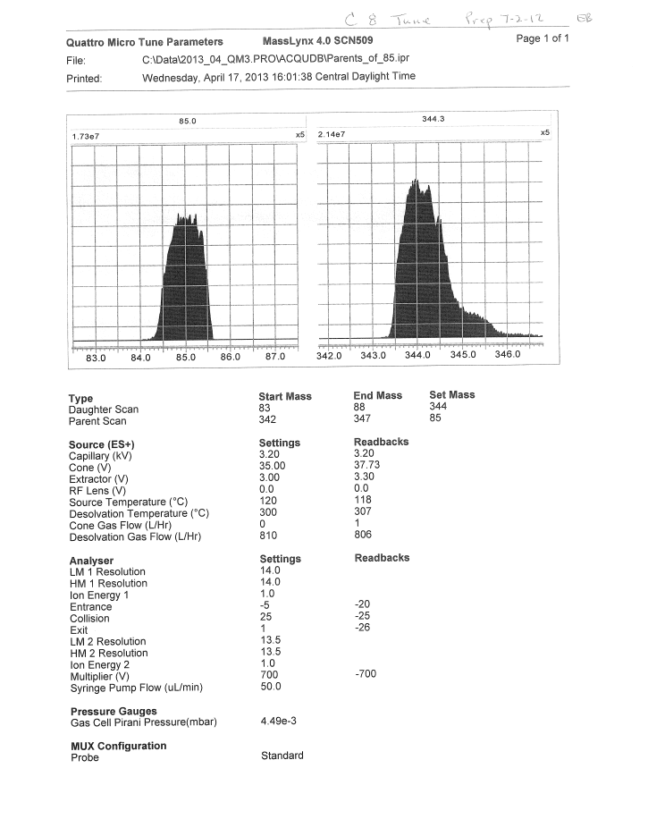
Intermediate Checks
There need to be defined procedures and schedules for carrying out checks needed to maintain confidence in the calibration status of:
  Reference standards
  Primary standards
  Working standards
  Transfer standards
  Reference materials

Slide 16
Things to Document for Analysis
Instrument
Unique ID
Conditions
Temperature
Column, other consumables
Quality Control (QC)
Method blank
Spikes
Continuing calibration
QC: Laboratory control samples (LCS);
how prepped, lot numbers, expiration, etc.

Slide 17
Support Equipment that require calibration
Not test equipment, but includes:
  Balances
  Ovens
  Refrigerators
  Freezers
  Incubators
  Water baths
  Temperature measuring devices
  Thermal/pressure sample preparation devices
  Volumetric dispensing devices (including automatic dilutor/dispensing devices)
If quantitative results are dependent on their accuracy

Slide 18
Support Equipment
Maintained in proper working order. Keep records of repair and maintenance
Remove from service until repaired or use established correction factors
Raw data records shall be retained to document equipment performance
On each day of use, equipment shall be checked and documented
Calibrated or verified annually using a recognized National Metrology Institute traceable reference
Date of Use Verification
Volumetric devices (except Class A glassware and Glass microliter syringes) shall be checked quarterly

Slide 19
Some questions to ask
Is there a system with a procedure on commissioning equipment, verifying its performance and calibration prior to use?
What is the plan/procedure for continuing calibration and verification of the equipment’s performance?
Are there records that show the continuing calibration and verification is ongoing on regularly scheduled intervals?
Are there labels that a user may see immediately to determine the status of the regular checks and calibrations?

Slide 20
References
ISO/IEC 17025:2005
https://www.iso.org/standard/39883.html

