Slide 1
Adaption of the CFSAN GenomeTrakr PT Pipeline for Internal Assessment of WGS Technical Proficiency
Kevin G. Libuit | Bioinformatics Lead Scientist
Division of Consolidated Laboratory Services

Slide 2
Genomics for Food Safety (Gen-FS) Whole-Genome Sequencing (WGS) Proficiency Testing (PT)
Enables laboratories to contextualize the quality of their WGS data relative to other public health laboratories
Sequencing of select PT isolates
Single analytical pipeline
Common report template with defined QC metrics
  Distribution of metrics across multiple laboratories

Slide 3
Proficiency Assessments of WGS Scientists at DCLS
DCLS generates WGS data to support surveillance investigations involving infectious disease pathogens
Critical to these initiatives is the assurance that DCLS scientists are capable of generating high-quality data
Scientists must demonstrate technical proficiency in WGS protocols prior to generating data that inform public health action

Slide 4

Proficiency Assessments of WGS Scientists at DCLS
DCLS relied on FDA to help determine technical
proficiency of WGS scientists
Gen-FS PT isolates were sequenced
by DCLS WGS scientists
Data shared with FDA and Gen-FS
PT analysis was performed
Report assessed at DCLS to determine competency

Slide 5

Proficiency Assessments of WGS Scientists at DCLS
FDA PT assessments were critical for DCLS, but
not a viable long-term solution
From 2013 – 2018, sequencing at DCLS grew significantly
2013 | 2018
12 Isolates Sequenced | >2,200 Isolates Sequenced
Single MiSeq Instruments | Three MiSeq Instruments
Single WGS Scientist | Four WGS Scientists

Slide 6
Adapting the CFSAN GenomeTrakr PT Pipeline for an Internal Assessment Workflow at DCLS
Collaborative Project with CFSAN (Joseph Baugher):
Based our approach on National 2018 Gen-FS WGS PT Study
  Used 2018 PT organisms
  Select metrics from 2018 study
      Upper quartile range as competency thresholds
  Mimicked 2018 bioinformatics workflow
  Customized report builder

Slide 7
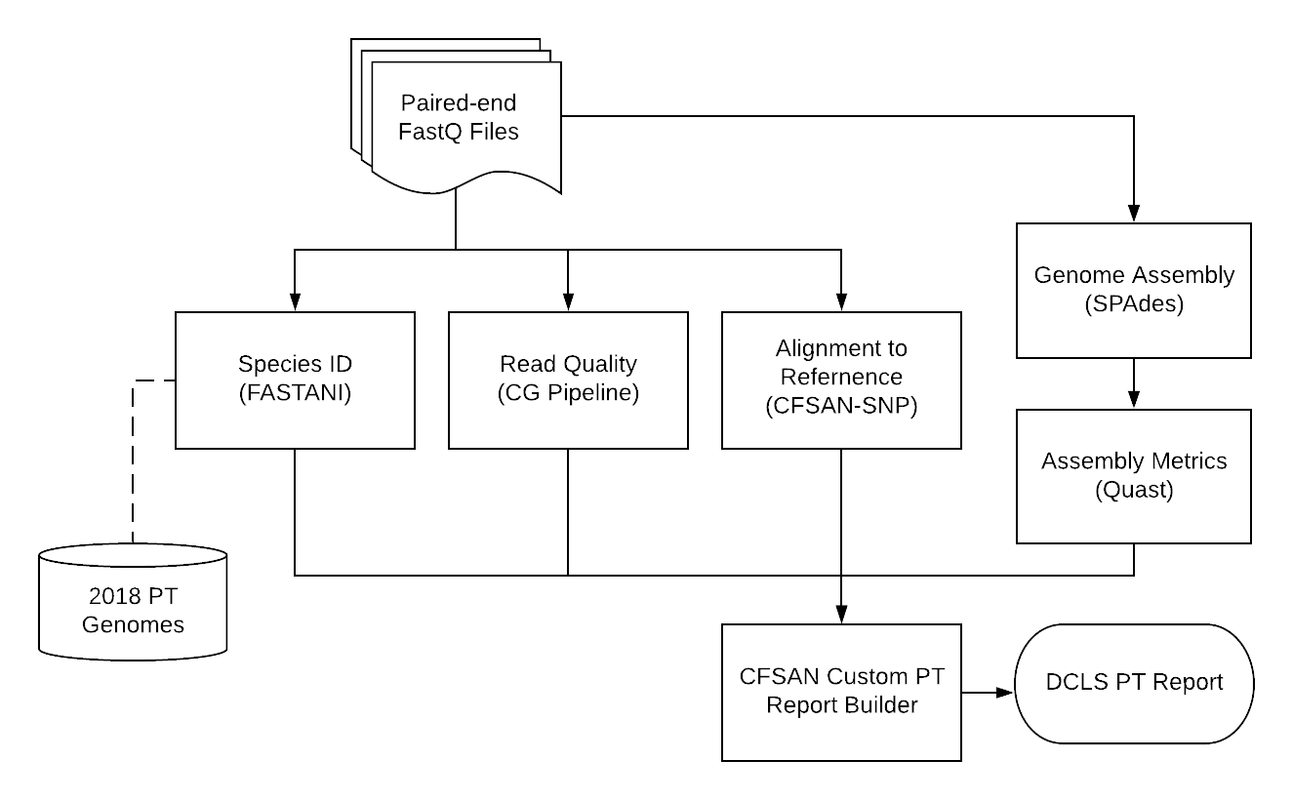
CutShaw: Bioinformatics Pipeline for Internal WGS PT at DCLS
*
*https://github.com/CFSAN-Biostatistics/wgs_competency

Slide 8
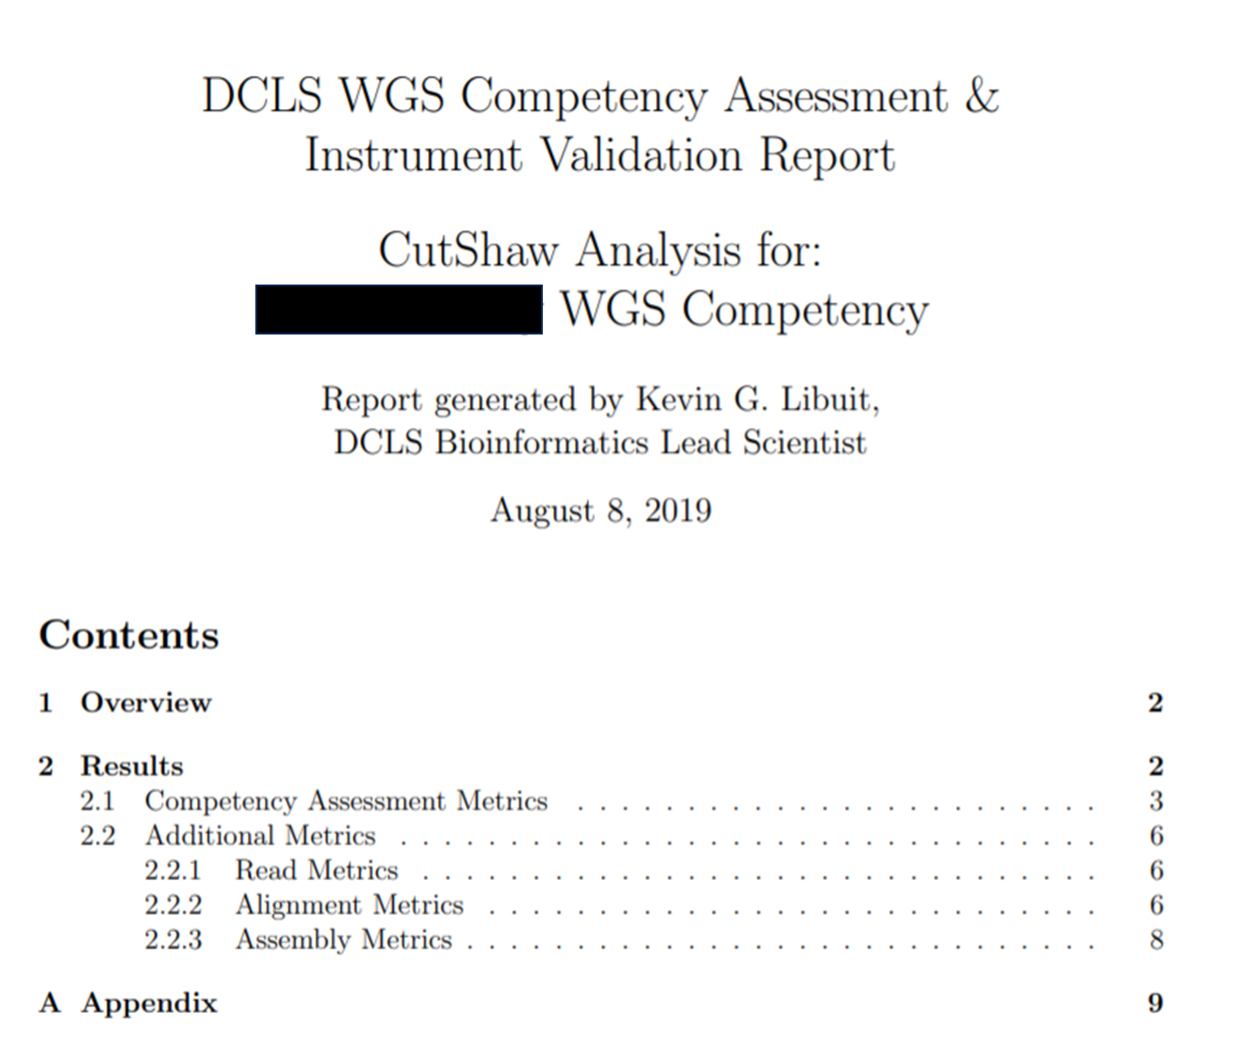
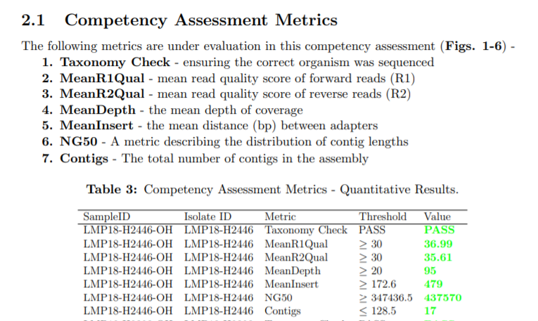

Slide 9
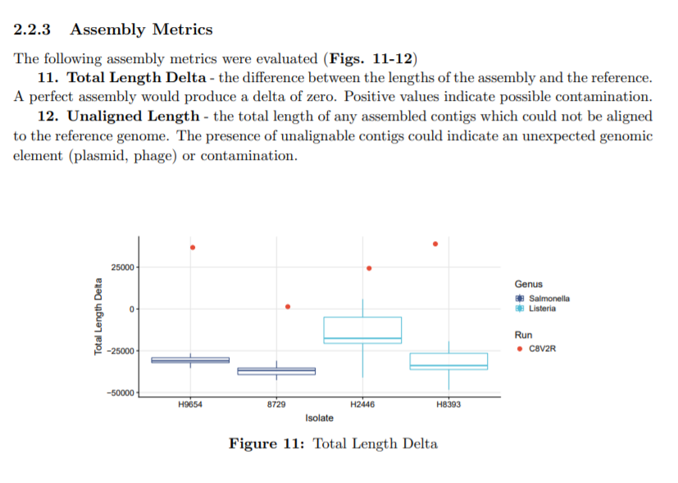

Slide 10
Validating the CutShaw Pipeline
Four bacterial strains --one Listeria and three Salmonella--from the 2018 Gen-FS Proficiency Testing exercise were sequenced and analyzed using the CutShaw pipeline
Sequence data was shared and simultaneously analyzed by the CFSAN laboratory
Results of the CutShaw and CFSAN analysis showed agreement in every quality metric assessed including taxonomic identification, mean Q-scores, and NG50

Slide 11
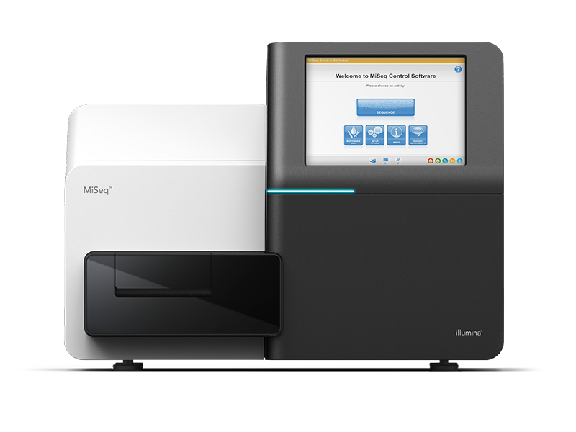
CutShaw PTs in 2019:
Three WGS scientists' competency assessments
One MiSeq instrument validation

Slide 12
Conclusion
Collaboration with FDA’s CFSAN team allowed DCLS to develop an internal WGS proficiency pipeline: CutShaw
Has been used to determine technical proficiency of scientists generating WGS data for outbreak investigations
  Instrument validation
  Lot/kit quality control
Strengthens quality management of WGS testing for improved reliability of results shared with national partners and published in data repositories

Slide 13
Acknowledgements
Genomics for Food Safety (Gen-FS) Team
Joseph Baugher (FDA CFSAN)
DCLS WGS Team
State Public Health Bioinformatics (StaPH-B) Workgroup
https://github.com/StaPH-B/docker-builds

Slide 14

Kevin G. Libuit, M.S. |Bioinformatics Lead Scientist
DCLS | Email: kevin.libuit@dgs.virginia.gov
Twitter: @KevinLibuit | GitHub: https://github.com/kevinlibuit

Slide 15
\

