Slide 1

2018 E. coli O157:H7/Romaine from Yuma Growing Region
LT Mark Otto, MSPH, REHS, CP-FS
09/17/2019

Slide 2
Overview
Spring 2018 E. coli O157:H7 Outbreak linked to Romaine lettuce from Yuma Growing Region
Challenges
Next Steps

Slide 3
SPRING 2018 E. COLI O157:H7 OUTBREAK LINKED TO ROMAINE LETTUCE FROM YUMA GROWING REGION

Slide 4
Background
4/4/18 – FDA learned about a cluster of E. coli O157:H7 infections in two states
4/5/18 – A new cluster was reported in multiple states
4/13/18 – Interviews with ill people and traceback of chopped romaine allowed health partners to identify chopped romaine from the Yuma growing region as the likely source
4/16/18 – Final day of romaine harvest in Yuma
4/19/18 – Alaska announced 8 people with E. coli O157:H7 at a correctional facility ate whole-head romaine from the Yuma growing region and on 4/27/18, FDA announced it had been traced back to a single farm
https://www.fda.gov/food/recallsoutbreaksemergencies/outbreaks/ucm604254.htm#Problem

Slide 5
Background
5/2/18 – FDA received confirmation from the Arizona Leafy Greens Marketing Agreement that romaine lettuce was no longer being produced and distributed from the Yuma growing region; due to the 21-day shelf life, we could not be certain romaine lettuce from Yuma was no longer in the supply chain
5/31/18 – FDA released a blog with updated information regarding ongoing traceback investigation
6/4-8/18 – FDA, CDC, and state partners conducted an Environmental Assessment (EA) in the Yuma growing region
6/28/18 - CDC announced that the outbreak was over. Additionally, FDA and CDC announced preliminary sample results from the EA
https://www.fda.gov/food/recallsoutbreaksemergencies/outbreaks/ucm604254.htm#Problem

Slide 6
Epidemiology
As of June 27, 2018, 210 people were infected with the outbreak strain of E. coli O157:H7 reported from 36 states.
  5 Deaths
  96 Hospitalizations
  Age Range 1-88, median 28
  67% Female
  27 people developed hemolytic uremic syndrome (HUS)
https://www.cdc.gov/ecoli/2018/o157h7-04-18/index.html
6

Slide 7
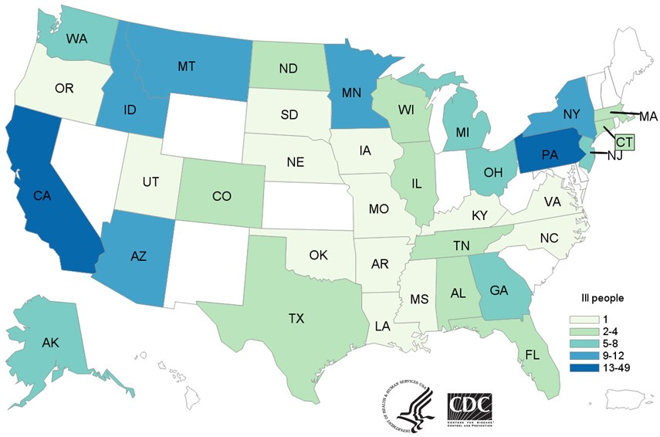
https://www.cdc.gov/ecoli/2018/o157h7-04-18/map.html
7

Slide 8
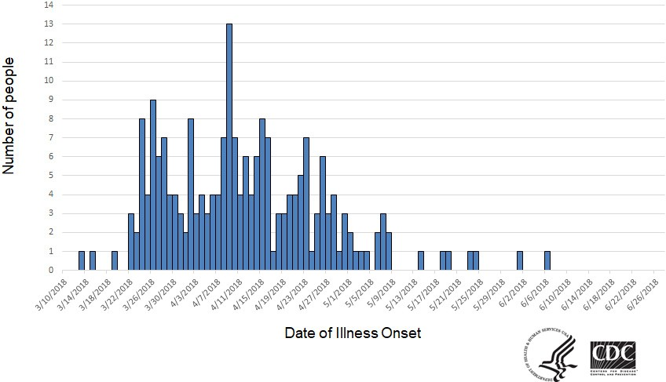
People infected with the outbreak strain of E. coli
O157:H7, by date of illness onset*
*n=210 for whom information was reported as of June 27, 2018. Some illness onset dates have been estimated from other reported information.
https://www.cdc.gov/ecoli/2018/o157h7-04-18/epi.html
8

Slide 9
Traceback: E. coli O157:H7/Apr 2018
Records were available, collected, and evaluated across multiple supply chains
9 legs were traced with no convergence on a single farm or grower
Nearly three dozen farms in the Yuma growing region supplied romaine lettuce during the timeframe of interest to points of service in the traceback
What does this mean?
  The traceback worked – we identified what farms supplied romaine lettuce
  Did a larger contamination event lead to multiple supply chains being affected??

Slide 10
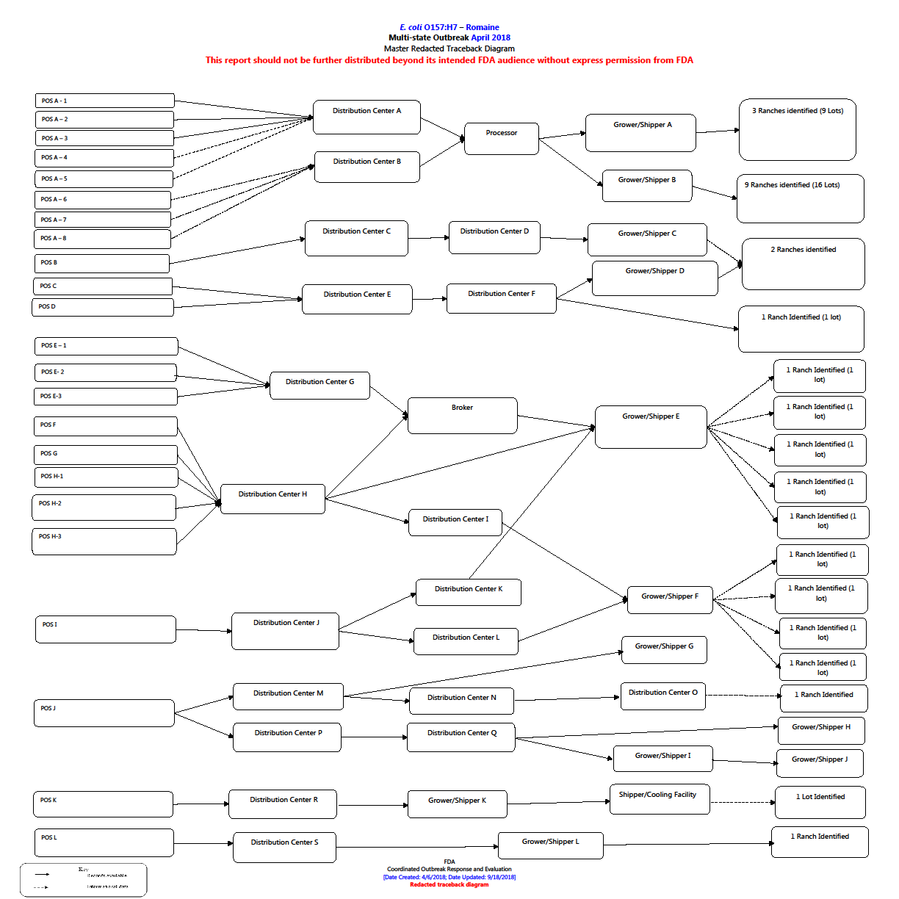

Slide 11
Environmental Assessment
June 4-8, 2018; July 11-12, 2018; and August 7-
8, 2018 in Yuma growing area
Conducted by FDA, CDC and State partners
CDC analysis of samples taken from canal water identified presence of E. coli O157:H7 with same genetic fingerprint as outbreak strain

Slide 12
Environmental Assessment Findings
Complex outbreak with pervasive contamination
Wide-ranging analysis including sampling
Several hypotheses under consideration and analysis
Canal water tested positive for the outbreak strain in multiple locations
No definitive conclusions have been made as to how the irrigation canal water or the romaine lettuce became contaminated
Further research and analysis is needed

Slide 13
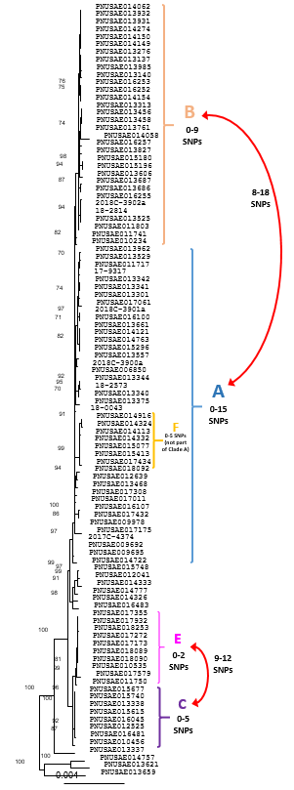
Whole Genome Sequencing
Clinical isolates were all closely related
  Multiple sub-clades
  Two primary sub-clades
  Multiple PFGE patterns
Water isolates collected during the Yuma EA from an irrigation canal were closely related to clinical isolates

Slide 14
Ongoing Surveillance and Evaluation
Cases related to this strain by sequencing are continuing to occur
Federal and state partners are collaborating to evaluate sequencing and epi data
All isolates with this strain are not thought to be epidemiologically related to a common proximate source

Slide 15

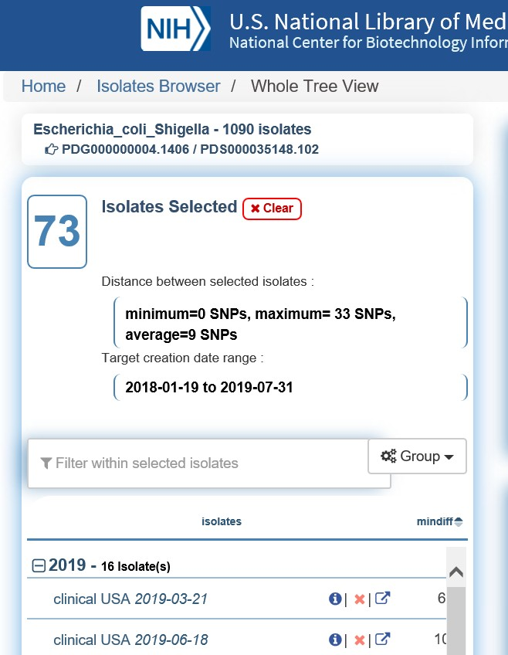
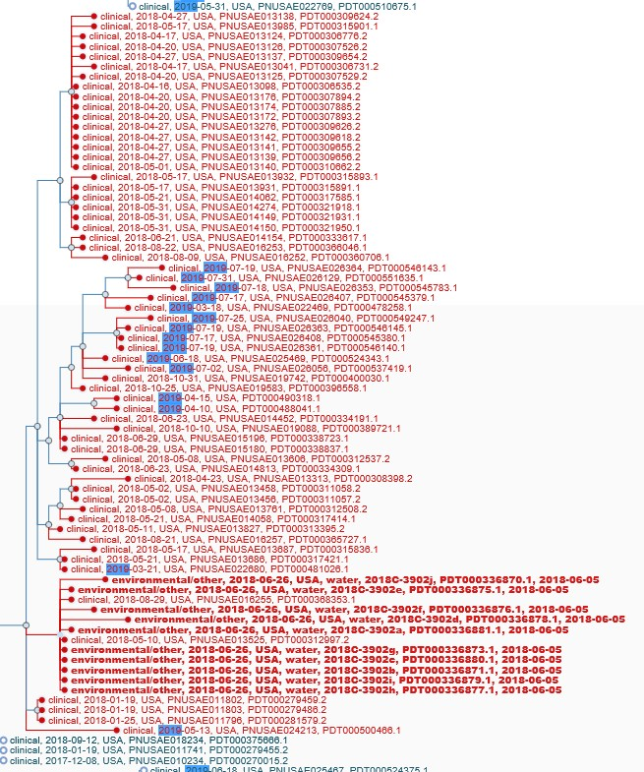
Ongoing Surveillance in 2019
w w w.fda.gov

Slide 16
Communications
Public Communications and Challenges
  https://www.fda.gov/Food/RecallsOutbreaksEmergencies/O utbreaks/ucm604254.htm
  https://www.fda.gov/NewsEvents/Newsroom/FDAVoices/uc m611991.htm
Industry Outreach
EA Report
  https://www.fda.gov/Food/RecallsOutbreaksEmergencies/O utbreaks/ucm624546.htm

Slide 17
CHALLENGES

Slide 18
Challenges
Traceability
  Production lot information
    Lot information was often not available at pointsof service
    Product is comingled
» In some instances, lettuce from multiple ranchescan make up one production lot, makingit very challengingto narrow down farms
  Records
    Each supply chain looksdifferent and utilizes different codingsystems. It takes time to deciphereach codingsystem and understand whatit’s
tellingus.
  Timing
    Traceback is a step by step process
    Records need to be reviewed and understood before we can move to the next pointin the supply chain

Slide 19
Challenges
Communications
  Place of origin of lettuce
  Chopped, bagged vs whole head Romaine lettuce
Recalls

Slide 20
Next Steps
FDA participated in a meeting with the Leafy
Greens Food Safety Task Force that was formed in response to the Yuma E. coli O157:H7 outbreak
United Fresh Produce Association/Produce Marketing Association – Romaine Task Force
  Prevention Standards: Agricultural Water Standards,
Improving Traceability, and Labeling now including Harvest Regions
Leafy Green Marketing Agreement -updated Food Safety Metrics
FDA Sampling assignments underway
FDA FSMA 204

Slide 21


