Slide 1

Listeria monocytogenes/Avocado Retrospective Outbreak Investigation
Brooke M. Whitney, Ph.D.
September 17, 2019

Slide 2
Outline
What is a “retrospective” outbreak?
Background on FDA avocado sampling
Outbreak investigation
Questions and Challenges

Slide 3
Traditional versus Retrospective Outbreak Investigations
Investigation begins with a cluster of illnesses
Epidemiology identifies a suspect food vehicle
Positive sample and/or Traceback Confirms Link Between Illness and Vehicle
Traditional
Public Health and Regulatory Actions Occur
Investigation begins with a vehicle (positive sample)
Molecular tools (PFGE, WGS) identify suspect cases of illness
Epidemiology and/or Traceback Confirms Link Between Illness and Vehicle
Retrospective

Slide 4

We love avocados!
https://www.amazon.com/Valentine-Avocado-Couple-Cartoon-Sticker/dp/B078NGF19X

Slide 5
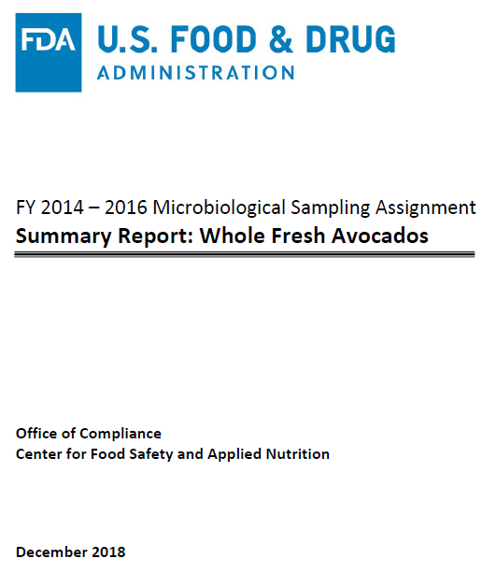
FY 2014 – 2016 Avocado Sampling
New, large sampling strategy to determine prevalence
Commodities sampled under these strategies:
  Avocados
  Raw milk cheese
  Sprouts
Avocado report published December 2018

Slide 6
FY 2014 – 2016 Avocado Sampling
1 sample = 10 avocado sub-samples
~3 months of sampling skin
Estimated Lm prevalences:
  0.24% in pulp
  17.73% on skin
Estimated Salmonella prevalence:
  0.74% (12 positives)
1615 avocado samples tested for Listeria monocytogenes
361 Skin method
247 Import
1254 Pulp method
890 Import
114 Domestic
33 Positive
31 Positive
364 Domestic
0 Positive
3 Positive

Slide 7
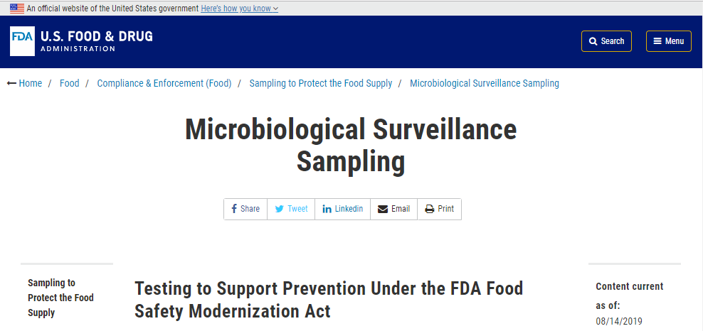
FY 2018 Sampling
“Also beginning with fiscal year 2018, the agency is sampling processed avocado and guacamole to test for Salmonella and Listeria monocytogenes.”

Slide 8
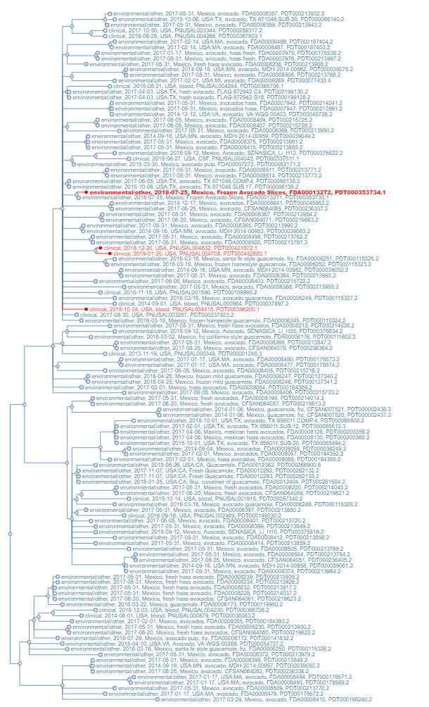
Outbreak Identification
January 2019 - CDC identifies and names a cluster of three illnesses and includes an isolate from a 2018 FDA sample from frozen avocado
  All isolates are within 14 alleles according to CDC’s analysis
March 2019 – FDA CORE Response engaged
Overall WGS cluster contains avocado-related isolates with Mexican origins

Slide 9
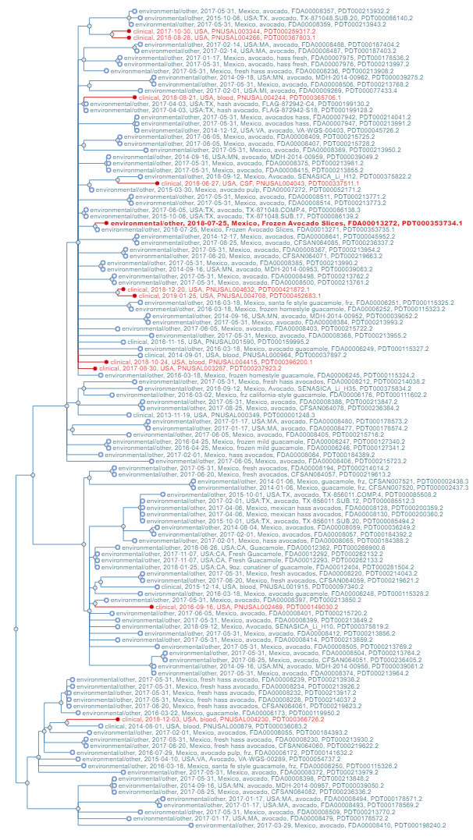
Outbreak Expanded
10 cases from 7 states: CA (3), CO (1), IN (1), MN (1), OH (1), TX (2), WY (1).
Isolation dates range from August 2016 to January 2019
  7 cases 2018-2019
6 cases reported consuming whole avocado
  1 also pre-packaged guacamole
Outbreak investigation was closed in June 2019 with avocado as the confirmed vehicle

Slide 10
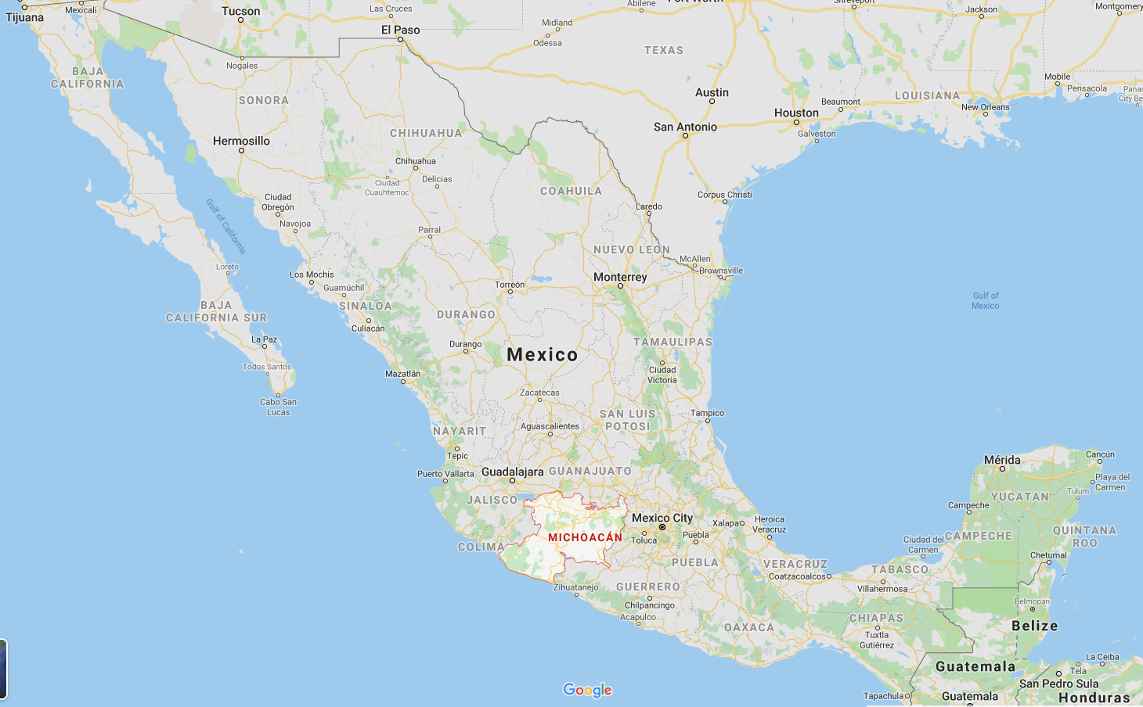
Traceback
Three single cases identified for traceback
  Grocery store A (Indiana, Dec 2018 purchase)
  Grocery store B (Colorado, Oct 2018 purchase)
  Restaurant A (Texas, June or July 2018 exposure)
At least 18 packing houses and over 100 orchards identified
No single firm, packing house, or grower could explain all three cases
All were sourced from Michoacán
  All Hass avocados imported from Mexico are from this state
Collaboration with USDA/APHIS
  Emp # - found on produce sticker & case
  HUE # - found on case

Slide 11
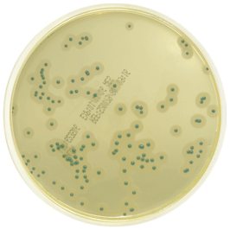
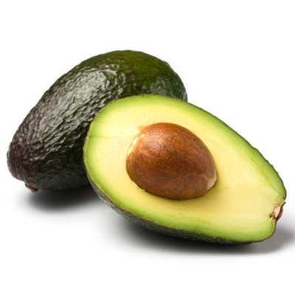
Laboratory
Avocado samples from three Mexican firms were collected using increased screening at import
Only the pulp was tested for Listeria monocytogenes
All samples were negative for Listeria monocytogenes

Slide 12

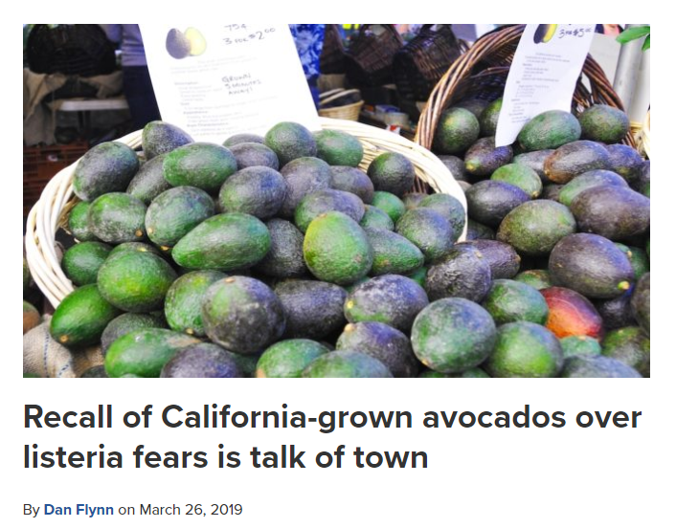
Avocado Recall (March 2019)
Not outbreak related
March 2019 – occurred just after FDA initiated a response to the outbreak
Recall occurred as a result of positive environmental sampling at avocado processing plant
WGS did fall into clusters with avocado-related isolates from CA

Slide 13
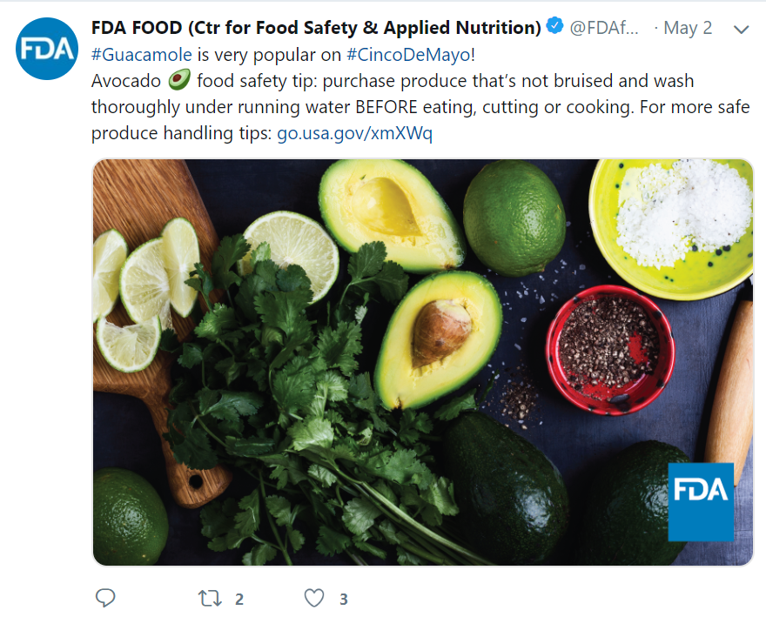
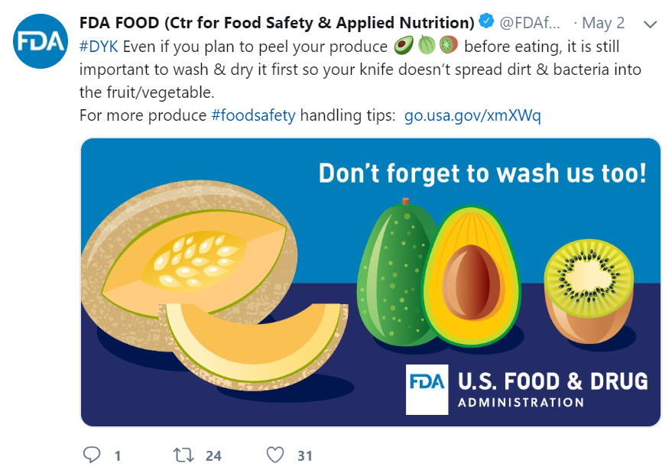
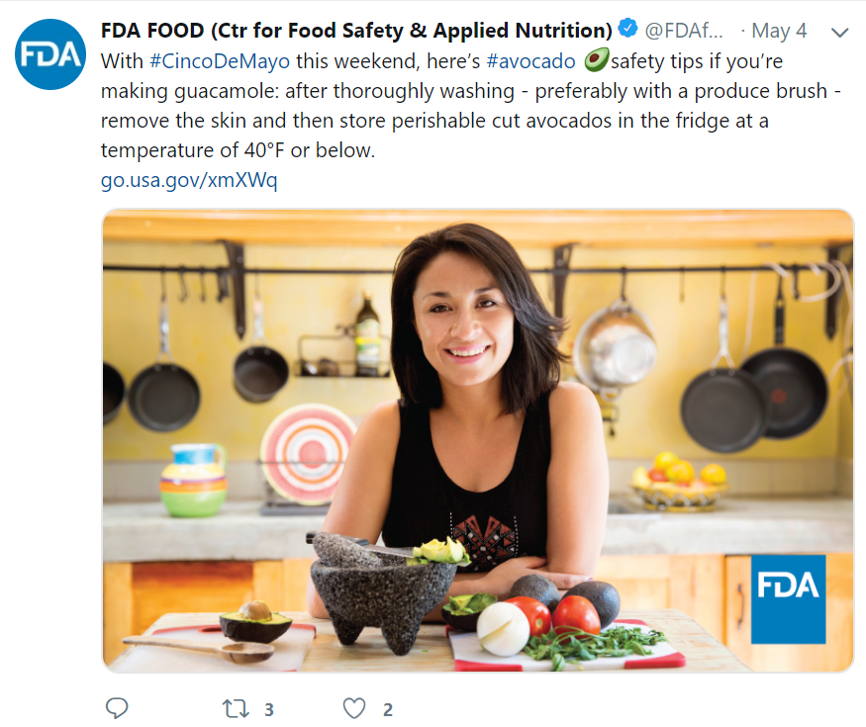
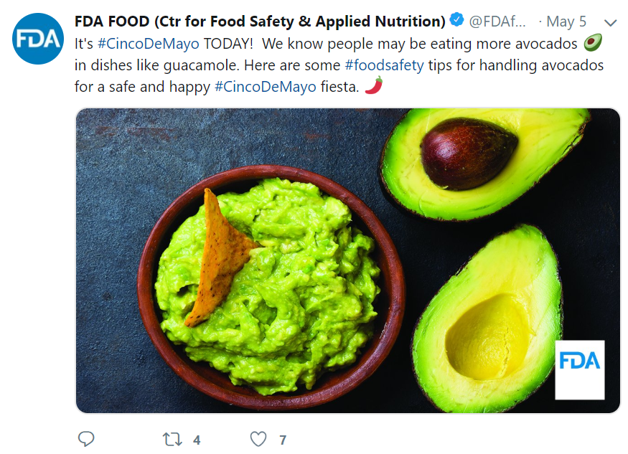
Communications - tweets

Slide 14
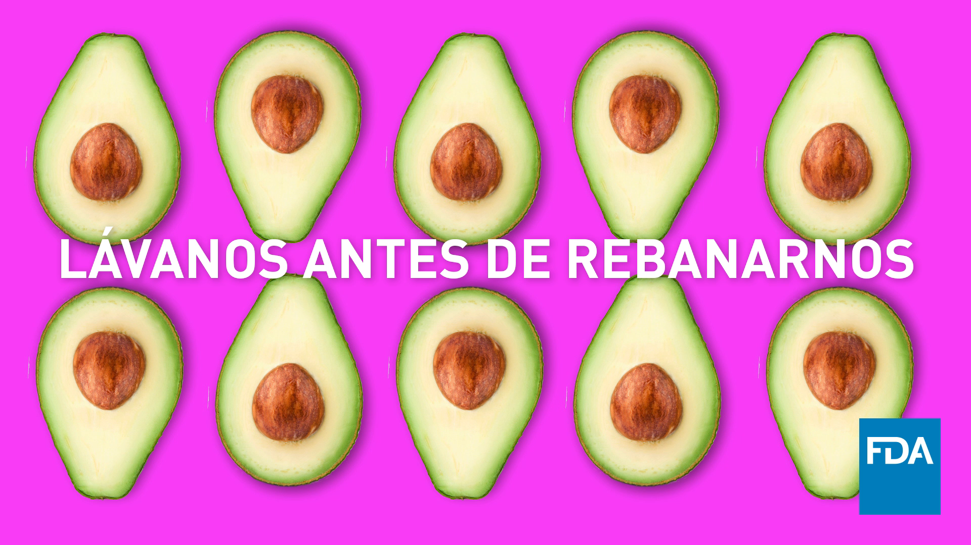
Tweets Continued
Translation: Wash us before slicing us

Slide 15
Challenges and Questions
How close is close enough to investigate?
Role of over-arching cluster with common source?
Nature of Listeria monocytogenes
At what point do case re-interviews become irrelevant?
What other commodities may be posing more risk?

Slide 16
Acknowledgements
US Federal Partners
USDA/Animal and Plant Health Inspection Service
Centers for Disease Control and Prevention
FDA Center for Food Safety & Applied Nutrition
FDA Office of the Commissioner
FDA Office of Regulatory Affairs
State & Local Partners
California
Colorado
Indiana
Minnesota
Ohio
Texas
Wyoming

