Slide 1
Proficiency Testing for Foodborne Pathogen Surveillance: An analysis of the 2019 GenomeTrakr PT Exercise
Joseph D. Baugher, PhD
September 18, 2019

Slide 2
THE ANALYSES PRESENTED TODAY are PRELIMINARY.
Notes:
The box defines the median value of the distribution as well as the lower and upper quartiles. The whiskers extend to the most extreme data point which is no more than 2.5 times the IQR from the median.

Slide 3
2019 GenomeTrakr PT Exercise
2019 PT Isolates
Expectations
  SOP Options
    GenomeTrakr or Pulsenet
  Kit Options
Notes:
V3 – improved cluster density, yield, base quality

Slide 4
2019 GenomeTrakr PT Exercise
Expectations
  Basic QC Thresholds
Submission Failures
  Sample Misannotation
  Basic QC Failure
  Obvious SOP Failure
    Kits, reagents, cycles, samples per run, etc.
    Run info submission

Slide 5
Bioinformatics Software
CFSAN SNP Pipeline (v2.1.0)
  Number of Reads
  Reads Mapped (%)
  Mean Insert Size
  SNPs
samtools (v1.8)
  Mean Depth
  Coverage Plots
Centrifuge (v1.0.4)
  Taxonomy
FastQC (v0.11.5)
  Read Quality
  Sequence length
SPAdes (v3.13.0) /QUAST (v5.0)
  Number of Contigs
  NG50
  Genome Fraction
  Unaligned Length

Slide 6
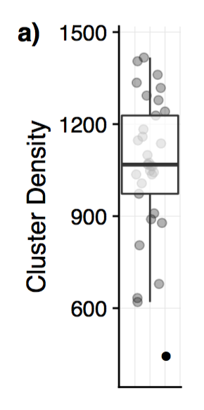
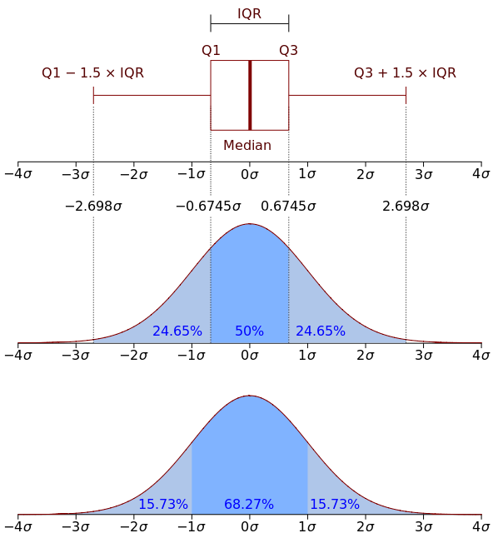
Interpretation
Sequencing Metric Distributions
  Provide statistical methods for evaluating performance
Graphical Representation
  Box plots
Notes:
The box defines the median value of the distribution as well as the lower and upper quartiles. The whiskers extend to the most extreme data point which is no more than 2.5 times the IQR from the median.

Slide 7
Run Metrics
*
*

Slide 8
Run Metrics
*
*

Slide 9
Read Metrics - Reads

Slide 10
Read Metrics - Reads
- High Indexing CV
- Overclustered
- Underclustered

Slide 11
Read Metrics - Read Quality

Slide 12
Read Metrics - Read Quality
- High Indexing CV
- Overclustered
- Underclustered

Slide 13
Alignment Metrics - Depth

Slide 14
Alignment Metrics - Depth
- High Indexing CV
- Overclustered
- Underclustered

Slide 15
Alignment Metrics - Mapping

Slide 16
Alignment Metrics - Mapping
- High Indexing CV
- Overclustered
- Underclustered

Slide 17
Alignment Metrics - SNPs

Slide 18
Alignment Metrics - Insert Size

Slide 19
Alignment Metrics - Insert Size
- High Indexing CV
- Overclustered
- Underclustered

Slide 20
Assembly Metrics – NG50

Slide 21
Assembly Metrics – NG50
- High Indexing CV
- Overclustered
- Underclustered

Slide 22
Assembly Metrics – Contigs

Slide 23
Assembly Metrics – Contigs
- High Indexing CV
- Overclustered
- Underclustered

Slide 24
Assembly Metrics – Length

Slide 25
Summary
Overclustering
  Causes
    Library quality, Library quantification, Library nucleotide diversity, Flow Cell loading
  Result
    Reduced base quality, Reduced clusters passing filter, (Reduced yield), Reduced mapping quality
Underclustering
  Causes
    Library quality, Library quantification, Flow Cell loading
  Result
    Reduced yield, Poor assemblies
High Indexing CV
  Causes
    Library quality, Library quantification, Flow Cell loading
  Result
    Inconsistent coverage, Inconsistent assemblies

Slide 26
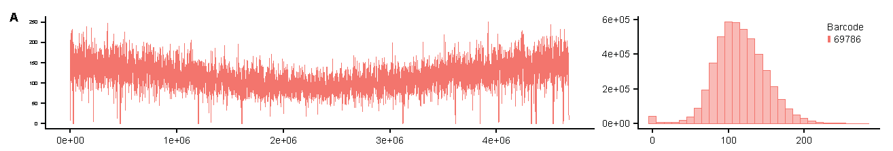
Alignment Metrics - Coverage
Variance
Depth

Slide 27
Interpretation
Sequencing Metric Distributions
  Provide statistical methods for evaluating performance
Graphical Representation
  Box plots
Notes:
The box defines the median value of the distribution as well as the lower and upper quartiles. The whiskers extend to the most extreme data point which is no more than 2.5 times the IQR from the median.

Slide 28
Alignment Metrics - Coverage
Variance

