Slide 1
Standardizing Metadata: Resistome Tracker
Heather Tate, PhD MS
U.S. National Antimicrobial Resistance Monitoring System (NARMS)
GenomeTrakr Meeting
September 17, 2019

Slide 2
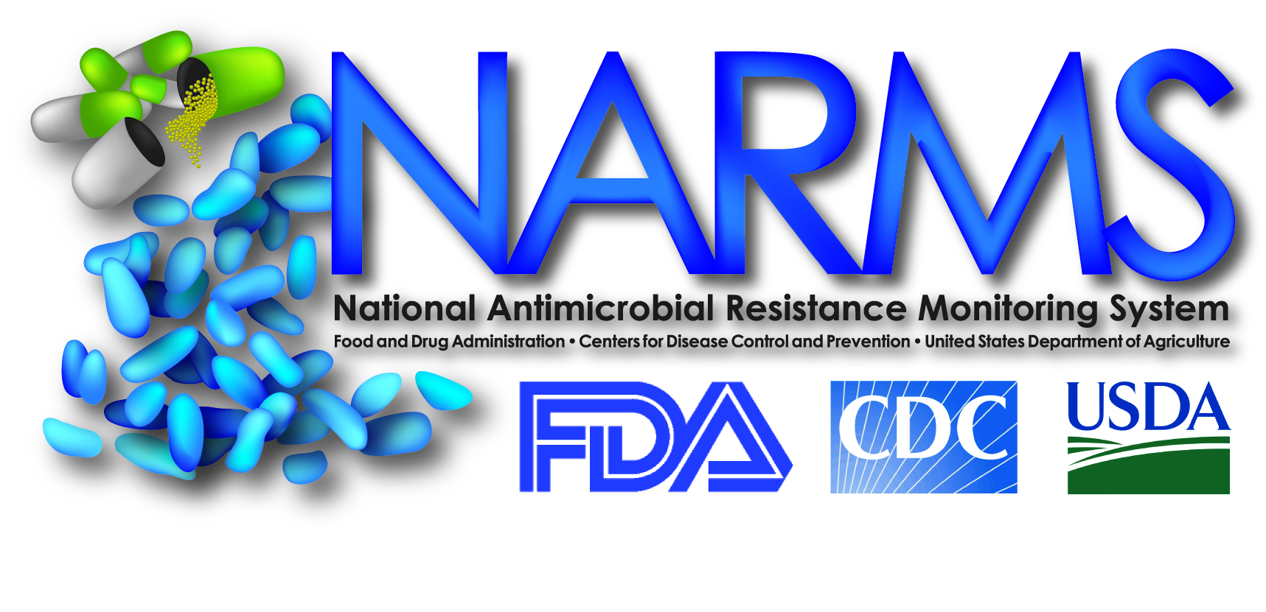






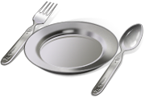
53 participating public health departments submit isolates
Slaughter/healthy animal isolates
20 participating universities and public health departments test retail meats and submit isolates

Slide 3
NARMS Transition to WGS
2013
CVM begins sequencing NARMS Salmonella isolates
2014
CVM teams with GenomeTrakr labs to sequence historical NARMS retail Salmonella and Campylobacter isolates. USDA begins sequencing NARMS Salmonella and Campylobacter isolates
2019
GenomeTrkr and PulseNet labs that are part of the NARMS retail network submit Salmonella, Campylobacter, and E.coli genomes to NCBI in near real time
2015
CDC begins sequencing all NARMS Salmonella isolates from humans
Notes:
We first began to use WGS routinely in 2013

Slide 4
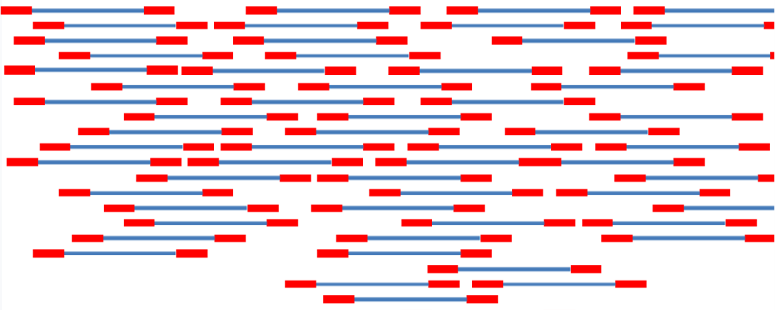

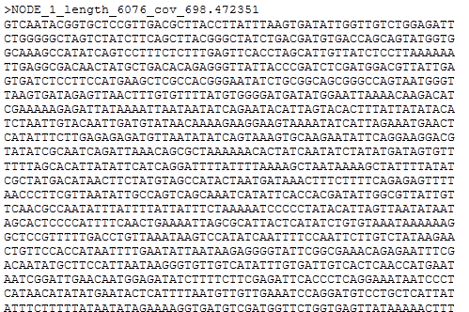




Converting Genome Sequences to Useful Data
AMR gene/mutations database
Input sequence data as raw reads or assemblies
Plain language report of identified AMR genes
Vizzes
Bioinformatic pipeline
e.g.- NCBI AMR Finder, DTU ResFinder

Slide 5
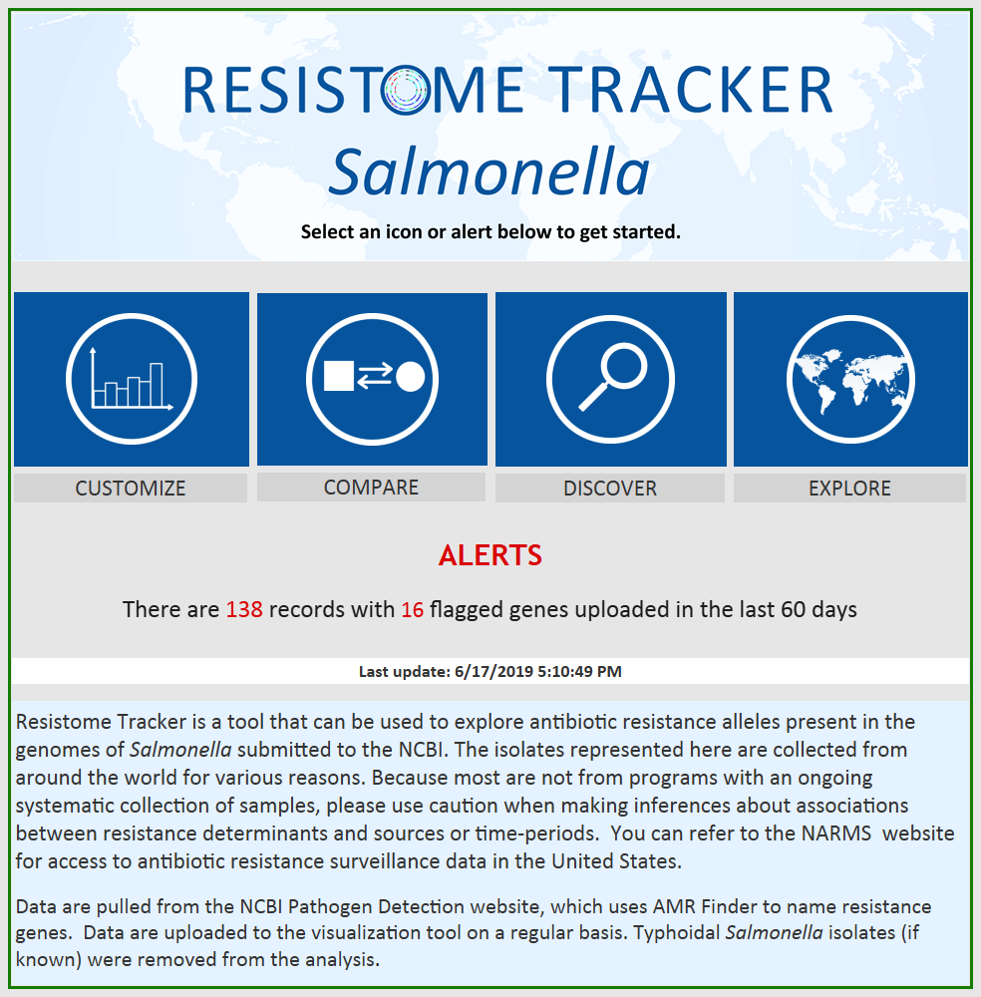
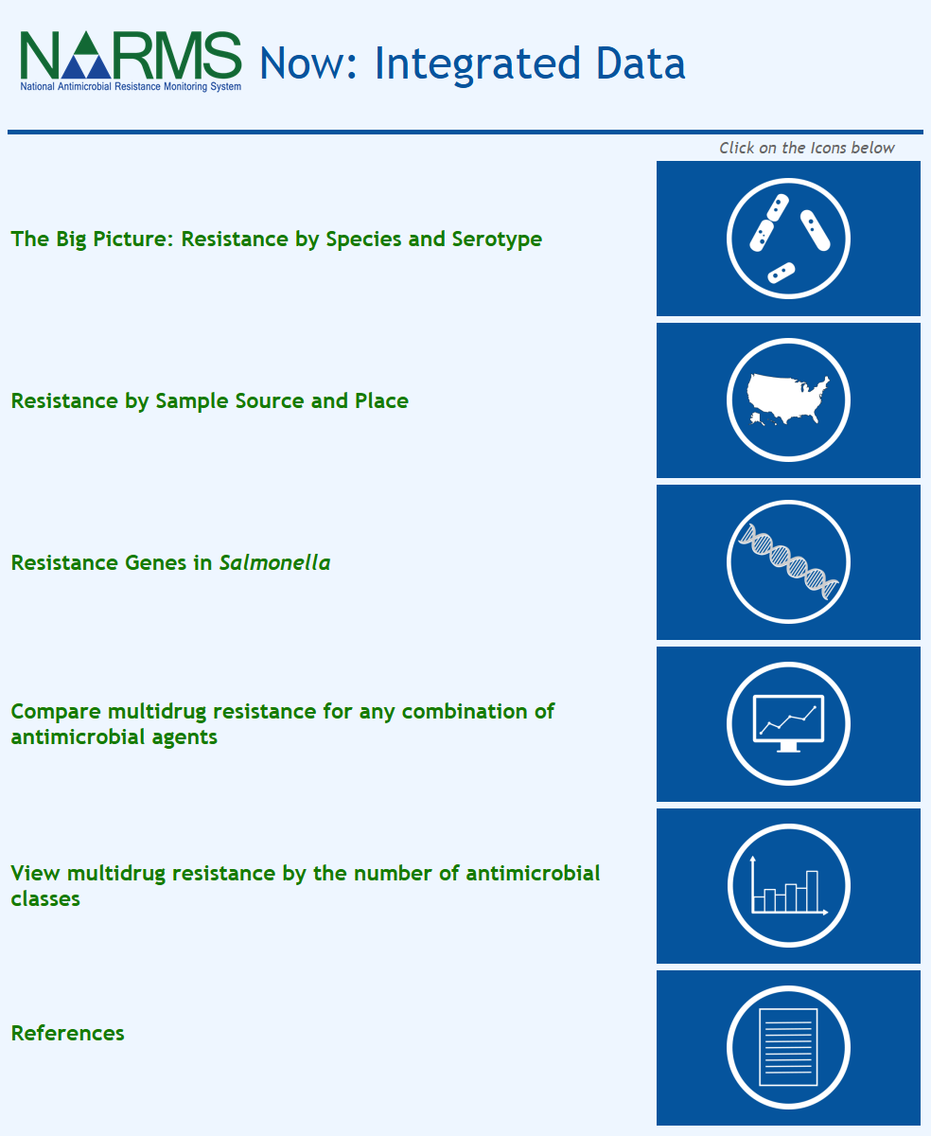
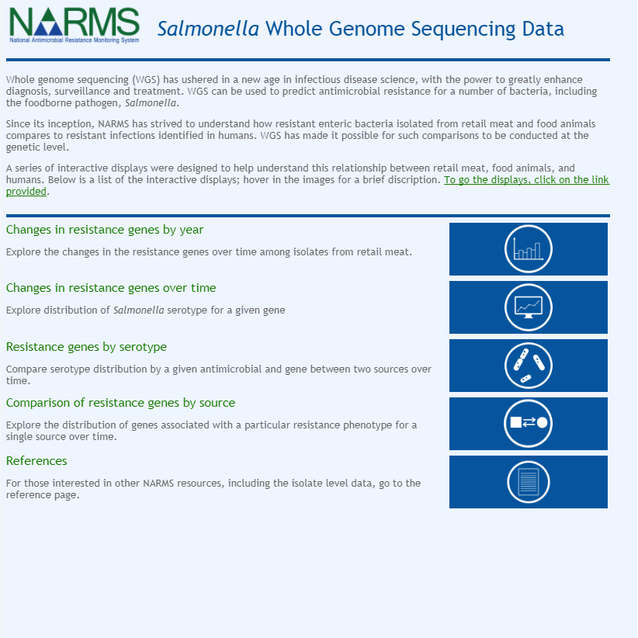
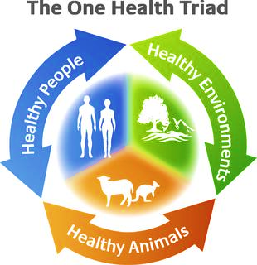
NARMS Visualization Tools for AMR Genes

Slide 6
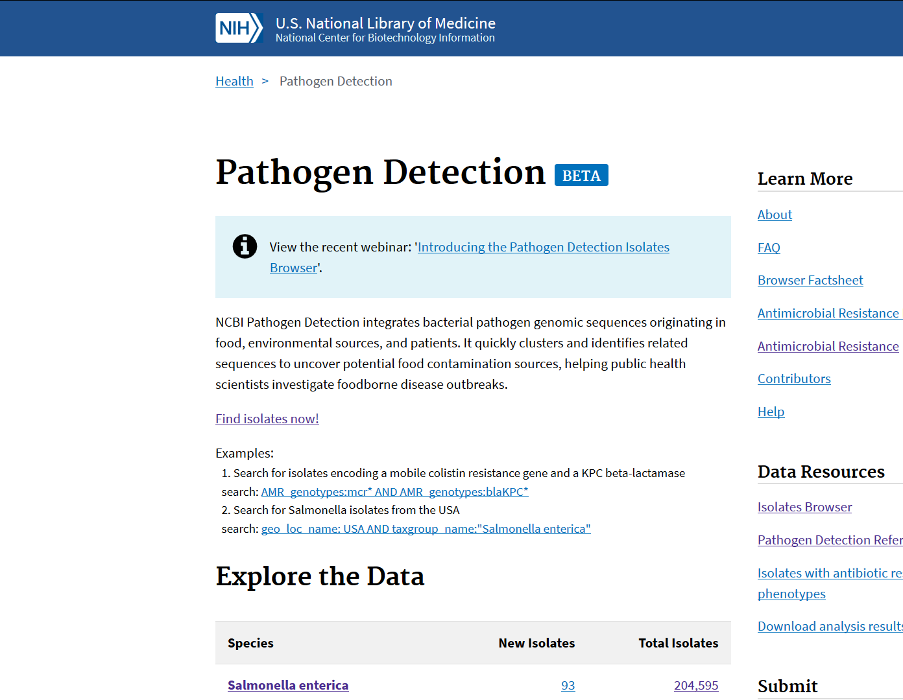
Resistome Tracker- data source
Data come from the curated NCBI Pathogen Detection database. Because this database includes global genomic sequences originating in food, animal, human, and environmental sources it is inherently One Health. A portion of these sequences are from GenomeTrakr sites.

Slide 7
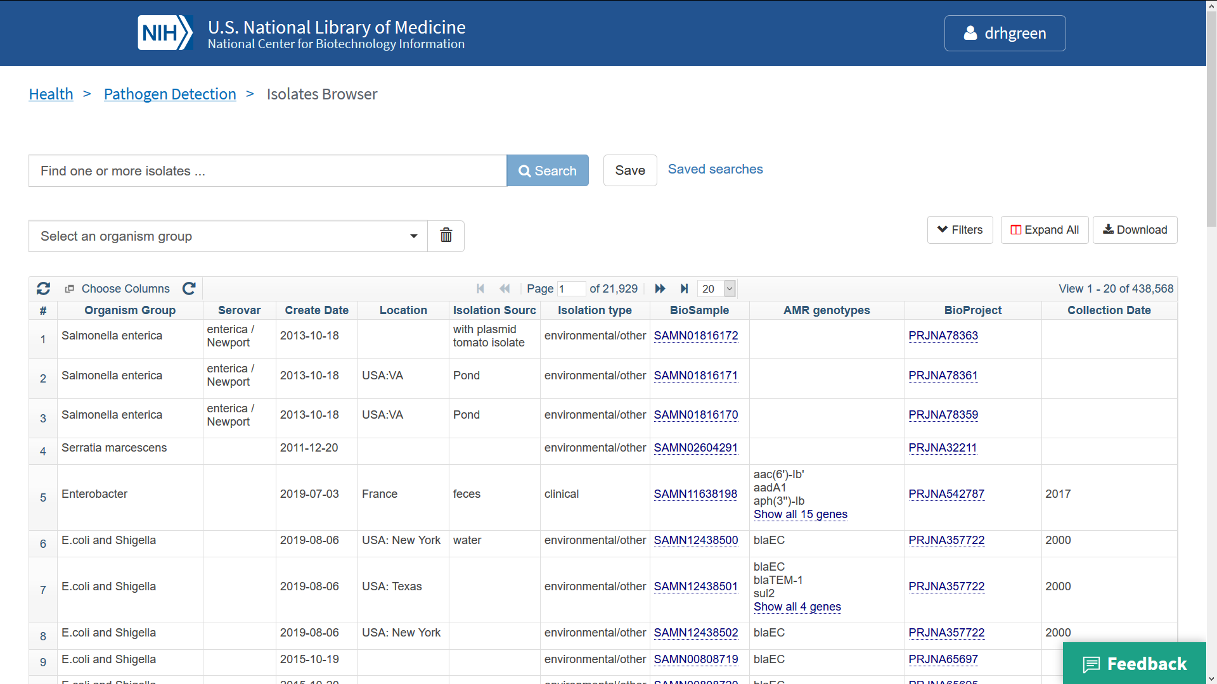
Fields pulled into Resistome Tracker

Slide 8
Isolate sources are grouped into broader categories
-provides better understanding of attribution of AMR and spread
Category | No. of BioSample Records
Animal Feed/Pet Food | 77
Cattle | 1,699
Cheese/Dairy | 13
Chickens | 3,955
Companion Animals (horse, cat, llama, alpaca, dog, etc) | 188
Environmental (swab, water, animal crate, fertilizer, etc) | 567
Game (rabbit, deer, elk) | 21
Humans | 8,606
Minor food animals (pheasant, quail, goat) | 30
Nuts | 27
Other Animals (panther, giraffe, kangaroo, sea lion, racoon, etc.) | 42
Other Avian/Eggs | 129
Other/Unknown (missing, stool, urine, blood, isolate) | 8,302
Produce | 123
Reptiles | 24
Seafood | 179
Seeds, Spices, Herbs | 113
Swine | 1,874
Turkeys | 2,024
Painter, J. et al, 2009

Slide 9
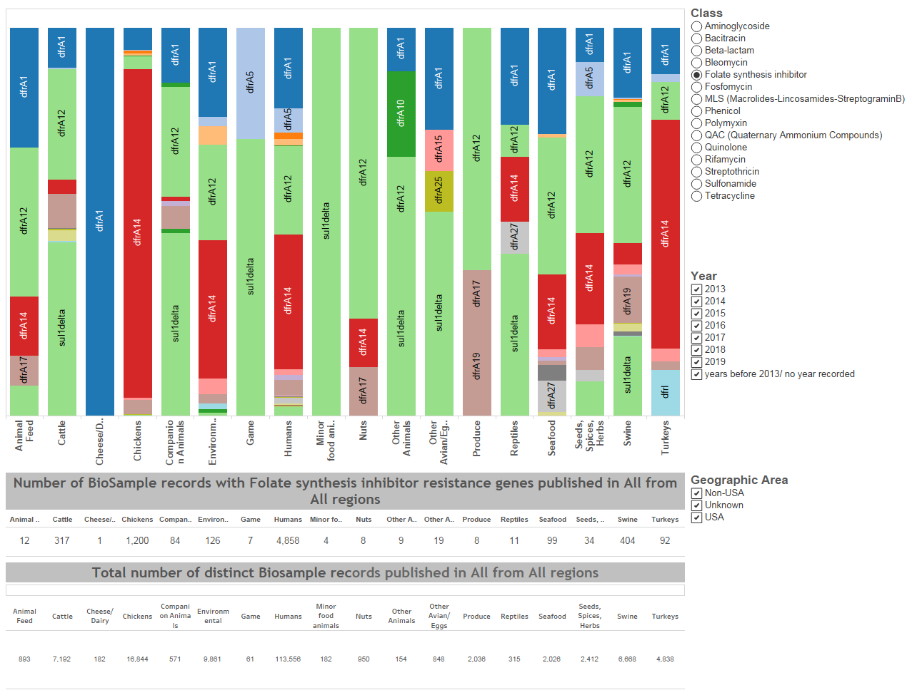
Compare Resistance Genes Across Sources/Potential Reservoirs
Source categories

Slide 10
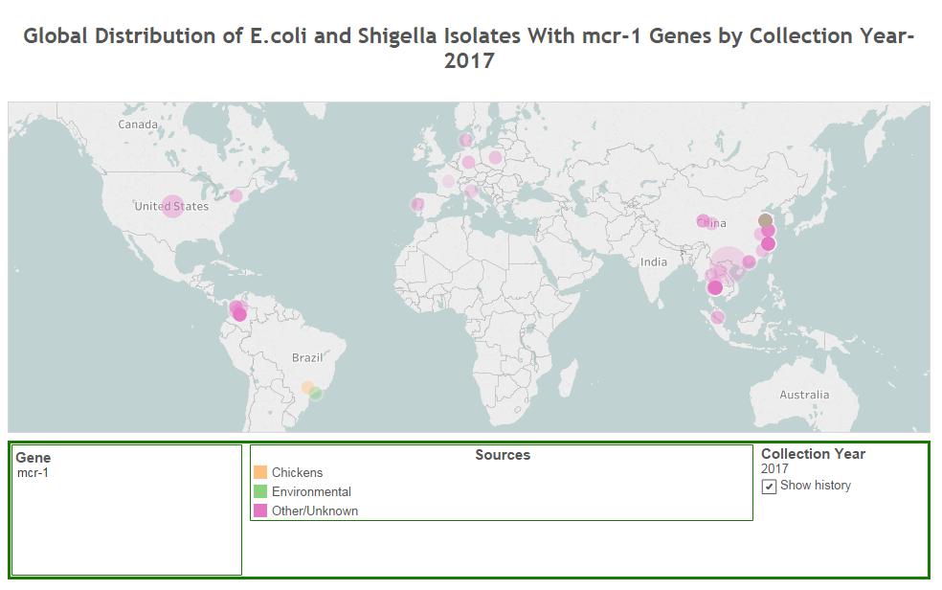
Track Resistance Genes Across Space and Time by Source
Source categories

Slide 11
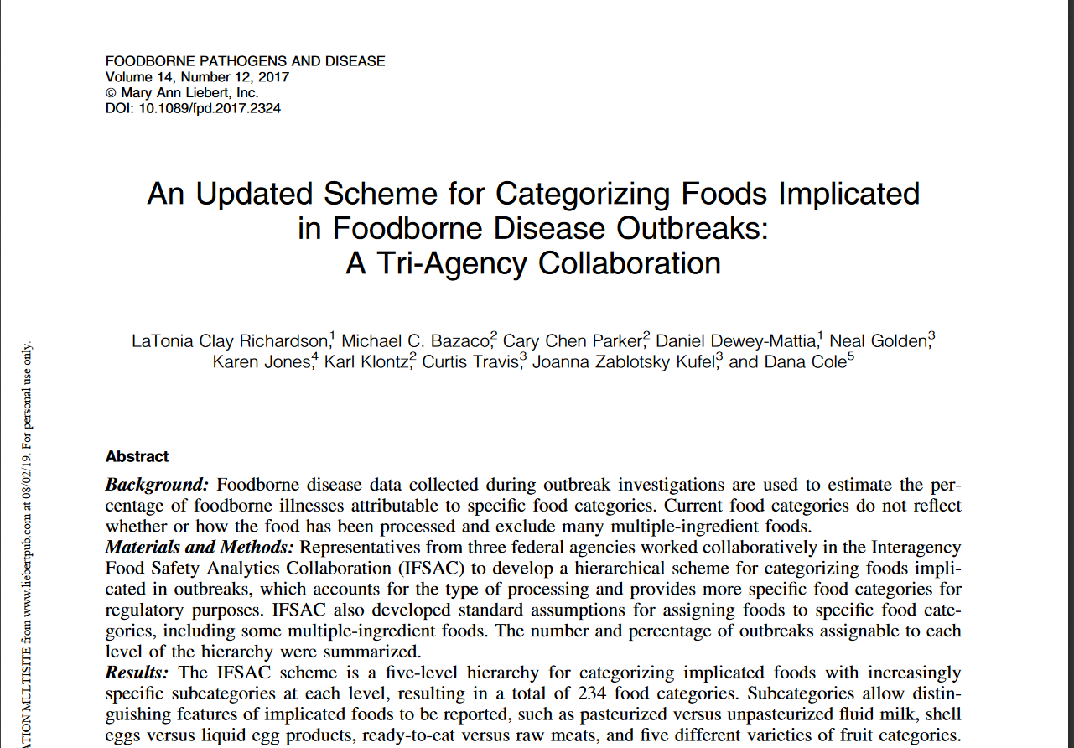
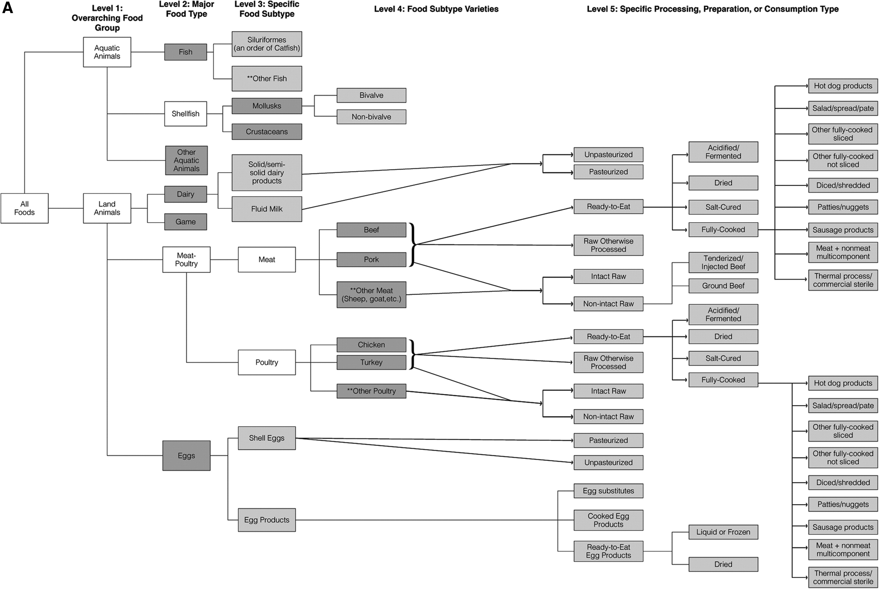
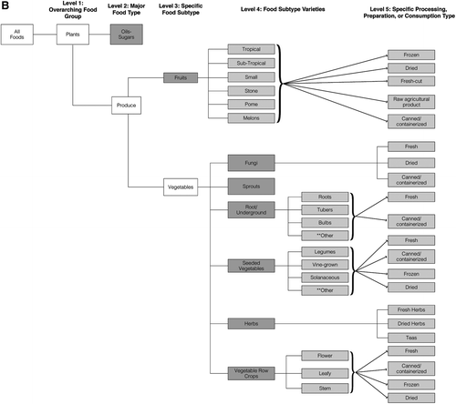
Desire #1: Have standardized source categories
IFSAC:
Interagency Food Safety Analytics Collaboration

Slide 12
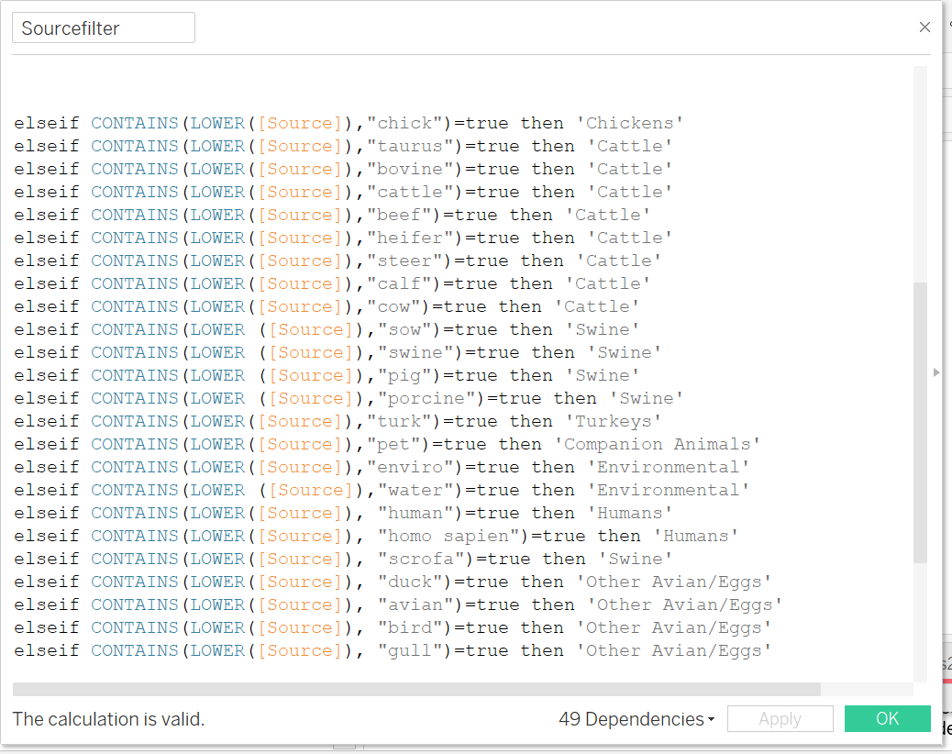
Desire #2 : Automated categorization
Code won’t categorize misspelled words: ‘chiken’ or ‘envrio’
Also difficult to categorize sources with few representative biosamples
Automated categorization requires a food and animal ontology

Slide 13
IFSAC+
Collaborative effort with GenomeTrakr and GenEpiO/FoodOn
IFSAC Food categories plus animal food and other non-food sources: (e.g.- Canis lupus feces, red-winged blackbird, bovine necropsy, bathroom counter, dog crate, Suwanee river water)
NARMS wants to be sure that new IFSAC+ categories make the most sense in terms of AMR transfer and routes of exposure (foodborne, waterborne, direct-contact, indirect-contamination)
We also want the option to compare across other group structures: Clinical (animal), Food, Environment

Slide 14
Drafting IFSAC+ Categories
Human Food
Animals
Environmental
Animal Feed

Slide 15
Drafting IFSAC+ Categories
Level 1: IFSAC+ Category
Level 2: Animal Class
Level 3: Animal category3
Level 4: Animal category 4
Level 5: Animal Name
Livestock
Cow
Terrestrial
Companion Animal
Pig
Mammals
Wildlife/Zoo
Aquatic
Companion Animal
Wildlife /Zoo
Poultry
Chicken
Companion Animal
Turkey
Avian
Wildlife/Zoo
Fish
Companion Animal
* ‘clinical/research’ qualifier can be added to any of these
Animals*
Wildlife/Zoo
Reptile
Companion Animal
Wildlife/Zoo
Amphibian
Companion Animal
Wildlife/Zoo
Insect
e.g. Cicada

Slide 16
Drafting IFSAC+ Categories
Level 1: IFSAC+ Category
Level 2: Animal Class
Level 3: Animal category3
Level 4: Animal category 4
Level 5: Animal Name
Level 6: Animal Organ
Livestock
Pig
Lung
Terrestrial
Companion Animal
Cow
Intestine
Mammals
Wildlife/Zoo
Lymph Node
Aquatic
Companion Animal
Wildlife /Zoo
Poultry
Chicken
Companion Animal
Turkey
Avian
Wildlife/Zoo
Fish
Companion Animal
* ‘clinical/research’ qualifier can be added to any of these
Animals*
Wildlife/Zoo
Reptile
Companion Animal
Wildlife/Zoo
Amphibian
Companion Animal
Wildlife/Zoo
Insect
e.g. Cicada

Slide 17
Drafting IFSAC+ Categories
Level 1: IFSAC+ Category
Level 2: Environmental Category 2
Level 3: Environmental Category 3
Pasture
Animal Housing
Farm
Irrigation Water
Factory/Production Facility/Abattoir
Environmental
Soil
Store/ Restaurant
Untreated (Sewage)
Water
Treated

Slide 18
Drafting IFSAC+ Categories
Level 1: IFSAC+ Category
Level 2: Feed Category 1
Level 3: Feed Category 2
Level 4: Feed Category 3
Animal Ing.
Livestock
Plant Ing.
Other
Animal Ing.
Poultry
Plant Ing.
Other
Animal Feed
Animal Ing.
Fish
Plant Ing.
Other
Raw
Animal Ing.
Wet
Pet Food
Plant Ing.
Canned
Other
Dry

Slide 19
Levels:
1
2
3
4
5
Human Food
Animals
  Mammals
    Terrestrial
      Livestock
        Cow
        Swine
      Companion
      Wildlife/Zoo
    Aquatic
      Companion
      Wildlife Zoo
  Avian
      Poultry
        Chicken
        Turkey
      Companion
      Wildlife/Zoo
  Fish
      Companion
      Wildlife/Zoo
  Reptile
      Companion
      Wildlife/Zoo
  Amphibians
      Companion
      Wildlife Zoo
  Insects
Environmental
  Environmental-Farm (Farm, Pasture, Animal Housing, Irrigation Water, soil)
  Environmental - Factory/Production Facility/Abattoir
  Environmental - Store/Restaurant
  Environmental – Water
    Sewage
    Treated (example- wastewater, tap water)
    Untreated (example- pond, river)
Animal Feed
  Livestock
    Animal
    Plant
    Other
  Poultry
    Animal
    Plant
    Other
  Fish
    Animal
    Plant
    Other
  Pet Food
    Animal
      Raw
      Wet
      Canned
      Dry
    Plant
    Other

Slide 20
What is Food vs. Animal?
‘ground beef’
‘ground turkey’

Slide 21
What is Food vs. Animal?
Level 1: IFSAC+ Category
Level 2: Animal Class
Level 3: Animal category3
Level 4: Animal category 4
Level 5: Animal Name
‘Fecal composite (dairy cow farm)’
‘Bovine’
‘cow’
‘Bos Taurus- feces’*
‘Tissue pool- Bos Taurus’*
Livestock
Cow
Terrestrial
Companion Animal
Pig
Mammals
Wildlife/Zoo
Aquatic
Companion Animal
Wildlife /Zoo
‘Meleagris gallopavo intestine’*
‘turkey’
Poultry
Chicken
Companion Animal
Turkey
Avian
Wildlife/Zoo
Fish
Companion Animal
* ‘clinical/research’ qualifier can be added to any of these
Animals*
Wildlife/Zoo
Reptile
Companion Animal
Wildlife/Zoo
Amphibian
Companion Animal
Wildlife/Zoo
Insect
e.g. Spider

Slide 22
Categories are not mutually exclusive
Animals
Environment
Human Food
Animal Food
‘Frog’
‘Turtle’
‘Ostrich’
‘Fecal composite (dairy cow farm)’
‘Raw ground turkey pet food’

Slide 23
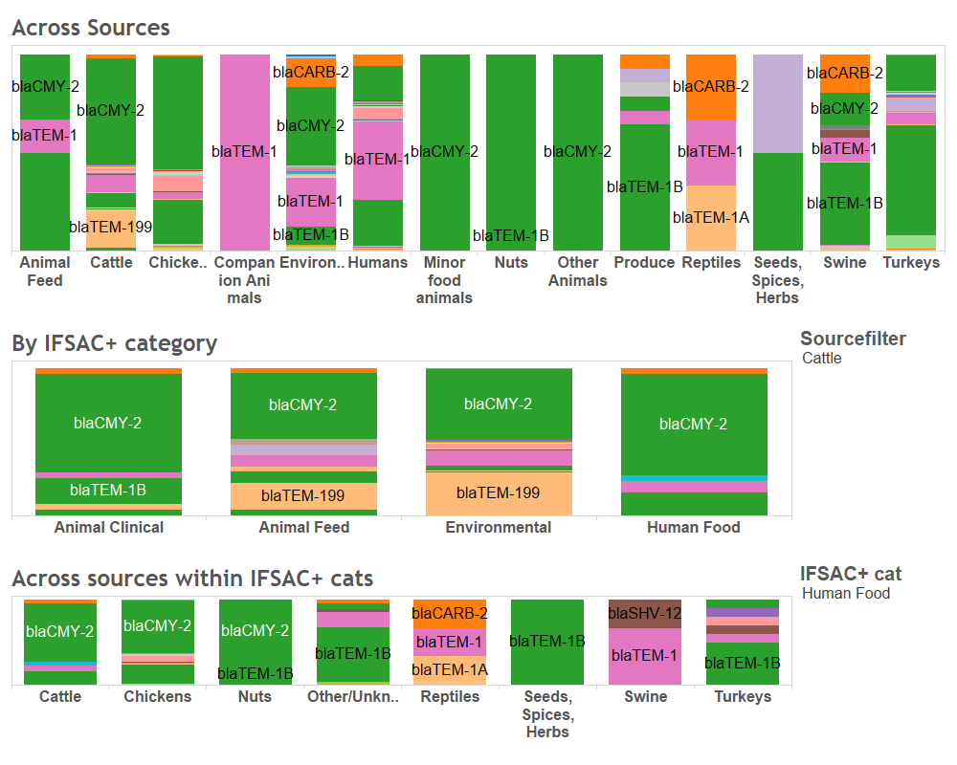
Resistome Tracker
Notes:
If these things were done, then in RT we could do the following:

Slide 24
Lessons Learned
Isolation source should be a mandatory field
Be as descriptive as possible when uploading metadata (e.g. ‘turkey ceca’ instead of ‘turkey’)
If exact source type cannot be determined from source field alone, other fields, if completed appropriately, may help to identify source (e.g. ORA sampling assignment numbers)
Additional fields may be helpful (e.g. Vet-LIRN fields)

Slide 25
Acknowledgments
Sophia Sadiq
GenEpiO
NARMS Leadership Team
DAFM Research Scientists
Vet-LIRN
FDA members of IFSAC WG
GenomeTrakr

