Slide 1



BioNumerics and Quality Control:
Overview and Perspective
Rebecca Lindsey, PhD.
Chief, PulseNet Next Generation
Subtyping Methods Unit
GenomeTrakr Meeting
September 18, 2019

Slide 2

Overview
Quality Management system for PulseNet
Quality Assurance in PulseNet
Viewing and Interpreting Basic Quality Control Metrics in the Reference ID Database
Viewing and Interpreting Basic Quality Control Metrics in the Organism Specific databases

Slide 3
The system and its processes
Management of personnel, resources, products and services, analysis and improvement
Quality Assurance (QA)
Process-focus
Identification and/or prevention of nonconformities in the process by looking up the line
Quality Control (QC)
Product-focus
Checking results to ensure the end-product turns out as expected
Quality Management System (QMS)

Slide 4
Quality Assurance in PulseNet
Quality manual – collection of electronic standard operation procedures (SOPs)
Standardized analysis software, plugins and nomenclature
Training of staff
Initial competency assessment of the newly trained staff (certification)
Annual proficiency testing

Slide 5

Quality Control in the PulseNet Drylab Workflow

Slide 6
Quality Control in the PulseNet Drylab Workflow – BioNumerics Analysis
Final Report (CLIA/non-CLIA)
Line list
Ref_ID Database – Assembly & ANI Identification & Contamination Check
Organism-specific Surveillance Database – Allele Calling
Serotype, Virulence & AMR Prediction,
cg/wgMLST Clustering,
Strain Type (Allele Code)
Upload to PulseNet National Database
NCBI Submission
Assembly QC Metrics,
ANI & MIDAS Acceptance
Criteria
Allele Call
QC Metrics
Acceptance Criteria
for Prediction Tools
& Allele Codes
Standard Operating Procedures outlined in the training manual (SharePoint)
Each QC check point needs to pass for the procedure to move forward
Notes:
For developing the standardized workflow for our NGS-based tests system, we focused on establishing Quality checkpoints throughout the process. If the sample doesn’t pass the defined quality threshold at each pass, it doesn’t continue through the process. All QC checkpoint information is recorded and maintained in a customized Access database which allows as to monitor performance over time and spot trends.

Slide 7
QC Metrics Summary Table (PHLs)
Updated: September 1, 2019. Subject to change.
Quality Metric | Listeria | Campylobacter | Escherichia | Salmonella | Vibrio
¥ Average quality | ≥ 30
¥ Average denovo Coverage | ≥ 20X | ≥ 20X | ≥ 40X | ≥ 30X | ≥ 40X
Length (Mbp) | ~2.8 – 3.1 | ~1.4 –2.2 | ~4.2 – 5.9 ~4.2 – 4.9 (Shigella, rare spp.) ~4.9 – 5.9 (most serotypes) | ~4.4 – 5.7 (common serotypes usually ~5.0) | ~3.8 – 4.3 (Vc) ~4.9 – 5.5 (Vp) ~4.7 – 5.3 (Vv)
Secondary species abundance | ≤ 1.0
£ Core percent called | ≥ 95% | ≥ 95% (C. jejuni) | ≥ 95% | ≥ 95% | NA
Use the quality assessment window to determine whether sequences pass/fail quality in the Reference ID and Organism-specific Databases; the instructions for setting up and using the quality assessment window were provided previously.
¥ Sequences may be usable if the average quality values are between 29.00-29.99 or 28.00-28.99 as long as the coverage is 10X or 20X higher than shown in the table, respectively. If the average quality value falls below 28, then the sequence fails QC regardless of coverage.
The value for secondary species abundance denotes that the percentage of the genome that contains DNA identified to an organism different than that identified using ANI (contamination detection using MIDAS).
The percent core present metrics can only be determined in the organism-specific databases.
£ Sequences pass quality and an allele code will be assigned if the percent core present value is greater than 95%; please contact pulsenet@cdc.gov before resequencing an isolate with a percent core present value between 85% and 94%. If the percent core present value falls below 85% for Listeria, Salmonella, Escherichia, and C. jejuni sequences, then the sequence fails quality and repeat sequencing is needed.

Slide 8
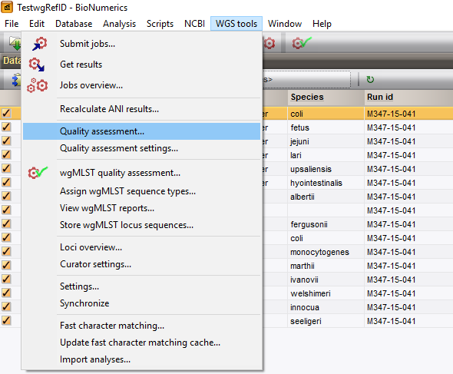
Examination of Sequence Quality-Reference ID Database
Notes:
Choose quality assessment in the WGS tools menu.

Slide 9
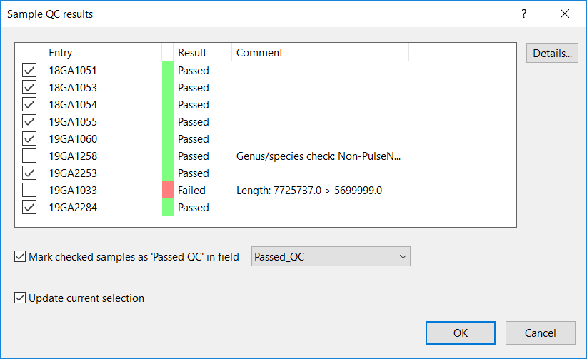
Examination of Sequence Quality-Reference ID Database

Slide 10
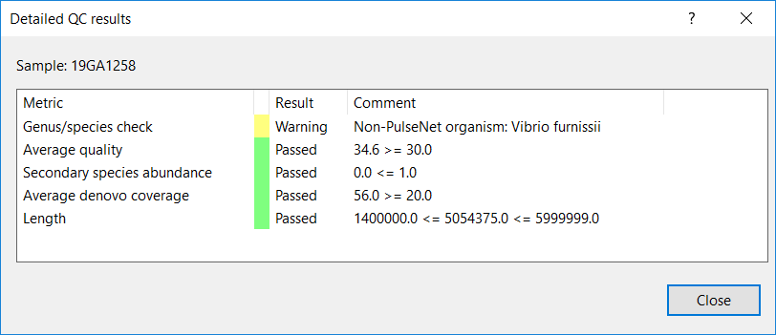
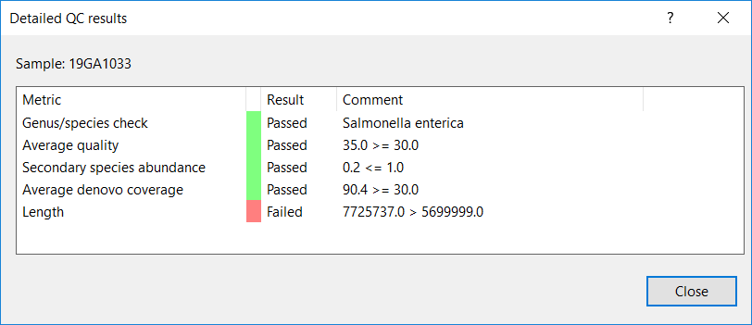
Examination of Sequence Quality-Reference ID Database

Slide 11
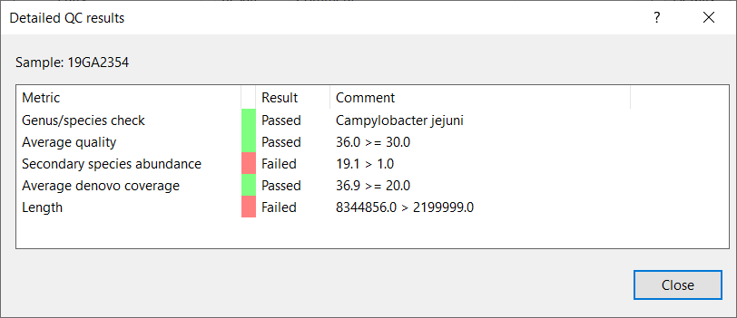
Examination of Sequence Quality-Reference ID Database
Notes:
Secondary species abundance: contamination detection using MIDAS
If the value is ≥1, contamination was detected in the sequence
The value denotes the percentage of the genome that contains DNA identified to an organism different than that identified using ANI

Slide 12
Quality Control in the Organism-Specific databases

Slide 13
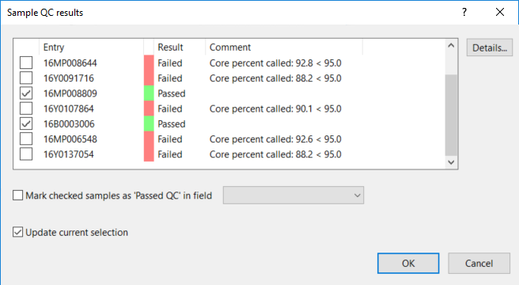
Examination of Sequence Quality-Organism Database

Slide 14
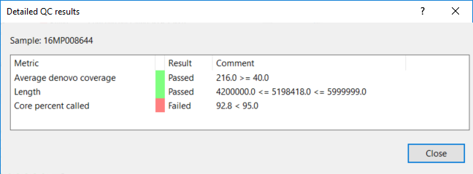
Examination of Sequence Quality-Organism Database
Notes:
This box shows an example of a sequence failing due to core present called. Contact pulsenet is % core value is between 85 and 94% before resequencing an isolate.

Slide 15
Summary
PulseNet has a Quality Management system which includes both Quality Assurance and Quality Control
  The quality control thresholds for BioNumerics are set across the system and analysis should not move forward if a sequence fails a QC check at any point
  PulseNet is continually reviewing its Quality Management System while working with other agencies to harmonize quality control thresholds
  PulseNet central is available for questions at any time from partners

Slide 16




Acknowledgements
Thank You!

