Slide 1
Ohio Animal Disease Diagnostic Laboratory Perspective –
GalaxyTrakr tools and workflows
Melanie Prarat, MS
Ohio Animal Disease Diagnostic Laboratory

Slide 2
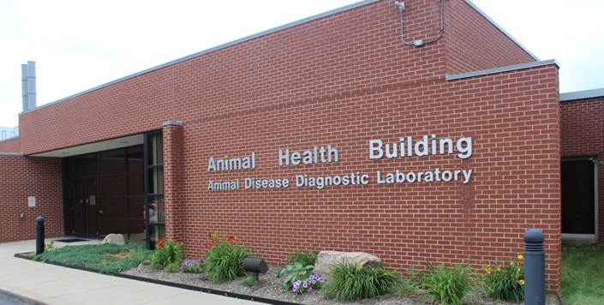
Ohio Animal Disease Diagnostic Laboratory (ADDL)
Full-service veterinary diagnostic laboratory comprised of 8 lab sections
  >400,000 tests/year
Laboratory Networks
  USDA NVSL NAHLN – Level 1
  FDA Vet-LIRN WGS Lab
  FDA GenomeTrakr
ADDL
Pathology
Bacteriology
Virology
Molecular Diagnostics
Serology
Toxicology
Next Generation Sequencing
Avian Diagnostics
Notes:
Lab Sections include Avian Diagnostics, Bacteriology, Molecular Diagnostics, Pathology, Serology, Toxicology, Virology, and Whole Genome Sequencing
We are 1 of 17 states with a Level 1 NAHLN lab
We are 1 of the 5 Whole Genome Sequencing Labs for Vet-LIRN
We are one of the 43 labs in the United States that are part of the GenomeTrakr network

Slide 3
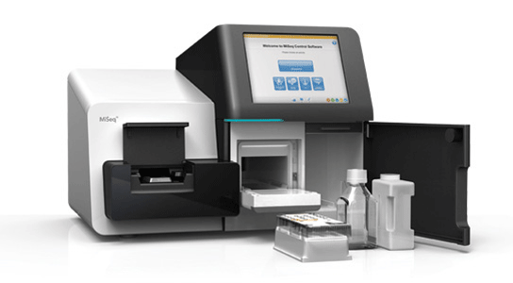
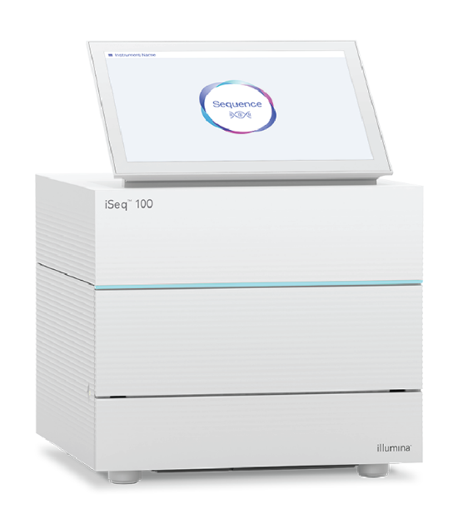
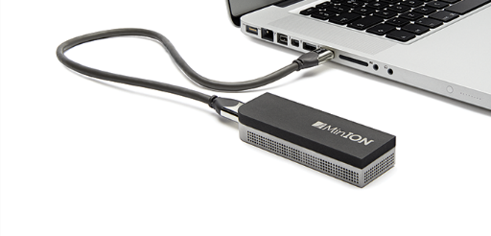
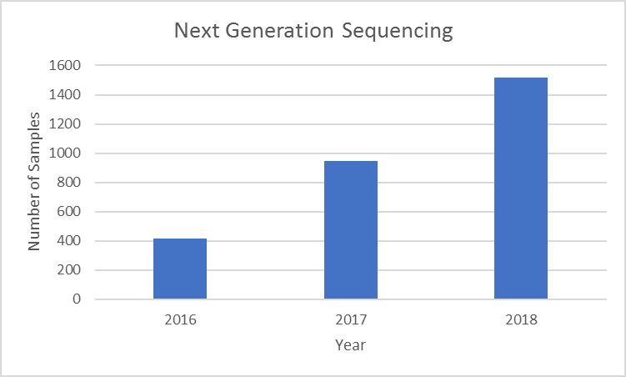
Ohio ADDL WGS Capabilities
Illumina MiSeq (2)
Illumina iSeq (1)
Nanopore MinION (1)
2019: ISO 17025 accredited whole genome sequencing method
Notes:
In 2016 we sequenced 418 isolates
In 2017 we sequenced 948 isolates
In 2018 we sequenced 1,515 isolates

Slide 4


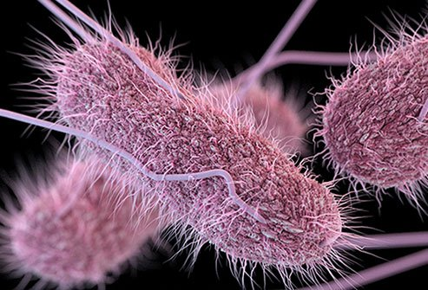
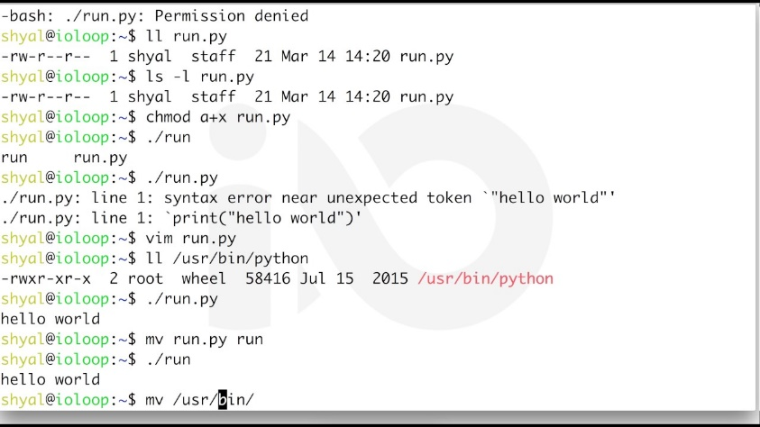
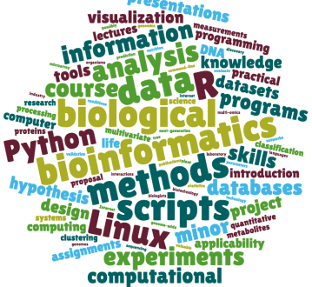
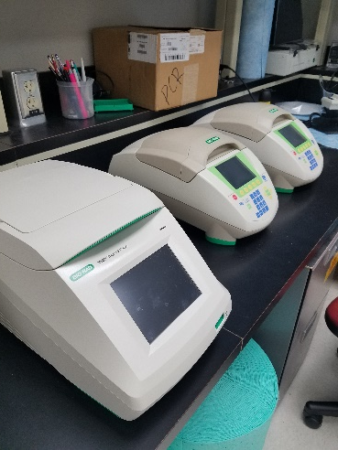

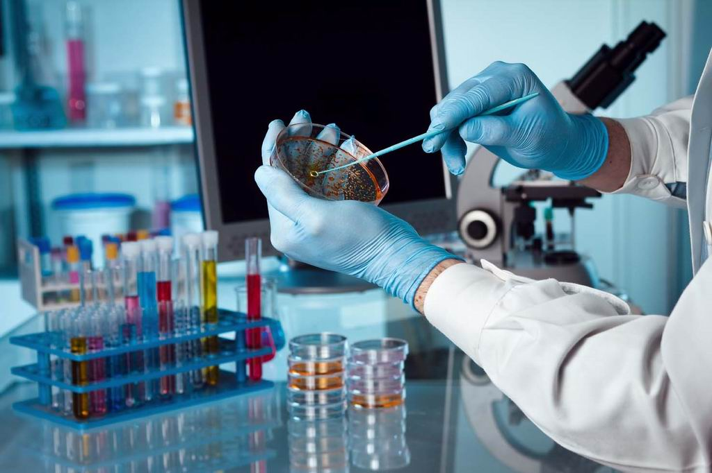
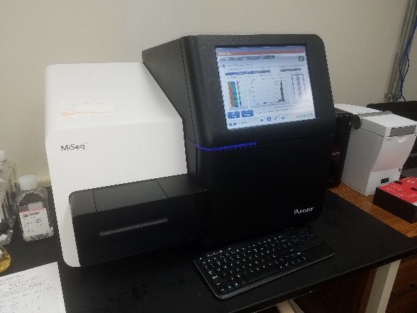

Biology
Bioinformatics
Notes:
WGS analysis integrates two different ‘worlds’ together.
A biologist can easily learn a new procedure, but may run into challenges analyzing massive amounts of data. A bioinformatician can easily write a script to analyze 1 million 250 base pair reads for each sample that come off of a MiSEq, but may be challenged trying to set up a PCR.

Slide 5
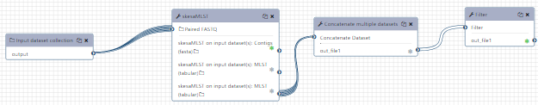
GalaxyTrakr
Implemented to allow laboratories, outside of the FDA internal network, to locally perform quality assessment of their sequence data and look for links between clinical isolates and positive food/environmental samples
Create Histories and Share Data
Upload Data
Tools
  QC
  Mapping
  Assembly
  Screening and Prediction
  Annotations
  Phylogenetics
Workflows
Example of a GalaxyTrakr workflow: MicroRunQC (Errol Strain)
Notes:
Galaxy is an open-source, web-based platform that allows non-bioinformaticians to analyze WGS data

Slide 6
GalaxyTrakr Workflows
End-to-end workflows: sample import – quality control & trimming – de novo assembly – serotype & AMR prediction – phylogenetic analysis – tree visualization
Benefits
  Curated tools
  Harmonized data output and organization across laboratories
  Consistent data interpretation of analysis results

Slide 7
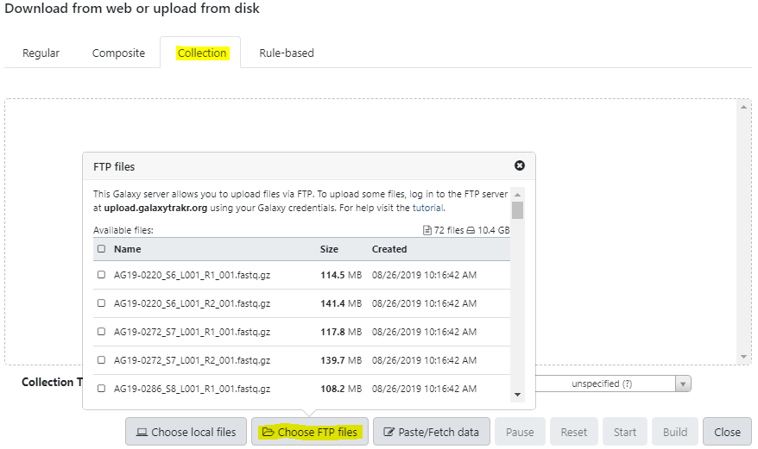
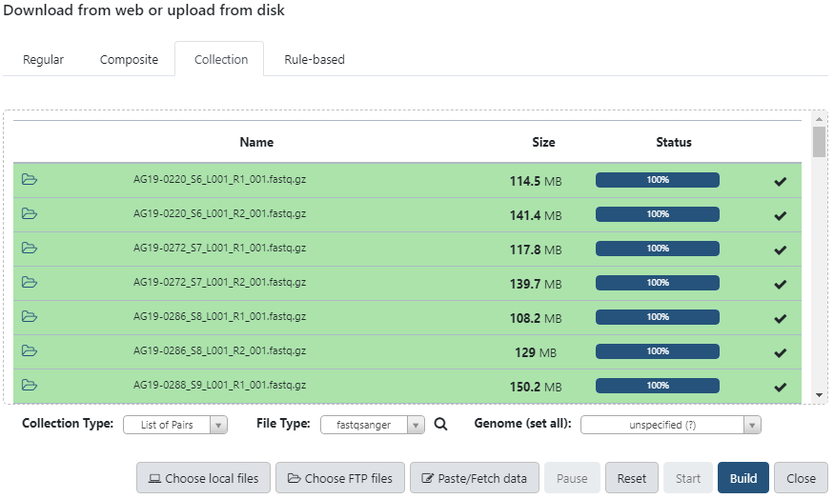
Current Workflow at Ohio ADDL
Get Data – use FTP to transfer all FASTQs files from a completed run into GalaxyTrakr
20-30 minutes to upload 72 FASTQs from MiSeq into FTP
<2 minutes to upload 72 FASTQs from FTP into GalaxyTrakr

Slide 8
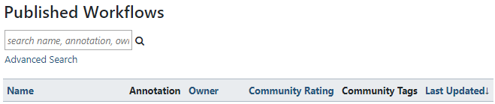
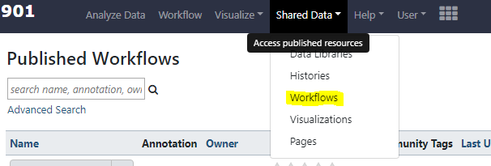
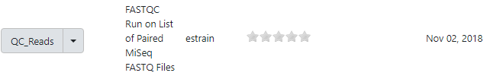

Current Workflow at ADDL
Quality checks
  Reads – QC_Reads workflow
  Assemblies – MicroRunQC workflow
3 minutes to run QC_Reads workflow on 72 FASTQs
11 minutes 30 seconds to run MicroRun QC workflow on 36 assemblies
Notes:
An automated email is sent once a workflow is complete
Both workflows concatenate the multiple datasets for each sample into a single table that can be used in reports

Slide 9
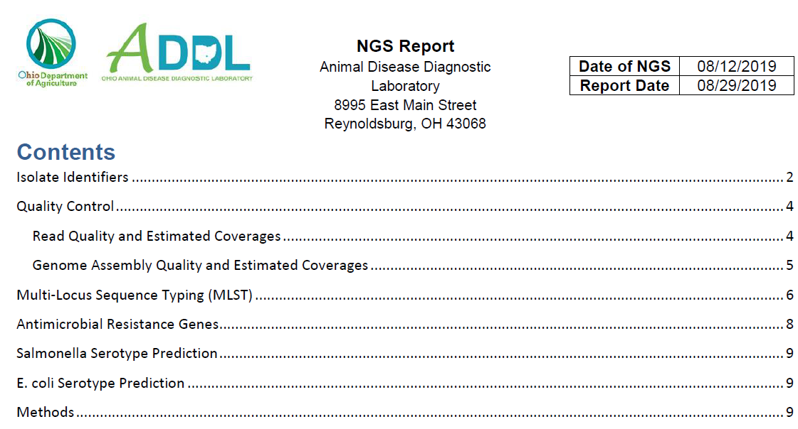
Current Workflow at ADDL
Screening and prediction tools – Salmonella serotype, E. coli serotype, AMR prediction
Report Generation – Run-specific, client-specific, investigation-specific…
Notes:
The output formats vary. Some need to be unzipped and then imported into Excel using the Combine Binaries power query tool

Slide 10
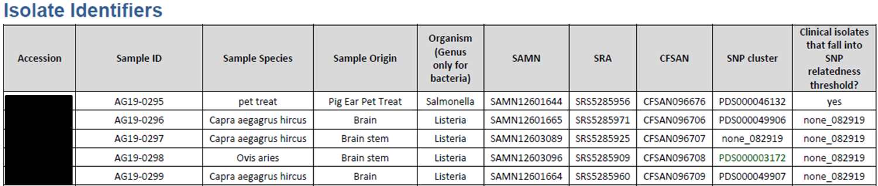
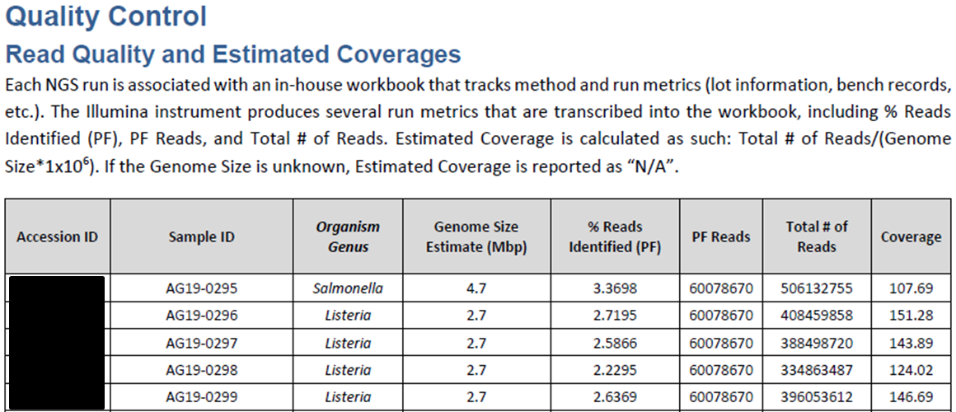
Current Ohio ADDL WGS Report
Notes:
Screenshots of actual reports.
These two tables are the only two that do not require GalaxyTrakr to generate.

Slide 11
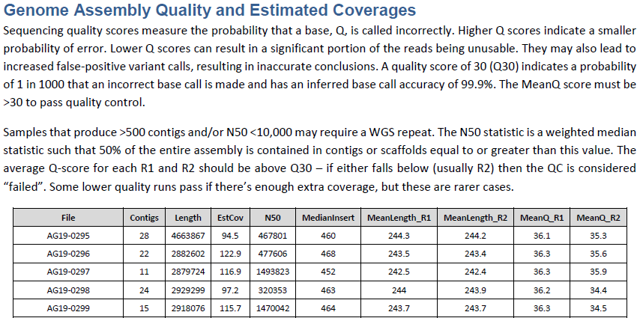
Current Ohio ADDL WGS Report
Notes:
These reports are shared with section heads and potentially state or federal partners who are not intimately familiar with the WGS analysis so I learned that I need to include descriptions of each section in the report.
This table is output from the MicroRunQC workflow.

Slide 12
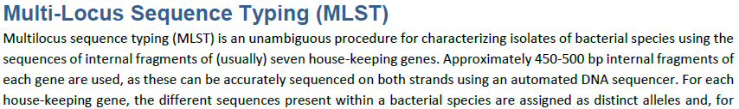
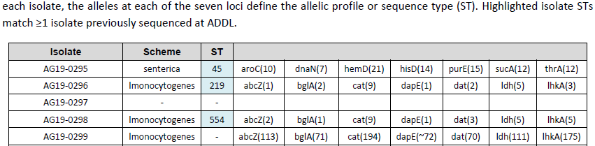
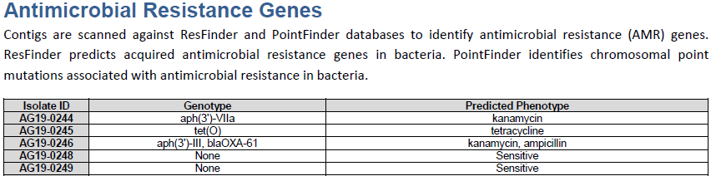
Current Ohio ADDL WGS Report
Notes:
This table is output from the MicroRunQC workflow.
GalaxyTrakr has several AMR prediction tools available at this time. I like staramr because of the output table.

Slide 13
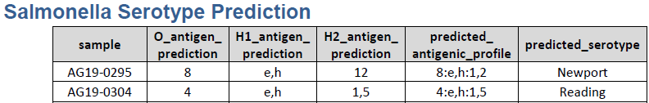
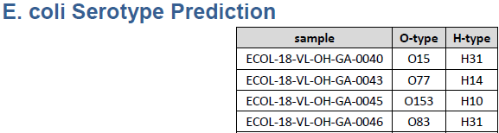
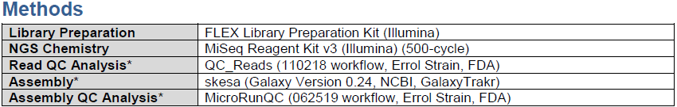
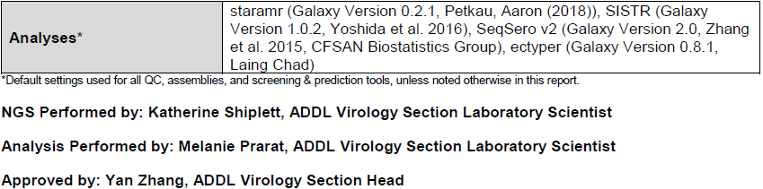
Current Ohio ADDL WGS Report

Slide 14
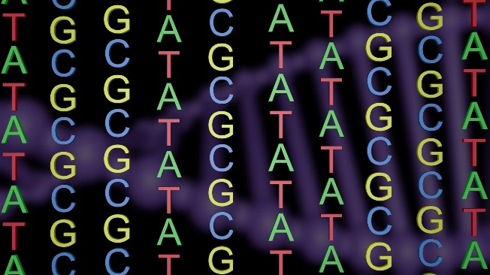

Information Requested by FDA for WGS Review
Method SOPs – DNA Extraction, Library Preparation
Analytical worksheets including starting date, completion date, results
NCBI identifiers – SAMN, SRA, CFSAN
Future – QC analysis? AMR prediction?
Notes:
As time goes on, sequence data will be used more often for outbreak investigations and genotyping.
We’ve received requests directly from Vet-LIRN but also from CVM’s Division of Compliance.
Our worksheets are developed in-house, reviewed by the section supervisor and laboratory director, then made accessible using our quality system software.
We recently received ISO 17025 accreditation of our WGS method used for sequencing of bacteria.

Slide 15


Foodborne Outbreaks in the Era of Whole Genome Sequencing
In the past decade, the cost of sequencing a whole genome has dropped 1000-fold¹
FDA, USDA & CDC are replacing many classic laboratory methods with WGS
  Outbreak investigations of foodborne pathogens
  Antimicrobial Resistance
NCBI Pathogens Browser, as of 7/15/2019:
  35,946 sequences from FSIS
  37,085 sequences from FDA
  100,246 sequences from CDC
  401,293 sequences from 28 organisms
https://www.ncbi.nlm.nih.gov/pathogens/
1. National Institutes of Health (NIH). National Human Genome Research Institute. The Cost of Sequencing a Human Genome. https://www.genome.gov/27565109/the-cost-of-sequencing-a-human-genome/. (2016).
Notes:
Decreased reliance on non-WGS technologies seen in many federal agencies tasked with outbreak response and investigation.
USDA FSIS has been using WGS since 2015 for routine use in investigating foodborne illnesses caused by Listeria, Campylobacter, STEC, and Salmonella. In 2018, WGS replaces PFGE for subtyping Listeria.
PulseNet has been using WGS since 2016 to support analysis of Salmonella WGS data to investigate outbreaks. In 2017, PulseNet started to use WGS to support Campylobacter jejuni outbreaks. CDC has spent years validating their wgMLST schemes - as of July 15, 2019 PulseNet no longer uses PFGE for any outbreak investigations.

Slide 16
Foodborne Outbreaks in the Era of Whole Genome Sequencing – What’s Next?
Continue to develop criteria for the application of WGS in regulatory decision making
  SNP analyses, K-merFinder, ResFinder and other tools
  GalaxyTrakr
Ability to rapidly identify new genotypes, genes of concern, predict phenotypes
Readily accessible data and user-friendly analysis and interpretation tools
Discussion and clarification on legal and regulatory issues
Standardization of WGS methods, simplified WGS-related communication, availability of WGS training and continuing education
Notes:
It is clear that more agencies and labs are depending on WGS to make decisions about identification of outbreak clusters, recalls, antimicrobial resistance genotypes and genes, etc.
What are the priorities when it comes to using WGS in the regulatory arena?

Slide 17
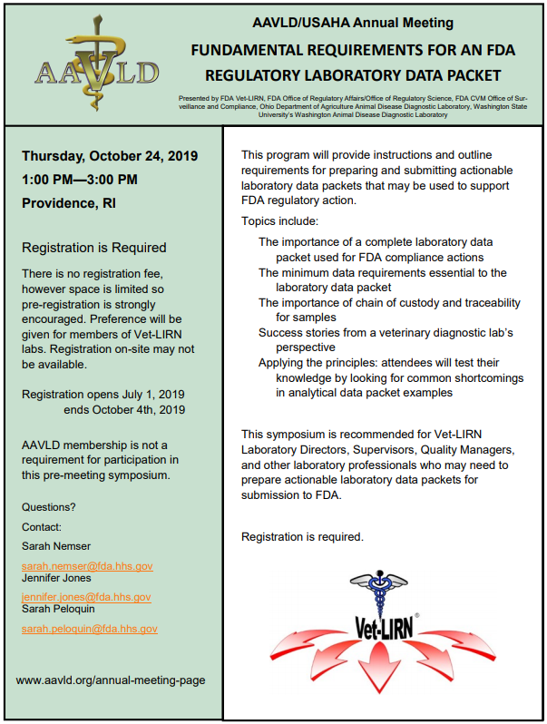

Be on the lookout!
Publication in progress using GalaxyTrakr for public health whole genome sequence data accessible to non-bioinformaticians
AAVLD – FDA Laboratory Data Packets

Slide 18
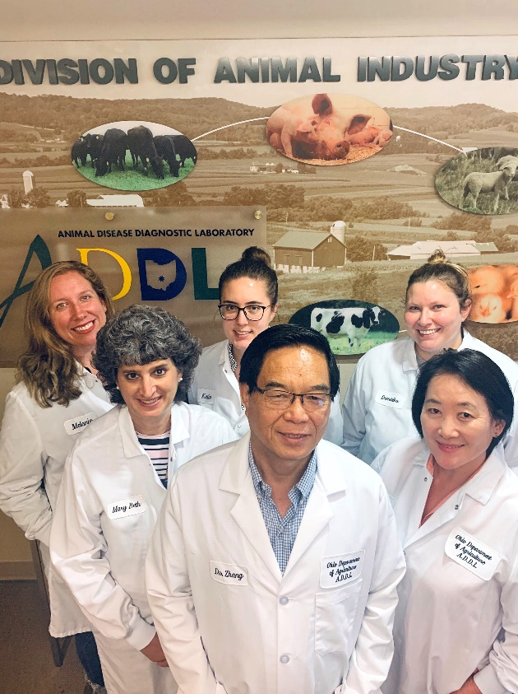
Acknowledgements & Thank You!
Ohio Department of Agriculture ADDL – Yan Zhang, Jing Cui, Katherine Shiplett, Dominika Jurkovic
Ohio Department of Health – Eric Brandt
FDA Vet-LIRN
FDA GenomeTrakr
FDA GalaxyTrakr
Any Questions?
melanie.prarat@agri.ohio.gov

