Slide 1
QA/QC Through GalaxyTrakr
Errol Strain
FDA Center for Veterinary Medicine
GenomeTrakr Meeting 2019

Slide 2
Overview
Why Do We Need QC in GalaxyTrakr?
GenomeTrakr/PulseNet Thresholds
  Survey of Pathogen Detection Isolates
Galaxy Workflow
  MicroRunQC
  MicroRunKraken2
Next Steps

Slide 3
Why QC in Galaxy?
Labs participating in real time pathogen surveillance networks need a check data quality before NCBI submission
  GenomeTrakr, NARMS, Vet-LIRN, PulseNet*
  Detect mistakes/errors as fix them as quickly as possible
Not all labs have a bioinformatician
  Even those with bioinformaticians may want to consider Galaxy
Not all labs have access to bioinformatics software and/or scientific workstations
  GalaxyTrakr runs in AWS, only requirement is Firefox/Chrome browser to connect

Slide 4
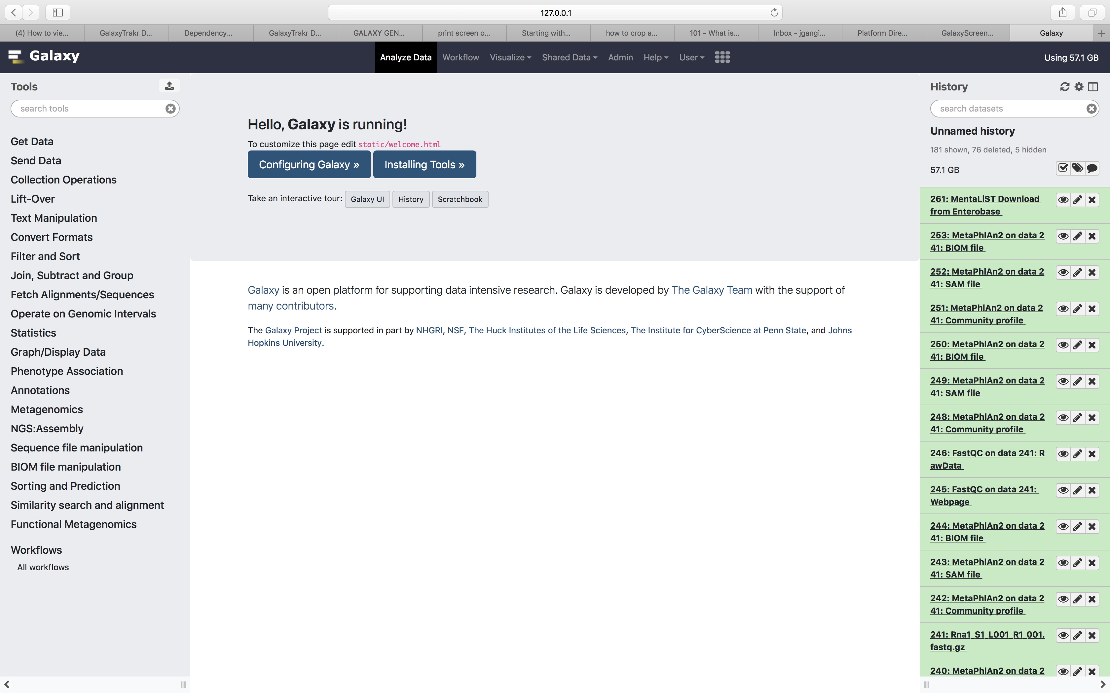
https://galaxytrakr.org
Linux-based computational system that enables users to perform genomic analyses by providing a unified, web-based interface for obtaining genomic data and applying data analysis tools.
TOOLS
INTERFACE
HISTORY

Slide 5
Quality Thresholds
Quality metric | Salmonella | Listeria | Escherichia/ Shigella | Campylobacter | Vibrio para.
Average read quality Q score for R1 and R2 | >=30 | >=30 | >=30 | >=30 | >=30
Average coverage | >=30X | >=20X | >=40X | >=20X | >=40X
De novo assembly: Seq. length (Mbp) | ~4.4-5.6 | ~2.8-3.1 | 4.2-5.9 | ~1.4-2.2 | ~4.9-5.5
De novo assembly: contigs | <=400 | <=200 | <=600 | <=200 | <=200

Slide 6
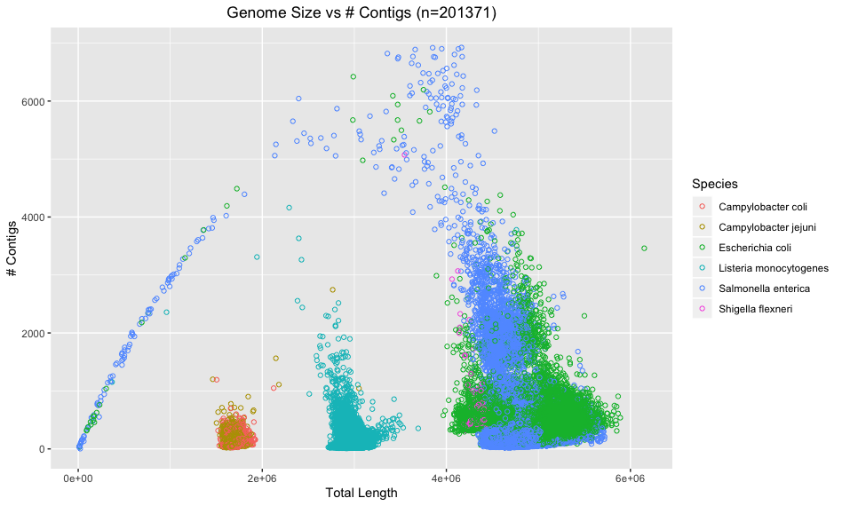

Slide 7
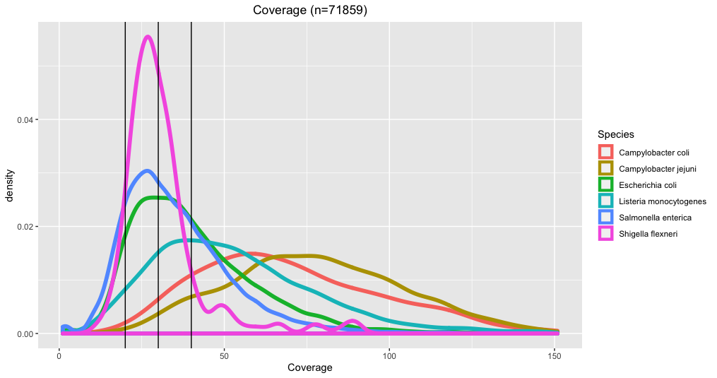
Campy
Listeria
Salmonella
E.coli
Shigella

Slide 8
SKESA Assemblies
(n=201371)
 |  |  | Percentiles
Species | Parameter | Mean | 1% | 5% | 95% | 99%
Campylobacter coli | Length | 1719280 | 1576385 | 1633346 | 1843165 | 1901435
Campylobacter coli | Contigs | 135 | 28 | 39 | 360 | 526
Campylobacter coli | N50 | 67020 | 6689 | 10523 | 162499 | 169540
Campylobacter jejuni | Length | 1680478 | 1574021 | 1596047 | 1776030 | 1818521
Campylobacter jejuni | Contigs | 113 | 32 | 40 | 269 | 455
Campylobacter jejuni | N50 | 64561 | 7918 | 14879 | 140372 | 166390
Escherichia coli | Length | 5055361 | 4252587 | 4379845 | 5426311 | 5536572
Escherichia coli | Contigs | 464 | 107 | 164 | 793 | 1715
Escherichia coli | N50 | 66721 | 5287 | 17503 | 145329 | 191207
Listeria monocytogenes | Length | 2971544 | 2810762 | 2852991 | 3104566 | 3163466
Listeria monocytogenes | Contigs | 92 | 16 | 20 | 303 | 784
Listeria monocytogenes | N50 | 259825 | 7517 | 23731 | 541796 | 1458094
Salmonella enterica | Length | 4753724 | 4466741 | 4546637 | 4998221 | 5145413
Salmonella enterica | Contigs | 208 | 37 | 49 | 485 | 1857
Salmonella enterica | N50 | 108720 | 4246 | 21773 | 266999 | 403435
Shigella flexneri | Length | 4400771 | 4234124 | 4318545 | 4479041 | 4516205
Shigella flexneri | Contigs | 571 | 384 | 420 | 748 | 1267
Shigella flexneri | N50 | 24238 | 7478 | 15244 | 29074 | 33535

Slide 9
SKESA Assemblies
(Salmonella n=139901)
 |  |  | Percentiles
Species | Parameter | Mean | 1% | 5% | 95% | 99%
Salmonella enterica | Length | 4753724 | 4466741 | 4546637 | 4998221 | 5145413
Salmonella enterica | Contigs | 208 | 37 | 49 | 485 | 1857
Salmonella enterica | N50 | 108720 | 4246 | 21773 | 266999 | 403435
Quality metric | Salmonella
De novo assembly: Seq. length (Mbp) | ~4.4-5.6
De novo assembly: contigs | <=400
35 out of 139901 > 5.6MB
8% of data would fail based on # of contigs

Slide 10
SKESA Assemblies
(Ecoli = 39315, Shigella=1018)
 |  |  | Percentiles
Species | Parameter | Mean | 1% | 5% | 95% | 99%
Escherichia coli | Length | 5055361 | 4252587 | 4379845 | 5426311 | 5536572
Escherichia coli | Contigs | 464 | 107 | 164 | 793 | 1715
Escherichia coli | N50 | 66721 | 5287 | 17503 | 145329 | 191207
Shigella flexneri | Length | 4400771 | 4234124 | 4318545 | 4479041 | 4516205
Shigella flexneri | Contigs | 571 | 384 | 420 | 748 | 1267
Shigella flexneri | N50 | 24238 | 7478 | 15244 | 29074 | 33535
Quality metric | Escherichia/ Shigella
De novo assembly: Seq. length (Mbp) | 4.2-5.9
De novo assembly: contigs | <=600
E.coli – 1 out of 39315 > 5.9
E.coli – 18% failure
Shigella – 22% failure

Slide 11
SKESA Assemblies
(Cc =677 , Cj=3213)
 |  |  | Percentiles
Species | Parameter | Mean | 1% | 5% | 95% | 99%
Campylobacter coli | Length | 1719280 | 1576385 | 1633346 | 1843165 | 1901435
Campylobacter coli | Contigs | 135 | 28 | 39 | 360 | 526
Campylobacter coli | N50 | 67020 | 6689 | 10523 | 162499 | 169540
Campylobacter jejuni | Length | 1680478 | 1574021 | 1596047 | 1776030 | 1818521
Campylobacter jejuni | Contigs | 113 | 32 | 40 | 269 | 455
Campylobacter jejuni | N50 | 64561 | 7918 | 14879 | 140372 | 166390
Quality metric | Campylobacter
De novo assembly: Seq. length (Mbp) | ~1.4-2.2
De novo assembly: contigs | <=200
C.coli – 16% failure
C.jejuni – 10% failure

Slide 12
SKESA Assemblies
(Listeria - 17247)
 |  |  | Percentiles
Species | Parameter | Mean | 1% | 5% | 95% | 99%
Listeria monocytogenes | Length | 2971544 | 2810762 | 2852991 | 3104566 | 3163466
Listeria monocytogenes | Contigs | 92 | 16 | 20 | 303 | 784
Listeria monocytogenes | N50 | 259825 | 7517 | 23731 | 541796 | 1458094
Quality metric | Listeria
De novo assembly: Seq. length (Mbp) | ~2.8-3.1
De novo assembly: contigs | <=200
5.9% > 3.1 MB
9% Failure

Slide 13
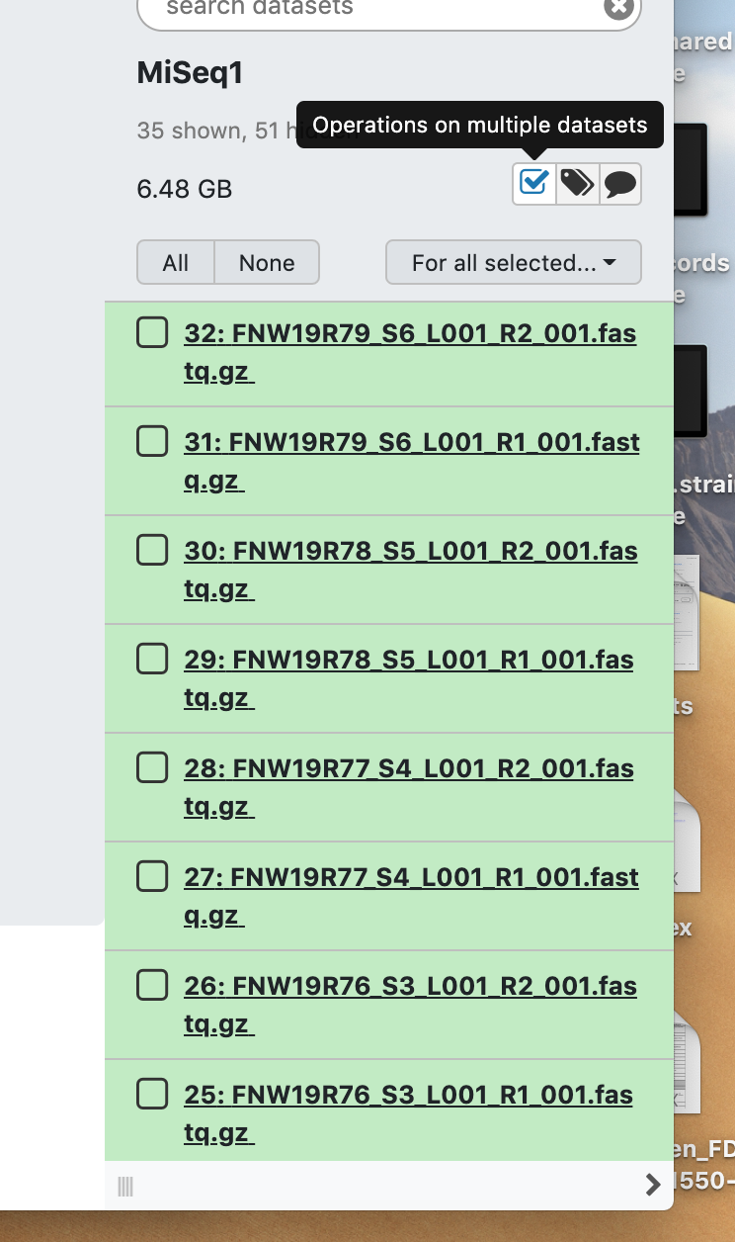
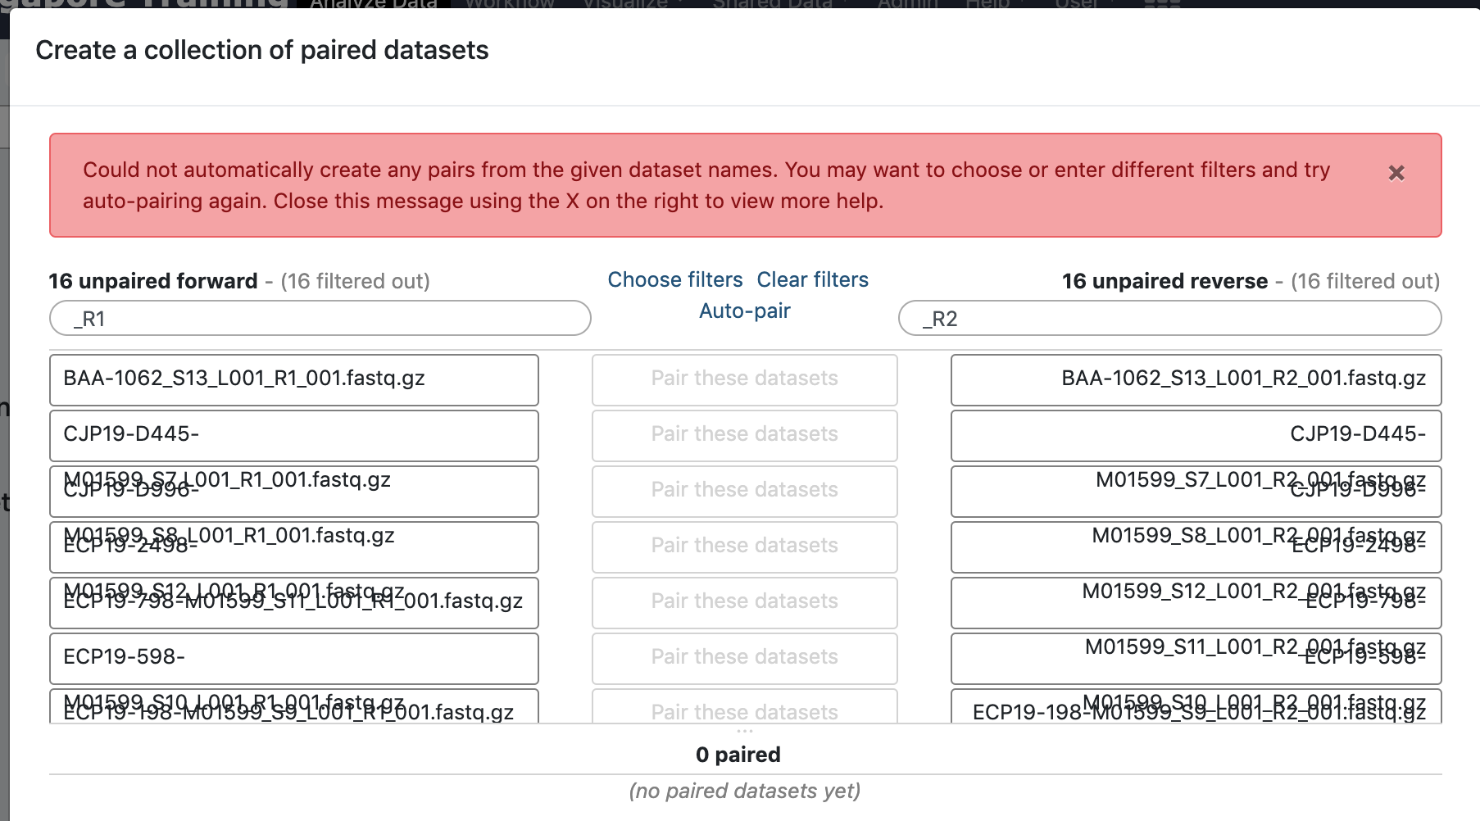
QC in GalaxyTrakr
Goal – Assess sequence quality and confirm identity (species/sequence type)
Create list of pairs for MiSeq runs
Note – Must specify filters in filenames that indicate forward and reverse reads

Slide 14
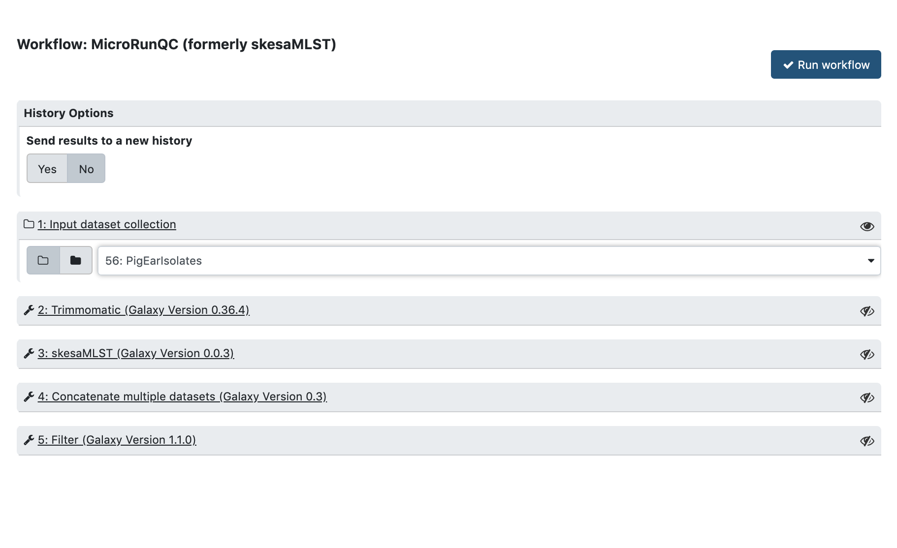
MicroRunQC
Shared Data -> Workflows

Slide 15
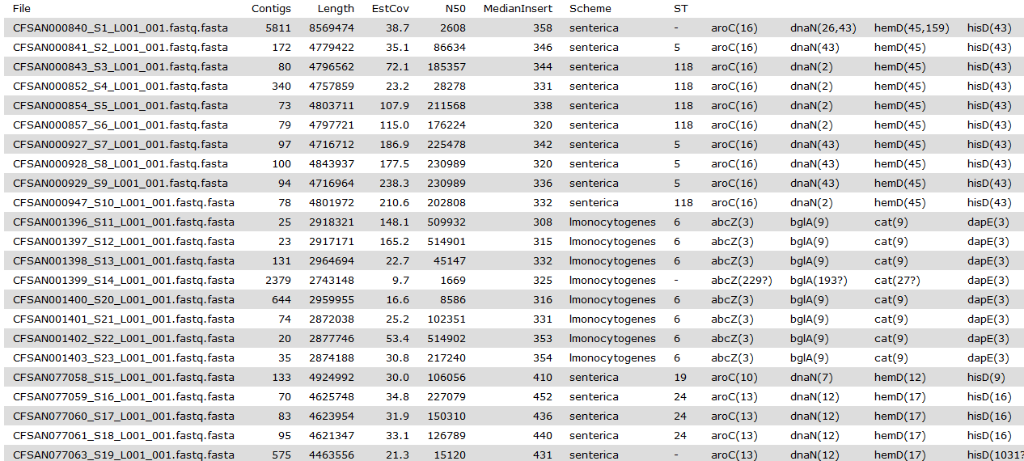
What to Check? SKESA
# of contigs, total length of contigs, estimated coverage, N50, median insert size
Poor assembly, low coverage
Mixture

Slide 16
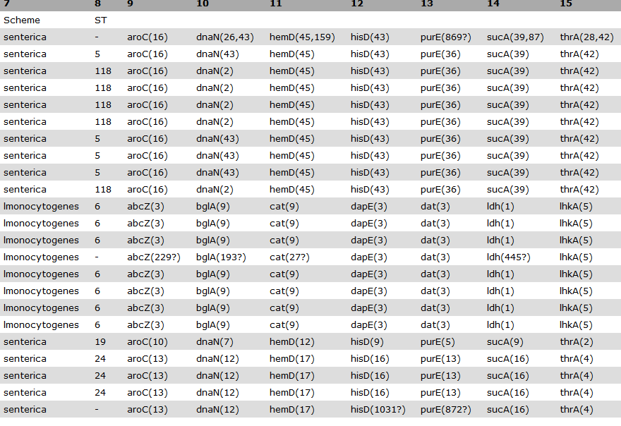
What to check? MLST
Species
Different sources typically have different sequence types

Slide 17
What to check? MLST
Mixture
Low quality run (575 contigs, 21X coverage) – Questionable allele calls

Slide 18
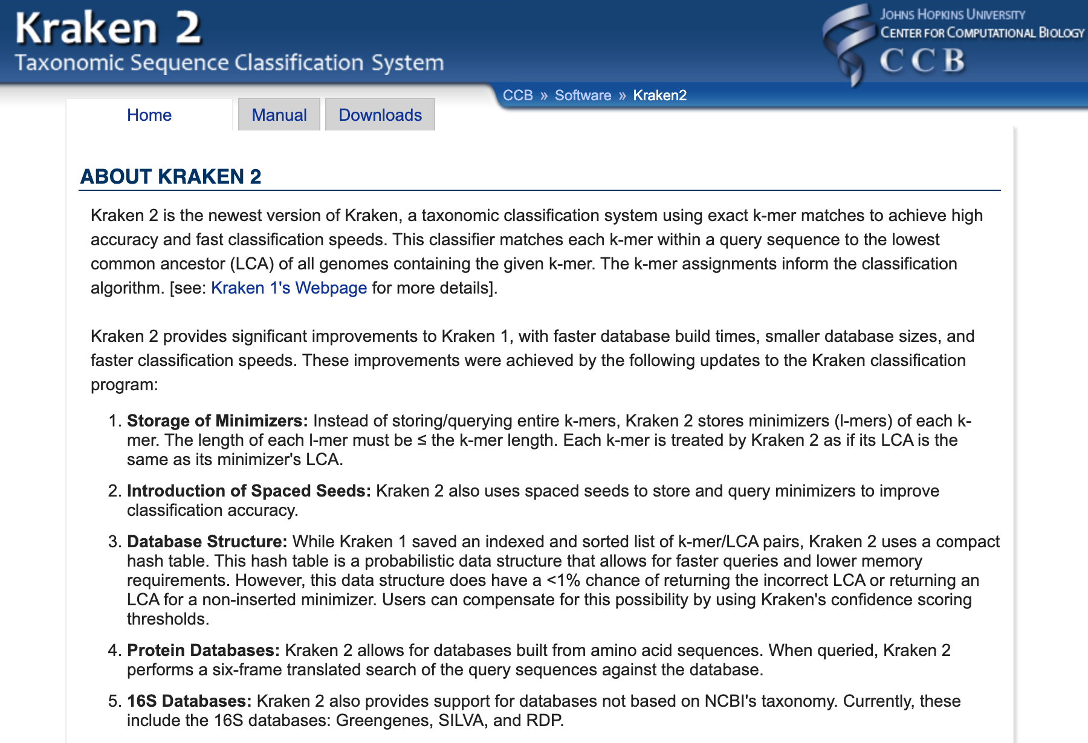
MicroRunKraken2

Slide 19
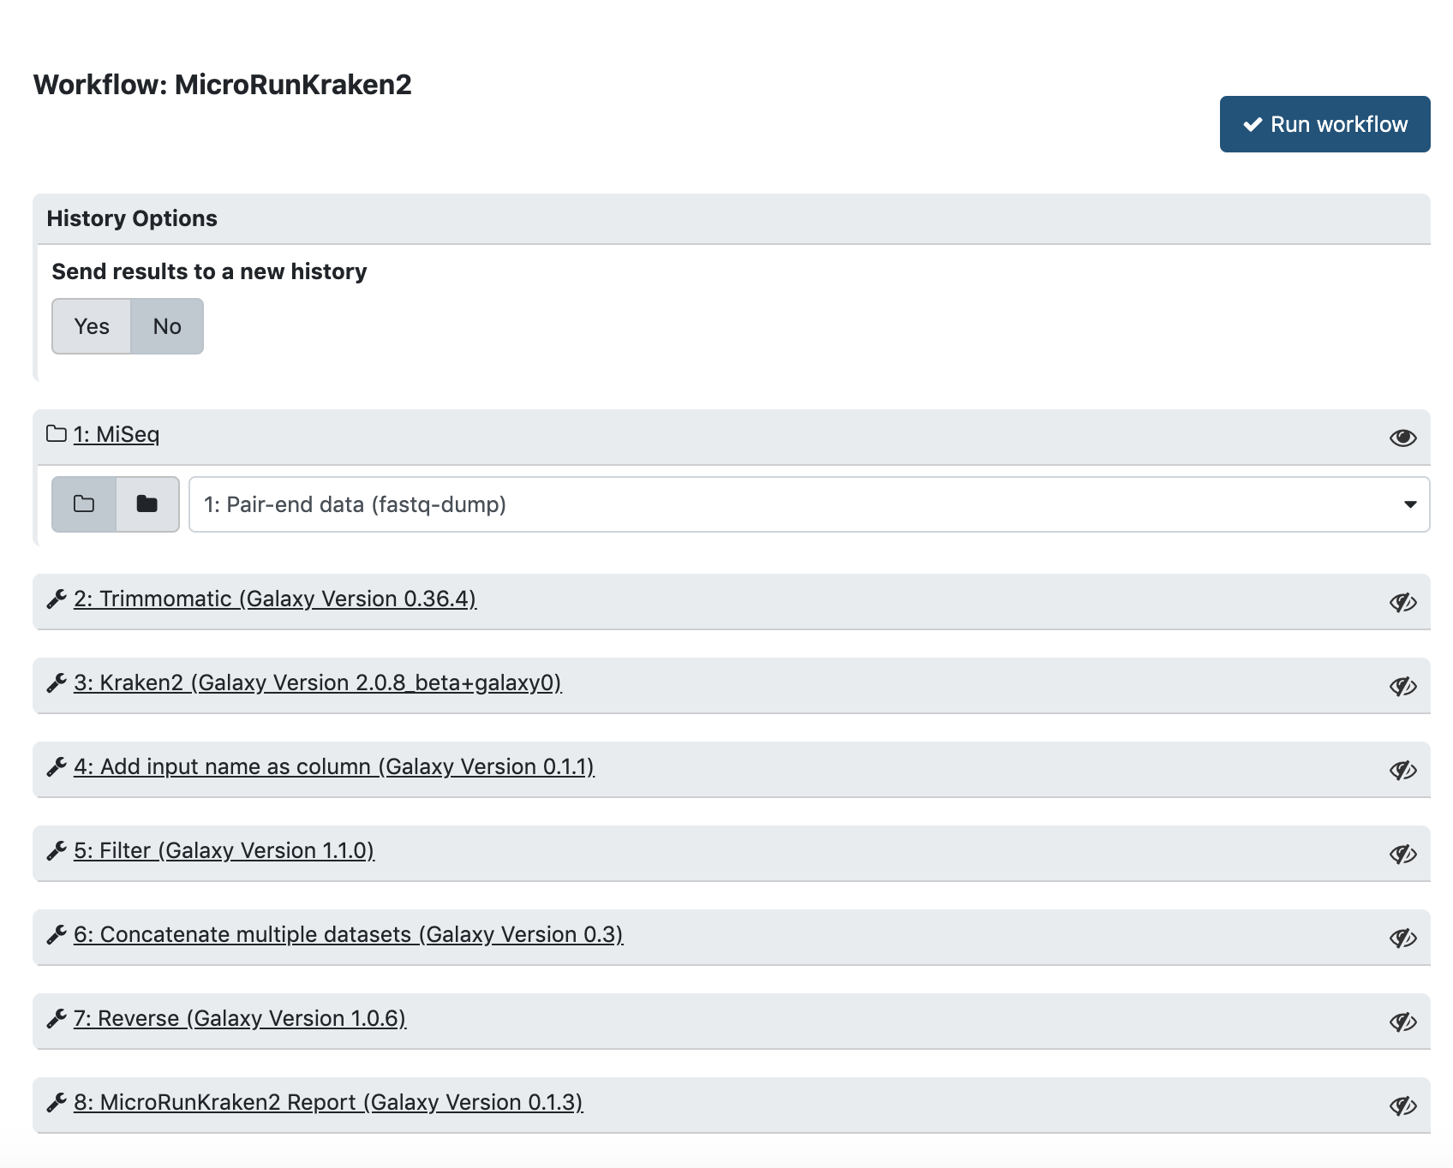
MicroRunKraken2

Slide 20
MicroRunKraken2
Sample | Name | TaxaID | Rank | FragRank | FragTotal | PercentageTotal
SRR1363307 | Salmonella | 590 | G | 6548 | 572873 | 91.36
SRR1363307 | Salmonella enterica | 28901 | S | 455179 | 566307 | 90.31
SRR2074986 | Salmonella | 590 | G | 8564 | 391850 | 88.78
SRR2074986 | Salmonella enterica | 28901 | S | 332544 | 383210 | 86.82
SRR3049944 | Salmonella | 590 | G | 15933 | 829921 | 95.56
SRR3049944 | Salmonella enterica | 28901 | S | 762378 | 813937 | 93.72
SRR3644931 | Listeria | 1637 | G | 38926 | 1240373 | 98.55
SRR3644931 | Listeria monocytogenes | 1639 | S | 1192069 | 1200811 | 95.4
SRR4116047 | Escherichia | 561 | G | 25558 | 1210591 | 71.34
SRR4116047 | Escherichia coli | 562 | S | 1124483 | 1183573 | 69.75
SRR5409483 | Listeria | 1637 | G | 25543 | 389012 | 89.24
SRR5409483 | Listeria monocytogenes | 1639 | S | 360159 | 363164 | 83.31
SRR5409483 | Enterococcus | 1350 | G | 7059 | 34351 | 7.88
SRR5725229 | Salmonella | 590 | G | 4753 | 1041155 | 91.28
SRR5725229 | Salmonella enterica | 28901 | S | 801763 | 1036286 | 90.86
SRR7788264 | Escherichia | 561 | G | 31872 | 628317 | 52.74
SRR7788264 | Escherichia coli | 562 | S | 590514 | 594245 | 49.88
SRR8914694 | Campylobacter | 194 | G | 55678 | 480702 | 99.22
SRR8914694 | Campylobacter jejuni | 197 | S | 383644 | 421806 | 87.07
SRR10068115 | Campylobacter | 194 | G | 106513 | 684754 | 40.02
SRR10068115 | Campylobacter jejuni | 197 | S | 262821 | 270341 | 15.8
SRR10068115 | Campylobacter helveticus | 28898 | S | 242300 | 242300 | 14.16

Slide 21
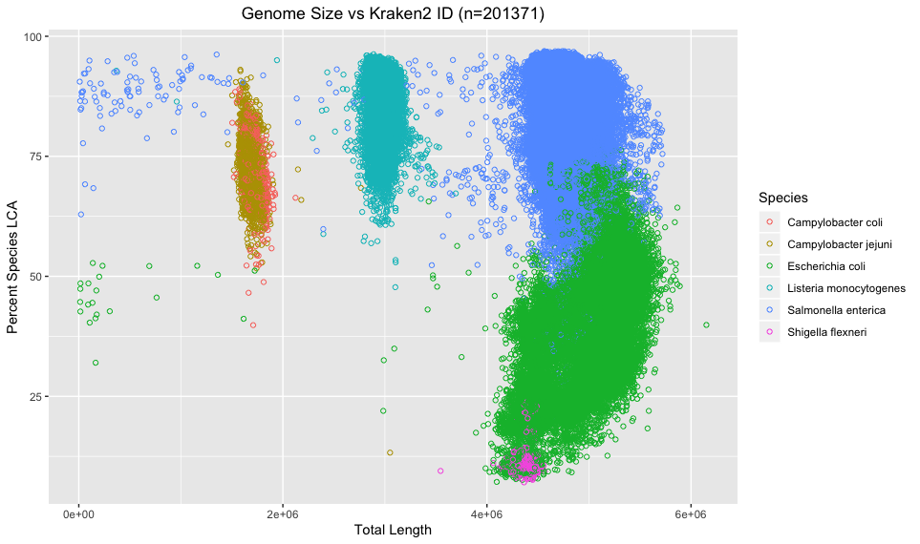

Slide 22
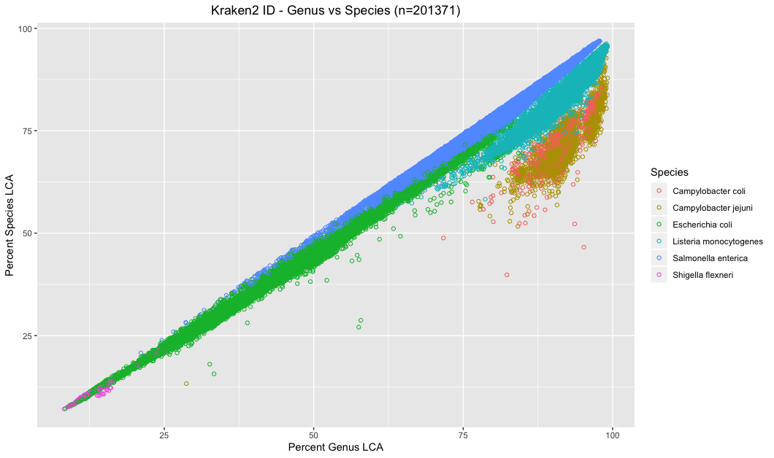

Slide 23
MicroRunKraken2
Species | Mean % | 1% | 5% | 95% | 99%
S. enterica | 85 | 65 | 72 | 94 | 95
E. coli | 42 | 11 | 20 | 59 | 69
C. jejuni | 71 | 60 | 64 | 82 | 87
S. flexneri | 12 | 8 | 9 | 21 | 23
C. coli | 72 | 54 | 62 | 82 | 86
L. monocytogenes | 86 | 70 | 75 | 94 | 95

Slide 24
What’s Next?
We need to increase reliability of GalaxyTrakr service
  Slow downs during peak usage
Provide cgMLST matching tool
  What is the nearest neighbor from Pathogen Detection/SRA
Provide phenotypic/functional information
  AMRfinder

Slide 25
Thank You
CFSAN
Justin Payne
Charles Strittmatter
Hugh Rand
Jimmy Sanders
James Pettengill
Arthur Pightling
Yan Luo
Yu Wang
Joseph Baugher
Jayanthi Gangiredla
Tom Farrell
Kelly Bunning
CVM
Pat McDermott
Chih-Hao Hsu
Claudia Lam
Gordon Martin
Jason Abbott

