Slide 1
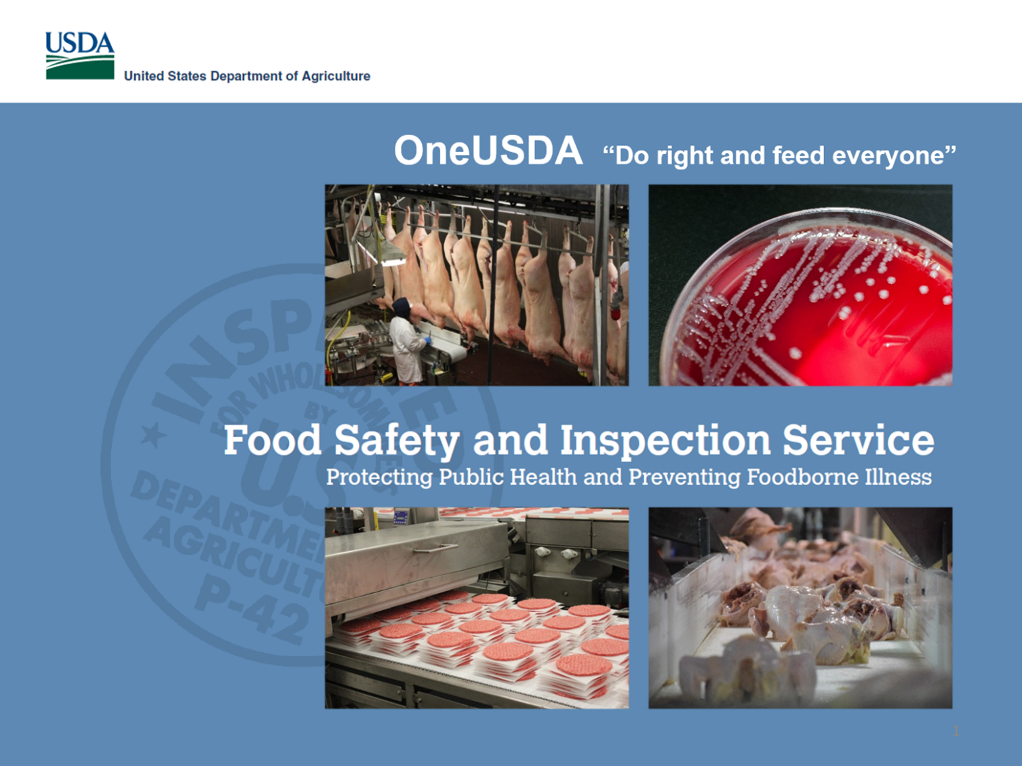

Slide 2
USDA-FSIS Transition to WGS
Mary Katherine Crews
Microbiologist
Eastern Laboratory Microbiology Characterization Branch
Office of Public Health Science
Food Safety and Inspection Service, USDA
GenomeTrakr Meeting
Sept. 17th, 2019

Slide 3
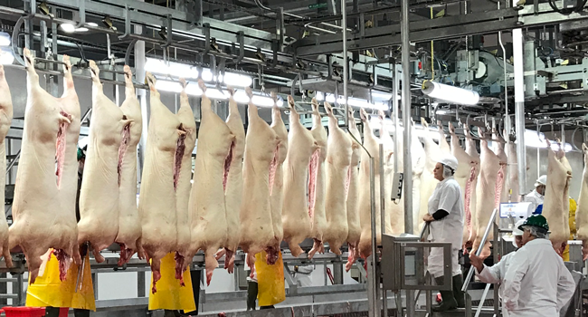
Overview of FSIS
Public health agency in the U.S. Department of Agriculture responsible for ensuring that the nation's commercial supply of meat, poultry, and egg products is safe, wholesome, and correctly labeled and packaged.
FSIS-regulated commodities:
  Red meat = beef, veal, pork, minor species; raw and RTE (ready-to-eat) products
  Poultry = chicken, turkey, minor species; raw and RTE products
  Eggs = dried, frozen, and liquid (non-intact) egg
About 6479+ Establishments
Over 7970 Inspection Personnel
>100K Microbiological samples/year
>256,333 Micro analyses/year
~7,000 regulatory bacterial isolates
~6000 NARMS cecal isolates

Slide 4
Sequencing capacity at FSIS
In 2018, 12,336 isolates were sequenced and uploaded to NCBI
Notes:
We generate a lot of data. The challenge is to find a way to condense the information into a format that is easily understandable to others who may not be experts in the field.

Slide 5
WGS Updates
Three FSIS Field Service Laboratories with 14 MiSeqs
Experimenting with using Illumina FLEX kits for library preparation
Evaluating the utility of Nanopore MinION technology for long reads
WGS FAQ Document for stakeholders is forthcoming
BioNumerics 7.6
20 analysts PulseNet certified for FASTQ generation
5 analysts PulseNet certified for analyses in BioNumerics 7.6
Fully transitioned away from PFGE on April 1st for all organisms
Uploading all isolates in real time to the PulseNet National database
Notes:
Whole Genome Sequencing Integration Workgroups
Greater communication between offices within FSIS
Training
Transparency
FAQs
3 bioinformaticists on staff
Flex – a little more costly and more hands on time. May help with reducing repeat rates for Campy – better N50 and assemblies. More costly
MinION – worked with USDA-ARS for a workflow for this. Gives us a way to look at closing plasmids. Will explore more in the next fiscal year. Publication coming soon.
Issues with BioNumerics – speed. Spend most of our time trying to submit or bring down jobs – little time for cluster detection. Mostly use the pathogen detection browser to get automated alerts when clinical isolates are within a close SNP range of one of our isolates.

Slide 6
WGS Updates
BioNumerics 7.6 Transition
Not currently including all isolates collected from ceca (NARMS)
The volume of isolate submissions to PulseNet causes slow downloads/uploads
Using Listeria monocytogenes allele codes for reporting results
Identifying illness clusters through multiple means
  NCBI Pathogen Detection Browser (email notifications)
  CDC Sharepoint
  PulseNet National Database
Notes:
Email notifications – cutoffs
Salmonella – 0 SNPS
Shiga toxin-producing Escherichia coli - <10 SNPs
Lm - <20 SNPs

Slide 7
Tracking Repeats
Analyzed Repeats from Jan. 1, 2019 – July 31st, 2019
On average ~10.8% of isolates needed to be repeated
Notes:
Reasons for repeat – pipette error, new analysts, inaccurate qubit readings, random error, reagent inconsistencies from lot to lot

Slide 8
Tracking Repeats
~86% of isolates are resolved upon re-sequencing
~1.1% of isolates require re-sequencing a 3rd time
Total
sequenced
(% repeated):
4061
(10.2%)
65
(9.2%)
692
(2.7%)
76
(1%)

Slide 9
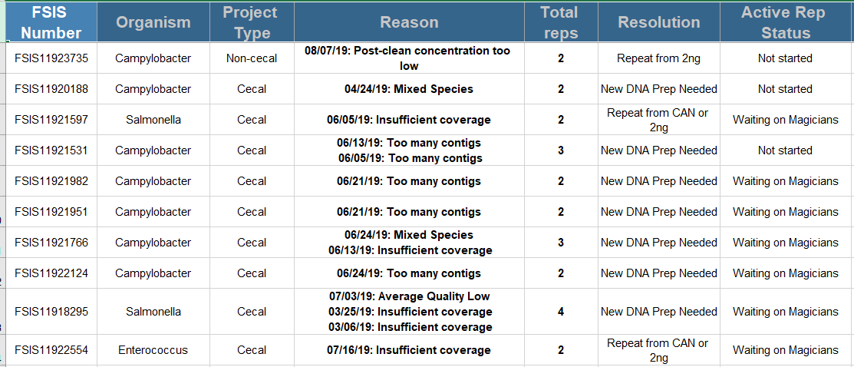
Tracking Repeats
The “Reason for Repeat” report provides analysts with:
A list of isolates that need to be repeated
Next steps to take based on the reason
Current status of the isolate

Slide 10
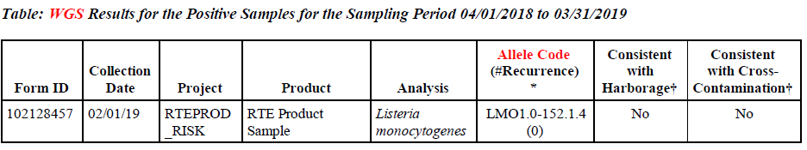
WGS for HACCP Verification – Quarterly Letters
Quarterly letters are sent to establishments with Salmonella, E. coli O157:H7, non-O157 STEC, and Lm positives.
Includes sampling results for the establishment and industry averages
WGS data will include:
  Allele codes
  WGS-predicted antimicrobial resistance profile
  WGS-derived serotype
00001
Notes:
Past letters included PFGE patterns, AMR phenotype, molecular serology
Letters will not include accession numbers.
Establishment Specific datasets are posted on the FSIS website.

Slide 11
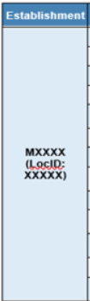
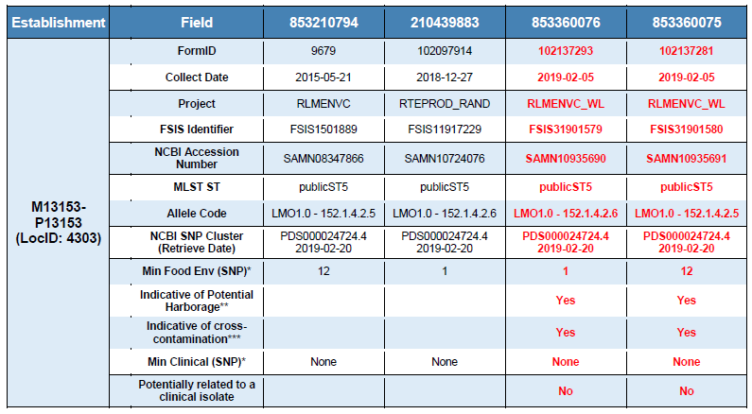
WGS for HACCP Verification – Lm Reports

Slide 12
WGS for HACCP Verification - Lm Reports

Slide 13
WGS: Use in Outbreaks and Extended Investigations
Salmonella I 4,[5],12:i:- in Pork (2015-2016)
Listeria monocytogenes Country Hams (2018)
Listeria monocytogenes Cha Chien (2018)
Salmonella Reading in Turkey (2018-2019)
Salmonella Newport in Beef (2018-Current)
Salmonella Infantis in Chicken (2016-2019)

Slide 14
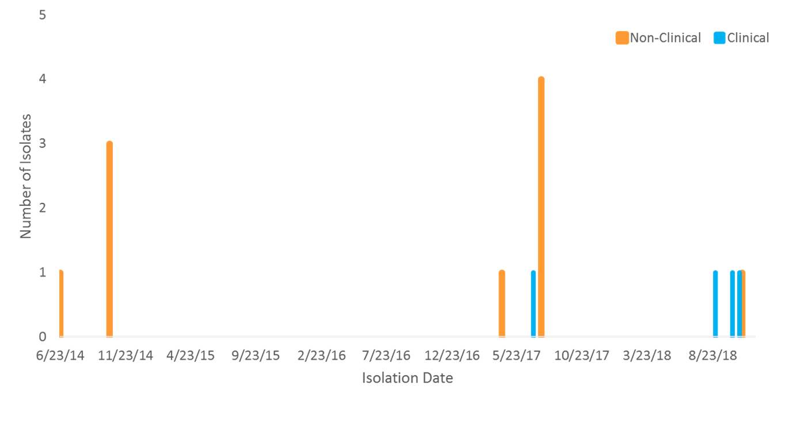
  Food Safety and Inspection Service:
  Listeria monocytogenes Cha Chien Outbreak
CDC notifies FSIS that clinical isolates are clustering with FSIS isolates on NCBI

Slide 15

  Food Safety and Inspection Service:
  Listeria monocytogenes Cha Chien Outbreak
Case-patients consumed Asian-style foods and 3 shopped at stores that received pork products from Est. x
6 intact product samples collected in commerce and 3 product samples collected at Est. x were negative for Lm
Intensified Verification Testing (IVT) conducted; 1 environmental isolate positive for Lm matched outbreak strain
Est. x recalled RTE pork patty rolls produced 5/21/18 – 11/16/18
Notes:
Cha Chien – Vietnamese Fried Ham

Slide 16
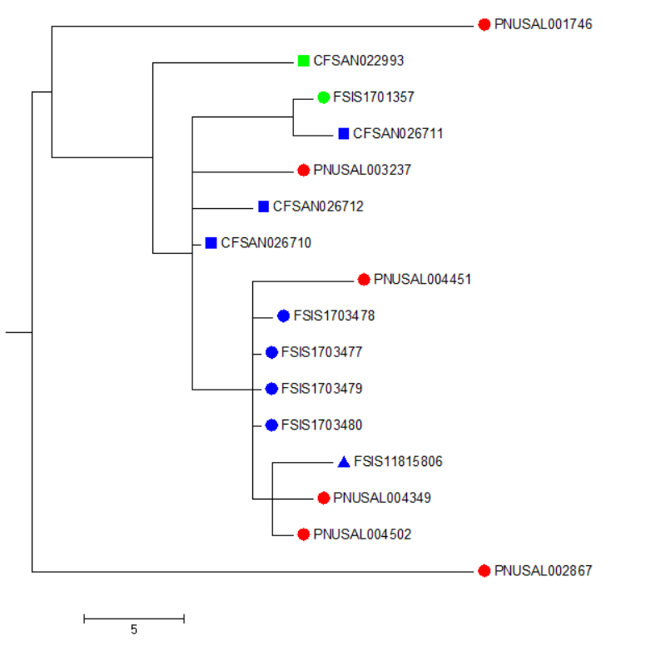
  Listeria monocytogenes Cha Chien Outbreak
0-17 SNPs
2014 RTE product Isolate
2017 RTE product Isolate
0-9 SNPs
2014 Environmental Isolate
2017 Environmental isolate
2018 Environmental isolate
Clinical isolate
NCBI cluster PDS000024952.5 accessed on 2019-06-04
Notes:
In this investigation three clinical isolates were from 2018, and one was from 2017. However the environmental isolates the isolates the 2018 clinical isolate were clustering with (0-9 SNPs) were all from 2017.
The only product isolates were from the same establishment as the environmental isolates that were clustering with the 2018 clinical isolates were from 2014 and 2017.
Additional samples were taken and an additional 2018 environmental isolate was confirmed, and it clustered with the clinical isolates (0-9) SNPs.
Despite there being no product isolates from 2018, there was strong evidence this establishment was the source of the clinical isolates. It should be noted the only other isolates on NCBI within this SNP cluster were from 2014 isolates from this same establishment. Thus the clinical isolates clustered with isolates from this establishment to the exclusion of all other isolates on NCBI.
10 FSIS isolates from Est. x collected 2014-2018 highly related to 4 clinical isolates by WGS

Slide 17
  Food Safety and Inspection Service:
  WGS at FSIS: Where Do We Go From Here
WGS in Risk and Attribution
Use in routine inspection process
Collaborations and data sharing
Standardize and simplify WGS related communications
Availability of audience specific WGS training modules.
WGS: Future
- Illness Prevention
- Collaborations
- Communications
Notes:
WGS in Risk and Attribution
Phenotype to Genotype focus
Virulence, Pathogenicity, Adaption, Gene mobility
Discussion and clarity on legal issues and ramifications
Continued engagement (Meetings, Webinars, FAQs etc.)
Communicating WGS results with regulated establishments
In-field detection, data analysis and decision making capability
Collaborations – NARMS, Gen-FS, ARS, Academia - MTAs

Slide 18









Acknowledgements

