Slide 1
PulseNet’s Transition to WGS
Kelley B. Hise
PulseNet Outbreak, Detection and Surveillance Unit
PROST/EDLB/DFWED
2019 GenomeTrakr Meeting
September 17, 2019

Slide 2
Overview
Transition Timeline
PulseNet Submission Expectations and WGS Data Analysis Workflow
PulseNet Submissions to NCBI
Cluster Detection with WGS
Future Improvements

Slide 3
WGS Transition Timeline
Sept. 2013
Listeria Initiative
WGS of all LM
Sent to CDC
Nov. 2015
LM Pilot
10 Pilot Labs Upload
Sequencers in Labs
Jan. 2018
WGS LM
Cluster Det.
Finalize allele schemes/DBs
July 15, 2019
WGS Gold Standard
Future Improvements
Create Pilot DB
CARB Funds
Validation
WGS Supplies
Personnel and Capacity Building
Convert to BN v7.6
WGS Cert., Install Plugins
Validation of schema and databases:
E. coli, Campy, Salmonella

Slide 4
Many Pieces to the Puzzle
WGS Wet Lab and Analysis Certified
PHLs Converted to BioNumerics v7.6
Local and National Cluster Detection by WGS
Allele Codes
Populate NDB/Share sequence data
PulseNet plugins and CE access ready for PHLs
98%
84%
PHLs Installed Plugins/ Gain CE access
84%
25%
Listeria
Salmonella
Escherichia
Campylobacter
✔
NDB: April 2018-19
Share: Dec 2018-June 2019
Percentages updated September 11, 2019
Notes:
73/74 labs converted
62/74 labs certified
62/74 rec’d instructions

Slide 5
PulseNet Submission Expectations
Sequence as many Listeria, STEC, Salmonella, Shigella, Campylobacter, and Vibrio as requested by CDC or state epidemiologists
Prior to upload
  Run sequences through CDC calculation engine
  Check sequence quality
  Verify standardization of metadata
Submit all WGS data and metadata to national databases within 24 hours of results; submit raw sequences to NCBI
Real-time surveillance is the goal of PulseNet laboratories and should involve real-time sequencing of PulseNet tracked organisms

Slide 6

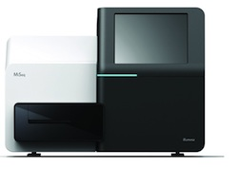


Data Analysis Workflow with National Database
PHL
PulseNet National Databases
Raw Sequence Data
Reference ID Database
Organism-specific Database
Private Raw Sequence Storage
1. Sequence isolates using PulseNet Key number
File naming format:
Key-LabID-M###-YYMMDD
2. Save generated sequence files locally, on BaseSpace, or external hard drive
3a. Link sequence data to Reference ID database by PulseNet Key name
4a. Import entries from Reference ID
4b. Add demographic information for entries
4c. Submit to the CE* for allele calls and genotyping results (serotype, AST, virulence)
4d. Verify quality and upload to national database (WGS id automatically assigned)
4e. Upload raw data sequence reads to NCBI
4f. Perform surveillance in BioNumerics
3b. Submit data to calculation engine (CE) for de novo assembly, species identification (Genus, Species—by ANI*), and contamination check
3c. Verify quality (Quality Assessment)
3d. Export entries
Public Raw Sequence Data Storage
*CE: Calculation Engine
*ANI: Average Nucleotide Identity
Updated 9/10/2019

Slide 7
Submissions to NCBI
Sequence data uploaded to PulseNet national databases—automatic WGS ID assigned for anonymization
  Submissions done in real-time
Submit data to NCBI through the NCBI uploader in BioNumerics
Use appropriate template to upload biosample and raw read data to NCBI
Errors with connection to BaseSpace fixed by latest plugin (7/12/2019)
Troubleshooting tips for users; retraction and resubmission
New Terms of Reference—new minimal metadata
  Serotype and collection year required
  No longer require additional metadata uploaded after 6 months

Slide 8
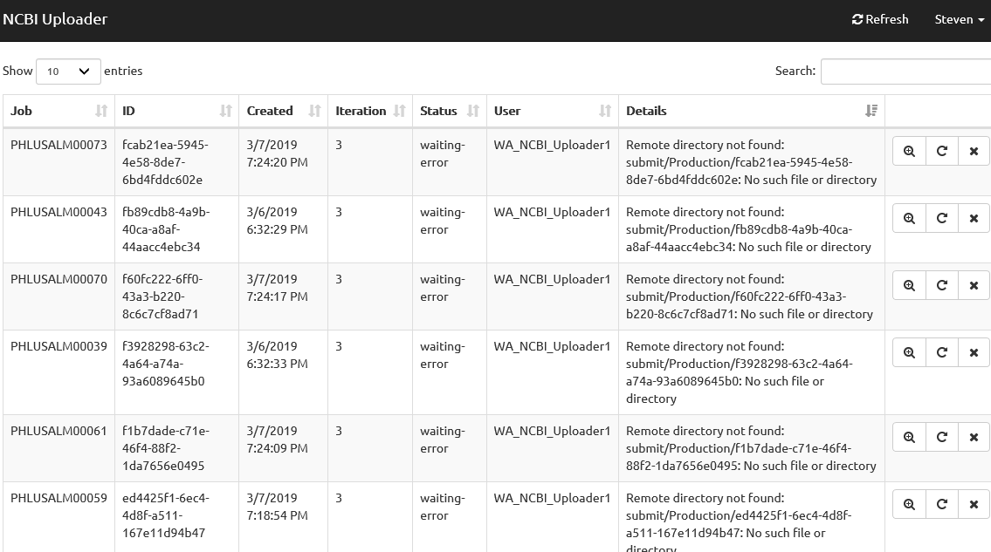
Troubleshooting for NCBI Errors using the NCBI Viewer
Authenticate to the PulseNetWGS Firewall
Login to the NCBI Viewer: https://pulsenetce-uploader.cdc.gov
Enter NCBI credentials
Expand details to evaluate and trouble-shoot errors

Slide 9
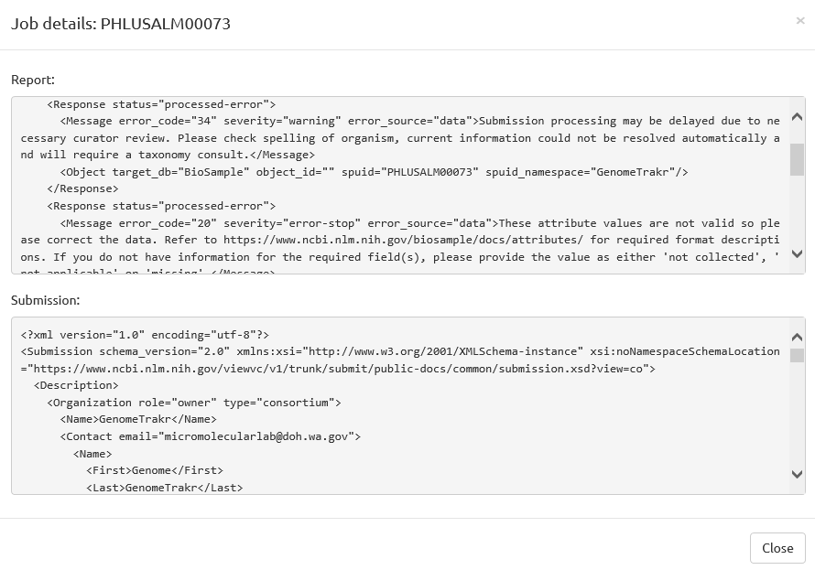
Expanded Troubleshooting for NCBI Errors using the NCBI Viewer
Generally, most errors are noted in the Report section of the Job details
These errors are usually pretty well explained and you should be able to fix most issues related to the failed upload
If not, send this report to NCBI for troubleshooting
Do not re-upload to NCBI before troubleshooting

Slide 10
Retract and Resubmit Sequences from NCBI
Retract
Quality issues detected after an SRA upload, sequence needs to be retracted and replaced
  Email the SRA Help Desk (sra@ncbi.nlm.nih.gov) to request a retraction of the SRA
  Receive an email back from NCBI confirming the withdrawal of the requested sequence files
  For duplicates, can also contact NCBI to remove both the biosample and SRA if needed
Resubmit
The biosample and accession number on NCBI can still be used to make a new SRA upload when sequencing has been repeated
To avoid issues with reuploading new sequence data to an existing biosample, must use a resubmission template formatted to handle re-uploaded data

Slide 11
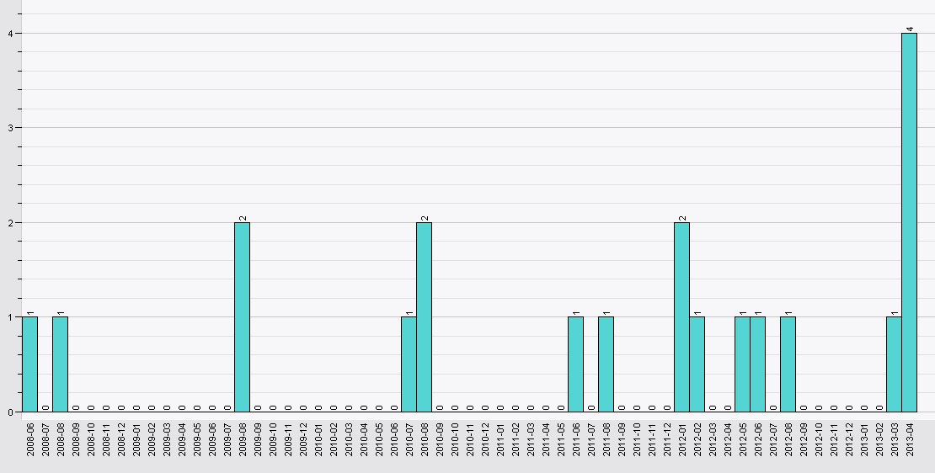
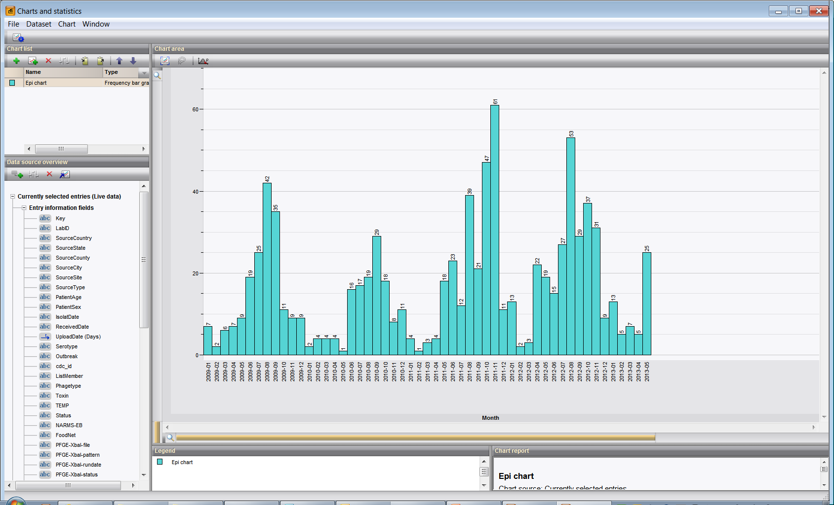
Historic Cluster Detection using PFGE
An increase in a particular PFGE pattern indicated something unusual
With thousands of PFGE patterns and many years of data, trends were easy to detect
As of July 15, 2019: PFGE no longer the gold standard for cluster detection in PulseNet
Notes:
Here’s another example: let’s say your lab has detected a cluster of this pattern, which is a fairly uncommon pattern in your state. Is this an increase in the past 60 days? (Yes, it looks to be an increase and over baseline). Should you check sequencing data? (Yes, it’s a good idea to sequence these 5 isolates if they haven’t been sequenced already, and look at the sequences to see how the allele differences compare).

Slide 12
Cluster Reporting: cgMLST Trees, Matrices
Dendrograms or similarity matrices exported into PowerPoint or Excel
  Mark allele differences using BioNumerics
  Use groups to highlight entries of interest
  Clade differences if two clusters are closely related or are being investigated together

Slide 13
Cluster Detection: Allele Codes (as of 9/15/2019, only available for Listeria)
All uploads that pass quality will receive an allele code which can then be downloaded into local databases
Allele codes are built on percent similarity thresholds between core genomes (cgMLST)
Because the allele codes let us know how closely related isolates are, we can use these names for cluster detection
Poor quality sequences will receive a “failed” allele code and should be resequenced
Allele codes will be available in SEDRIC
For cluster detection, compare entries within the past 60 or 120 days that share allele codes up to the cluster detection threshold (may vary depending on organism) and evaluate any historical isolates with matching allele codes
Notes:
Moving forward, once WGS nomenclature has been validated for the other organisms, and once labs have all moved to BN7, you will be able to download allele codes from the national database, similar to downloading PFGE pattern names, then compare entries within the past 60 or 120 days that share allele codes up to the cluster detection threshold (which will probably be matching 4 or 5 digits). If they appear related, you can report the cluster to your epis and to SP, then continue monitoring for additional allele code matches.

Slide 14
Listeria Nomenclature
71 Alleles
51 Alleles
36 Alleles
19 Alleles
7 Alleles
0 Alleles
These allele definitions are approximate!
LMO1.0 -
5 1 1 2 5 . 1
.
.
.
.
Organismversion
Allele Code
Partial names
Sequence A
LMO1.0 - 5 . 1 . 2
Sequence B
LMO1.0 - 5 . 1 . 2 . 2 . 5 . 1
When sequences have partial names, it means they are singletons in clusters below their last digit.
The sequences A and B above are within approximately 36 and 19 alleles of each other.

Slide 15
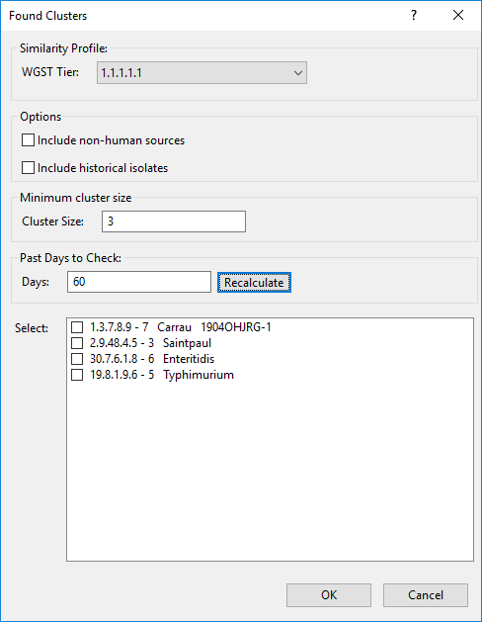
Cluster Detection: Find Clusters Tool
Note: the below recommendations are for Listeria
1
  Recommend to look at allele code up to the 5th digit (~7 allele difference)
  Human entries only when looking for clusters of cases
  Cluster size—dependent on lab
    National level, we look at 3-5
    Local level may need to change to 2, for example
  Use the last 120 days for Listeria
  Found clusters are displayed below with Allele code and number of cases
  Note
  Defaults can be changed to match on any digit in the allele code (1st, 2nd, 3rd, 4th, 5th, or 6th), historical cases, non-human, cluster size, and/or number of days to check
2
3
4
5

Slide 16
Future Improvements
Develop/deploy allele codes for Escherichia, Salmonella and Campylobacter
Update NCBI submission tool for new metadata requirements
Update genotyping schemes on the CDC calculation engine
Improved ResFinder output in BioNumerics
Develop schema for Vibrio, Yersinia and Cronobacter
Improve current schemes, removing problem loci
Improve speed of analysis on the calculation engine

Slide 17


Thank you
Telephone: 404-639-4558
E-mail: PulseNet@cdc.gov Web: www.cdc.gov/pulsenet
#PulseNet

