Slide 1
Illumina Updates
2019 GenomeTrakr Meeting
Dan Schoeffner, Ph.D.
Staff Applications Scientist
Illumina, Inc.
Sept 18th, 2019

Slide 2
Objectives
Specifications for v2 and v3 chemistry
New Software Suite
Nextera ™ XT vs Nextera™ DNA Flex
Illumina Proactive Instrument Monitoring
Windows Remote Desktop Security Notice
Windows 10 upgrades

Slide 3
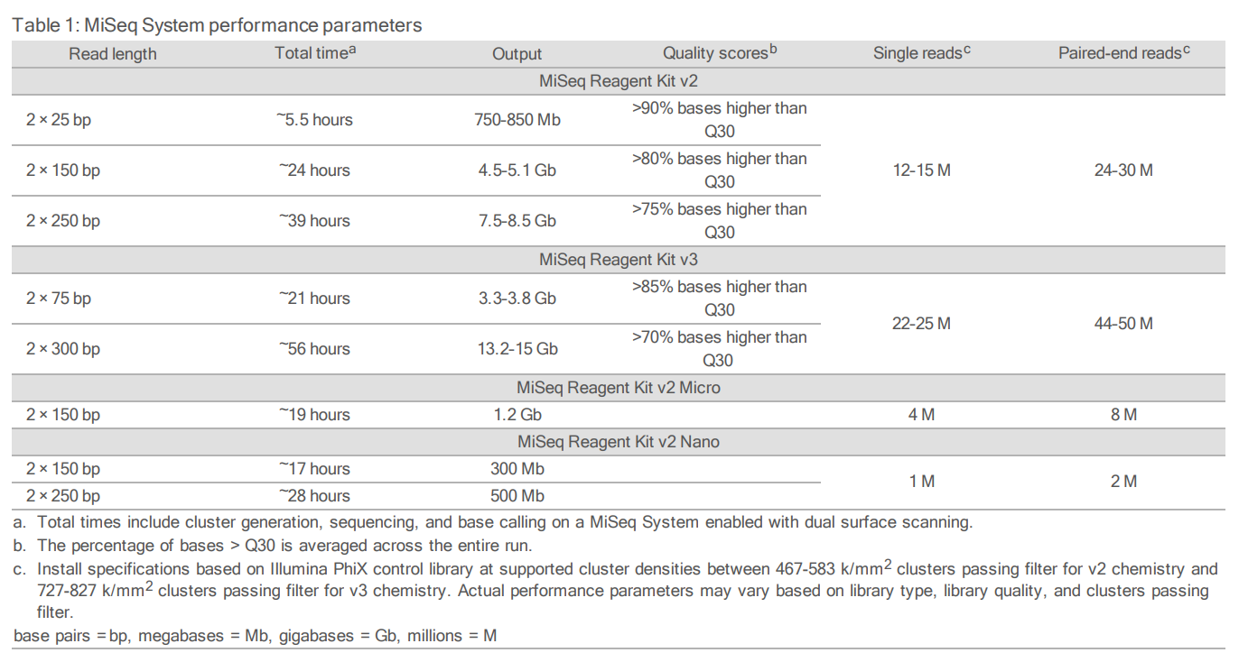
MiSeq performance specification based on Illumina PhiX Control Library
For Research Use Only. Not for use in diagnostic procedures.

Slide 4
Nextera XT/Flex Performance at 2x251 with Dual Indices: (random sampling)
V2: 800-1200K/mm,
24-30M, 7.5-8.5Gb, >75 % Q30
V3: 1200-1400K/mm,
44-50M, 13.2- 15.0 Gb, >75% Q30
Nextera XT/Flex performance at 2x251 with dual-index
For Research Use Only. Not for use in diagnostic procedures.

Slide 5
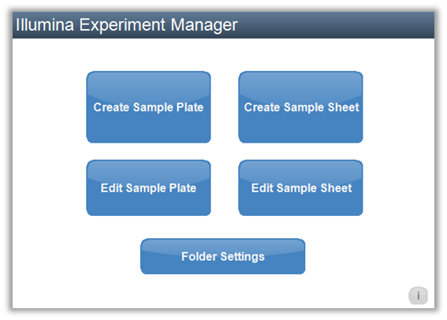
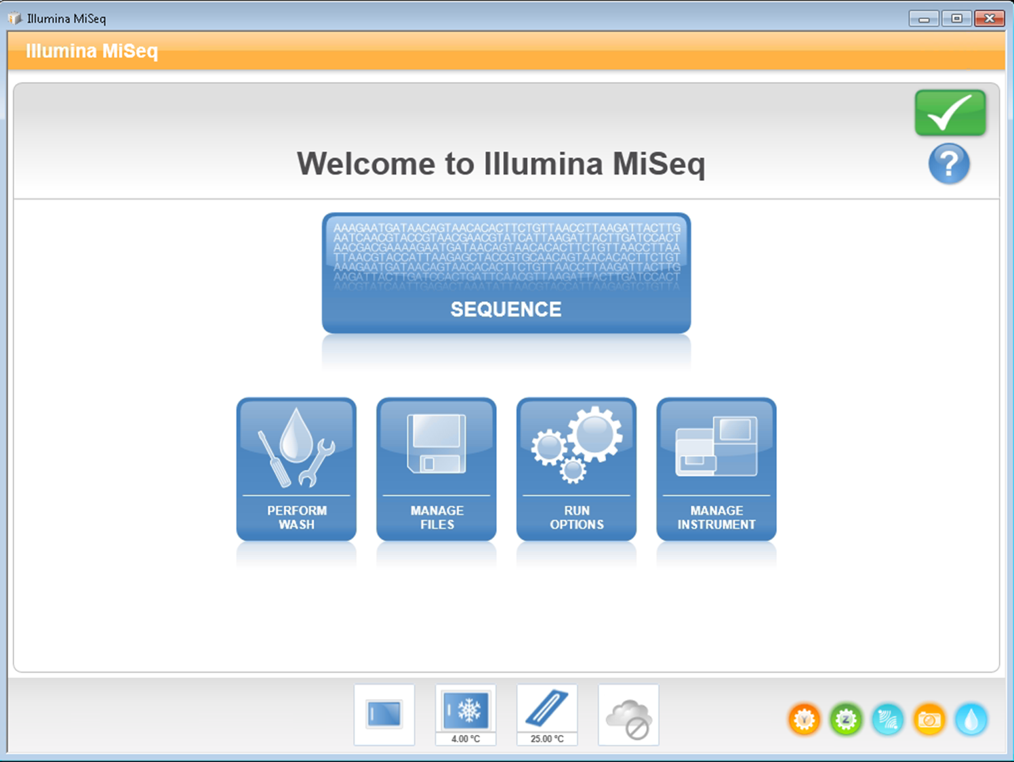
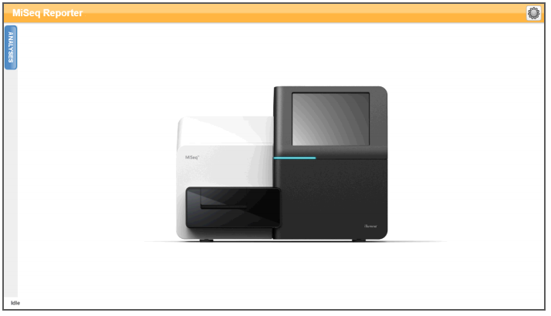
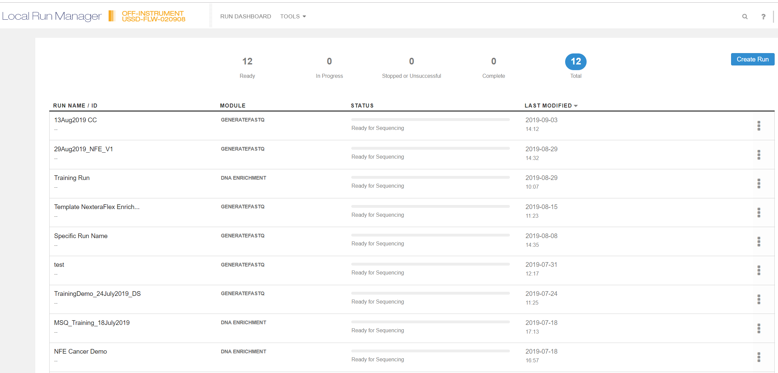
New MiSeq Software Suite for MiSeq
Sample sheet creation
Data Collection
Data Analysis
Sample Sheet Creation
Data collection*
Data Analysis
Illumina Experiment Manager
MiSeq Control Software 2.6
MiSeq Reporter v2.6
OLD
Local Run Manager 2.0
MiSeq Control Software 3.1
Local Run Manager 2.0
NEW
*MiniSeq uses a different version of Local Run Manager (1.3). Framework and analysis modules are distinct between MiniSeq and MiSeq.
Off- instrument version of LRM 2.0 can analyze both MiniSeq and MiSeq data
For Research Use Only. Not for use in diagnostic procedures.

Slide 6
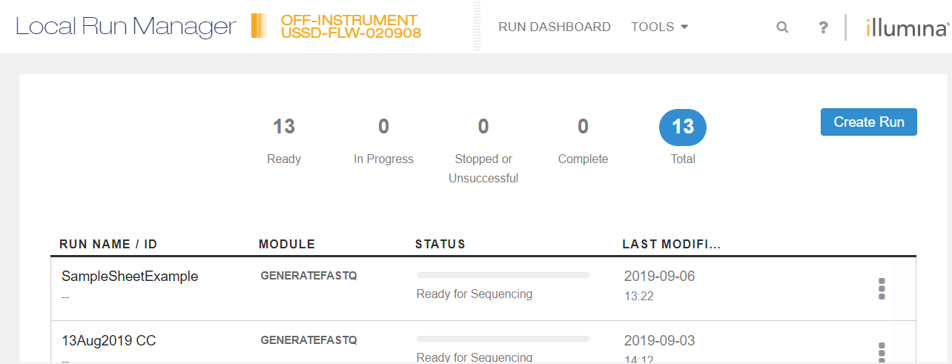
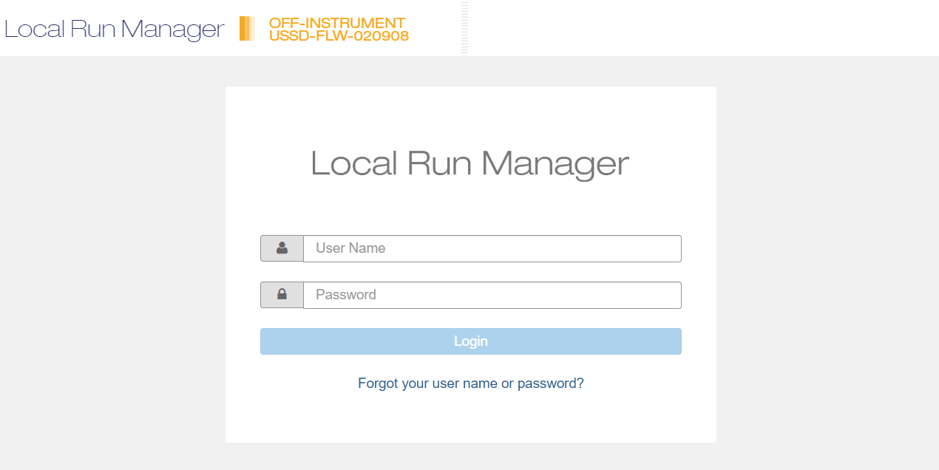
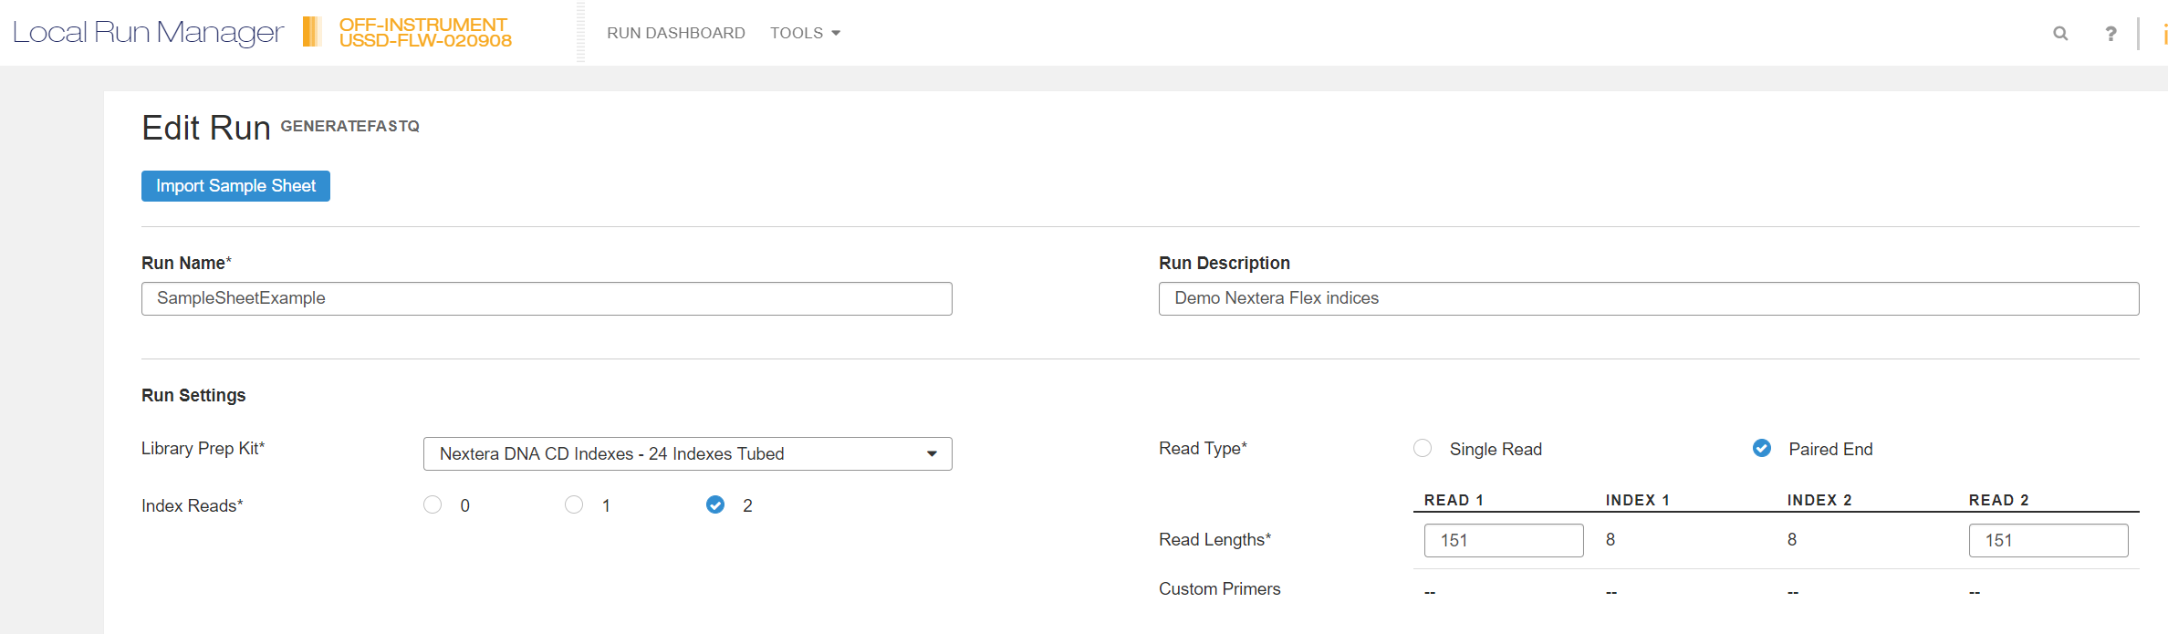
LRM 2.0
http://localhost/#/login
For Research Use Only. Not for use in diagnostic procedures.

Slide 7
Sample Sheets can be imported and exported using a template
Template sample sheet can be modified to
include only indexed samples in a given run
Recommend importing back into LRM to check
formatting for valid sample sheet
Importing into MCS may not be checked for
accuracy
For Research Use Only. Not for use in diagnostic procedures.

Slide 8
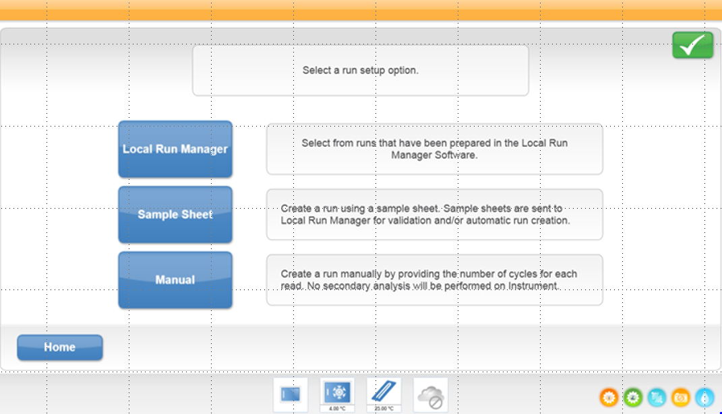

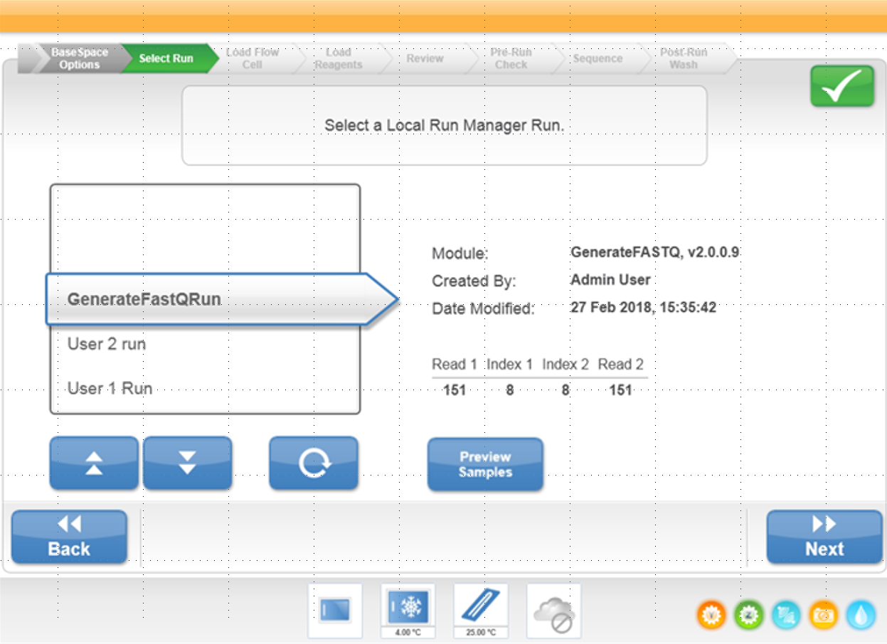
MCS 3.1
Select Local Run Manager
NOT Sample Sheet
All runs in LRM in Status
“Ready for Sequencing”
will appear in window
For Research Use Only. Not for use in diagnostic procedures.

Slide 9
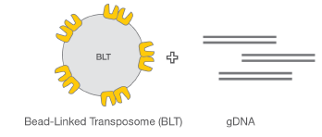
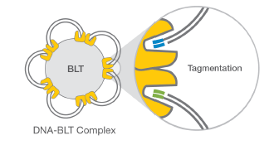
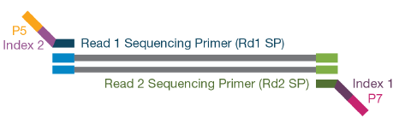

Nextera DNA Flex Workflow
Tagmentation
Bead-linked transposomes mediate the simultaneous fragmentation of gDNA and the addition of sequencing primers
Reduced-cycle PCR amplifies sequencing ready DNA fragments and adds indexes and adapters
Self-normalization >100ng input
PCR amplification
Cleanup and
size selection
Notes:
QB#7400

Slide 10

Nextera XT vs Nextera DNA Flex*
Nextera XT Workflow: 2 quantification steps, 2 thermal cycler steps (~60 mins total), 1 bead clean-up steps
Approximately 3-5 hours
Kit + Indexes = $4290 ($45 per samples, but does not include Ampure beads)
Nextera Flex Workflow: Only quantify the pool, 3 thermal cycler steps (~60 mins total), 2 bead clean-up steps
Approximately 3-5 hours
Kit + Indexes = $4512 ($47 per sample, includes Ampure beads)
*Workflow comparison created by CDC. Cost analysis based on CDC pricing of library preparation kits and indexes for 96 samples only
For Research Use Only. Not for use in diagnostic procedures.

Slide 11
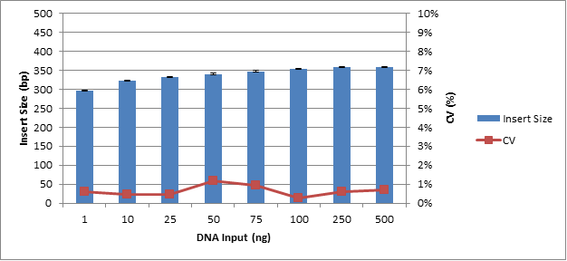
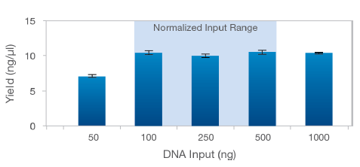
Wide DNA Input with Nextera DNA Flex
Consistent insert sizes and Normalization
Consistent insert size obtained with the use of a wide DNA input range
Normalized libraries are be obtained with:
  100ng-500ng gDNA input
  Use of the liquid blood, saliva, dried blood, or bacterial colony protocol
  With Nextera™ DNA Flex, precise input quantification is not required
  to yield consistent DNA insert sizes and normalized libraries
  *Data maintained in Illumina internal files 2017
For Research Use Only. Not for use in diagnostic procedures.
Notes:
9% CV on insert size across all sample inputs

Slide 12
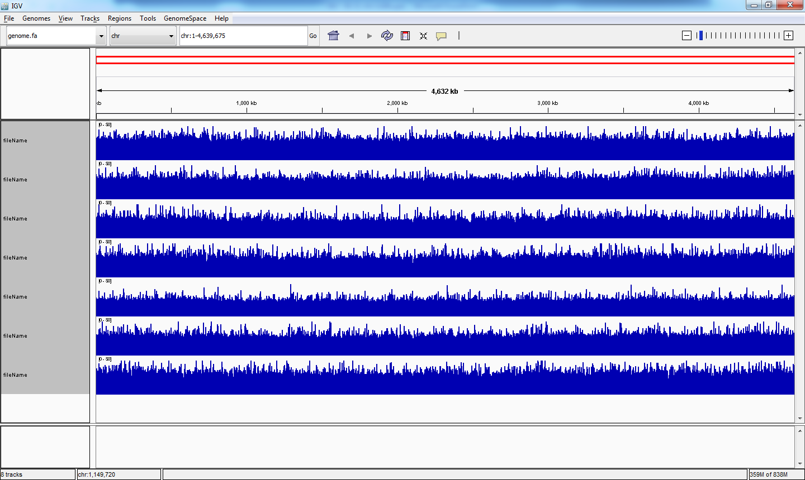
E. coli (51% GC): coverage uniformity
1ng input, 500,000 PE reads subsampled, IGV plots of whole genome
Kit | Fragment | PCR
Nextera™ Flex | BLT | +
A | Enz. | +
B | Shear | -
C | Shear | +
D | Enz. | -
E | Enz. | +
Nextera™ XT | Tpsm | +
Coverage
Genome position
y axis is coverage, x axis is genome position, whole genome shown
For Research Use Only. Not for use in diagnostic procedures.
Notes:
Bruinsma et al. BMC Genomics (2018) 19:722 Bead-linked transposomes enable a
normalization-free workflow for NGS library preparation

Slide 13
Nextera DNA Flex: Validation Set
Fragment Size vs Q30 Read length
For Research Use Only. Not for use in diagnostic procedures.

Slide 14
Nextera DNA Flex: Validation Set
Index Distribution
Index distribution compared between 5 runs prepared using Nextera XT & 5 runs prepared using Nextera DNA Flex
For Research Use Only. Not for use in diagnostic procedures.

Slide 15
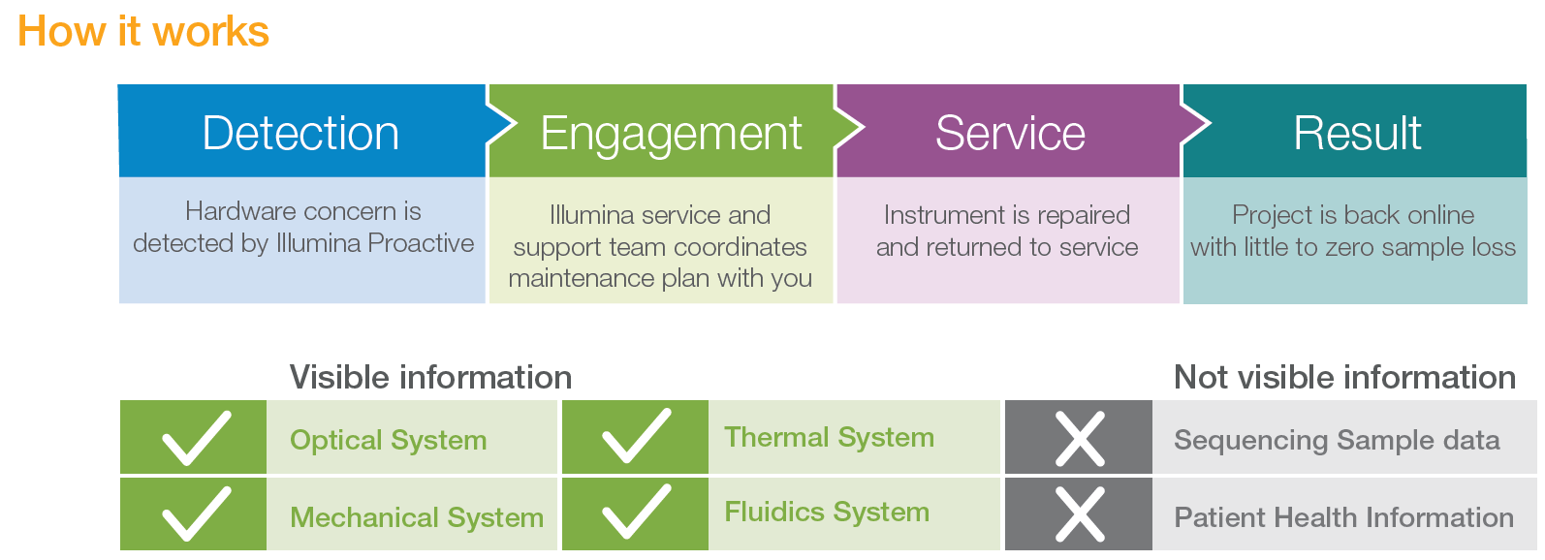
Illumina Proactive Instrument Monitoring
Port 443, 80, and 8080
Illumina Proactive is a complimentary, secure, and remote instrument monitoring and proactive support service.
Opt-out for all RUO instrument, Opt-in for all DX instruments
For Research Use Only. Not for use in diagnostic procedures.

Slide 16
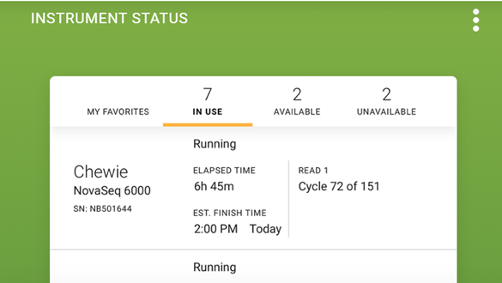
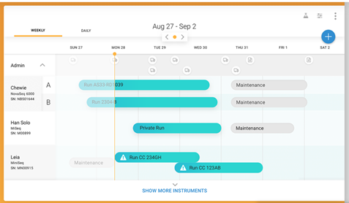
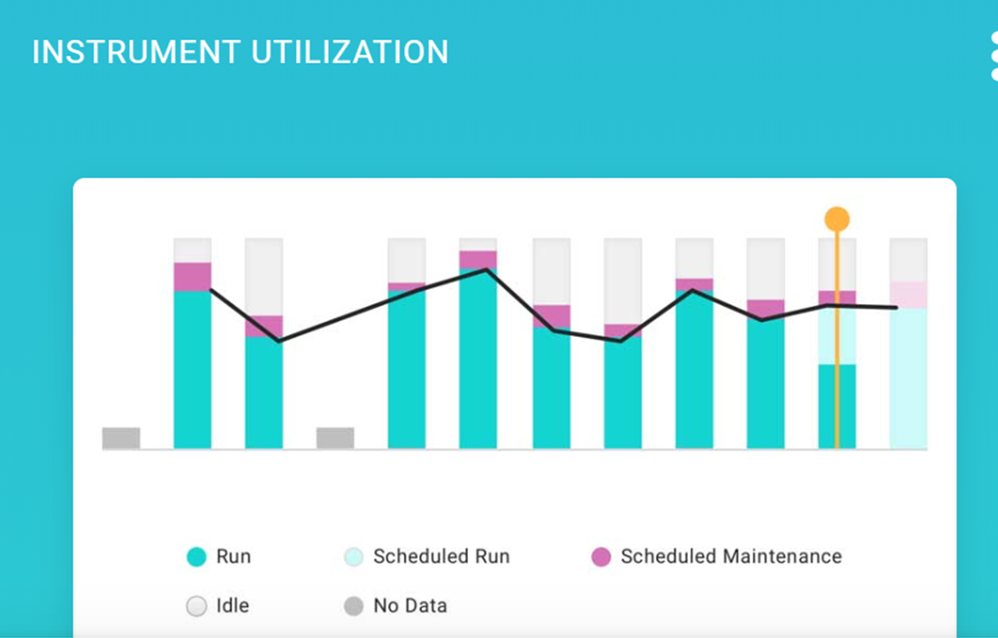
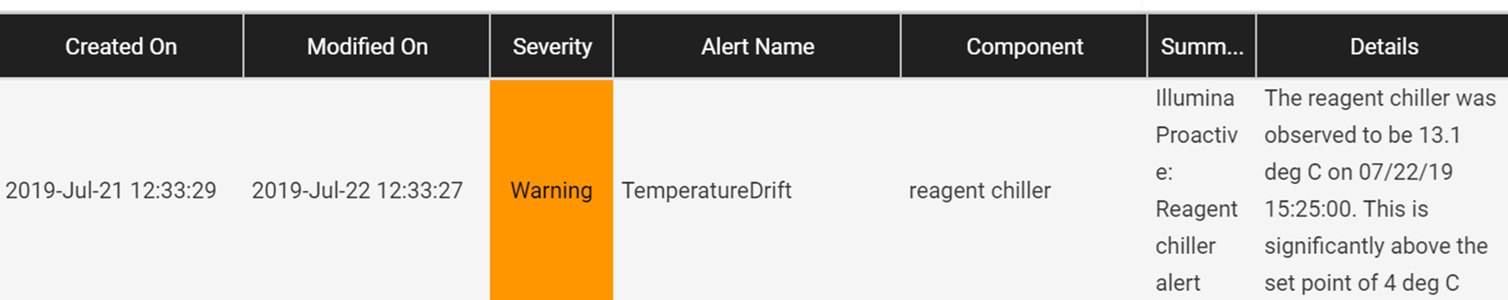
Benefits of Proactive
Visible through MyIllumina account, linked to customer account #
Instrument configuration
General and run-specific logs
Run-specific analytics (SAV)
For Research Use Only. Not for use in diagnostic procedures.

Slide 17
Windows Remote Desktop Security Notice
Media reported Remote Desktop Protocol (RDP) worms (Bluekeep and DejaBlue) and vulnerabilities within Microsoft Windows systems, including all versions of Windows 7 and Windows 10.
There have been no reported infections of Illumina systems, but we encourage customers to take the best security posture available
  Illumina Security Best Practices Guide
  Turn off Remote Desktop Protocol (RDP)
BlueKeep only affects Window 7: SAFE
  Windows 7 for x64-based (or x32)Systems Service Pack It is safe to update with KB 4499175 Security Only (not Roll-up)
DejaBlue affects both Windows 7 and 10: NOT SAFE
  Illumina is currently in the process of testing the Microsoft released update patches for DejaBlue on our instruments (all instruments, Windows 7 and Windows 10) to ensure compatibility
https://support.illumina.com/illumina-security.html
For Research Use Only. Not for use in diagnostic procedures.

Slide 18
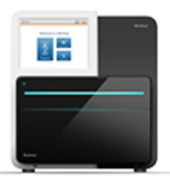
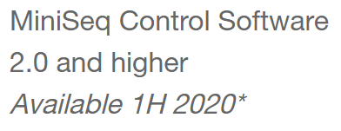
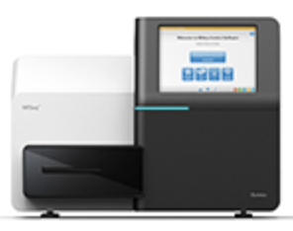
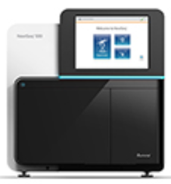
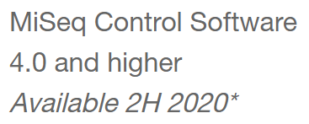
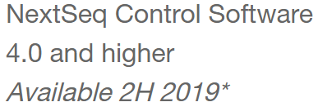
Windows 10 upgrades
Microsoft is ending support of the Windows 7 operating system (OS) in 2020. The end of support (EOS) date is October 2020 for Windows 7 Embedded.
MiniSeq, MiSeq, MiSeqDx, NextSeq, and some iScan Systems use Windows 7 embedded and will be supported through October 2020.
Customers will be notified when an upgrade for their instrument becomes available
  The upgrade requires a visit from an Illumina Field Service Engineer
  There will be a nominal fee for the upgrade
Your instrument will continue to function normally if it is not upgraded, but using an unsupported operating system increases the risk of exposure to malware
https://support.illumina.com/support-content/windows10.html
For Research Use Only. Not for use in diagnostic procedures.

Slide 19
Questions?

