Slide 1
Use of Metagenomics in a Veterinary Diagnostic Lab
Patrick Mitchell, ScD
Cornell University
College of Veterinary Medicine
Animal Health Diagnostic Center / NYSVDL
pkm57@cornell.edu

Slide 2
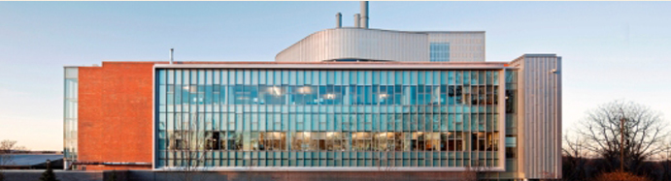
Outline
Background
  Why use metagenomics?
  Tools
  Considerations and pitfalls
Examples from our lab

Slide 3
Background

Slide 4
Why use metagenomics
Interested in community rather than a single isolate
Difficult to culture/isolate organism
Broad-scope/multiplex testing
Unknown target/Discovery

Slide 5
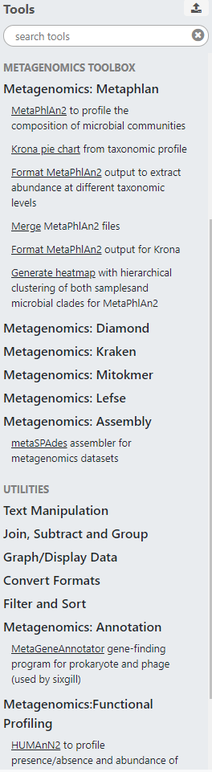
Tools
Classification
  Kraken2
  Diamond
  MetaPhlAn2/HUMAnN2
Assembly
  SPAdes (metaSPAdes and rnaSPAdes)
  Trinity (for RNAseq)
Visualization
  MEGAN
  Krona

Slide 6
Considerations and Pitfalls
Targeted vs. Shotgun
DNA vs. RNA
Assembly vs. read-based classification
Classification databases and thresholds

Slide 7
Examples

Slide 8
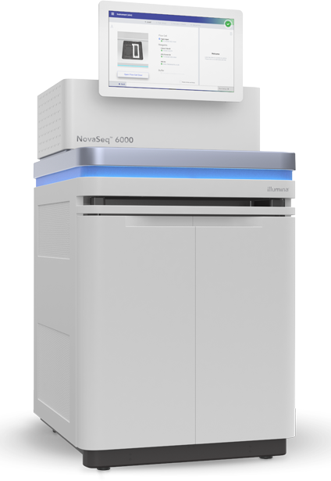
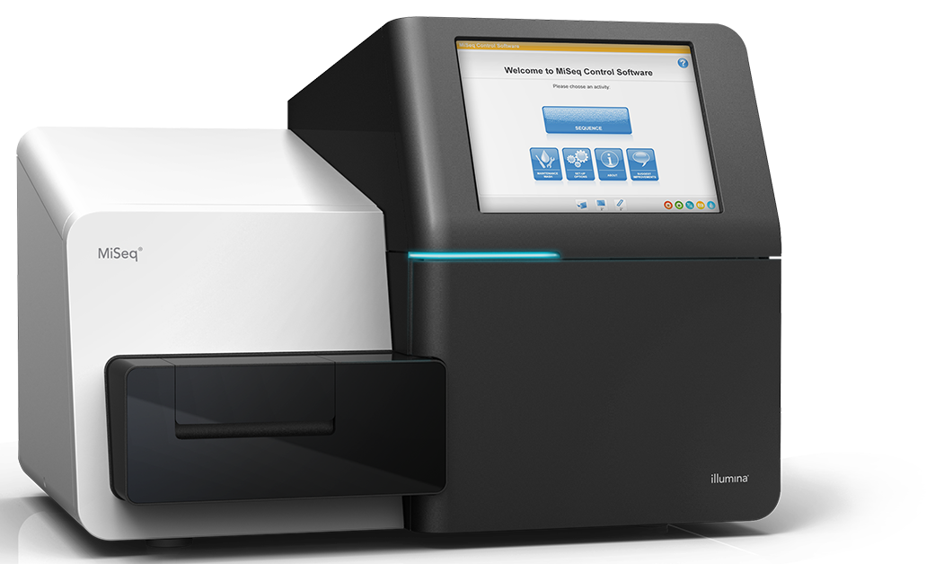
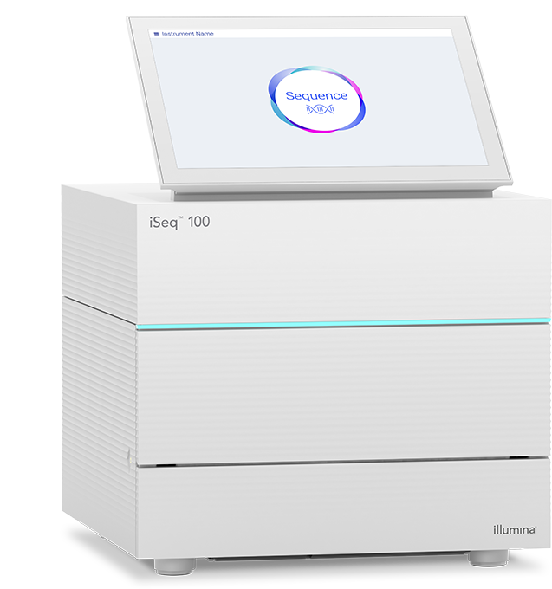
What do we do?
Amplicon-based fungal identification
Screening for suspected pathogens
Pathogen identification
Pathogen discovery
AMR gene screening

Slide 9
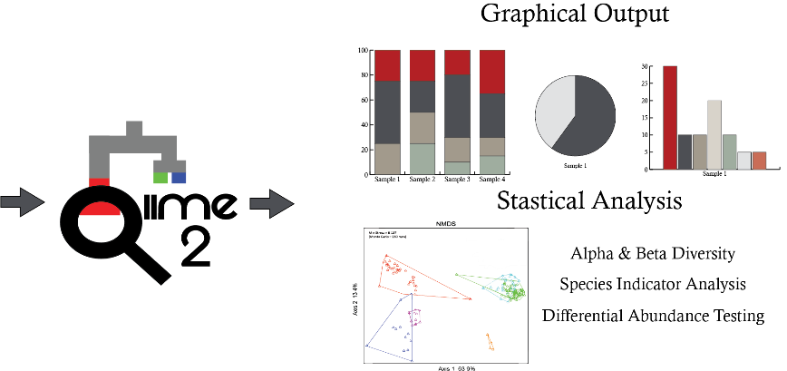
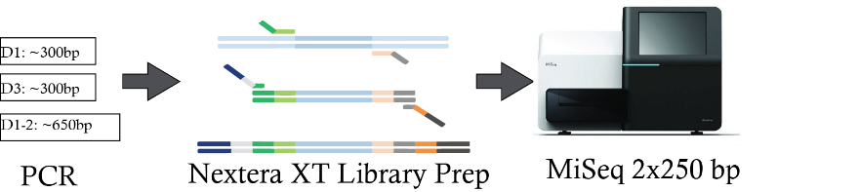
Fungal Identification
Two targets: 28S and ITS
Run alongside other samples on MiSeq
Cost: ~$235 (both amplicons)
Analyzed using QIIME2 workflow
28S D1
ITS1
PCR

Slide 10
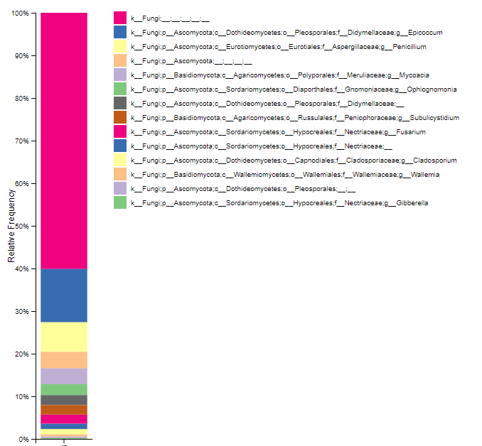
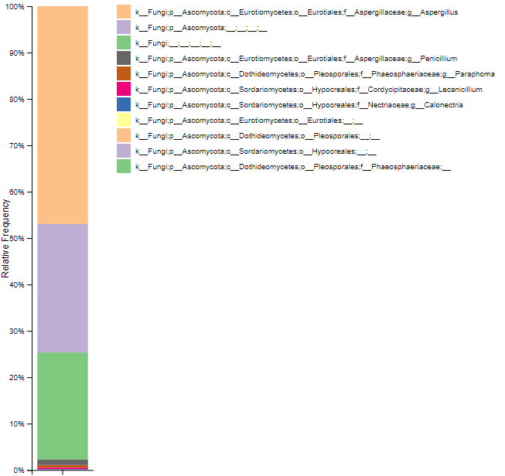
Fungal Identification

Slide 11
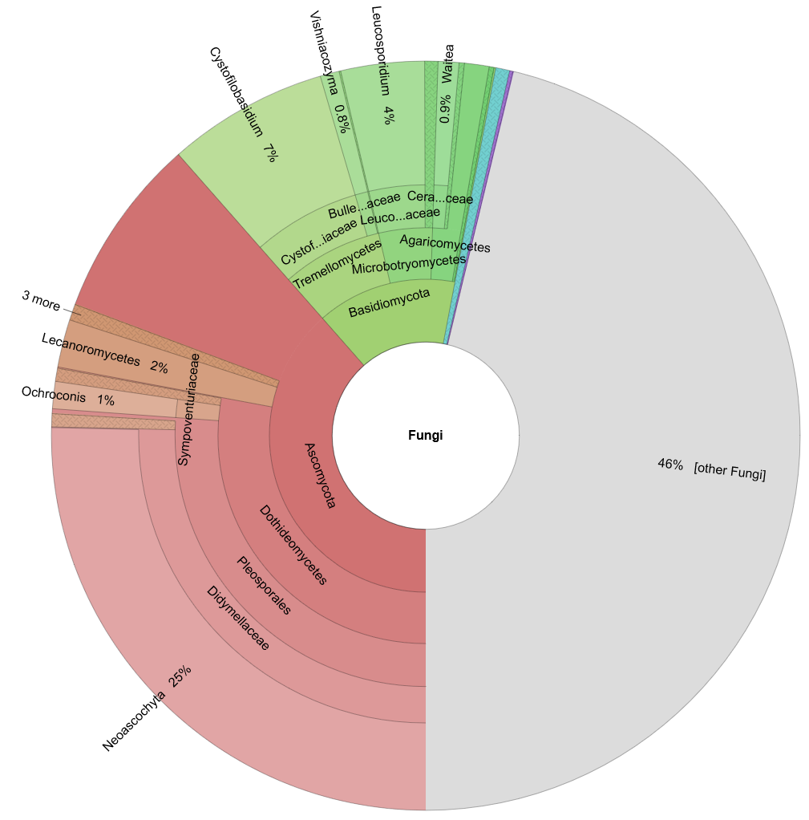
Fungal Identification

Slide 12
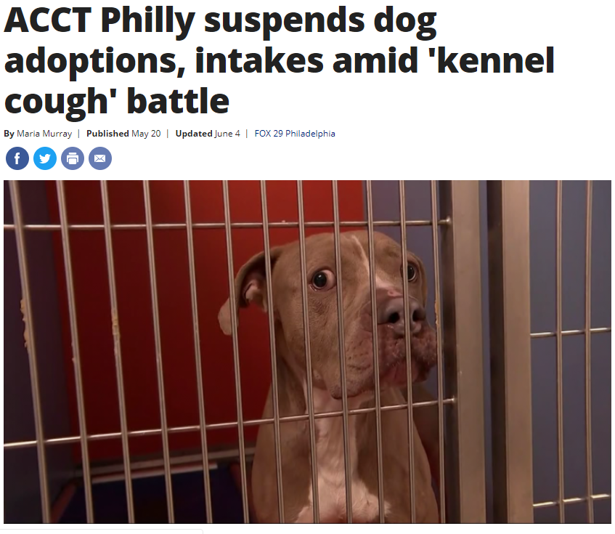
Pathogen Screening
Canine respiratory disease outbreak
Canine pneumovirus suspected as a contributing factor
Discordant PCR results between labs/assays

Slide 13
Pathogen Screening
Extracted RNA from 3 acute case nasal swabs
Run on iSeq, generated 1.4–2.1M 2x150 reads
Assembled using SPAdes (standard and rnaSPAdes)
Classified resulting contigs using Kraken
Recovered single-contig canine pneumovirus genomes from 2/3 samples (15 Kb, 17–30X coverage)

Slide 14
Pathogen Identification
Virology service identified potential virions (~20 nm) in clinical sample
RNAseq requested
for identification
150K 2 x 250bp reads
Estimated cost: ~$125
Classified reads (unpaired) using Diamond + MEGAN

Slide 15
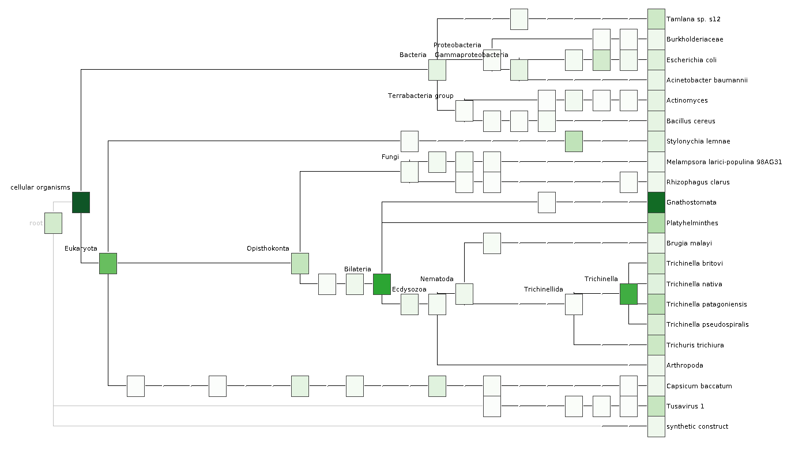
Pathogen Identification

Slide 16
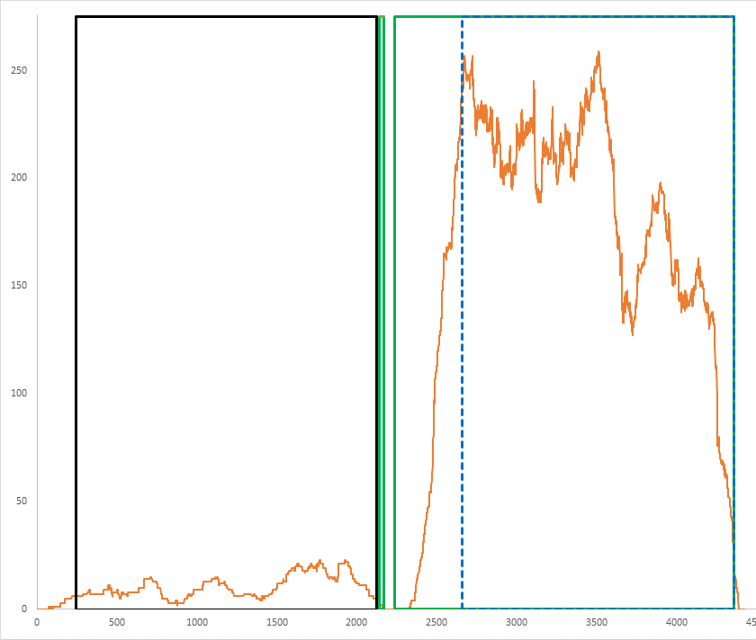
Pathogen Identification
~2.4K reads mapped to tusavirus
  ‘Human’ protoparvovirus
  Consistent with size of virions
High mapping depth to VP1/VP2 region of reference sequence
Trinity assembly produced 5 transcripts matching region
PCR primers designed for further screening

Slide 17
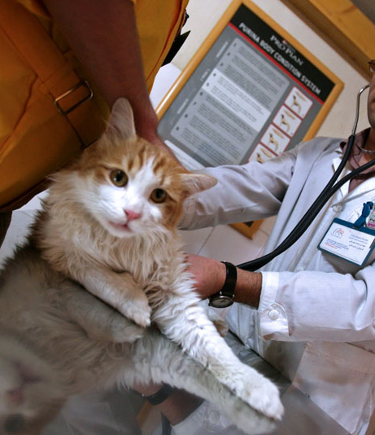
Pathogen Discovery
Hypothesis: Infectious etiology underlying feline endomyocarditis
Deep sequencing of RNA from case and control samples (~100M 2 x 150 bp reads/sample)
Cost: $462 per sample
  Library prep by RNA core (internal): $215/sample
  Sequencing from Novagene (NovaSeq S4 lane): $6415

Slide 18
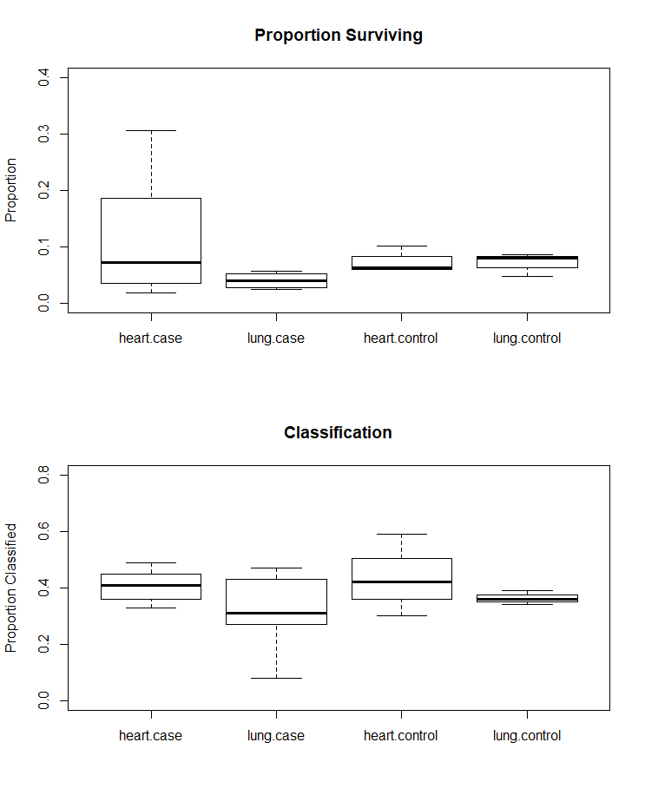
Pathogen Discovery
Read filtering (host, human, rRNA) using STAR and sortmerna:
  10-fold reduction in reads
Assembly using Trinity
Classification with Kraken2 (reads and assemblies)

Slide 19
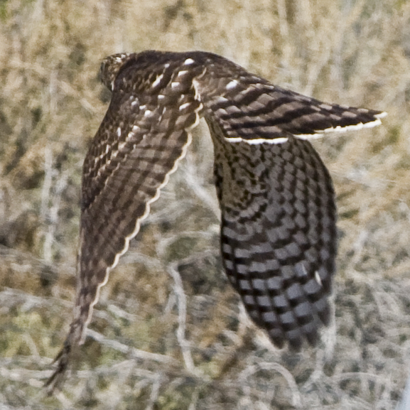
AMR Gene Screening
Screen for AMR genes in raptors receiving antibiotic prophylaxis
AmpliSeq AMR Panel: 815 amplicons covering 478
AMR genes
Will know which genes are present, but not what organism(s) carry them

Slide 20
AMR Gene Screening
2.5M reads/sample
Mapped to target amplicon sequences using BBMap
Work in progress
Sample
+ Control
- Control

Slide 21
Conclusions

Slide 22
Conclusions
Metagenomics is a broad umbrella
Variety of applications requiring differing resources
Many tools available

Slide 23


Acknowledgments
  AHDC Molecular R&D Team
  Laura Goodman
  Renee Anderson
  Brittany Chilson
  Becky Tallmadge
  Ava Jarvis
  Derek Rothenheber
Jen Grenier
Katie Kelly
Ann Tate
Faraz Ahmed
Ed Dubovi
Randall Renshaw
VetLIRN

Slide 24
Questions?

