Slide 1
A comparison of Nextera XT and Nextera DNA Flex in a Public Health Laboratory
2019 GenomeTrakr Conference
Matt Plumb
Minnesota Department of Health | Infectious Disease Laboratory

Slide 2
Overview
Comparison of Nextera XT and Nextera DNA Flex
Cost comparison
Our experience and thoughts
Bioinformatic analysis

Slide 3
MN Department of Health experience with DNA Flex
Piloted DNA flex for Pulsenet late 2018
  Performed 4 runs totaling 96 samples
Revisited DNA flex summer of 2019
  Comparison of XT and Flex

Slide 4
Cost Comparison
Laboratory Time:
Comparable time spend on Nextera XT and Nextera DNA
DNA Flex may be faster with increased familiarity and skill
Liquid handling robots
Library Preparation Reagent Costs
Item | Uses | Cost | Cost per Use | Cost/sample
Nextera XT DNA Library Preparation Kit (96 samples) | 96 | $3,270.00 | $34.06 | $37.62
NXTR® XT IDX Kt v2 Set A 96 IDXS,384 SMP | 384 | $1,173.00 | $3.05
Ampure Beads (60 mL) | 2400 | $1,200.00 | $0.50
Nextera DNA Flex Library Prep (96 Samples) | 96 | $4,032.00 | $42.00 | $47.00
Nextera™ DNA CD Indexes (96 Indexes, 96 Samples) | 96 | $480.00 | $5.00
Notes:
Current list price. Have our contract price at the end.
We already load more than 16 samples per V2 500 cycle kit so samples loaded per cartridge is similar.

Slide 5
Our experiences and thoughts on DNA Flex
Increased use of beads and magnetic block
Change in tip usage
Increased thermocycler usage
Consistent fragment size after cleanup
Notes:
Tech dependent beads
Less 10 tips and more 100 tips
Tagment and tagment stop. 5 min to 15 min. Additional thermocycler usage.
Very consistent ~950bp with pulsenet cleanup protocol
Lot of boxes
Still modify for QC

Slide 6
Bioinformatic Analysis
Reference mapping and de novo assembly
  Using BWA-MEM and SPADES
BWA v0.7.17-r1188
SPADES v3.12.0
spades.py -k 21,33,55,77,99,127 –careful
Quast v4.3
Samtools v1.9

Slide 7
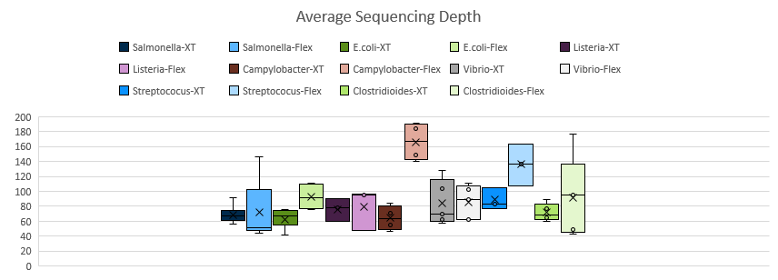
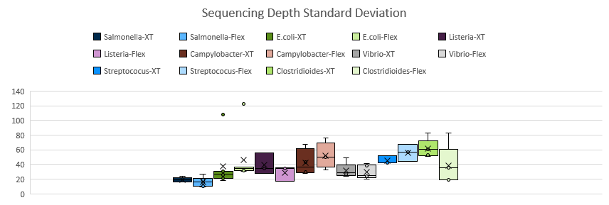
Reference mapping
 | Salmonella enterica (6) |  | Escherichia coli (7)
 | XT | Flex | XT | Flex
Average Depth | 68.88 | 71.53 | 62.48 | 92.43
Std dev | 19.38 | 16.38 | 37.44 | 46.13
 | Listeria monocytogenes (3) |  | Campylobacter jejuni (4)
 | XT | Flex | XT | Flex
Average Depth | 83.83 | 71.15 | 64.25 | 166.29
Std dev | 39.63 | 28.92 | 42.33 | 52.26
 | Vibrio parahaemolyticus (5) |  | Streptococus pyogenes (3)
 | XT | Flex | XT | Flex
Average Depth | 84.26 | 85.19 | 88.43 | 136.17
Std dev | 31.57 | 29.66 | 45.43 | 56.14
 | Clostridioides difficile (5)
 | XT | Flex
Average Depth | 66.83 | 102.88
Std dev | 62.09 | 38.95

Slide 8
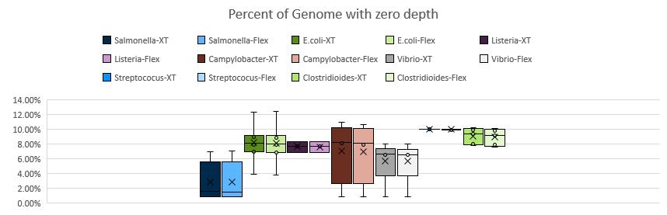
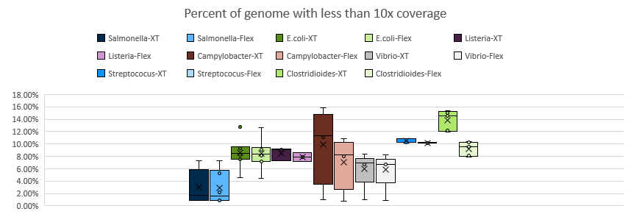
Reference mapping
 | Salmonella enterica (6) |  | Escherichia coli (7)
 | XT | Flex | XT | Flex
% Zero depth | 2.81% | 2.82% | 8.16% | 8.13%
% Depth < 10 | 2.97% | 2.93% | 8.63% | 8.49%
 | Listeria monocytogenes (3) |  | Campylobacter jejuni (4)
 | XT | Flex | XT | Flex
% Zero depth | 7.28% | 7.24% | 7.03% | 6.90%
% Depth < 10 | 8.54% | 7.91% | 9.85% | 7.04%
 | Vibrio parahaemolyticus (5) |  | Streptococus pyogenes (3)
 | XT | Flex | XT | Flex
% Zero depth | 5.71% | 5.70% | 9.99% | 9.95%
% Depth < 10 | 5.98% | 5.88% | 10.48% | 10.19%
 | Clostridioides difficile (5)
 | XT | Flex
% Zero depth | 8.65% | 8.51%
% Depth < 10 | 13.26% | 8.80%

Slide 9
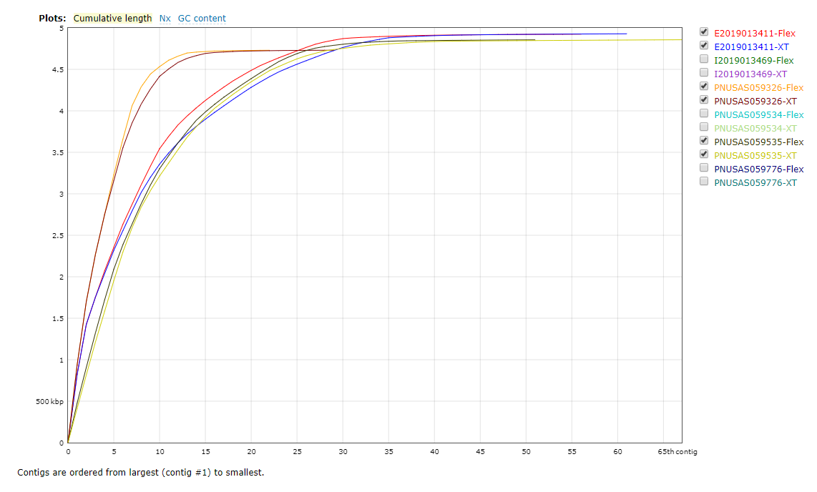
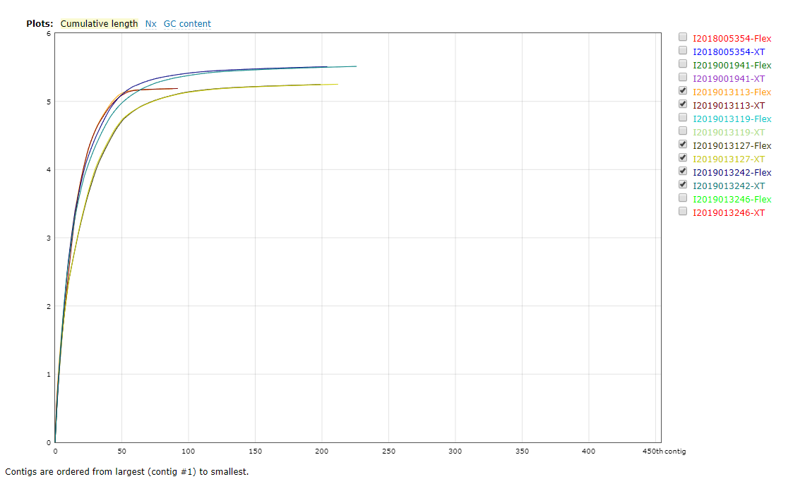
De novo assembly
Salmonella enterica
Escherichia coli
 |  | Coverage | Contigs (>500bp) | Largest Contig
Salmonella (6) | XT | 68.88 | 47.17 | 830,264
 | Flex | 71.53 | 38.67 | 853,230
 |  | Coverage | Contigs (>500bp) | Largest Contig
Escherichia coli (7) | XT | 62.48 | 209.57 | 374,564
 | Flex | 92.43 | 208.71 | 365,537
Notes:
Very similar

Slide 10
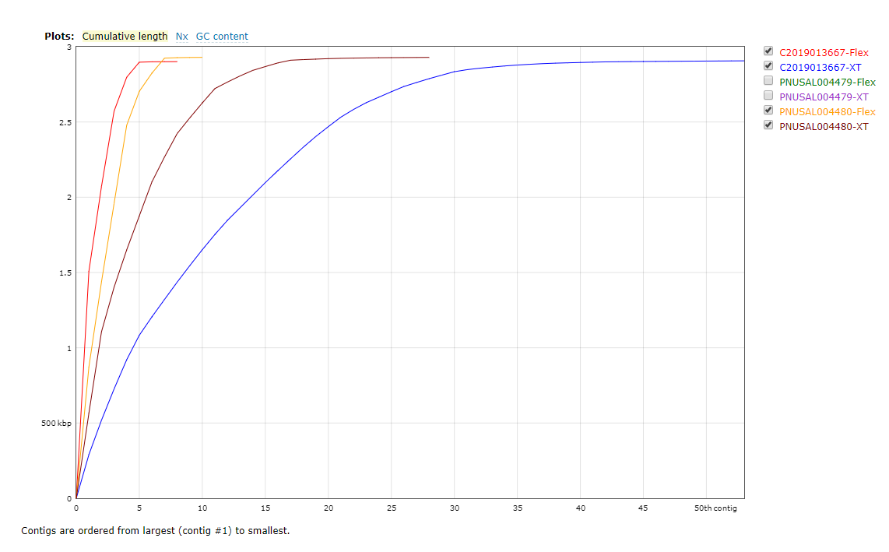
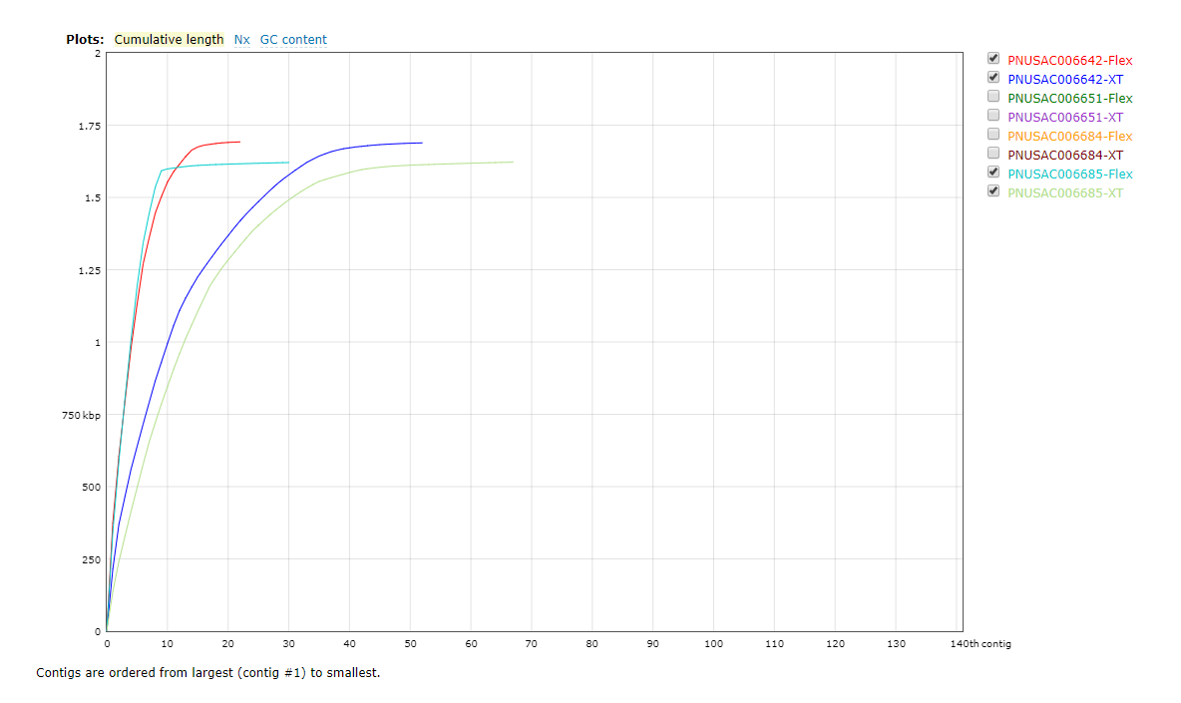
De novo assembly
Listeria monocytogenes
Campylobacter jejuni
 |  | Coverage | Contigs (>500bp) | Largest Contig
Listeria monocytogenes (3) | XT | 75.89 | 33.33 | 374,564
 | Flex | 79.57 | 10.67 | 365,537
 |  | Coverage | Contigs (>500bp) | Largest Contig
Campylobacter jejuni (4) | XT | 64.25 | 82.00 | 168,368
 | Flex | 166.29 | 33.50 | 339,406
Notes:
Flex is noticeably better. Due to coverage in campy?

Slide 11
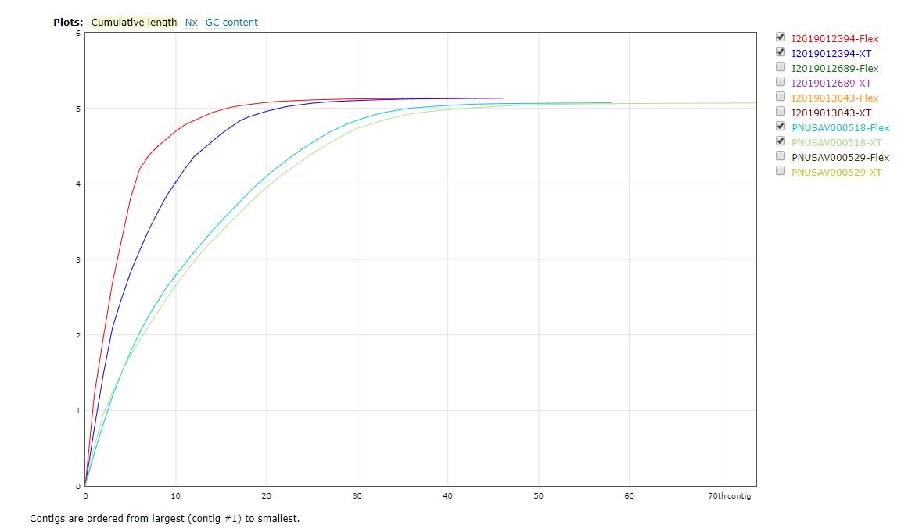
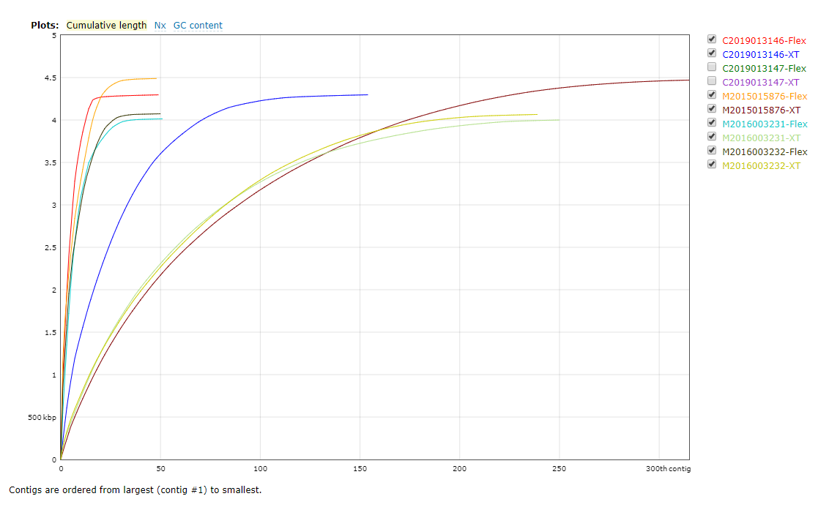
De novo assembly
Vibrio parahaemolyticus
Clostridioides difficile
 |  | Coverage | Contigs (>500bp) | Largest Contig
Vibrio parahaemolyticus (5) | XT | 84.26 | 53.20 | 801,202
 | Flex | 85.19 | 39.80 | 794,625
 |  | Coverage | Contigs (>500bp) | Largest Contig
Clostridioides difficile (5) | XT | 71.76 | 212.40 | 169,733
 | Flex | 91.93 | 48.20 | 939,737
Notes:
Flex is mildly better for vibrio and extremely better for C. diff

Slide 12
Would we switch?
Improved bioinformatics
  Greatly improved for Clostridioides difficile
Increased cost
CLIA validated assay using Nextera XT

Slide 13
Thank you.
Matt Plumb

Slide 15
Contract Price
Item | Uses | Cost | Cost per Use | Cost/sample
NXTR® XT LIB Prep KT PulseNet (96 SMP) | 96 | $2,850.00 | $29.69 | $32.71
NXTR® XT IDX Kt v2 Set A 96 IDXS,384 SMP | 384 | $969.00 | $2.52
Ampure Beads (60 mL) | 2400 | $1,200.00 | $0.50
Nextera DNA Flex Library Prep (96 Samples) | 96 | $3,830.40 | $39.90 | $44.65
Nextera™ DNA CD Indexes (96 Indexes, 96 Samples) | 96 | $456.00 | $4.75

Slide 16
Reference mapping
Salmonella enterica (6) | XT | Flex |  | Escherichia coli (7) | XT | Flex
Average Depth | 68.882 | 71.535 |  | Average Depth | 62.476 | 92.426
Std dev | 19.381 | 16.375 |  | Std dev | 37.436 | 46.135
# Position with zero depth | 134,929 | 135,494 |  | # Position with zero depth | 378,542 | 377,257
%Position with zero depth | 2.81% | 2.82% |  | %Position with zero depth | 8.16% | 8.13%
# Position with depth =< 10 | 142,884 | 141,035 |  | # Position with depth =< 10 | 400,396 | 394,092
%Position with depth =< 10 | 2.97% | 2.93% |  | %Position with depth =< 10 | 8.63% | 8.49%
Campylobacter jejuni (4) | XT | Flex |  | Listeria monocytogenes (3) | XT | Flex
Average Depth | 64.253 | 166.29 |  | Average Depth | 83.83 | 71.149
Std dev | 42.328 | 52.262 |  | Std dev | 39.634 | 28.92
# Position with zero depth | 115,331 | 113,219 |  | # Position with zero depth | 224,778 | 223,648
%Position with zero depth | 7.03% | 6.90% |  | %Position with zero depth | 7.28% | 7.24%
# Position with depth =< 10 | 161,742 | 115,555 |  | # Position with depth =< 10 | 251,552 | 232,797
%Position with depth =< 10 | 9.85% | 7.04% |  | %Position with depth =< 10 | 8.54% | 7.91%
Notes:
Box plots

Slide 17
Reference mapping
Streptococus pyogenes (3) | XT | Flex |  | Clostridioides difficile (5) | XT | Flex
Average Depth | 88.434 | 136.17 |  | Average Depth | 66.83 | 102.88
Std dev | 45.434 | 56.138 |  | Std dev | 62.09 | 38.95
# Position with zero depth | 185,044 | 184,334 |  | # Position with zero depth | 371,002 | 365,147
%Position with zero depth | 9.99% | 9.95% |  | %Position with zero depth | 8.65% | 8.51%
# Position with depth =< 10 | 194,084 | 188,811 |  | # Position with depth =< 10 | 569,056 | 377,406
%Position with depth =< 10 | 10.48% | 10.19% |  | %Position with depth =< 10 | 13.26% | 8.80%
Vibrio parahaemolyticus (5) | XT | Flex |  | Acinetobacter baumannii (1) | XT | Flex
Average Depth | 84.256 | 85.19 |  | Average Depth | 54.165 | 38.268
Std dev | 31.57 | 29.655 |  | Std dev | 39.069 | 24.298
# Position with zero depth | 187,878 | 187,518 |  | # Position with zero depth | 799,550 | 800,880
%Position with zero depth | 5.71% | 5.70% |  | %Position with zero depth | 18.44% | 18.47%
# Position with depth =< 10 | 196,664 | 193,285 |  | # Position with depth =< 10 | 906,624 | 836,838
%Position with depth =< 10 | 5.98% | 5.88% |  | %Position with depth =< 10 | 20.91% | 19.30%

Slide 18
De novo assembly
Average |  | Coverage | Contigs (>500bp) | Largest Contig | Total Length | N50 | N75 | L50 | L75
Salmonella (6) | XT | 68.88 | 47.17 | 830,264 | 4,837,399 | 346,807 | 207,441 | 5.17 | 10.17
 | Flex | 71.53 | 38.67 | 853,230 | 4,836,681 | 361,505 | 237,726 | 5.00 | 9.67
Streptococus pyogenes (3) | XT | 88.43 | 15.00 | 556,748 | 1,685,924 | 163,045 | 102,418 | 3.33 | 6.33
 | Flex | 136.17 | 17.00 | 629,943 | 1,686,496 | 163,045 | 87,513 | 3.00 | 6.00
Clostridioides difficile (5) | XT | 71.76 | 212.40 | 169,733 | 4,201,304 | 51,635 | 28,117 | 33.60 | 69.80
 | Flex | 91.93 | 48.20 | 939,737 | 4,209,967 | 387,360 | 260,372 | 4.40 | 8.60
Campylobacter jejuni (4) | XT | 64.25 | 82.00 | 168,368 | 1,672,100 | 77,131 | 40,756 | 10.25 | 20.00
 | Flex | 166.29 | 33.50 | 339,406 | 1,678,832 | 168,410 | 119,491 | 4.25 | 7.50
Listeria monocytogenes (3) | XT | 75.89 | 33.33 | 532,541 | 2,900,189 | 278,706 | 168,273 | 5.33 | 9.67
 | Flex | 79.57 | 10.67 | 1,041,100 | 2,897,166 | 835,948 | 427,034 | 2.33 | 4.00
Vibrio parahaemolyticus (5) | XT | 84.26 | 53.20 | 801,202 | 5,064,205 | 289,824 | 167,241 | 6.40 | 12.80
 | Flex | 85.19 | 39.80 | 794,625 | 5,062,297 | 364,770 | 216,384 | 5.80 | 11.00
Escherichia coli (7) | XT | 62.48 | 209.57 | 374,564 | 5,192,176 | 131,746 | 68,827 | 16.71 | 35.71
 | Flex | 92.43 | 208.71 | 365,537 | 5,211,997 | 132,050 | 69,287 | 16.86 | 36.00
Acinetobacter baumannii (1) | XT | 54.16 | 172.00 | 171,054 | 3,859,635 | 46,435 | 26,355 | 25.00 | 52.00
 | Flex | 38.27 | 141.00 | 171,054 | 3,869,688 | 60,939 | 30,658 | 19.00 | 43.00
Notes:
Quast results

Slide 19
Salmonella enterica
Notes:
Very similar

Slide 20
Escherichia coli
Notes:
Very similar

Slide 21
Listeria monocytogenes
Notes:
Differences, flex is better.

Slide 22
Campylobacter jejuni
Notes:
Differences, flex is better.

Slide 23
Vibrio parahaemolyticus
Notes:
Flex is mildly better

Slide 24
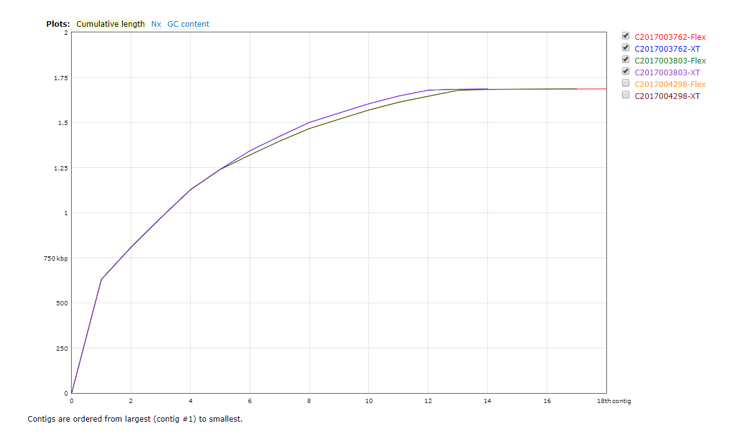
Streptococus pyogenes
Notes:
Very similar

Slide 25
Clostridioides difficile
Notes:
Flex is massively better

